Slide 1
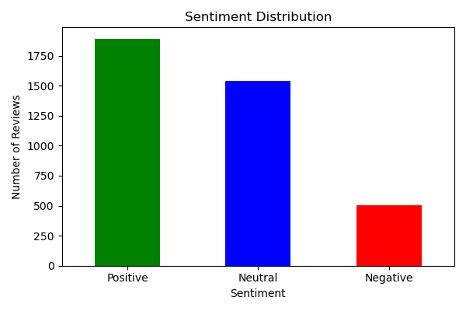
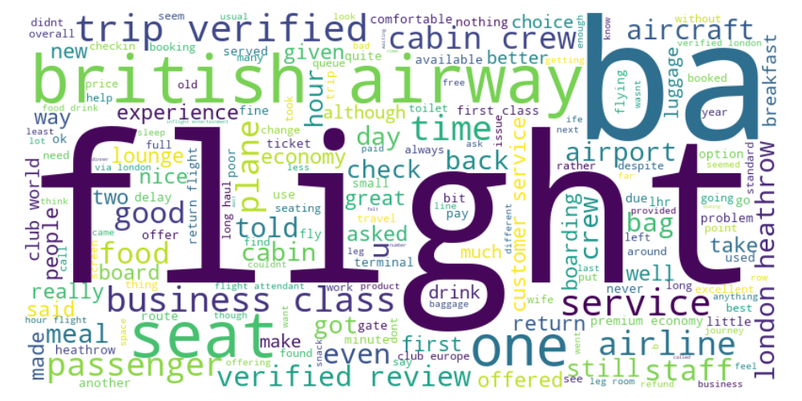
British Airways Customer Review Insights
Key Insights
- Majority of reviews are neutral, but negative sentiment outweighs positive.
- Common themes: Food quality, Cabin comfort, Staff service, Check-in delays.
- In-flight entertainment and outdated systems were frequently criticized.
- BA needs to improve consistency across services to justify premium pricing.

