Slide 1

Curriculum Overlap Analysis
Master of Public Health (MPH) & Master in Hospital Administration (MHA)
Mapping of common teaching courses, contents & shared-class delivery
Batch 2022 · Codes 097 & 098
Scope: teaching courses only — project work, dissertation, internship & hospital training excluded

Slide 2

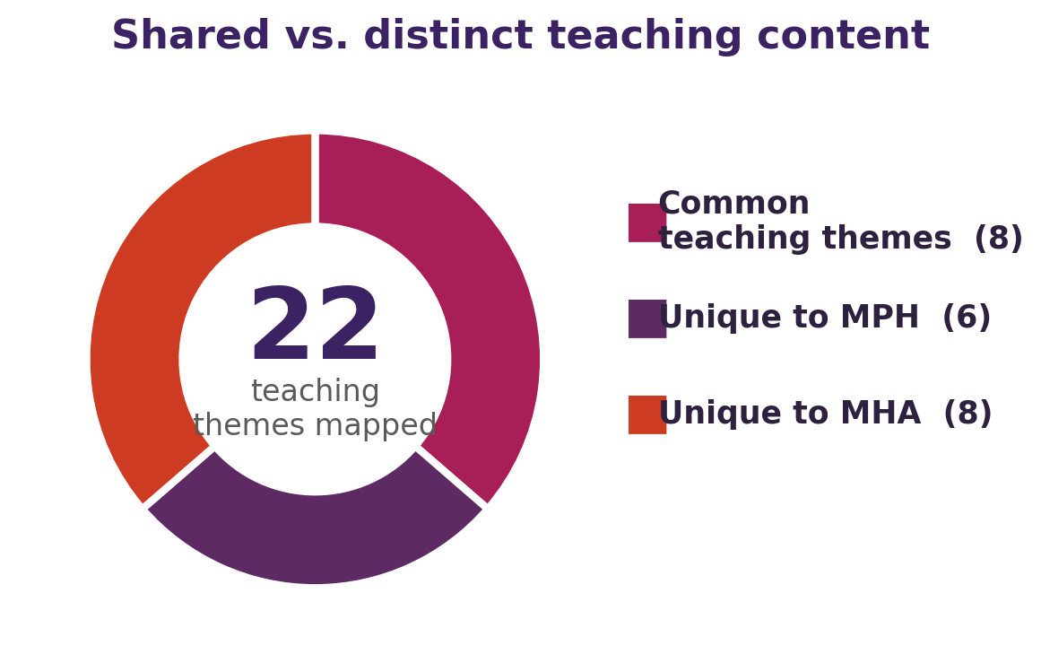
The two programmes at a glance
Master of Public Health
Code 097
Master in Hospital Admin.
Code 098
Credits
80
Credits
82
Focus
Population / public health
Focus
Hospital administration
Taught
≈ 15 theory courses
Taught
≈ 13 theory courses
Award
MPH · 2 yrs FT
Award
MHA · 2 yrs FT
M. S. Ramaiah University of Applied Sciences · Faculty of Life & Allied Health Sciences
2

Slide 3
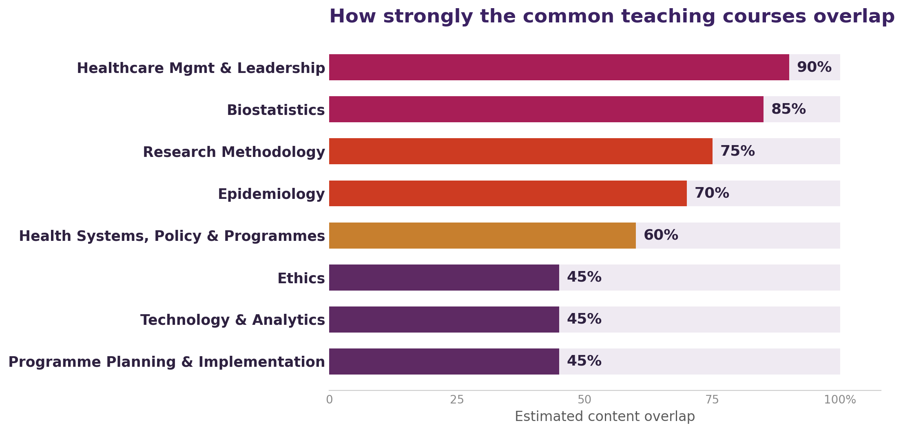
Overlap summary — 8 common teaching themes
Reading the chart
≥ 80% Near-identical
65–79% Strong
55–64% Moderate–High
≤ 50% Moderate
M. S. Ramaiah University of Applied Sciences · Faculty of Life & Allied Health Sciences
3

Slide 4
Strongest overlaps — near-identical
Healthcare Management & Leadership
Very High
Biostatistics
Very High
PHC504B · HAC510C
PHC505A · HAC511C
Organization & organizational behaviour (structure, culture, climate, team dynamics, personality); management functions (planning, organizing, staffing, directing, coordinating …
Definition/scope of statistics; data types & scales of measurement; construction of scales; reliability & validity; tabulation & graphical presentation; descriptive statistics (central …
Research Methodology
High
Epidemiology
High
PHC508A · HAC511C
PHC503A · HAC504C
Meaning & types of research; steps in conducting research; research problem, objectives & hypothesis formulation; literature review; research methods & methodology; sample size & …
Scope of epidemiology; measures of disease frequency & association; study designs — ecological/geographical, case-control, cohort, intervention & randomized controlled trials; random …
M. S. Ramaiah University of Applied Sciences · Faculty of Life & Allied Health Sciences
4

Slide 5
Healthcare Management & Leadership
Overlap: Very High
MPH PHC504B — Healthcare Management and Leadership
MHA HAC510C — Healthcare Management and Leadership
Common content taught in BOTH programmes
Organization & organizational behaviour (structure, culture, climate, team dynamics, personality)
Management functions (planning, organizing, staffing, directing, coordinating, budgeting)
Leadership concepts, roles and traits
Leadership theories (Great Man, Trait, Contingency, Situational, Behavioural)
Motivation theories (Maslow, Herzberg, intrinsic vs extrinsic)
Leadership models (Ruth-Seliger, Maxwell, Bagchi's platform vs purpose, sources of power)
Conflict management
Leadership challenges & change management.
Key difference: MPH frames delivery around public-health programmes/health systems; MHA frames the same content around hospital administration and the healthcare/VUCA context. Course titles are identical.
M. S. Ramaiah University of Applied Sciences · Faculty of Life & Allied Health Sciences
5

Slide 6
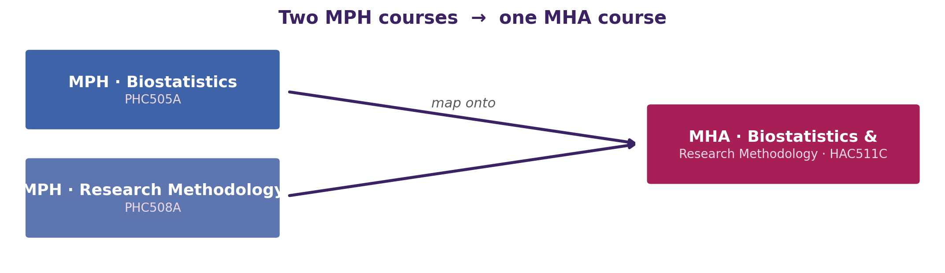
A shared quantitative-methods core
MPH teaches Biostatistics and Research Methodology as two courses; MHA combines both into one.
Shared topics: descriptive & inferential statistics, sampling & sample size, correlation & regression, the research process, data collection and report writing.
Opportunity: a single common quantitative-methods module could serve both cohorts, with an added qualitative / mixed-methods tutorial for MPH.
M. S. Ramaiah University of Applied Sciences · Faculty of Life & Allied Health Sciences
6

Slide 7
Epidemiology & health systems overlap
Epidemiology (PHC503A ↔ HAC504C)
Health systems & policy (PHC502A ↔ HAC504C)
Study designs: case-control, cohort, RCT, ecological
Measures of disease frequency & association
Bias, confounding, effect modification
Validity, reliability & screening
Delivery system in India: sub-centre → tertiary
National programmes (NHM, RCH, UIP, RNTCP…)
National health policy & five-year plans
International agencies (WHO, UN, World Bank)
…then the programmes diverge
MPH extends into advanced epidemiology — chronic, infectious, nutritional, environmental & psychiatric.
MHA extends into public-health administration — hospital roles across prevention levels, national programmes & policy from an administrator's view.
M. S. Ramaiah University of Applied Sciences · Faculty of Life & Allied Health Sciences
7

Slide 8
Ethics, technology & analytics
Ethics
Technology, informatics & analytics
MPH: PHC510A — Ethics in Public Health
MHA: HAC601C — Legal Aspects & Ethics in Healthcare
Common: ethical theory & principles; quality, safety & patient-care ethics; resource allocation; professional integrity
Difference: MPH is a stand-alone ethics course; MHA embeds ethics in a mainly legal / medico-legal course
MPH: PHC602A — Technology in Public Health
MHA: HAC602C — Healthcare Analytics & OR (+ HAE605A, HAE607A)
Common: health information systems; EHR/EMR; data-driven decisions; decision support; data security
Difference: MPH → standards (ICD, SNOMED), interoperability, HIM; MHA → business analytics & operational research
M. S. Ramaiah University of Applied Sciences · Faculty of Life & Allied Health Sciences
8

Slide 9
Elective overlaps & what stays unique
Electives on the same subject in both programmes
Evidence-based practice
Health economics / financing
Advanced biostatistics
Patient safety & quality
PHE602A
HAE610A
Health Economics (MDEC elective)
HAE518A
PHC505A
HAE517A
PHC510A
HAE514A
Unique to MPH — public health
Unique to MHA — hospital administration
Principles & Practice of Public Health
Public Health Priorities I & II
Health Behaviour & Health Promotion
Global Health
Demography & Population Sciences
Accounting & Financial Management
Human Resource Management
Management of Clinical & Non-Clinical Services
Hospital Planning & Designing
Quality Management; Marketing; Legal aspects
M. S. Ramaiah University of Applied Sciences · Faculty of Life & Allied Health Sciences
9

Slide 10
Common classes — leaders & subject experts
The common courses can run as combined MPH + MHA classes, led internally or by an invited external subject expert.
Common course | Suggested external subject expert | Internal course leader
Healthcare Management & Leadership | Senior hospital administrator / CEO; healthcare-leadership faculty from a business school; a management consultant in the health sector | Faculty of Management & Commerce (healthcare-management stream); Department of Hospital Administration
Biostatistics | Biostatistician from a public-health institute or ICMR centre; statistics faculty from a partner medical college | Biostatistics / Statistics faculty; Department of Community Medicine
Research Methodology | Senior researcher from ICMR / a public-health foundation; research-methods trainer from a research institute | Public-health research faculty; University research-methodology cell
Epidemiology | Field epidemiologist (e.g., NIE / India EIS); Community Medicine faculty from a medical college | Department of Community Medicine (PSM); public-health / epidemiology faculty
Health Systems, Policy & National Programmes | Health-policy specialist from a state health department, PHFI or a health-systems think-tank | Health-policy & systems faculty; public-health department
Ethics | Bioethicist from a bioethics centre; a medico-legal / health-law expert | Bioethics / medical-ethics faculty; Institutional Ethics Committee members
Technology, Informatics & Analytics | Health-informatics or health-data-analytics professional from the HealthTech industry | Health-informatics faculty; Department of Computer Science / Data Science
Programme Planning & Implementation | Monitoring & evaluation (M&E) specialist from an NGO / development / public-health programme | Public-health programme-management faculty
M. S. Ramaiah University of Applied Sciences · Faculty of Life & Allied Health Sciences
10

Slide 11

Key observations & recommendations
01
Two courses are effectively identical
Healthcare Management & Leadership (PHC504B / HAC510C) — same units, theories and models, same title.
02
A shared quantitative-methods core exists
MPH Biostatistics + Research Methodology map almost completely onto MHA's combined HAC511C.
03
Epidemiology is a common foundation
Study designs, measures and biases are shared before the programmes diverge.
04
Common classes can use shared & external experts
Eight common themes can run as combined classes led internally or by invited specialists.
Recommendation: shared quantitative-methods & management modules, common foundational lectures, cross-listed electives, and a panel of internal + external experts for the common classes.

