Slide 1
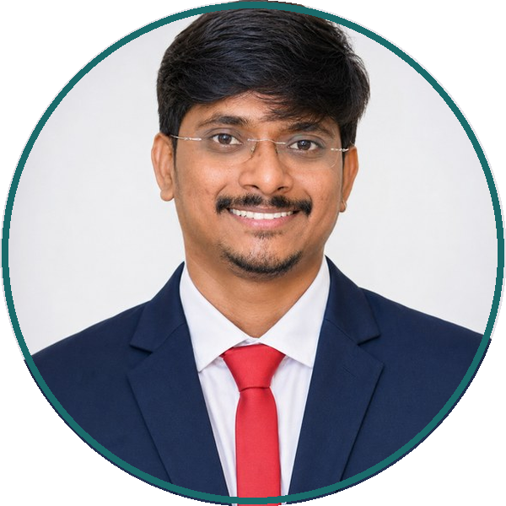
45+
Publications
Peer-reviewed papers (IF up to 56.7)
10+
Digital Health Tools
Deployed platforms (Onco Care, Vichara)
1
Patent Published
Medical Technology device patent
ESMO / JSMO
International Awards
Travel Grants (Europe & Japan)
RESEARCH & INNOVATION FOCUS
▪ Digital Health & mHealth Interventions: User-centred co-design, psychometric scales, symptom tracking & patient adherence platforms.
▪ Oncology Care Delivery: Scalable mHealth interventions to reduce cancer care disparities in low- & middle-income settings.
▪ Health Technology Assessment (HTA): Cost-effectiveness, health economic modelling, and technology appraisal.
▪ Implementation Science & AI for Health: Machine-learning decision support, quasi-experimental & target trial emulation methods.
ACADEMIC & PROFESSIONAL ROLES
▪ Assistant Professor (Public Health)
Ramaiah School of Public Health, MSRUAS (2025–Present)
Teaching MPH programme: Research Methodology, Biostatistics, Technology in Public Health, and NCDs.
▪ Scientist-D / Senior Research Officer
PGIMER, Chandigarh (Nov 2024–Jul 2025)
Involved in developing online Health Technology Assessment (HTA) course.
▪ Field Investigator
World Health Organization (WHO) / JSS Medical College
Multi-centre clinical trial on oxygen & respiratory support in COVID-19 in LMICs.
Dr G. Hari Prakash
Assistant Professor (Public Health)
Ramaiah School of Public Health
MS Ramaiah Univ. of Applied Sciences, India
PhD (Public Health) · Pharm.D · MPH
🌐 Website: www.drhari.co.in
✉ Email: hariprakash607@gmail.com
📱 Phone: +91 7306789341
🆔 ORCID: 0000-0002-9463-4084
EDITORIAL APPOINTMENTS & INTERNATIONAL AFFILIATIONS
• Associate Editor: Archives of Public Health (BMC / Springer Nature) | Clinical Epidemiology and Global Health (Elsevier)
• Professional Memberships: European Society of Medical Oncology (ESMO) | ESMO & JSMO Travel Fellowship Awardee

Slide 2
45+
Publications
Peer-reviewed papers (IF up to 56.7)
10+
Digital Health Tools
Deployed platforms (Onco Care, Vichara)
1
Patent Published
Medical Technology device patent
ESMO / JSMO
International Awards
Travel Grants (Europe & Japan)
RESEARCH & INNOVATION FOCUS
▪ Digital Health & mHealth Interventions: User-centred co-design, psychometric scales, symptom tracking & patient adherence platforms.
▪ Oncology Care Delivery: Scalable mHealth interventions to reduce cancer care disparities in low- & middle-income settings.
▪ Health Technology Assessment (HTA): Cost-effectiveness, health economic modelling, and technology appraisal.
▪ Implementation Science & AI for Health: Machine-learning decision support, quasi-experimental & target trial emulation methods.
ACADEMIC & PROFESSIONAL ROLES
▪ Assistant Professor (Public Health)
Ramaiah School of Public Health, MSRUAS (2025–Present)
Teaching MPH programme: Research Methodology, Biostatistics, Technology in Public Health, and NCDs.
▪ Scientist-D / Senior Research Officer
PGIMER, Chandigarh (Nov 2024–Jul 2025)
Involved in developing online Health Technology Assessment (HTA) course.
▪ Field Investigator
World Health Organization (WHO) / JSS Medical College
Multi-centre clinical trial on oxygen & respiratory support in COVID-19 in LMICs.
Dr G. Hari Prakash
Assistant Professor (Public Health)
Ramaiah School of Public Health
MS Ramaiah Univ. of Applied Sciences, India
PhD (Public Health) · Pharm.D · MPH
🌐 Website: www.drhari.co.in
✉ Email: hariprakash607@gmail.com
📱 Phone: +91 7306789341
🆔 ORCID: 0000-0002-9463-4084
EDITORIAL APPOINTMENTS & INTERNATIONAL AFFILIATIONS
• Associate Editor: Archives of Public Health (BMC / Springer Nature) | Clinical Epidemiology and Global Health (Elsevier)
• Professional Memberships: European Society of Medical Oncology (ESMO) | ESMO & JSMO Travel Fellowship Awardee

