Slide 1















Final Presentation
Desire A, Driane P
11:11PM

Slide 2
















Section Header • Section Header • Section Header • Section Header • Section Header • Section Header • Section Header • Section Header
What is Docker
Back to Agenda Page
Section Header • Section Header • Section Header • Section Header • Section Header • Section Header • Section Header • Section Header

Slide 3
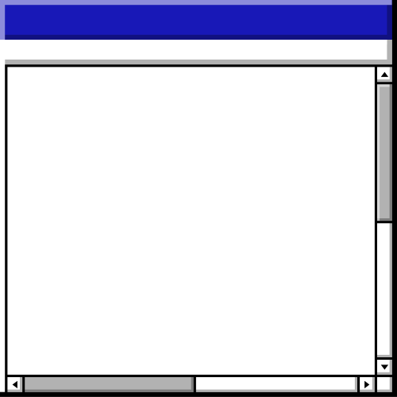

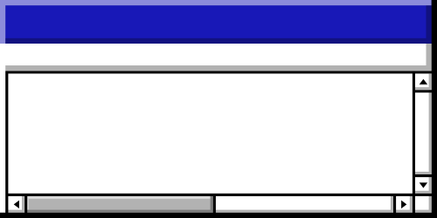

Agenda • Agenda • Agenda • Agenda • Agenda • Agenda • Agenda • Agenda • Agenda • Agenda • Agenda • Agenda • Agenda • Agenda
Tip: Use links to go to a different page inside your presentation.
How: Highlight text, click on the link symbol on the toolbar, and select the page in your presentation you want to connect.
Topics Covered
What is Docker
How does docker work
Docker
Working with Docker
Code demo

Slide 4
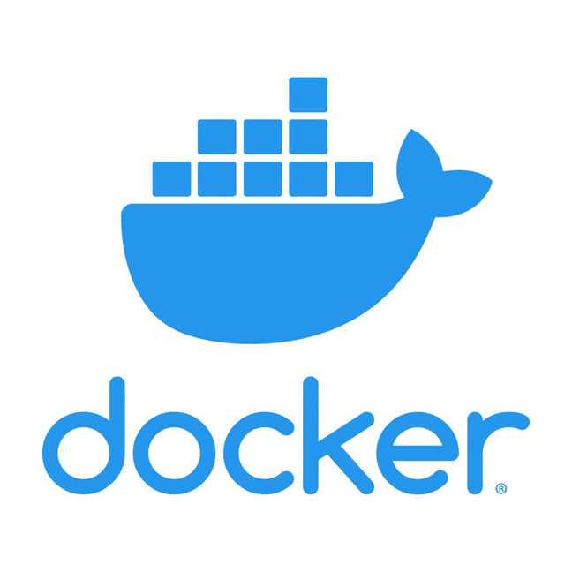
Docker
Docker is an open platform for developing, shipping, and running applications. Docker enables you to separate your applications from your infrastructure so you can deliver software quickly. With Docker, you can manage your infrastructure in the same ways you manage your applications
Back to Agenda Page

Slide 5
Section Header • Section Header • Section Header • Section Header • Section Header • Section Header • Section Header • Section Header
Why use Docker instead of a VM?
Back to Agenda Page
Section Header • Section Header • Section Header • Section Header • Section Header • Section Header • Section Header • Section Header

Slide 6


Virtual Machines
Docker
Back to Agenda Page

Slide 7
Section Header • Section Header • Section Header • Section Header • Section Header • Section Header • Section Header • Section Header
How does Docker work?
Back to Agenda Page
Section Header • Section Header • Section Header • Section Header • Section Header • Section Header • Section Header • Section Header

Slide 8
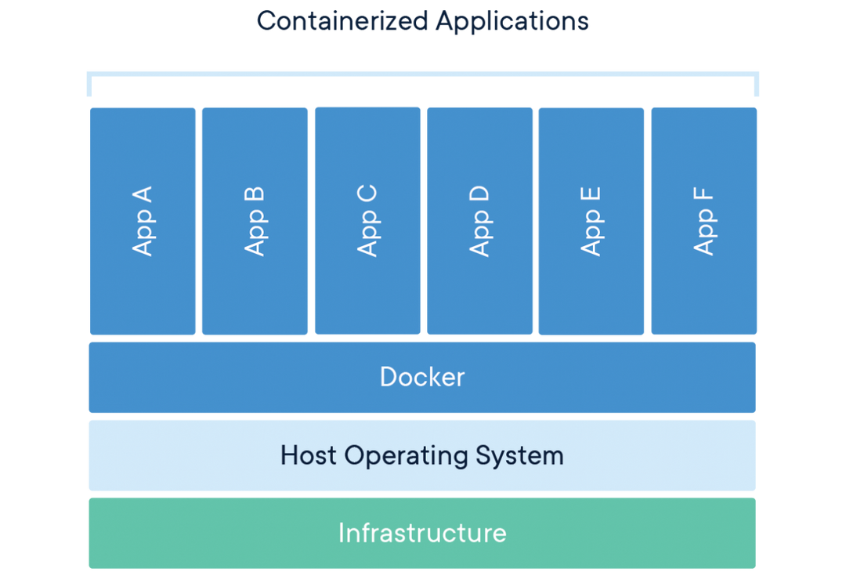
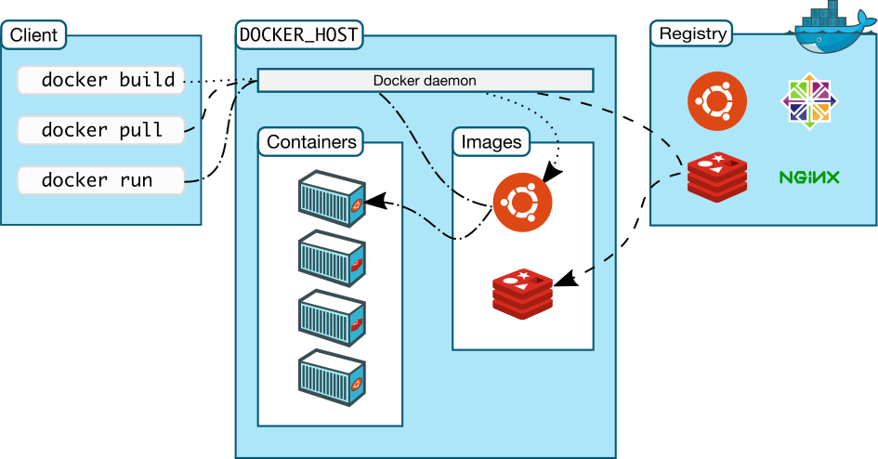
How Docker Works
Back to Agenda Page

Slide 9

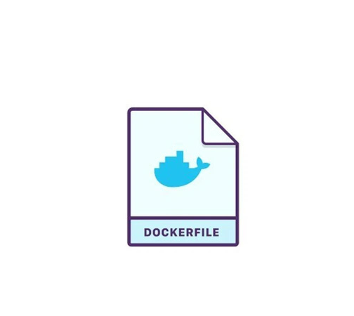

How Docker Works
Dockerfile
Image
Containers
A text document that contains all the commands a user could call on the command line to assemble an image
a file used to execute code in a Docker container. Images become containers at runtime
A Docker container image is a lightweight, standalone, executable package of software that includes everything needed to run an application
Back to Agenda Page

Slide 10
Advantages
Docker provides the ability to package and run an application in a loosely isolated environment called a container. The isolation and security allows you to run many containers simultaneously on a given host
Improves ability for team to share environments that are consistent.
Quick and easy to configure applications
Back to Agenda Page

Slide 11
Section Header • Section Header • Section Header • Section Header • Section Header • Section Header • Section Header • Section Header
Setting Up Docker
Back to Agenda Page
Section Header • Section Header • Section Header • Section Header • Section Header • Section Header • Section Header • Section Header

Slide 12
Elaborate on the featured statistic • Elaborate on the featured statistic • Elaborate on the featured statistic • Elaborate on the featured statistic
Download Docker Desktop and enable hyper visualization
Run Docker --version on cmd to ensure that it was installed properly
Get started with staging your first app
Elaborate on the featured statistic • Elaborate on the featured statistic • Elaborate on the featured statistic • Elaborate on the featured statistic

Slide 13
Section Header • Section Header • Section Header • Section Header • Section Header • Section Header • Section Header • Section Header
Code demo
Back to Agenda Page
Section Header • Section Header • Section Header • Section Header • Section Header • Section Header • Section Header • Section Header

