Slide 1
Fastcomm
Recommendation System
Memory based Collaberative filtering
  K nearest neighbors
    Euclidean similarity
    Cosine similarity
    Pearson similarity
  General Popularity
Model based Collaberative filtering
  Singular Value Decomposition
Content based
  K-means clustering

Slide 2
Fastcomm
Recommendation System
Memory based Collaberative filtering
  K nearest neighbors
    Euclidean similarity
    Cosine similarity
    Pearson similarity
  General Popularity
Model based Collaberative filtering
  Singular Value Decomposition
Content based
  K-means clustering

Slide 3
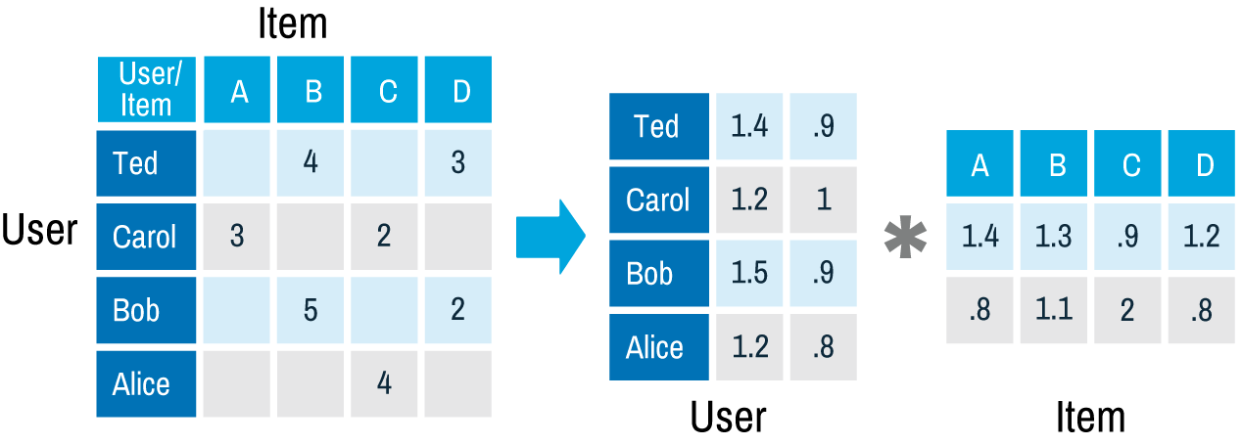
Matrix factorisations
Features
Features

Slide 4
Matrix factorisations: SVD
Name | Avengers | Titanic | Spiderman | The notebook
User 1 | 5 | 2 | 0 | 1
User 2 | 1 | 4 | 0 | 5
User 3 | 4 | 0 | 5 | 1
User 4 | 1 | 0 | 0 | 4
User 5 | 0 | 5 | 1 | 4

Slide 5
Matrix factorisations: SVD
Name | Avengers | Titanic | Spiderman | The notebook
User 1 | 5 | 2 | 0 | 1
User 2 | 1 | 4 | 0 | 5
User 3 | 4 | 0 | 5 | 1
User 4 | 1 | 0 | 0 | 4
User 5 | 0 | 5 | 1 | 4
Name | Avengers | Titanic | Spiderman | The notebook
User 1 | 5 | 2 | 5.1 | 1
User 2 | 1 | 4 | 0.78 | 5
User 3 | 4 | 2.13 | 5.0 | 1
User 4 | 1 | 3.95 | 0.96 | 4
User 5 | 2.76 | 5 | 1 | 4
2 Features

Slide 6
Matrix factorisations: SVD
Name | Avengers | Titanic | Spiderman | The notebook
User 1 | 5 | 2 | 0 | 1
User 2 | 1 | 4 | 0 | 5
User 3 | 4 | 0 | 5 | 1
User 4 | 1 | 0 | 0 | 4
User 5 | 0 | 5 | 1 | 4
Name | Avengers | Titanic | Spiderman | The notebook
User 1 | 5 | 2 | 5.1 | 1
User 2 | 1 | 4 | 0.78 | 5
User 3 | 4 | 2.13 | 5.0 | 1
User 4 | 1 | 3.95 | 0.96 | 4
User 5 | 2.76 | 5 | 1 | 4
Superhero fan
Romantic
Superhero fan
Romantic
Romantic

Slide 7
Matrix factorisations: SVD
Advantages
  Does not need whole table
  After training inferencing is quick and constant
  Can be implemented iteratively
  Adjustable number of features
Disadvantages
  Training is needed

Slide 8
Future work
Cold start: Popularity algorithm
Hybrid system with Content based
  K-means clustering

