Slide 1




Fastcomm
Recommendation System

Slide 2
Goal of system
Name | Avengers | Titanic | Spiderman | The notebook
User 1 | 5 | 2 | - | 1
User 2 | 1 | 4 | - | 5
User 3 | 4 | - | 5 | 1
User 4 | 1 | - | - | 4
User 5 | - | 5 | 1 | 4
Notes:
The goal of a recommendation system is to recommend items new items that a user will most likely like. Thus in the toy example above each of the 5 users can watch 4 possible movies. Each user have already rated( out of 5) some movies. The movies the user has not seen yet is indicated with a ‘-’.
The goal is thus to predict for each user the ‘-’ ratings based on the other ratings given.

Slide 3
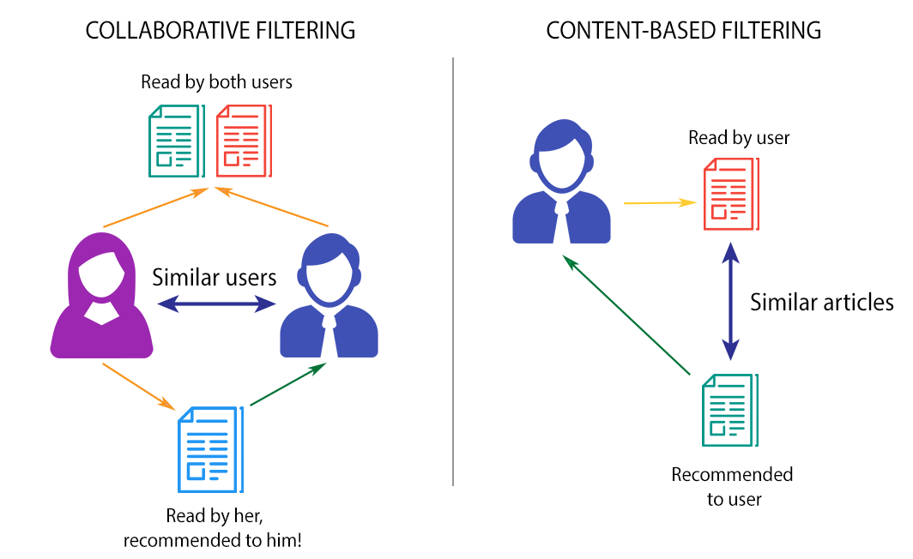
Types of recommendation systems
Notes:
Collabrative filtering searches for similar users based on their ratings and the uses them to recommend new items to the user.
Content-based filtering looks in the atributes of the item to find similar items. If the user likes a book that has labels for action or fantasy the system can find similar items based on that.

Slide 4
Algorithms
Memory based Collaborative filtering
Model based Collaborative filtering
Content based
Hybrid system

Slide 5
Algorithms
Memory based Collaborative filtering
  General Popularity
  K Nearest Neighbors
    Euclidean similarity
    Cosine similarity
    Pearson similarity

Slide 6
  General Popularity
Name | Avengers | Titanic | Spiderman | The notebook
User 1 | 5 | 2 | - | 1
User 2 | 1 | 4 | - | 5
User 3 | 4 | - | 5 | 1
User 4 | 1 | - | - | 4
User 5 | - | 5 | 1 | 4

Slide 7
  General Popularity
Name | Avengers | Titanic | Spiderman | The notebook
User 1 | 5 | 2 | - | 1
User 2 | 1 | 4 | - | 5
User 3 | 4 | - | 5 | 1
User 4 | 1 | - | - | 4
User 5 | - | 5 | 1 | 4
Name | Avengers | Titanic | Spiderman | The notebook
User 1 | 5 | 2 | 3.0 | 1
User 2 | 1 | 4 | 3.0 | 5
User 3 | 4 | 3.67 | 5.0 | 1
User 4 | 1 | 3.67 | 3.0 | 4
User 5 | 2.75 | 5 | 1 | 4
Notes:
This algorithm just assigns the average movie rating to each ‘-’. This is a fast, but unpersonalised starting method.

Slide 8
  K Nearest Neighbors
Find top K most similar users
Make recommendations based on these users

Slide 9
  K Nearest Neighbors
Name | Avengers | Titanic | Spiderman | The notebook
User 1 | 5 | 2 | - | 1
User 2 | 1 | 4 | - | 5
User 3 | 4 | - | 5 | 1
User 4 | 1 | - | - | 4
User 5 | - | 5 | 1 | 4

Slide 10
  K Nearest Neighbors
Name | Avengers | Titanic | Spiderman | The notebook
User 1 | 5 | 2 | - | 1
User 2 | 1 | 4 | - | 5
User 3 | 4 | - | 5 | 1
User 4 | 1 | - | - | 4
User 5 | - | 5 | 1 | 4
User 2, 5 similar to User 4

Slide 11
  K Nearest Neighbors
Name | Avengers | Titanic | Spiderman | The notebook
User 1 | 5 | 2 | - | 1
User 2 | 1 | 4 | - | 5
User 3 | 4 | - | 5 | 1
User 4 | 1 | - | - | 4
User 5 | - | 5 | 1 | 4
User 2, 5 similar to User 4
Name | Avengers | Titanic | Spiderman | The notebook
User 1 | 5 | 2 | - | 1
User 2 | 1 | 4 | - | 5
User 3 | 4 | - | 5 | 1
User 4 | 1 | 4.56 | 1.0 | 4
User 5 | - | 5 | 1 | 4
Similarity: 0.8
4*0.8 + 5*1.0
1 + 0.8
Similarity: 1.0
Notes:
The algorithm works by first finding the K( specific number) users that are closest in ratings to the user. Methods to find these users will be discussed next. The weighted average of these ratings can then be used to estimate the users rating for the other items.

Slide 12
  K Nearest Neighbors
Euclidean similarity
Cosine similarity
Pearson similarity

Slide 13
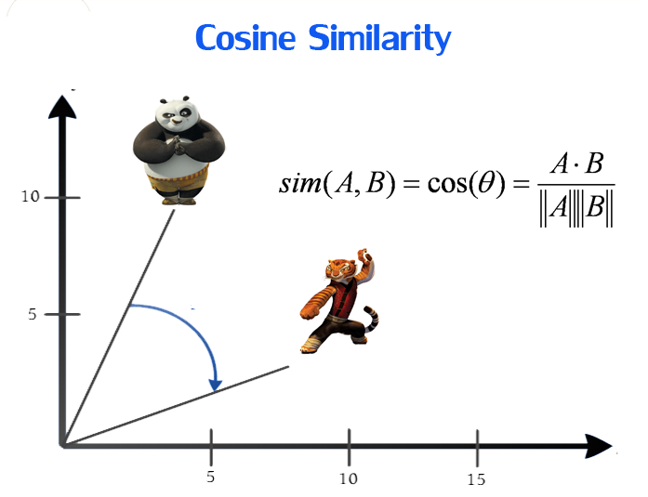
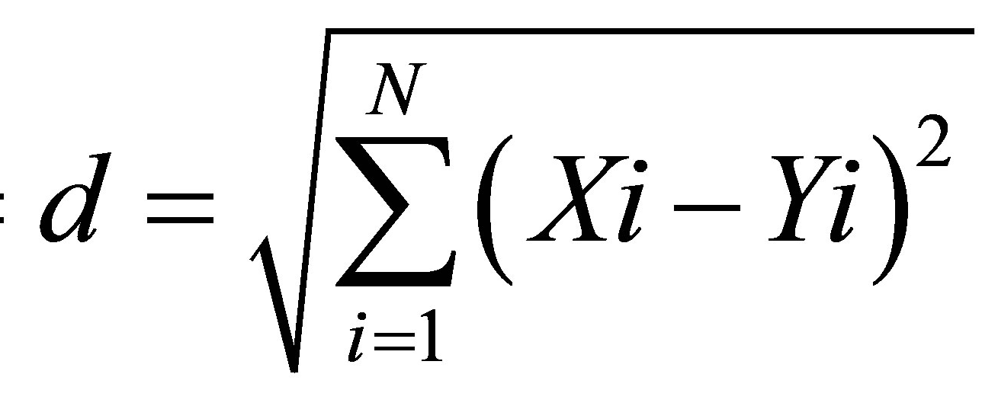
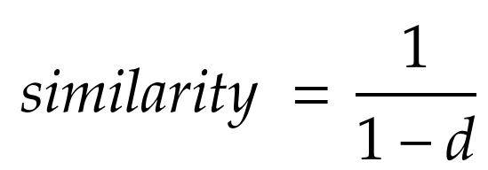
  K Nearest Neighbors
Euclidean similarity
Rating 1
A
A
B
5
2.5
B
Rating 2
2.5
5
Notes:
In this example the users have to commonly rated movies. To find there euclidean similarity you simply take the square root in diffference of all the ratings. The value then gets normalized. Thus if the users rated exactly the same the similarity would be 1. If they rated completely opposite the value whould be close to 0.

Slide 14
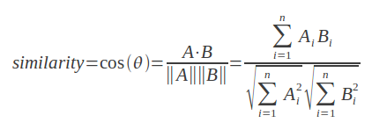
  K Nearest Neighbors
Cosine similarity
Rating 1
5
A
2.5
B
θ
Rating 2
2.5
5
Notes:
This works the same as the previous example and now the similarity is calculated in terms of the theta value between the two points.

Slide 15
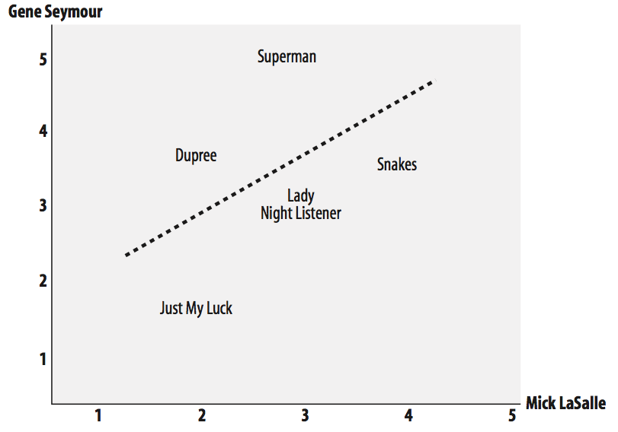
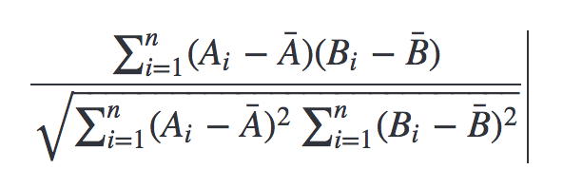
  K Nearest Neighbors
Pearson similarity
Notes:
This similarity is used when calculating the correlation between two users. Thus even if one person rates cosistantly harsher than the other a common pattern can still be found and thus a high similarity.

Slide 16
Algorithms
Model based Collaborative filtering
  Singular Value Decomposition
Notes:
This type of systems creates a model of the data and predicts new ratings based on that.

Slide 17
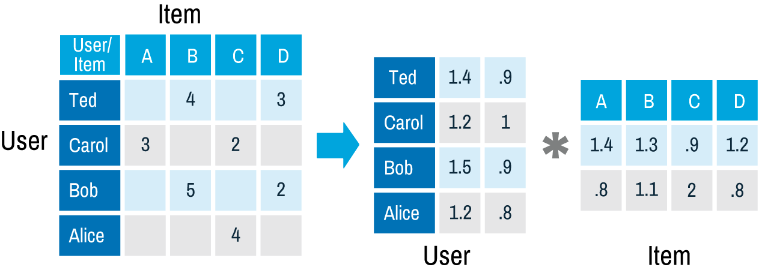
Matrix factorisations
Features
Features
Notes:
Matrix factorisation works by trying to factorise a matrix into two smaller matrixes. In the example above each user and movie gets assigned to two features. Thus Ted is 1.4*feature1 + 0.9*feature2. Thus the rating for Ted on item A can be calculated with the dot product between the Ted vector and Item A vector: rating = 1.4*1.4 + 0.9*0.8.
(This is just a example. The values are random and not trained from the table.)

Slide 18
  Singular Value Decomposition
Name | Avengers | Titanic | Spiderman | The notebook
User 1 | 5 | 2 | - | 1
User 2 | 1 | 4 | - | 5
User 3 | 4 | - | 5 | 1
User 4 | 1 | - | - | 4
User 5 | - | 5 | 1 | 4

Slide 19
  Singular Value Decomposition
Name | Avengers | Titanic | Spiderman | The notebook
User 1 | 5 | 2 | - | 1
User 2 | 1 | 4 | - | 5
User 3 | 4 | - | 5 | 1
User 4 | 1 | - | - | 4
User 5 | - | 5 | 1 | 4
Name | Avengers | Titanic | Spiderman | The notebook
User 1 | 5 | 2 | 5.1 | 1
User 2 | 1 | 4 | 0.78 | 5
User 3 | 4 | 2.13 | 5.0 | 1
User 4 | 1 | 3.95 | 0.96 | 4
User 5 | 2.76 | 5 | 1 | 4
2 Features

Slide 20
  Singular Value Decomposition
Name | Avengers | Titanic | Spiderman | The notebook
User 1 | 5 | 2 | - | 1
User 2 | 1 | 4 | - | 5
User 3 | 4 | - | 5 | 1
User 4 | 1 | - | - | 4
User 5 | - | 5 | 1 | 4
Name | Avengers | Titanic | Spiderman | The notebook
User 1 | 5 | 2 | 5.1 | 1
User 2 | 1 | 4 | 0.78 | 5
User 3 | 4 | 2.13 | 5.0 | 1
User 4 | 1 | 3.95 | 0.96 | 4
User 5 | 2.76 | 5 | 1 | 4
2 Features
Superhero fan
Romantic
Superhero fan
Romantic
Romantic
Notes:
This is a real result from the SVD calculated. Two features was used to create this SVD. As can be seen the two features looks like it represents a superhero fan and romantic type of user.

Slide 21
  Singular Value Decomposition
Full SVD
  Needs complete table
  Fixed training time
  Needs extra artificial data
Iterative SVD
  Slower than full SVD on small datasets
  Only uses actual data
  Adjustable training time
  Does not need complete table

Slide 22
  Iterative SVD
Generate random tables
Apply gradient decent until convergence
Notes:
The iterative SVD can be calculated by first constructing two matricies, depeding on how many features is desired. In the above example two features are used.
The iterative SVD algorithm then tunes each value using gradient decent until the known ratings and the predicted are close. Then the system can use these matrixes to predict all the other user ratings.

Slide 23
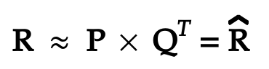
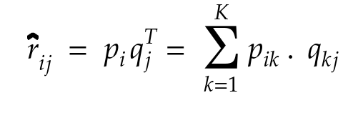
  Iterative SVD
Matrix approximation:
Rating for user and movie:

Slide 24
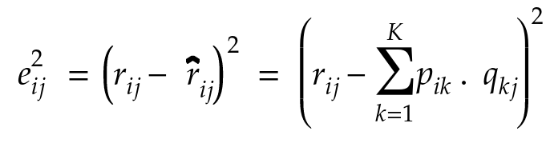
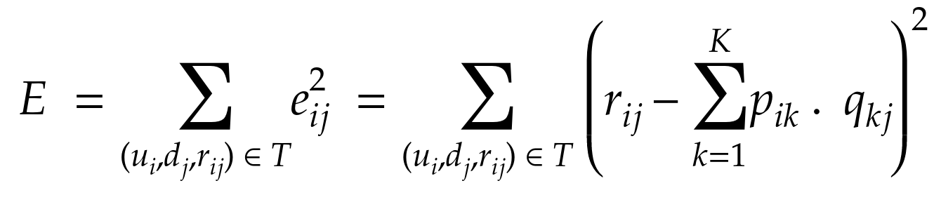
  Iterative SVD
Square error per rating:
Objective function (minimise):

Slide 25
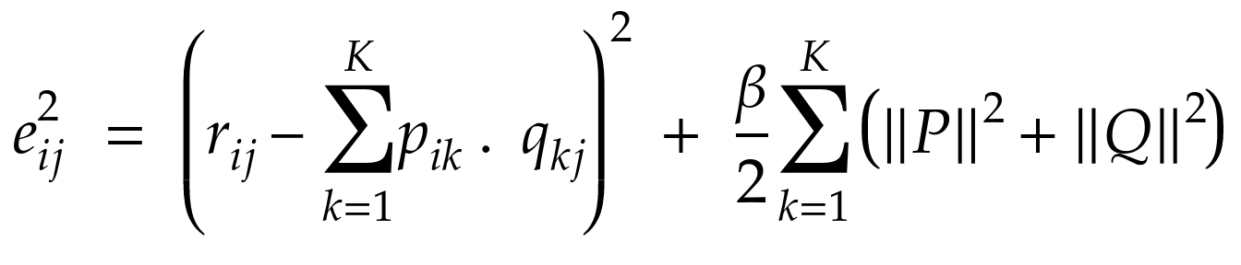
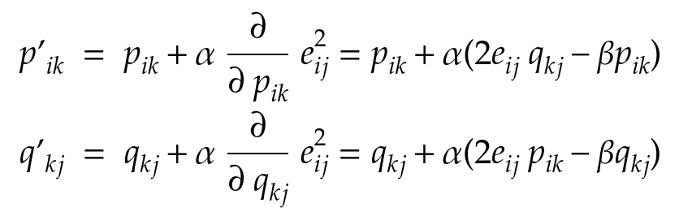
  Iterative SVD
Regularization:
Update rules:

Slide 26
Algorithms
Content based
  K-Means

Slide 27
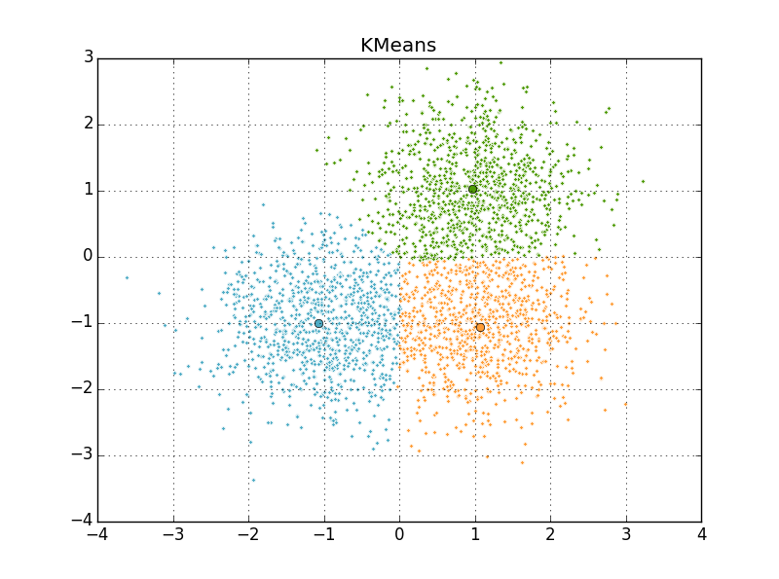
  K-Means
Notes:
This unsupervised machine learning algorithm is used to find clusters in data. The number of clusters gets manually specified the system will then try and find these clusters.

Slide 28
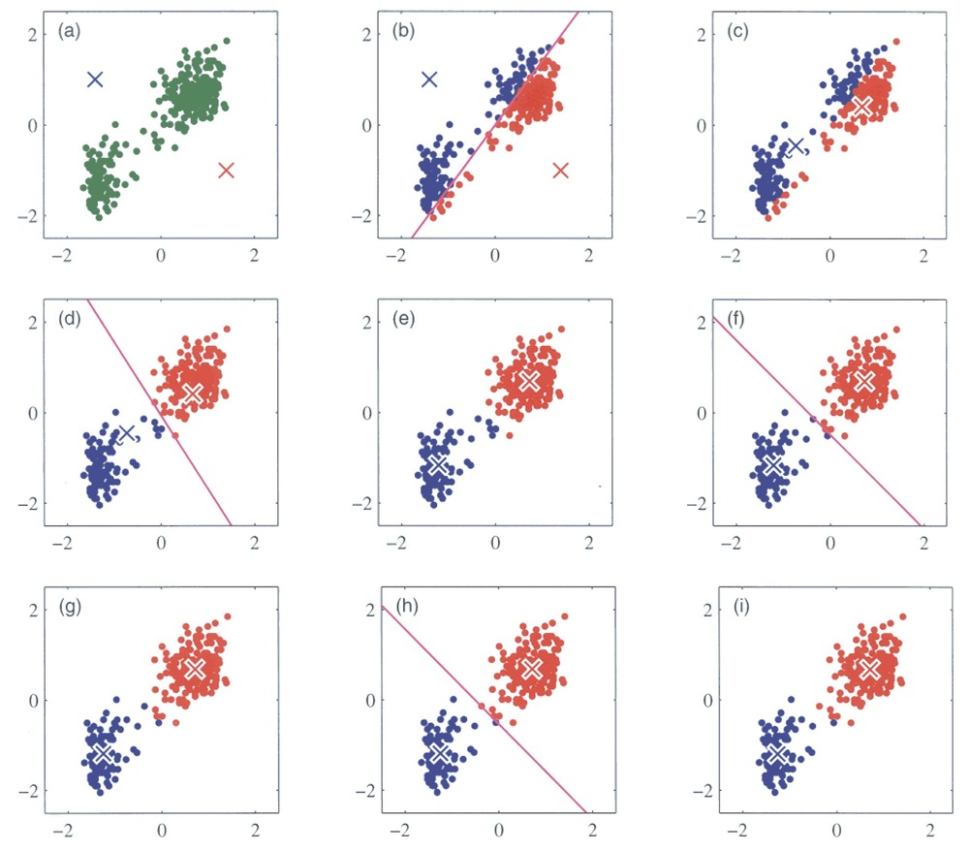
  K-Means
Notes:
The algorithm is spit into 4 steps.
Step 1: Initialise random mean points.
Step 2: Classify all the points into cluster by using the distance from the means.
Step 3: Recalculate the cluster mean using the means of the classified points.
Step 4: Repeat steps 2 and 3 until convergence.

Slide 29
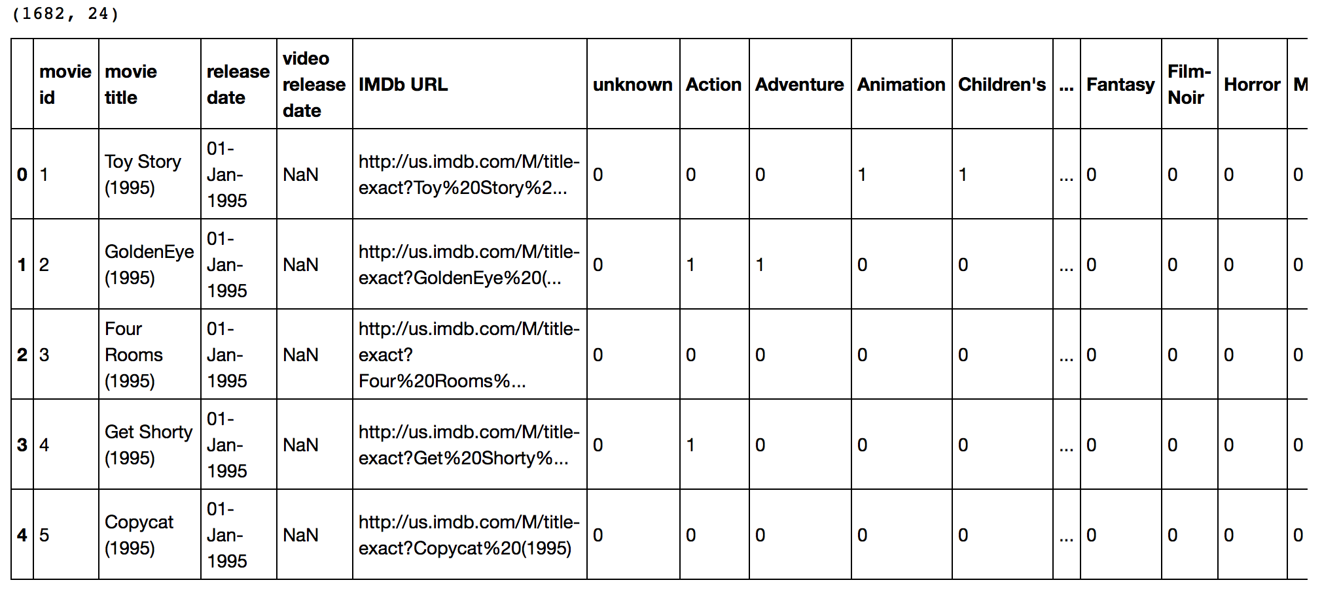
  K-Means
Notes:
The K-Means algorithm can be used to find clusters in movies using there metadata as seen in the image.

Slide 30
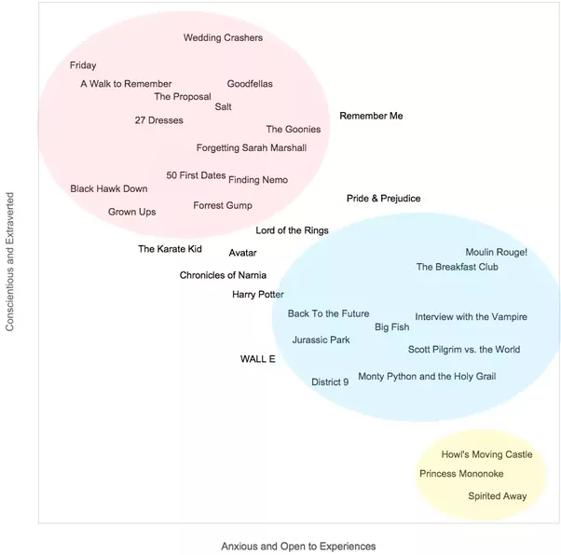
  K-Means
Notes:
These clusters can the be used to labeled movies into different categories. If a user likes a movie from one category the system can recommend more movies from that category.

Slide 31
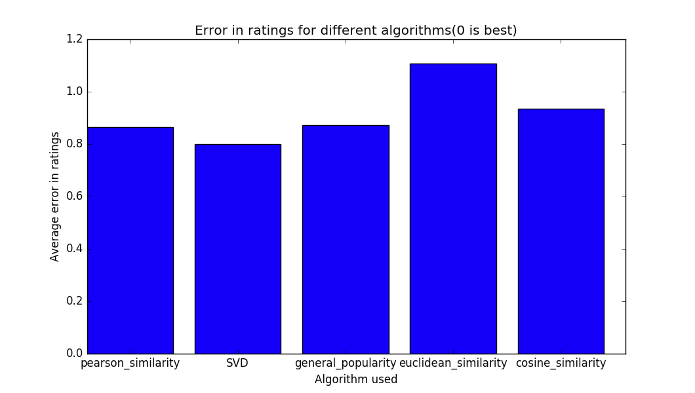
Results
100k ratings

Slide 32
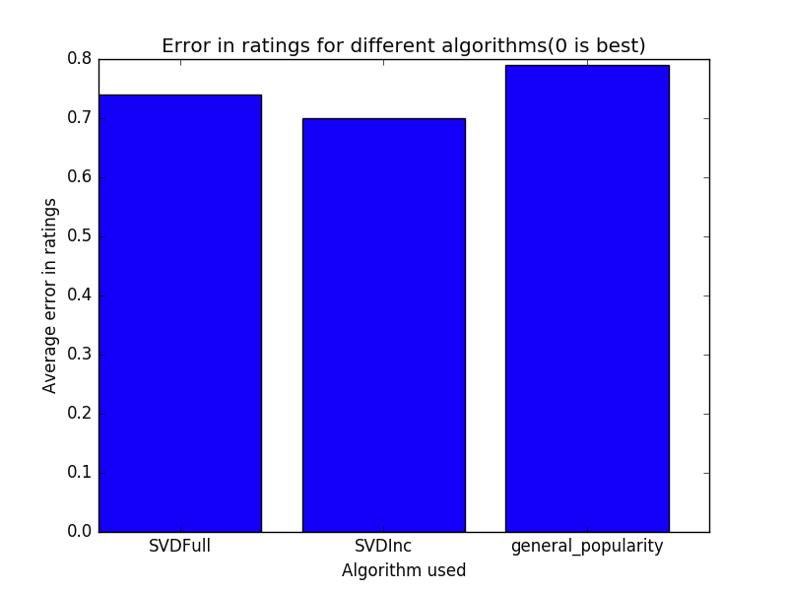
Results
1 million ratings with 200 iterations
Notes:
Here SVDFull is full SVD calculation agorithm. The SVDInc is the iterative algorithm with 200 iterations used.

Slide 33
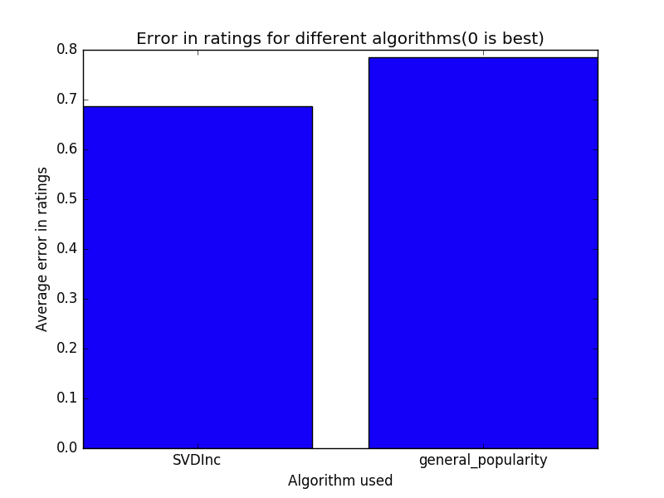
Results
20 million ratings with 50 iterations
Notes:
The SVDFull algorithm is to slow to run for 20 million ratings.

Slide 34
Future work
Cold start: Popularity algorithm
Hybrid system with Content based
  K-means clustering
Restricted Boltzmann machine

Slide 35
Thank you

