Slide 1
Automatic Test Grading Using Image Processing and Machine Learning Techniques
AP Smit

Slide 2
Content
Introduction
Solution
System overview
Image processing
Machine learning
Character recognition using Neural Networks
Final decision making using Probabilistic Graphical Models
Results and conclusions

Slide 3

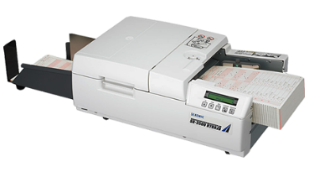
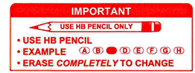
Introduction
Tutors and teaching assistant grade tests incorrectly
Online tests impractical due to class size
Current OMR systems require special scanners
Current OMR systems are difficult to use

Slide 4
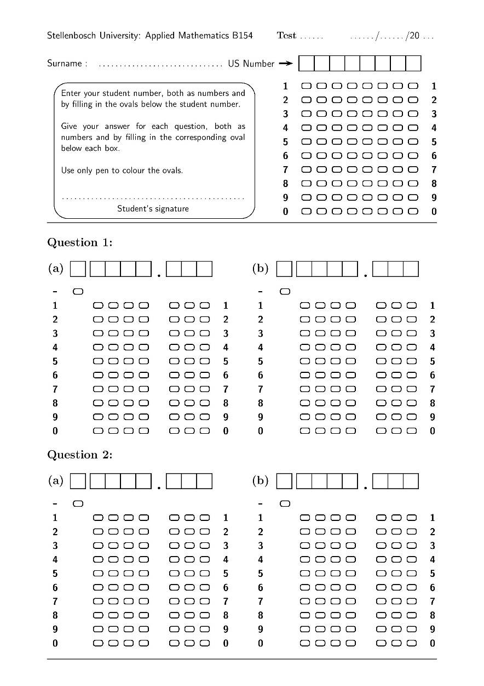
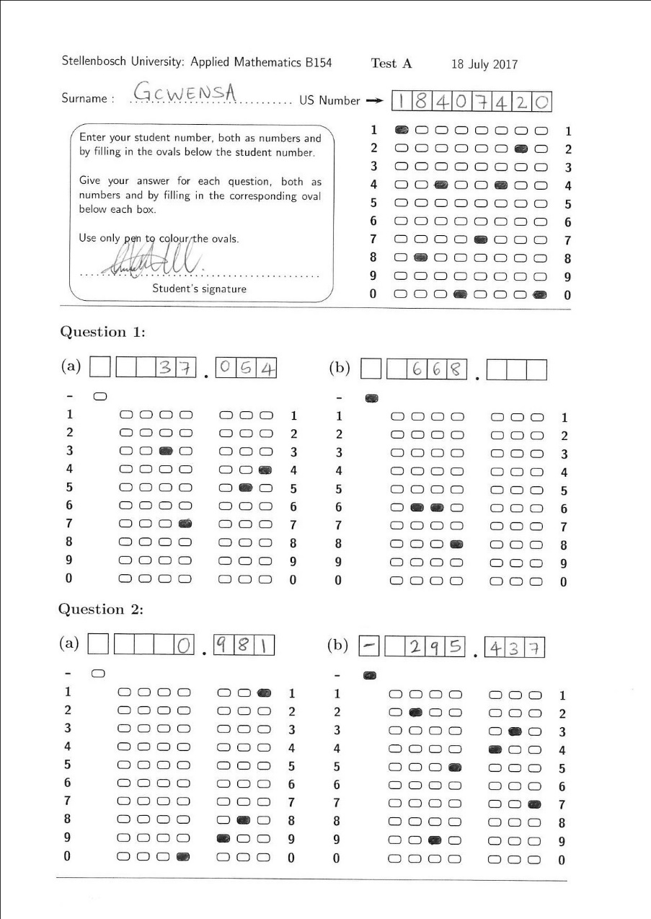
Solution
Template that allows for decimal valued answers
Software that can handle crossed-out answers
Software also identifies characters through character recognition to increase reliability

Slide 5
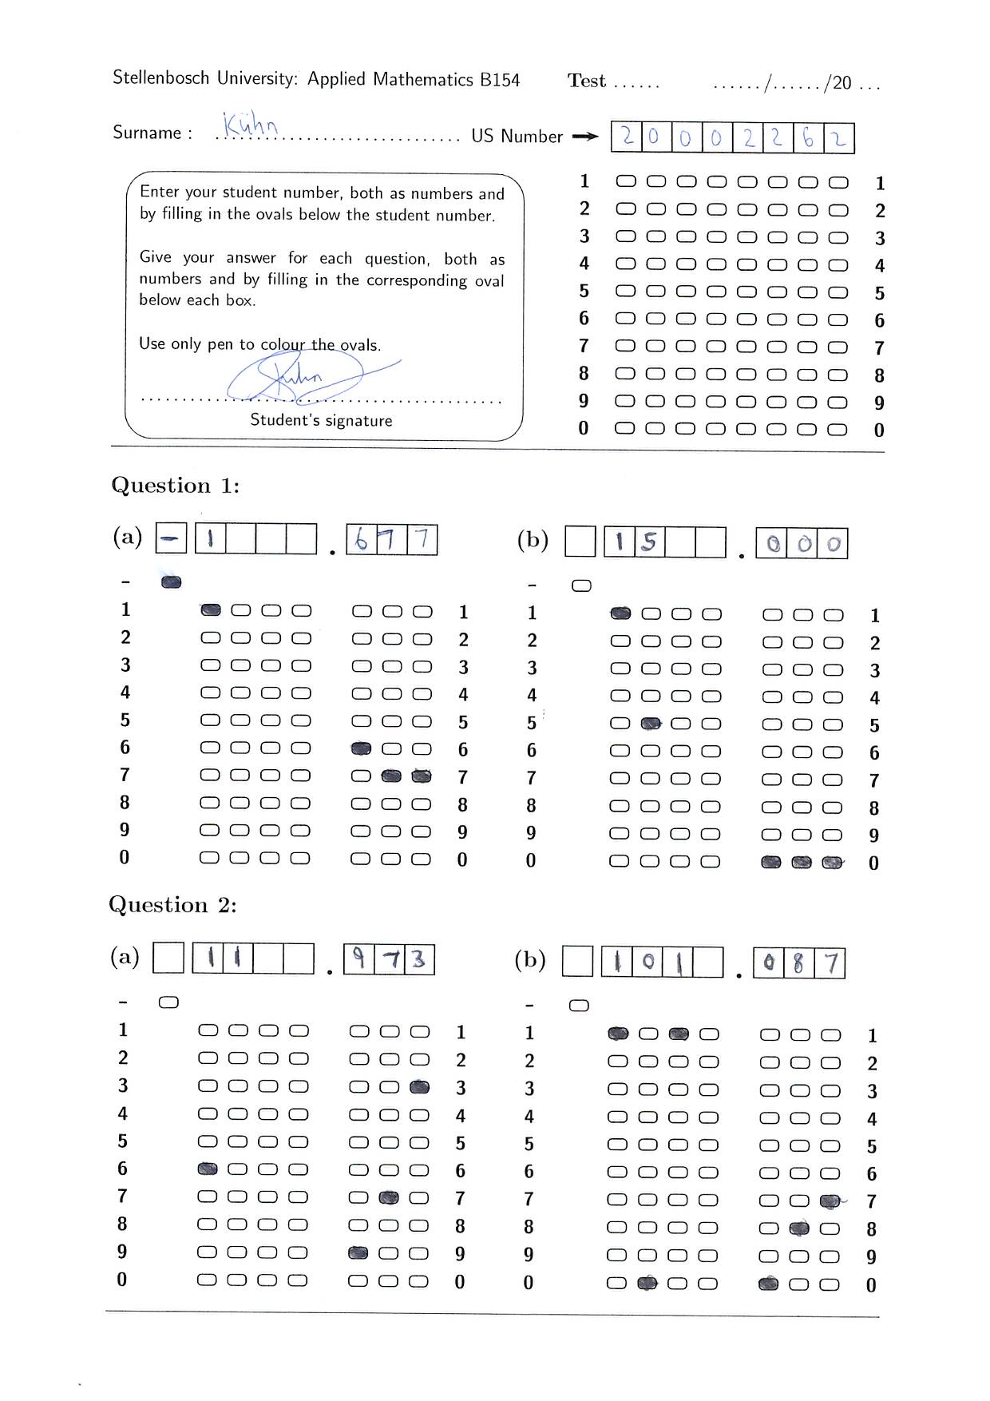
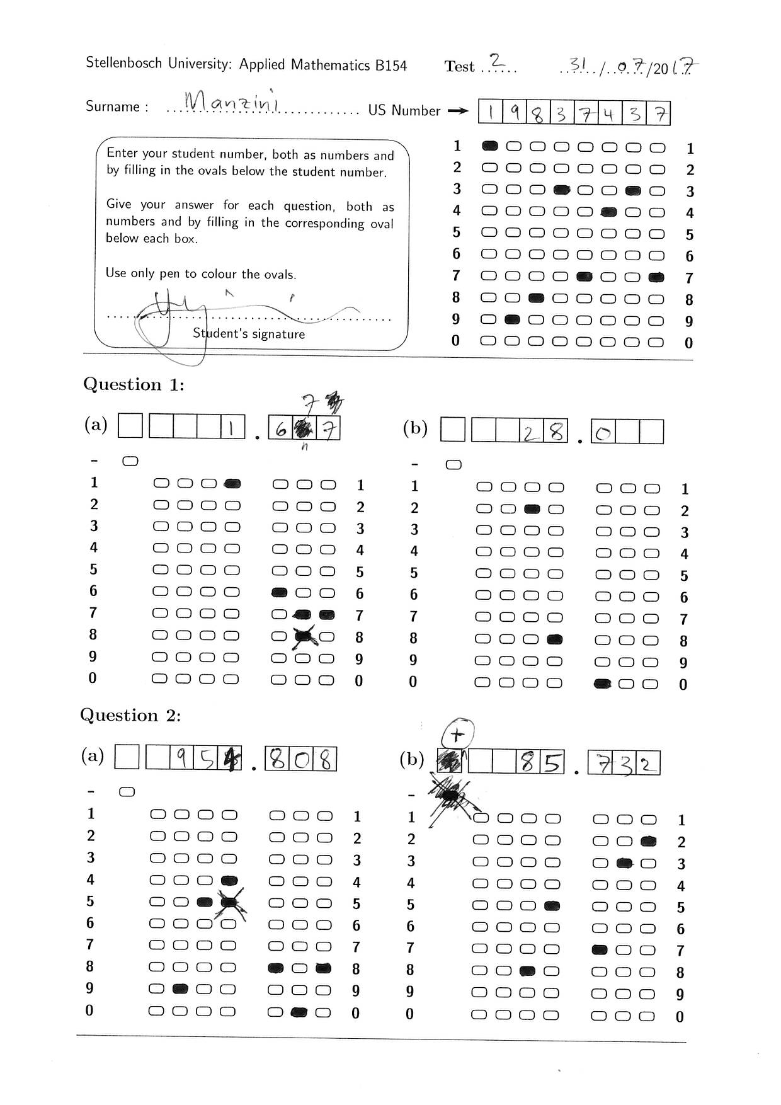
Solution

Slide 6
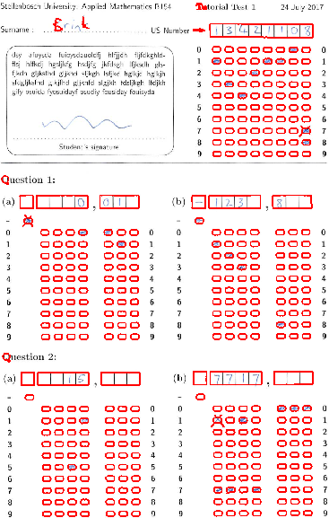
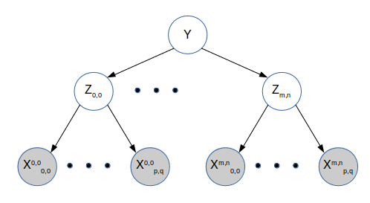
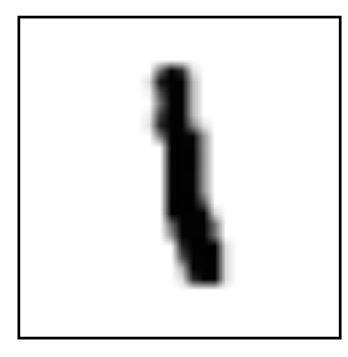
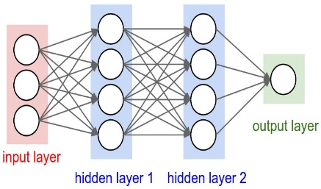

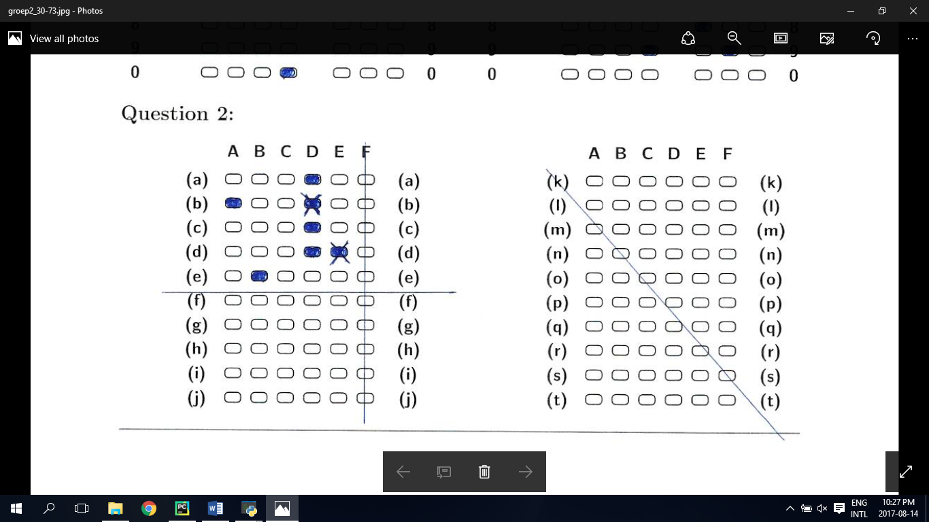
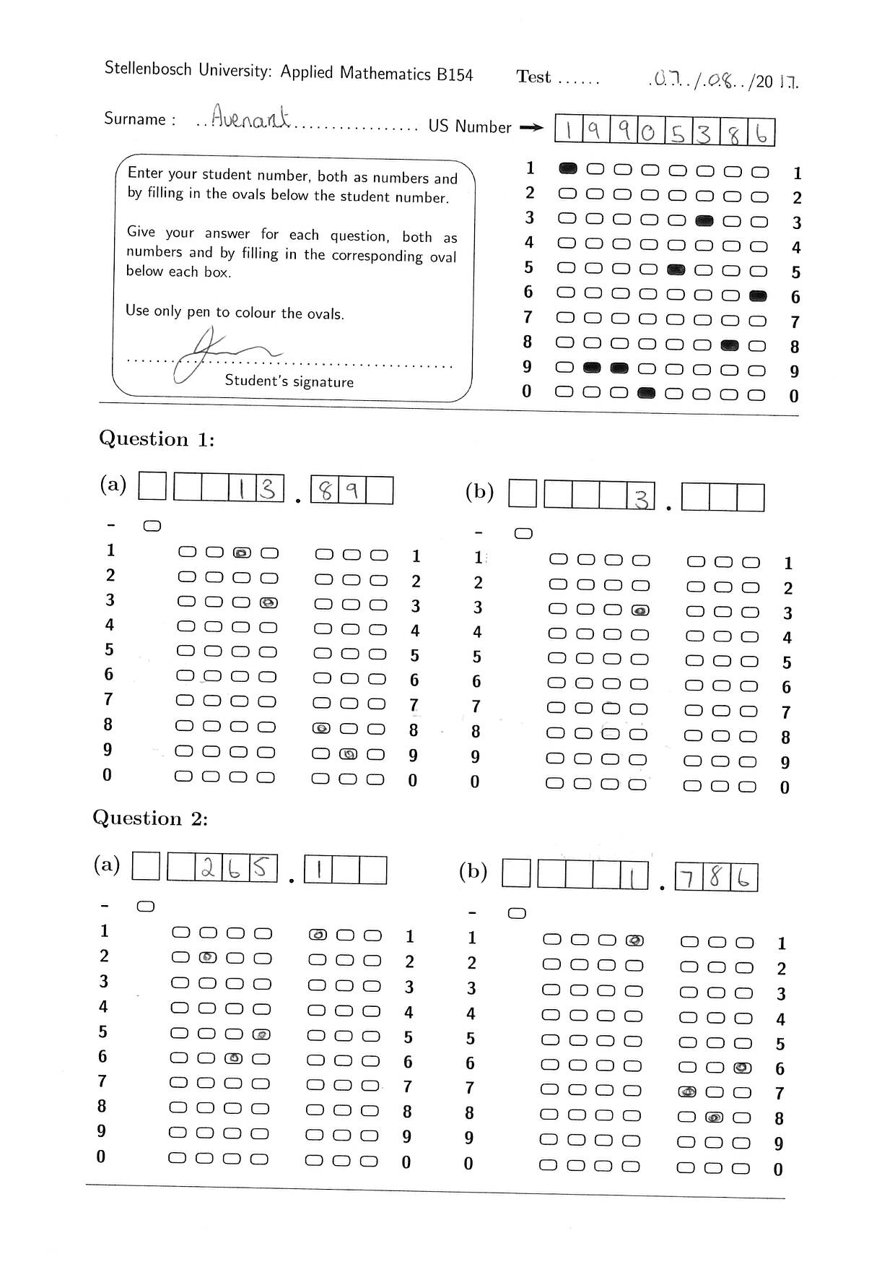
System overview
Image Processing
Character evidence
Neural Network
Probabilistic graphical models
Answers
Bubble evidence

Slide 7

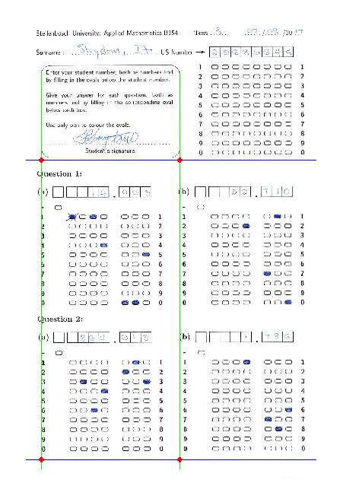
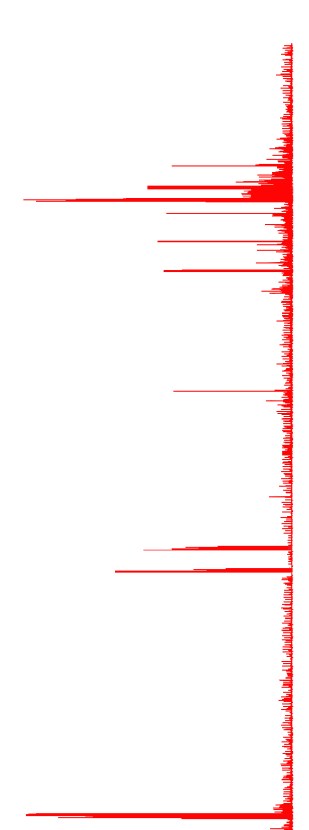
Image Processing
First step is to find the orientation of the template

Slide 8
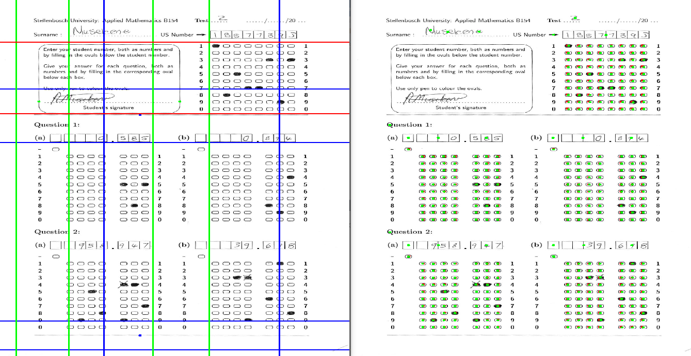
Once this is done the bubble locations can be found and processed.

Slide 9
Machine learning techniques

Slide 10
Neural Networks

Slide 11
Probabilistic Graphical Models

