Slide 1
Automatic Test Grading Using Image Processing and Machine Learning Techniques
AP Smit

Slide 2
Content
Introduction
Solution
System overview
Image processing
Machine learning
Character recognition using Neural Networks
Final decision making using Probabilistic Graphical Models
Results and conclusions

Slide 3

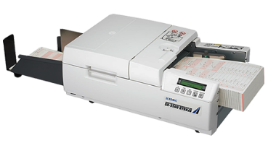
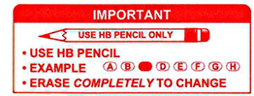
Introduction
Tutors and teaching assistants
Online tests impractical
Current Optical Marker Recognition
Special scanners
Difficult to use
Notes:
Tutors and teaching assistant grade tests incorrectly
Online tests impractical due to class size
Current Optical Marker Recognition systems require special scanners
Current Optical Marker Recognition systems are difficult to use

Slide 4
Solution
Template allows decimal valued answers
Software handles crossed-out answers
Character recognition to increase reliability

Slide 5
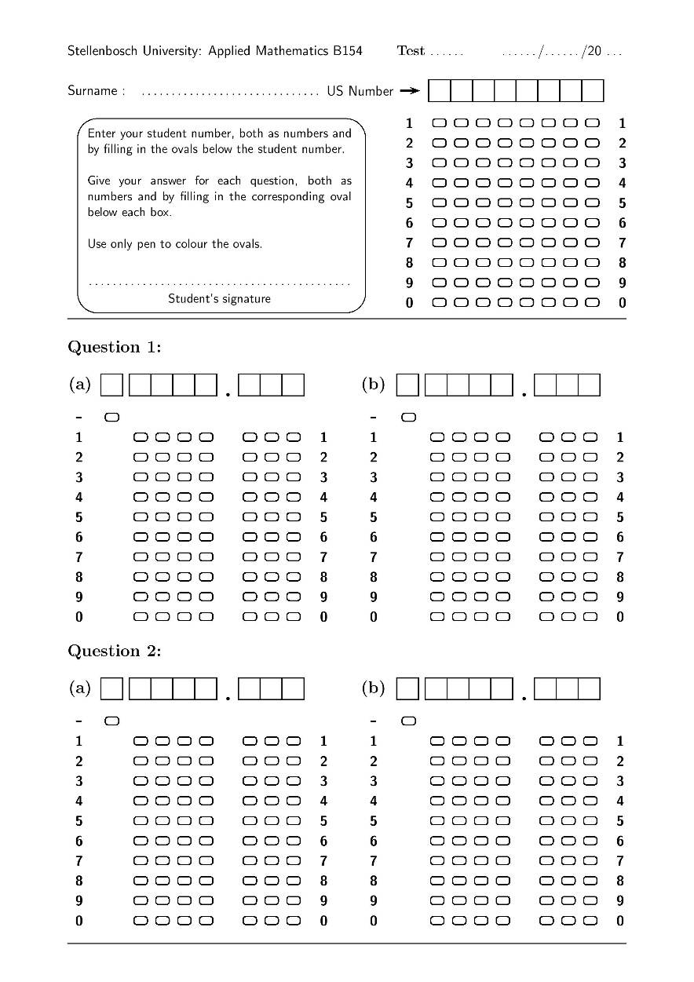
Solution

Slide 6
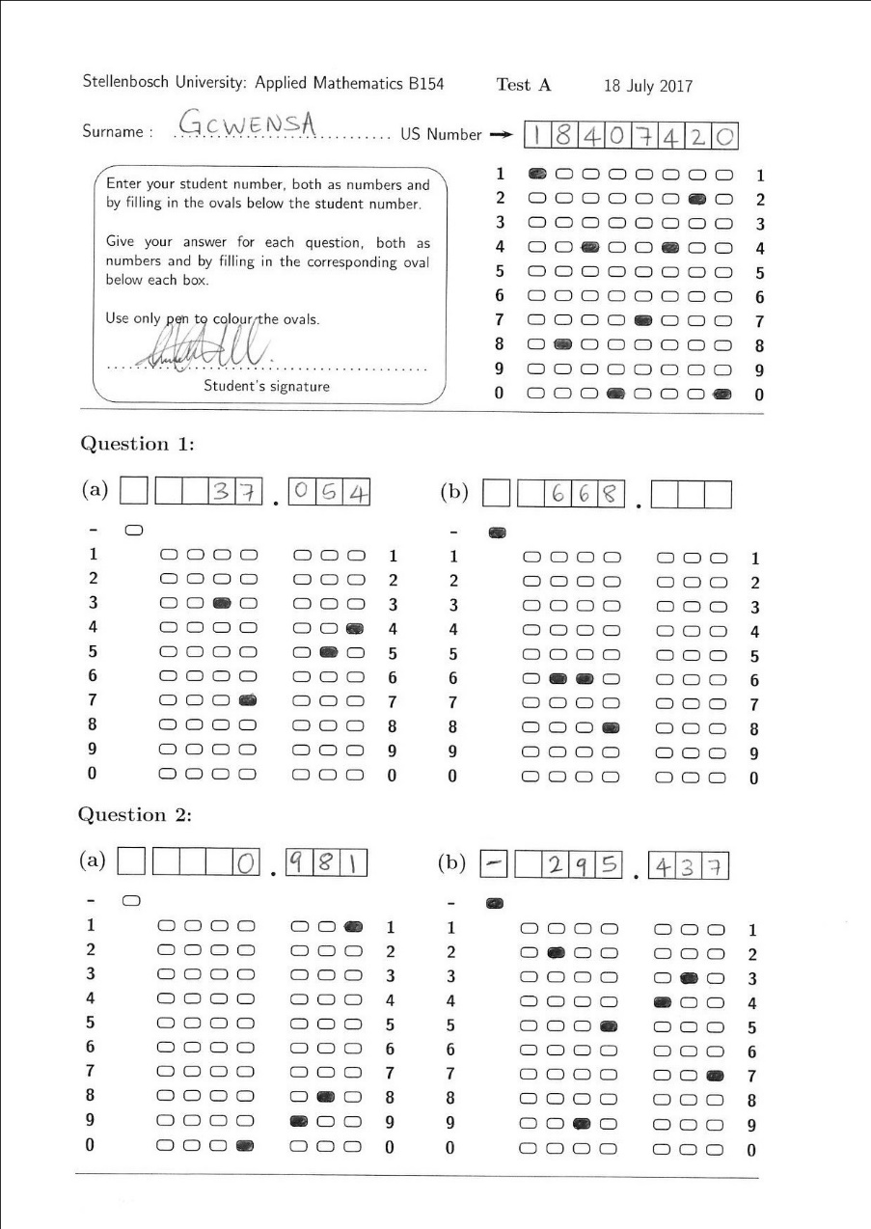
Solution

Slide 7
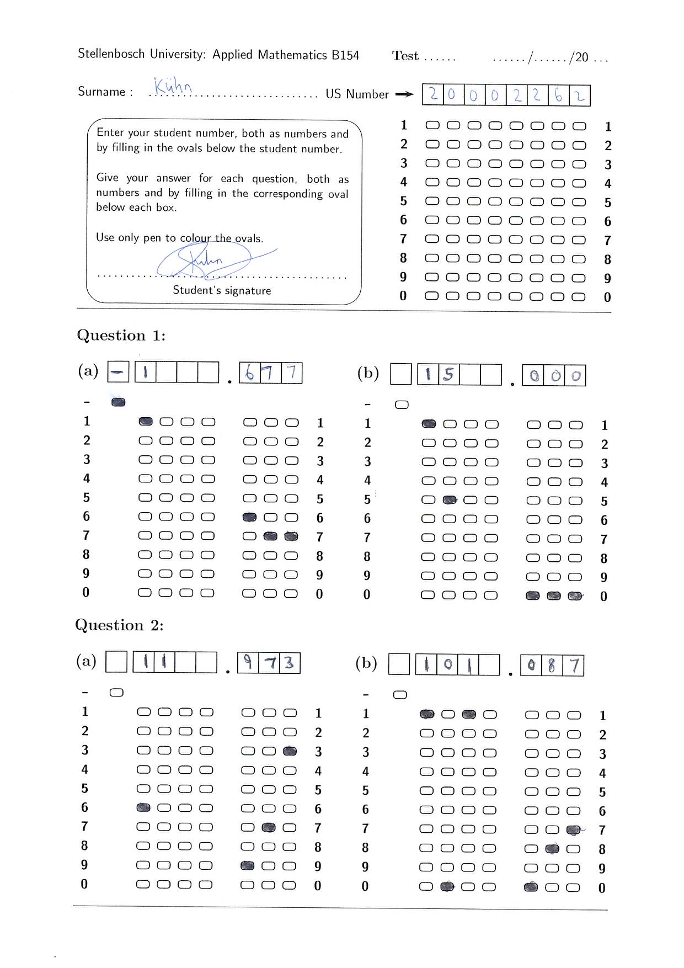
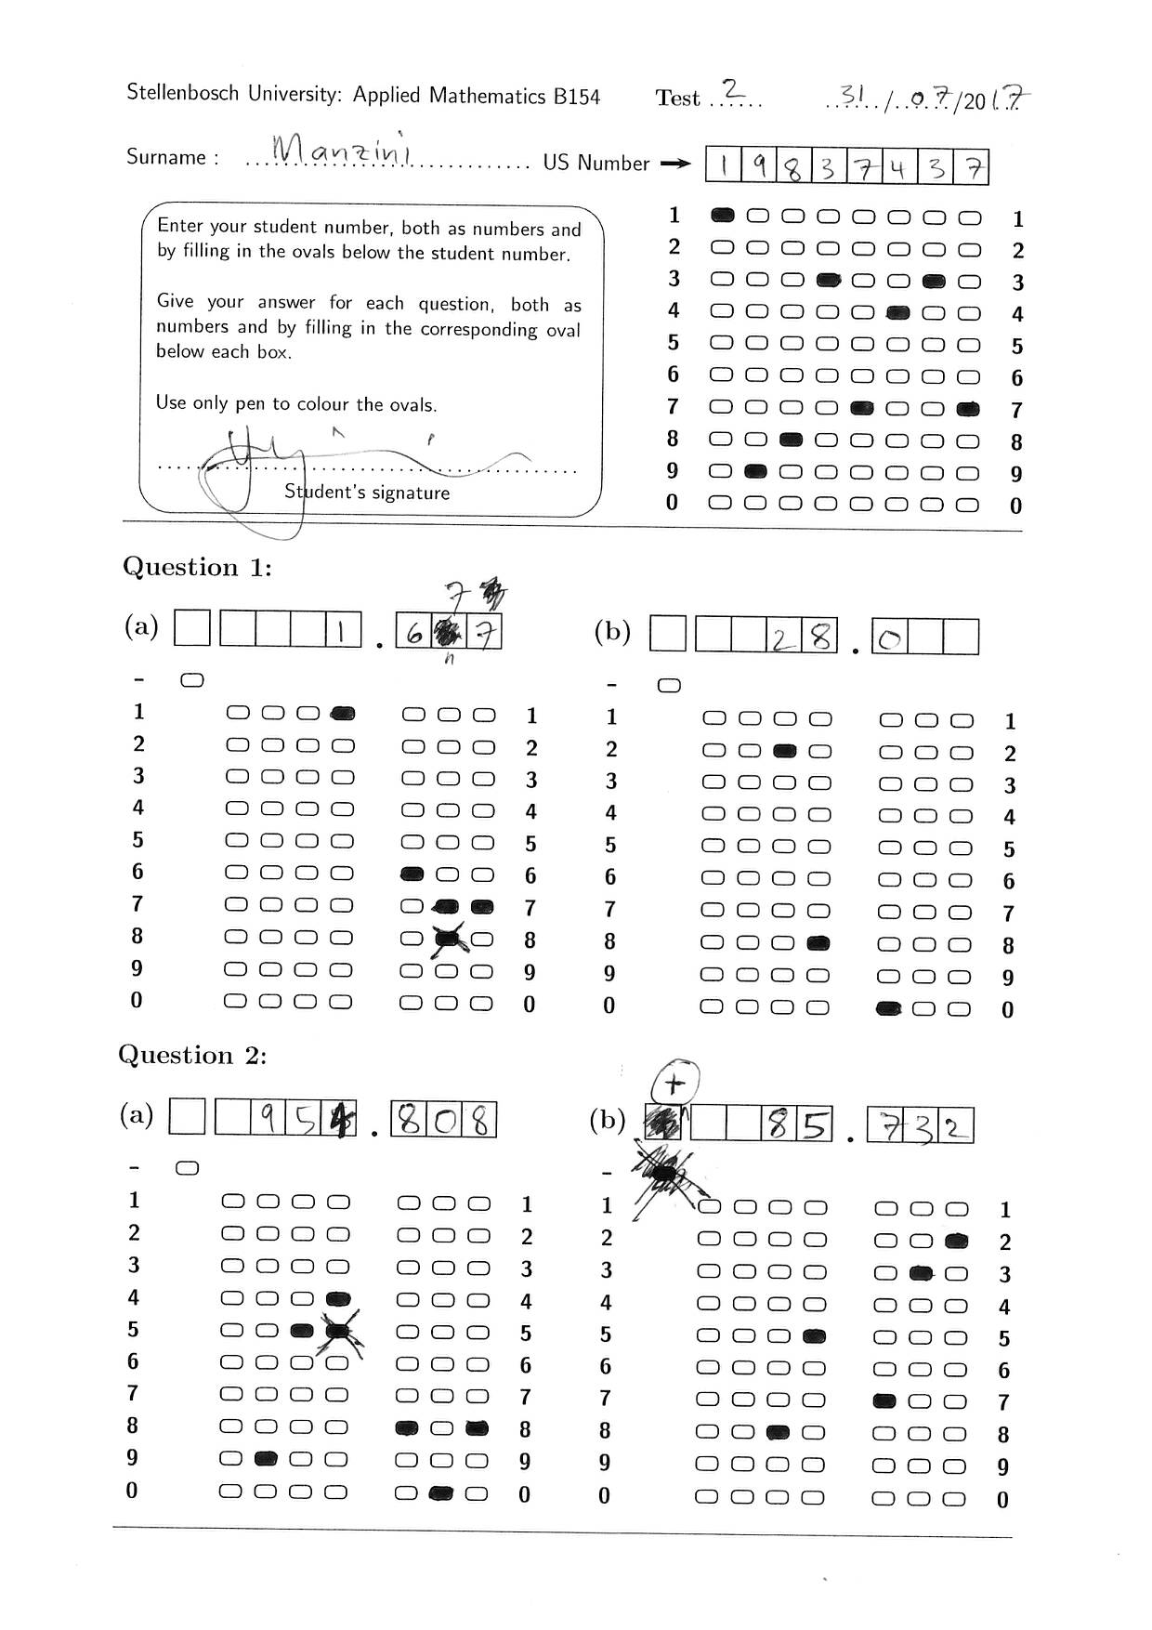
Solution

Slide 8
Solution

Slide 9
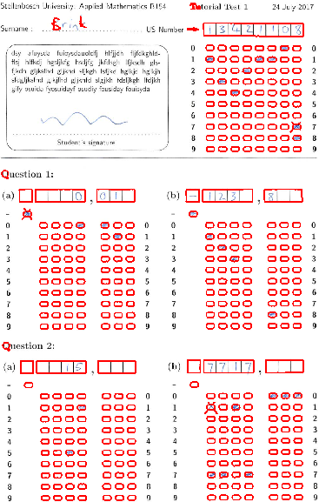
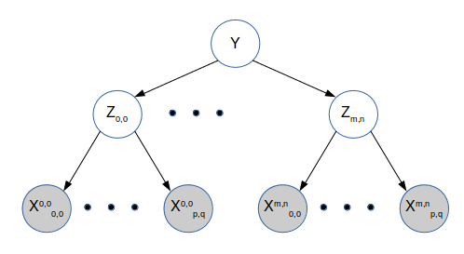
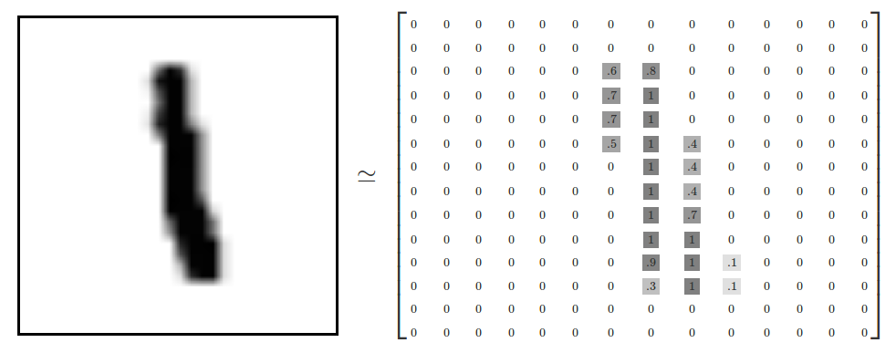
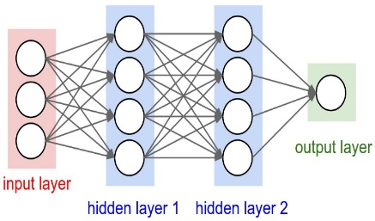

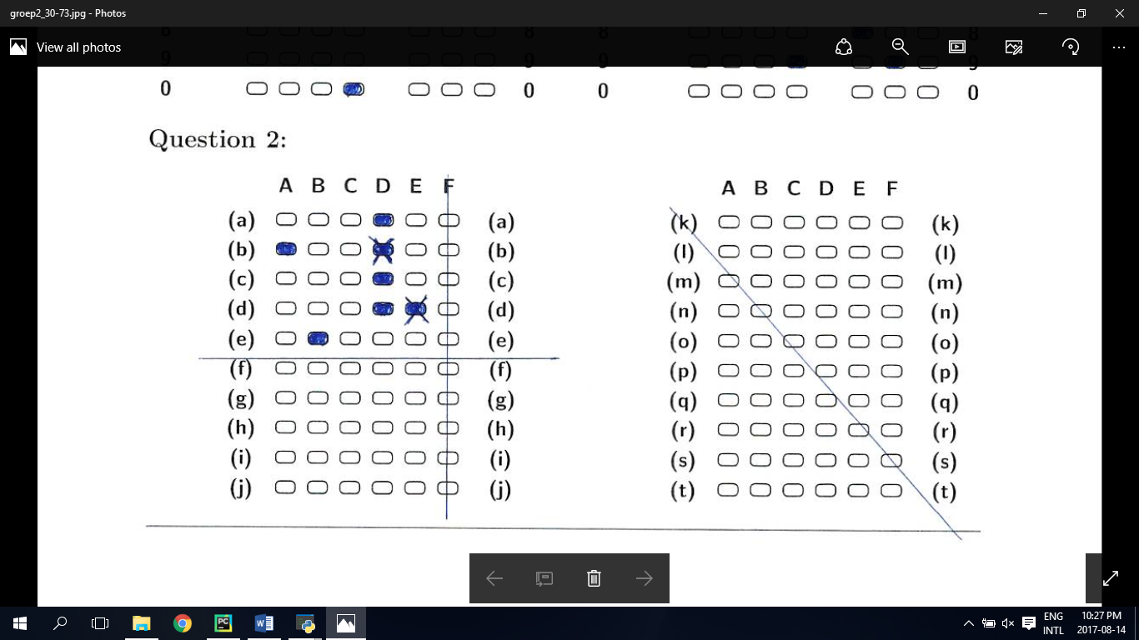
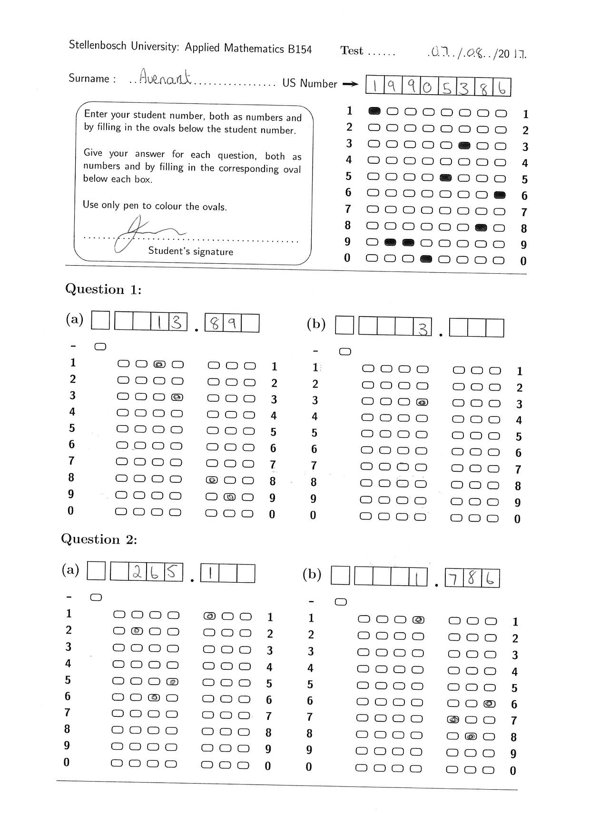
System overview
Image Processing
Character evidence
Neural Network
Probabilistic graphical models
Answers
Bubble evidence

Slide 10

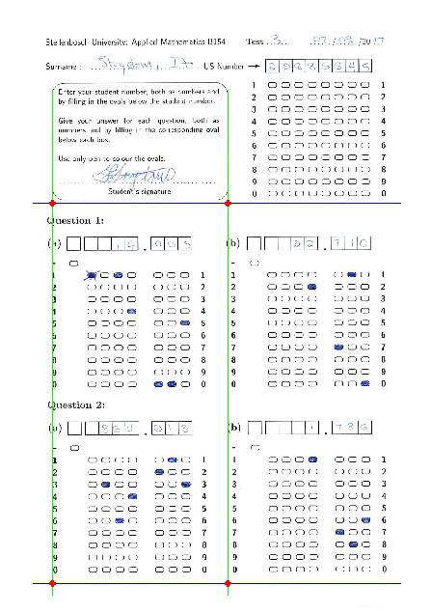
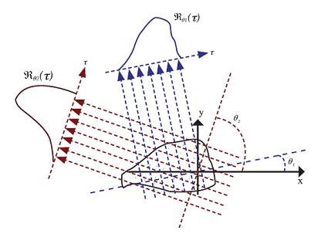
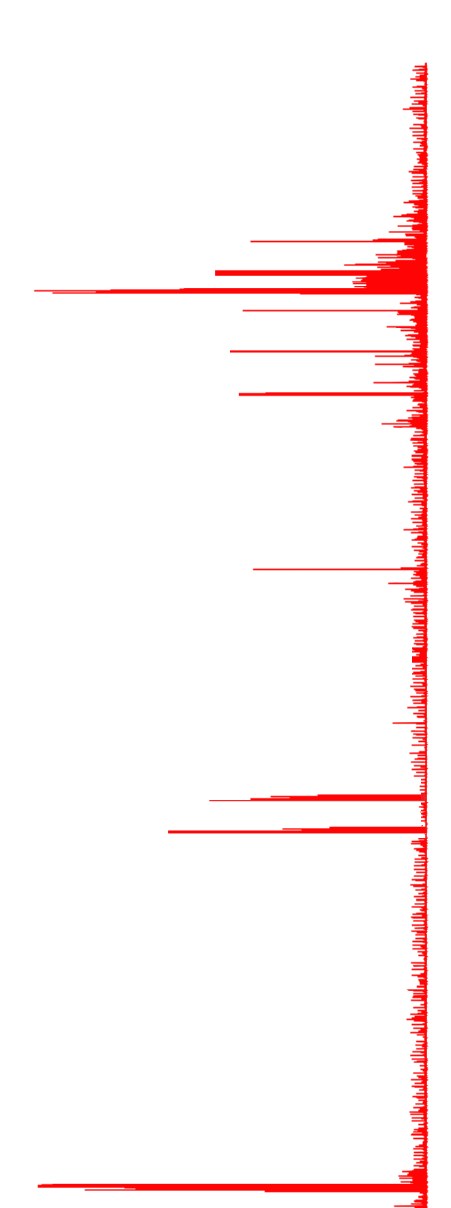
Image Processing
1) Orientation of the template

Slide 11
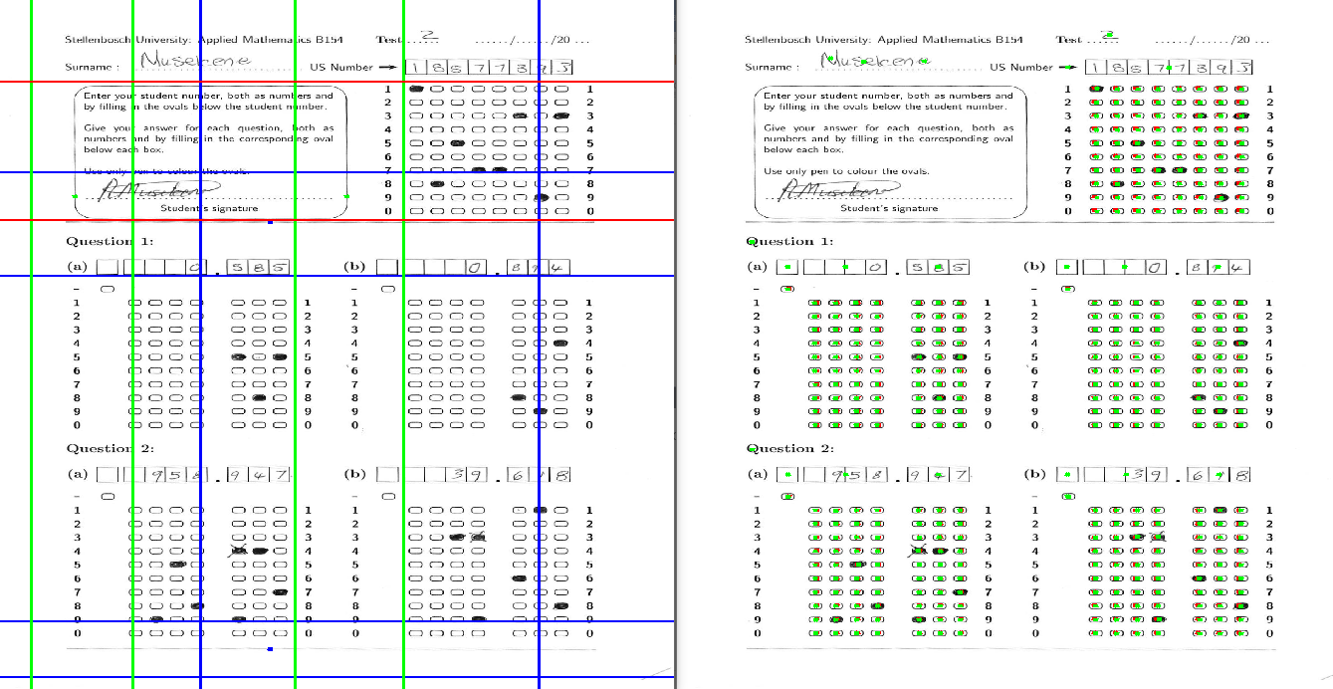
Basic Image Processing
2) Process bubbles

Slide 12
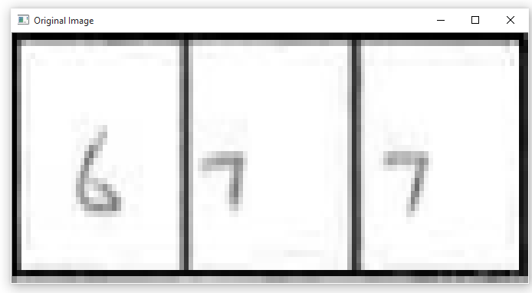
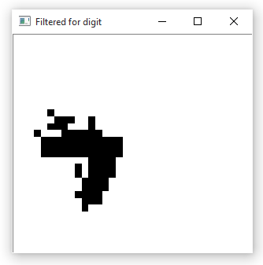
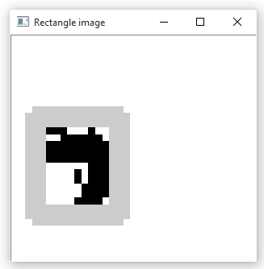

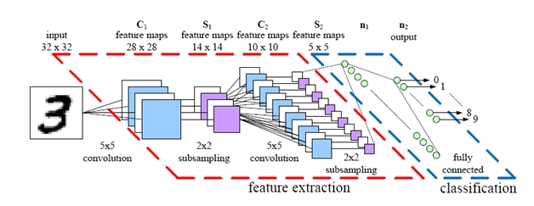
Character recognition: Neural Networks
Custom segmentation algorithm
28 by 28 input vector is created
Convolutional neural network classifies digits implemented in TensorFlow

Slide 13
Probabilistic Graphical Models
True Answer
Bubble evidence
Character priors

Slide 14

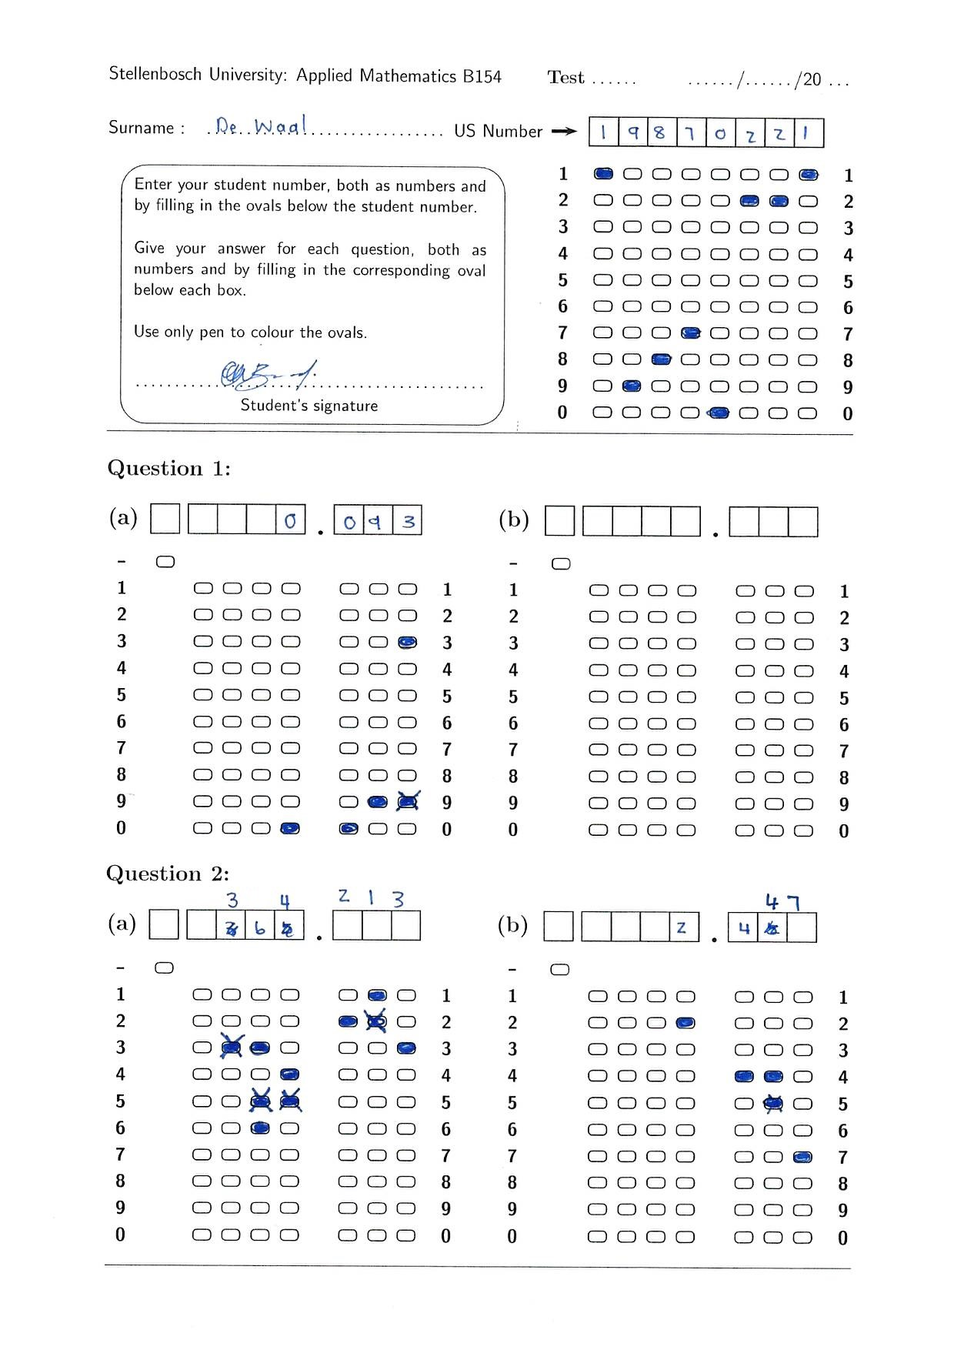
Probabilistic Graphical Models
Probably
a 6
Probably 20002262
Final
guess: 6
Final guess: 20002262
Probably
a 3 or 6
Don’t know

Slide 15
Results and conclusion
11 tutorials and 12 300 tests graded
Grades 1000 test in 30 minutes
New automatic grading accuracy 97.1%
Sends 2.8% of tests for manual grading
Only 0.1% or 1 test per tutorial graded incorrectly
System extended to 2 new templates

