Slide 1
Automatic Test Grading Using Image Processing and Machine Learning Techniques
AP Smit

Slide 2
Content
Problem statement
Solution
System overview
Image processing
Machine learning
Neural Networks for character recognition
Probabilistic graphical model for final decision
Results and conclusions

Slide 3

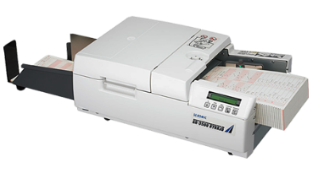
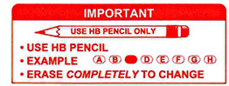
Problem statement
Tutors and teaching assistant grade tests incorrectly
Online tests impractical due to class size
Current OMR systems require special scanners
Current OMR systems are difficult to use

Slide 4
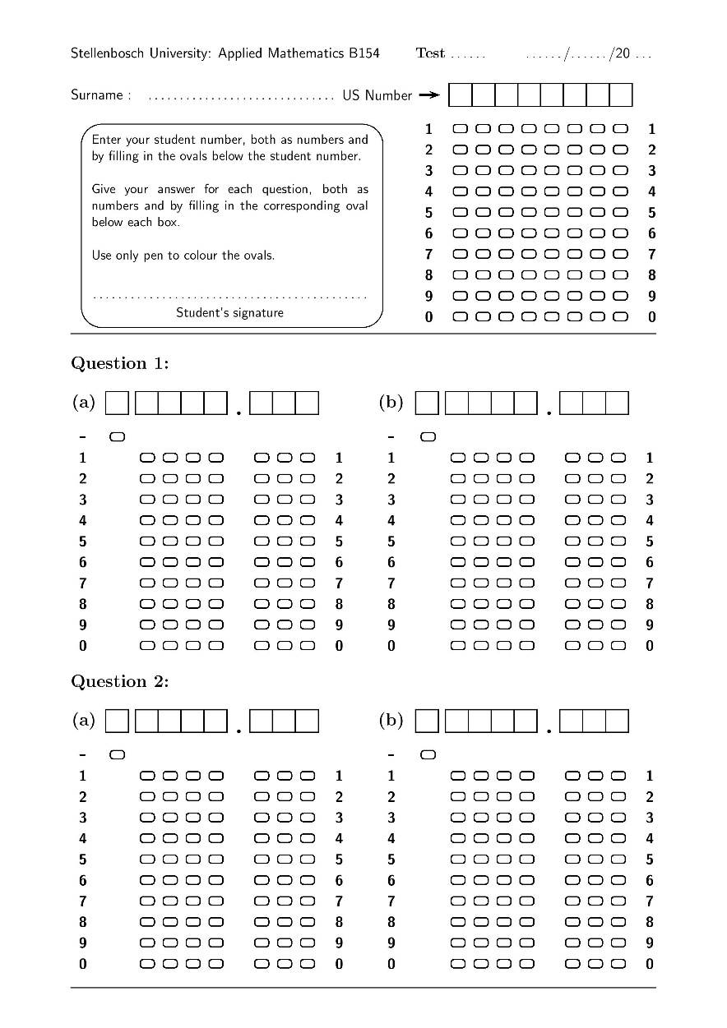
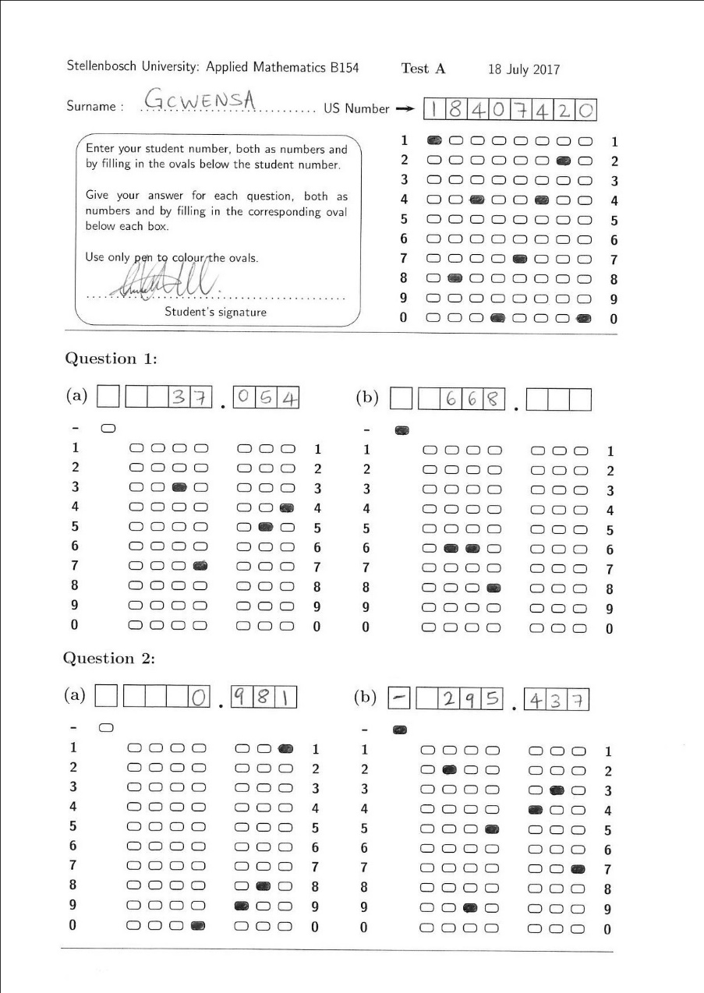
Solution
Template that allows for decimal valued answers
Software that can handle crossed-out answers
Software also identifies characters through character recognition to increase reliability

Slide 5
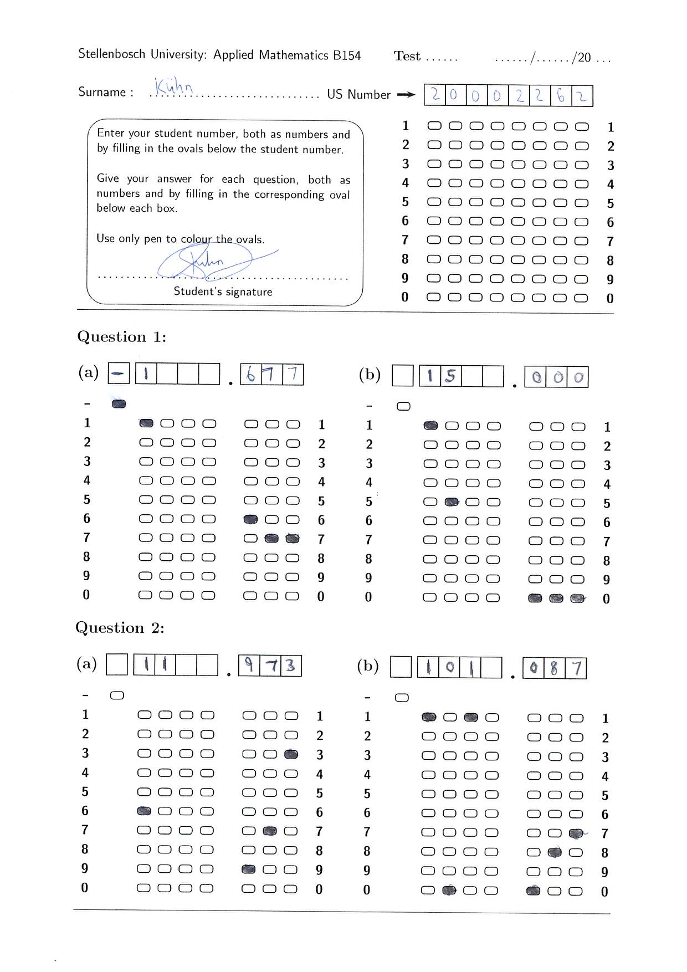
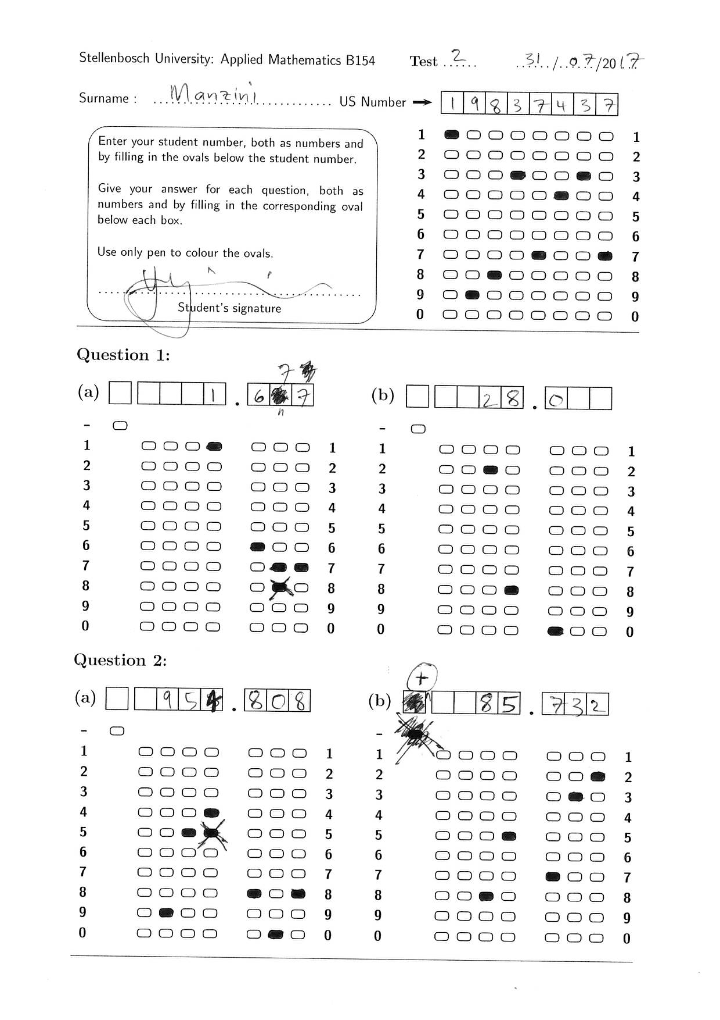
Solution

Slide 6
Introduction
The erosion characteristics of shells and shell fragments are investigated
The incipient motion of shells and shell fragments has been studied experimentally by researchers (Dey (2001, 2004))
Ramsdell and Miedema (2010); Miedema and Ramsdell (2011) related findings of the critical shear stress for erosion to a Shields diagram for non-uniform particle distributions

Slide 7
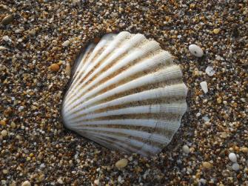
Introduction
The incipient motion, and thus also the erosion of shells and shell fragments, differs from that of equivalent sized sand particles
Only a small cross-sectional area of a shell is exposed to the horizontal direction of the flow making shells difficult to erode
They have low settling velocities due to their large cross-sectional area:
This implies that shells are mostly visible on top of the sand
consequently also shielding the finer, more easily erodible sediment such as sand

