Slide 1
Automatic Test Grading Using Image Processing and Machine Learning Techniques
AP Smit

Slide 2
Content
Introduction
Solution
System overview
Image processing
Machine learning
Character recognition using Neural Networks
Final decision making using Probabilistic Graphical Models
Results and conclusions

Slide 3

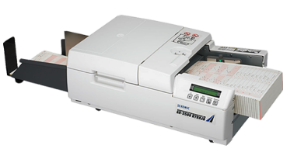
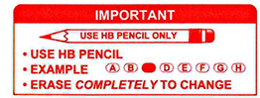
Introduction
Tutors and teaching assistant grade tests incorrectly
Online tests impractical due to class size
Current OMR systems require special scanners
Current OMR systems are difficult to use

Slide 4
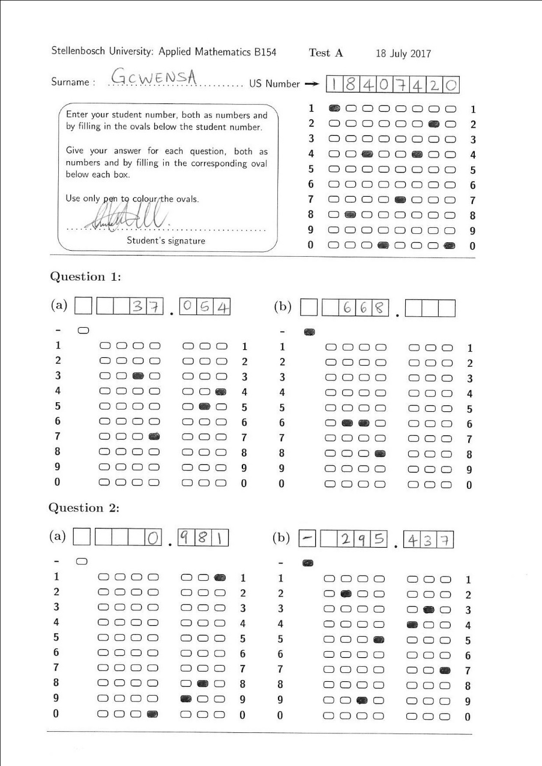
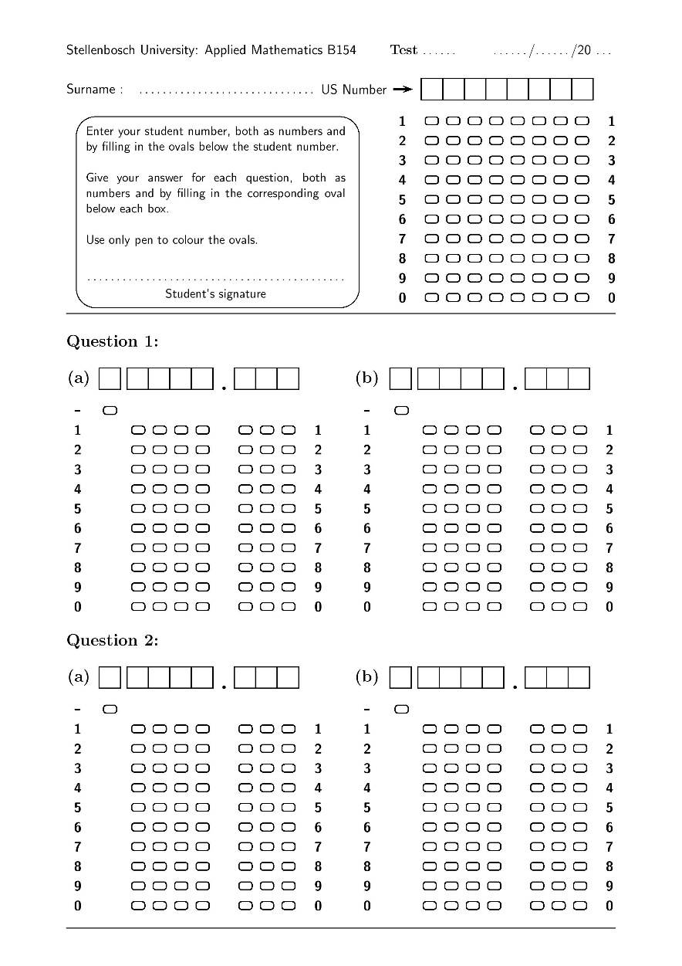
Solution
Template that allows for decimal valued answers
Software that can handle crossed-out answers
Software also identifies characters through character recognition to increase reliability

Slide 5
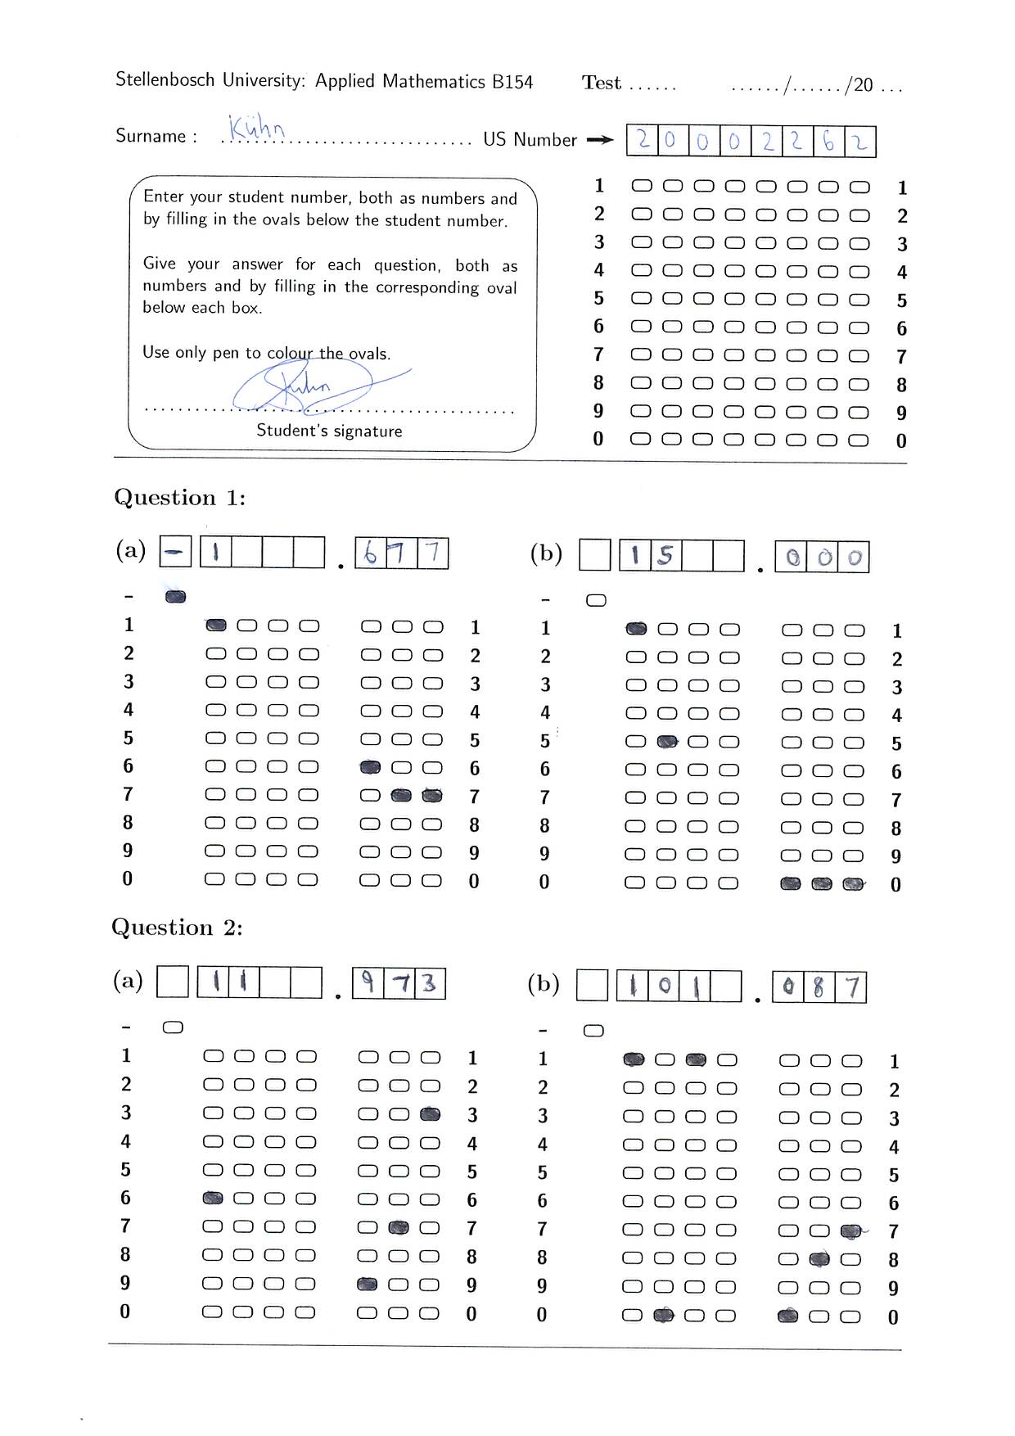
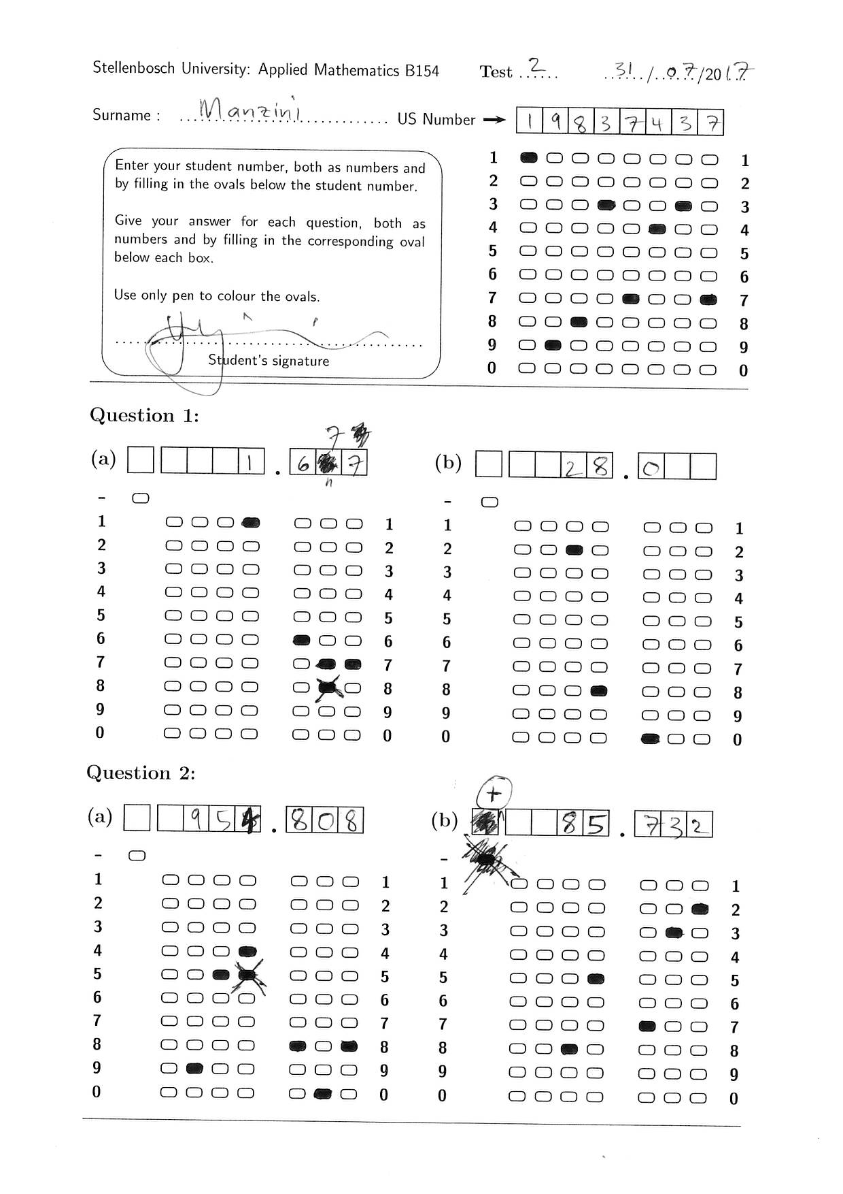
Solution

Slide 6
Solution

Slide 7
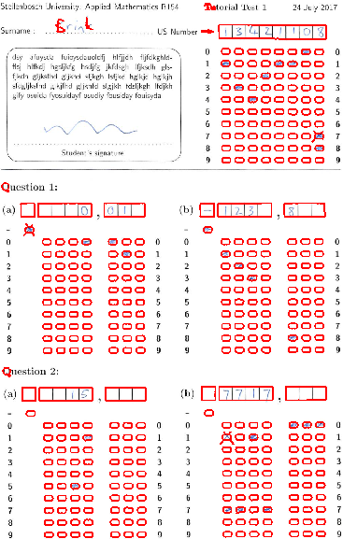
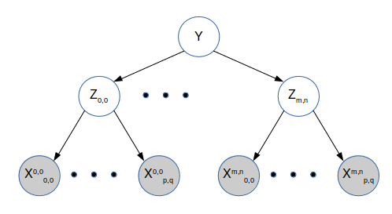
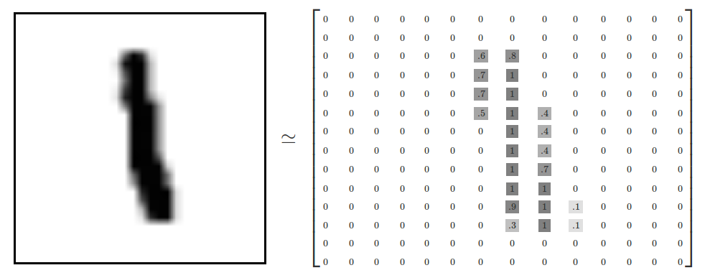
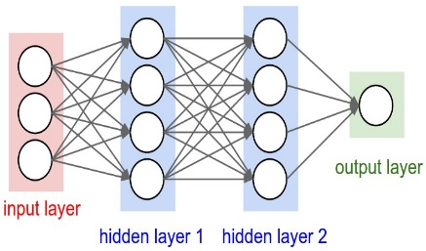

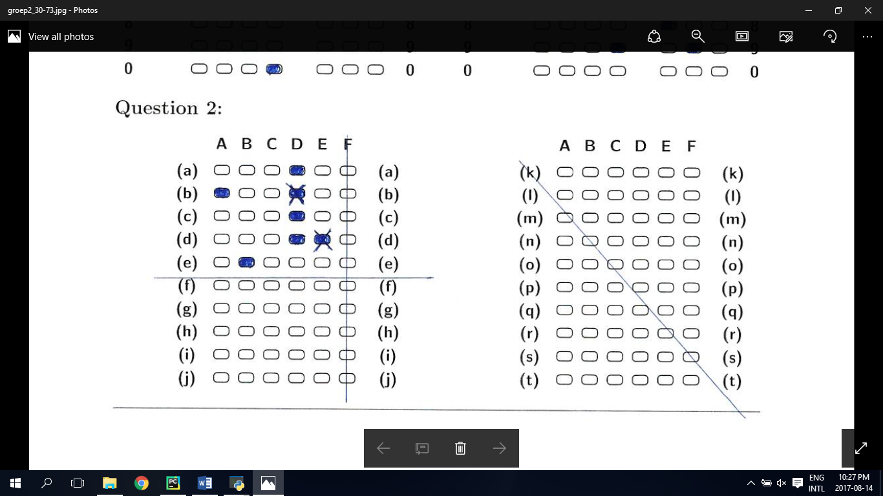
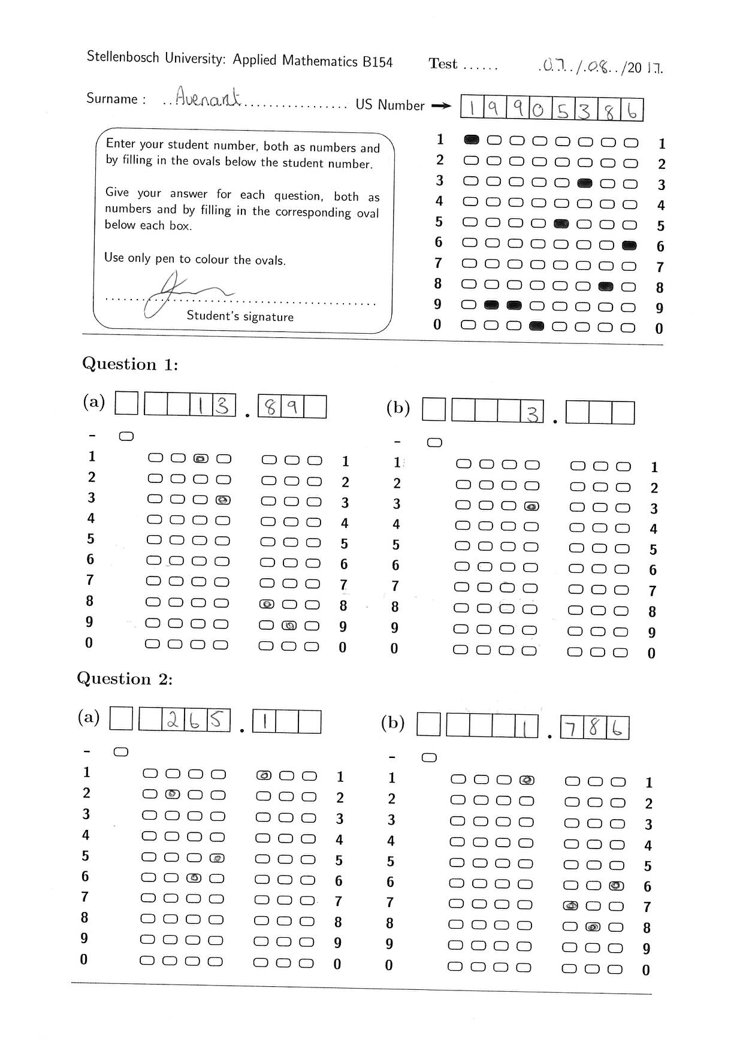
System overview
Image Processing
Character evidence
Neural Network
Probabilistic graphical models
Answers
Bubble evidence

Slide 8

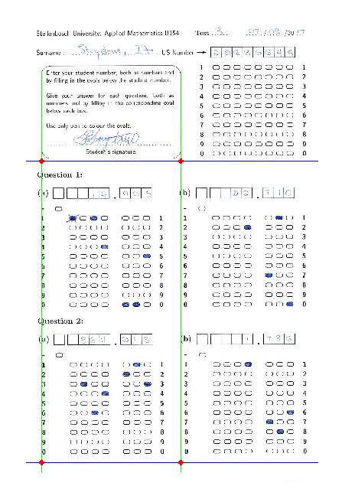
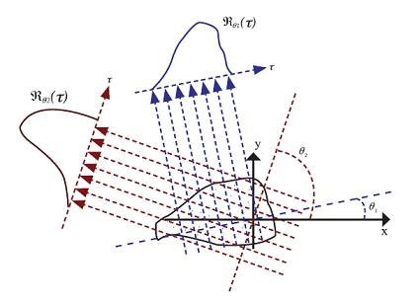
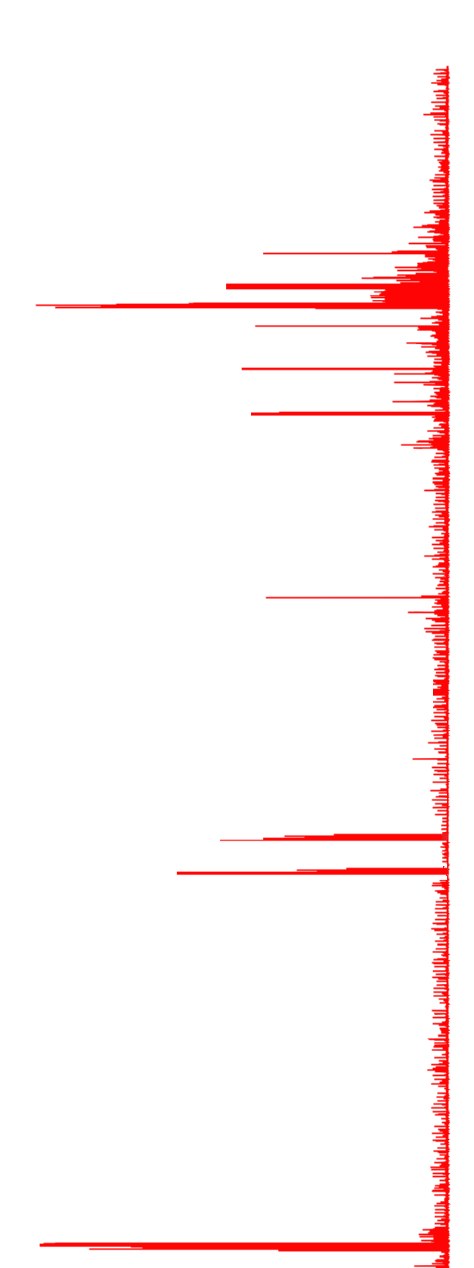
Image Processing
First step is to find the orientation of the template

Slide 9
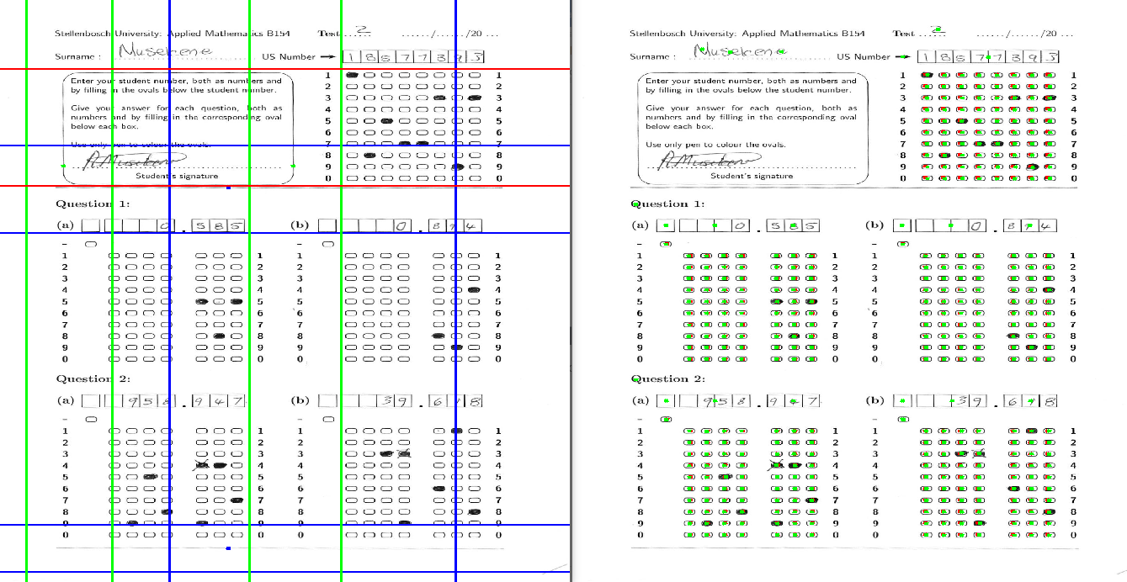
Basic Image Processing
Once this is done the bubble locations can be found and processed.

Slide 10
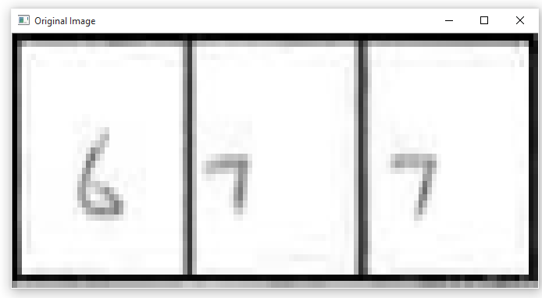
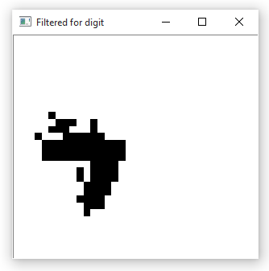
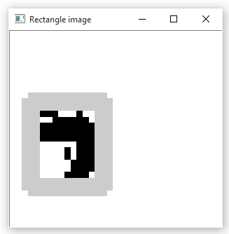
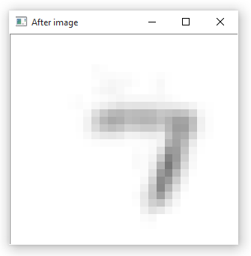
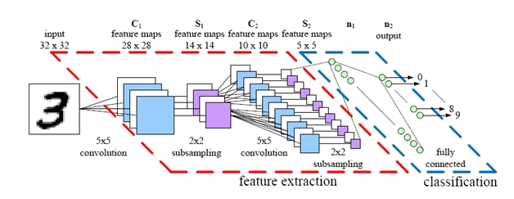
Character recognition: Neural Networks
Initial image processing is done on the digit using a custom segmentation algorithm
28 by 28 input vector is created
Convolutional neural network classifies digits implemented in TensorFlow

Slide 11
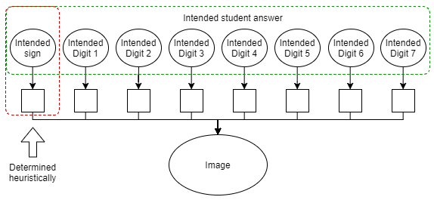
Probabilistic Graphical Models

Slide 12

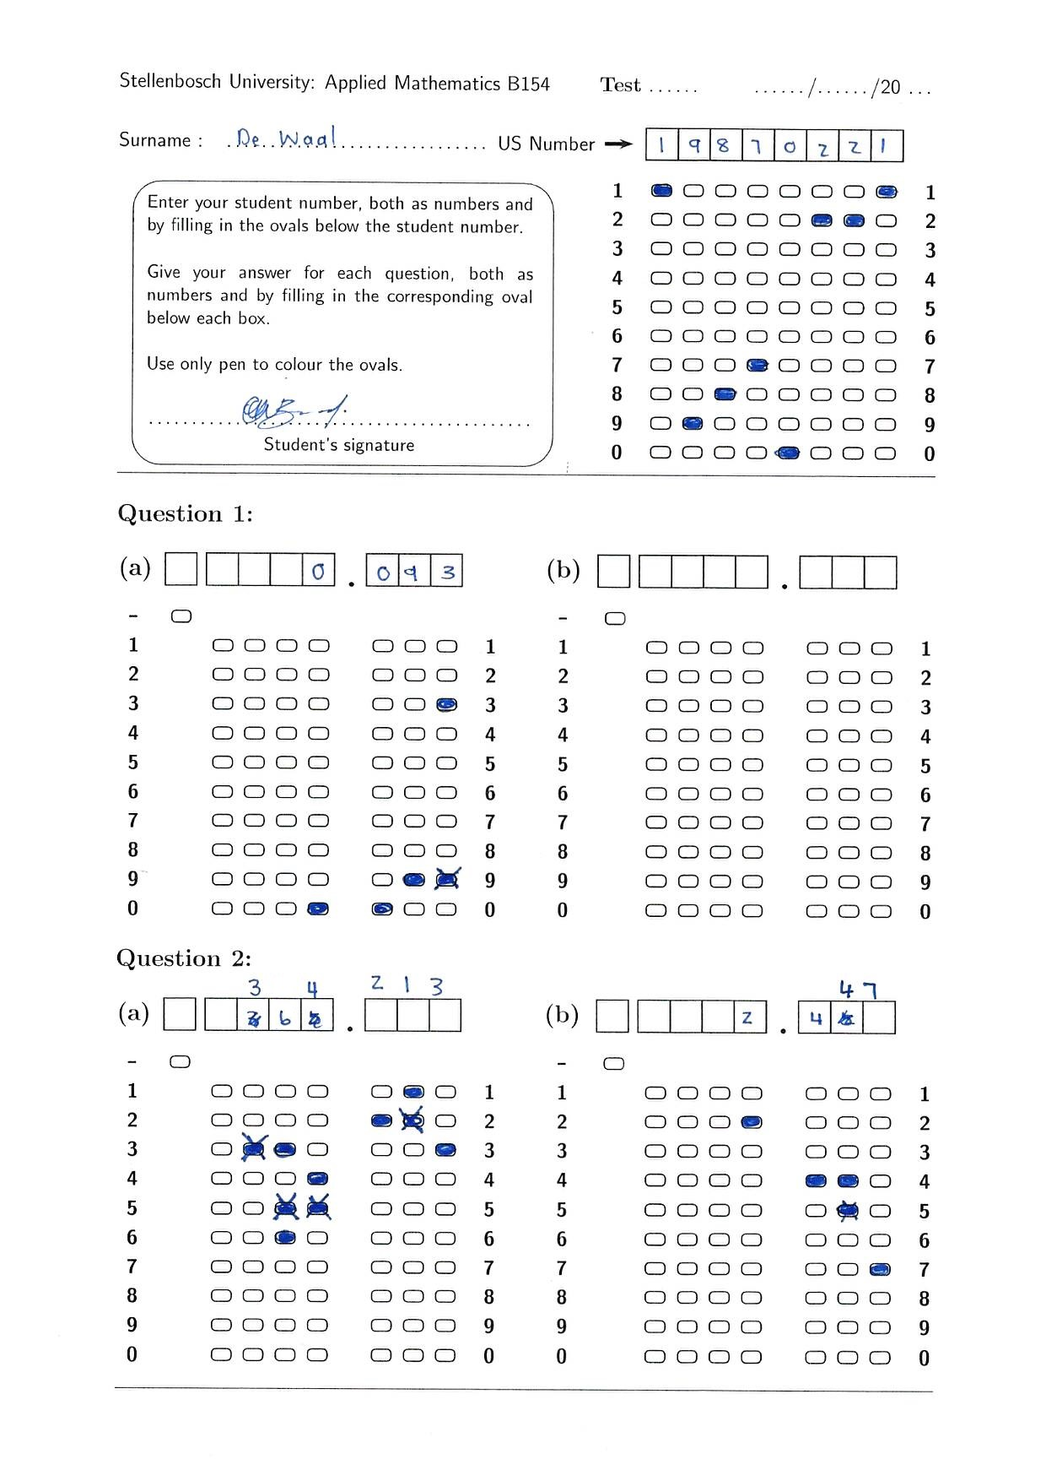
Probabilistic Graphical Models
Probably
a 6
Probably 20002262
Final
guess: 6
Final guess: 20002262
Probably
a 3 or 6
Don’t know

Slide 13
Results and conclusion
Grades 1000 test in 30 minutes
Automatic grading accuracy 97.1%
Sends 2.8% of tests for manual grading
In a tutorial session on average only 0.1% or 1 test or less gets graded incorrectly

