Slide 1
Automatic Test Grading Using Image Processing and Machine Learning Techniques
AP Smit

Slide 2
Content
Introduction
Solution
System overview
Image processing
Machine learning
Character recognition using Neural Networks
Final decision making using Probabilistic Graphical Models
Results and conclusions

Slide 3

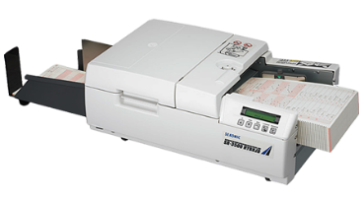
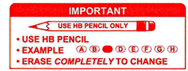
Introduction
Tutors and teaching assistant grade tests incorrectly
Online tests impractical due to class size
Current OMR systems require special scanners
Current OMR systems are difficult to use

Slide 4
Solution
Template that allows for decimal valued answers
Software that can handle crossed-out answers
Software also identifies characters through character recognition to increase reliability

Slide 5
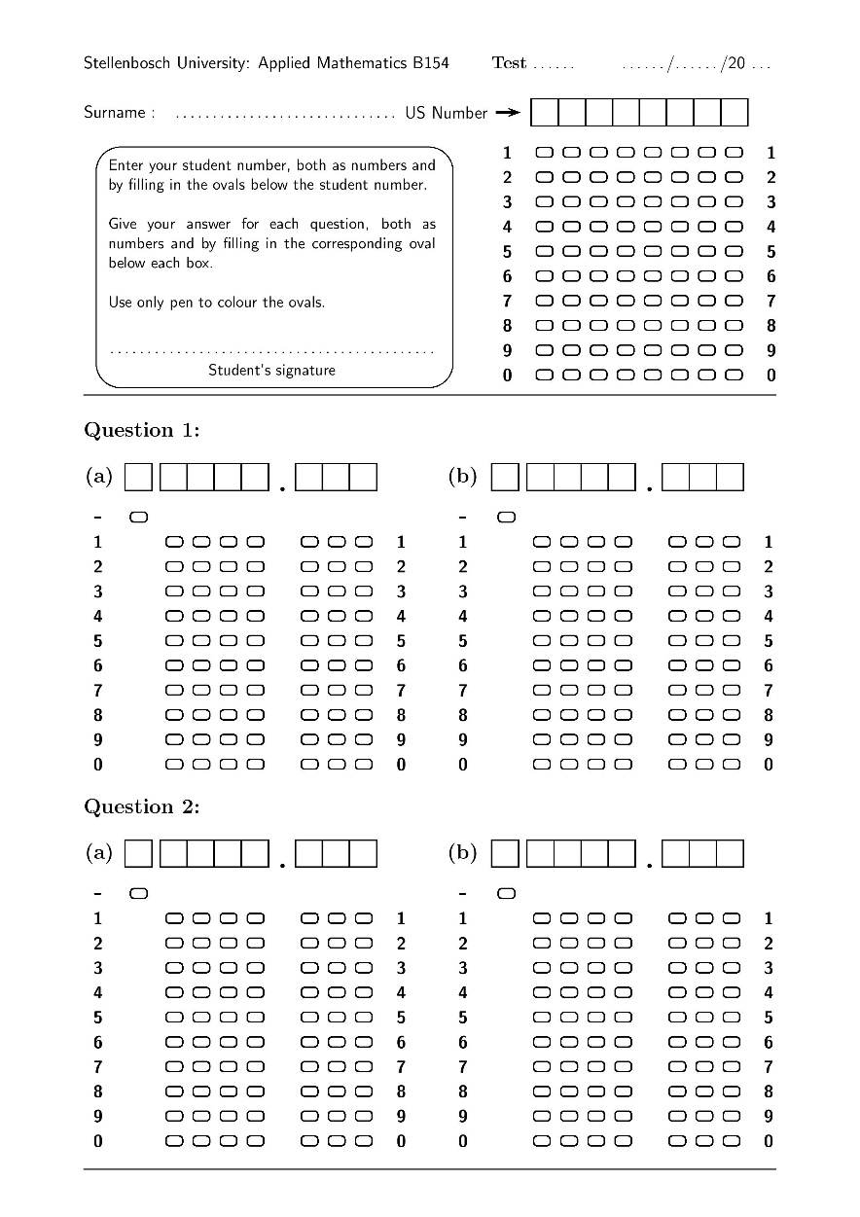
Solution

Slide 6
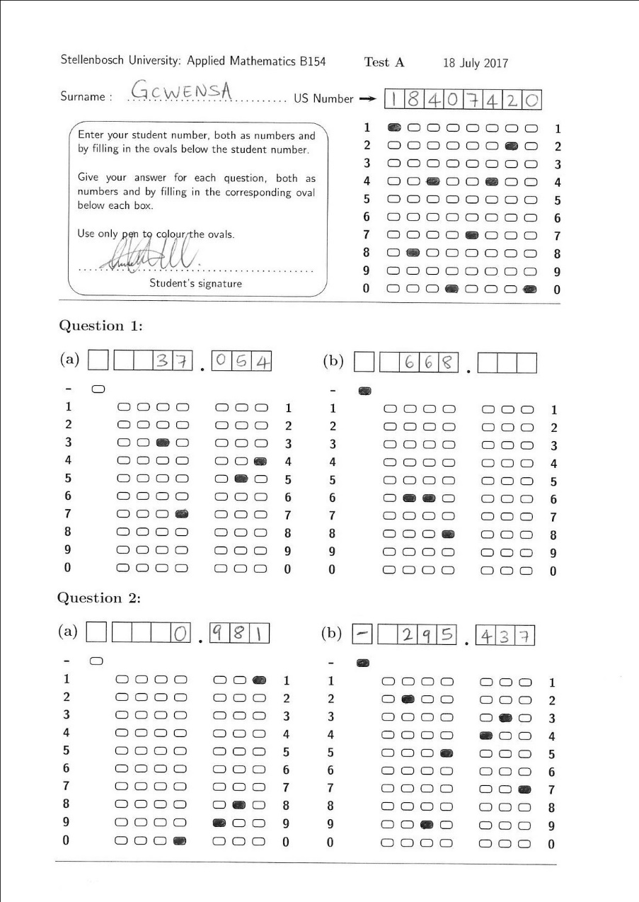
Solution

Slide 7
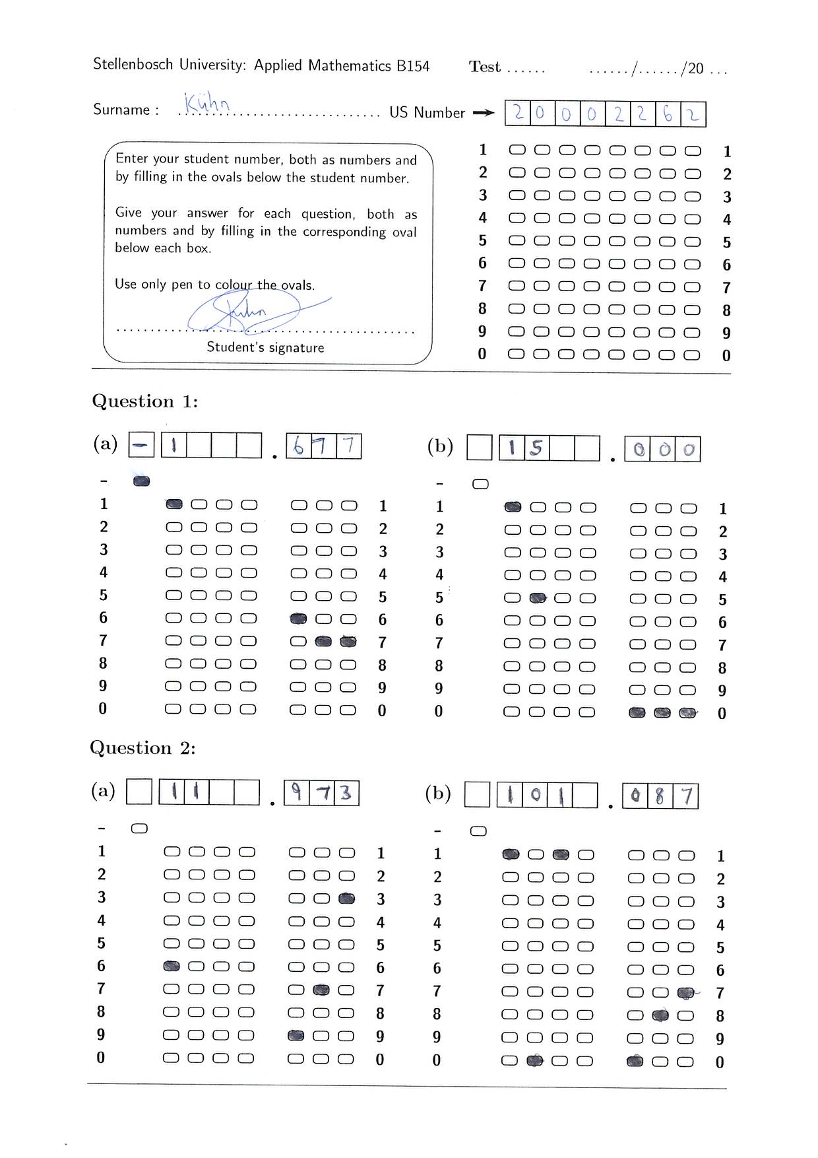
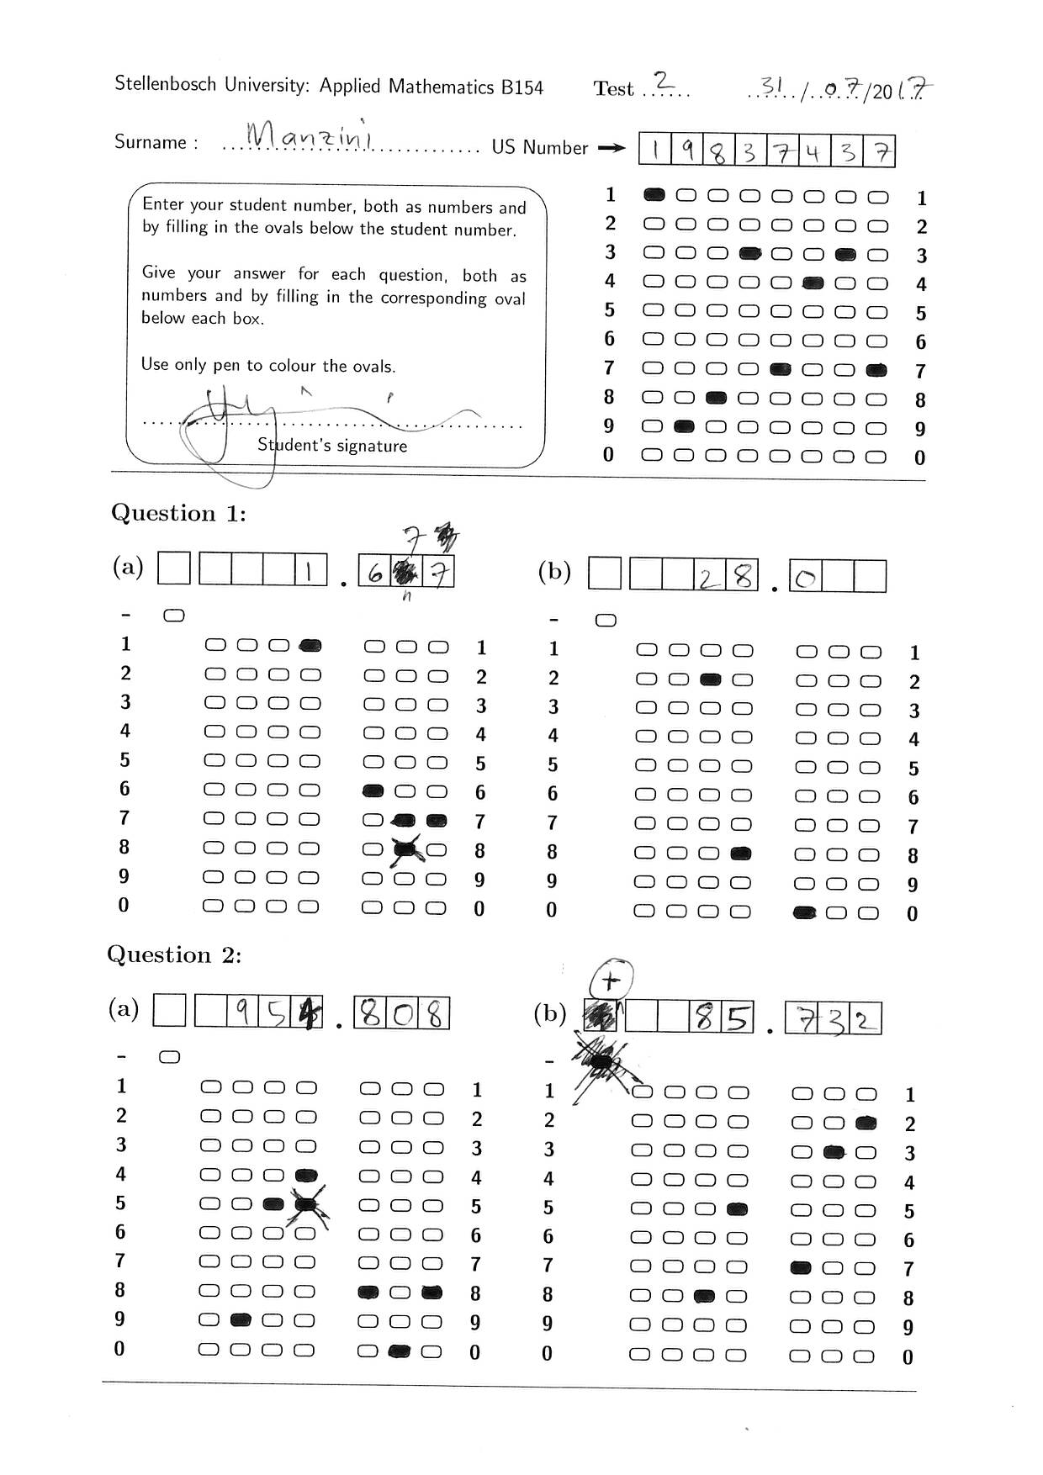
Solution

Slide 8
Solution

Slide 9
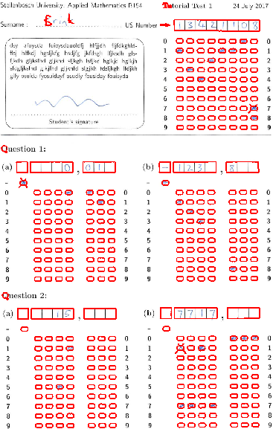
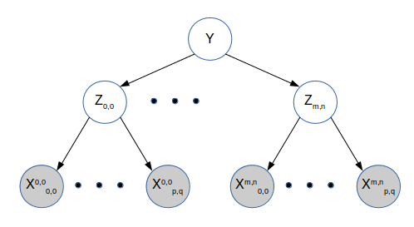
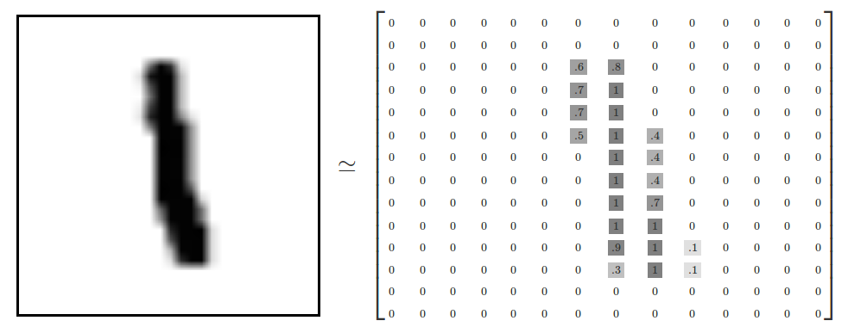
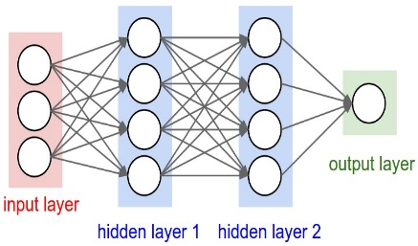

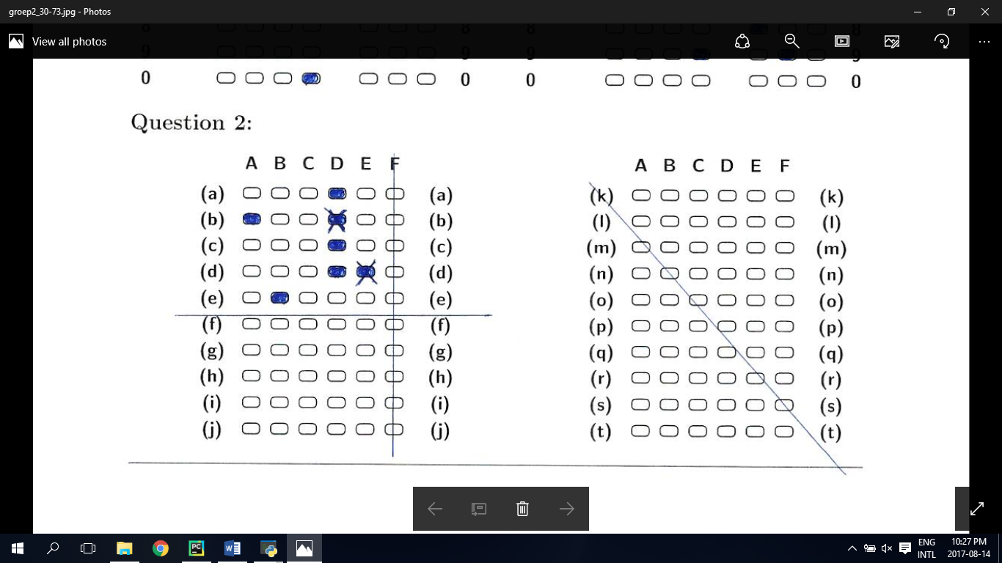
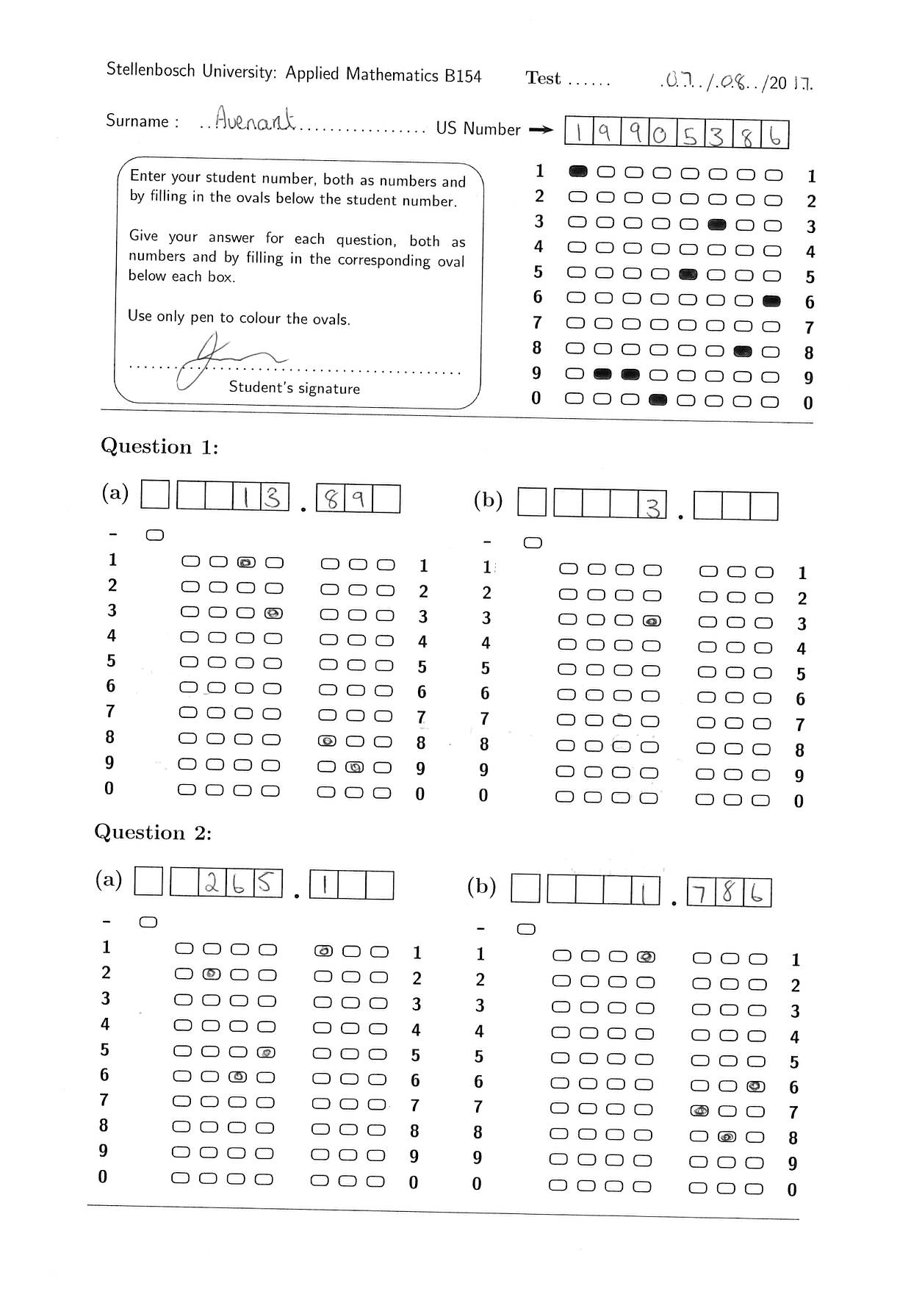
System overview
Image Processing
Character evidence
Neural Network
Probabilistic graphical models
Answers
Bubble evidence

Slide 10

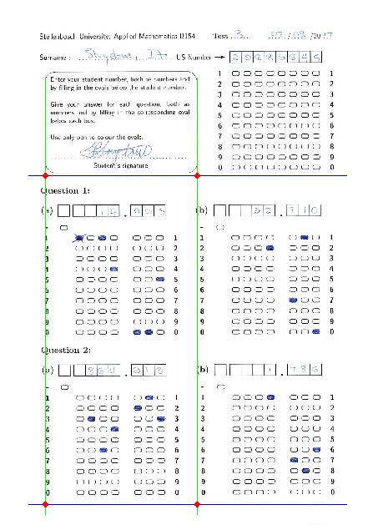
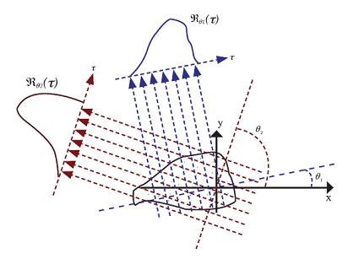
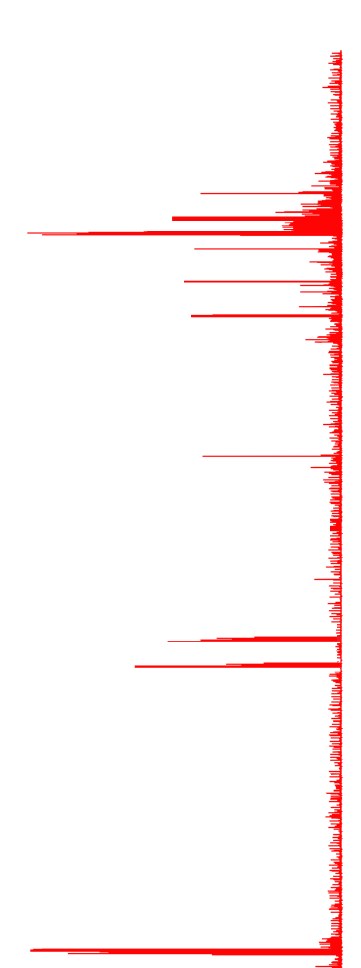
Image Processing
First step is to find the orientation of the template

Slide 11
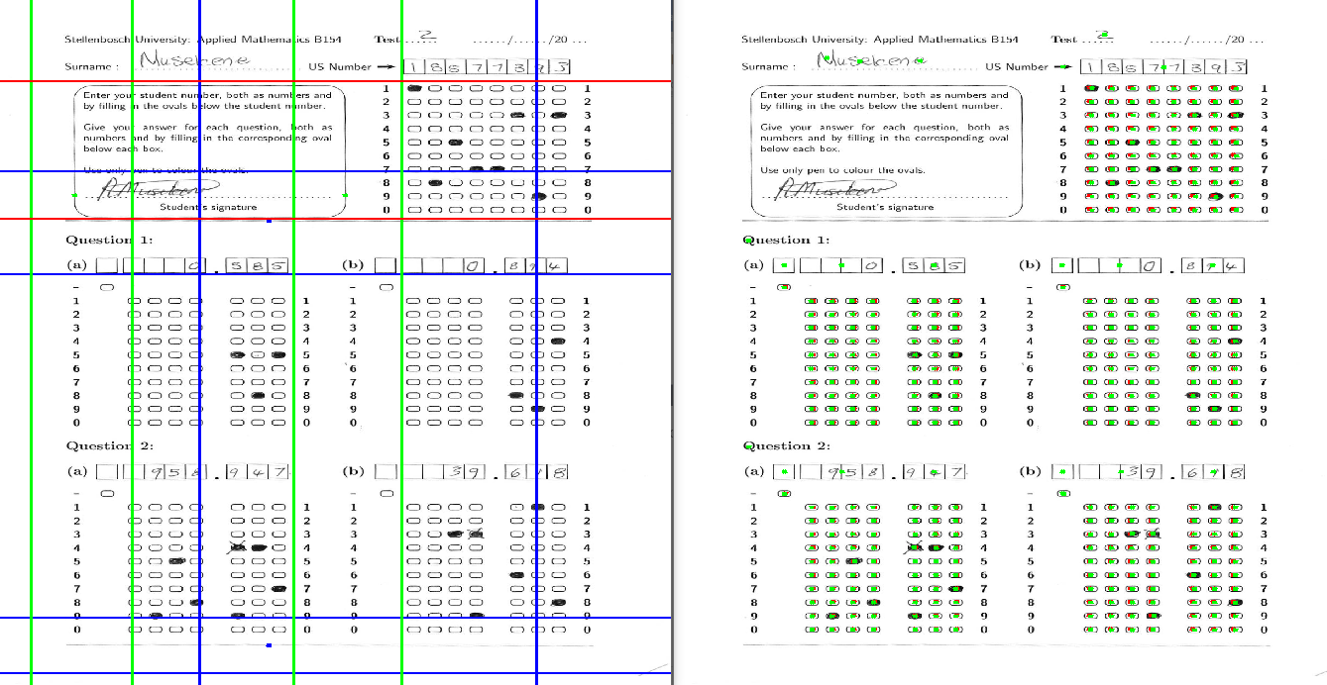
Basic Image Processing
The bubble locations can then be found and processed.

Slide 12
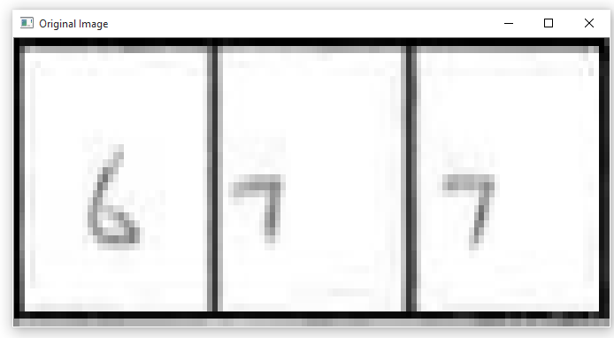
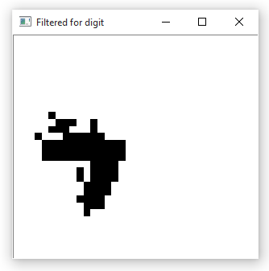
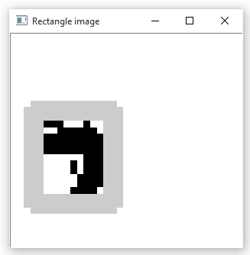
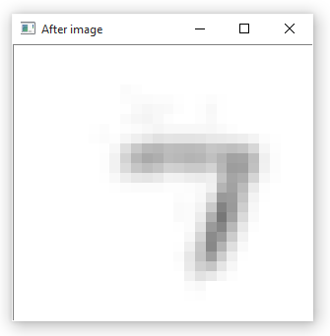
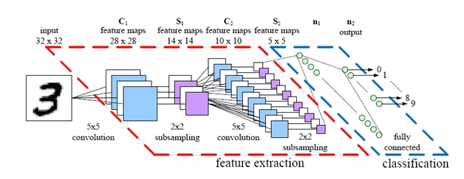
Character recognition: Neural Networks
Initial image processing is done on the digit using a custom segmentation algorithm
28 by 28 input vector is created
Convolutional neural network classifies digits implemented in TensorFlow

Slide 13
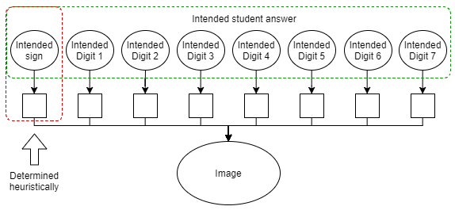
Probabilistic Graphical Models

Slide 14

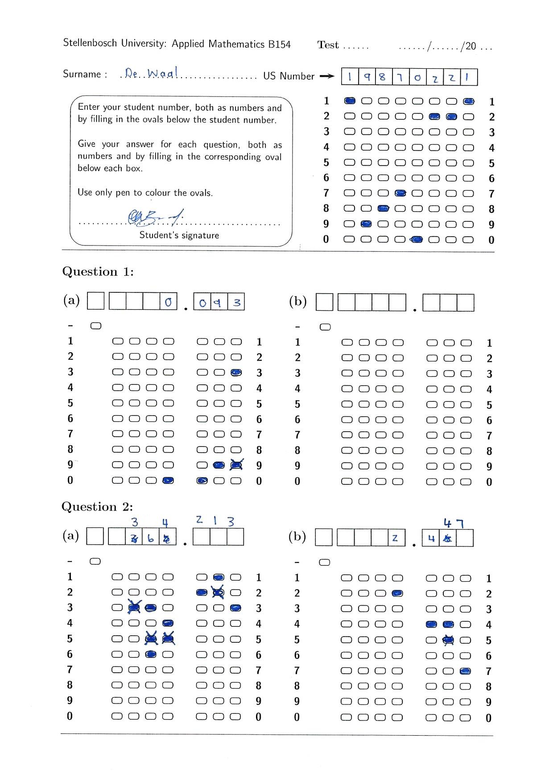
Probabilistic Graphical Models
Probably
a 6
Probably 20002262
Final
guess: 6
Final guess: 20002262
Probably
a 3 or 6
Don’t know

Slide 15
Results and conclusion
11 tutorials and 12 300 tests graded
Grades 1000 test in 30 minutes
Automatic grading accuracy 97.1%
Sends 2.8% of tests for manual grading
In a tutorial session on average only 0.1% or 1 test or less is graded incorrectly
System has now been extended to 2 new templates

