Slide 1


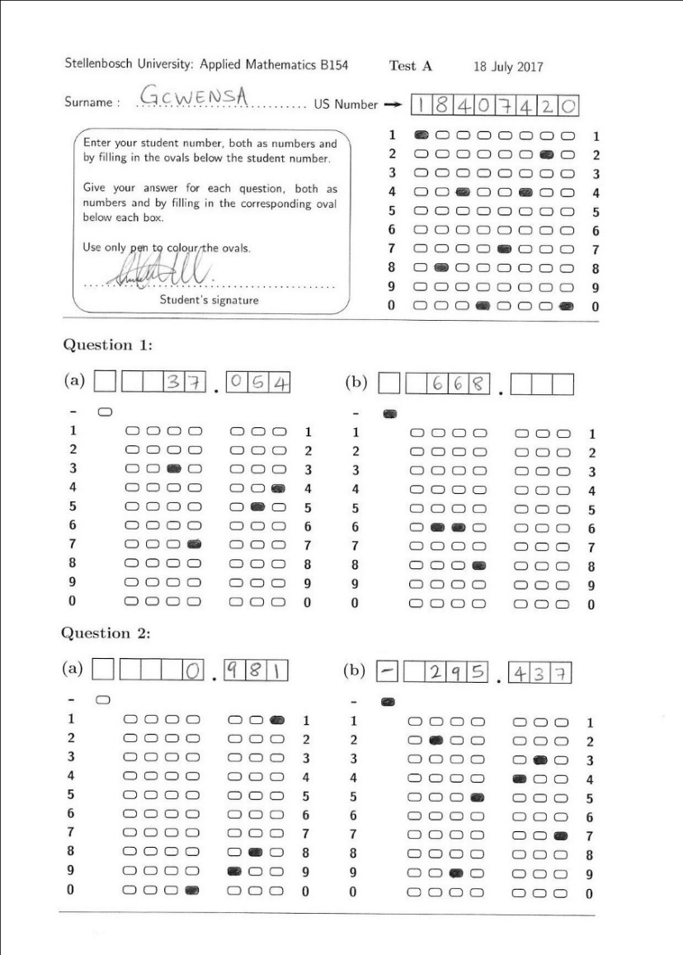
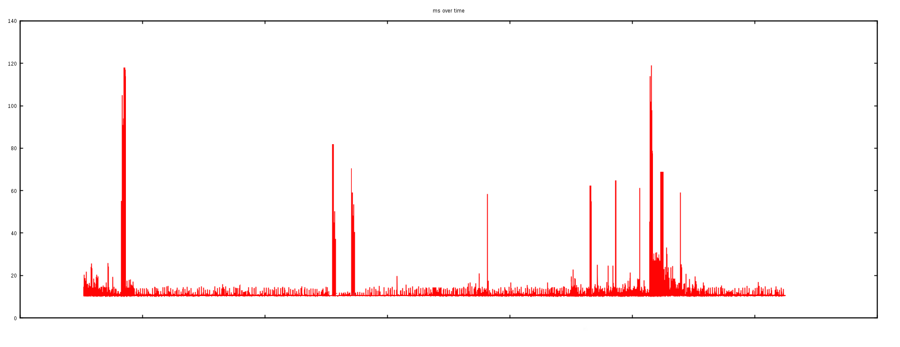

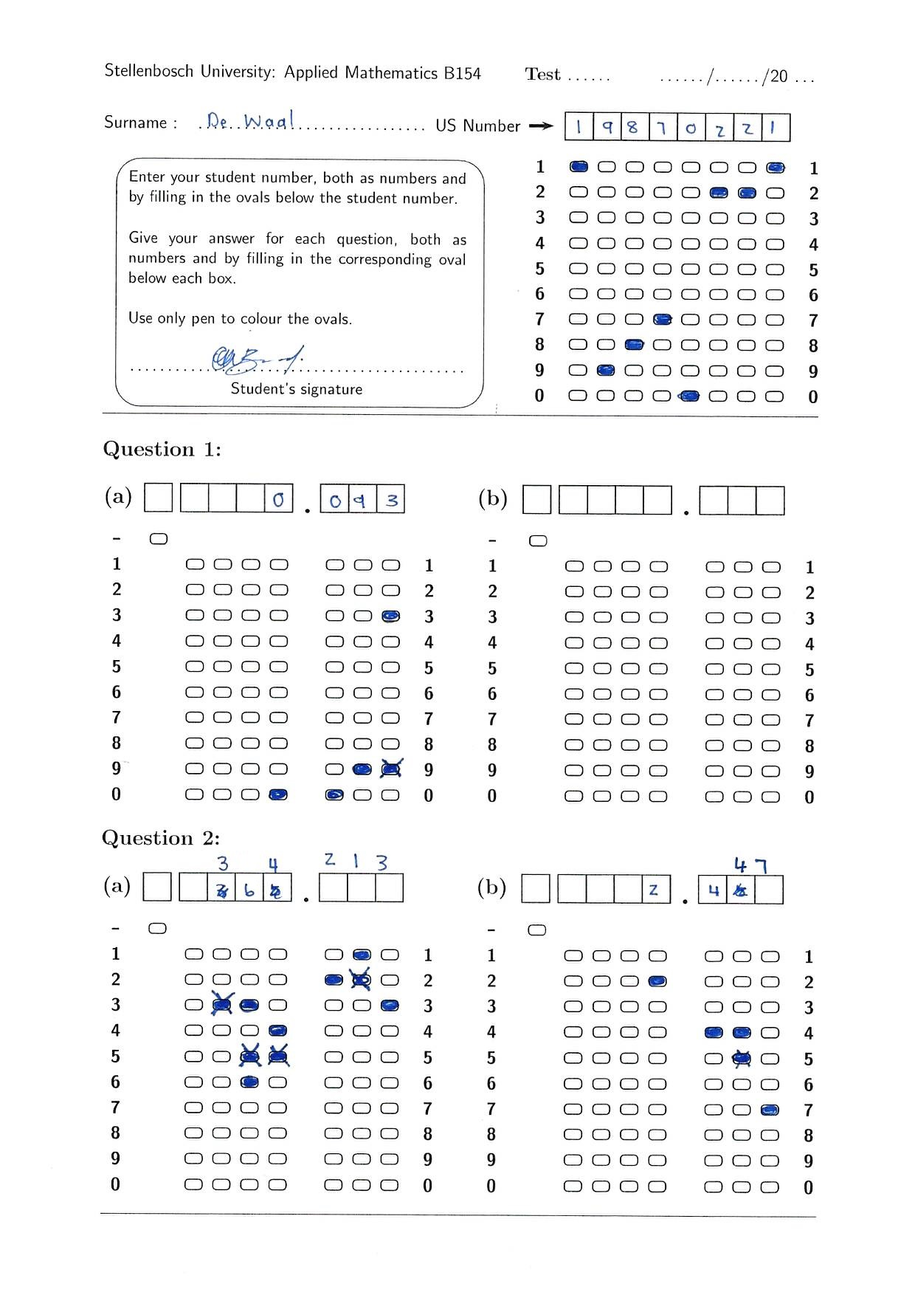
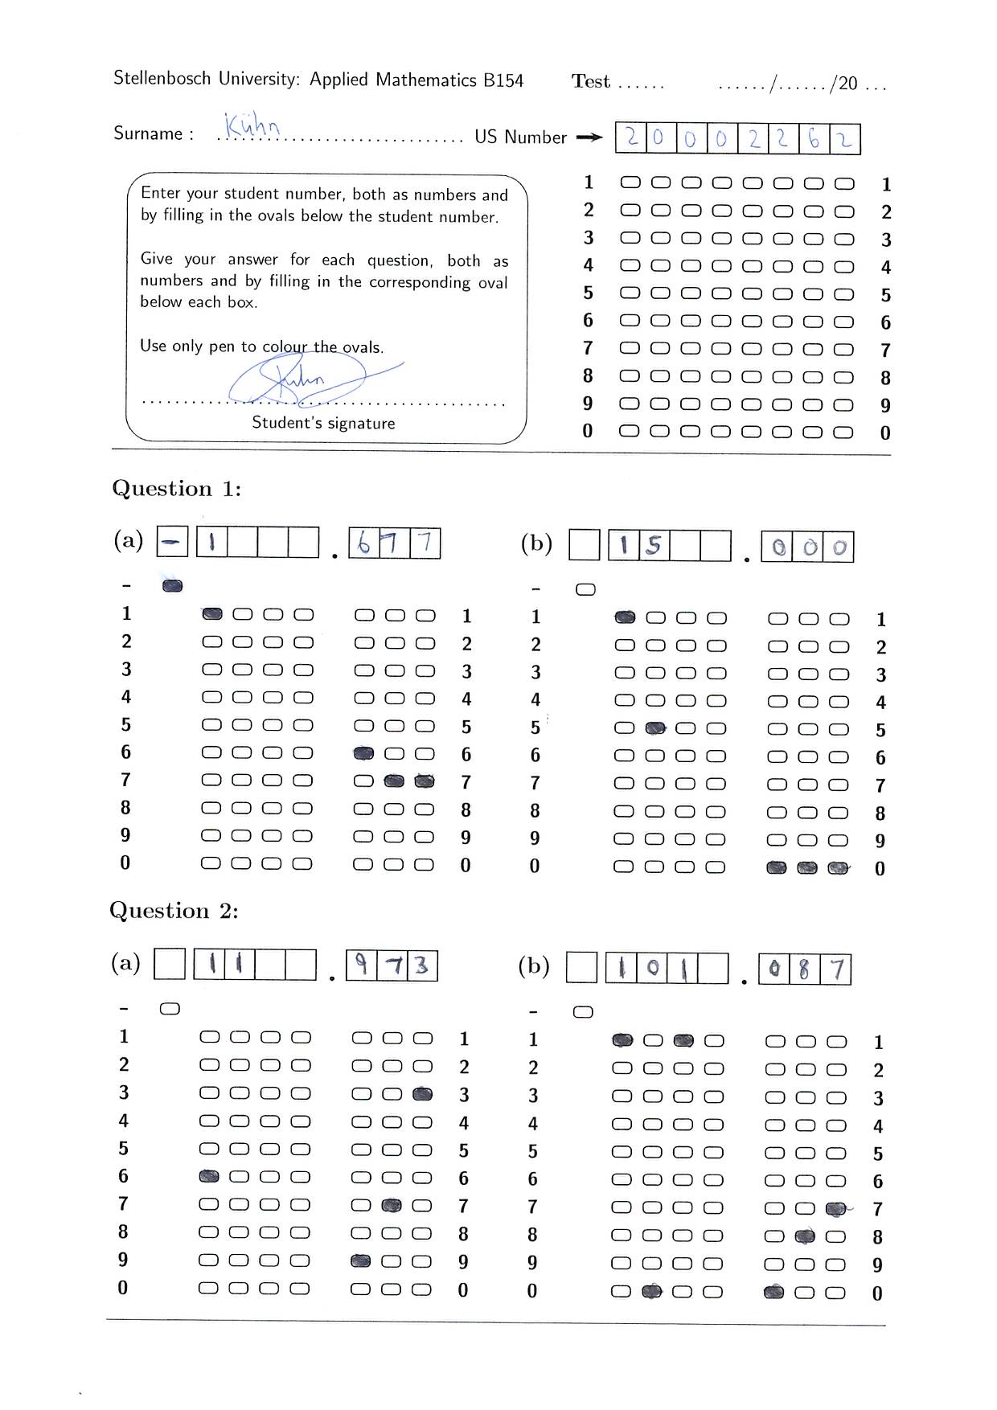
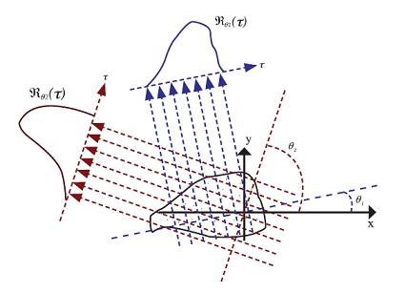
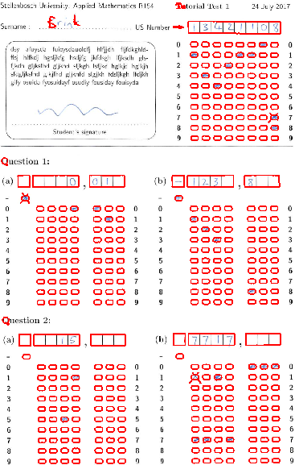
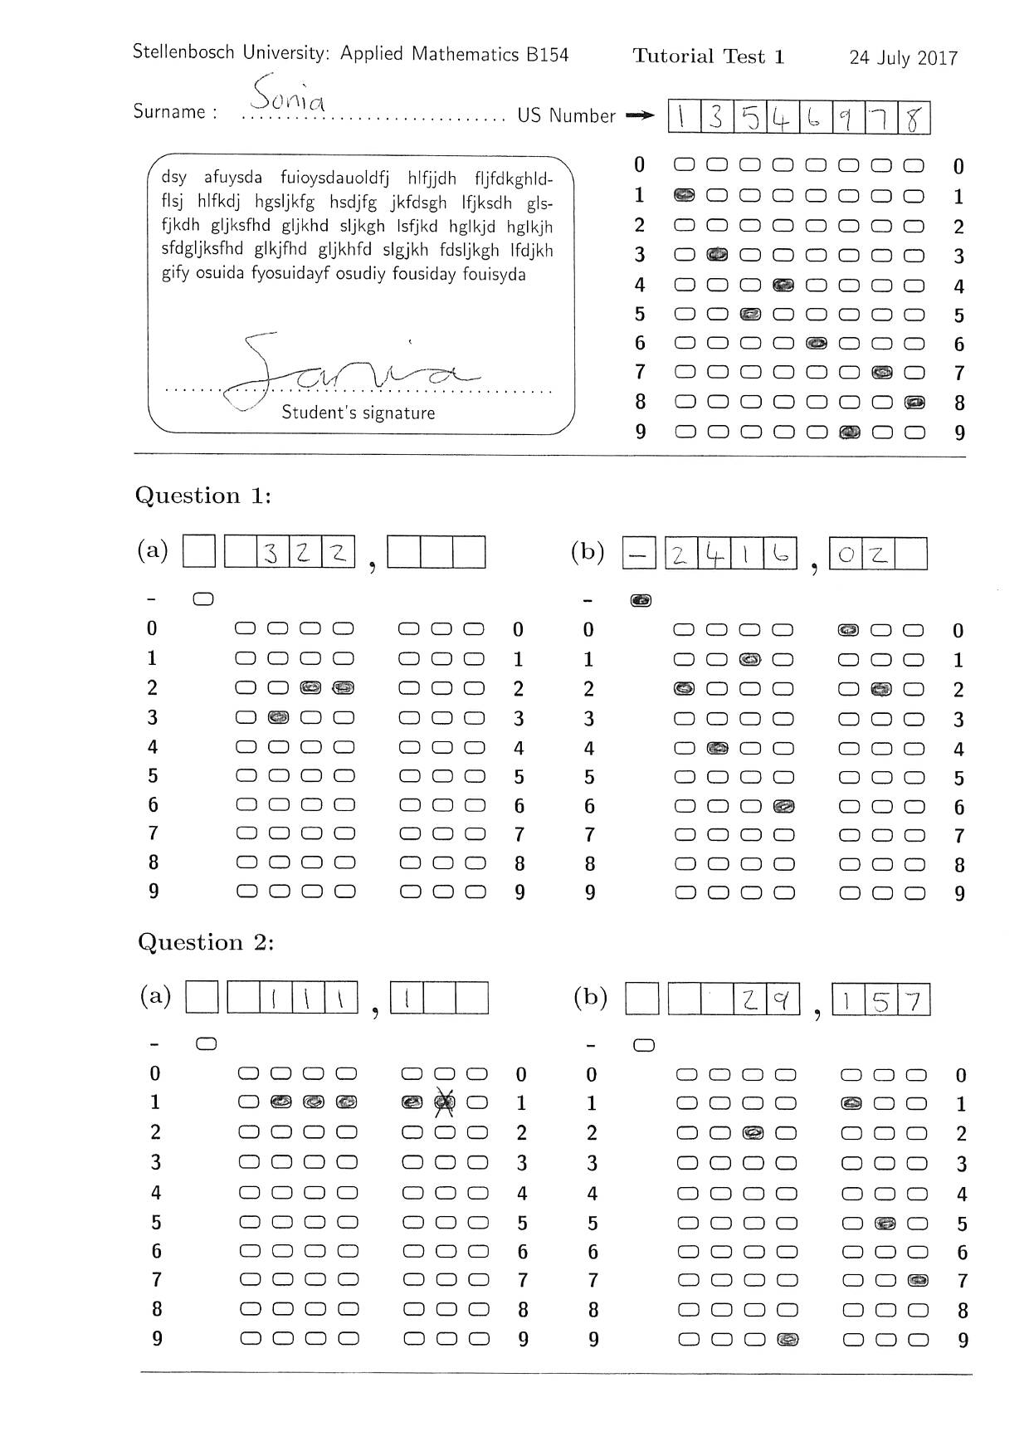
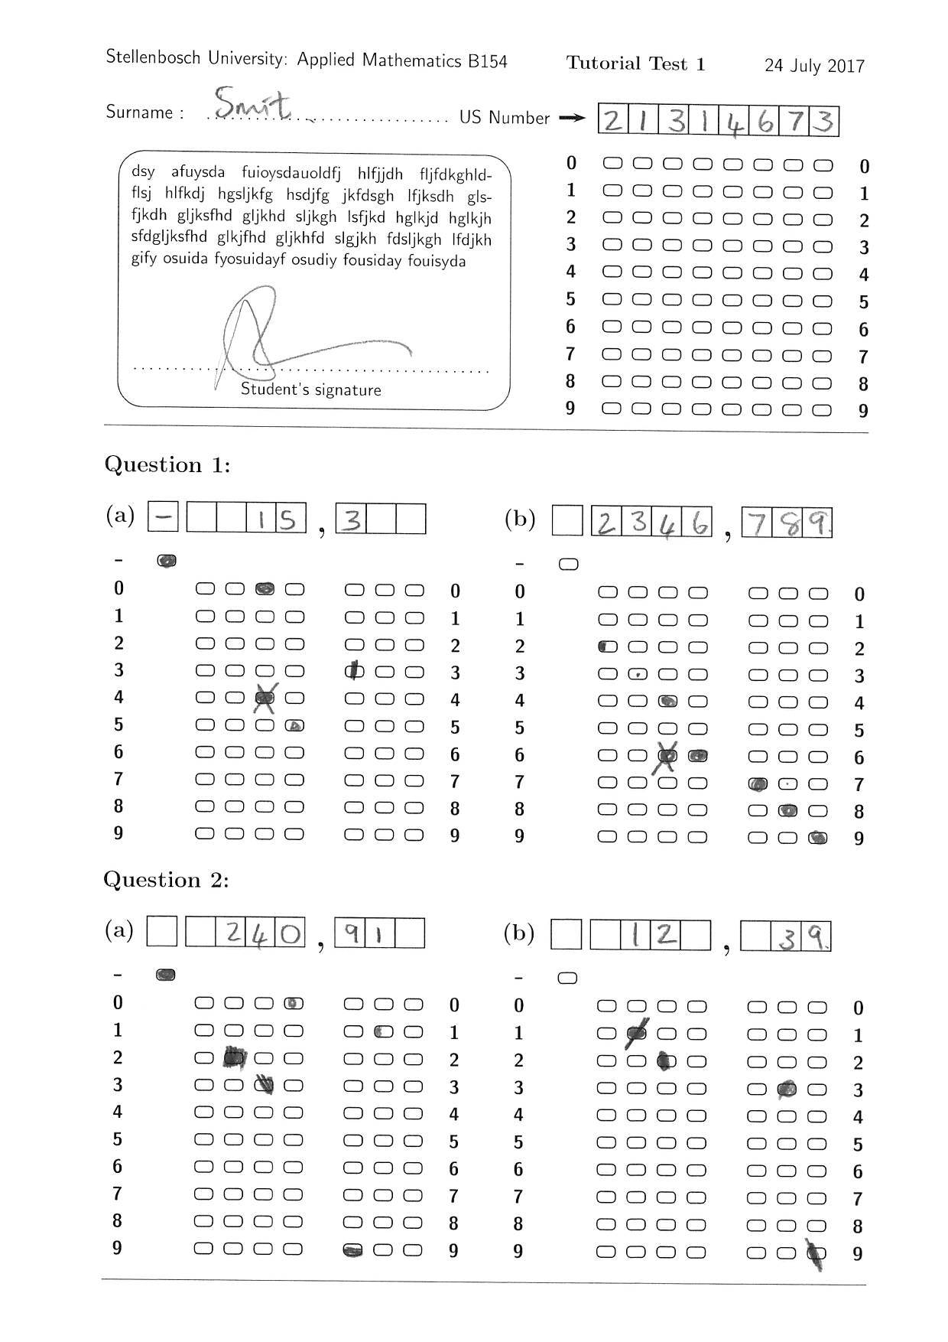
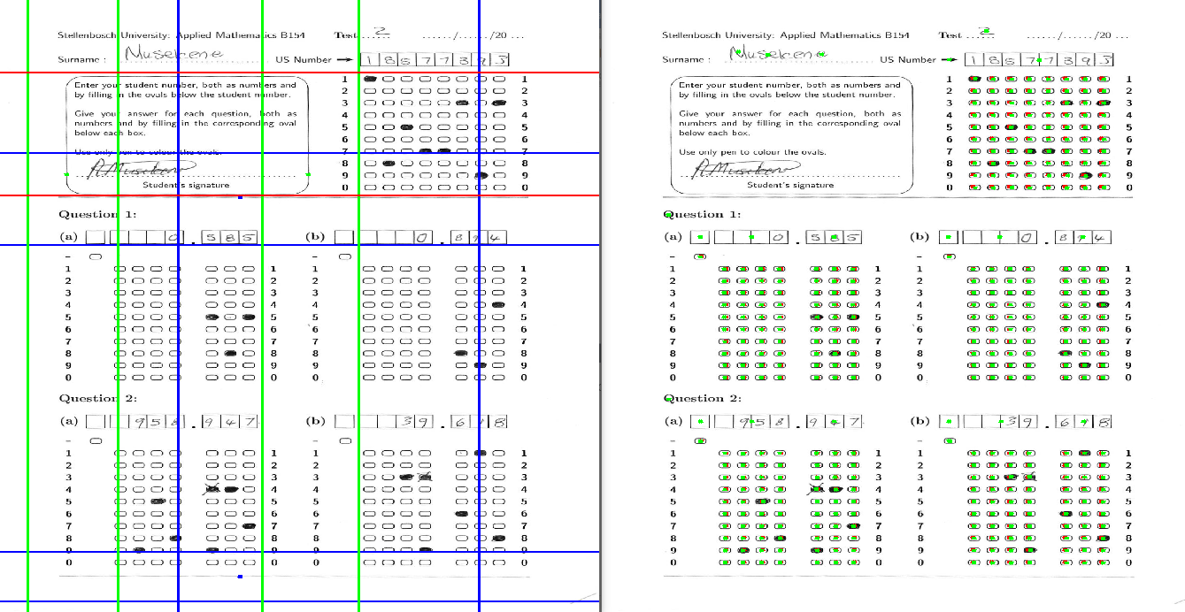
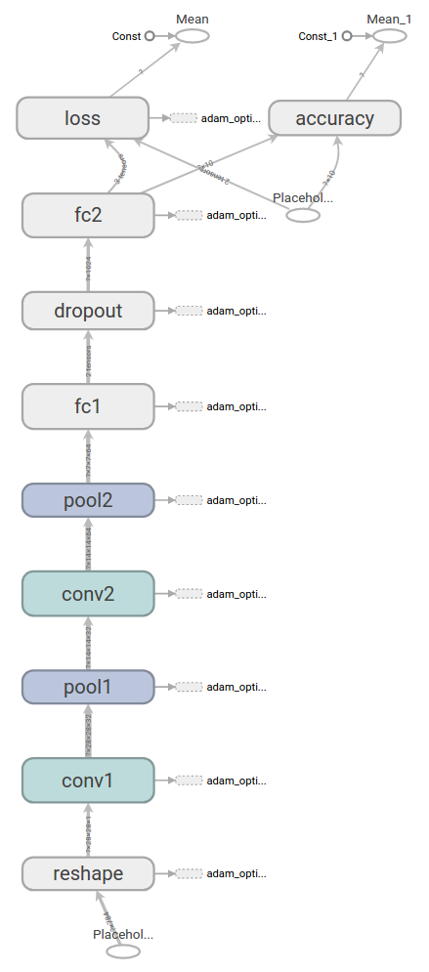
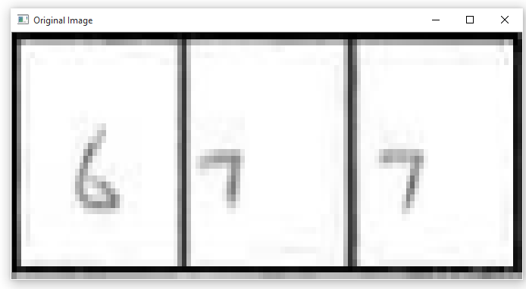
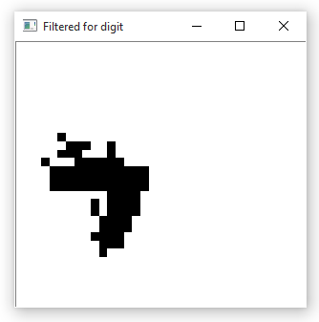
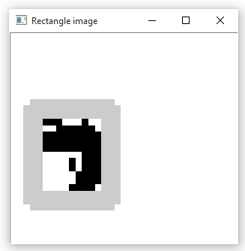
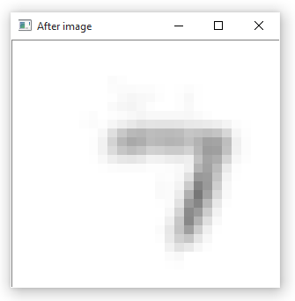
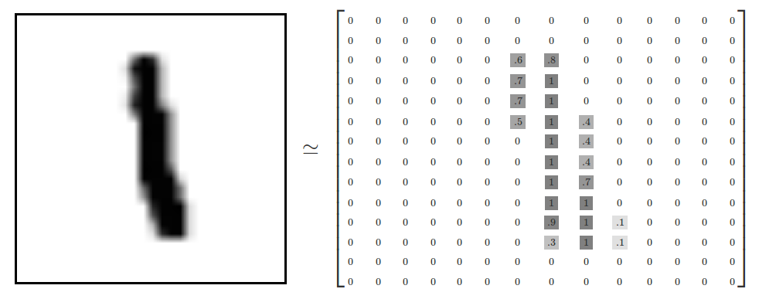
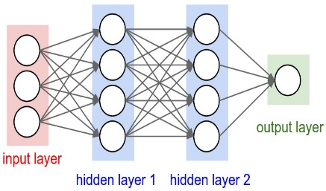
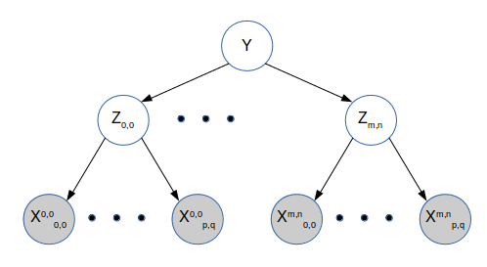

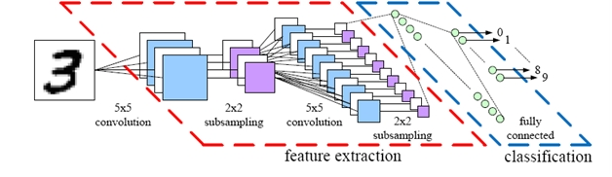
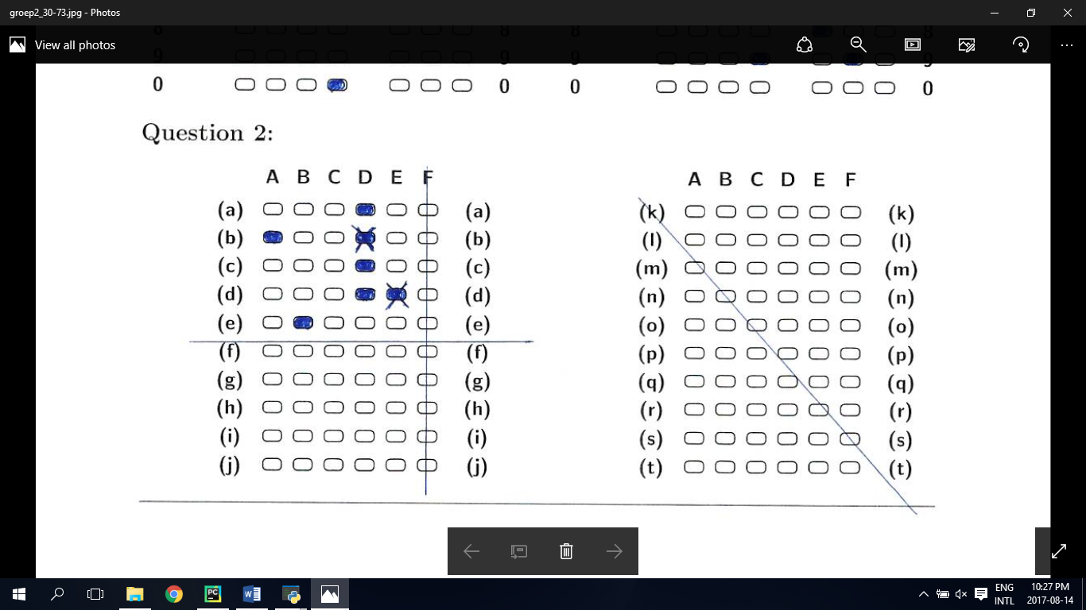
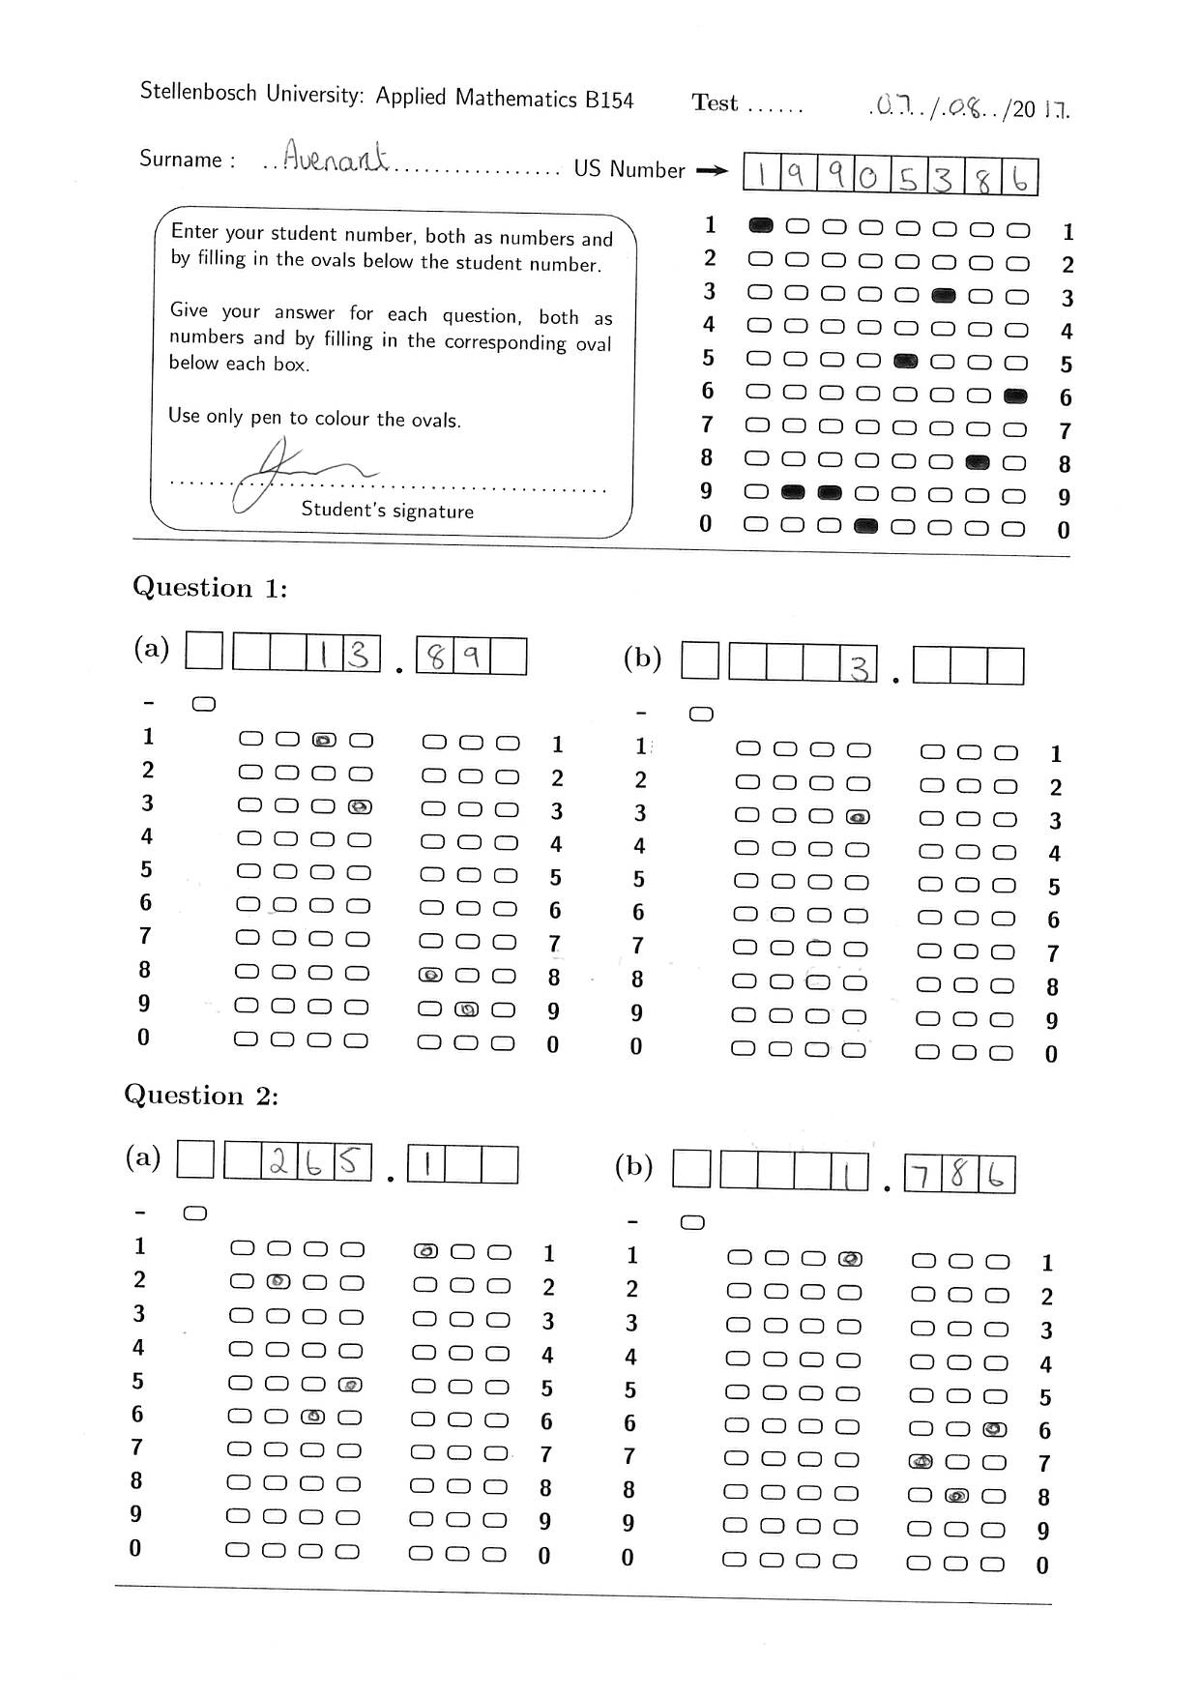
Automatic Test Grading Using Image Processing and Machine Learning Techniques
1. Introduction
4. Image Processing
6. Probabilistic Graphical Models
In recent years the Applied Mathematics department of Stellenbosch notice a drop in teaching assistant’s accuracy in grading tutorial tests. The department thus decided to automate the process of grading these tests. There is a need for Optical Marker Recognition (OMR) software to grade tests written on a special template automatically. This reduces the time to mark tutorial tests, while still allowing for a high accuracy in grading tests.
To find the template inside the image, the system first uses a Radon Transform to locate the two longest horizontal lines, as well as the two vertical lines of the comment box. These lines are then used to calculate four reference points on the page, indicating where the template is.
Once the template is found, contour analysis is done on the page. The reference template found in the image is then used to estimate the locations of each bubble in the template. Each bubble is then assigned a contour that has a centre closest to that estimated locations. Using the contour area and average pixel intensity, inside the contour, the each bubble is classified.
Two probabilistic graphical models are used to predict the final values the student wrote. The first model predicts digits while the second model predicts the indented student number. Interesting results from these models are show below.
Probably
a 6
Final
guess: 6
Probably 20002262
Final guess: 20002262
Reference points after Radon transform is applied
Probably
a 3 or 6
Don’t know
Radon transform
Digit PGM prediction
Student number PGM prediction
2. Solution
The template, seen to the right, allows for decimal valued answers. An improvement over current Optical Marker Recognition systems allows for a student to cross out bubbles instead of needing to completely erase it. Further, the system also allows questions to be answers using handwritten digits.
7. Results
11 tutorials and 12 300 tests graded
Grades 900 test in 30 minutes
Automatic test grading accuracy of 97.1%
Assigns 2.8% of tests for manual grading
Only 0.1% or 1 test per tutorial is graded incorrectly
Contours found using contour analysis
Example tests
Green: Bubble estimated locations
Red: Found contour centres
3. System Overview
5. Character Recognition
Initially, image processing is done on the image and produces character and bubble evidence, as is shown in the image below. The bubble evidence contains a classification for each bubble on the template. The bubble can be open, crossed-out, partially filled-in or completely filled-in. The character evidence, in the form of a 28 by 28 array is then process by a Convolutional Neural Network (CNN) to classify the digit in the image. Lastly, two probabilistically graphical models are used to estimate the most likely answers written on the page.
A custom segmentation algorithm is first applied to allow for the CNN to classify each digit, by normalizing and centering the digit.
8. Conclusion
It was found that a system could be designed that can reliably grade tutorials tests while also allowing for crossed-out answers and handwritten entries.
An interesting result was found when the student only writes his/her student number using characters. The system can still recover that particular student number even if some of the digits are classified incorrectly by the neural network. This is due to the PGM’s ability to find the nearest student number to the one estimated by the neural network.
The software has also been extended to allow for two additional templates to grade multiple choice questions, as well as a mixture between decimal valued and multiple choice questions.
Normalization and centering of digit
The CNN is then used to analyse this input image and estimate the probability of each digit being present in the image.
Image Processing
Character evidence
Neural Network
Probabilistic graphical models
Bubble evidence
Answers
Graphical overview
CNN visual setup
CNN TensorFlow setup

