Slide 1

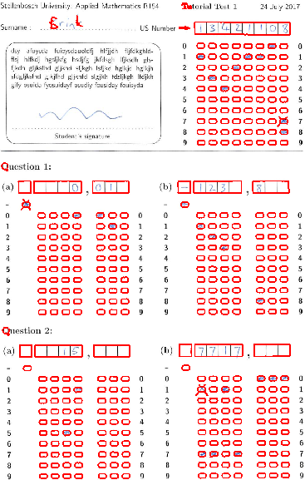
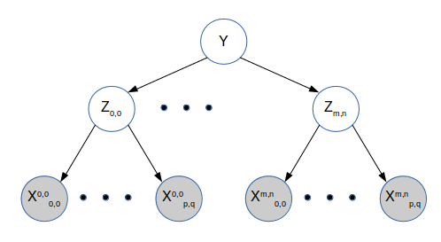
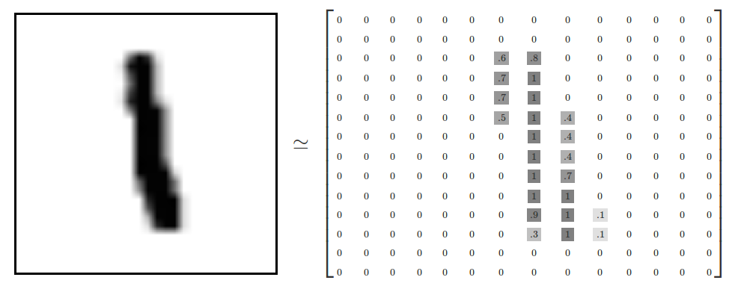
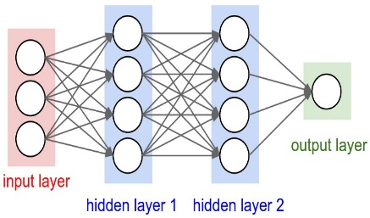
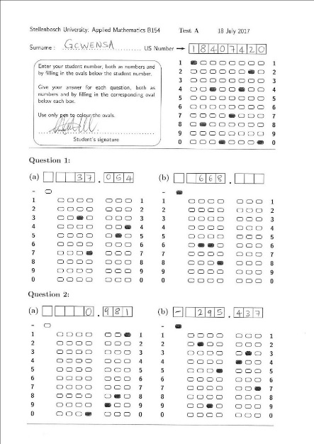
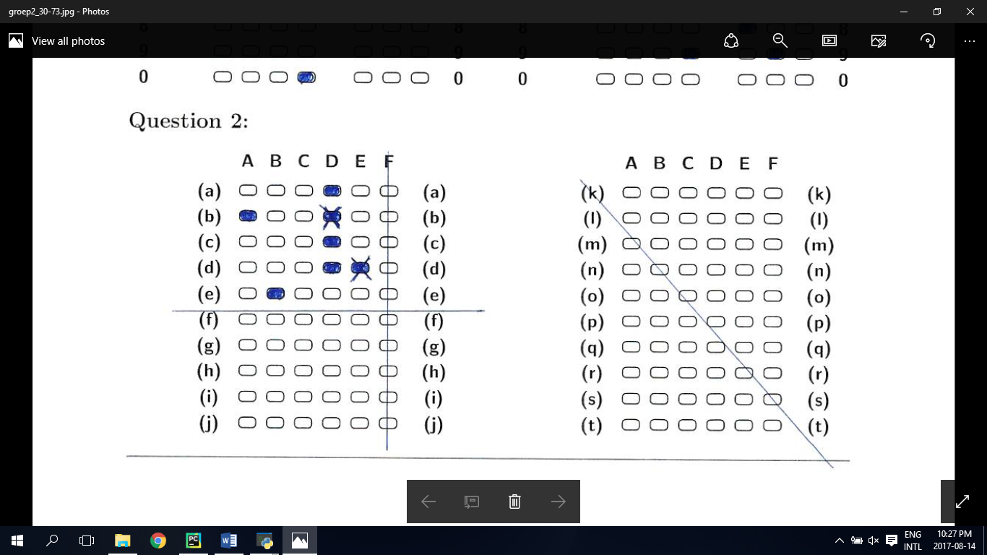
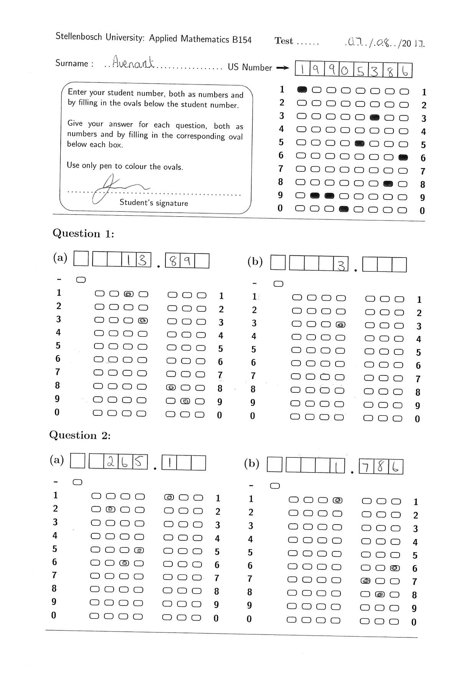
Automatic Test Grading Using Image Processing and Machine Learning Techniques
System overview
Isentially the system is tasked woth
System overview
Isentially the system is tasked woth
Image Processing
Character evidence
Neural Network
Probabilistic graphical models
Bubble evidence
Answers
System overview
Isentially the system is tasked woth
Image Processing
Character evidence
Neural Network
Probabilistic graphical models
Bubble evidence
Answers

