Slide 1


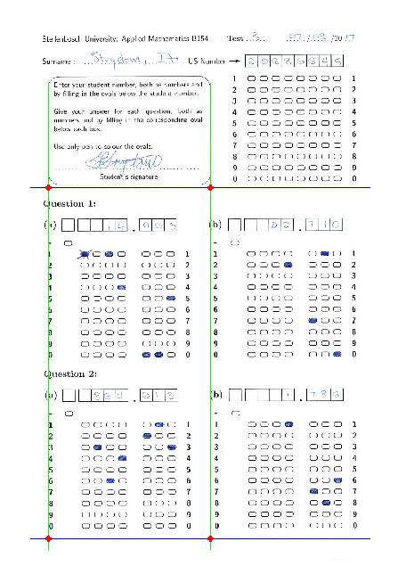
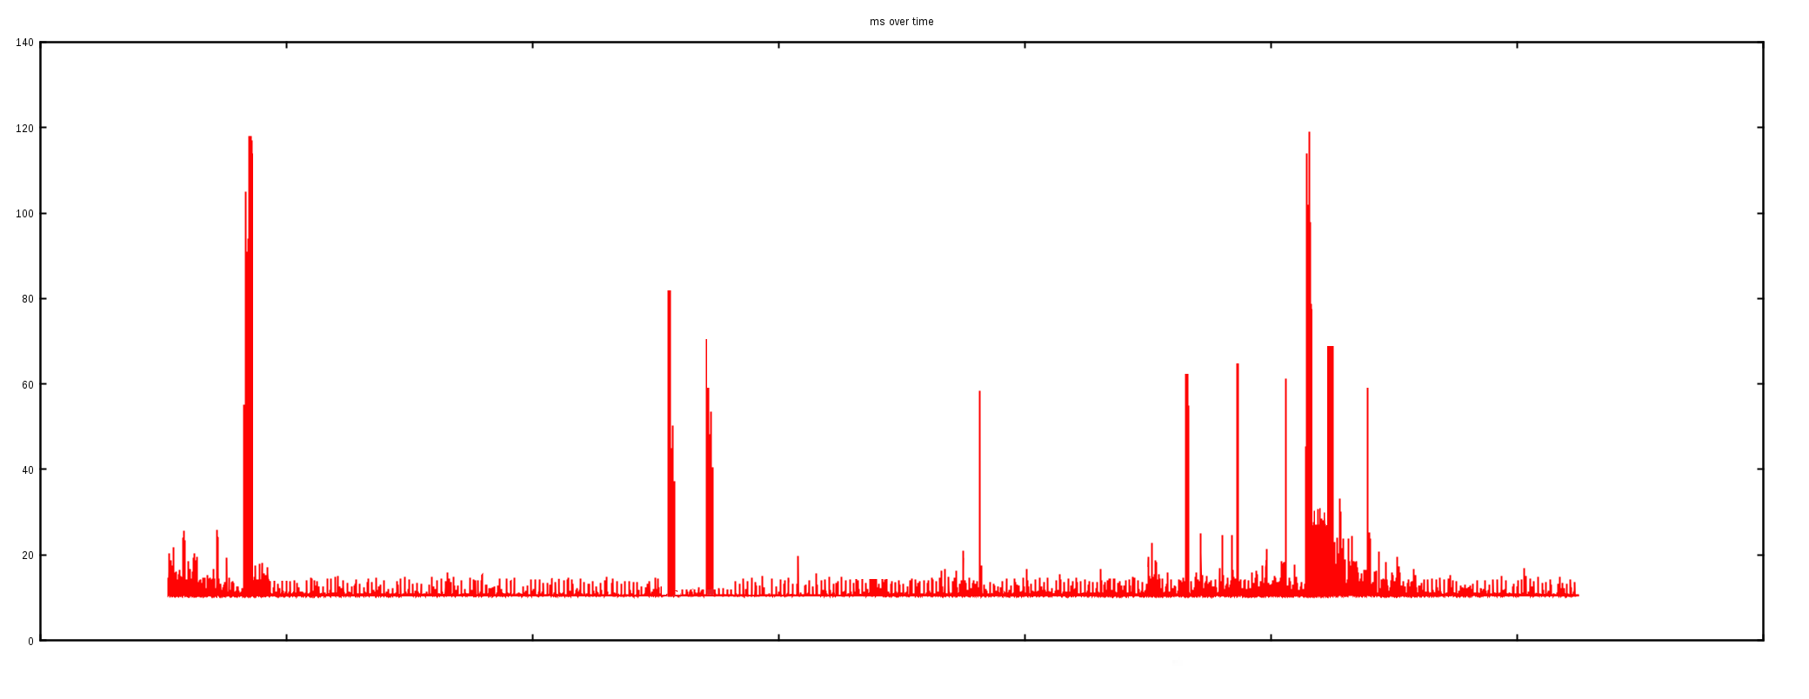
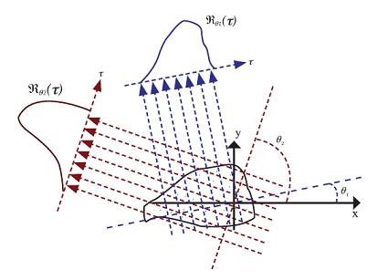
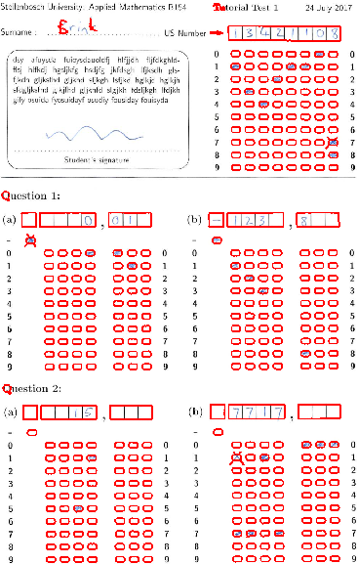
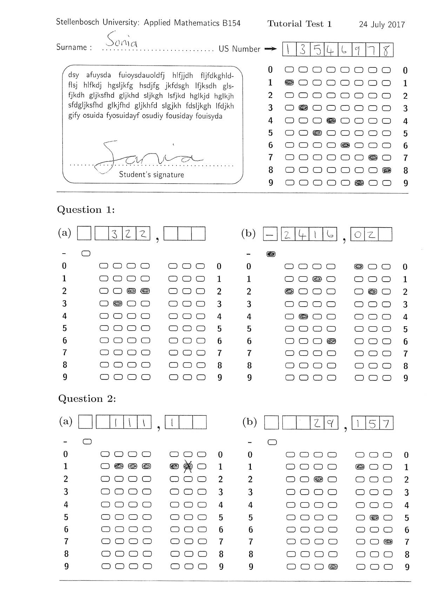
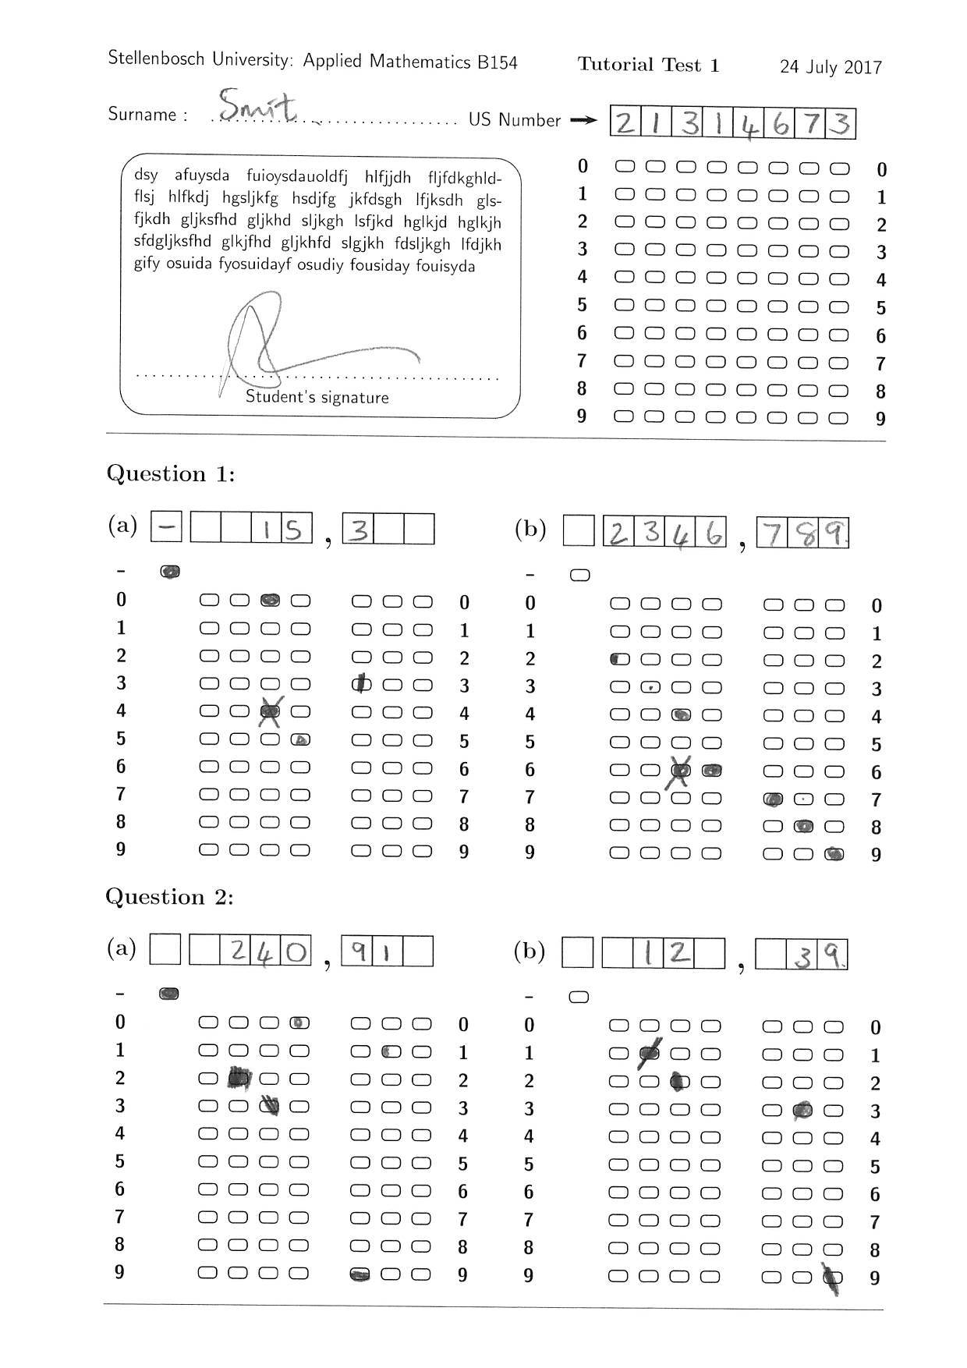
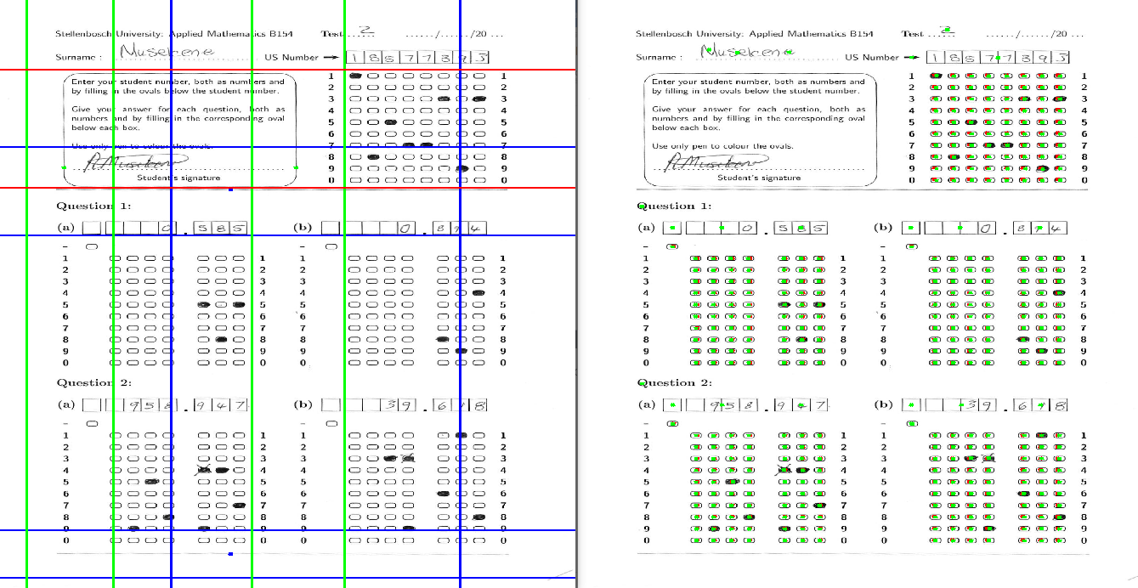
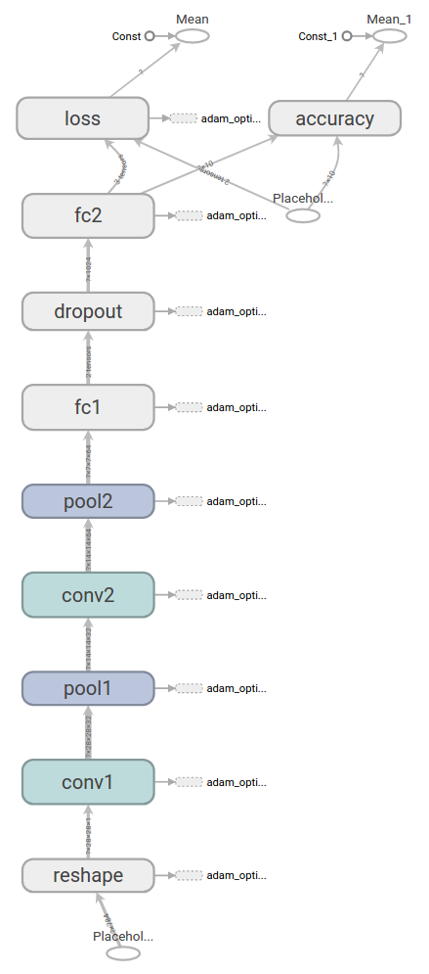
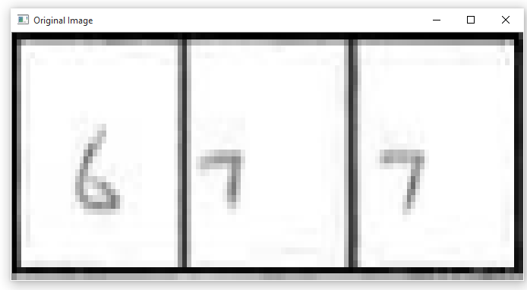
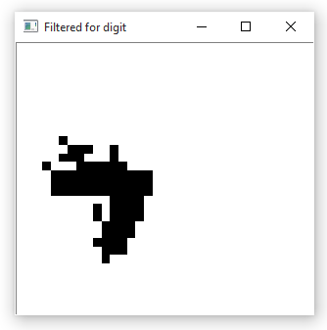
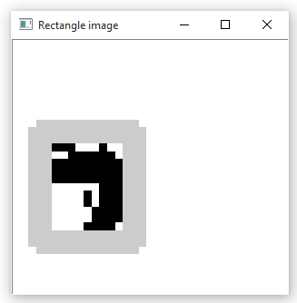
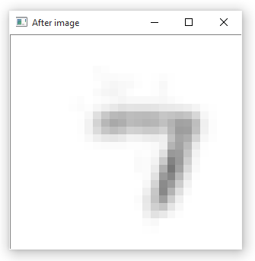
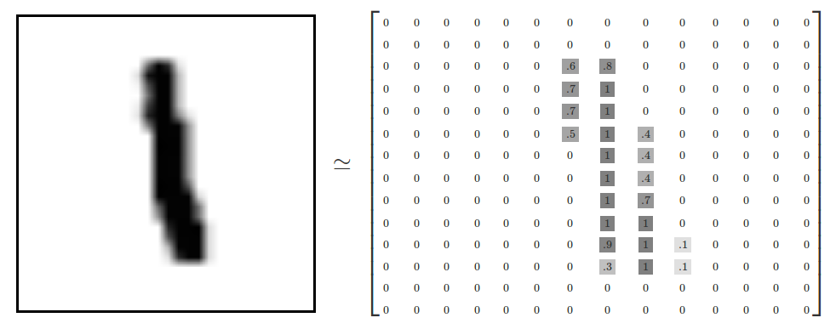
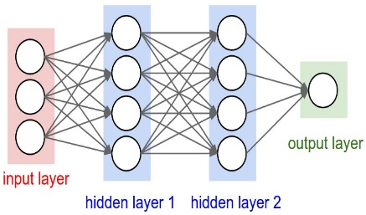
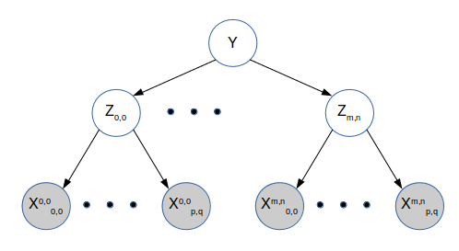
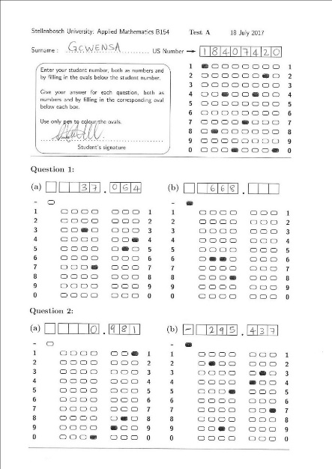
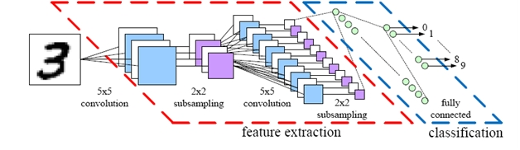
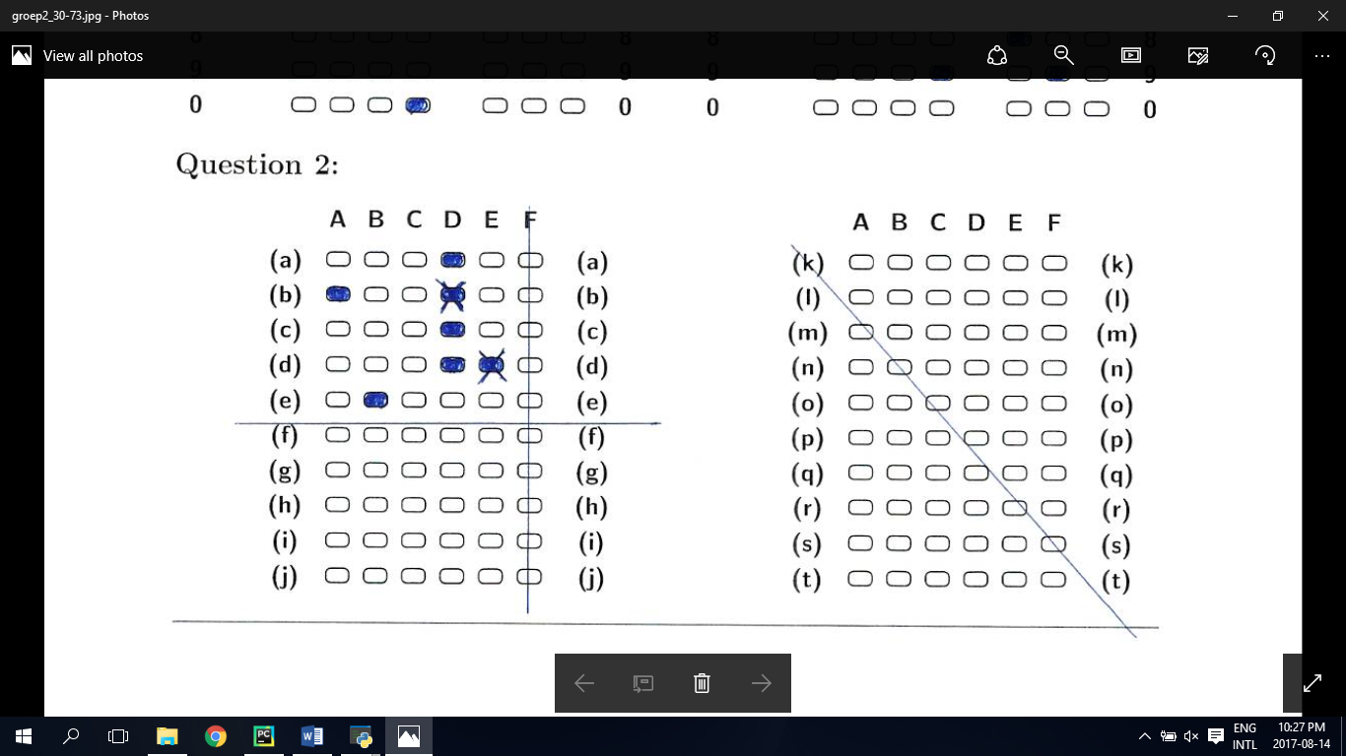
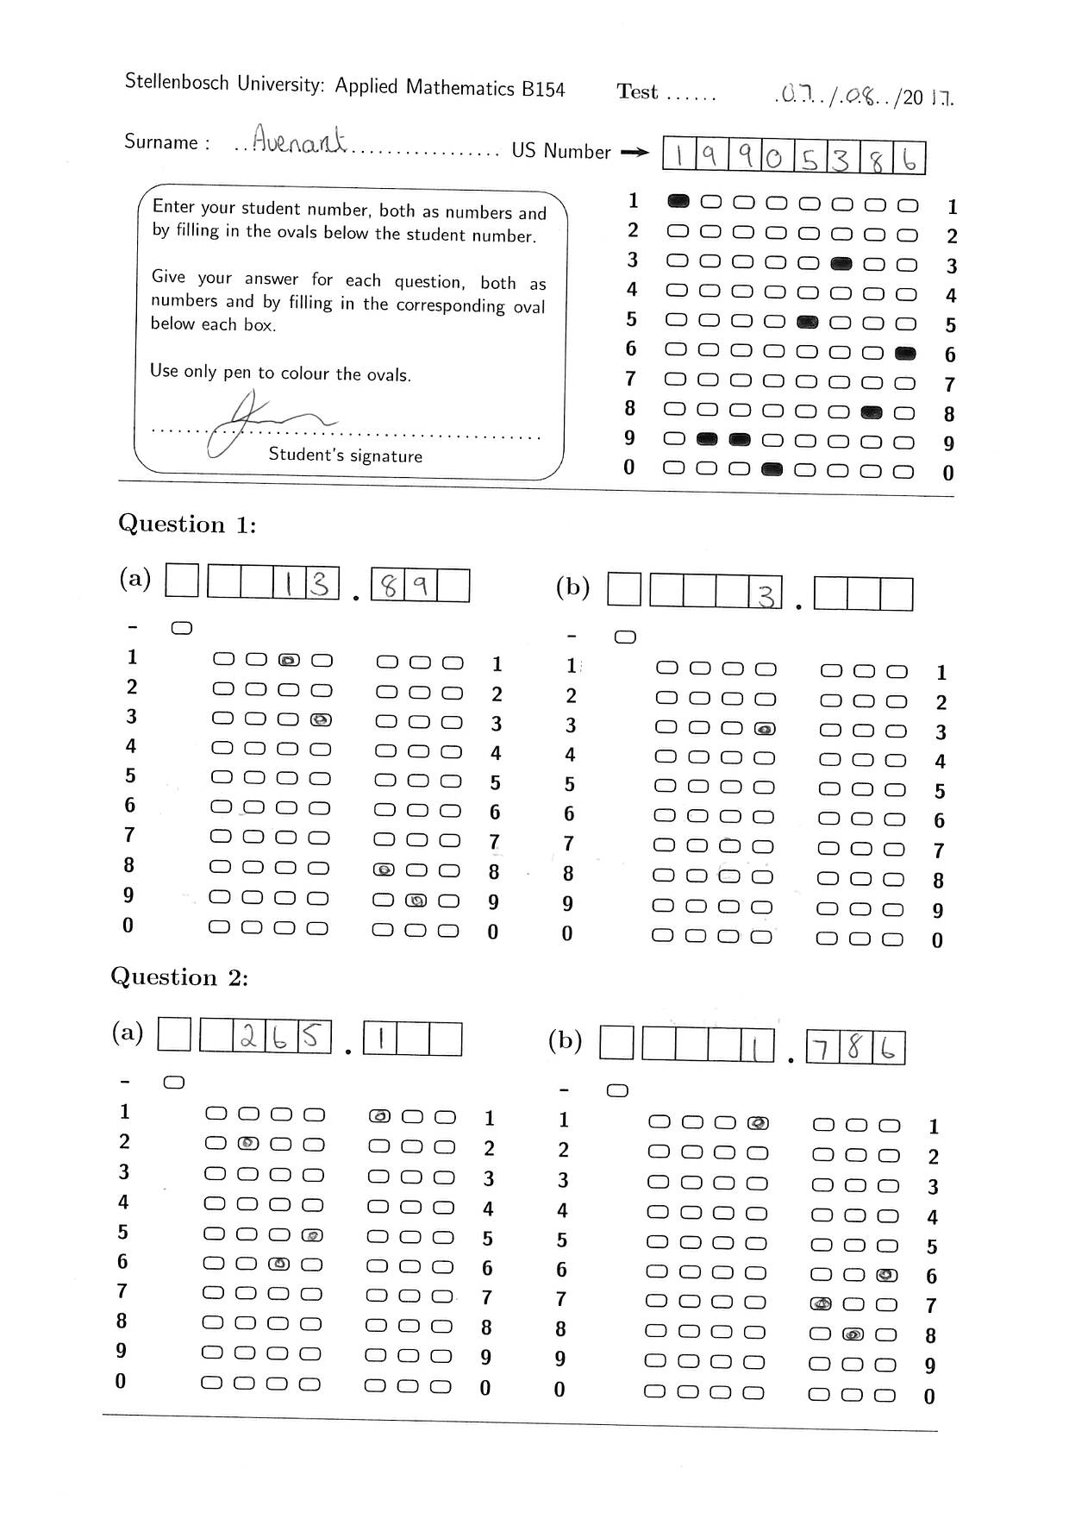

Automatic Test Grading Using Image Processing and Machine Learning Techniques
1. Introduction
4. Image Processing
6. Probabilistic Graphical Models
In recent years the Applied Mathematics department of Stellenbosch notice a drop in teaching assistant’s accuracy in grading students’ tutorial tests. The department has decided to automate this process of grading tests. The department wants Optical Marker Recognition software to graded tests written on a special template automatically. This reduces the time to mark tutorial tests, while still allowing for a high accuracy in grading tests.
To find the template inside the image the system first utilizes a Radon Transform to locate the two longest horizontal lines, as well as the two vertical lines of the comment box. These lines are then used to calculate four reference points on the page, indication where the template is.
Once the template is found contour analysis is done on the page. The reference template found in the image can then be used to estimate the locations of each bubble in the template. Bubble then is assigned a contour that has a centre closest to that estimated locations. In the figure below the red dots are the estimate bubble locations and the green dots the centres of the contours found.
aadasdasdasd
Radon transform
Reference points with Radon transform applied
2. Solution
7. Results
The template allows for decimal valued answers. An improvement over current Optical Marker Recognition systems allows for a student to cross out bubbles instead of needing to completely erase it. Further the system also allows for handwritten digits to answer questions.
aadasdasdasd
Contours found using contour analysis
Example tests
Green: Bubble reference points. Red: Contour centres
3. System Overview
5. Character Recognition
8. Conclusion
Initially, image processing is done on the image and produces character and bubble evidence, as is shown in the image. The bubble evidence contains a classification for each bubble on the template. The bubble can be open, crossed-out, partially filled-in or completely filled-in. The character evidence, in the form of a 28 by 28 array is then process by a Convolutional Neural Network(CNN) to classify the digit in the image. Lastly two probabilistically graphical models are used to estimate the most likely answers written on the page.
To allow for a neural network to classify the digit a custom segmentation algorithm is first used to normalize and centre the digit.
aadasdasdasd
Normalization and cantering of digit
A Convolution Neural Network(CNN) is then used to process this clean input to estimate the probability of each digit being present in the image.
Image Processing
Character evidence
Neural Network
Probabilistic graphical models
Bubble evidence
Answers
Graphical overview
CNN visual setup
CNN TensorFlow setup

