Slide 1


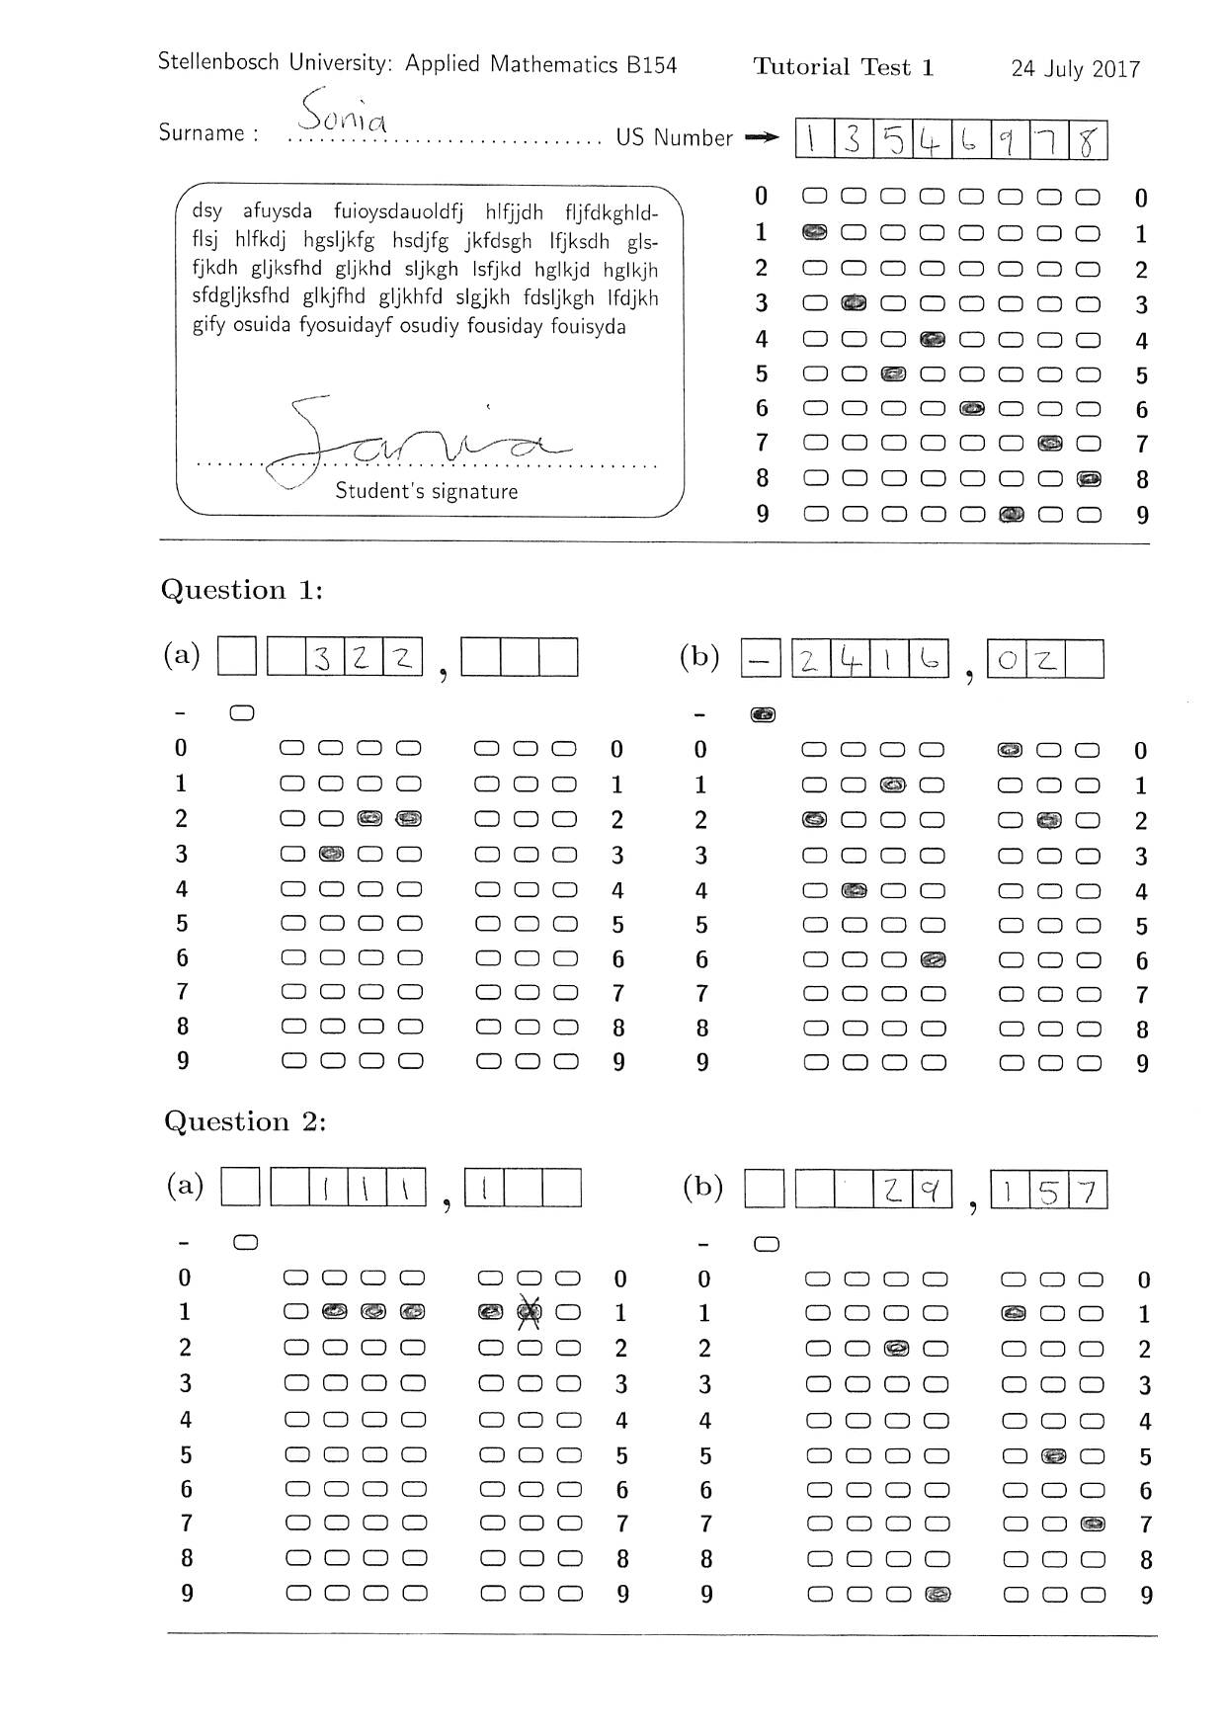
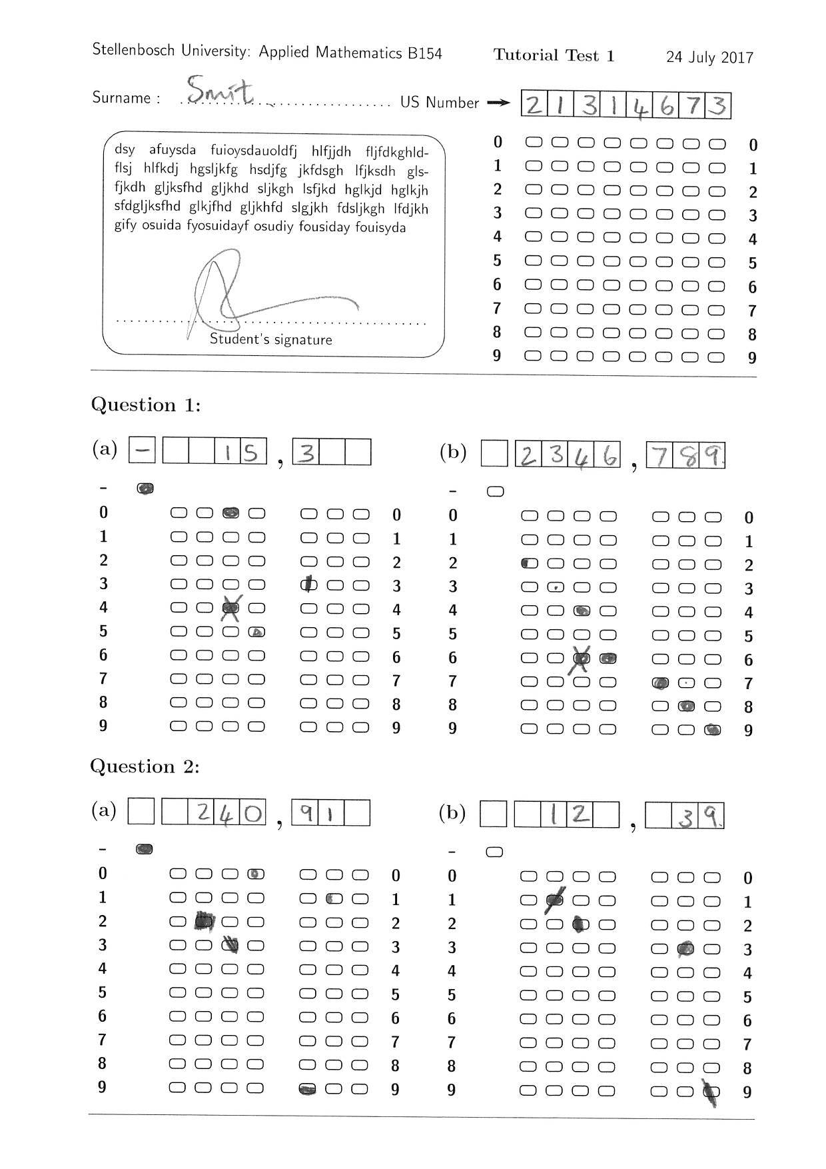
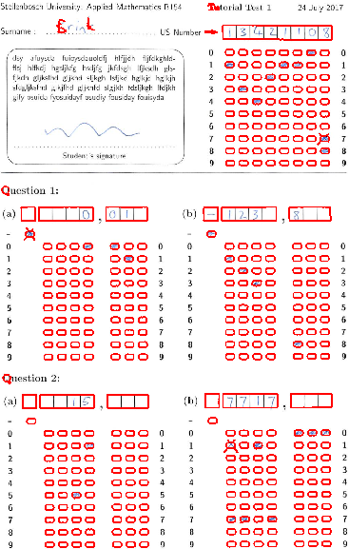
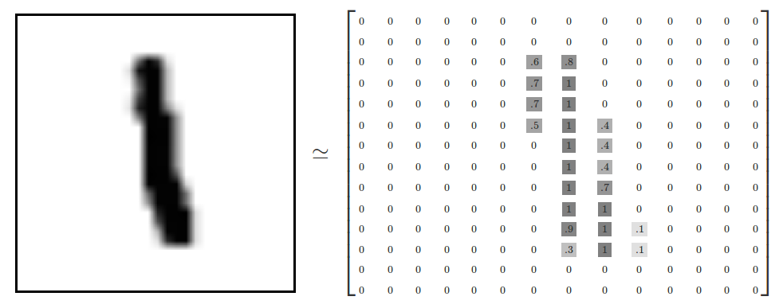
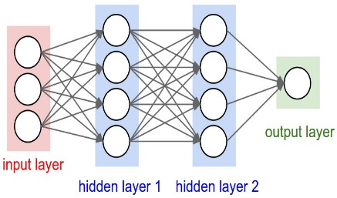
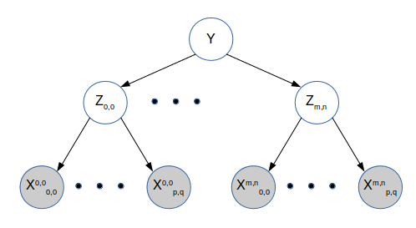
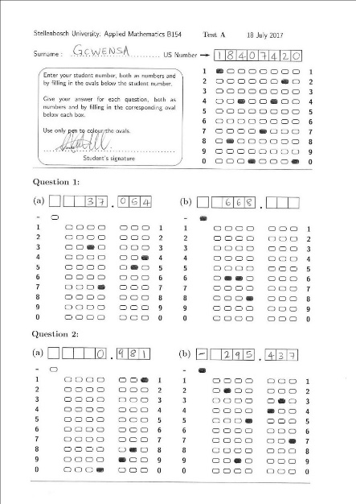
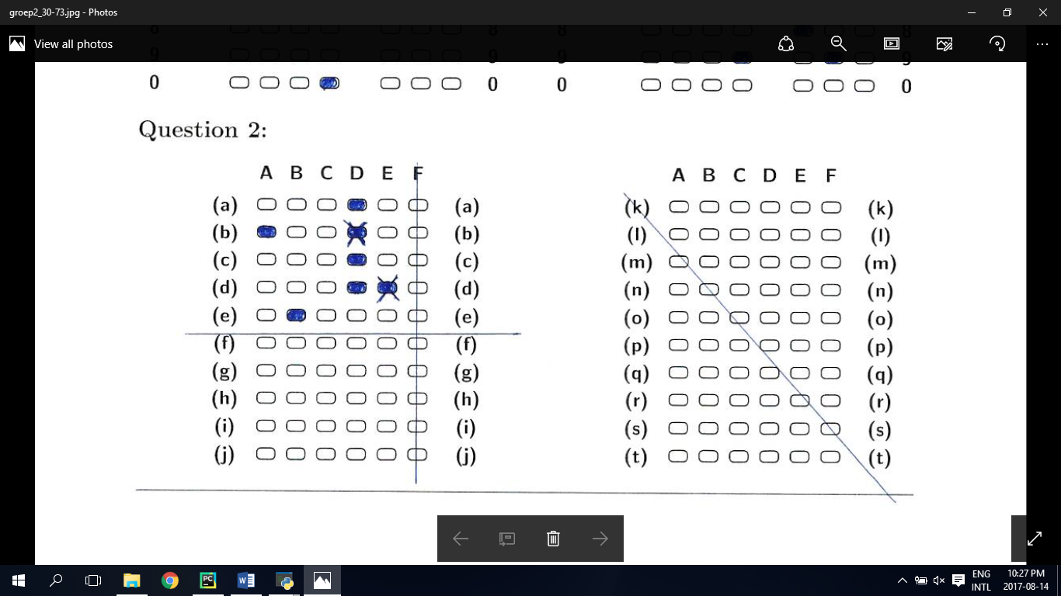
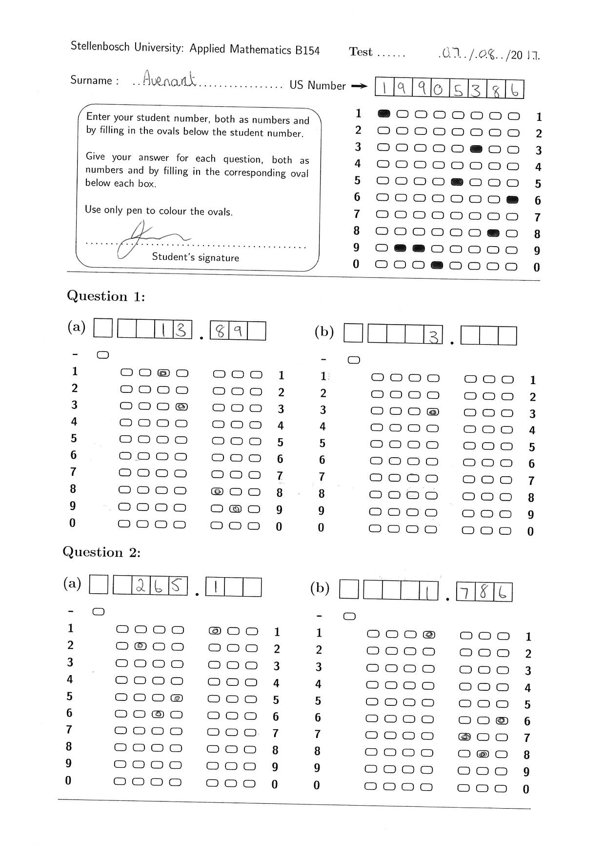

Automatic Test Grading Using Image Processing and Machine Learning Techniques
1. Introduction
4. Image Processing
6. Probabilistic Graphical Models
In recent years the Applied Mathematics department of Stellenbosch notice a drop in teaching assistant’s accuracy in grading students’ tutorial tests. The department has decided to automate this process of grading tests. The department wants Optical Marker Recognition software to graded tests written on a special template automatically. This reduces the time to mark tutorial tests, while still allowing for a high accuracy in grading tests.
aadasdasdasd
aadasdasdasd
2. Solution
7. Results
The template allows for decimal valued answers. An improvement over current Optical Marker Recognition systems allows for a student to cross out bubbles instead of needing to completely erase it. Further the system also allows for handwritten digits to answer questions.
aadasdasdasd
3. System Overview
5. Character Recognition
8. Conclusion
aadasdasdasd
aadasdasdasd
Image Processing
Character evidence
Neural Network
Probabilistic graphical models
Bubble evidence
Answers

