Slide 1

Canvas Chess Application

Slide 2
How it’s made.
The Project is made entirely using JavaScript for the logic, and Canvas for the visualization of the chess board.
CSS is used for styling.
DOM manipulation for event handling.
Using FEN notation for importing board states.

Slide 3

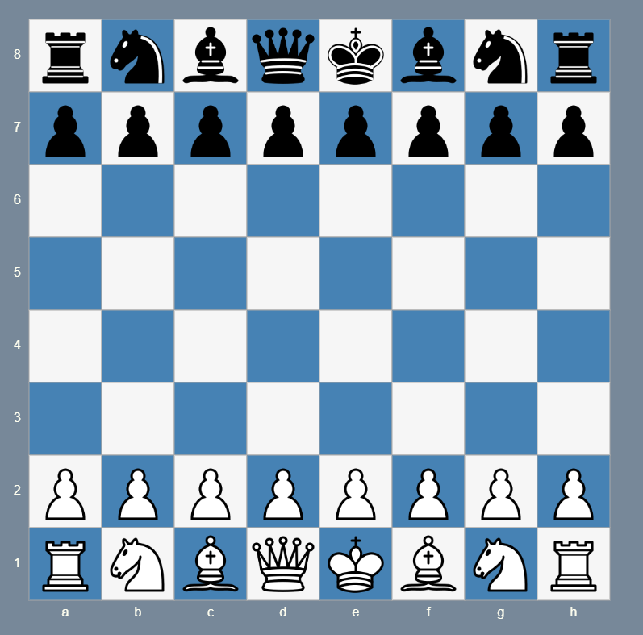
Board & Pieces
8x8 board stored as an array of 64 integers.
Each piece encoded using bitwise flags.
Color and type packed into a single integer value
whiteQueen = Piece.Queen | Piece.White
0110 | 1000 = 1110 (14 in decimal)

Slide 4

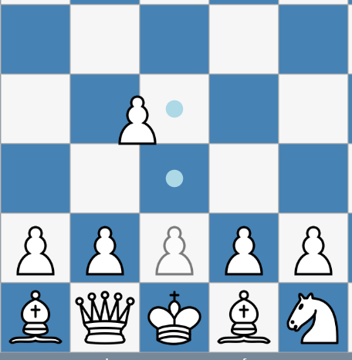
Pieces are moved using Drag and Drop
mousedown: Select piece and highlight valid moves.
mousemove: Drag piece, valid moves are highlighted.
mouseup: Validate move, handle all rule logic and end turn.

Slide 5
Rule enforcment
Move validation per piece type
Simulated moves in different instances to prevent illegal king exposure.
Castling and en passant conditions handled.
End conditions: Checkmate, stalemate, insufficient material.

Slide 6
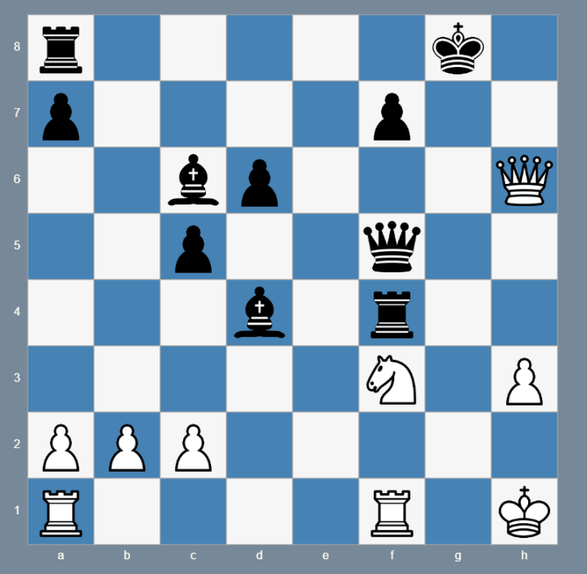
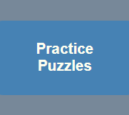
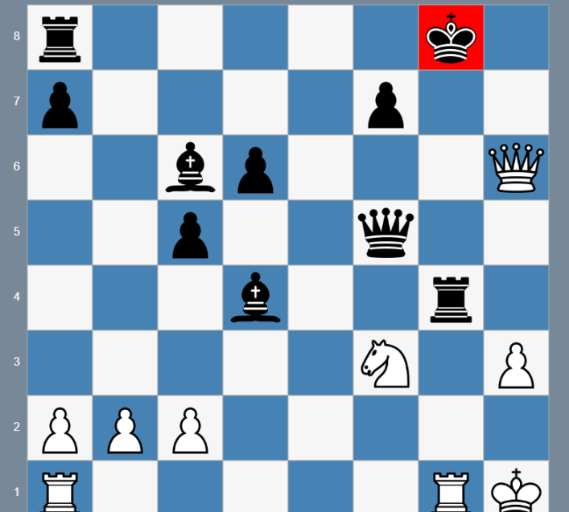
Puzzles
Store puzzles as objects, using fen notation.
Board initialized per puzzle setup.
Solution checker compares player moves step by step.
Auto response from opponent.

Slide 7
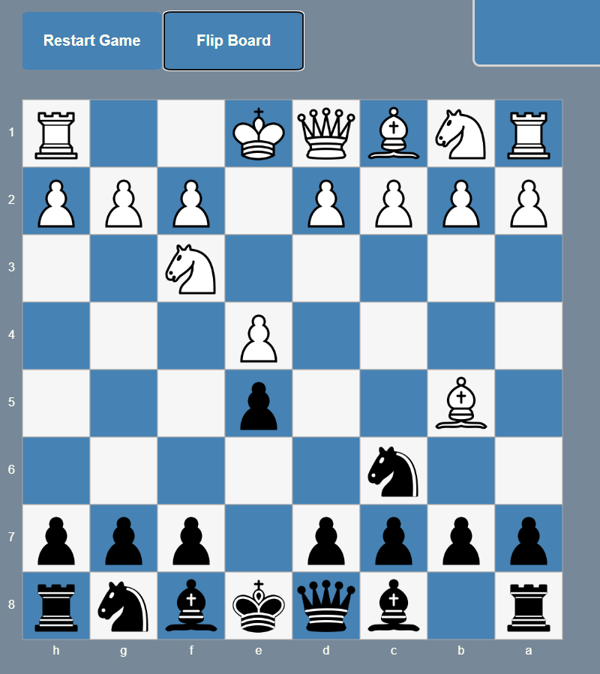
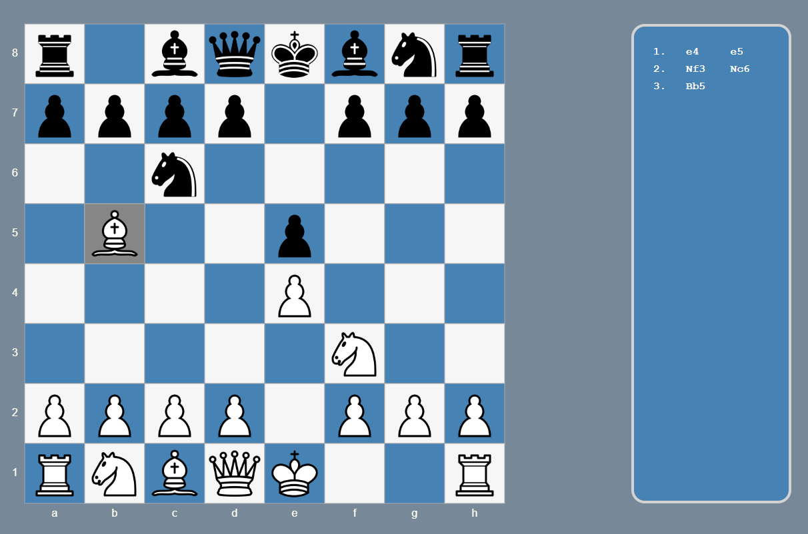
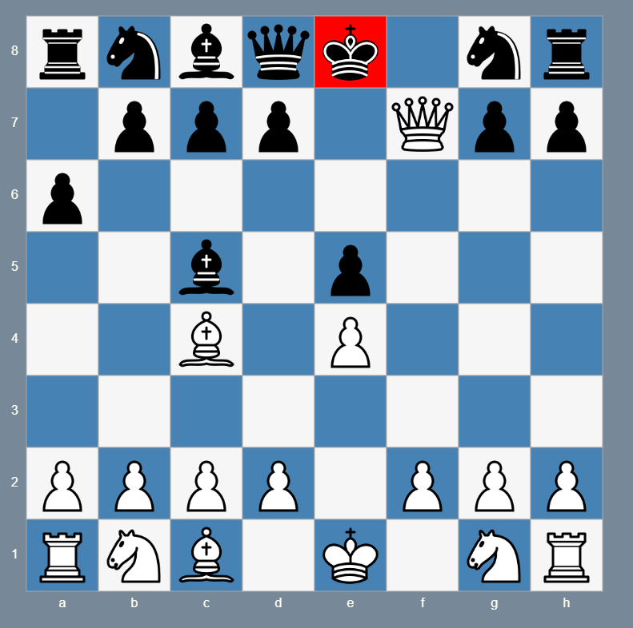
Play Chess
Fully functioning chess game.
Can flip the board and move both sides.
All game states are available, including checkmate and stalemate.

Slide 8

Thank you for your attention

