Slide 1
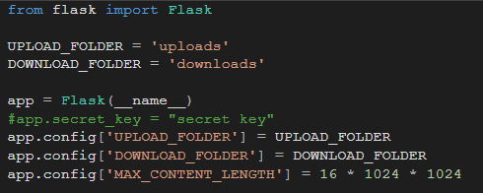







Slide 2

Probleme, Vor/Nachteile, Verbesserungen
Problem Download:
image select vs. All(zipped)
download folder selection
Verbesserungen:
UI
Cleanup (Zip Delete on Server)
Umleitung/Message as popup

Slide 3
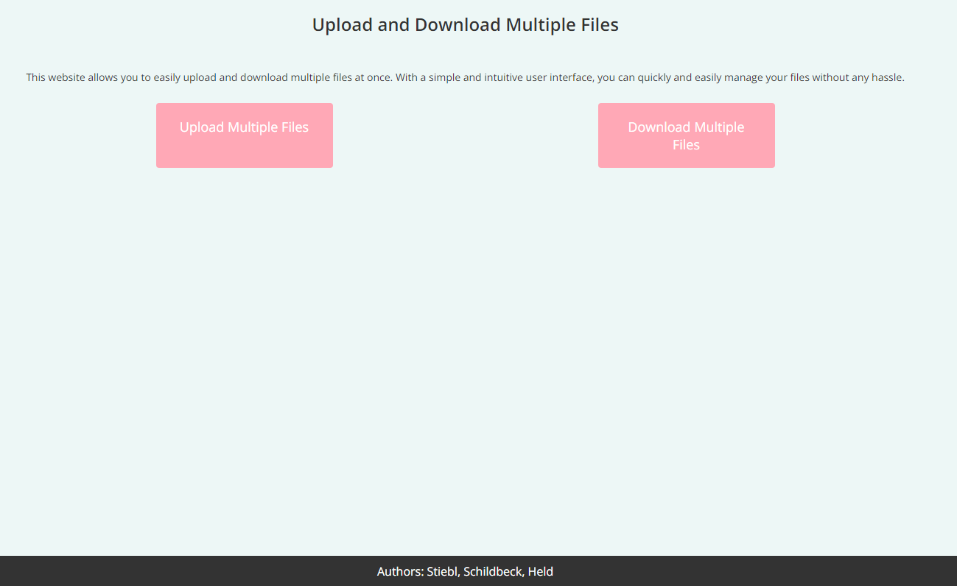

Slide 4
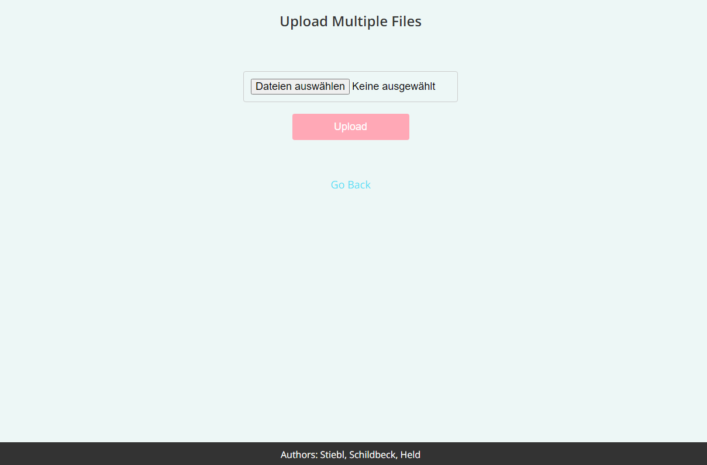

Slide 5
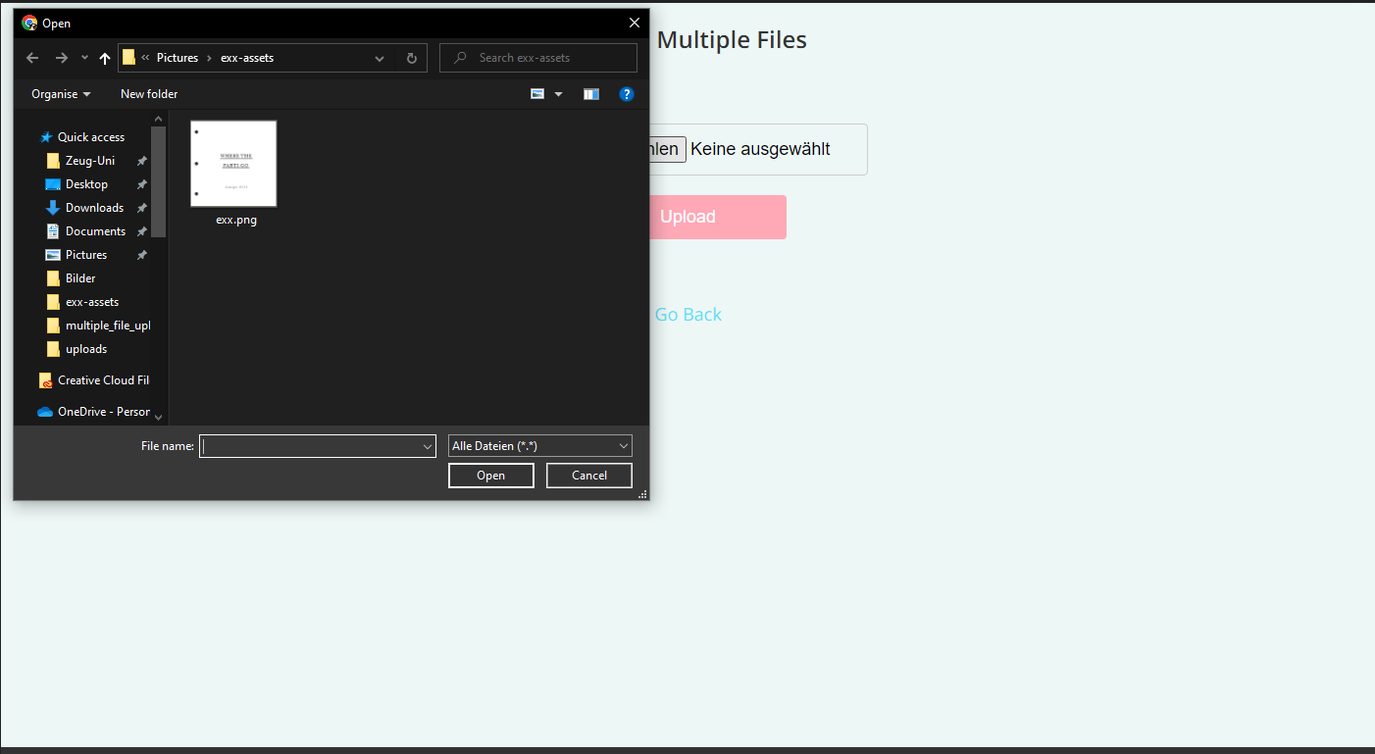

Slide 6
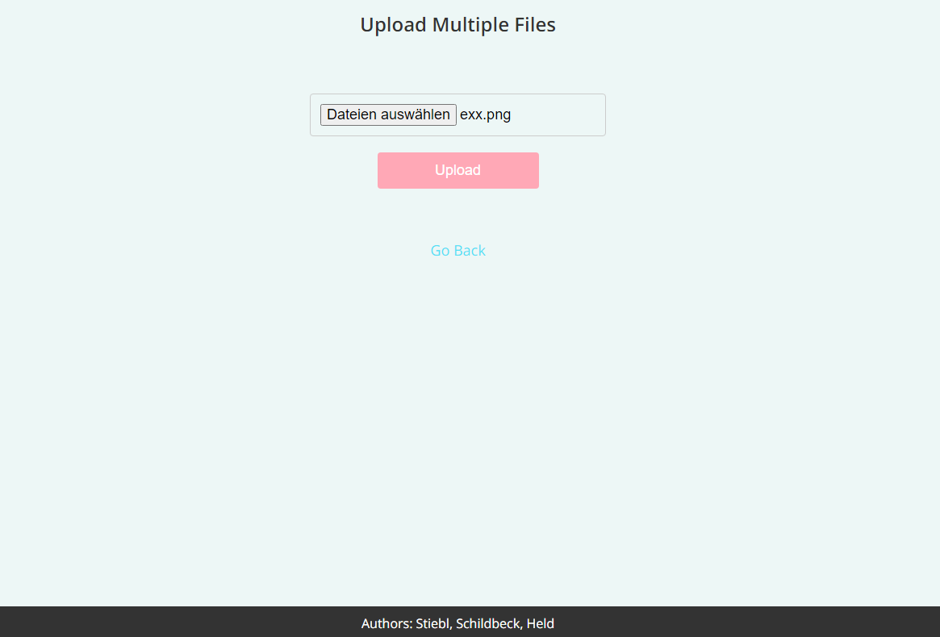

Slide 7
