Slide 1
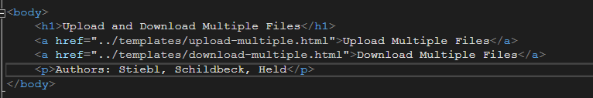
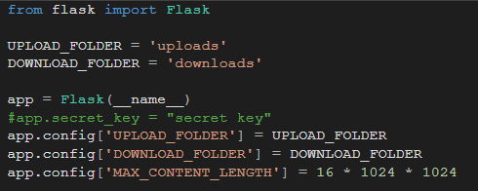
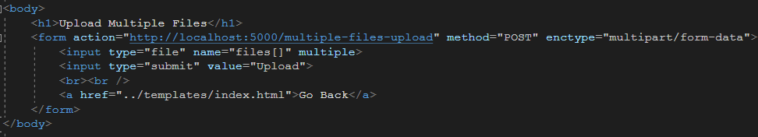

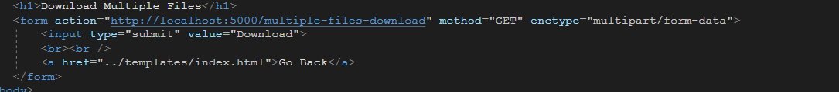

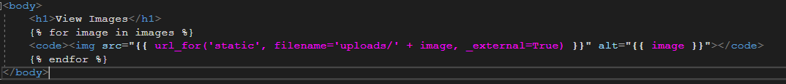
HTML & css code
HTML & css code

Slide 2

Probleme, Vor/Nachteile, Verbesserungen
Problem Download:
image select vs. All(zipped)
download folder selection
Verbesserungen:
UI
Cleanup (Zip Delete on Server)
Umleitung/Message as popup(as seen in screenshot below)

Slide 3
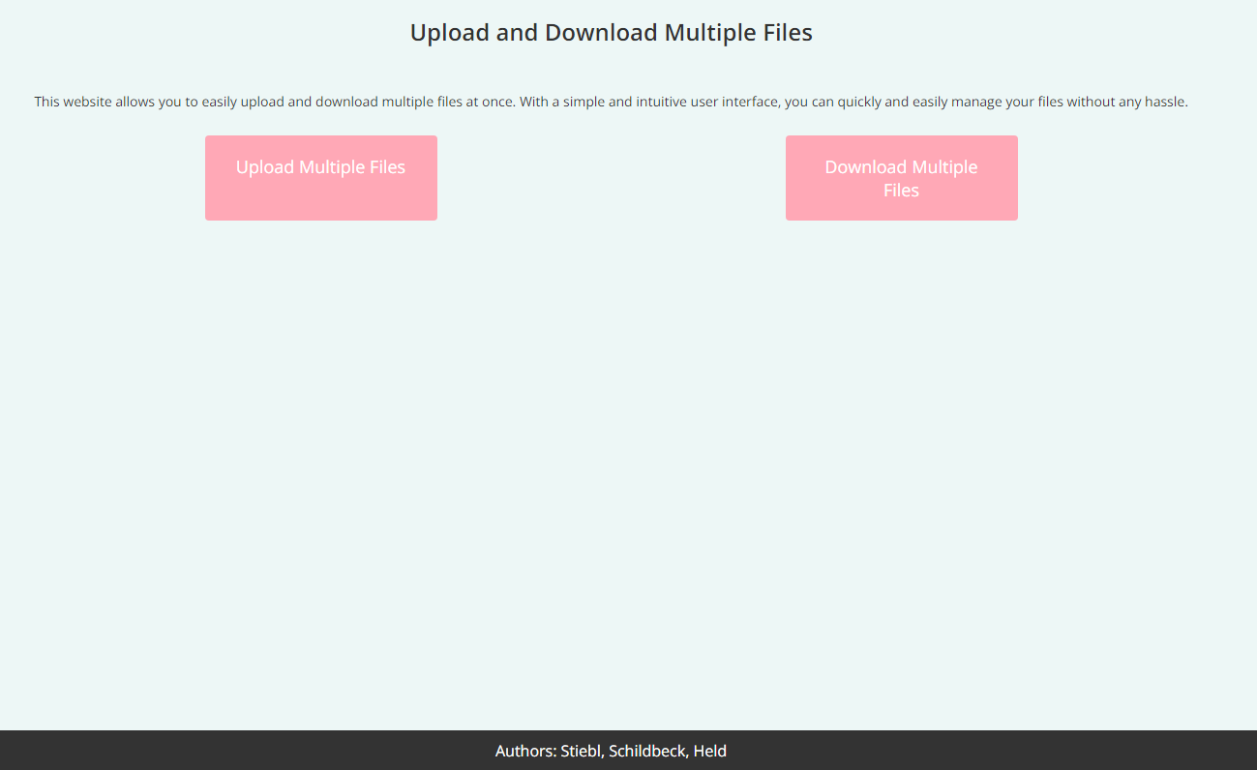
UI

Slide 4
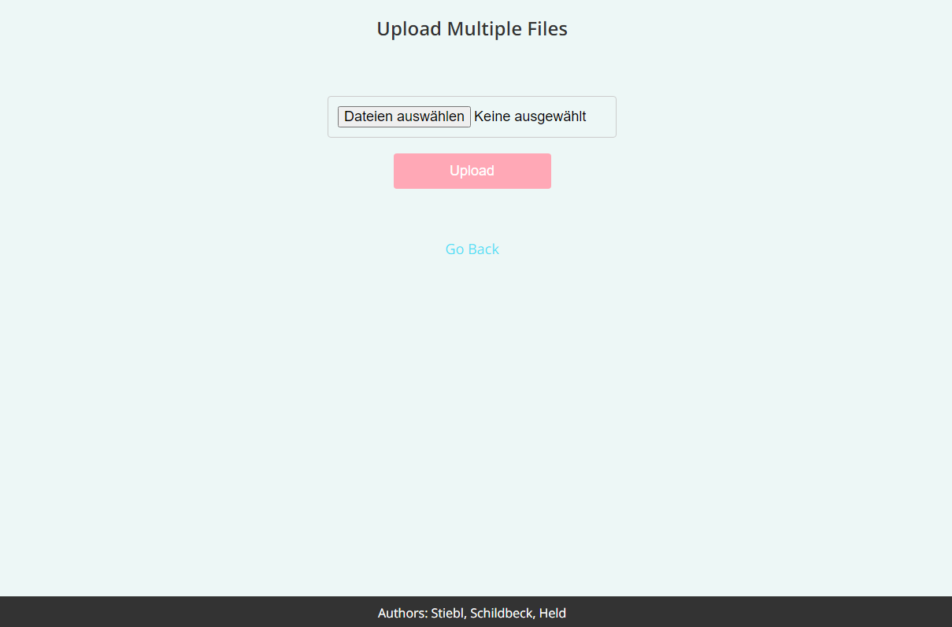
UI

Slide 5
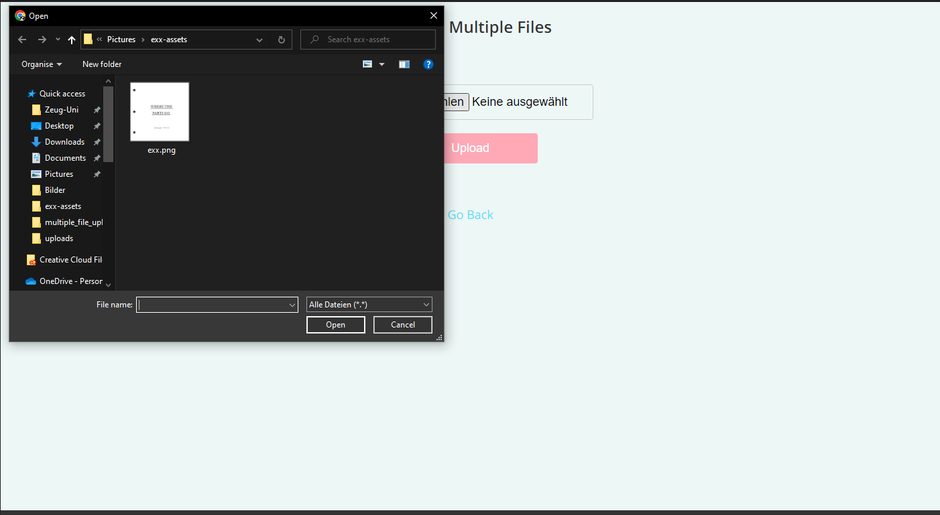
UI

Slide 6
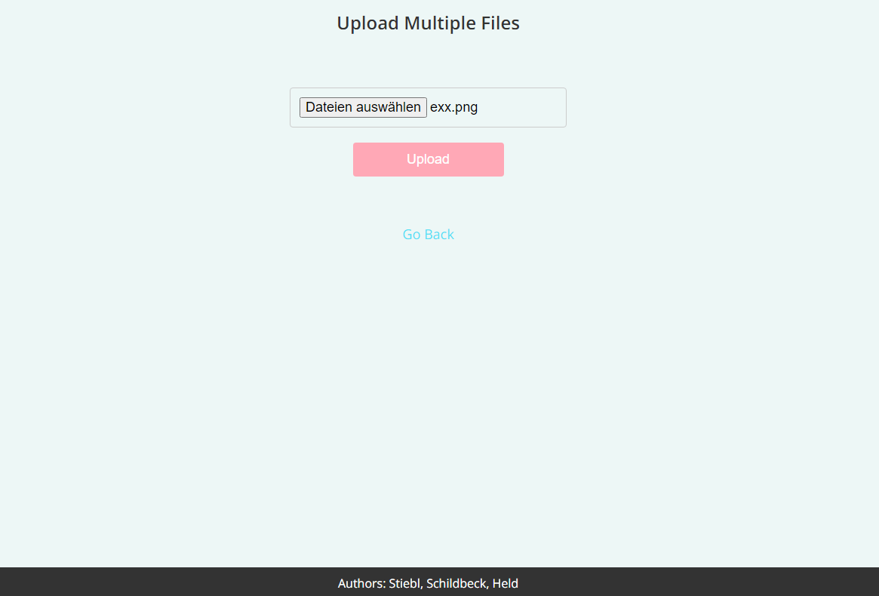
UI

Slide 7
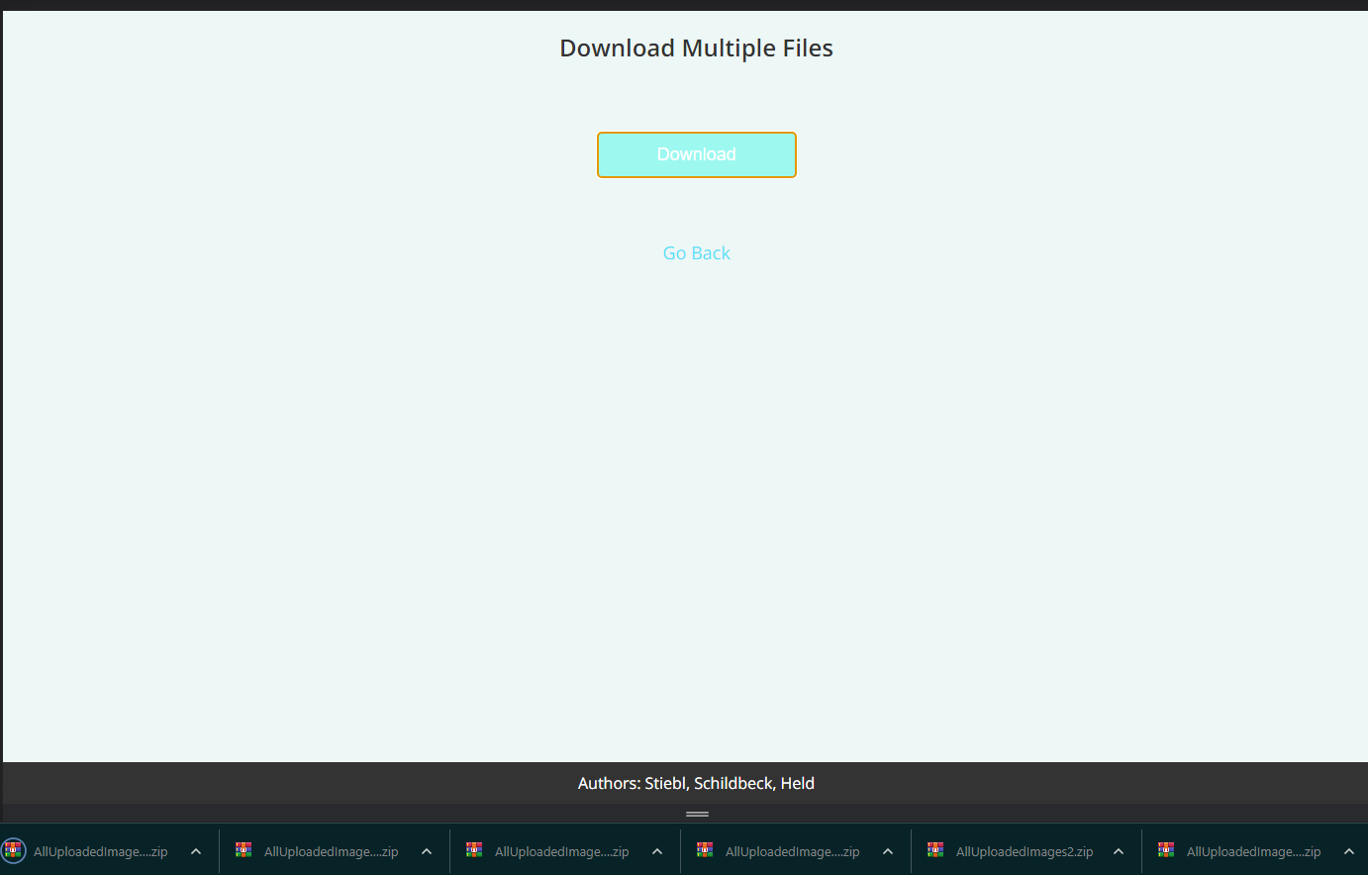
UI

