Slide 1
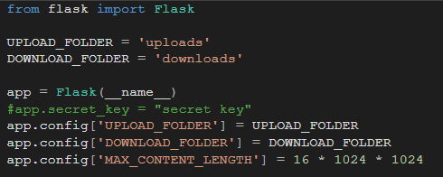
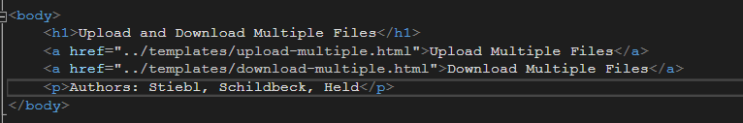

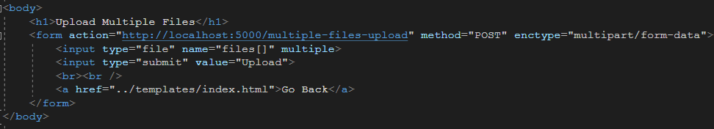

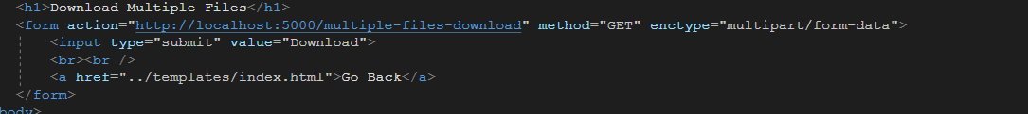
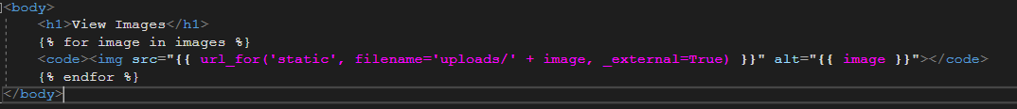

Slide 2
Probleme, Vor/Nachteile, Verbesserungen
Problem Download:
image select vs. All(zipped)
download folder selection
Verbesserungen:
UI
Cleanup (Zip Delete on Server)

