Slide 1
Topic :Blood Donation Management System
Group Members :
Durgesh Prajapati
Sujeet Pandit
Gulab Singh
Ankita Yadav
Project Guide :
Prof. Madhuri Gedam

Slide 2
INTRODUCTION
Blood donation is required during an organ transplant, accidents, cancer treatment etc. For blood donation, one needs to check for a donation camp or needs to visit blood bank.
The Manual Blood donation system has many disadvantages which includes, it is too time consuming, often leads to error prone results, consumes lot of manpower, lacks donor information, retrieval of data takes a lot of time, percentage of accuracy is less. In the time of emergency, it becomes difficult to approach the right donor. Rare blood groups are not available all the time at all blood banks and recipients find difficulties to track the right blood donor.
So it will be very helpful if we can donate as well as get blood online .

Slide 3
PROPOSED SYSTEM
In current situation there is need to all people blood on time otherwise it will result in their death. So, This project aims at maintaining all information regarding blood donors, different blood groups available in blood banks as wells as blood camps and help them manage in a better way.

Slide 4
IMPLEMENTATION
This online blood donation management system maintains the list of blood donors and also helps the recipients to track and search the right donor easily. It has two modules namely Admin and User. Admins can add hospitals having blood banks and can also add various blood donation camps. He/she can also view the list of donors of a particular area with proper Blood cross match. He/she can also check for blood requests and in case of emergency he/she can send notifications to blood donors as per the requirements. Users can register and make a request. Users can also register as a donor. Donors can check for Blood camps and hospitals for blood donation and will be getting notifications in case of emergency.

Slide 5
IMPLEMENTATION
Home Page
Home Page
Campground Page
Login Page
About Page
Login Page
Signup Page
Contact Page
Login based on usertype
Details

Slide 6
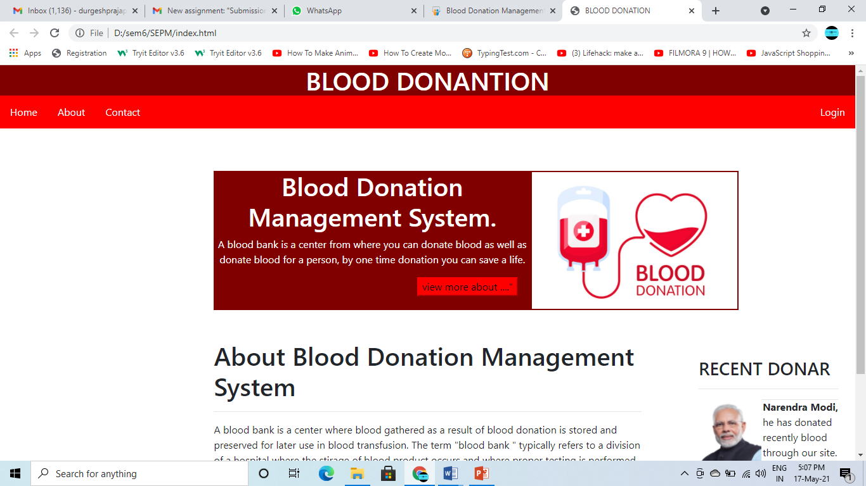
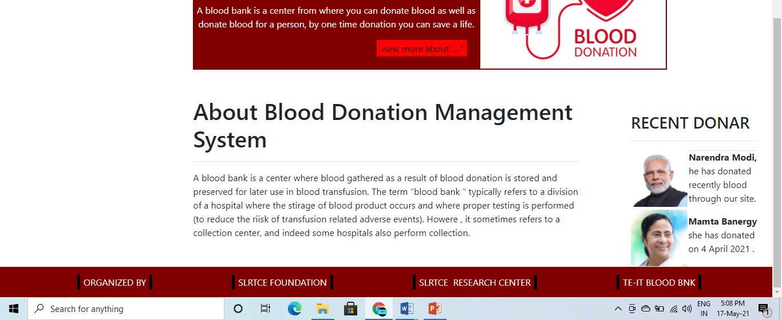

Slide 7
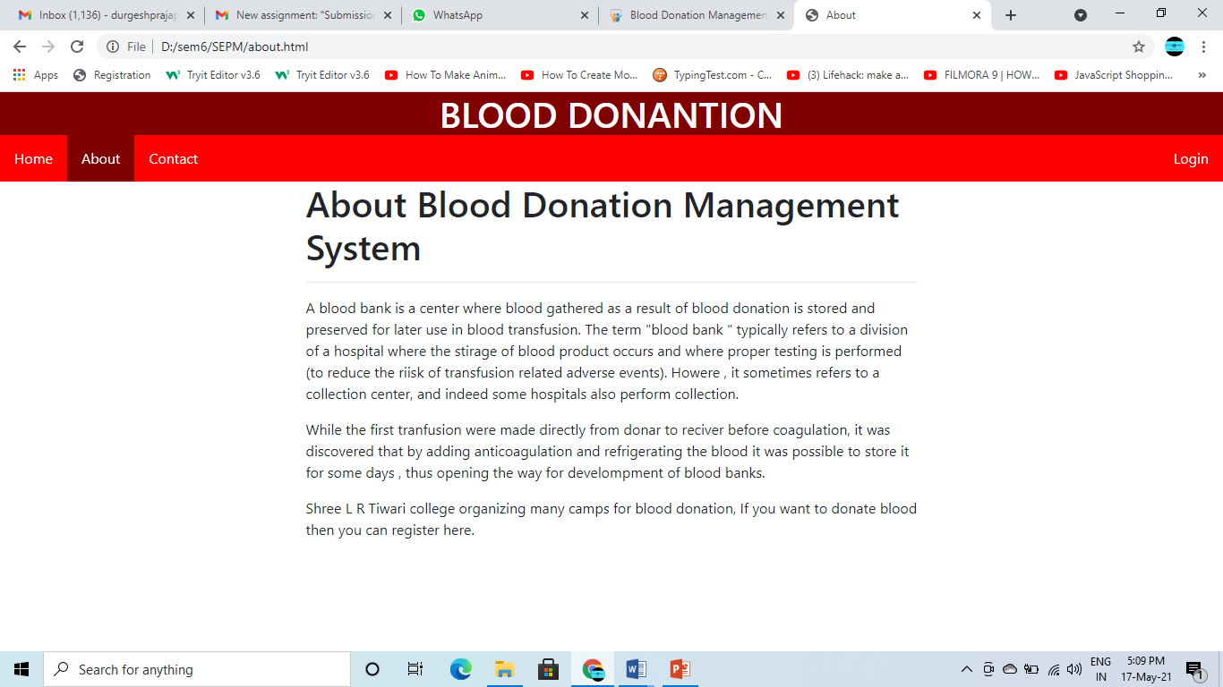

Slide 8
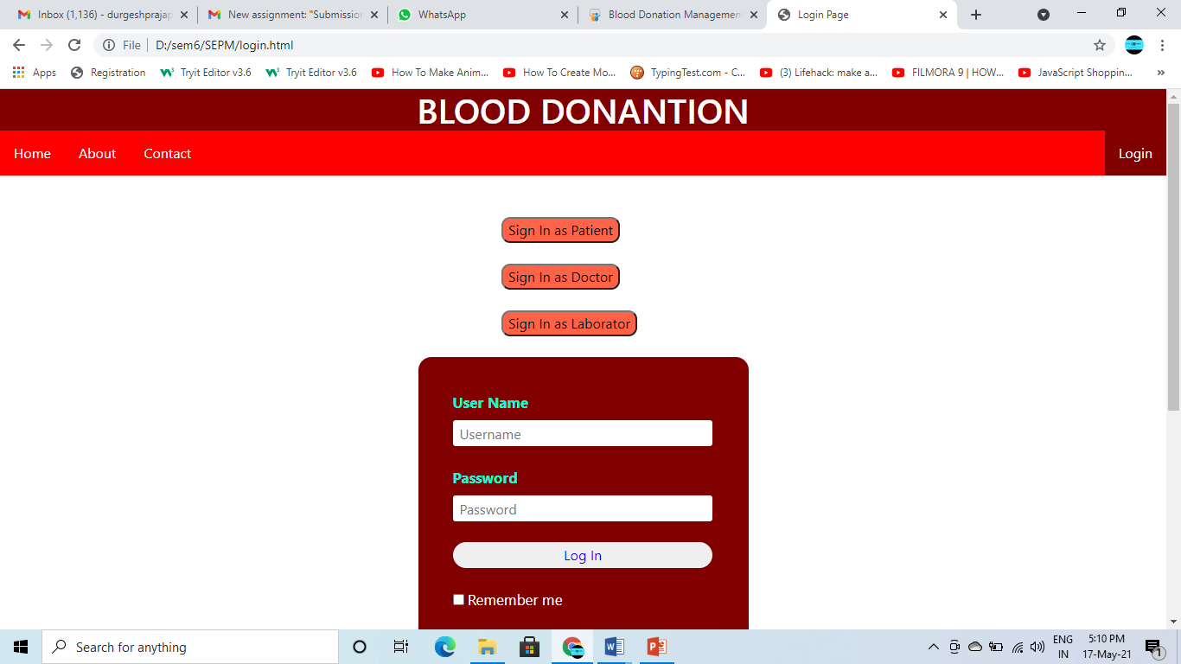

Slide 9


Slide 10
UML DIAGRAMS
What is UML?
UML is an acronym that stands for Unified Modeling Language. Simply put, UML is a modern approach to modeling and documenting software. In fact, it’s one of the most popular business process modeling techniques.
It is based on diagrammatic representations of software components. As the old proverb says: “a picture is worth a thousand words”. By using visual representations, we are able to better understand possible flaws or errors in software or business processes.
Types Of UML Diagrams :-
Use Case Diagram
Class Diagram
Activity Diagram
Sequence Diagram
Component Diagram
Deployment Diagram

Slide 11
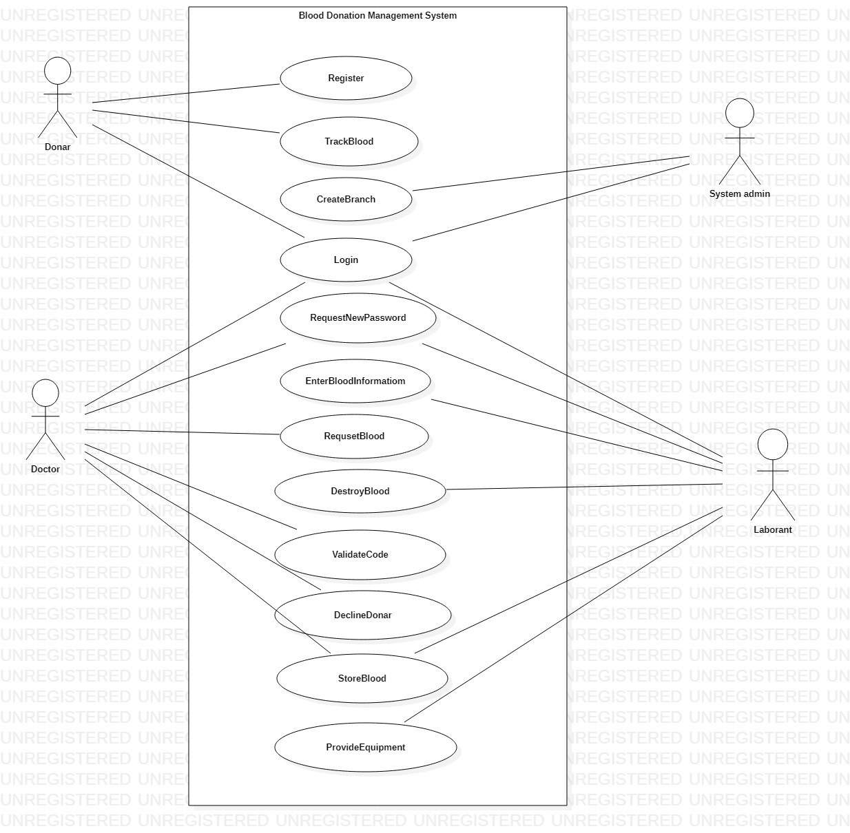
Use Case Diagram :
A use case diagram at its simplest is a representation of a user's interaction with the system that shows the relationship between the user and the different use case in which the user is involved. A use case diagram can identify the different types of users of a system and the different use cases of diagrams as well. The use cases are represented by either circles or ellipses.

Slide 12
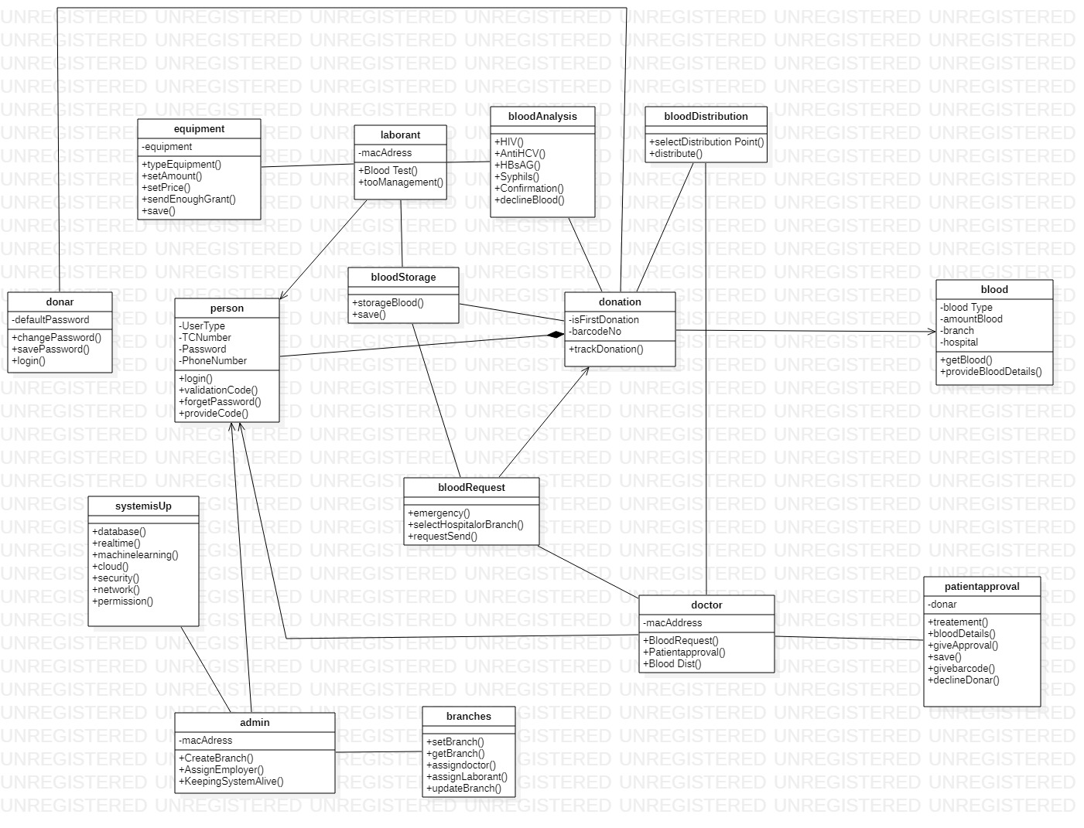
Class Diagram :
a class diagram in the Unified Modeling Language (UML) is a type of static structure diagram that describes the structure of a system by showing the system's classes, their attributes, operations (or methods), and the relationships among objects.
Class diagrams basically represent the object-oriented view of a system, which is static in nature.

Slide 13
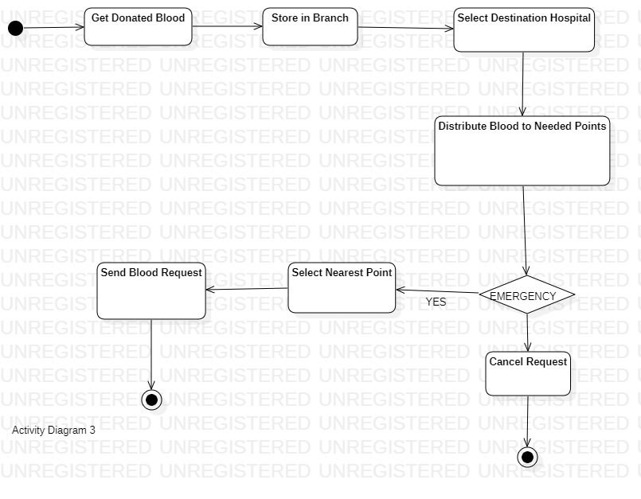
Activity Diagram :
Activity diagram is another important diagram in UML to describe the dynamic aspects of the system. Activity diagram is basically a flowchart to represent the flow from one activity to another activity. The activity can be described as an operation of the system. The control flow is drawn from one operation to another.

Slide 14
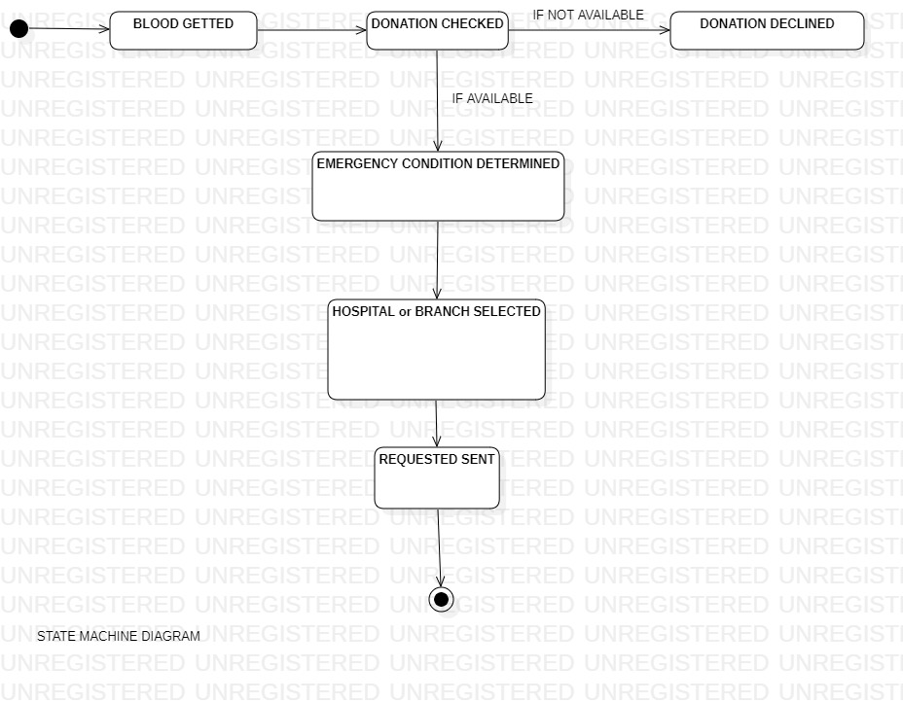
State Diagram :
State chart diagram is used to represent the event driven state change of a system. It basically describes the state change of a class, interface, etc.
State chart diagram is used to visualize the reaction of a system by internal/external factors

Slide 15
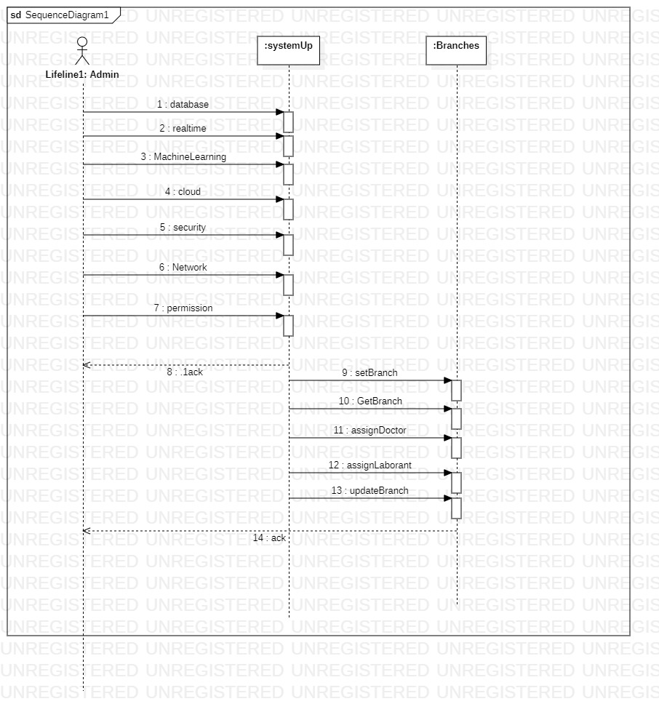
Sequence Diagram :
A sequence diagram simply depicts interaction between objects in a sequential order i.e. the order in which these interactions take place. We can also use the terms event diagrams or event scenarios to refer to a sequence diagram.
Sequence diagrams describe how and in what order the objects in a system function.

Slide 16
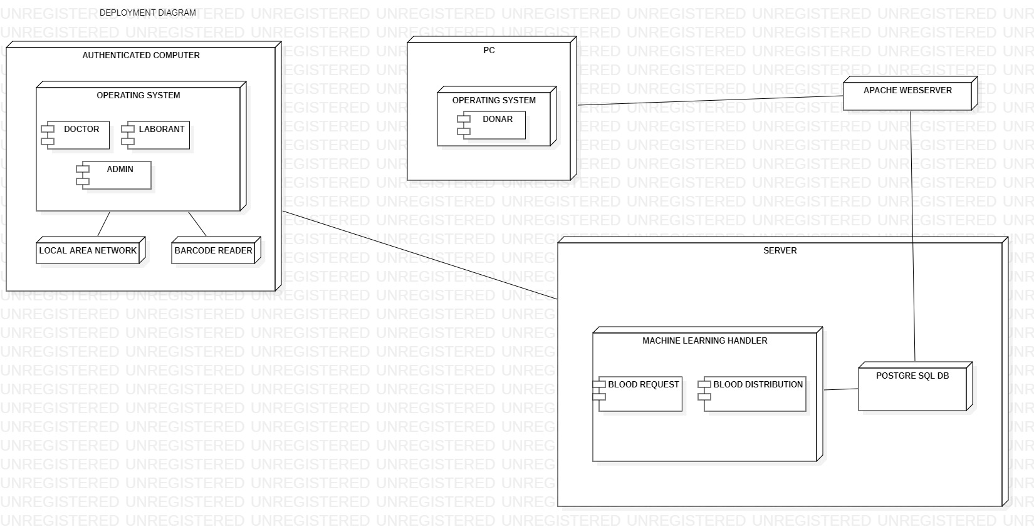
Deployment Diagram :
A deployment diagram is a UML diagram type that shows the execution architecture of a system, including nodes such as hardware or software execution environments, and the middleware connecting them.
Deployment diagrams are typically used to visualize the physical hardware and software of a system.

Slide 17
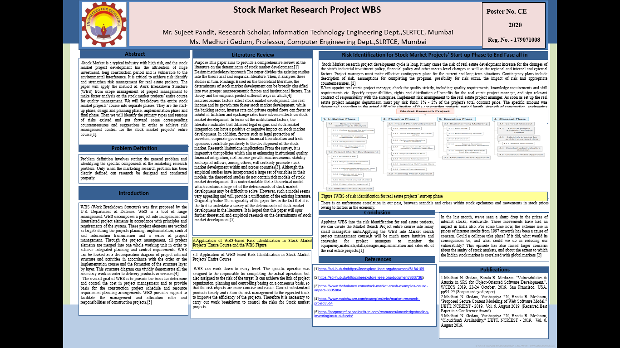

Slide 18
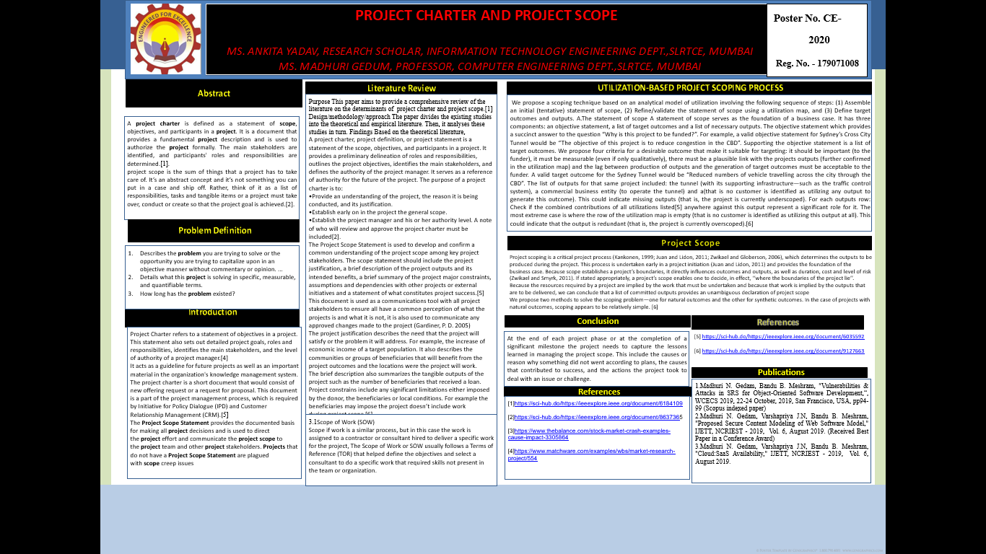

Slide 19
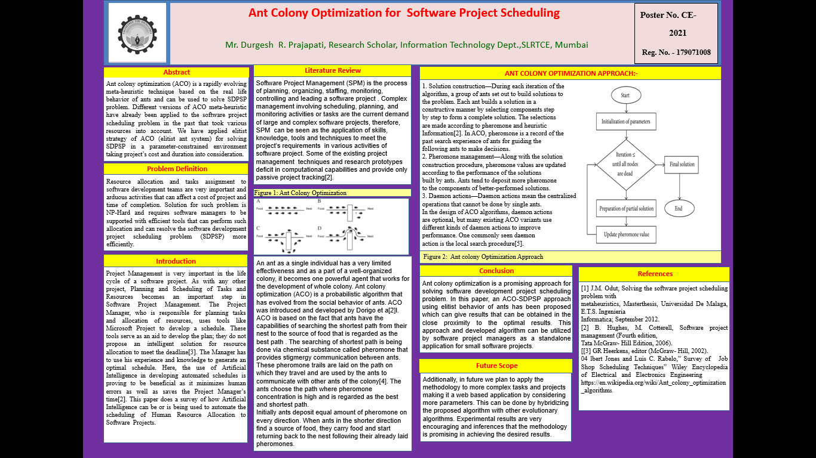

Slide 20
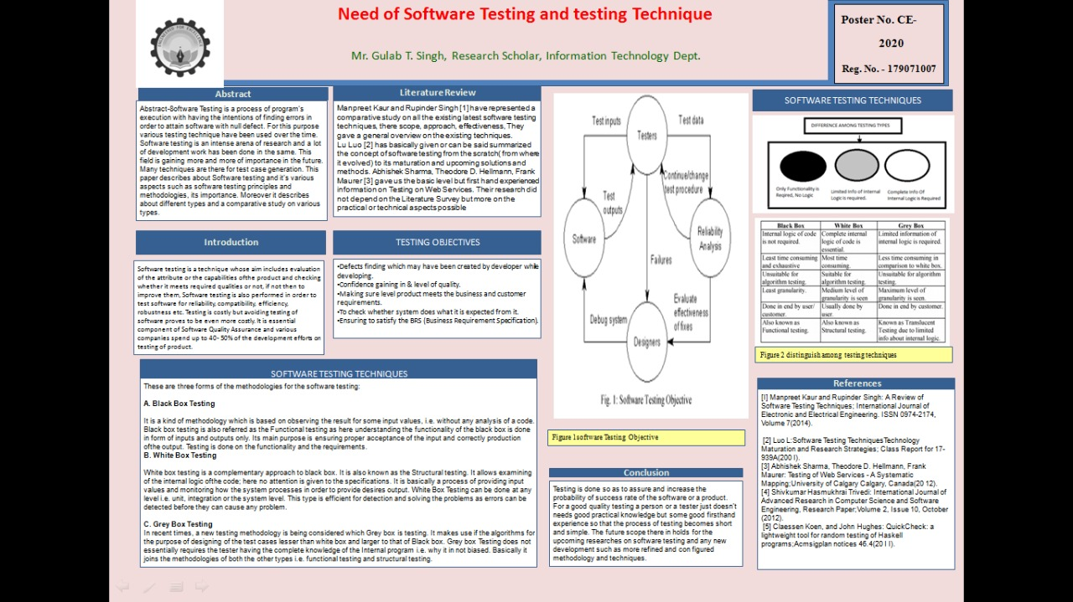

Slide 21
THANK YOU

