Slide 1

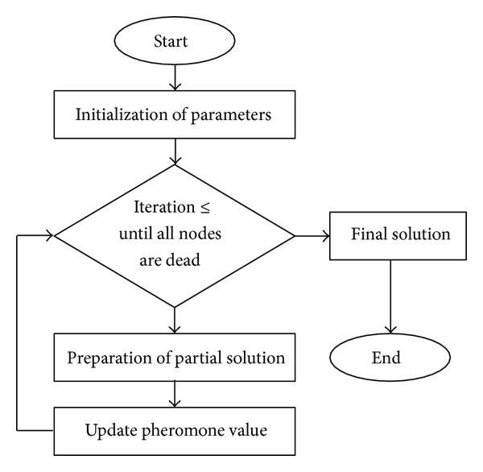
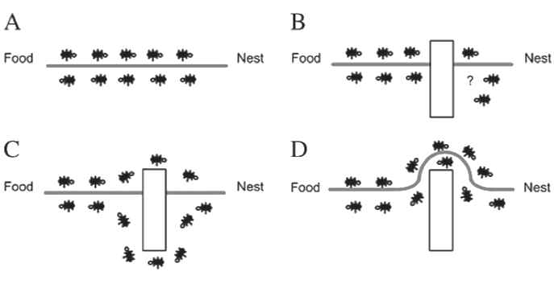
Ant Colony Optimization for Software Project Scheduling
Mr. Durgesh R. Prajapati, Research Scholar, Information Technology Dept.,SLRTCE, Mumbai
Poster No. CE-
2021
Reg. No. - 179071008
Abstract
Literature Review
ANT COLONY OPTIMIZATION APPROACH:-
Ant colony optimization (ACO) is a rapidly evolving meta-heuristic technique based on the real life behavior of ants and can be used to solve SDPSP problem. Different versions of ACO meta-heuristic have already been applied to the software project scheduling problem in the past that took various resources into account. We have applied elitist strategy of ACO (elitist ant system) for solving SDPSP in a parameter-constrained environment taking project’s cost and duration into consideration.
Software Project Management (SPM) is the process of planning, organizing, staffing, monitoring, controlling and leading a software project . Complex management involving scheduling, planning, and monitoring activities or tasks are the current demand of large and complex software projects, therefore, SPM can be seen as the application of skills, knowledge, tools and techniques to meet the project’s requirements in various activities of software project. Some of the existing project management techniques and research prototypes deficit in computational capabilities and provide only passive project tracking[2].
1. Solution construction—During each iteration of the
algorithm, a group of ants set out to build solutions to
the problem. Each ant builds a solution in a
constructive manner by selecting components step
by step to form a complete solution. The selections
are made according to pheromone and heuristic
Information[2]. In ACO, pheromone is a record of the
past search experience of ants for guiding the
following ants to make decisions.
2. Pheromone management—Along with the solution
construction procedure, pheromone values are updated
according to the performance of the solutions
built by ants. Ants tend to deposit more pheromone
to the components of better-performed solutions.
3. Daemon actions—Daemon actions mean the centralized
operations that cannot be done by single ants.
In the design of ACO algorithms, daemon actions
are optional, but many existing ACO variants use
different kinds of daemon actions to improve
performance. One commonly seen daemon
action is the local search procedure[5].
Problem Definition
Resource allocation and tasks assignment to software development teams are very important and arduous activities that can affect a cost of project and time of completion. Solution for such problem is NP-Hard and requires software managers to be supported with efficient tools that can perform such allocation and can resolve the software development project scheduling problem (SDPSP) more efficiently.
Figure 1: Ant Colony Optimization
Introduction
An ant as a single individual has a very limited effectiveness and as a part of a well-organized colony, it becomes one powerful agent that works for the development of whole colony. Ant colony optimization (ACO) is a probabilistic algorithm that has evolved from the social behavior of ants. ACO was introduced and developed by Dorigo et a[2]l. ACO is based on the fact that ants have the capabilities of searching the shortest path from their nest to the source of food that is regarded as the best path . The searching of shortest path is being done via chemical substance called pheromone that provides stigmergy communication between ants. These pheromone trails are laid on the path on which they travel and are used by the ants to communicate with other ants of the colony[4]. The ants choose the path where pheromone concentration is high and is regarded as the best and shortest path.
Initially ants deposit equal amount of pheromone on every direction. When ants in the shorter direction find a source of food, they carry food and start returning back to the nest following their already laid pheromones.
Figure 2: Ant colony Optimization Approach
Project Management is very important in the life cycle of a software project. As with any other project, Planning and Scheduling of Tasks and Resources becomes an important step in Software Project Management. The Project Manager, who is responsible for planning tasks and allocation of resources, uses tools like Microsoft Project to develop a schedule. These tools serve as an aid to develop the plan; they do not propose an intelligent solution for resource allocation to meet the deadline[3]. The Manager has to use his experience and knowledge to generate an optimal schedule. Here, the use of Artificial Intelligence in developing automated schedules is proving to be beneficial as it minimizes human errors as well as saves the Project Manager’s time[2]. This paper does a survey of how Artificial Intelligence can be or is being used to automate the scheduling of Human Resource Allocation to Software Projects.
Conclusion
References
Ant colony optimization is a promising approach for solving software development project scheduling problem. In this paper, an ACO-SDPSP approach using elitist behavior of ants has been proposed which can give results that can be obtained in the close proximity to the optimal results. This approach and developed algorithm can be utilized by software project managers as a standalone application for small software projects.
[1] J.M. Odut, Solving the software project scheduling problem with
metaheuristics, Masterthesis, Universidad De Malaga, E.T.S. Ingenieria
Informatica; September 2012.
[2] B. Hughes, M. Cotterell, Software project management (Fourth edition,
Tata McGraw- Hill Edition, 2006).
[[3] GR Heerkens, editor (McGraw- Hill, 2002).
04 lbert Jones and Luis C. Rabelo,” Survey of Job Shop Scheduling Techniques” Wiley Encyclopedia of Electrical and Electronics Engineering
https://en.wikipedia.org/wiki/Ant_colony_optimization_algorithms.
Future Scope
Additionally, in future we plan to apply the methodology to more complex tasks and projects making it a web based application by considering more parameters. This can be done by hybridizing the proposed algorithm with other evolutionary algorithms. Experimental results are very encouraging and inferences that the methodology is promising in achieving the desired results.

