Slide 1

Bank Management System OOTs Using JAVA (BMICSE0352/BCSEH0352/BCSE0352)
Department of Computer Science and Engineering
(Submitted To: Mr. Ibrar Ahmed)
Group Members
Name of Member | Roll Number | Role | Department n Section
Shivani Singh | 2301330100192 | Documentation, Logical Building | CSE - A
Sweta Yadav | 2301330100209 | Database | CSE - A
Drishay Raj Chauhan | 2301330100084 | Frontend and Backend | CSE - B

Slide 2

Index
Introduction
Literature Survey/Existing System
Problem Statement
Proposed Methodology
Feasibility Study
Hardware /Software Requirement
Results and Conclusion
References
Live Demonstration of Project

Slide 3
Introduction
Overview:
Purpose of the project: To create a banking management system that efficiently handles customer accounts, transactions, and security.
Importance of banking systems in today’s digital economy

Slide 4
Existing System
Existing Systems:
Brief overview of traditional banking systems and their limitations.
Discussion on existing software solutions (e.g., online banking, mobile apps).

Slide 5
Problem Statement
Identified Problems:
Lack of user-friendly interfaces in traditional systems.
Inefficiencies in managing customer data and transactions.
Security vulnerabilities in existing systems.

Slide 6
Methodology
Methodology Overview:
Use of SQL for database management.
Development of a user-friendly interface for bank staff and customers.
Implementation of security measures (e.g., password hashing).

Slide 7
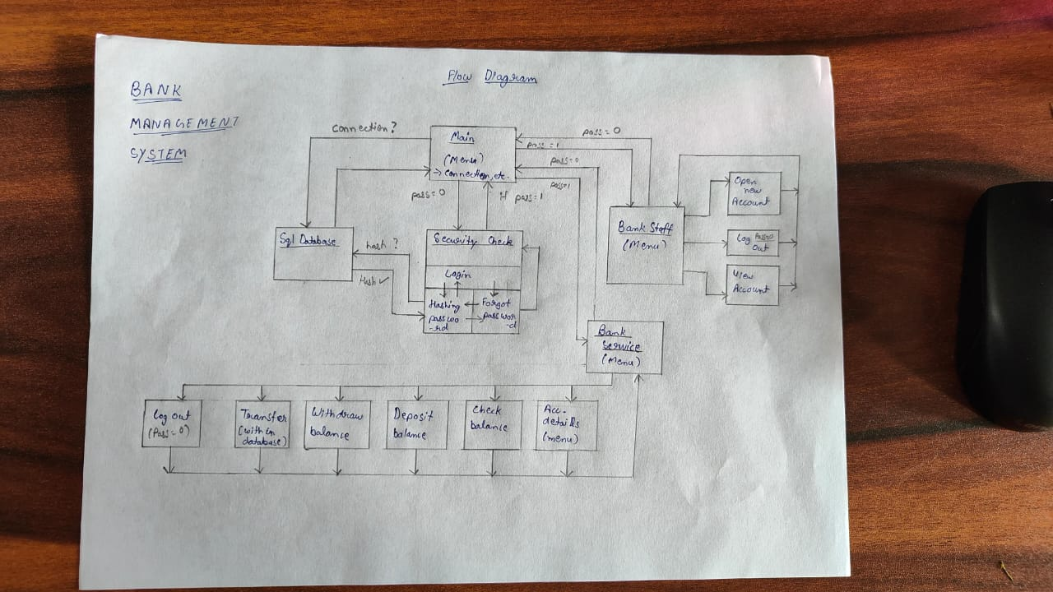
Bank Management System

Slide 8
Feasibility
Feasibility Analysis:
Technical Feasibility: Assessment of the technology stack (Java, SQL).
Economic Feasibility: Cost analysis and budget considerations.
Operational Feasibility: User acceptance and staff training.

Slide 9
Hardware / Software Requirement
Hardware Requirements:
Processor: Intel i3 or higher
RAM: 4 GB (8 GB recommended
Storage: 10 GB of free space
Display: 15-inch monitor or larger
Network Connectivity: Required for online features
Software Requirements:
Operating System: Windows 10/11, Linux, or macOS
Java Development Kit (JDK): JDK 8 or higher
SQL Database: MySQL or PostgreSQL
Java IDE: IntelliJ IDEA, Eclipse, VS code
Database Tools: MySQL Workbench
Version Control: Git (GitHub)
JDBC Driver: For Java-SQL connection

Slide 10
Results & Conclusion
Results:
Overview of system features implemented (account management, transaction processing).
Expected benefits (improved efficiency, better security).
Conclusion:
Summary of the project’s significance and future enhancements.

Slide 11
References
JAVA - https://www.oracle.com/in/java/technologies/downloads/#jdk23-windows
- https://www.w3schools.com/java/default.asp
MySQL - https://www.mysql.com/downloads/
- https://www.w3schools.com/mysql/default.asp
JDBC - https://dev.mysql.com/downloads/connector/j/
- https://www.geeksforgeeks.org/introduction-to-jdbc/
- https://docs.oracle.com/javase/tutorial/jdbc/basics/processingsqlstatements.html
YouTube – https://www.youtube.com/

Slide 12
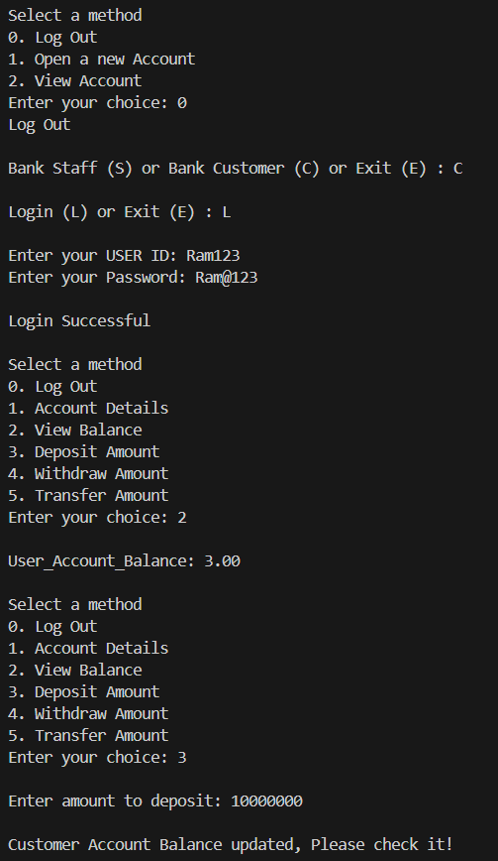
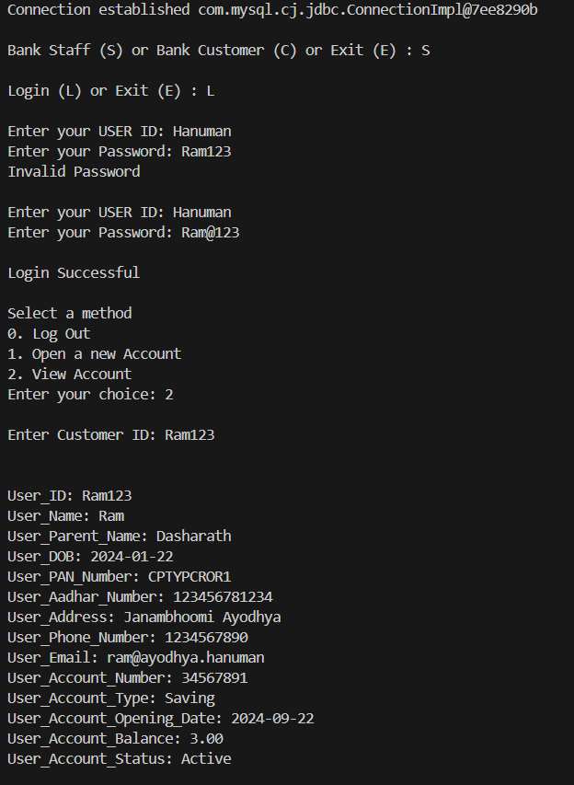
Snapshots

Slide 13
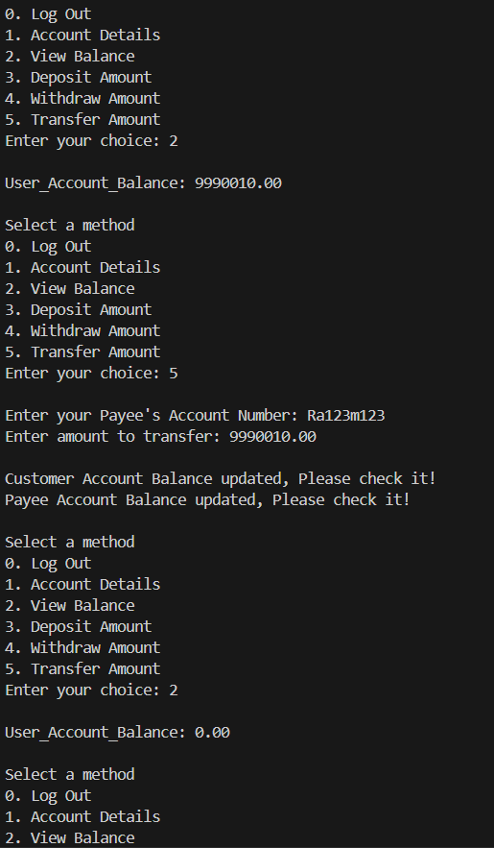
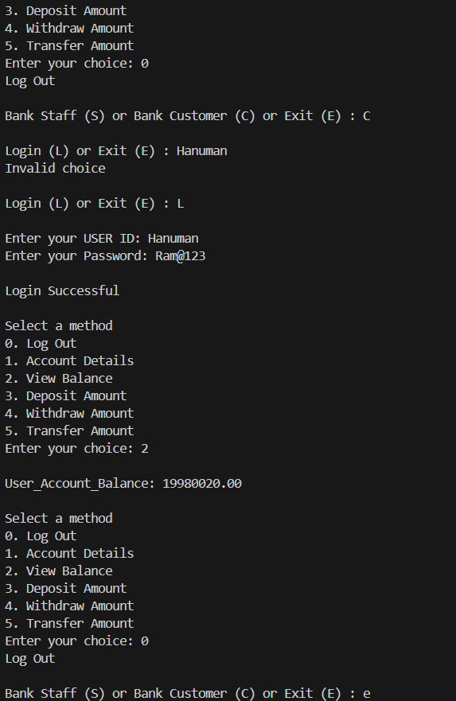
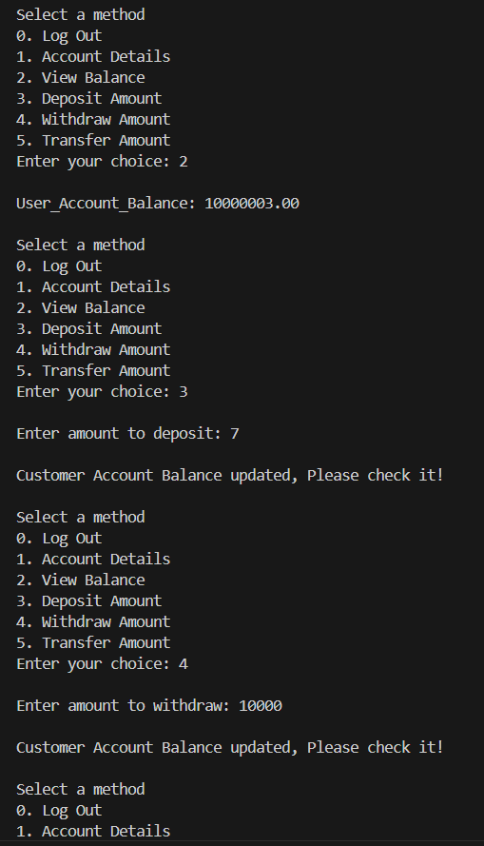
Snapshots

Slide 14
Thank You!

