Slide 1

Secured Online Bank Management System DBMS (BCSE0452)
Department of Computer Science and Engineering
CSE
(Submitted To: Mrs. NEETI TANEJA )
Student Name | Roll Number | Department & Section
DRISHAY CHAUHAN | 2301330100084 | B.Tech CSE-B

Slide 2

Index
Introduction
Literature Survey/Existing System
Problem Statement
Proposed Methodology
Flowcharts and Use Case/ER Diagrams
Feasibility Study
Hardware /Software Requirement
Results and Conclusion
Refrences
Live Demonstration of Project with screenshots in ppt
Notes:
Aaj

Slide 3
INTRODUCTION
Title: Secured Online Bank Management System
Overview:
A web-based banking system designed to ensure secure transactions and data management.
Integrates a Java-based backend with MySQL database and a modern React frontend.
Focuses on enhancing security, user authentication, and efficient transaction handling.
Key Objectives:
Improve system security using robust login, encryption, and access controls.
Provide a user-friendly interface for customers, bank employees, and managers.
Transition from a terminal-based system to a scalable web-based solution.

Slide 4
Literature Survey/Existing System
Existing Systems:
Traditional bank management systems often use legacy technologies (e.g., terminal-based interfaces, older Java or JSP frameworks).
Many legacy systems have security vulnerabilities, limited scalability, and poor user interfaces.
Literature Findings:
Research emphasizes the need for secure user authentication, data encryption, and robust security frameworks.
Studies show modern web interfaces (e.g., using React) can significantly improve user experience.
Comparative Analysis:
Legacy systems vs. modern web-based systems:
Legacy: Limited interactivity, higher maintenance, security risks.
Modern: Enhanced security, user-friendly, scalable architecture.

Slide 5
Problem Statement
Challenges in Existing Systems:
Insecure login processes and data transmission.
Outdated user interfaces that are not intuitive or mobile-friendly.
Difficulties in system maintenance and integration with new technologies.
Specific Issues:
Security: Vulnerability to unauthorized access and data breaches.
Scalability: Limited support for increased user load and transaction volume.
Usability: Terminal-based operations cause inefficiency and steep learning curves.
Aim of Our Project:
To develop a secure, efficient, and user-friendly online banking system that addresses these core issues.

Slide 6
Proposed Methodology
System Architecture:
Backend: Java Servlet-based backend with MySQL connectivity.
Frontend: React-based web interface providing a dynamic, responsive user experience.
Security: Incorporation of hashing for passwords, secure login via servlets, and potential use of HTTPS.
Development Phases:
Analysis: Review existing system flaws and determine security requirements.
Design: Create detailed flowcharts, ER diagrams, and use case diagrams.
Implementation: Code the backend logic and integrate with the frontend.
Testing: Conduct functional and security testing.
Deployment: Package as a WAR file and deploy on Apache Tomcat.
Technologies Used:
Java, MySQL, Apache Tomcat, React, HTML/CSS/JavaScript, JDBC.

Slide 7
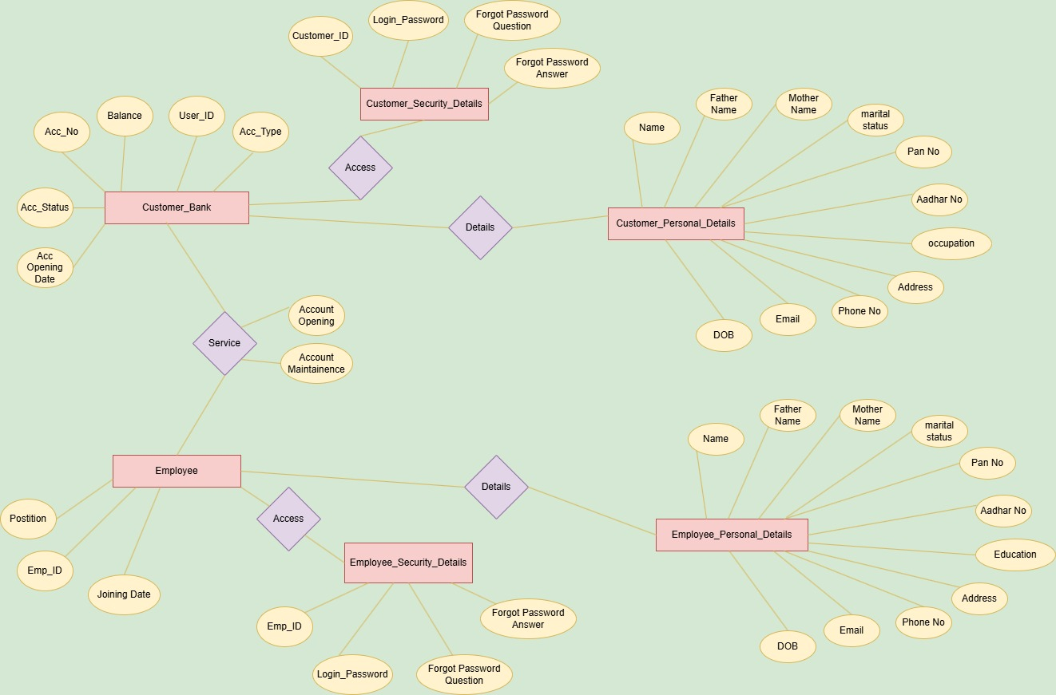
ER Diagram

Slide 8
Feasibility Study
Technical Feasibility:
Utilizes proven technologies: Java, MySQL, React, and Tomcat.
Easier integration with existing banking databases and security protocols.
Economic Feasibility:
Open-source and free tools/libraries reduce overall cost.
Scalability can lead to lower cost per transaction as user base grows.
Operational Feasibility:
User-friendly interfaces improve user acceptance.
Enhanced security reduces risk and cost associated with data breaches.
Schedule & Resource Feasibility:
Project is modular and can be developed in iterative phases.
Utilizes existing skills in Java and basic web development, speeding up development.

Slide 9
Hardware /Software Requirement
Hardware:
A standard personal computer/server for development.
Sufficient RAM (4–8GB minimum) and storage for database and deployment.
Software Requirements:
Backend:
Java JDK (JDK 22 in your case)
Apache Tomcat (for deploying the Java web application)
MySQL (database server)
Frontend:
Node.js and npm (for React development)
A modern web browser (Chrome, Firefox)
Development Tools:
VS Code or any Java IDE (Eclipse/IntelliJ)
Git for version control.

Slide 10
Results and Conclusion
Results:
Developed a secure online banking system featuring a robust authentication process.
Successful transition from a terminal-based interface to a modern web-based UI.
Enhanced user experience and improved system scalability.
Key Improvements:
Secure login using hashed passwords and servlet-based validation.
Intuitive React frontend providing a seamless user experience.
Modular design for easy maintenance and future enhancements.
Conclusion:
The project demonstrates a significant improvement over legacy systems.
It lays a strong foundation for future expansion, such as integrating more features (auto-trading, real-time notifications).
Overall, it meets the critical needs of modern banking systems while ensuring data security and ease of use.

Slide 11
References
Online Resources:
Apache Tomcat Documentation: https://tomcat.apache.org/
React Official Documentation: https://reactjs.org/
Oracle Java Tutorials: https://docs.oracle.com/en/java/
Other References:
MySQL Documentation: https://dev.mysql.com/doc/

Slide 12
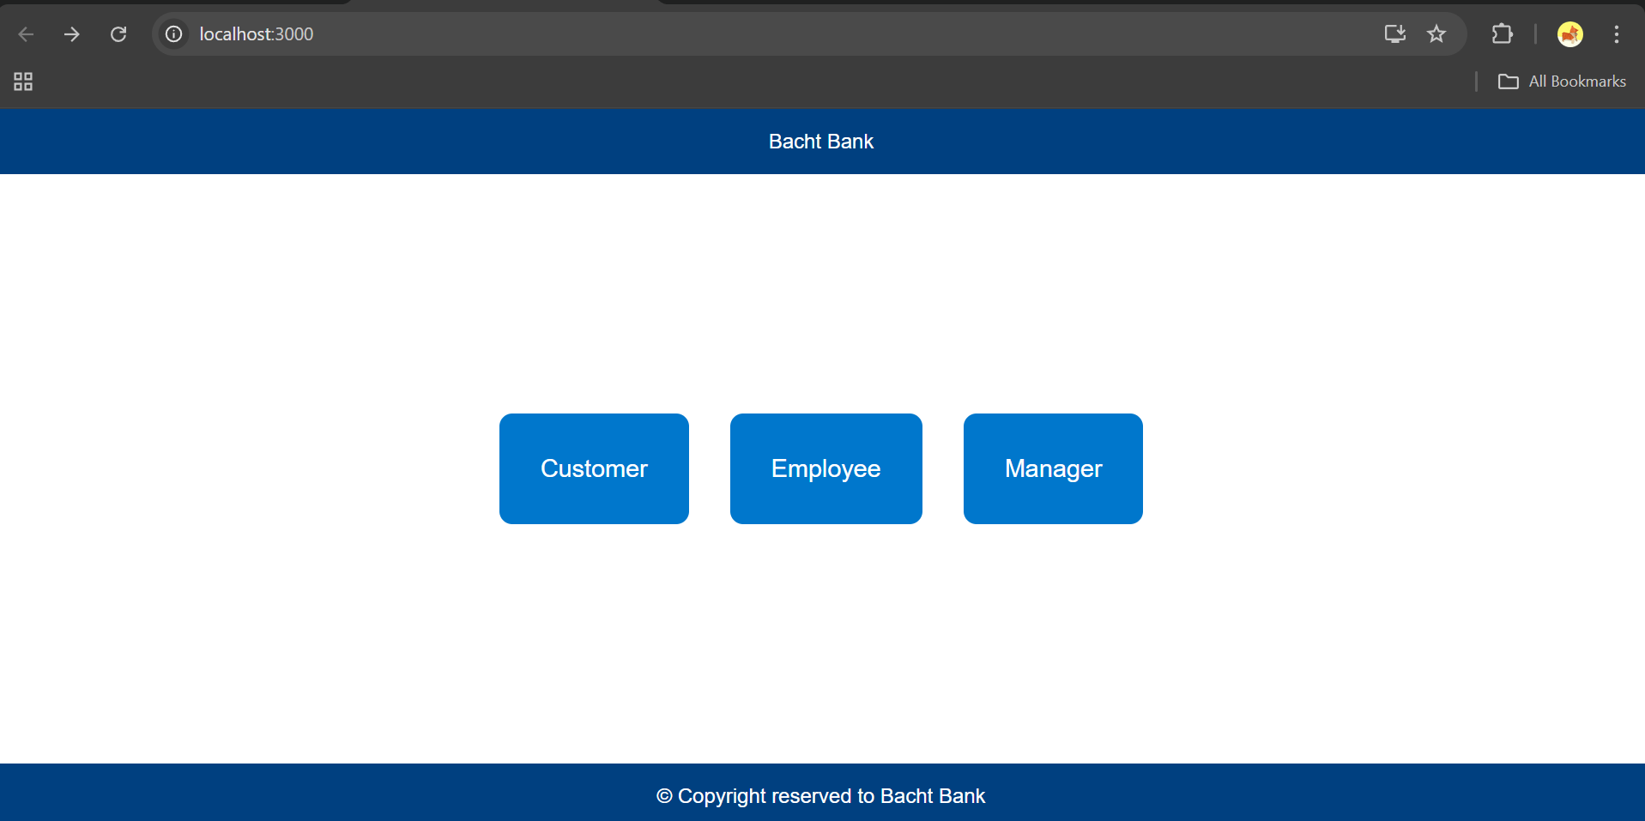
Live Demonstration of Project

Slide 13
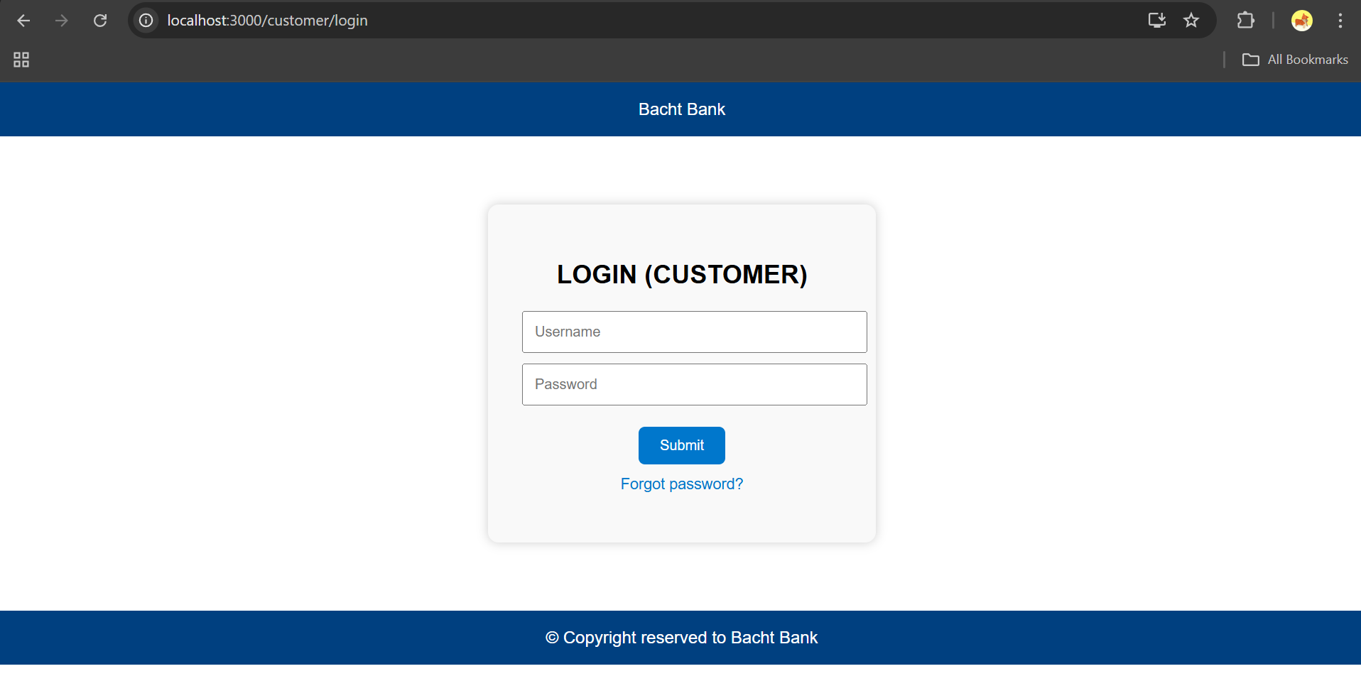

Slide 14
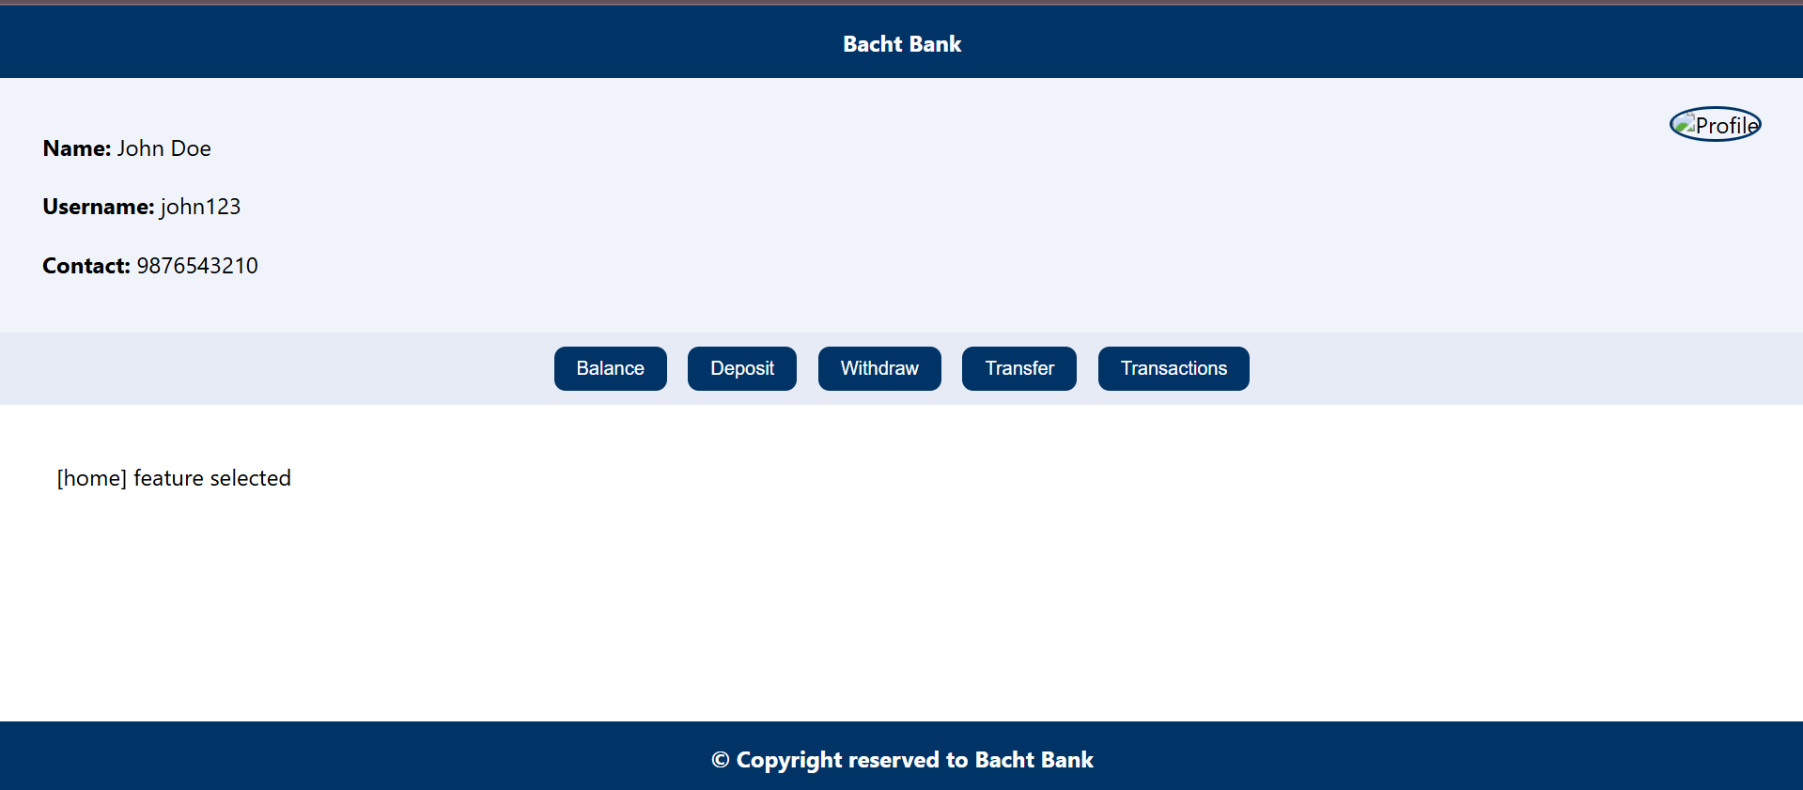

Slide 15
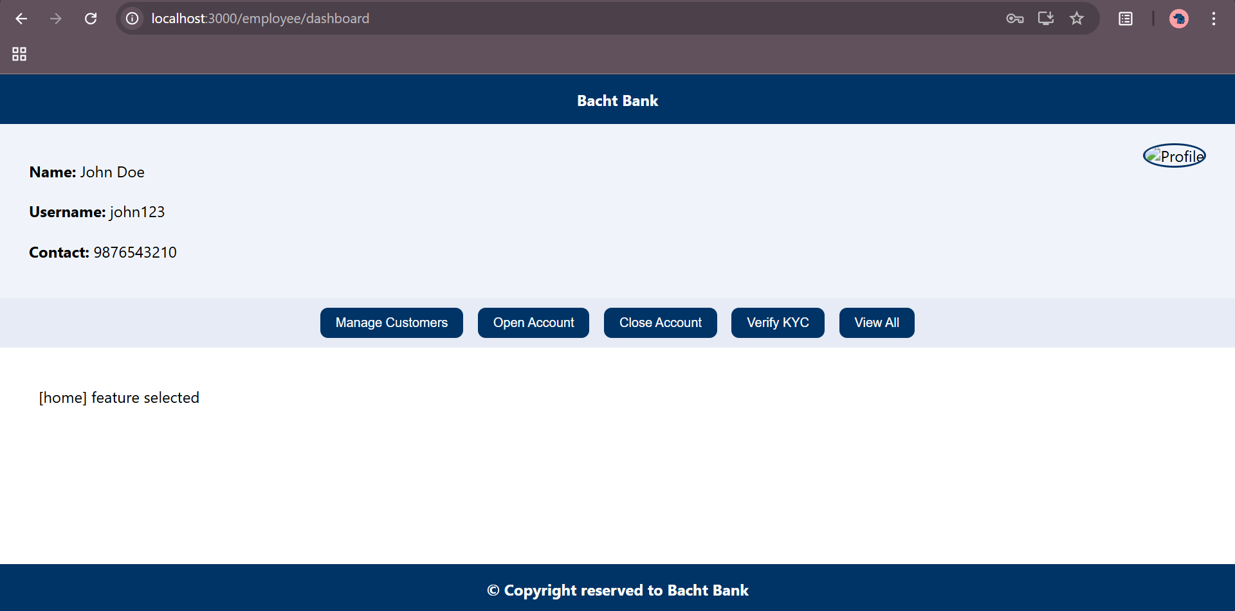

Slide 16
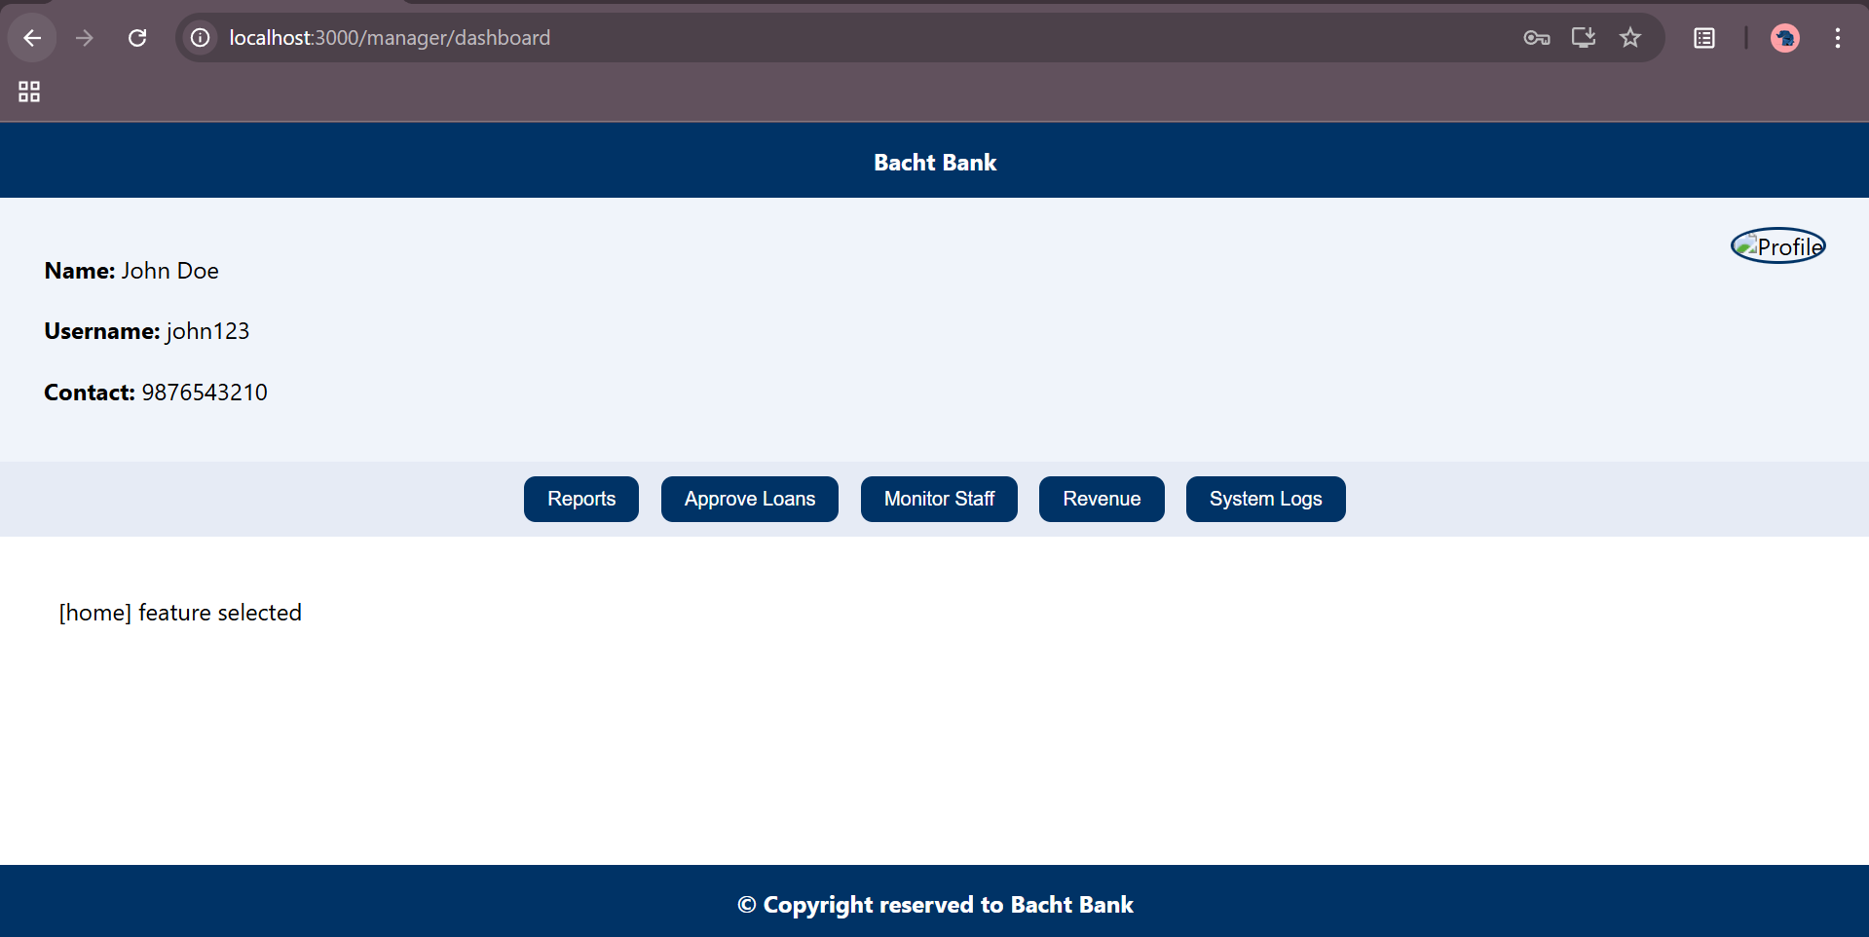

Slide 17
Thank You

