Slide 1
Named Entity Recognition (NER) Model Deployment
Advanced Model Optimisation & Deployment Plan

Slide 2
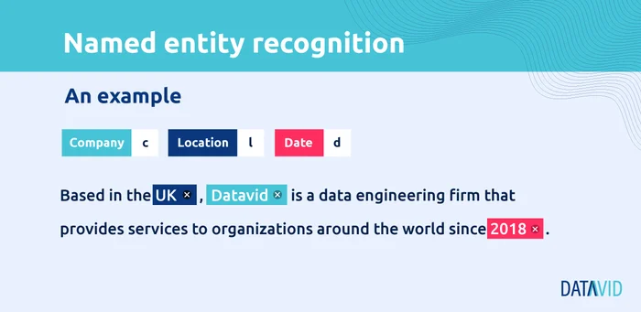
Context: Why Named Entity Recognition (NER)?
NER identifies entities like persons, locations, organisation’s etc. It is used in chatbots, search engines, finance, and healthcare and helps in enhancing business intelligence and decision making.

Slide 3
Significant Discoveries & Challenges
Below are some of the key discoveries made during the creation of the NER solution for the provided use case:
Baseline model performed well on common entities (PER, LOC, ORG) however it struggled with rare entities (ART, EVE, NAT) due to class imbalance.
Entities like "art", "eve", "nat" have low precision & recall (F1-score ~ 30-40%). The model struggles with underrepresented classes because it doesn’t see enough training examples.
Potential Solutions:
1. Oversampling rare entity sentences 2. Data augmentation (synonym replacement, back-translation, GPT-generated examples)
Required improvements in handling long sequences and OOV words.
New words (e.g., company names, product names, slang) are not in BERT’s training data.
Potential Solutions:
1. Use character-based embeddings (e.g., CharCNN, FastText) for better generalisation. 2. Use external knowledge sources (Wikipedia, DBpedia) for contextual learning.

Slide 4
Baseline model struggles with longer sequences
BERT has a maximum input length of 512 tokens and if a sentence is long, it gets truncated, leading to incomplete context.
Potential Solution:
1. Split long documents into overlapping chunks before feeding into BERT.
Confusion between similar entities
The model sometimes misclassifies "GPE" as "LOC" (e.g., "California" vs. “USA"). "PER" vs. "ORG" confusion (e.g., "Tesla" as a person instead of an organisation).
Potential Solutions:
1. Train a secondary classifier to refine labels after BERT predicts them.

Slide 5
Improvements in the New Model
Below are some of the potential improvements that can be made to the baseline model for better results:
Use RoBERTa/DeBERTa for better contextual understanding.
Use a more powerful model can counter this limitation as RoBERTa handles context better by removing Next Sentence Prediction (NSP) and DeBERTa improves contextual embeddings for low-resource entities.
Augment data to improve rare entity detection.
Use data augmentation techniques(GPT based paraphrasing, synonym replacement) for oversampling sentences containing rare entities
Add confidence scores to reduce misclassification.
Use data Modify loss function to return confidence probabilities and mark low-confidence predictions as "UNKNOWN"

Slide 6
Deployment Plan for the NER Model
Model Hosting
Deploy the trained NER model as a FastAPI service, exposing an API for real-time predictions.
Canary Deployment
Gradually roll out a new model version (v2) alongside the old version (v1) to a small percentage of users before full deployment.
CI/CD Pipeline
Automate model training, testing, and deployment using GitHub Actions, Docker, and Kubernetes, ensuring seamless updates.
CI Monitoring & Logging
Continuously track model performance, latency, and data drift to detect issues early.
Scaling
Automatically scale the model inference service based on traffic using Kafka and load balancers for efficient resource management.

Slide 7
Future Scope for Optimisation
Implement active learning for continuous improvement
Continuously improve model performance by retraining on uncertain predictions flagged by confidence scores.
Experiment with multilingual NER for global applications
Extend the model to support multiple languages using XLM-RoBERTa or mBERT for broader applicability.
Optimise real-time inference using edge AI deployment
Deploy the NER model on edge devices (e.g., Jetson Nano, TensorRT) for low-latency, on-device processing without cloud dependency.CI Monitoring & Logging
Improve explainability with SHAP/LIME analysis
Use SHAP (SHapley Additive Explanations) or LIME to interpret why the model predicts certain entities, improving trust and debugging.

