Slide 1

Movie Ticket Booking System in C
Data Structures Mini Project
A console-based cinema booking system built in C, demonstrating practical applications of structures, arrays, queues, linear search, bubble sort, functions, loops, and conditional statements.
Team Members
Miraya Ballav(1262251072)
Drishti Parashar(1262250911)
Saksham Jain(1262250842)
Aayush Manjrekar(1262251824)

Slide 2
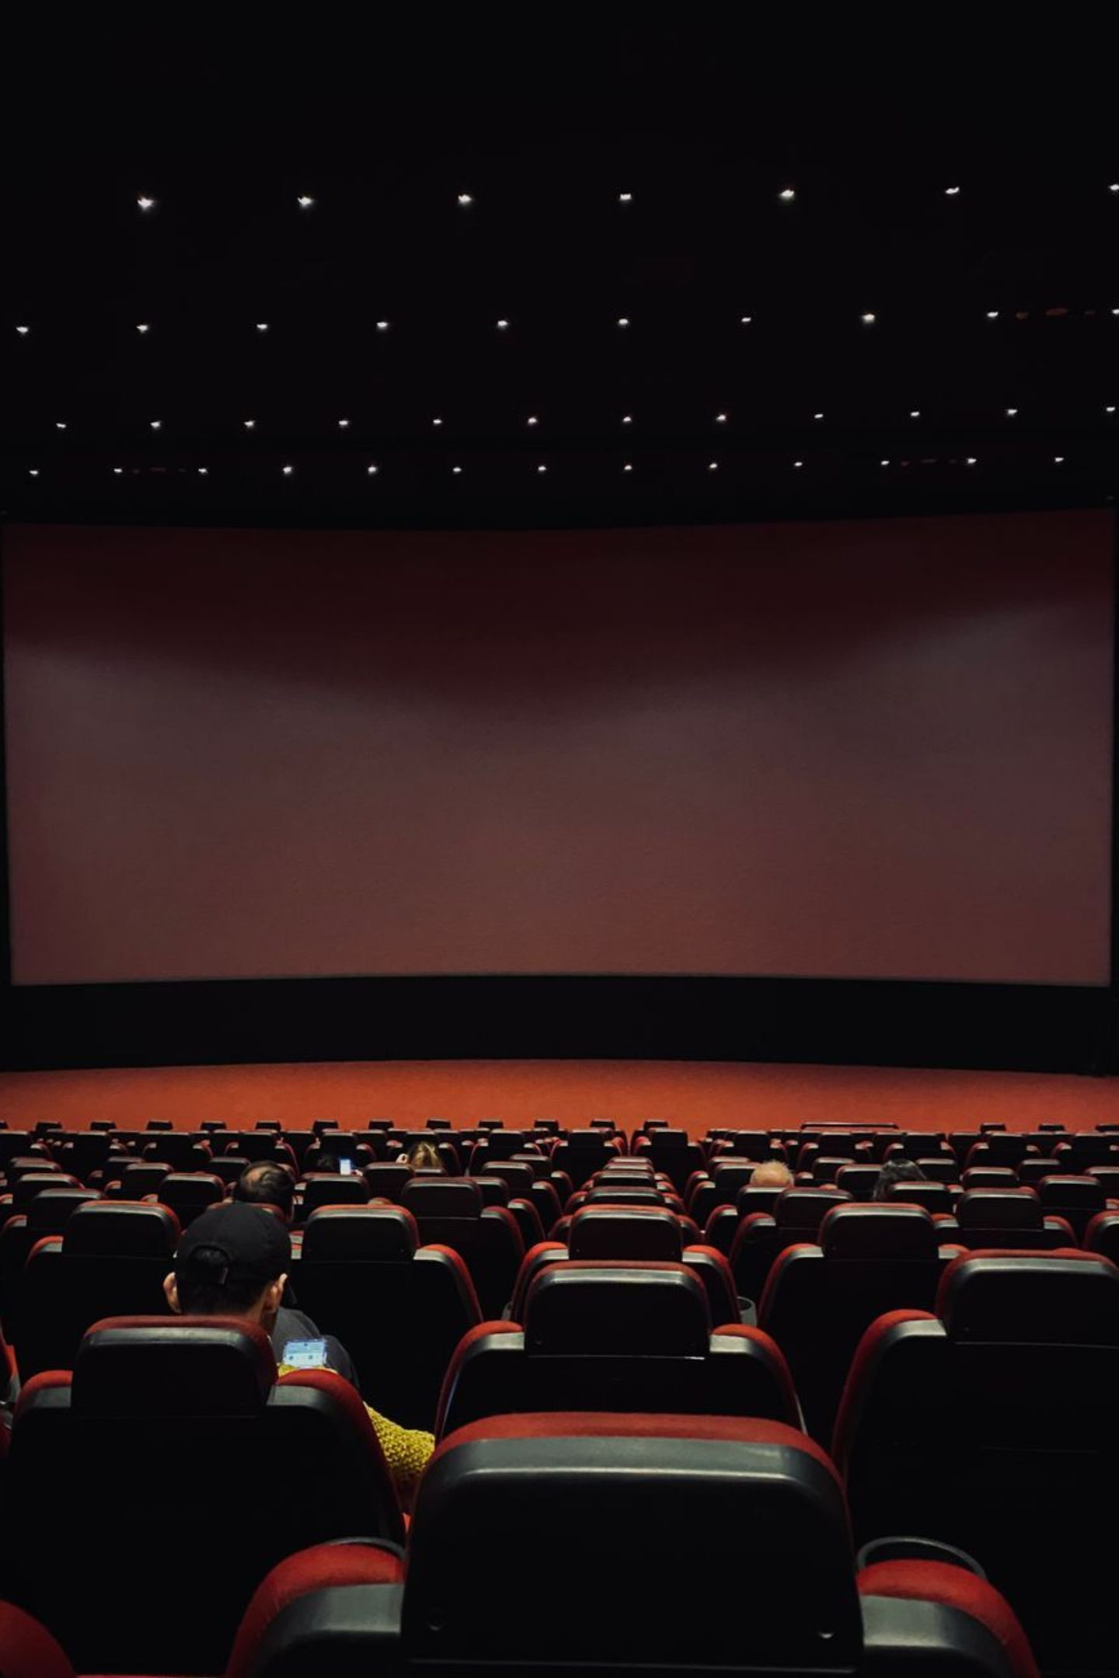
Project Overview
The Movie Ticket Booking System simulates a small cinema where users interact through a console menu. The system manages 30 predefined movies, handles seat availability, and maintains a waiting queue when shows are sold out.
View & Search
Sort & Book
Display all movies, view details, and search by Movie ID using linear search.
Sort movies by ticket price using bubble sort and book available seats.
Cancel & Queue
Cancel tickets using Booking ID. When a show is sold out, customers can join a FIFO waiting queue, and when a seat becomes available through cancellation, the waiting customer is automatically assigned the seat.

Slide 3
Data Structures & Algorithms Used
This project integrates eight core C programming and DSA concepts. Each concept maps directly to a functional requirement of the booking system.
DSA / C Concept | Application in This Project
Structure | Stores Movie, Customer and Booking Information
Array | Stores 30 movie records and the array-based waiting queue
Queue | Handles customers waiting for sold-out shows (FIFO)
Linear Search | Finds a movie record by matching Movie ID
Bubble Sort | Sorts all movies by ticket price in ascending order
Functions | Divides the program into logical, reusable modules
Loops | Drives menu operations, searching, sorting, and queue processing
If-Else | Controls seat availability checks and input validation

Slide 4
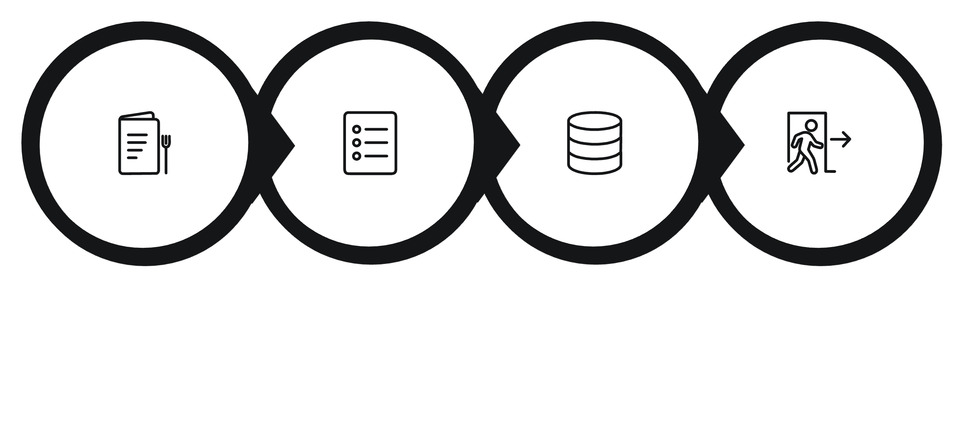
System Workflow
The program runs a continuous menu loop. Users select an operation, the system updates movie or queue data, and control returns to the menu until Exit is chosen.
Select Operation
Update Data
Return or Exit
Start Menu
The booking decision path: when a user selects a movie, the system checks seat availability. If seats are available, the booking proceeds and the seat count decreases. If the show is full, the customer is added to the waiting queue instead.

Slide 5
Movie Data Structure
struct Movie — C Definition
Field Descriptions
id — Unique Movie ID for lookup
name — Movie title
genre — Category (Action, Sci-Fi, etc.)
language — Audio language
time — Show timing
seats — Available seat count
price — Ticket price in rupees
struct Movie
{
int id;
char name[50];
char genre[20];
char language[20];
char time[15];
int seats;
float price;
};
Sample Movie Records (30 Predefined)
ID | Movie | Genre | Language | Time | Seats | Price
101 | Avengers Endgame | Action | English | 10:00 AM | 120 | ₹250
104 | Interstellar | Sci-Fi | English | 2:30 PM | 45 | ₹300
108 | Inception | Sci-Fi | English | 8:00 PM | 35 | ₹280
118 | Avatar | Sci-Fi | English | 9:00 PM | 30 | ₹350

Slide 6
Ticket Booking & Cancellation
Booking Flow Cancellation Flow
Enter Customer Name
↓
Enter Movie ID
↓
Linear Search
↓
Movie Found?
↓
Check Seats
/ \
Seats > 0 Seats = 0
↓ ↓
Book Ticket Ask to join
↓ Queue
Seats--
Enter Booking ID
↓
Search booking
↓
Booking found?
↓
Cancel booking
↓
Seat++
↓
Check waiting queue
↓
Assign seat to waiting customer

Slide 7
Waiting Queue — FIFO
When a movie has no available seats, the customer joins a waiting queue. When a seat is freed via cancellation, the customer at the front is assigned the seat automatically.
Front: Rahul → Priya → Aman → Rear: Riya
struct Customer
Queue Operations
Enqueue — Add customer at rear
Dequeue — Remove from front
front — Index of first customer
rear — Index of last customer
Max capacity: 50 customers
Storage: Array-based implementation
struct Customer
{
char name[50];
int movieID;
};

Slide 8
Searching & Sorting
1. Linear Search — O(n)
2. Bubble Sort — O(n²)
Finds a movie by scanning records sequentially until the matching Movie ID is located.
Sorts movies by ticket price in ascending order by comparing and swapping adjacent pairs.
for (i = 0; i < MAX_MOVIES; i++)
{
if (movies[i].id == id)
return i;
}
for (i = 0; i < MAX_MOVIES-1; i++)
for (j = 0; j < MAX_MOVIES-i-1; j++)
if (movies[j].price > movies[j+1].price)
{
temp = movies[j];
movies[j] = movies[j+1];
movies[j+1] = temp;
}
Worst-case: O(n) — all 30 records checked.
Time Complexity: O(n²)
Bubble Sort — Pass-by-Pass Example
Initial: ₹250 ₹180 ₹300 ₹150
Pass 1: ₹180 ₹250 ₹150 ₹300 (swap adjacent if left > right)
Pass 2: ₹180 ₹150 ₹250 ₹300
Pass 3: ₹150 ₹180 ₹250 ₹300 ← Sorted

Slide 9
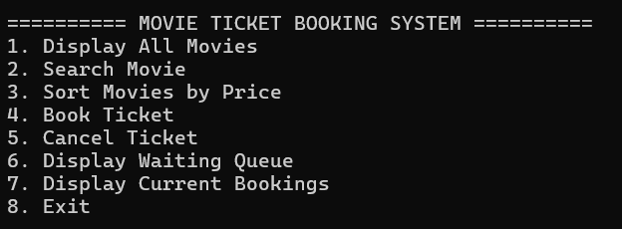
Program Structure & Main Menu
Console Menu
Module Breakdown from main()
displayMovies() — Lists all 30 records
searchMovie() — Linear search by ID
sortMovies() — Bubble sort by price
bookTicket() — Seat check and booking
cancelTicket() — Free seat, process queue
displayQueue() — Print queue contents
displayBookings() – lists all the bookings
================================
MOVIE TICKET BOOKING SYSTEM
================================
1. Display All Movies
2. Search Movie
3. Sort Movies by Price
4. Book Ticket
5. Cancel Ticket
6. Add Customer to Waiting Queue
7. Display Waiting Queue
8. Process Waiting Queue
9. Exit
================================
Language
Movies
Queue Capacity
C
30 predefined
50 customers
Search
Sort
Linear — O(n)
Bubble — O(n²)

Slide 10

Conclusion & Future Scope
What We Achieved
Structures organizing movie and customer data
Arrays storing 30 movie records and queue
FIFO queue for waiting customers
Linear Search for Movie ID lookup
Bubble Sort for price-based sorting
Modular functions and dynamic seat management
Future Enhancements
Booking Features
Data Persistence
System Features
Unique booking IDs, multi-ticket booking, seat-number selection, booking receipts
File handling for permanent storage, customer booking history
Admin login, movie add/delete, circular queue, online payment simulation

