Slide 1
CUSTOMER SERVICE ANALYTICS
Executive Briefing
Where We Are Losing Customers — and Money
16.3%
52%
2.68M
of all orders generate
a CS contact
of contacted orders
call back a second time
real CS contacts
over 12 months
Analysis period: May 2024 – April 2025 · 6.3M orders analysed
1 / 5

Slide 2
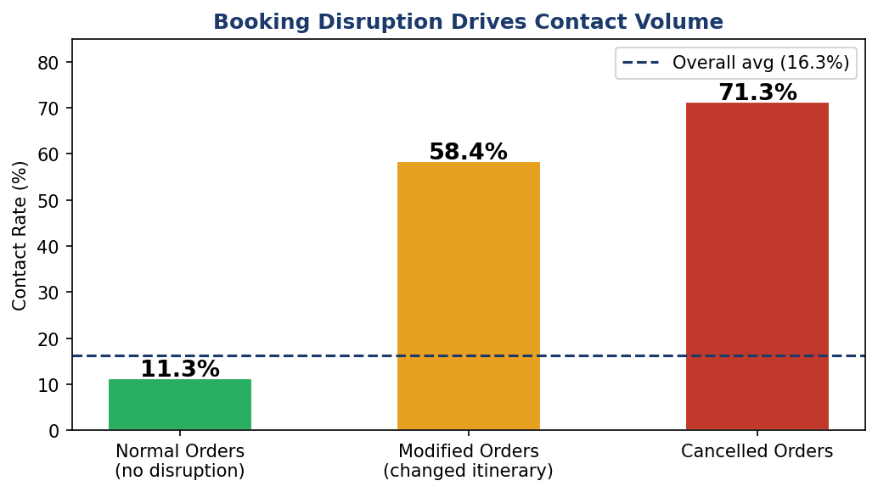
The Root Cause
One finding explains most of the contact volume
Booking disruption — not poor service design — is the primary driver
14.1%
Normal orders
contact rate
59.8%
Modified orders
contact rate
71.3%
Cancelled orders
contact rate
Statistical significance: chi-square p < 0.001 across all four tested factors (cancellation, modification, customer group, order value). Effect size is large — cancelled orders are 5× more likely to contact CS than normal orders.
2 / 5

Slide 3
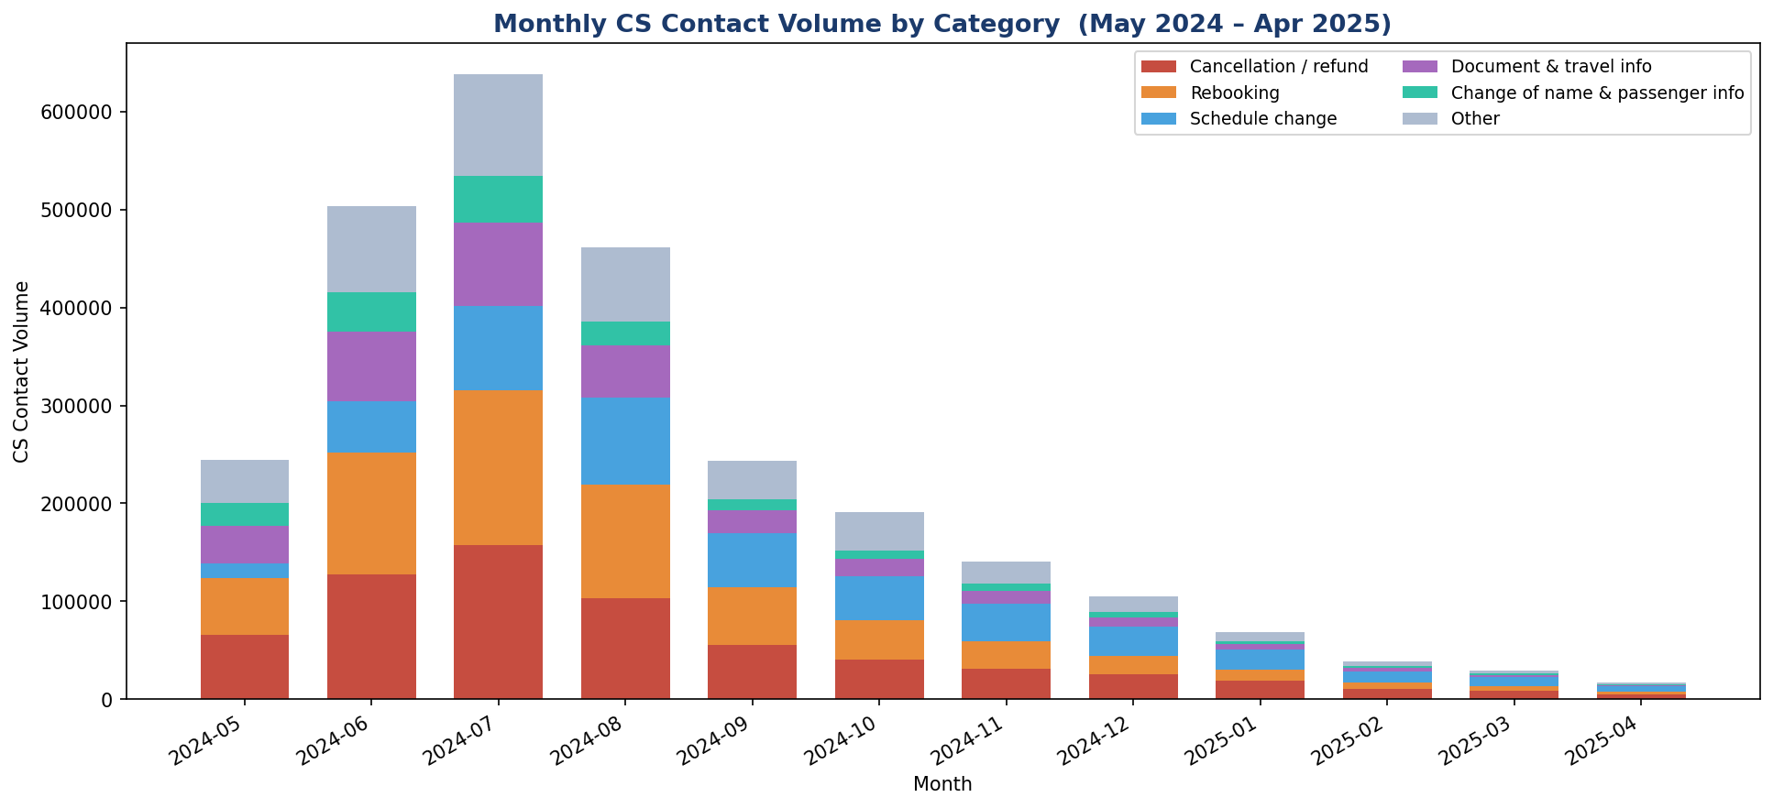
The Opportunity
What a 20% reduction in avoidable contacts would mean
Gap to Close
Phone deflection to chat
31.7% of contacts via phone.
Shifting 10 pts to chat ≈ 268K fewer costly calls/yr.
Reduce repeat contacts
52% of contacted orders call back.
Schedule-change contacts repeat at 70%.
Proactive disruption comms
Cancelled/changed orders are 4–5× more
likely to contact — target with automated updates.
3 / 5

Slide 4
The Recommendation
One concrete action, one owner, one quarter
Launch a Proactive Disruption Notification Programme
Automatically trigger a personalised email/SMS to any customer whose booking is cancelled or significantly changed — within 2 hours of the event — with self-service rebooking and refund options. Target: reduce disrupted-order contact rate from 65% → 45%.
① Owner
② Timeline
③ Investment
④ Success Metric
VP Customer Service
+ CRM/Tech lead
Q3 pilot (6 weeks)
Q4 full rollout
CRM config + comms
template build (est. low)
Contact rate on disrupted
orders ≤ 45% by end-Q4
Secondary lever: Route schedule-change contacts to a dedicated fast-track team. These contacts repeat at 70% — the single highest repeat driver in the dataset. First-contact resolution for this category could unlock the largest single reduction in total contact volume.
4 / 5

Slide 5
The Risk
What we are most uncertain about — and why it matters
Cost data is absent
HIGH
We have no per-contact cost (phone vs chat vs mail). Our opportunity sizing assumes phone costs 3–5× chat — a defensible industry benchmark, but unverified here. If cost differential is smaller, the financial case shrinks. Recommend: pull call centre cost-per-minute from finance in Week 1.
Currency heterogeneity
MED
Order_Amount spans AUD, BRL, EUR, USD and 10+ others. No FX normalisation was applied in this analysis. High-value order insights may reflect exchange-rate effects rather than true booking value. A single-currency revenue view (e.g. EUR) would sharpen all financial conclusions.
Model predicts at booking-time — but most contacts are late
MED
The contact prediction model achieves AUC 0.61, limited because 77% of first contacts happen more than 24 hours after booking. Disruption events (schedule changes, weather) occur post-booking and are not yet knowable. The model is best used for channel routing, not volume forecasting.
One significant data anomaly was found
LOW
204,404 records (7.1% of raw errands) were flagged is_test_errand=1 and excluded. These represent operational testing contacts, not real customers. All contact rate figures in this analysis use the cleaned 2.68M real errand dataset only.
5 / 5

