Slide 1


Final Project Report: Exploring MIMIC-III for Collaborative Disease Insights
Drishti Sharma, 20353192 Jing Tao, 20311294
Jasmine Mishra, 20155909 Veronika Grigoreva, 20311294
Notes:
Hello everyone,
We are here to present our project report for the course CISC 839 Topics in Information Sytem. Our project is tiles - Exploring MIMIC 3 for Collaborative Disease insights.

Slide 2

Impact of Misdiagnosed Diseases
In healthcare, accurate medical diagnoses are crucial for effective treatment and patient care.
Annually, around 12 million individuals worldwide are impacted by medical misdiagnosis.
Diagnostic errors made by physicians during the complex process of deciphering patient conditions can lead to exacerbated illness and, tragically, fatalities.
Diagnostic inaccuracies extend beyond individual health, imposing significant financial burdens on patients, insurers, and healthcare systems.
Notes:
Diagnostic errors, occasionally made by physicians during the process of determining a patient's condition, can have severe consequences. These errors may exacerbate the patient's illness or, in more tragic instances, result in fatalities. Beyond the detrimental impact on individual health, such errors impose significant financial burdens on patients, their insurance providers, and governmental healthcare systems. Furthermore, they can tarnish the reputation and career prospects of the healthcare provider involved, particularly in cases where incorrect medications are prescribed or incorrect diagnoses are made.

Slide 3

Data Mining for Accurate Disease Categorization
Innovative approaches are imperative to mitigate diagnostic errors
Data mining methodologies to exploring historical patient data and refining the diagnostic process.
The project aims to comprehensively explore past patient data to uncover patterns and associations, with a focus on improving diagnostic accuracy.
Different models utilized for disease prediction based on symptoms extracted from doctor's notes.
Notes:
Data mining plays a crucial role in disease prediction by using innovative approaches to reduce diagnostic errors and improve medical diagnoses. Modern data mining methodologies enable the exploration of extensive historical patient records, extracting valuable insights, and enhancing the diagnostic process. By analyzing large datasets with sophisticated algorithms, data mining identifies patterns, trends, and correlations that may not be apparent through traditional methods. These insights help healthcare professionals to make more accurate and timely diagnoses, ultimately improving patient outcomes and reducing the prevalence of diagnostic errors.

Slide 4

Problem Description
Misdiagnosis can cause:
Extra costs
Patient harm
Insurance penalties
Doctor’s career setbacks
Misuse of medicine
Addressing diagnosis with data can lead to a more informed diagnosis process
https://www.micoope.com.gt/?o=misdiagnosed-addressing-mental-illness-when-you-don-t-know-nn-xaR3N0H5
Notes:
In our project, we are dedicated to use data mining methodologies to delve into past patient records comprehensively, uncovering important insights to enhance the diagnostic procedure. Through meticulous examination of disease symptoms, our methodology seeks to precisely anticipate type of disease afflicting a patient.
In this project, we're using the MIMIC-III medical dataset, which contains information about patients and the notes doctors wrote during their assessments. Our goal is to analyze these notes to identify the diseases or health issues patients might have. This analysis could provide valuable insights into the patients' health status and help in their medical treatment and care. Through in-depth analysis of the MIMIC-III database, we have carefully screened and integrated data related to the top 10 most frequently occurring diseases.
Initially, we were targeting four overarching categories: Respiratory, Cardiovascular, Mental Health, and Others to categorise our symptoms but for our final project, we decided to go a step further and classify not only in 4 categories but predict the actual disease based on symptoms.
Expanding disease categorization beyond just four categories to include a wider range of specific diseases enhances disease prediction by providing a finer level of granularity, precision, and flexibility in the analysis. By accommodating the diversity of health conditions beyond the four disease categories that we initially decided to work upon, the model can better adapt to the complexities of clinical data and offer comprehensive coverage of diseases present in the dataset.

Slide 5
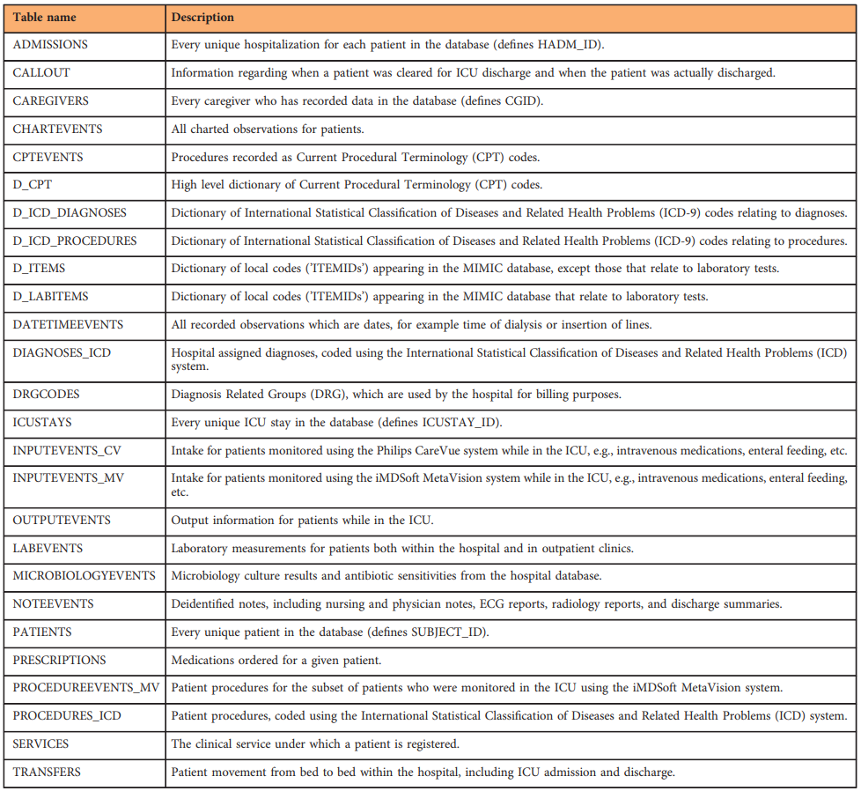
Data Introduction - MIMIC iii
Description:
A Collaborative dataset created between MIT and Beth Israel Deaconess Medical Center
Types of data included: vital signs, lab test results, medical procedures, drug information, nursing records, diagnostic information, etc.
Used tables:
NOTEEVENTS
D_ICD_DIAGNOSES
DIAGNOSES_ICD
Notes:
The MIMIC-III database, is a publicly available database developed by the Computational Physiology Laboratory at the Massachusetts Institute of Technology (MIT) in collaboration with Beth Israel Deaconess Medical Center. It collects hospital admission records for over 40,000 intensive care patients.
This database contains a wealth of medical information such as patient vital signs, lab test results, medical procedures performed, medications administered, caregiver records, and diagnostic information. The breadth and depth of this data makes MIMIC-III an invaluable resource for medical research, especially in the areas of artificial intelligence and machine learning as applied to healthcare.
In our project, we delve into three pivotal tables within the MIMIC-III database: NOTEEVENTS which provides unfiltered insights into the patient's condition as recorded by healthcare professionals, DIAGNOSES_ICD, and D_ICD_DIAGNOSES which helped us to uncover the disease codes associated with each patient's diagnosis. The ICD codes, derived from the International Classification of Diseases, serve as a universal language for disease diagnosis, allowing for consistent and accurate categorization of patient conditions. This standardized approach is vital for our subsequent research endeavors, enabling us to correlate specific symptoms with corresponding diagnoses, thereby enhancing the precision of disease identification and analysis.
By extracting keyword symptoms and disease codes from its comprehensive dataset, MIMIC 3 helped us pave the way for innovative healthcare solutions that promise to enhance the quality and effectiveness of patient care. Each of these tables serves a unique purpose in our research, enabling us to extract vital information for further analysis.

Slide 6
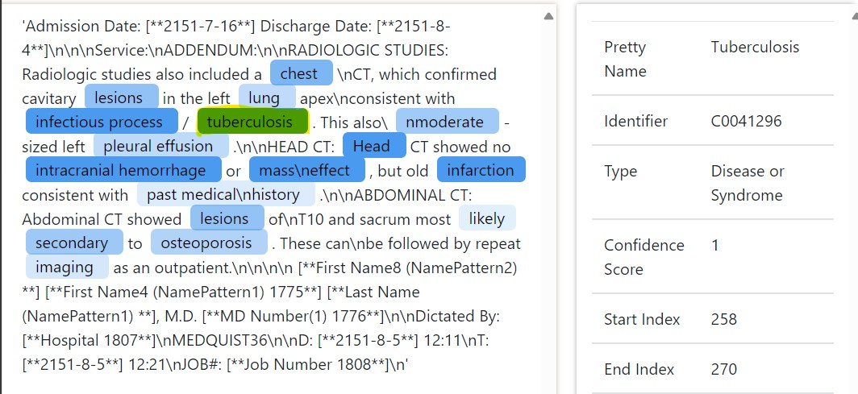
Medical Extraction Tool - MedCAT
NLP tool, extracts medical concepts and terms from medical texts, matches entities to pre-existing ontologies
We paid particular attention to the following attributes:
Symptoms or signs (Sign or Symptom)
Disease or Syndrome
Pathologic Function (Pathologic Function)
Body Part, Organ, or Organ Component (Body Part, Organ, or Organ Component)
Craniocerebral Injury (CRANIOCEREBRAL INJ)
Notes:
In this project, we used an advanced natural language processing tool, MedCAT, to extract key symptom keywords from medical texts.MedCAT is an advanced tool that combines deep learning techniques and natural language processing technologies to accurately understand and analyze a wide range of textual materials, including medical records, research reports, clinical trial notes, and more. At the heart of this technology lies its deep understanding of medical domain knowledge, which enables it to recognize a wide range of medical entities, such as disease names, symptoms, drugs, etc., and match these entities with existing medical lexicons or ontologies, such as the Unified Medical Language System (UMLS).
With MedCAT, we are able to efficiently perform the extraction of key symptoms.
For example, when we focus on identifying a specific symptom or disease, MedCAT is able to identify relevant terms in the text through its deep learning algorithms and match them with medical ontologies such as UMLS, thus ensuring the accuracy and reliability of information extraction.
MedCAT can not only efficiently extract key symptoms from complex medical texts, but also deepen our understanding of the diagnosis and treatment process of diseases, thus advancing the development of the healthcare industry!

Slide 7
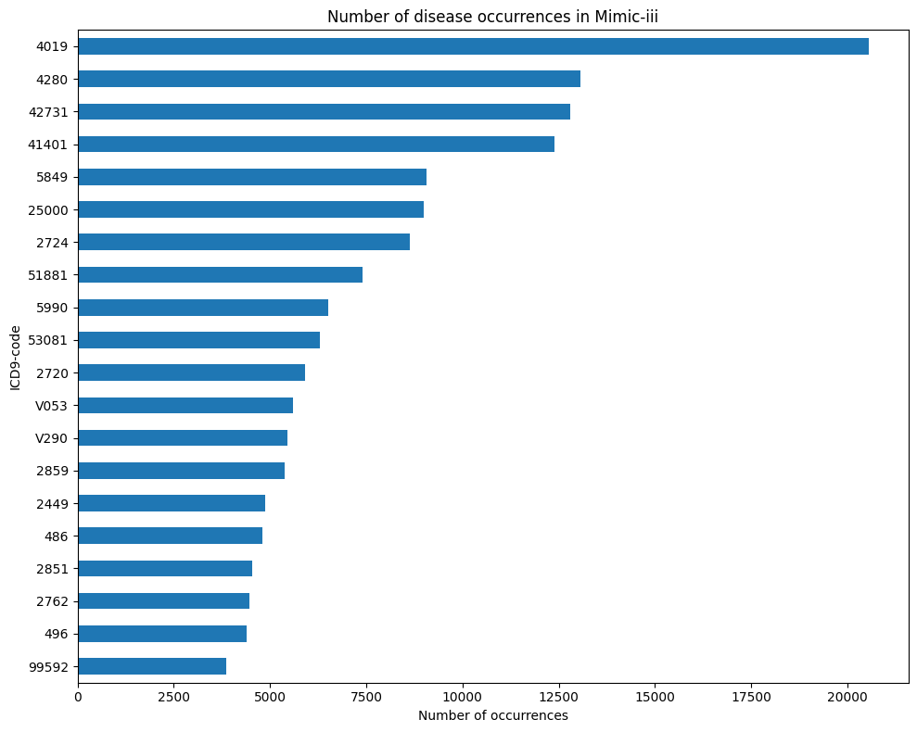
Data Exploration
Cleaned the dataset: Removed any irrelevant or redundant information.
Handled missing values: Used Removal method for dealing with missing values.
Multi-classification model using the recorded data of these 20 diagnosed diseases
Notes:
Using the aforementioned tools we extracted the medical terms refined the raw data into 58,361
structured records
After that, we performed an in-depth data cleaning.
We removed missing values to ensure the accuracy and reliability of the analysis.
We successfully identified the 20 diagnostic diseases with the high-
est frequency of occurrence. These 20 diseases reflect the most common medical problems in the dataset and
provide a clear direction for our subsequent analysis

Slide 8
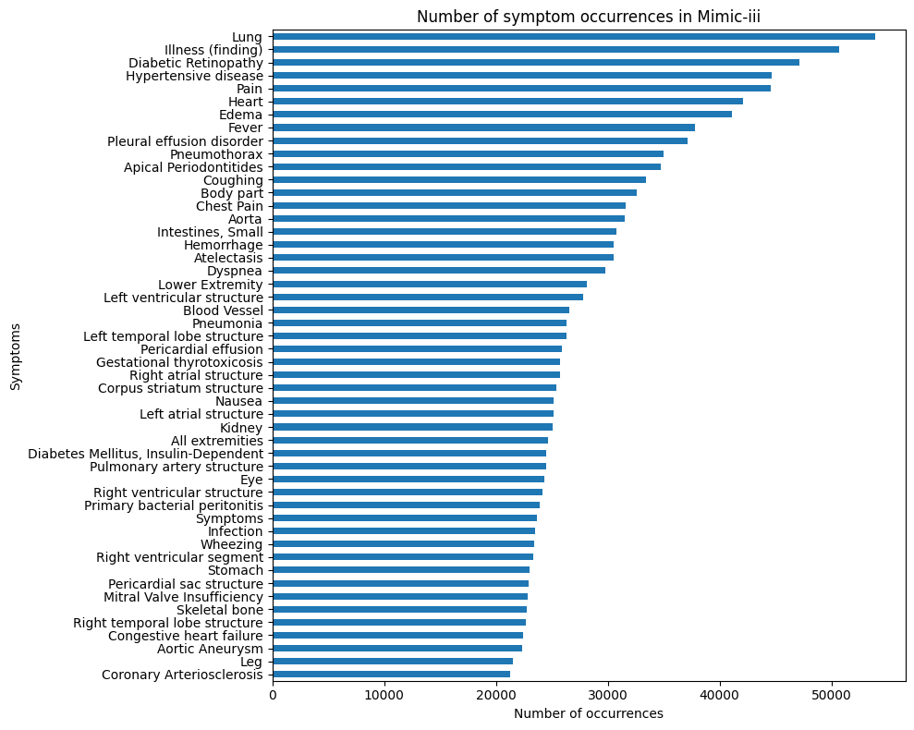
Feature Report
Performed an exhaustive statistical analysis of the diagnosis codes and their corresponding disease keyword occurrence
Feature selection: Selected relevant features (symptoms) for classification.
Notes:
Then, we narrowed down the records to the top 10 disease of the data. We found the diseases with the highest frequency in the data for this so that we can prioritize during data extraction.

Slide 9
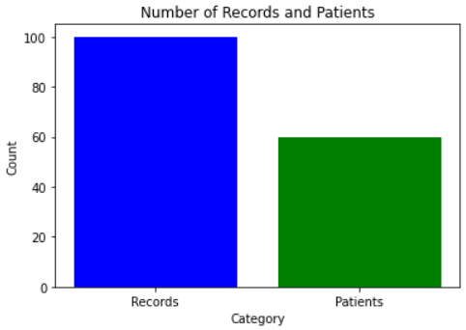
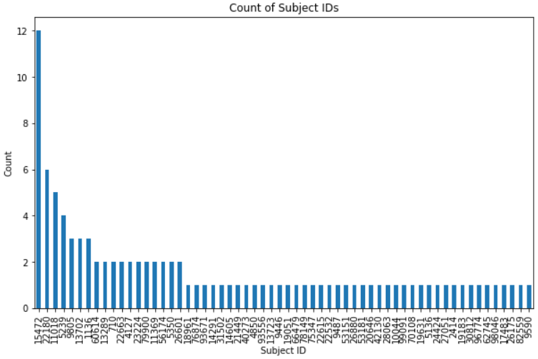
Preprocessing
EMR notes to the set of diseases with MedCAT
Extracted Keywords
Records of the top 10 disease labeling data
Notes:
The first step of pre-processing was mapping the set of EMR notes to the set of diseases the patient has using MedCAT. First we identified which notes would be relevant to diagnosing diseases.
We extracted various keywords such as symptoms, organs, etc.
Then, we narrowed down the records to the top 10 disease of the data.
We also found that we had more than one note per patient in many instances and that there were multiple diseases with mutliple notes, which we can see in these two charts.

Slide 10
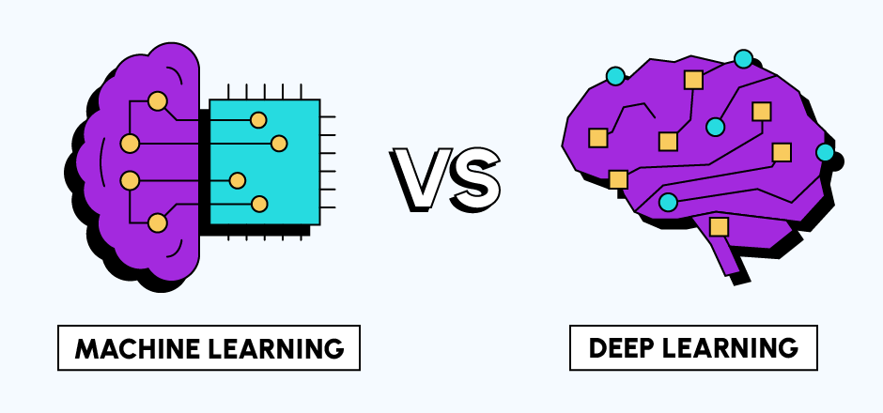

Challenges
Large amount of unstructured medical record text and EMR data
MIMIC-III records may have multiple diseases, requiring multi-label classification.
Variability and specificity of EMR text, require highly adaptive models
Solution: Incorporating both ML and DL techniques along with Natural Language Processing
https://datascientest.com/en/unraveling-machine-learning-vs-deep-learning-key-differences-explained
Notes:
Several complex challenges were encountered for this project, mainly in predicting diseases from a large amount of unstructured medical record text. Each record in the MIMIC-III database may be associated with multiple diseases, which poses the challenge of multi-label classification, which is considerably more complex than the traditional single-label task.
The large volume of EMR data also complicates model training. Due to the large amount of data processing, schemes that utilize large language models or techniques such as BERT require significant computational resources and long training times.
In addition, the variability and specificity of EMR texts, filled with medical terms and patient information, require highly adaptive models that can understand the nuanced data to classify disease labels accurately. Thus, we face both technical and performance challenges.
Overcoming these challenges for successful project implementation requires navigating through complex technical, data processing, and model training choices to achieve high accuracy in disease prediction. This requires innovative strategies and technological advances to navigate the complexities of multi-label classification effectively.
To address these challenges, we have decided to perform both machine learning and deep learning techniques to evaluate the dataset for disease prediction. We also incorporate techniques from natural language processing to evaluate the large amount of language data extracted from the patient symptoms.

Slide 11
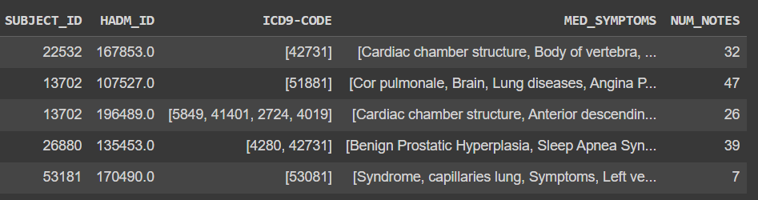
Data Entries
IDs | IDs | Labels - Diseases | Features - Text List of Symptoms | Num Feature

Slide 12
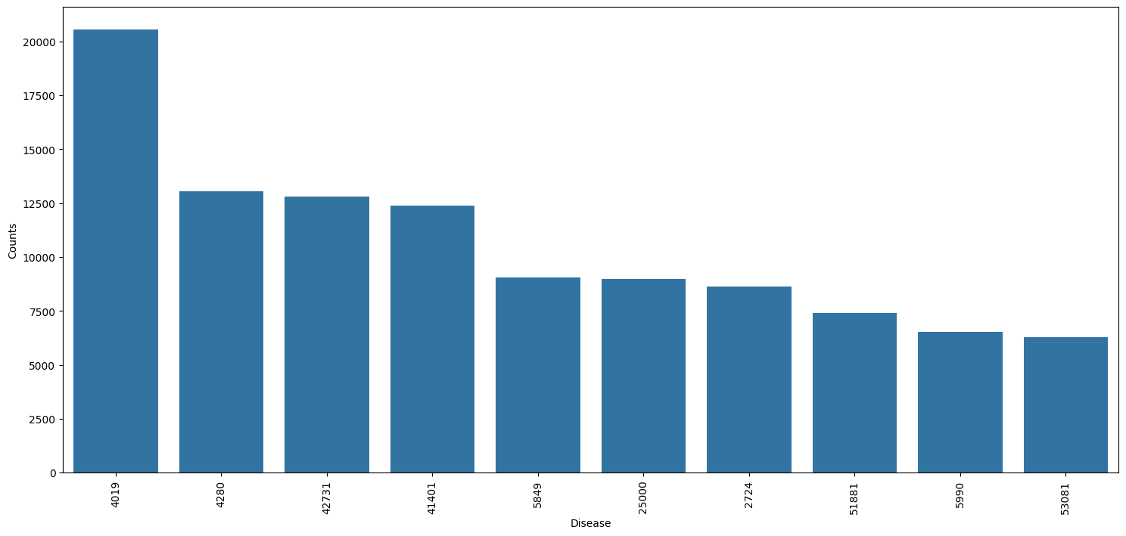
Label Counts
TODO: slides with data analysis graphs

Slide 13
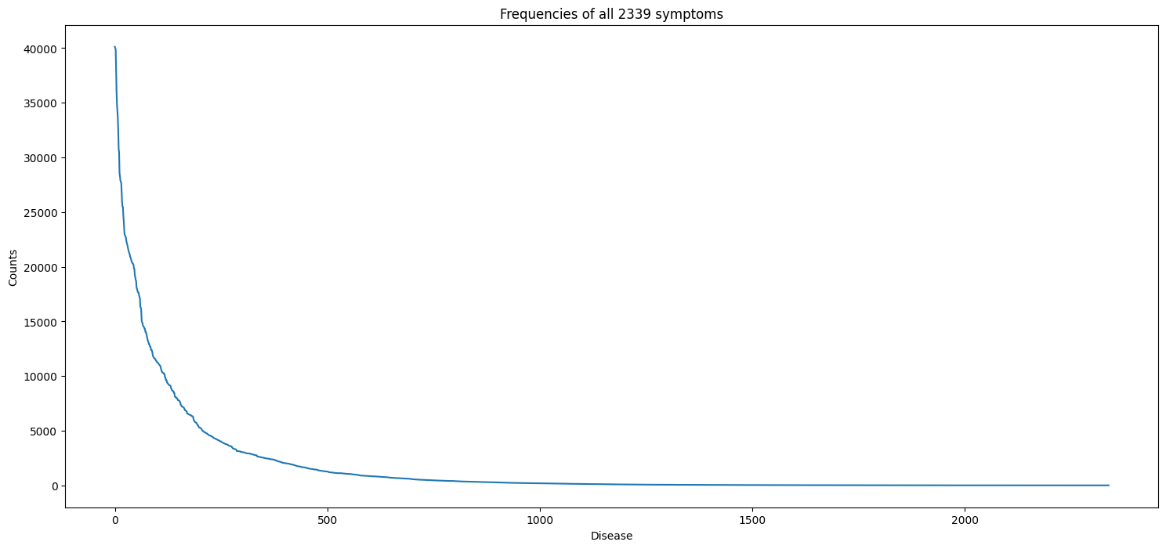
Symptoms Distribution
TODO: slides with data analysis graphs

Slide 14
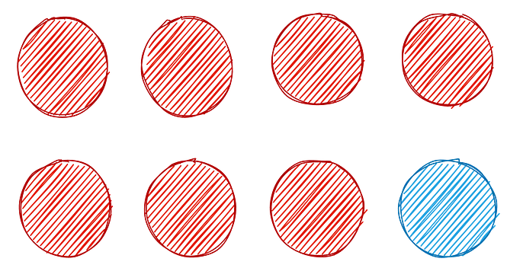
Analysis Methodology
Multi-label classification => accuracy is ill-suited
Using precision, recall, F1. Micro, macro and average calculation
Fraction of correct labels as an additional metric

Slide 15
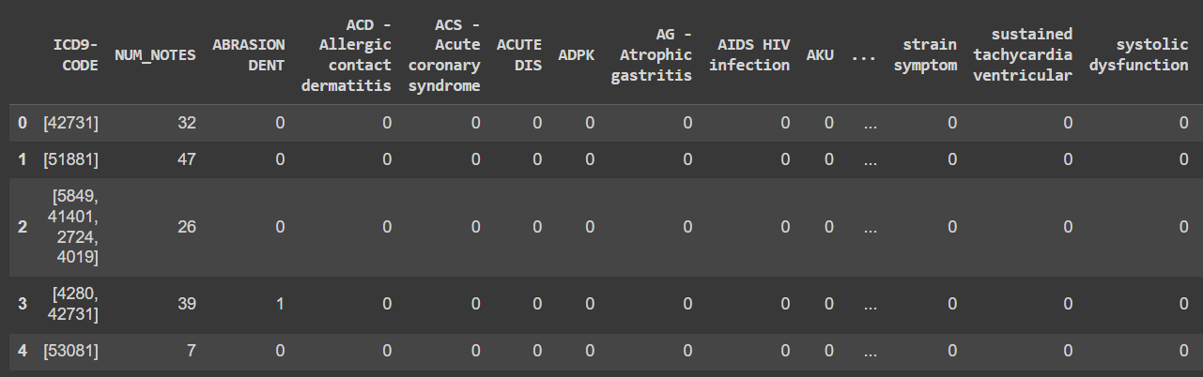
ML Approach: Data Processing
Each symptom as a feature, predicting a label vector
Each disease as a separate label, sparse table

Slide 16
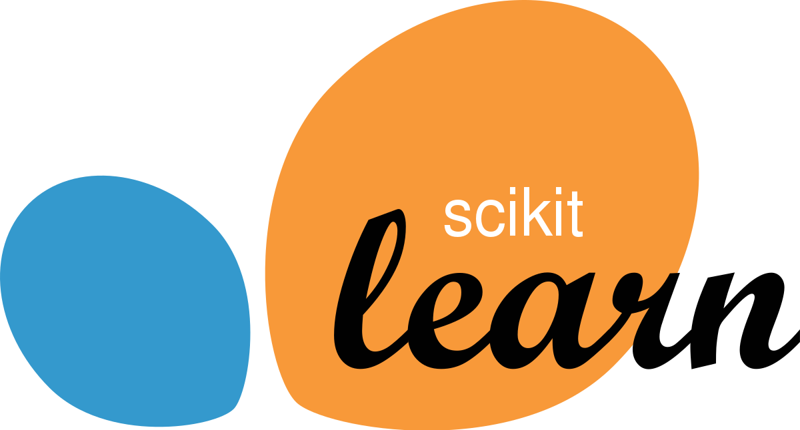

ML Approach: Models
Dummy baseline - stratified labels
K nearest neighbors baseline
Random forest
Catboost gradient boosting
Catboost with textual features
Catboost with optuna hyperparameter search

Slide 17
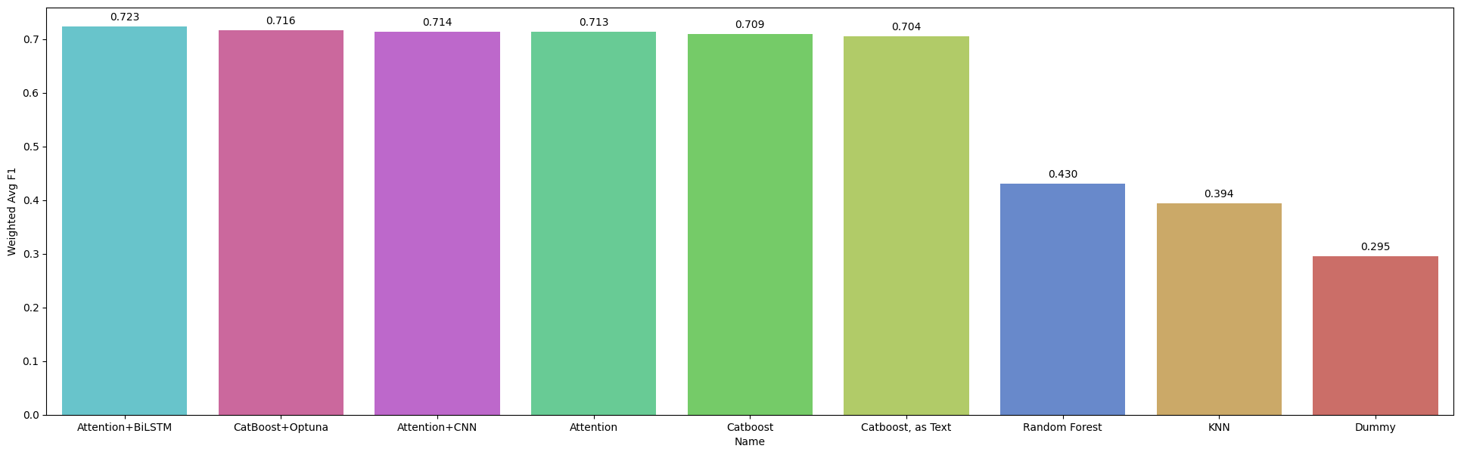
ML Approach: Comparison
Optimized Catboost shows best results, one-hot features work better than text
Notes:
Since we successfully reduced the problem to the multi-class classification task, we can now attempt to solve it. We plan to use and compare several state-of-the-art methods for classifying tabular data. Firstly, we will try Random Forest. We will also experiment with several implementation of Gradient Boosting. And lastly, we will try solving the task with a simple neural network for tabular data.
To achieve the best results, we will experiment with hyperparameters and attempt to find the best combination for each method. To do it, we will use simple grid search or more advanced search frameworks like optuna.
To compare the results, we will use several metric. We will start with accuracy. It will likely be illustrative as the imbalance in the data is manageable. But we will also attempt using more intricate metrics such as multi-class F1-score and, potentially, try to develop a metric specifically design for the data at hand using the incites from the data analysis step

Slide 18
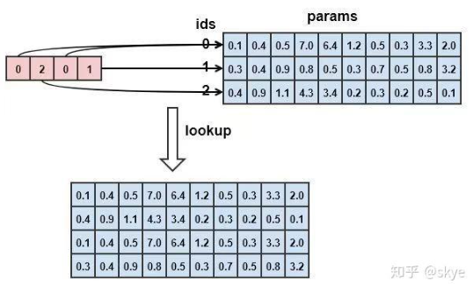
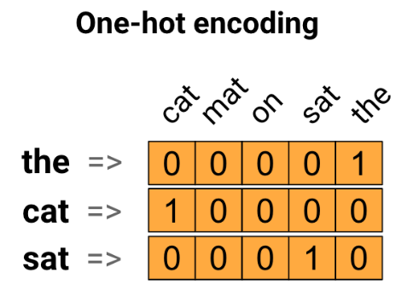
DL Approach: Data Processing
Preprocessing:
Lookup table method as Input Embedding
Input embedding
One hot- embedding for labels
Notes:
In our deep learning of the MIMIC-III database, we have prioritized complex data processing techniques to translate complex medical terminology into a language that our model can understand and analyze effectively.
At the heart of the data processing is the lookup table approach. This innovative technique allows us to convert raw categorical data into a numerical format that is integral to the operation of deep learning models.
Our use of input embedding is a game changer. It transforms sparse, high-dimensional data into a low-dimensional, dense vector space. By doing so, we capture the essence and context of medical terms, enabling richer analysis and more nuanced predictions.
One-hot coding is another cornerstone of our preprocessing phase. This process transforms classification labels into binary matrices, allowing our model to accurately classify diseases without the ambiguity of textual data.
But the real breakthrough comes from the implementation of the attention mechanism. Since transformers have an absolute place in long text, we retained the attention mechanism to try to get correlations between words. With Attention, Attention+CNN and Attention+Bi-LSTM, our model not only processes the data, but also learns to focus on the most relevant parts of the input sequence, which is like how a doctor can find the key symptom in a lot of patient information.

Slide 19
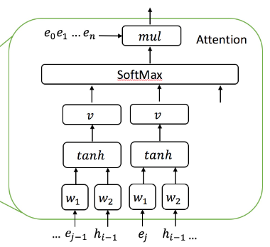
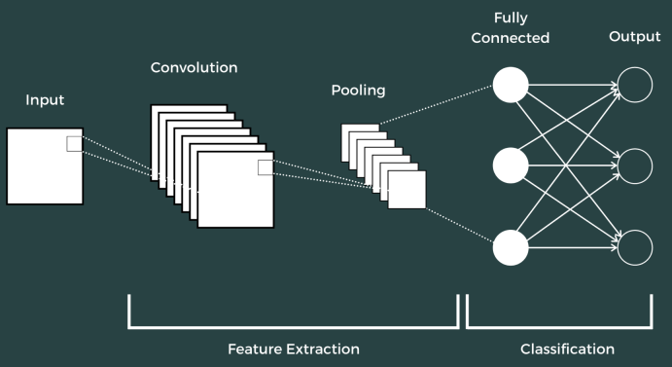
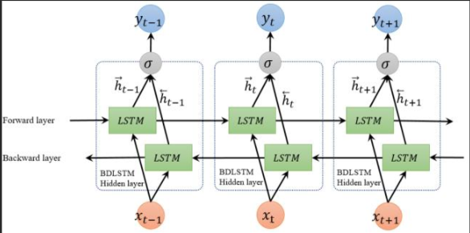
DL Approach: Models
Models:
Attention
Attention+CNN
Attention+Bi-LSTM
Notes:
I'm going to explain why we chose these models in the first place
Attention mechanisms can selectively focus on the most informative parts of the input data, which is crucial when dealing with a wide range of medical records, as each symptom can lead to multiple diagnoses.
Next, we introduced CNN and BiLSTM.CNN is very good at recognizing patterns and structures in the data, and when combined with the Attention mechanism, the model not only recognizes relevant information, but also understands the context and relationships in the medical data, providing us with unparalleled deep analysis.
The Bi-LSTM component processes data in both forward and backward directions, effectively capturing information about past and future states. That's why we chose them.

Slide 20
Weighted Average F1
Attention + BiLSTM shows best overall results, Optimized Catboost is close
Notes:
Next, we show the results of the DL model and compare them with the ML model. It is worth noting that our result values here are AVERAGE due to the fact that our task is a MULTI LABEL TASK, which means that we will have an evaluation matrix for each category. However we are most interested in his overall prediction results. As shown in the figure, CNN+Bilstm has the highest F1 value, while the traditional ML model gets the lowest score.

Slide 21
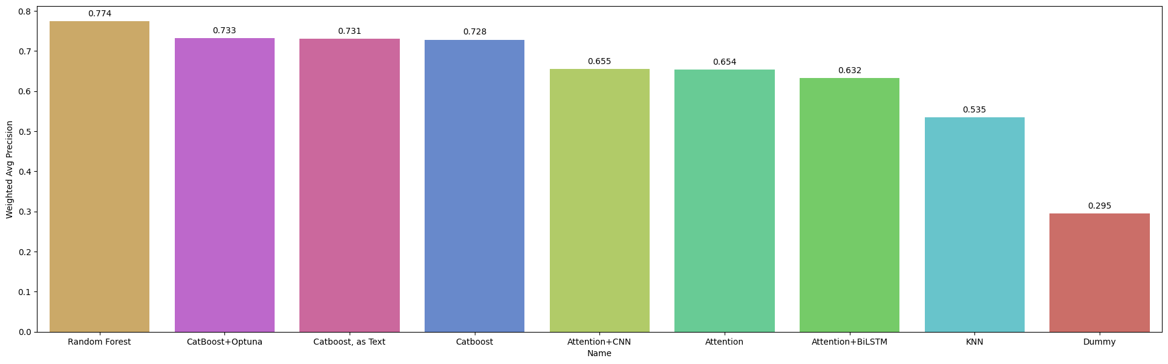
Weighted Average Precision
ML approaches show better average precision
Notes:
To our surprise on precision, randomforest is surprisingly the highest, which means that randomforest is weakly predictive of actual positive samples. That is why randomforest got a low F1 score but the precision is high.

Slide 22
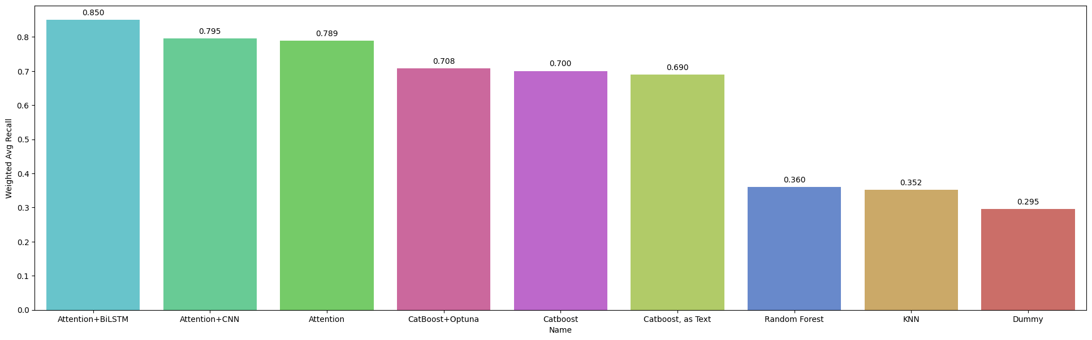
Weighted Average Recall
DL approaches show better average recall
Notes:
For the recall metric, attention+Bistm is still ahead of the rest, with a recall value of 0.85, as shown in the graph.

Slide 23
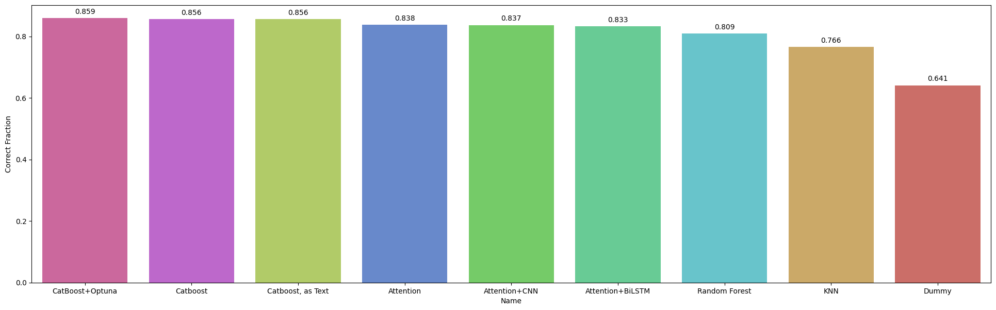
Fraction of Correct Labels
Catboost predict the most singular labels correctly
Notes:
We also counted the probability of labeling correctly, and since it was a multi-label task, each model showed high scores. We speculate that this is because the models can improve their scores by simply labeling as many labels as possible, so they try to label as many labels as possible.

Slide 24


Discussion + Conclusion
Improvement: Most approaches perform significantly better than “naive” models: dummy model that predicts the most common label and KNN
Best results: Natural language approach - BiLSTM with attention - shows the best results overall, as the features are given in natural language
Tradeoff: Depending on the importance of precision or recall - and in medical tasks recall is usually more important - different methods are best suited
Performance: Optimized gradient boosting shows scores close to the NLP method, as such, there can be a case for using it under resource constraints

Slide 25

THANK YOU

