Slide 1
G O A R M Y .
INFO 5100
Application Engineering & Development
Team
Binge Code
Team Members Akshata Nanjappa
Drishti Goda Shivangee Nagar

Slide 2

250,000
60-80%
Troops Leave the Military Every year
Left the military without access to adequate higher education, vocational training, access to adequate mental healthcare or employment

Slide 3
What does it mean to leave the Armed Forces?
Relocating, living independently for the first time
No access to adequate mental healthcare
No access to adequate Higher Education
These major life changes are challenging for military people, just as they are challenging for anyone.
The challenges associated with these changes are not easily studied or represented, in part because they are not captured by medical diagnoses, and in part because it is difficult to draw meaningful lines between physiological, psychological, and social problems.
Moreover, this stuff of everyday life tends to be overshadowed by veterans’
other, more extreme, experiences in combat.

Slide 4
So, what can we do to help this situation?
Develop, design and deploy a multi-party organization that can connect the troop to one or more organizations
Incorporate Medical, Education, Employment & Housing Enterprises. Multiple organizations under the said enterprises under which the troop can apply for training, seek medical help etc.
Organizational users can review applications/requests and approve/reject the same - or if required route them to other organizations under a different enterprise
Healthcare
Organizations
Troop
Educational
Institutions
Housing Organizations

Slide 5
Ecosystem Architecture
Physical Health
Rehab Enterprise
Mental Health
Medical Enterprise
Vocational Training
EcoSystem
Education Enterprise
Graduate School
Housing Enterprise
Temporary Shelters
Job Enterprise
Permanent Housing

Slide 6
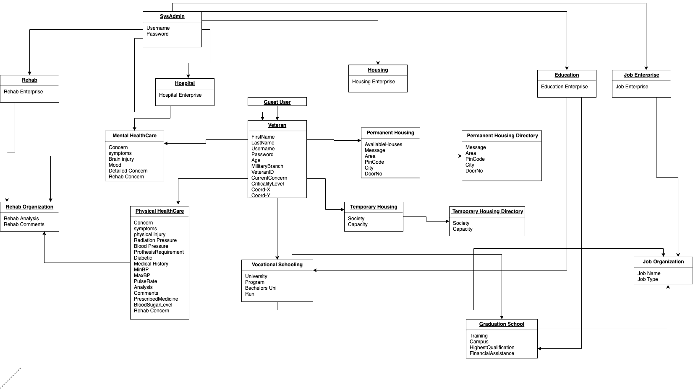
Class Diagram

Slide 7
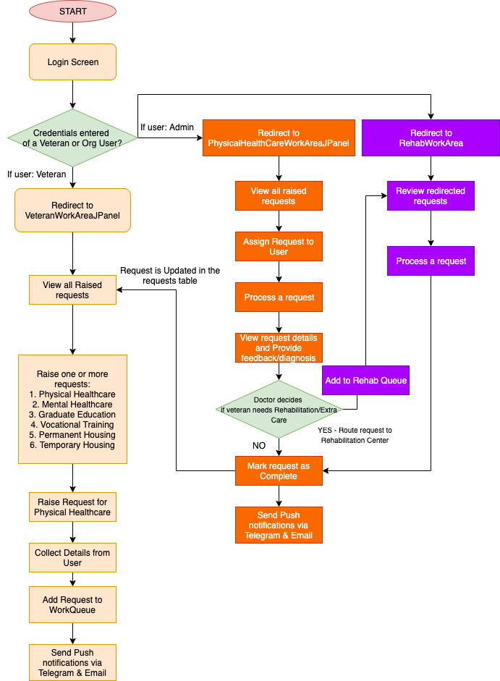
User Request Workflow
Troop initiating a medical request/concern and effective resolution by the doctor.
The same workflow is applicable to all requests raised between the user & organizations - for example, requesting for Temporary Accommodation or Applying for Higher Education / Vocational Training

Slide 8
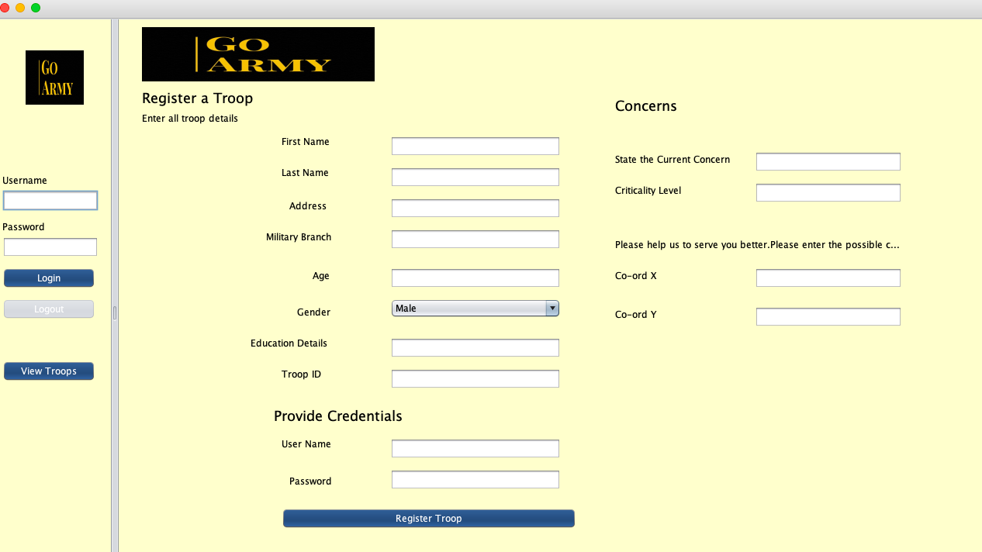
Screenshots

Slide 9
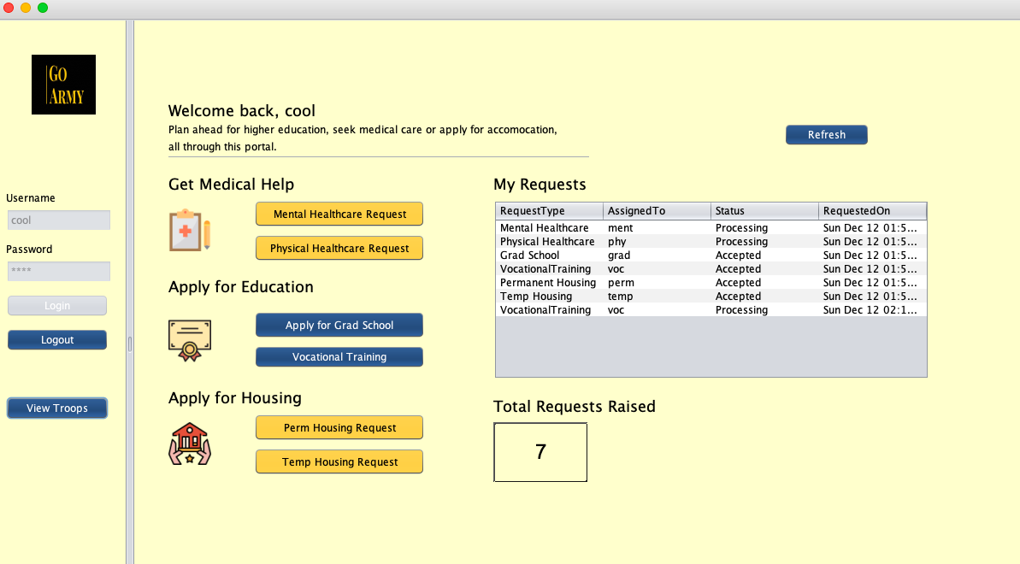
Screenshots

Slide 10
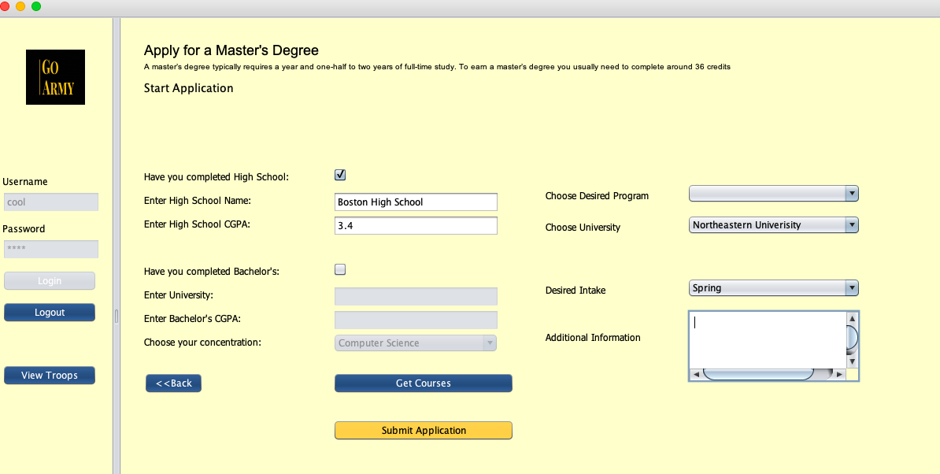
Screenshots

Slide 11
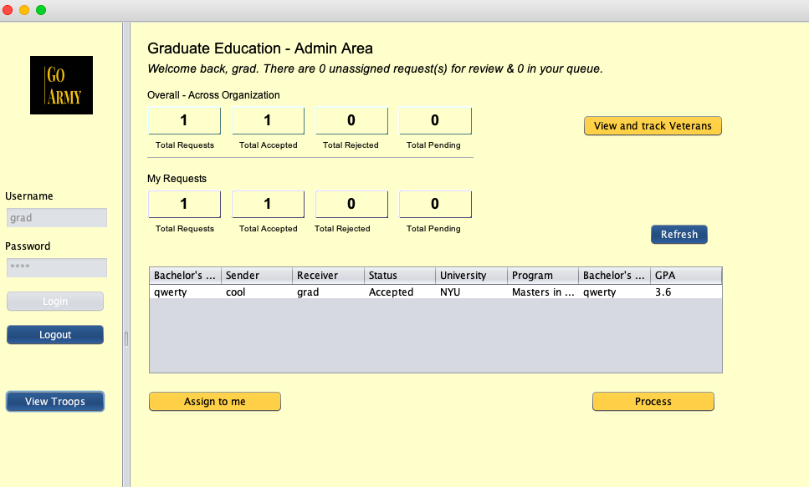
Screenshots

Slide 12
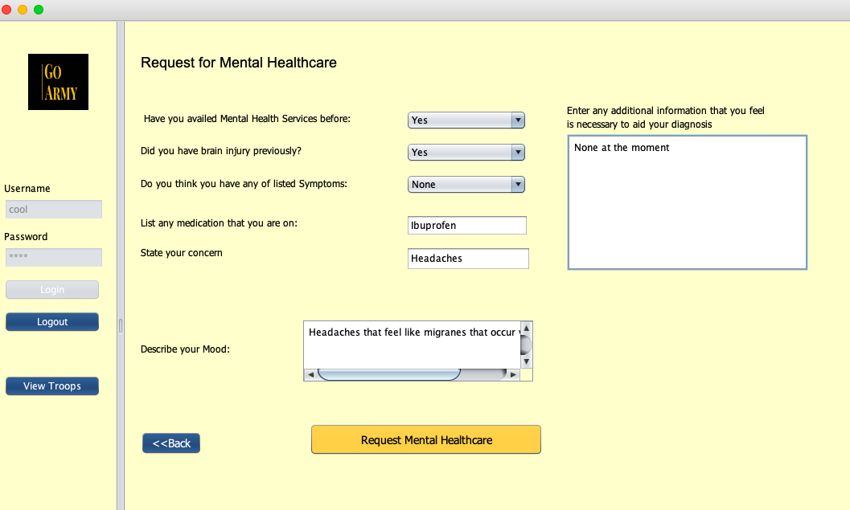
Screenshots

Slide 13
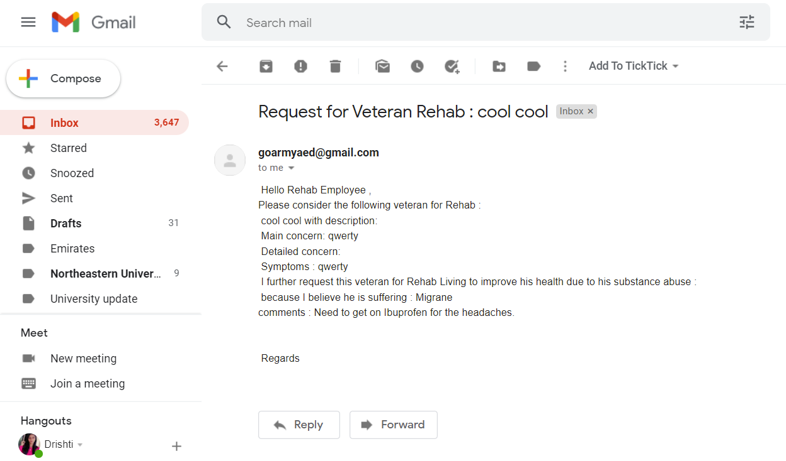
Screenshots

Slide 14

Thank you!

