Slide 1

HONQP-GEN AI
Presented by
Akshitha
Drishti
Yash
Ankush
Shreya
Gayatri
Demo1-Akshaya R, Saurav K T, Maitreya
Demo2-Somashekar, Rahul
Team Mentors:
Sarayu Keshavan
Priyanka Mathapati

Slide 2
TABLE OF CONTENTS
Introduction
Working of the HoNQP
Java Code Generation
Class diagram of the Code Generator
Documentation Generation
Implementation Steps
Challenges and Solutions
Results
Applications
Conclusion

Slide 3
INTRODUCTION
PROJECT AIM
To develop a system that can generate hands-on question papers using Java code. The system will be trained on a curated dataset of Java programming problems and solutions to ensure the generation of high-quality, contextually relevant questions.
GOAL
The goal of this project is to develop a system capable of generating high-quality, hands-on Java programming question papers. This system will be trained on a dataset of Java code problems and solutions and will utilize advanced models like llama and Mixtral-8x7b to produce relevant and educational questions. The project aims to streamline the process of creating educational content, providing educators with a valuable tool to enhance learning experiences in computer science.

Slide 4
INTRODUCTION TO HONQP-GEN AI
The HoNQP-Gen AI Tool is an innovative application designed to streamline the creation of high-quality, hands-on Java programming question papers. It utilizes advanced models, LLaMA and Mistral, to generate relevant and educational questions. LLaMA handles the generation of complex, contextually appropriate questions, while Mistral ensures data integration and quality assurance from a curated dataset of Java problems and solutions. The workflow includes dataset curation, model training, question generation based on user inputs, customization, randomization, and a feedback loop for continuous improvement. Benefits include efficiency, quality, customization, and leveraging advanced AI models for educational content creation, making HoNQP-Gen a significant advancement in educational technology.
Key Features
Code Generation
Class Diagram Creation
Document Generation

Slide 5
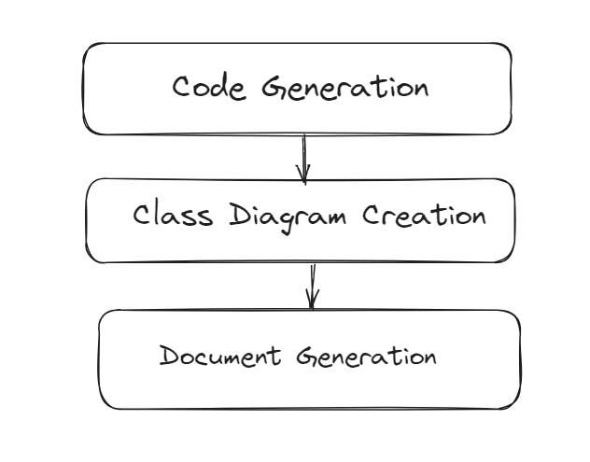
WORKING OF THE HONQP
Working Process:
Input Interpretation:
The model begins by analyzing the input problem statement provided by the user.
Code Generation:
Utilizing its trained neural network, the model generates Java code that implements the functionalities described in the problem statement.
The generated code is designed to be efficient, following best practices and coding standards.

Slide 6
Class Diagram Generation:
PlantUML: The plantuml codes will be generated by the models using the Java code generated. This plant uml code is will be passed on to a function where it will get prettified. The final prettied uml codes will be passed on to the class diagram generation function and the output will get saved as a .png file
Mermaid: The process involves loading a fine-tuned language model using the unsloth library to convert Java class code into Mermaid class diagram code. The script initializes the model with specified parameters for efficient GPU usage, formats a prompt with detailed instructions for conversion, and uses the model to generate Mermaid code from the given Java input. The generated Mermaid code is then used to create a class diagram
Output Compilation:
The final output produced includes: Class diagrams generated using PlantUML and Mermaid, depicting the relationships and structure of the system . Detailed explanations for each class and their methods, helping to understand their roles and functionalities within the system.

Slide 7
IMPLEMENTATION STEPS
Java Code Generation
Prompt Analysis: Develop a parser to analyze the prompt and identify the required classes and attributes.
Code Generation Logic: Create templates for Java classes and Write logic to fill templates with parsed data.
Class Diagram Creation
Extract Information: Develop logic to extract class names, attributes, and relationships from the generated Java code.
Documentation Generation
Template Creation: Design a DOCX template with placeholders for class details and code snippets.

Slide 8
JAVA CODE GENERATION
LLAMA MODEL
The llama model is a large language model designed to generate Java code from natural language input. It works by tokenizing the input, processing it through transformers to understand the context, and then generating the corresponding Java code tokens
These models are trained on vast datasets, enabling them to produce coherent and contextually appropriate responses, including programming code snippets when prompted.
The final output is a syntactically correct Java code snippet.
MIXTRAL-8X7B MODEL
The Mistral model, specifically the Mistral 8x7B, is a state-of-the-art large language model developed for various natural language processing tasks, including code generation. It utilizes advanced transformer architectures to understand and generate human-like text.
This raw java code will be fed to a function and this function will extract the java code, leaving behind the unnecessary texts included. This prettified java code will be printed.

Slide 9
CLASS DIAGRAM OF THE CODE GENERATOR
Inheritance Structure: Full Time Employee and Part Time Employee inherit common attributes and methods from the Employee base class.
Encapsulation: Private attributes with public getters and setters ensure data integrity and controlled access.
Specific Methods: Each subclass includes unique methods, like calculate Annual Salary() for Full Time Employee and calculate Total Earnings() for Part Time Employee.
Constructor Overloading: Each subclass defines its own constructors to initialize specific attributes, enhancing flexibility in object creation.
Attribute Specialization: Subclasses introduce additional attributes (hourlyRate and hoursWorked for FullTimeEmployee, salary and department for PartTimeEmployee) tailored to their specific requirements.

Slide 10
DOCUMENT GENERATION
Template Creation: Design the Word template.
Content Generation: Generate problem statement, class diagram, and class explanations.
Diagram Generation: Create diagrams using PlantUML or Mermaid.
Document Assembly: Combine and format content in the template.
Output: Generate the final Word document.

Slide 11
CHALLENGES AND SOLUTIONS
Challenge: Accurate Prompt Parsing
Solution: Implement robust natural language processing (NLP) techniques to correctly interpret complex prompts.
Challenge: Ensuring Code Correctness
Solution: Integrate unit testing for generated code to verify functionality and correctness automatically.
Challenge: Class Diagram Accuracy
Solution: Use reliable UML generation tools and validate the output against the parsed data to ensure consistency.

Slide 12
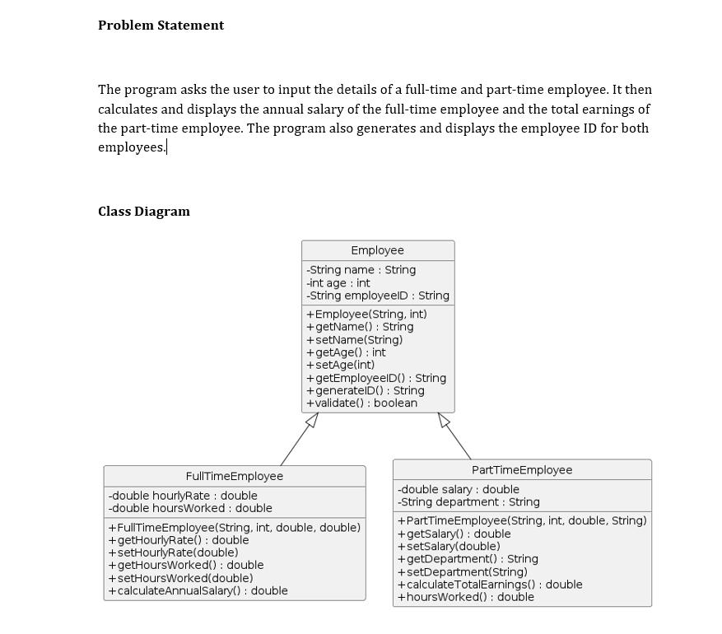
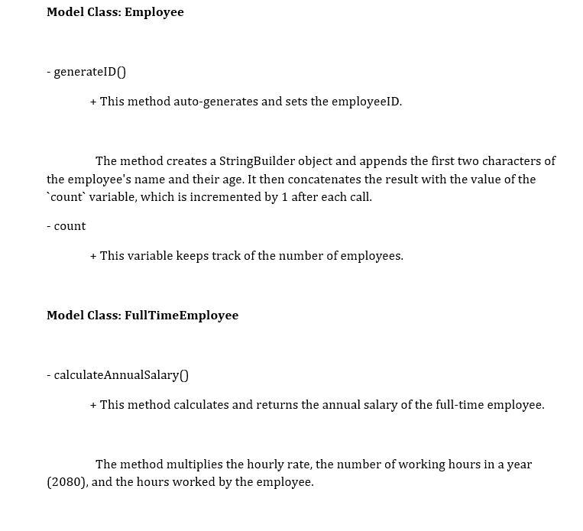
RESULTS

Slide 13
APPLICATIONS
Educational Use: Create coding exercises and corresponding class diagrams, helping students visualize and understand object-oriented programming concepts.
Software Development: Quickly creates initial code and class diagrams for new projects, aiding in brainstorming and initial development stages.
Hackathons and Competitions: Quickly create the initial code and diagrams for their projects, allowing them to focus on innovation and problem-solving.
Tutorial: HONQP-Gen to generate sample code and diagrams for tutorials, making it easier to explain complex concepts.

Slide 14
CONCLUSION
Summary: This project demonstrates an automated system that takes a user prompt and generates Java code, a corresponding class diagram, and detailed documentation in DOCX format.
Benefits: The approach enhances productivity by automating repetitive tasks, ensures consistency in code and documentation, and helps in maintaining up-to-date project documentation.
Future Work: Future enhancements could include support for additional programming languages, more complex prompt handling, and integration with other development tools for a more seamless workflow.
Final Thought: By leveraging NLP and automation tools, this project showcases a significant step towards simplifying and streamlining software development and documentation processes.

Slide 15
DEMO

Slide 16
THANK YOU

