Slide 1
Exploratory Data Analysis on Indian Land Use and Agriculture Dataset
Insights into Land Utilization Patterns Across Indian States

Slide 2
Introduction
Land is one of the most critical natural resources for agriculture and development.
Efficient land utilization directly impacts food security, sustainability, and economic planning.
This project analyzes land use patterns across Indian states using government-sourced data.

Slide 3
Problem Statement
With India’s growing population, land pressure
is increasing.
There’s a need to understand how land is
distributed and used for agriculture, forestry,
non-agriculture, etc.
This project uses EDA to uncover patterns,
Inconsistencies, and trends in land usage over time.

Slide 4
Objective 1: Analyze state-wise trends in total geographical and reported land area This objective focuses on understanding how different Indian states report land use and how it compares to their total geographical area, helping identify inconsistencies or gaps.

Slide 5
Objective 2: Study proportions of different land use categories: forest, non-agricultural, barren land, etc. It aims to break down land usage into major categories and examine how much land is allocated to forests, agriculture, barren land, and urban expansion across various states.

Slide 6
Objective 3: Identify states with the highest and lowest percentages of net sown area This helps highlight regional disparities in agricultural land usage and showcases states that are either heavily dependent on agriculture or underutilizing cultivable land.

Slide 7
Objective 4: Evaluate trends in cultivable waste and fallow land across decades By observing cultivable waste and fallow land data over the years, we aim to identify patterns that may reflect land degradation, shifting practices, or policy impacts.

Slide 8
Objective 5: Correlate regional disparities in land use with demographic/agricultural indicators This objective links land usage with external factors like population density or rainfall to understand deeper causes of uneven land distribution.

Slide 9
Methodologies Used
Data Cleaning (handling missing values, type conversions) Data Preprocessing (filtering, renaming columns) Tools: Python, Pandas, Matplotlib, Seaborn, Jupyter Notebook Visualization Techniques (line plots, bar charts, heatmaps)

Slide 10
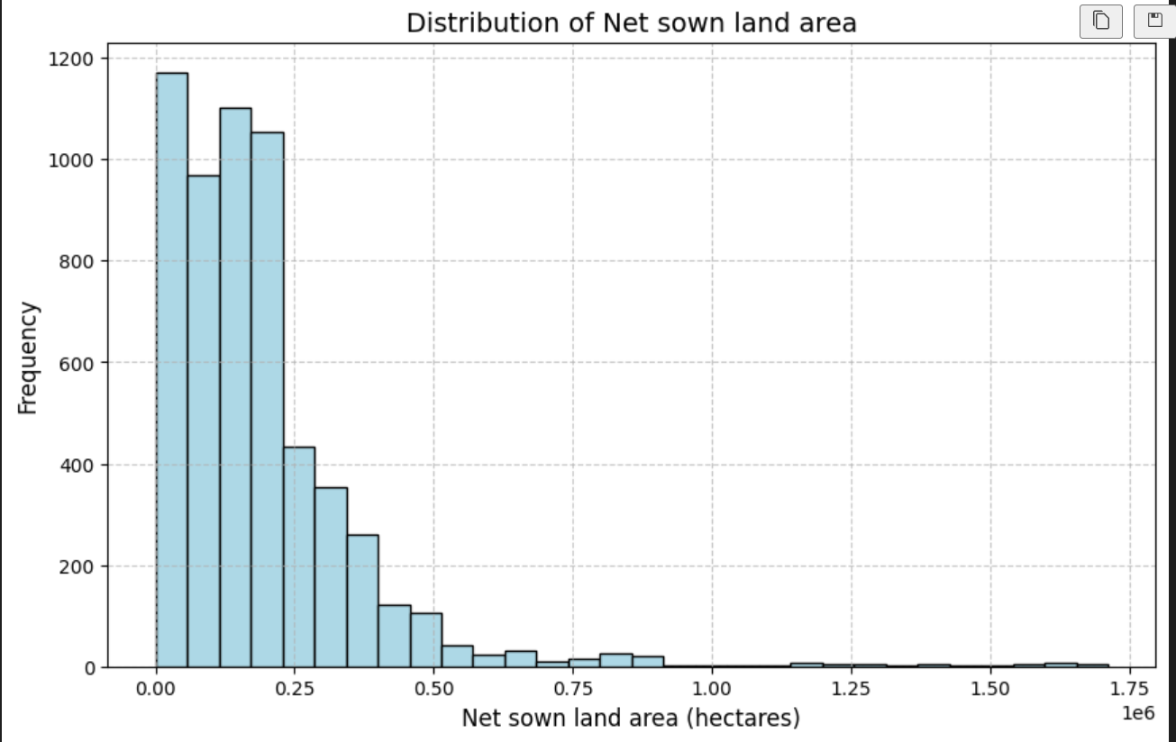

Slide 11
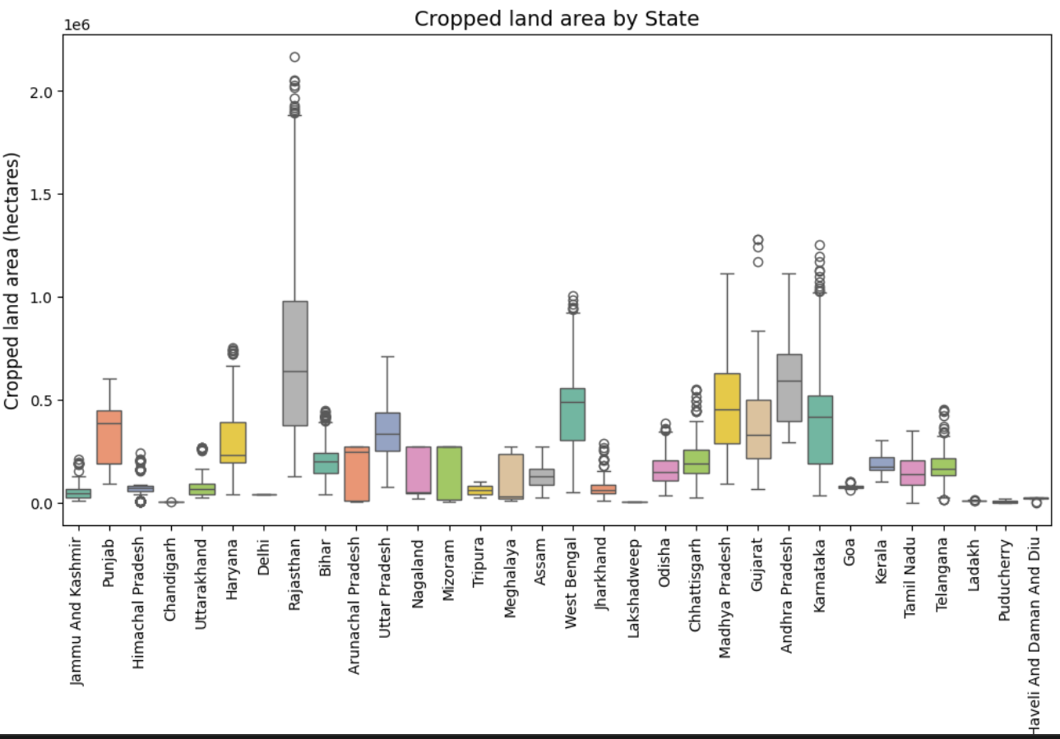

Slide 12
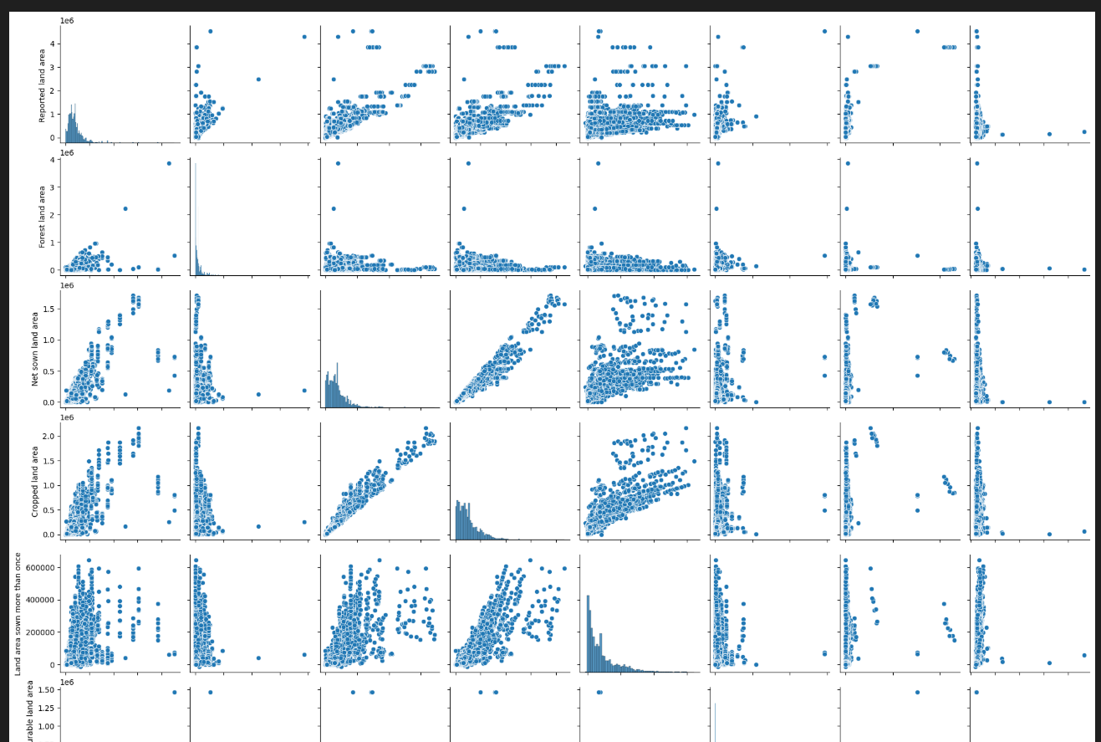

Slide 13
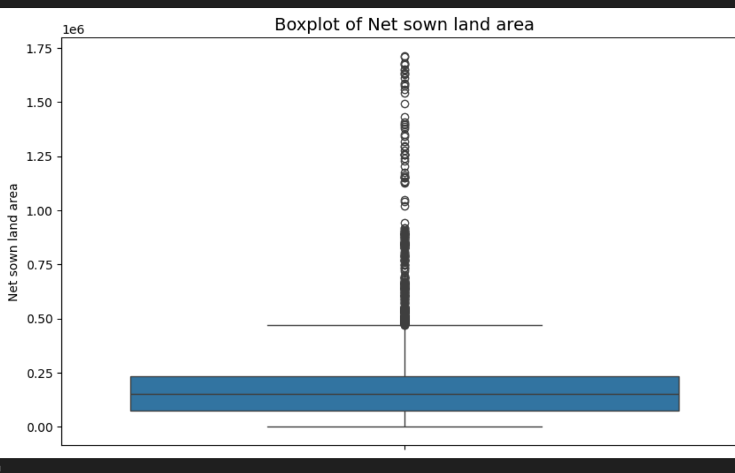

Slide 14
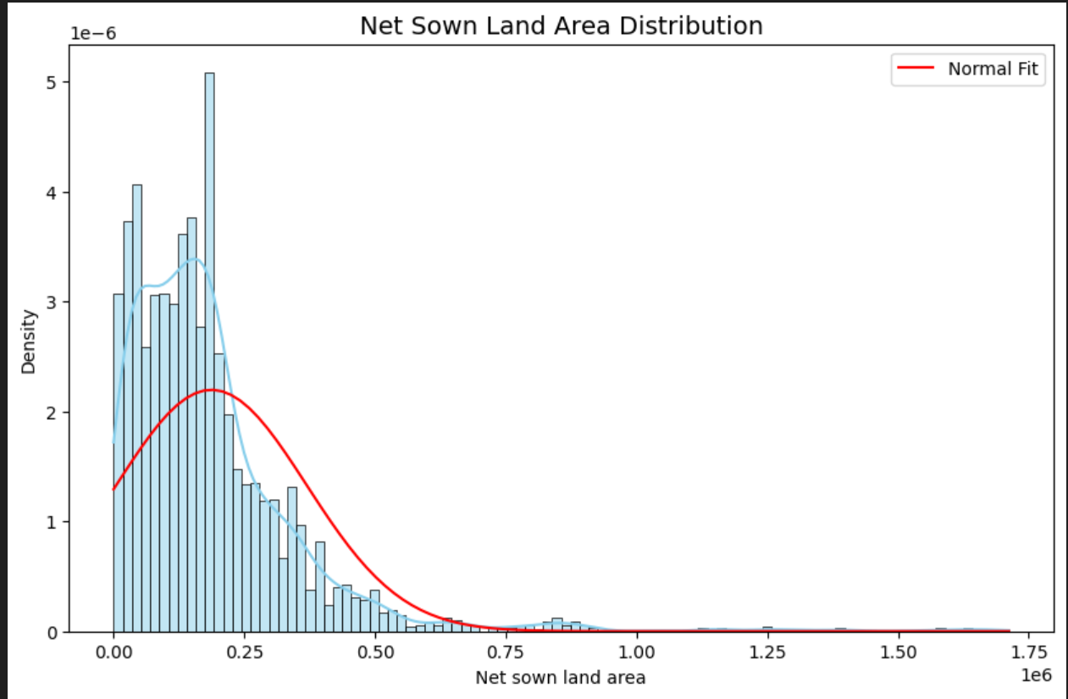

Slide 15
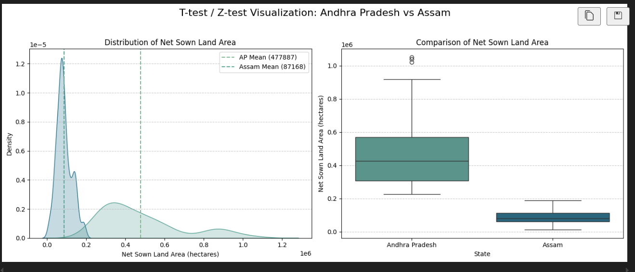

Slide 16
Application
Businesses can use this analysis to tailor marketing campaigns for different customer segments, improving customer satisfaction and profitability.
State governments can use insights from land use data to plan irrigation systems, crop patterns, and soil conservation efforts by identifying underutilized or degraded agricultural land.
Urban planners can forecast land availability and predict future expansion needs by examining trends in non-agricultural and barren land categories, aiding in smart city development.

Slide 17
Conclusion
EDA revealed meaningful customer segments using demographic and behavioral data.
KMeans helped classify customers into 5 actionable clusters.
Understanding these groups enables targeted marketing and service personalization.

