Slide 1

An Introduction to eHealthCare Initiatives
Proprietary & Confidential

Slide 2
Background
Started in 2000 Argusoft is now a mature platform based
software technology company in its 18th year of business
Mainstream focus as a turnkey Enterprise Software
Development, Integration and Maintenance house
Specializing in SOA integration, Java & Web technologies
Leveraging core platforms to develop web2.0 based
product services in the healthcare and education arenas
Small but experienced team (personalized engagement)
HQ and Development Center in India with US office

Slide 3
Argusoft eHealth Platforms
Teleconsultation
Teleopthalmology implementation: Tripura Vision Centers, India
http://www.youtube.com/watch?v=dqVCnd8PPCU (click to see video)
TeleDOCs
integrated patient-doctor teleconsultation platform
mRHM – A Remote HealthCare Service Delivery and Management Platform using smart mobile phones
mDOC (Imtecho) - Delivery of basic healthcare triage and management
mRCH (Janani) – Pregnancy health of mother and child programs
mAID - Prevention of transmission of AIDS from mother to child
mEPI – managing and triaging pediatric epilepsy patients
TriageTRACE – nursing home patient management solution
TriageSTAT – Hospital and Home Health communication solution

Slide 4
TeleOpthalmology - Tripura Vision Center
Eye care provided through 40 remote care centers with local optometrist to manage the patients
Doctor can view patients ‘eye’ using slit lamp camera device from hospital base in metros, remotely examine and suggest appropriate next steps for care
Service caters to over 4M rural populace thru 41 Community TVCs in 4 districts of the Tripura state and is fully operational currently
http://www.youtube.com/watch?v=dqVCnd8PPCU

Slide 5
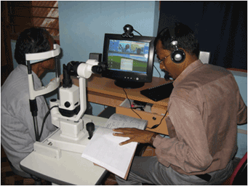
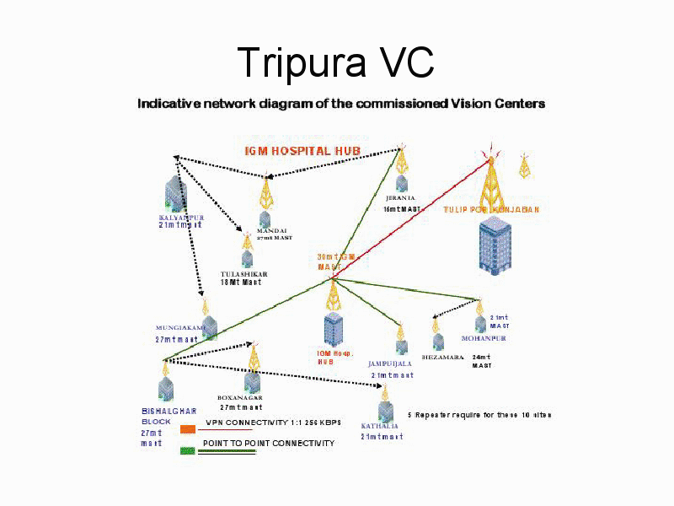
How it Works …
Patient visits with the remote/local Vision
Centre (NRHMs), to undergo eye exam
Ophthalmic Assistant (OA) based at the
centre conducts patient eye screening
OA uses teleconsultation platform to work
with the remote doctor based at IGM
hospital in Agartala for assessment.
OA then either prepares glasses or advises
patient to go to Agartala for further
treatment ( Cataract, Glaucoma etc)
C@W TeleConsultation platform presently
connects 41 centers with IGM Hospital in
Agartala over a 2 Mbps network (Tulip)
Winner of the Manthan award for eGov
100,000+ patients have been seen in 3yrs

Slide 6
TeleDOCs Platform
Complete portal for patient-doctor experience including case management, scheduling and PHR
Full Audio/Video session with tools for a virtual, live, interactive doctor office visit experience
Connect Doctors and Hospitals in cities to the remote areas. Connect to doctors worldwide
Enable healthcare for all by setting up healthcenters in remote areas for access to doctors in metros

Slide 7
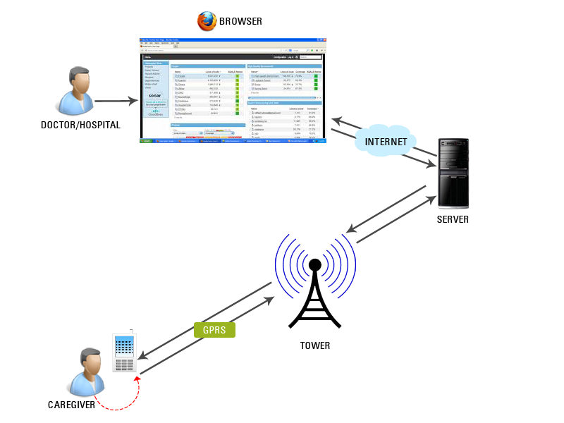
mRHM Platform
Dashboard of Reports (preconfigurable)
AGENCIES/MANAGEMENT
Configurable Business
rules to meet application
requirements on server
Cell phones
Smart Phones
Tablets
2G/3G
cellular
Decision Tree
Data Collection

Slide 8
mRHM Platforms
Using mobile phone for remote Service delivery & Management
mDOC (ImTecho) - Basic healthcare education and triaging using decision trees on mobile phones for remote areas
mRCH (Janani) - Reproductive Child Health Program for pre-post pregnant mother and child health
mAID (P-HMMS) - Program to Prevent the transmission of AIDS from mother to child
mEPI – Managing and Triaging pediatric epilepsy patients
mEDU - Training and Data collection for infectious diseases

Slide 9
mRCH (Janani) Program
Program for Reproductive Child Health to reduce pre-post pregnancy Mother and Infant mortality
Track and educate mothers on pregnancy diet/health, institutionalized childbirth, immunizations etc
Pilot program completed in Gujarat, India
Managing 250 outreach workers
Reached out to 10,000+ patients
Nationwide rollout being planned

Slide 10
mAID (P-HMMS) Program
Prevent transmission of AIDS from mother to child
Program goal is to identify and educate the positive mothers (and fathers) on the ease of prevention
Track & Treat positive pregnant mothers and monitor health of child post pregnancy for 18 mo
Nationwide rollout completed across India
Managing 3600 outreach workers
Managing over a quarter million patients

Slide 11
mDOC (ImTecho) Program
Program to provide pregnancy related education and triaging in remote areas lacking medical facilities
Decision tree based diagnosis on mobile phones by nurses in the field, managed by doctors from metros
Identify complications requiring move to hospitals
Pilot Program implemented in Gujarat, India
Pilot with 250 outreach workers
Reaching out to over half a million people

Slide 12
mEPI Program
Program to provide basic triaging and data collection for delivery of care to pediatric epilepsy patients
Decision tree based triaging on mobile phones by caregivers to manage patients during episodes
Episodic Data Collection for providing analytics to neurologists for better care plan and counseling
Being currently developed for a US children's hospital

Slide 13
Benefits
Manual system lacked enough checks for ensuring use of funds, service delivery and consumption
Field Health workers were spending a significant amount of time in data capture and manual (paper) aggregation for reporting purposes
Ensuring repeated services delivery was a challenge
Innovative data capture through mobile phones, in local language, removed all manual aggregation, so FHWs could spend more time providing services, guarantee service delivery and minimize wastage of funds for logistics

Slide 14
Salient Features
Redundant interfaces – Mobile and Web based
Unique ID based system tracks individual mother and child health throughout their lifetime
mRHM system generates work items for FHWs on a daily basis and ‘pushes’ work list for better traceability and delivery while pulling feedback to the server over mobile network
Leverages GPS functionality to detect service delivery location along with Photo capture for service delivery authentication
Configurable Reports available from any web browser at all times
System tracks migration & service alerts ‘follow’ beneficiary
Decision Tree based triaging capability to identify morbidities.

Slide 15
Value Proposition
Strong development oriented offshore team (150+)
with expertise in Java, C⁺⁺ and web technologies
Expand product portfolio and customer base
leveraging Platform IPs in eHealth, mHealth,
eLearning and web collaboration
Software Services
- Turnkey software projects from offshore
- mODC services for supplementing client teams

Slide 16
Core IP
Developed indigenously - roobroo provides a highly integrated, real-world functionality for online collaboration using VoIP Audio, Video, Desktop Sharing, Enhanced Whiteboard, and Chat, with the point of presence capability made popular by Instant Messengers, while leveraging Peer-to-Peer technology for all media transactions to maximize performance and scalability. Enables web based video conferencing at the OEM/Enterprise level and Consumer level.

Slide 17
Argusoft Contacts www.argusoft.com
Argusoft America Inc
35463 Dumbarton Court, Newark, CA 94560
Contact: Ram Gopalan 510-435-0567 ramgopalan@argusoft.com
Argusoft India Ltd
A66, Sector 25, GIDC
Gandhinagar - 382016, Gujarat, India
Contact: Ravi Gopalan 011 91 9974666600
rgopalan@argusoft.com

