Slide 1

REINTEGRATION OF RETURN MIGRANTS INTO KERALA’S LABOUR MARKET:
A STUDY ON THE IMPACT OF FORIGN-ACQUIRED SKILL ON THE REINTEGRATION PROCESS
THESIS PRESENTATION
DRISYA KRISHNAN M
242ECO05
Under the Guidance of
Dr. Nikhil Jha

Slide 2
CONTENTS
Introduction
Literature review
Research gaps
Research objectives
Theoretical frameworks
Data and methodology
Trends in dataset
Empirical analysis result
Conclusion and discussion
Policy recommendations
Appendices

Slide 3
INTRODUCTION
Migration
Better jobs & living conditions
Wage & household decisions
Return Migration
Transfer of skills & experience
“Brain gain” effect
Challenges
Skill mismatch
Reintegration issues
Kerala Context
1.8+ million return migrants
Strong dependence on migration
Reintegration remains uneven
RESEARCH QUESTION
Do foreign-acquired skills improve employment, wages, and entrepreneurship among return migrants in Kerala?
How effective are institutional support programs in facilitating reintegration?

Slide 4
LITERATURE REVIEW
KEY FINDINGS
Foreign-acquired skills lead to higher wages and improved productivity
Migration experience increases the likelihood of entrepreneurship and self-employment
Return migrants contribute to human capital formation and economic development
However, many face skill mismatch and underemployment in domestic labour markets
Limited institutional support and policy gaps affect effective reintegration

Slide 5
KEY STUDIES
📊Impact of skill and wages
Dustmann, C., & Frattini, T. (2011): Return migrants earn higher wages with foreign experience
Borjas, G. J. (1994): Migration driven by wage differentials & skill returns
💼Entrepreneurship
McCormick, B., & Wahba, J. (2001): Migration experience increases self-employment likelihood
🌍Human Capital & Development
Lucas (2005): Migration contributes to human capital & economic growth
Kerala Studies
Zachariah, K. C., & Rajan, S. I. (2012): Migration improves income & living standards
Rajan, S. I., & Pattath, K. C. (2022): Return migrants face reintegration challenges

Slide 6
RESEARCH GAPS
Limited focus on skill impact
Few studies assess impact of foreign acquired skills
Kerala context gap
Focus on remittances; reintegration under explored
Lack of quantitative evidences
Limited analysis of [program accessibility
Missing comprehensive approach
Rare integration of employment, wage and entrepreneurship.

Slide 7
RESEARCH OBJECTIVES
Impact of foreign acquired skills
Examine effects on employability, entrepreneurship, and wages of return migrants
Skill utilization analysis
Analyze utilization among return migrants
Role of Government Support
Assess effectiveness of support programs in labour market reintegration
Provide policy recommendations to improve reintegration strategies

Slide 8
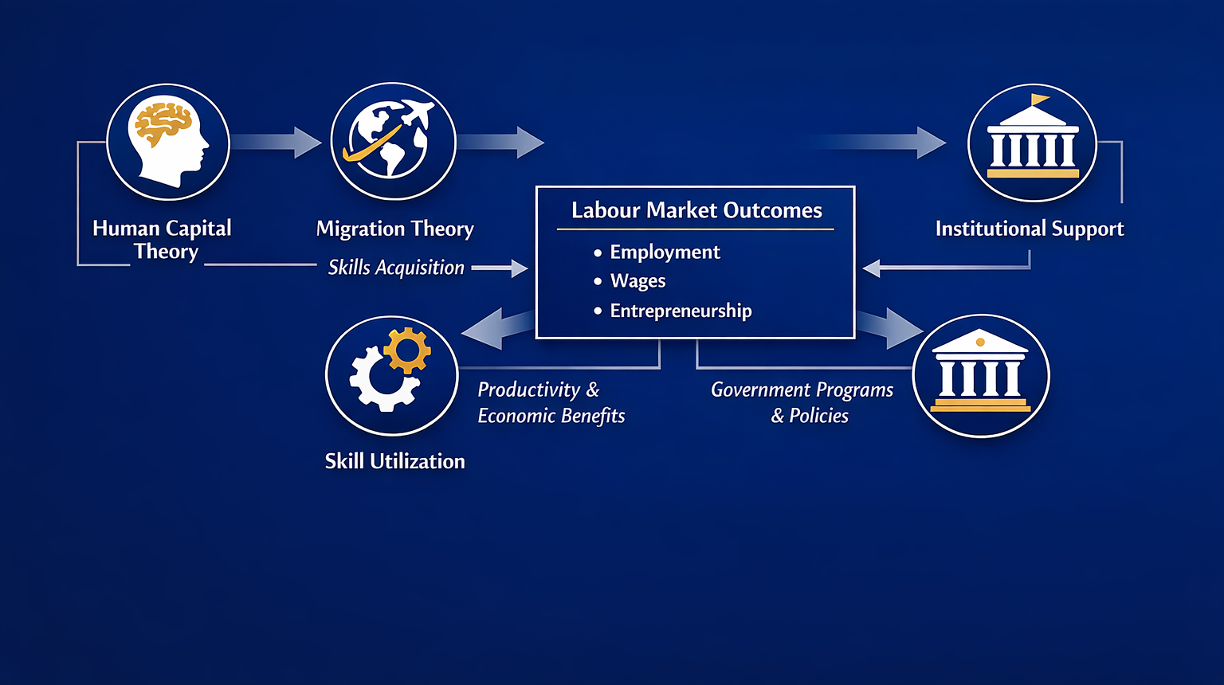
THEORETICAL FRAMEWORKS

Slide 9
DATA AND METHODOLOGY
📊 Data Source
Primary survey
Return migrants
Sample
300 respondents
Study Area
Kerala
⚙️ Empirical Method
Logit model: Formal employment, Entrepreneurship Odd ratios
OLS model: Wage, Skill utilization

Slide 10
ECONOMETRIC MODELS

Slide 11
VARIABLES
DEPENDENT VARIABLES
Formal employment
Entrepreneurship
Wage
Skill utilization
KEY EXPLANATORY VARIABLES
Skill index
Years of experience abroad
Government support
Education
CONTROL VARIABLES
Age
Gender
Marital status

Slide 12
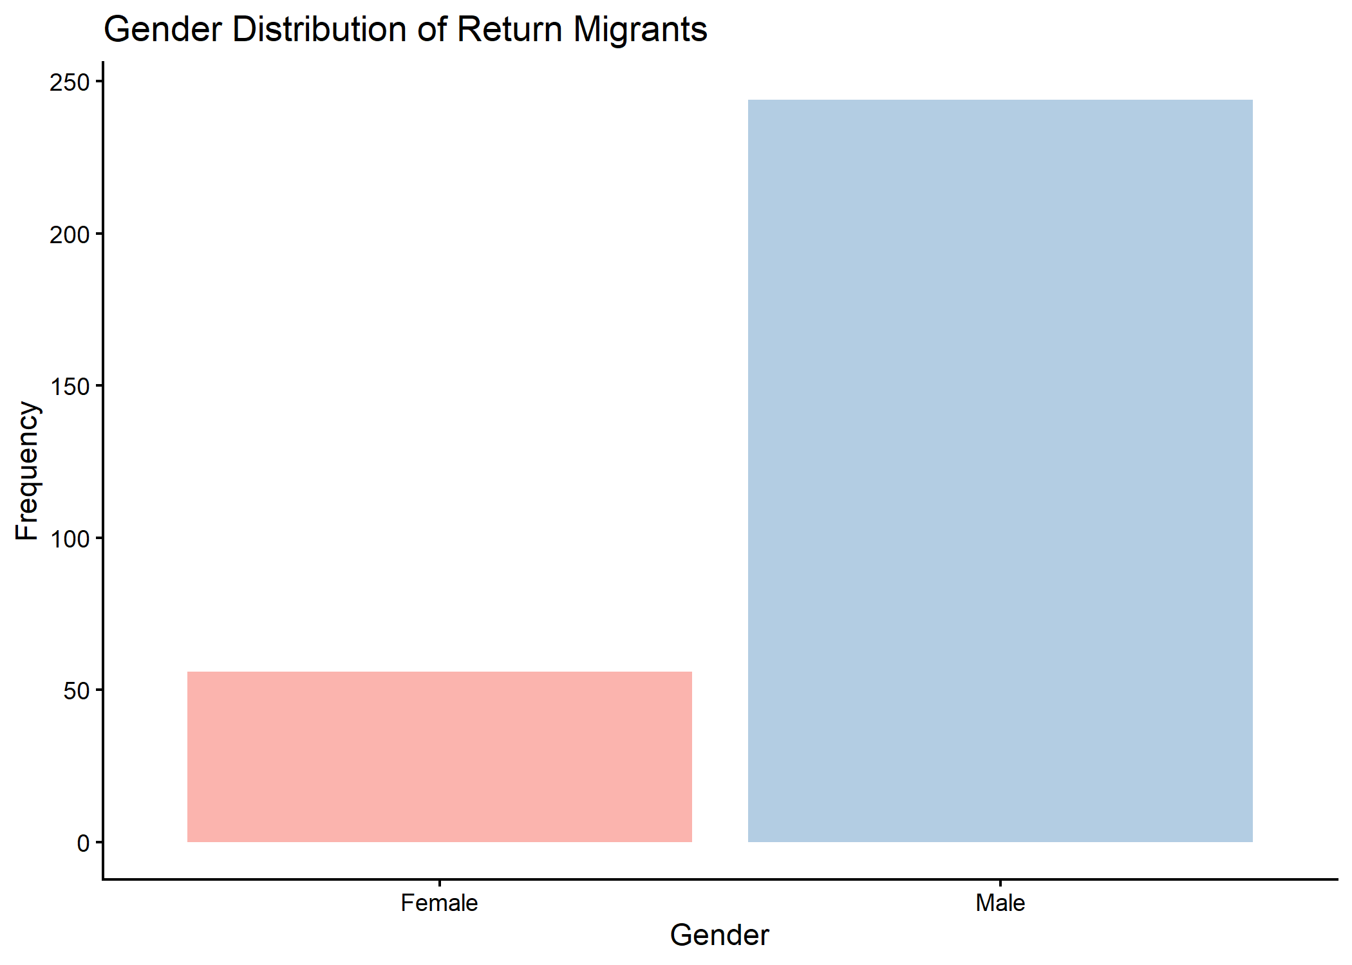
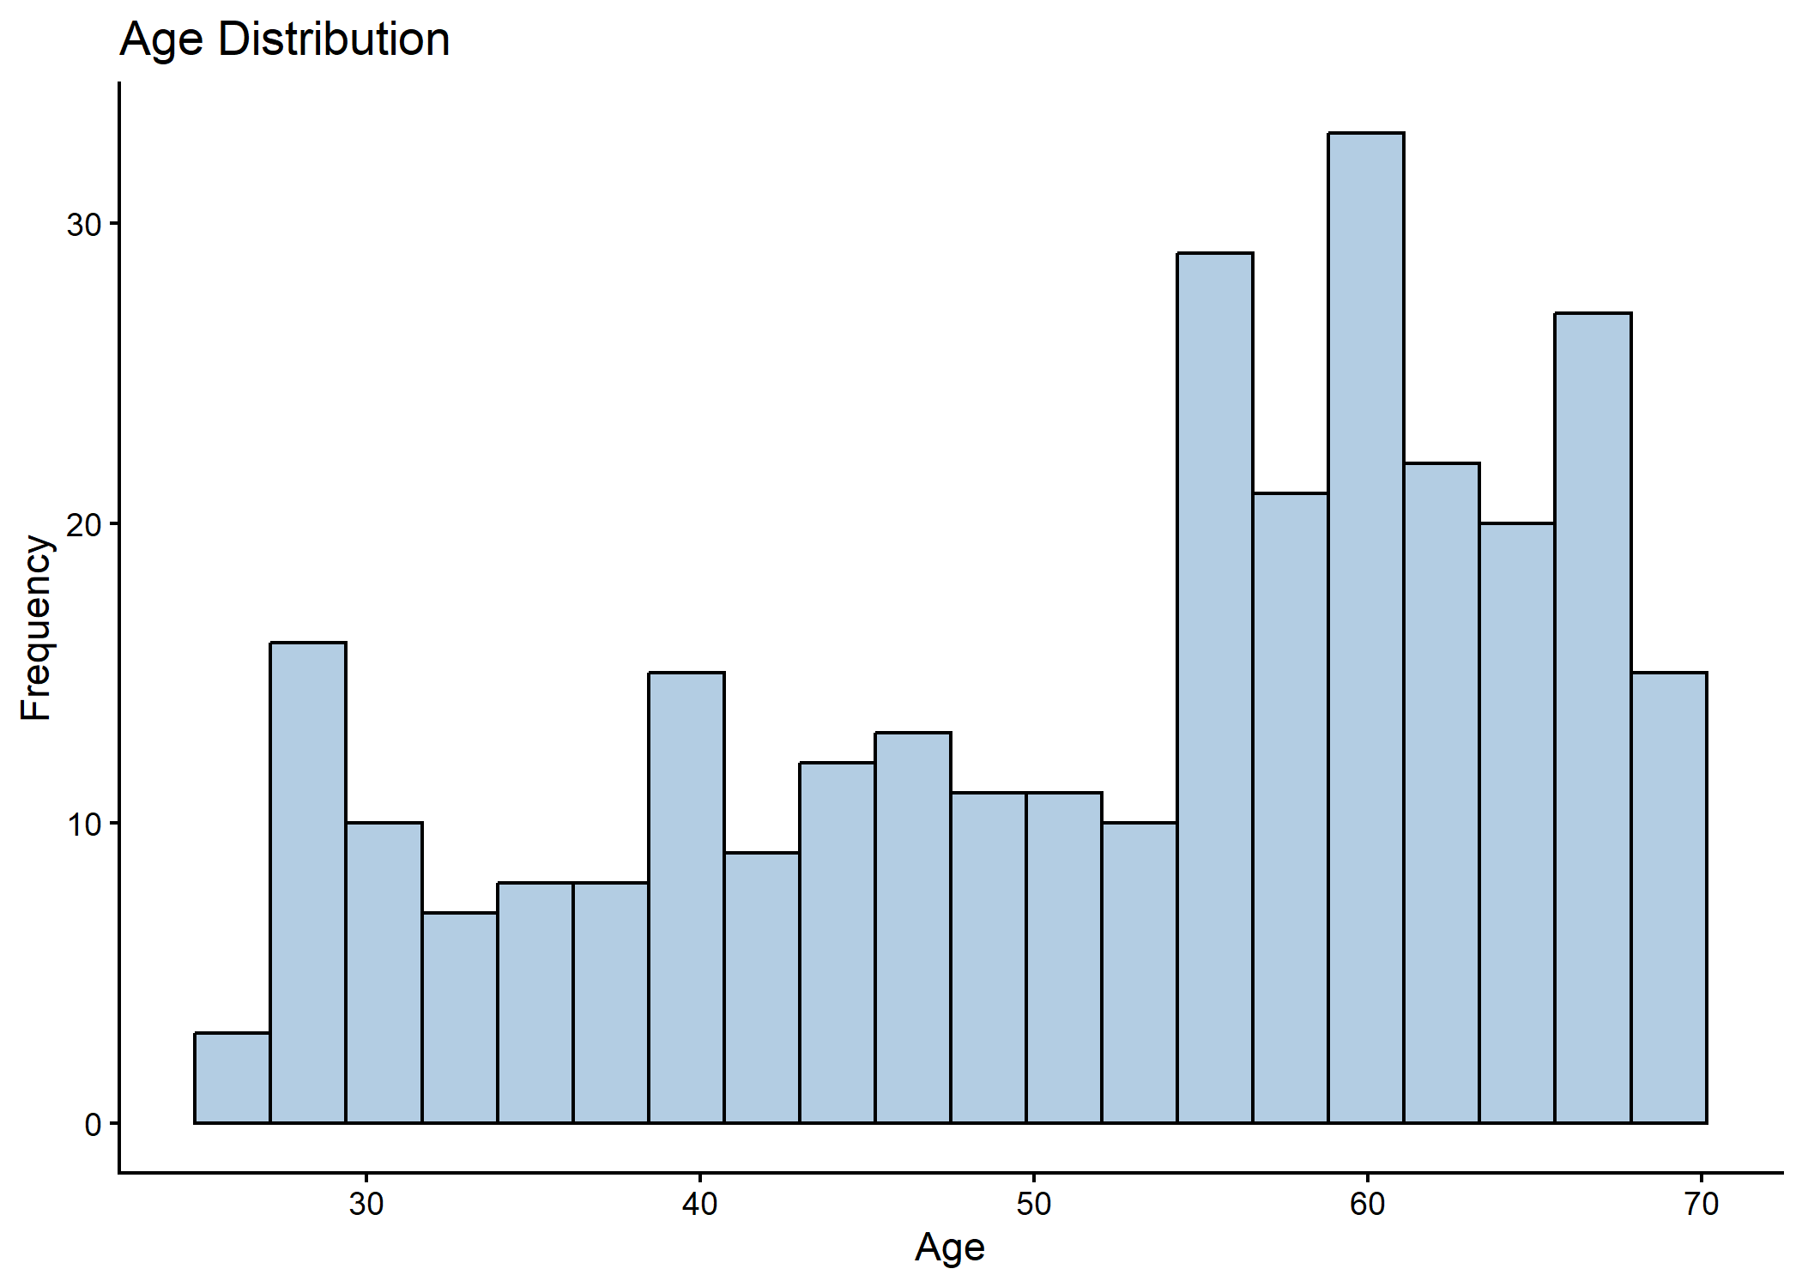
TRENDS IN DATASET
GENDER
AGE

Slide 13
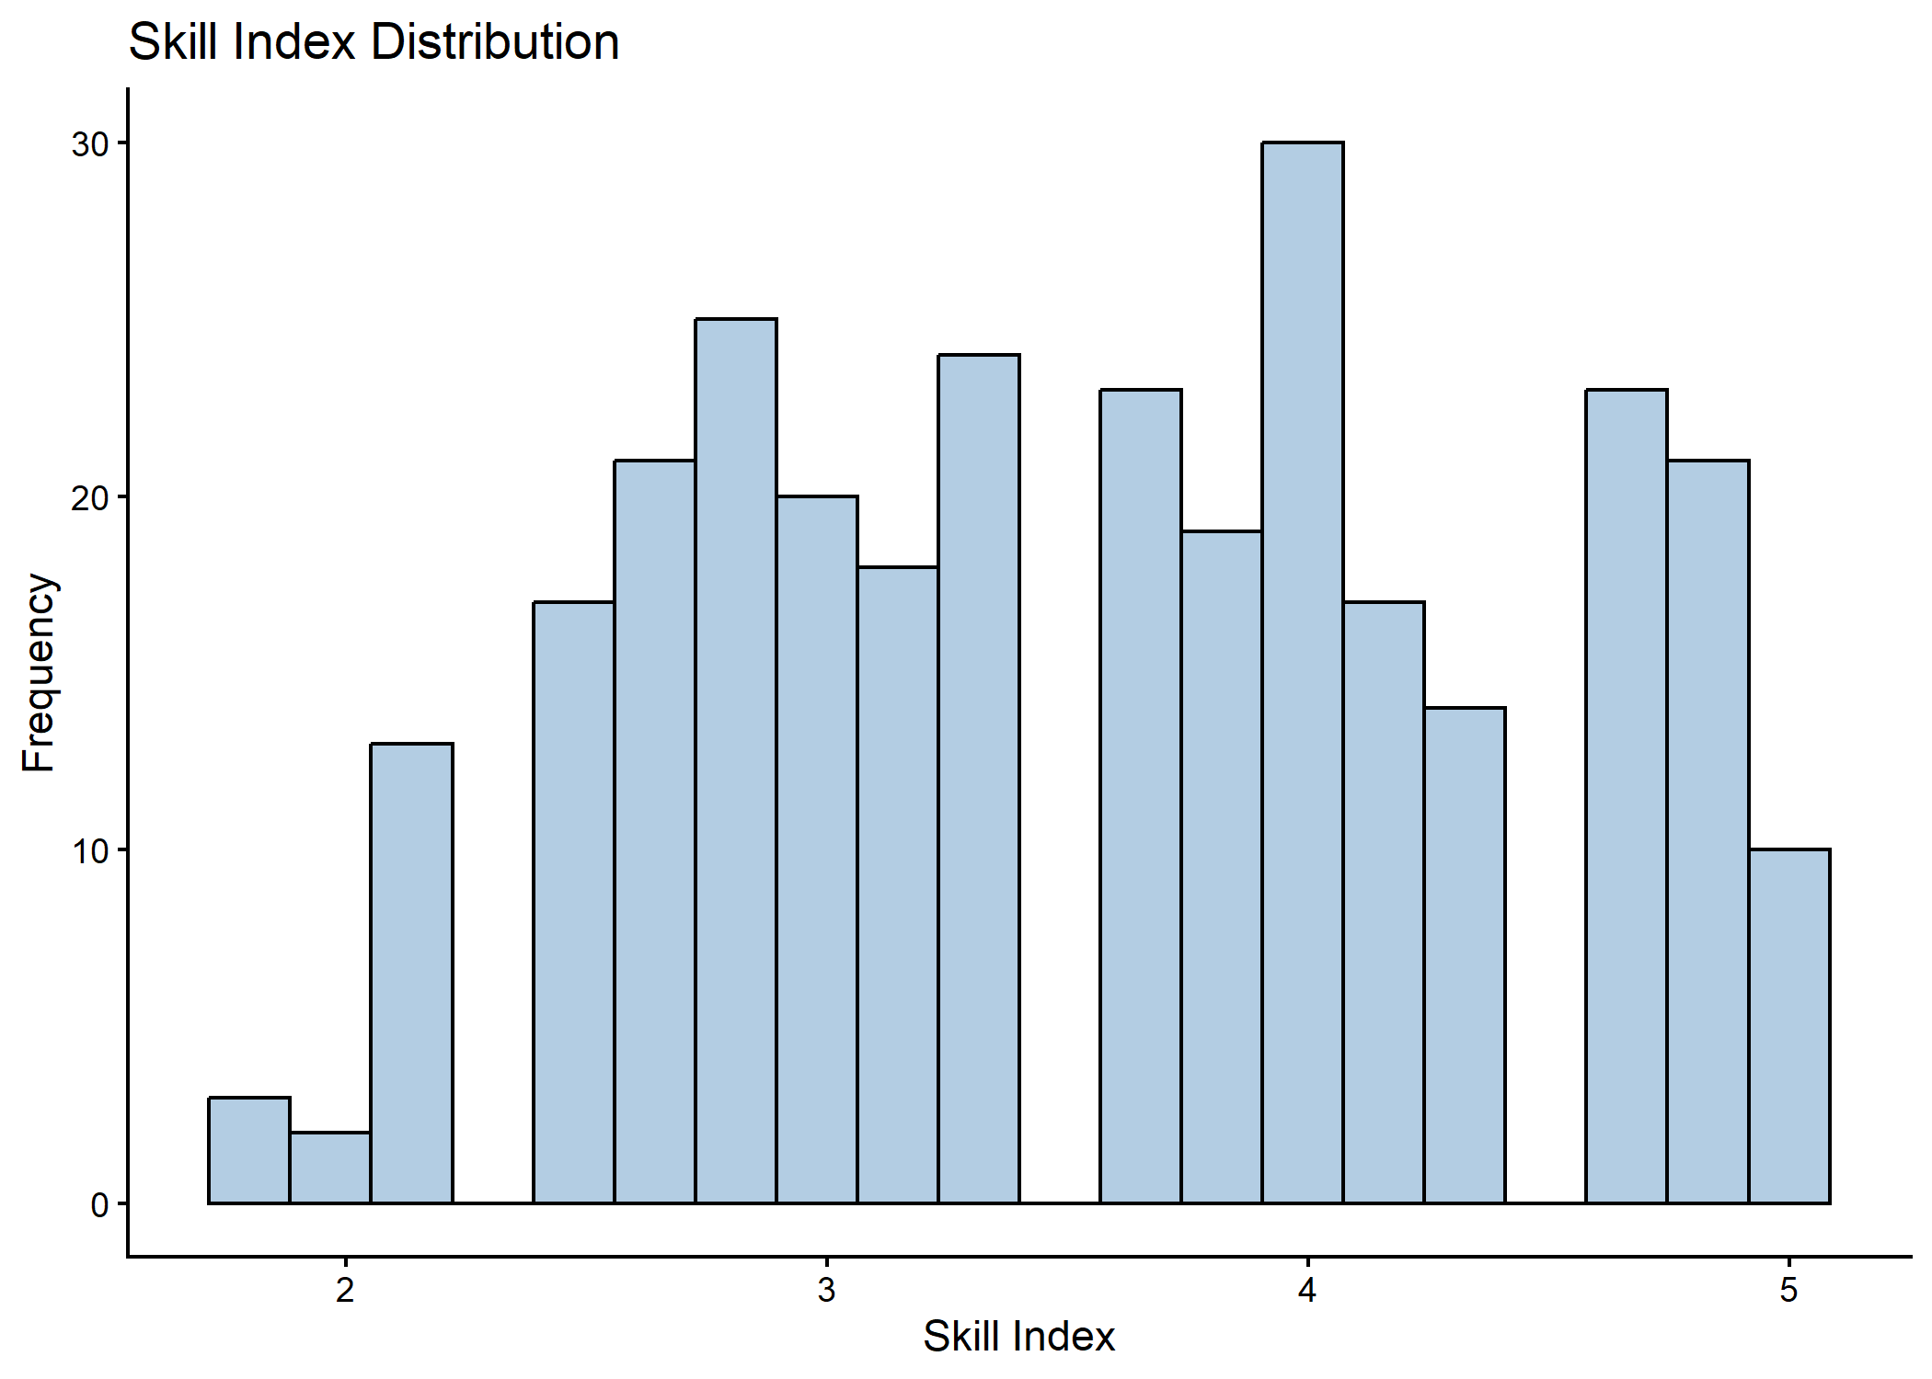
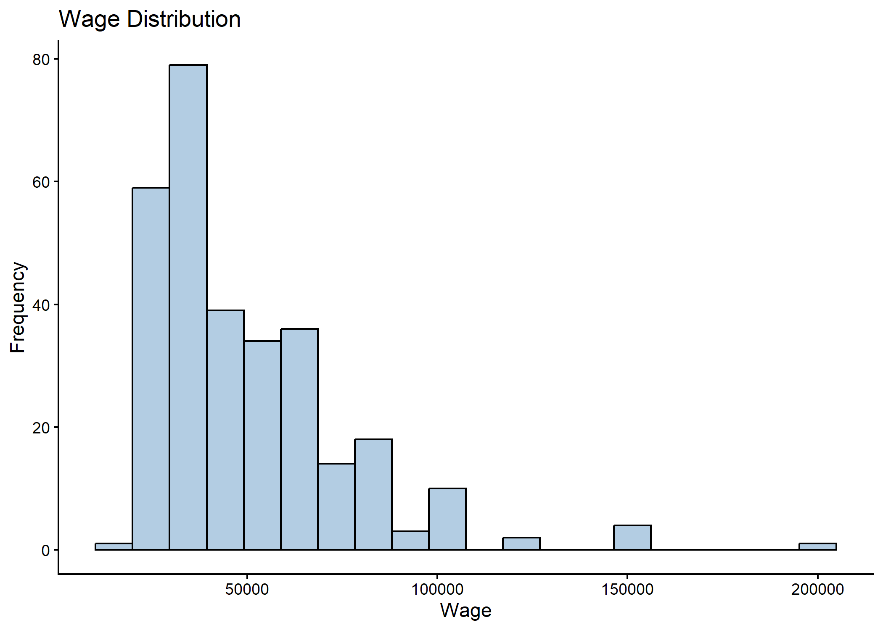
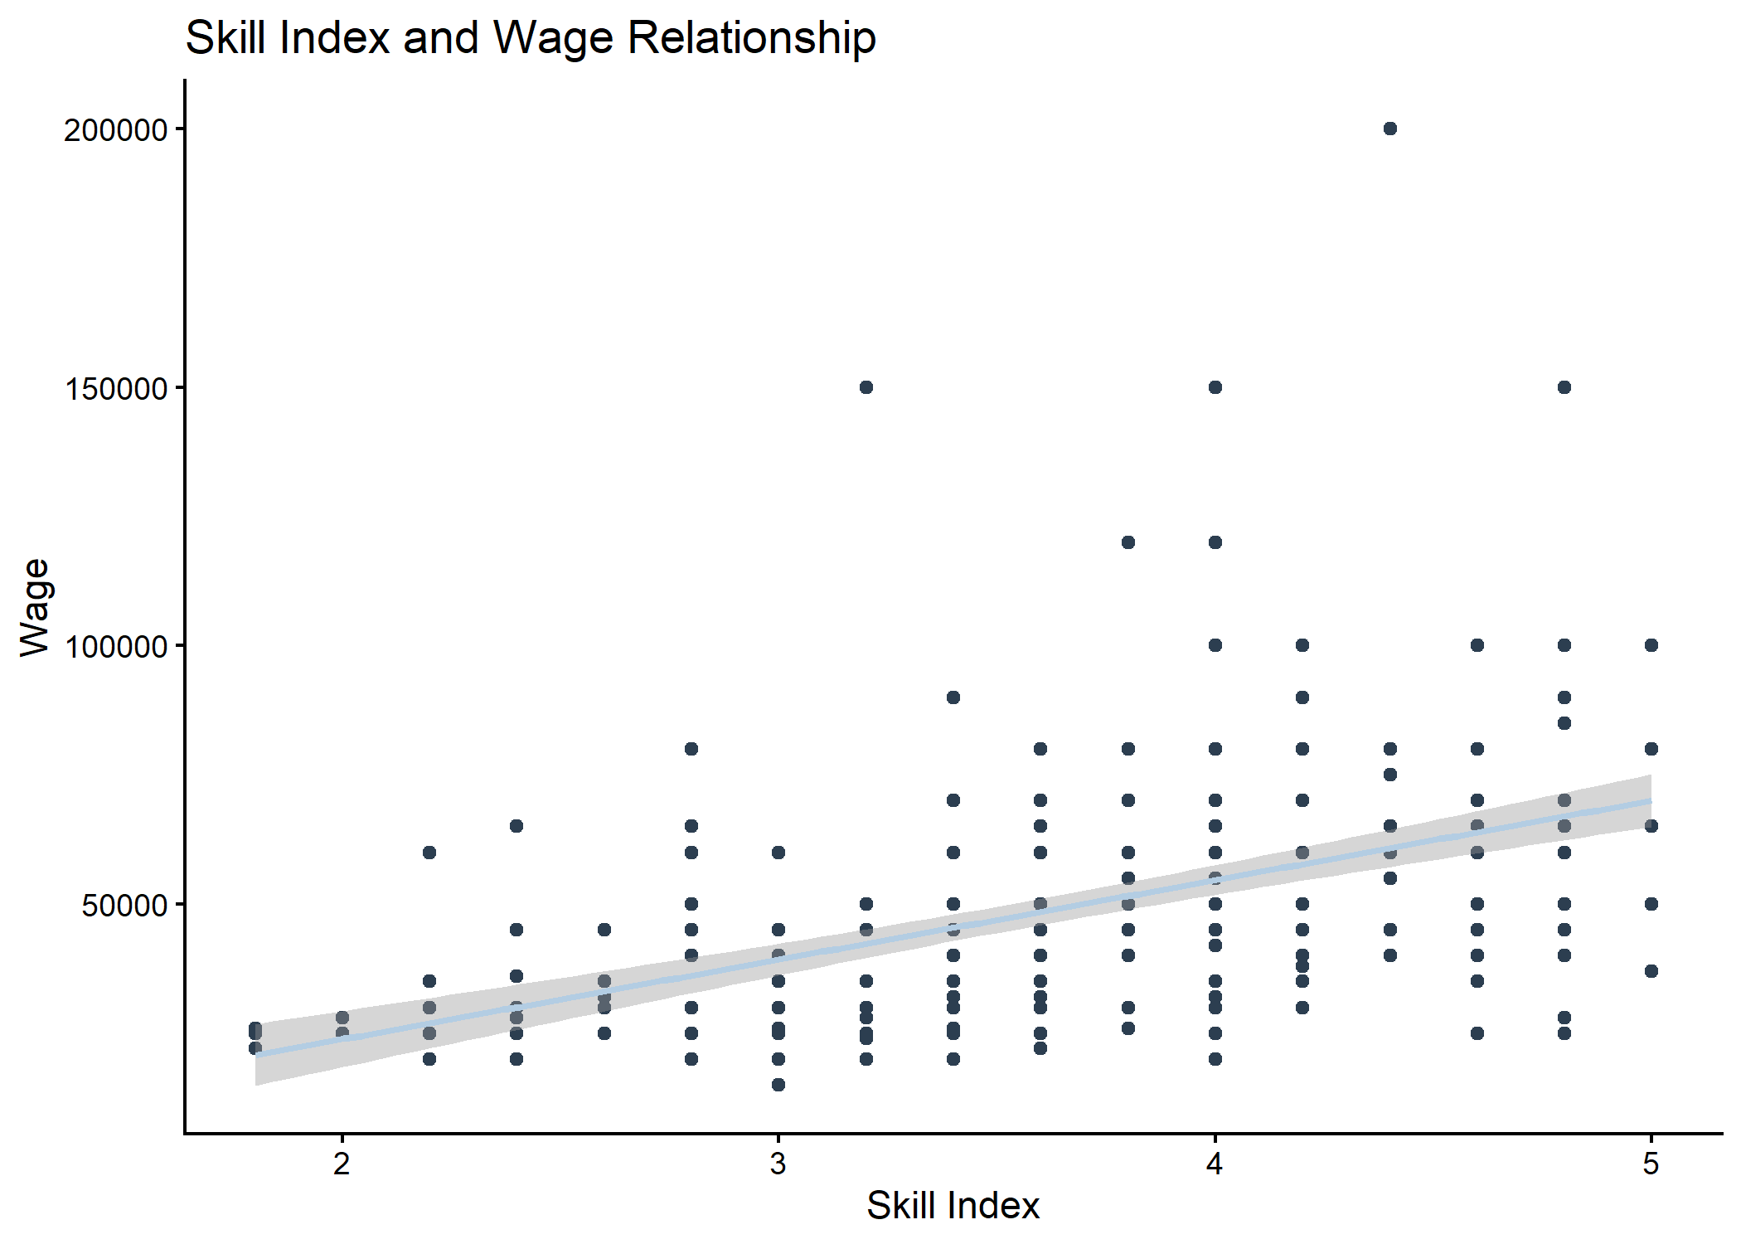
Positive relationship between skill index and wages, supporting human capital theory, though variation suggests influence of other factors
SKILL INDEX & WAGE
SKILL INDEX
WAGE
Migration significantly enhances human capital
Wages are concentrated between ₹25,000–₹60,000, with few at extremes, indicating moderate earnings with variation across occupations.

Slide 14
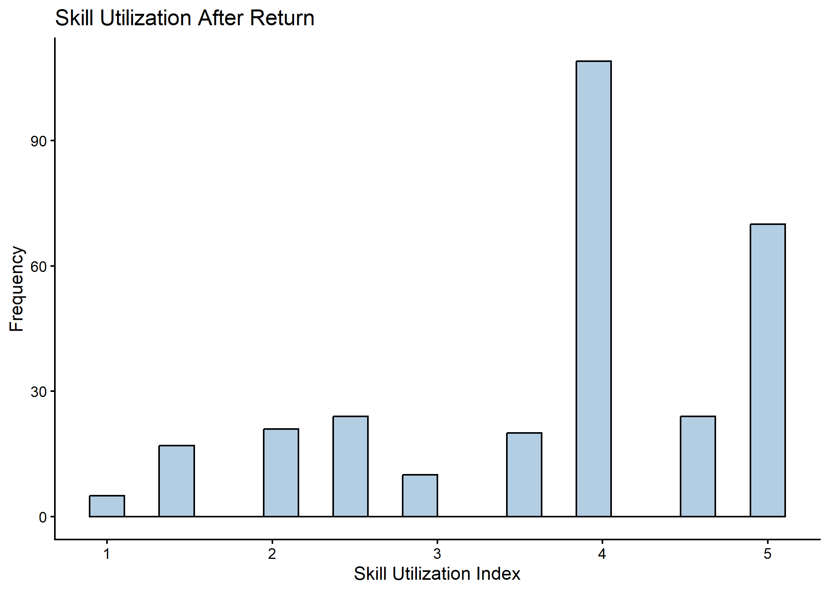
COMPARISON- ENTREPREPRENEURS & NON-ENTREPRENEURS
SKILL UTILIZATION INDEX
Variables | Non-Entrepreneurs | Entrepreneurs
Age | 48.47 | 59.26
Experience Abroad | 10.51 | 17.25
Skill Index | 3.56 | 3.56
Government Support | 0.168 | 0.394
Wage | 41214.29 | 60403.85
Most return migrants effectively utilize foreign-acquired skills, though some mismatch persists.
Peak around 4 → moderate level skill utilization
Entrepreneurship is driven by experience and yields higher income, beyond skill alone.

Slide 15
SUMMARY STATISTICS
Variable | Mean | SD | Min | Max
Age | 52.21 | 12.31 | 26 | 69
Years of experience abroad | 12.85 | 8.10 | 0 | 42
Male | 0.81 | 0.39 | 0 | 1
Married | 0.89 | 0.31 | 0 | 1
Education before migration Secondary or below
 | 0.23 | 0.42 | 0 | 1
Higher-secondary | 0.25 | 0.43 | 0 | 1
Undergraduate | 0.40 | 0.49 | 0 | 1
Post-graduate | 0.07 | 0.25 | 0 | 1
Other | 0.05 | 0.22 | 0 | 1

Slide 16
Variable | Mean | SD | Min | Max
Skill index | 3.56 | 0.829582 | 1.8 | 5
wage | 47866.67 | 25724.46 | 15000 | 200000
Skill utilization | 3.75 | 1.100688 | 1 | 5
Govt support | 0.25 | 0.431791 | 0 | 1
Education after return | 0.07 | 0.255573 | 0 | 1
Education abroad | 0.17 | 0.37626 | 0 | 1
Entrepreneur | 0.35 | 0.476704 | 0 | 1
Formal job | 0.44 | 0.51 | 0 | 1
WINS
Experienced
Possess moderate to high skill levels
Skill utilization is high
CONCERNS
Access to government support remains limited

Slide 17
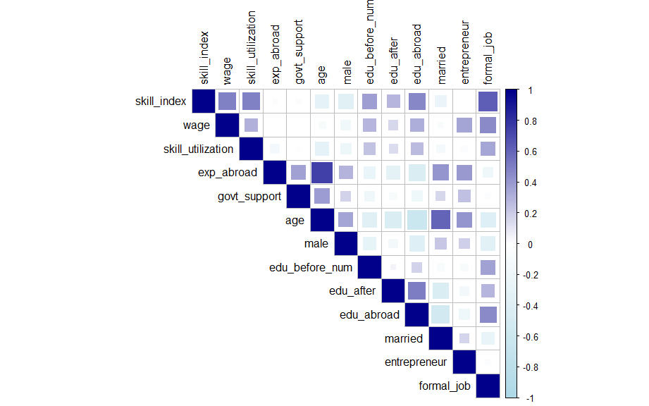
ASSOCIATIONS
Skill index, skill utilization, and wages, indicating the role of skills in improving earnings.
Experience abroad is strongly associated with wages and entrepreneurship.
CORRELATION BETWEEN VARIABLES
NOTE
Absence of high correlations suggests no serious multicollinearity among variables.

Slide 18
EMPIRICAL ANALYSIS RESULTS
Variables | Models
 | Logit Models |  | OLS Models
 | Formal Employment | Entrepreneurship | Wage | Skill Utilization
Skill Index | 4.791*** | 1.463 | 0.220*** | 0.634***
Experience abroad | 1.006 | 1.021 | 0.0005 | -0.002
Government support | 2.036+ | 1.312 | 0.047 | 0.235
Age | 0.966 | 1.105*** | 0.010*** | -0.031***
Gender Female | 1.557 | 0.428+ | -0.070 | -0.026
Marital Status Single | 1.021 | 2.439 | -0.033 | -0.408*

Slide 19
Variables | Models
 | Logit Models |  | OLS Models
 | Formal Employment | Entrepreneurship | Wage | Skill Utilization
Education before secondary or below | 0.546 | 0.531 | -0.248*** | 0.122
Education before higher secondary | 0.586 | 0.649 | -0.180*** | -0.036
Education before postgraduation | 4.997 | 0.273 | 0.214** | -0.011
Education before Other | 1.381 | 1.366 | -0.080 | 0.008
Education abroad | 4.012+ | 1.453 | 0.369*** | -0.155
Education after return | 2.061 | 0.727 | 0.105 | -0.285
Constant | 0.012** | 0.001*** | 9.380*** | 3.150***

Slide 20
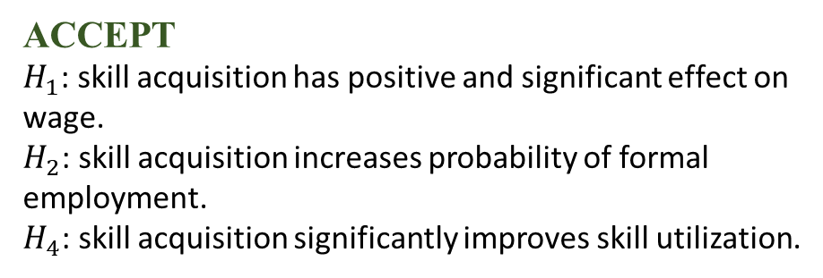
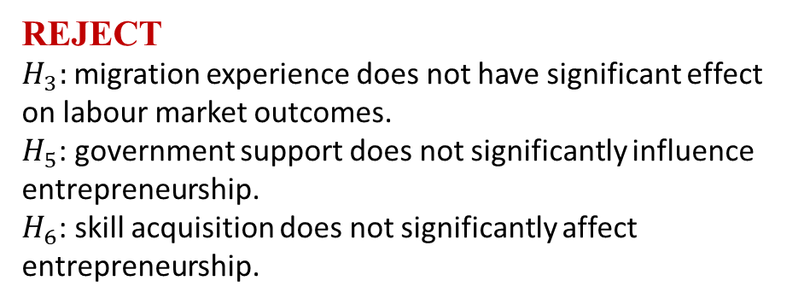
POSITIVE SIGNIFICANT EFFECT
Skill index
Wage
Skill utilization
Formal employment
Age
Entrepreneurship: older migrants more likely to start businesses
Wage
NEGATIVE SIGNIFICANT EFFECT
Age
Skill utilization: older migrants may not fully utilize skills
Lower-level education
Wage: individual with less education earn less
WEAK/ NOT SIGNIFICANT EFFECT
Formal education: limited independent impact.
Government support: gaps in policy effectiveness.
Experience abroad
ACCEPT
$H_{1}$: skill acquisition has positive and significant effect on wage.
$H_{2}$: skill acquisition increases probability of formal employment.
$H_{4}$: skill acquisition significantly improves skill utilization.
REJECT
$H_{3}:$ migration experience does not have significant effect on labour market outcomes.
$H_{5}$: government support does not significantly influence entrepreneurship.
$H_{6}$: skill acquisition does not significantly affect entrepreneurship.

Slide 21
CONCLUSIONS AND DISCUSSIONS
Skill acquisition is the most important determinant of labour market outcomes, significantly improving wages, formal employment, and skill utilization.
Formal education does not have an independent impact, indicating that practical skills matter more than qualifications.
Entrepreneurship is not driven by skills, but is more influenced by factors such as age and experience.
Government support has a limited role, suggesting gaps in policy effectiveness and outreach.
Overall, there exists a gap between skill acquisition and its effective utilization in the labour market.

Slide 22
LIMITATIONS
Sample size and coverage are limited which may affect generalizability.
Focus is only on individual-level analysis, excluding household or employer perspective.
Some variables may not be fully captured or measured accurately.
FUTURE SCOPE
Include employer side analysis
Explore gender differences in labour market outcome.
Examine the effectiveness of government schemes in greater detail.
Examine the impact of external economic conditions.
Deep analyze in age-related patterns in entrepreneurship activities.

Slide 23
POLICY RECOMMENDATIONS
Strengthen NORKA ( Non-Resident Keralites Affairs) with structured reintegration and skill recognition
Align skills with Kerala’s labour market needs
Introduce certification & recognition of foreign skills
Improve institutional coordination & labour market information
Promote inclusive entrepreneurship, especially among youth
Increase awareness and access to support programs

Slide 24
THANK YOU

Slide 25
Hypothesis
H1: Skill acquisition has a positive and significant impact on the wage outcome of return migrants.
H2: Skill acquisition increases the probability of formal employment among return migrants.
H3: Migration experience has a positive effect on the labor market outcome.
H4: Skill acquisition positively influences skill utilization by return migrants in the domestic labor market.
H5: Government support increases the chances of entrepreneurial activities.
H6: Skill acquisition has a significant effect on entrepreneurial activities.

Slide 26
APPENDICES
Variables | Models
 | Logit Models |  | OLS Models
 | Formal Employment | Entrepreneurship | Wage | Skill Utilization
Skill Index | 4.791*** (<0.001) | 1.463 (0.111) | 0.220*** (0.035) | 0.634*** (0.091)
Experience abroad | 1.006 (0.843) | 1.021 (0.443) | 0.0005 (0.004) | -0.002 (0.011)
Government support | 2.036+ (0.088) | 1.312 (0.433) | 0.047 (0.055) | 0.235 (0.143)
Age | 0.966 (0.167) | 1.105*** (<0.001) | 0.010*** (0.003) | -0.031*** (0.009)
Gender Female | 1.557 (0.392) | 0.428+ (0.085) | -0.070 (0.064) | -0.026 (0.165)
Marital Status Single | 1.021 (0.979) | 2.439 (0.253) | -0.033 (0.091) | -0.408* (0.234)

Slide 27
Variables | Models
 | Logit Models |  | OLS Models
 | Formal Employment | Entrepreneurship | Wage | Skill Utilization
Education before secondary or below | 0.546 (0.206) | 0.531 (0.131) | -0.248*** (0.065) | 0.122 (0.167)
Education before higher secondary | 0.586 (0.254) | 0.649 (0.300) | -0.180*** (0.060) | -0.036 (0.156)
Education before postgraduation | 4.997 (0.146) | 0.273 (0.130) | 0.214** (0.093) | -0.011 (0.240)
Education before Other | 1.381 (0.614) | 1.366 (0.652) | -0.080 (0.103) | 0.008 (0.267)
Education abroad | 4.012+ (0.083) | 1.453 (0.573) | 0.369*** (0.086) | -0.155 (0.221)
Education after return | 2.061 (0.546) | 0.727 (0.732) | 0.105 (0.102) | -0.285 (0.263)
Constant | 0.012** (0.004) | 0.001*** (<0.001) | 9.380*** (0.202) | 3.150*** (0.522)

Slide 28
Num.Obs. | 300 | 300 | 300 | 300
AIC | 268.5 | 334.8
BIC | 316.6 | 382.9
R² |  |  | 0.413 | 0.300
Adjusted R² |  |  | 0.389 | 0.271
+ p < 0.1, * p < 0.05, ** p < 0.01, *** p < 0.001

Slide 29
Formal employment regression result
Variables | Formal employment
 | Model1 | Model2 | Model3
Skill index | 7.062*** (<0.001) | 4.946*** (<0.001) | 4.791*** (<0.001)
age | 0.954** (0.005) | 0.973 (0.265) | 0.966 (0.167)
Gender Female | 1.839 (0.189) | 1.505 (0.424) | 1.557 (0.392)
Marital status Single | 1.324 (0.685) | 1.048 (0.954) | 1.021 (0.979)
Edu before Higher secondary |  | 0.721 (0.464) | 0.586 (0.254)

Slide 30
edu_beforeOther |  | 1.730 (0.380) | 1.381 (0.614)
edu_beforePost-graduation |  | 4.588 (0.167) | 4.997 (0.146)
edu_beforeSecondary or below |  | 0.595 (0.275) | 0.546 (0.206)
edu_abroad |  | 4.114+ (0.078) | 4.012+ (0.083)
edu_after |  | 2.149 (0.521) | 2.061 (0.546)

Slide 31
exp_abroad |  | 1.014 | 1.006
 |  | (0.622) | (0.843)
govt_support |  |  | 2.036+
(Intercept) | 0.007*** | 0.007** | 0.012**
 | (<0.001) | (0.001) | (0.004)
Num.Obs. | 300 | 300 | 300
AIC | 264.3 | 269.4 | 268.5
BIC | 282.8 | 313.8 | 316.6
Log.Lik. | −127.128 | −122.686 | −121.227
F | 20.843 | 7.203 | 6.600
RMSE | 0.37 | 0.36 | 0.35

Slide 32
Entrepreneurship regression result
Variables | Dependent Variable
 | Entrepreneurship
 | Model1 | Model2 | Model3
Skill Index | 1.647** | 1.485+ | 1.463
 | (0.009) | (0.096) | (0.111)
Age | 1.113*** | 1.110*** | 1.105***
 | (<0.001) | (<0.001) | (<0.001)
Gender Female | 0.468+ | 0.423+ | 0.428+
 | (0.095) | (0.083) | (0.085)
Marital status Single | 2.517 | 2.539 | 2.439
 | (0.197) | (0.234) | (0.253)

Slide 33
Education before Secondary or below |  | 0.546 | 0.531
 |  | (0.148) | (0.131)
Education before Higher secondary |  | 0.688 | 0.649
 |  | (0.360) | (0.300)
Education before Post-graduation |  | 0.262 | 0.273
 |  | (0.120) | (0.130)
Education before Other |  | 1.487 | 1.366
 |  | (0.560) | (0.652)
Education abroad |  | 1.468 | 1.453
 |  | (0.566) | (0.573)

Slide 34
Experience abroad |  | 1.023 | 1.021
 |  | (0.393) | (0.443)
Government support |  |  | 1.312
 |  |  | (0.433)
Intercept | 0.000*** | 0.000*** | 0.001***
 | (<0.001) | (<0.001) | (<0.001)
Num.Obs. | 300 | 300 | 300
AIC | 326.5 | 333.4 | 334.8
BIC | 345.0 | 377.8 | 382.9
Log.Lik. | −158.230 | −154.687 | −154.382
F | 12.952 | 4.809 | 4.484
RMSE | 0.42 | 0.41 | 0.41
+ p < 0.1, * p < 0.05, ** p < 0.01, *** p < 0.001

Slide 35
Variables | Dependent variable:
 | ln_wage
 | Model1 | Model2 | Model3 | Interaction Model
Skill Index | 0.329*** | 0.223*** | 0.220*** | 0.307***
 | (0.029) | (0.035) | (0.035) | (0.037)
Age | 0.003 | 0.010*** | 0.010*** | 0.005
 | (0.002) | (0.003) | (0.003) | (0.003)
Gender Female | 0.024 | -0.070 | -0.070 | -0.026
 | (0.063) | (0.064) | (0.064) | (0.065)
Marital status Single | 0.025 | -0.028 | -0.033 | 0.069
 | (0.089) | (0.090) | (0.091) | (0.090)

Slide 36
Education before Secondary or below |  | -0.242*** | -0.248*** | -0.208***
 |  | (0.064) | (0.065) | (0.066)
Education before Higher secondary |  | -0.171*** | -0.180*** | -0.128**
 |  | (0.059) | (0.060) | (0.062)
Education before Post-graduation |  | 0.210** | 0.214** | 0.141
 |  | (0.093) | (0.093) | (0.096)
Education before Other |  | -0.066 | -0.080 | -0.113
 |  | (0.102) | (0.103) | (0.106)

Slide 37
Education abroad |  | 0.370*** | 0.369***
 |  | (0.086) | (0.086)
Education after return |  | 0.106 | 0.105
 |  | (0.102) | (0.102)
Experience abroad |  | 0.001 | 0.0005 | -0.0004
 |  | (0.004) | (0.004) | (0.004)
Government support |  |  | 0.047 | 0.348
 |  |  | (0.055) | (0.231)

Slide 38
Skill Index:government support |  |  |  | -0.087
 |  |  |  | (0.066)
Constant | 9.339*** | 9.345*** | 9.380*** | 9.368***
 | (0.178) | (0.198) | (0.202) | (0.217)
Observations | 300 | 300 | 300 | 300
R² | 0.336 | 0.412 | 0.413 | 0.372
Adjusted R² | 0.327 | 0.389 | 0.389 | 0.348
Residual Std. Error | 0.382 (df = 295) | 0.363 (df = 288) | 0.364 (df = 287) | 0.376 (df = 288)
F Statistic | 37.299*** (df = 4; 295) | 18.335*** (df = 11; 288) | 16.851*** (df = 12; 287) | 15.476*** (df = 11; 288)
*p<0.1; **p<0.05; ***p<0.01

Slide 39
Variables | Dependent variable:
 | Skill utilization
 | Model1 | Model2 | Model3
Skill Index | 0.599*** | 0.649*** | 0.634***
 | (0.072) | (0.090) | (0.091)
Age | -0.024*** | -0.028*** | -0.031***
 | (0.006) | (0.009) | (0.009)
Gender Female | -0.053 | -0.026 | -0.026
 | (0.156) | (0.165) | (0.165)
Marital status Single | -0.476** | -0.382 | -0.408*
 | (0.218) | (0.235) | (0.234)

Slide 40
Education before Higher secondary |  | 0.013 | -0.036
 |  | (0.154) | (0.156)
Education before Other |  | 0.077 | 0.008
 |  | (0.264) | (0.267)
Education before Post-graduation |  | -0.033 | -0.011
 |  | (0.240) | (0.240)
edu_beforeSecondary or below |  | 0.153 | 0.122
 |  | (0.167) | (0.167)
Education abroad |  | -0.151 (0.222) | -0.155 (0.221)

Slide 41
Education after |  | -0.279 | -0.285
 |  | (0.264) | (0.263)
Experience abroad |  | -0.0001 | -0.002
 |  | (0.011) | (0.011)
Government support |  |  | 0.235
 |  |  | (0.143)
Constant | 2.920*** | 2.978*** | 3.150***
 | (0.437) | (0.512) | (0.522)
Observations | 300 | 300 | 300
R² | 0.286 | 0.293 | 0.300
Adjusted R² | 0.277 | 0.266 | 0.271
Residual Std. Error | 0.936 (df = 295) | 0.943 (df = 288) | 0.940 (df = 287)
F Statistic | 29.570*** (df = 4; 295) | 10.875*** (df = 11; 288) | 10.253*** (df = 12; 287)
*p<0.1; **p<0.05; ***p<0.01

Slide 44
Reliability test of skill index
Statistic | Value
Number of Items | 5
Cronbach’s Alpha (Raw) | 0.84
Standardized Alpha | 0.86
Average inter-item correlation | 0.55
Sample Size | 300

