Slide 2
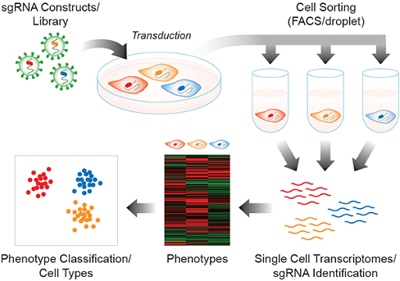
What is perturb-seq?
•Also known as CRISP-seq or CROP-seq
•High throughput single cell RNA sequencing on perturbation pools
•Gene perturbation à Phenotype expression

Slide 3
Library design and vectors

Slide 4
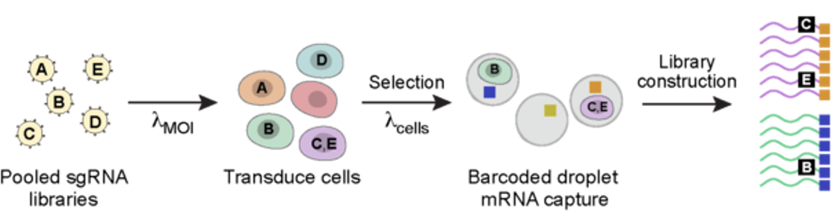
Transduction, selection and single-cell library preparation

Slide 5
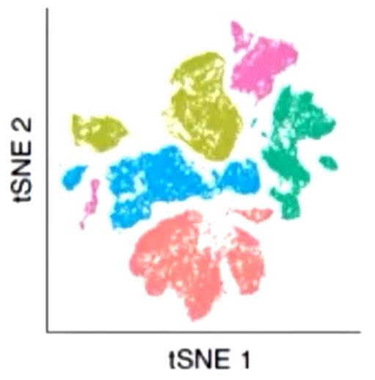
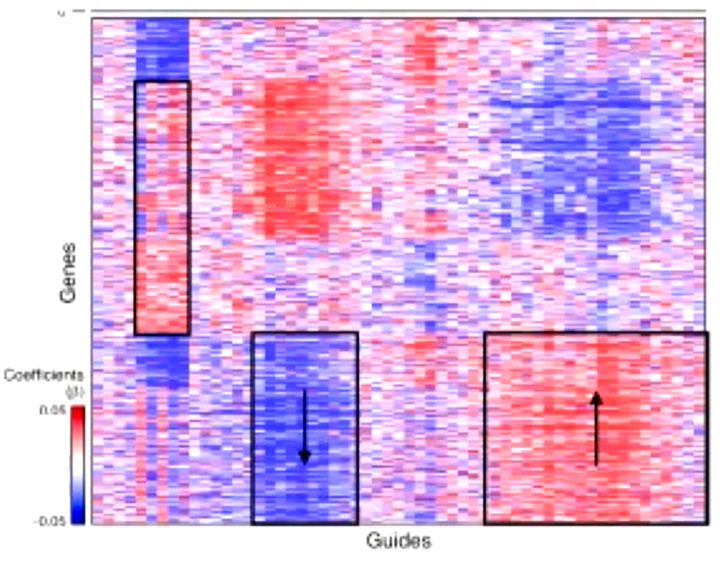
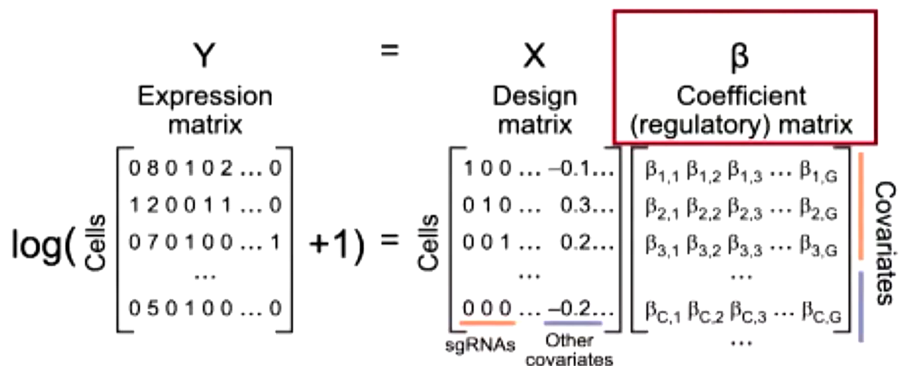

What can we learn from data?
Cells heterogenity (types/states)
Dimensionality reduction and clustering
Transcriptional changes due to perturbations and perturbation modules
MIMOSCA and heatmap
Effects of combination of perturbations
Addictive, synergistic…

