Slide 2

DTU Health Technology
Bioinformatics
Quantitative metagenomics
Trine Zachariasen
PhD student
Metagenomics group
DTU Bioinformatics section
Notes:
I’m In Gisles group for metagenomics.
Quantitative megagenomics → quantitative is a way of estimating the numbers or abundances of the organisms found in our metagenomics sample

Slide 3
Menu
Diversity measurements
Abundance
Alpha & beta diversity

Slide 4
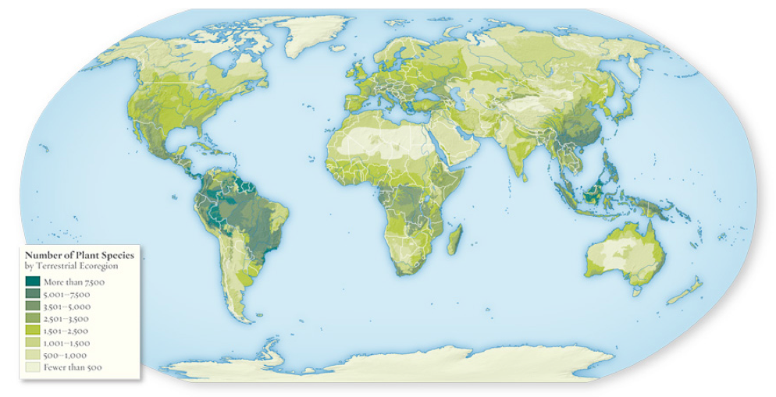
Classical measures of diversity
Abundance
Richness
Rarefaction
Diversity
Alpha
Beta
Notes:
Abundance: How many of each organism do we see?
Richness: How many different organisms do we have in our sample?
Rarefaction: The richness is a result of sampling, small sample - how many different taxa, larger sample - larger amount of taxa?
Diversity: we can combine the information of the organisms present in the samples and compare it to calculate the diversity

Slide 5
Describing the spatial component of biodiversity: Alpha-diversity
Describes the diversity WITHIN a sample
SAMPLE1
Different microorganisms
Alpha diversity: 3

Slide 6

Describing the spatial component of biodiversity: Beta-diversity
Describes the diversity BETWEEN samples,
c = species in common
SAMPLE1
SAMPLE2
ß
Alpha diversity: 3
Alpha diversity: 4

Slide 7
Describing the spatial component of biodiversity: Beta-diversity
(3-2) + (4-2) = 3
SAMPLE1
SAMPLE2
ß=3
Alpha diversity: 3
Alpha diversity: 4
Notes:
The beta and alpha diversity can also be compared between multiple sites as a measurement of diversity

Slide 8
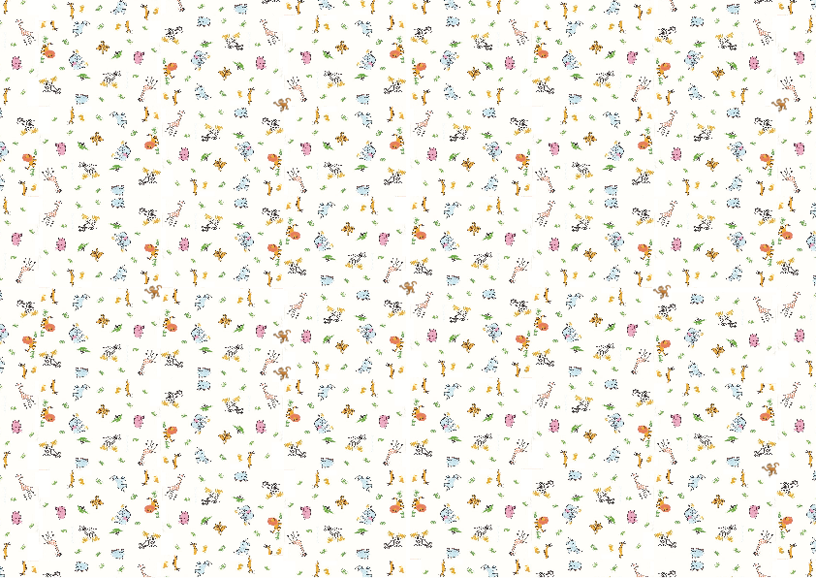
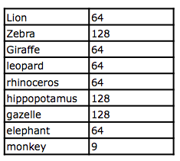
Abundance (counts)
Notes:
Abundance or the counts of different organisms is a different way of quantifying the metagenomics samples.
These are simply the raw counts of the organisms and can be used to further describe the environment.

Slide 9
Species richness
The number of different species in a system
9 observed species
Notes:
One of the metrics that can be extracted from the abundance is the richness.
This is the number of different species found in the environment.
In this case we can count 9 different organisms, so the richness is 9.
In the ideal world we will have sampled the whole ecosystem with all it’s species.
However this is in practice not possible. And depending on the richness and abundance of the system, different sequencing depths will be required in order to reach a satisfactory level of coveragre
However the truth is that we will never be able to sequence it all and the “required

Slide 10
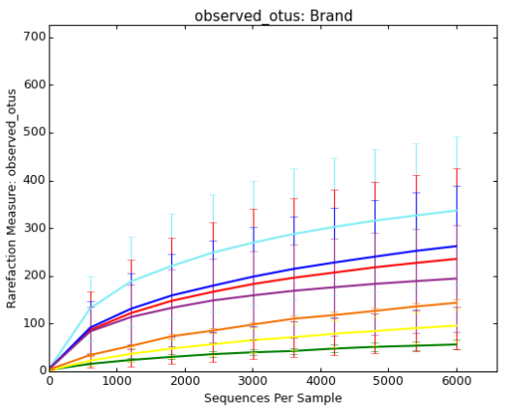
Rarefaction
Operational Taxonomic Unit
Species richness is a function of our no. observations
When have we sampled enough?
Mostly used for 16s rRNA amplicons…why?
Notes:
The more we sample, the more species we expect to see in our sample → we will reach a point, where we have already seen “all” the species in the environment. This is where the plot will plateau.
It is made by subsampling the sequences/reads and counting the number of different species in the data
It can be used to estimate, when we have sequencesd deep enough, but also to generate an estimate of how many species we have not yet identified in our data! If the curve keeps increasing it can also be a sign of sequencing errors/noice in the data!
Mostly used for amplicon/16s rRNA data, since we have the references! If we use shotgun data, then we will need to know exactly which organism the read is originating from in order to correctly estimate the number of species in the sample!

Slide 11
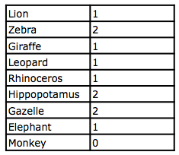

Species richness
8 observed species
Chao1 index = S_{obs} + f₁²/(2f₂)
S_{obs} = observed species
F_{x} = species observed x times
Chao1 index = S_{obs} + f₁²/(2f₂)
Richness = 8
Chao1 index = 8 + 5²/(2*3) = 12

Slide 12

Shannon index
Incorporates species richness & eveness
Quantify the entropy (information content)
Quantifies the uncertainty (degree of surprise) associated with a prediction
The Shannon index increases as both the richness and the evenness of the community increase
Typical values are generally between 1.5 and 3.5 in most ecological studies, and the index is rarely greater than 4
P_{i} = species proportion
R = observed species = richness
Notes:
The shannon index can be interpreted as the probability/surprice associated with the prediction.
The idea is that the more species there are, and the closer their proportional abundances in the species of interest, the more difficult it is to correctly predict which species will be the next one in the sampling. Thus the more species there are with equal distributions, the uncertainty will also increase.
The diversity is highest with low shannon values

Slide 13
Shannon index
11 animals (NOT species) meaning each animal is 0.09 of the total abundance
H’ = -(ln(0.09^{0.09}) + ln(0.18^{0.18}) + … = 2.0
Notes:
Here we have a total of 11 animals – Each animal has a probability of 0.09
If we then plug in the number observations of each species into the formular, then we get a Shannon entropy of 2.
This is for 1 sample/environment, what if we want to compare across?

Slide 14
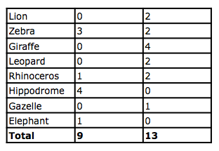
Bray-curtis dissimilarity
0 ≤ B ≤ 1
B_{ij} = 1 - 2C_{ij} / (S_{i} + S_{j})
C = sum of the lowest count of all common species
S = total count of the sample
1 means that they do not share anything
B_{s1s2} = 1 - 2*(2+1) / (9 + 13) = 0.73
Notes:
quantify the compositional dissimilarity between two different sites, based on counts at each site.
VERY much dependent on the sample size and how we sampled!!!

Slide 15
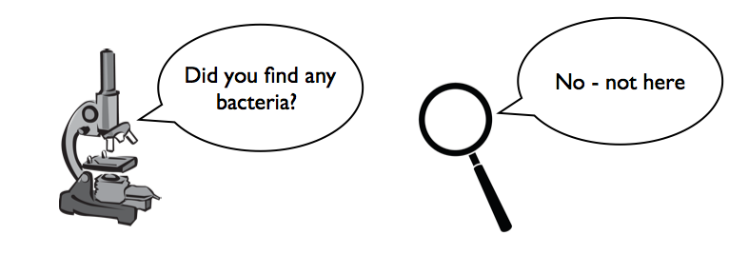
Sampling effect
To be fair we should sample equally in the systems we investigate
Notes:
In general with metagenomics it is very important to remember the sampling effect, as we are not able to sample/sequence exhaustevely!!

Slide 16
Sample sizes
Notes:
Different sample sizes will of course result in different abundances and richness et
There are a few ways of how we can control for this!

Slide 17
Sample sizes
Accounting for different sample sizes:
Normalize to sample size
Rarefy (downsize) samples
Statistically model the variance

Slide 18
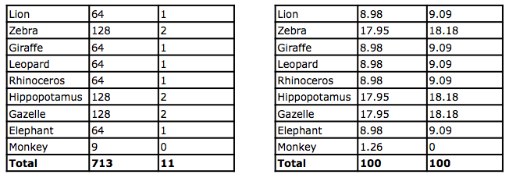
Normalizing
N = n_{i}/n_{tot}
Issue with different sampling power (higher chance of observing rare species) and does not take compositional nature into account
Notes:
Here we divide the number of counts with the total number of observations
We still have the 2 samples, which are nowmalized.
For a larger sample the chance of having the rare species is higher!!
We see difference for the ”rare” monkey, - it is observed in the larger sample but not in the smaller one, as the probability of the small sample capturing the rare one will be skewed. (plus if it was included, then the prediction of its abundance would also be wrong)

Slide 19
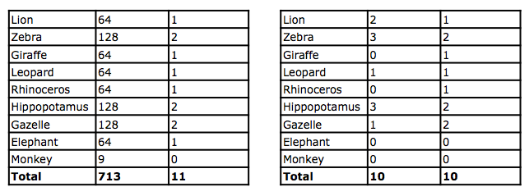
Downsize / rarefy
Resample x amount of observations
Notes:
Here we can decide a number of observations, which we want to have for both samples and draw them randomly from the samples.

Slide 20
Downsize / rarefy
Select the target depth carefully
The more reads we keep the more sensitive
We may have to remove samples with few counts
We might throw away a lot of data
Still does not take compositional nature of data into account
Notes:
As a good rule of thumb, take the number of reads, which is present in the smallest sample

Slide 21
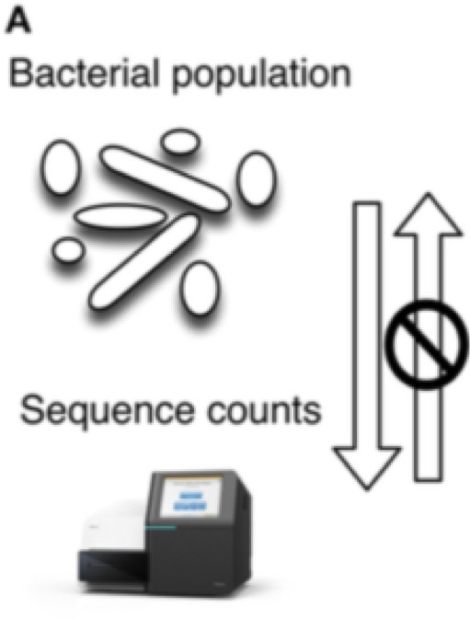
Compositional data
Arbitrary total
Sequencing depth never 100%
Species can co-exist without abundance inter-influences
Independence between abundance is aﬀected by the capacity of the sequencing instrument
Sequencing instrument has fixed number of slots
Figure from: Gloor, Gregory B. et al., Microbiome Datasets Are Compositional: And This Is Not Optional. Frontiers in Microbiology 8 (2017)

Slide 22
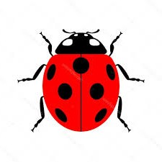

Compositional data problems
•
Example: an environment containing both tigers and ladybugs
The abundances of the two are not aﬀected by each other
If the abundance of the ladybugs increases some of the slots with tigers must instead be filled by ladybugs
i.e. the two environmentally independent species are aﬀecting the read count of each other
Population: 12 tigers and 8 ladybugs
Population: 12 tigers and 10 ladybugs
Increase in abundance of ladybugs, no change in abundance of tigers
Count: 6 tigers and 4 ladybugs
Count: 5 tigers and 5 ladybugs

Slide 23
Relative abundance
The counts we get is not the absolute abundance, but their proportions relative to each other
Population: 12 tigers and 8 ladybugs
Population: 12 tigers and 10 ladybugs
Increase in abundance of ladybugs, no change in abundance of tigers
Count: 6 tigers and 4 ladybugs
Count: 5 tigers and 5 ladybugs

Slide 24
Dealing with compositional data
Statistically model the variance & heteroscedasticity
Use packages developed for RNA-seq such as DESeq2 and edgeR
DESeq2 takes raw counts divided by sample-specific size factors determined by median ratio of gene counts relative to geometric mean per gene (See this link for a brilliant explanation)

Slide 25
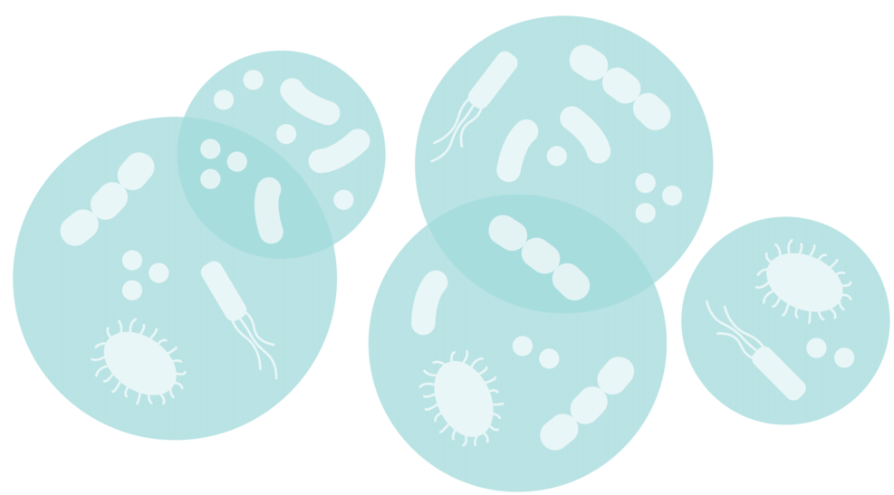
If you found it interesting check out the course at DTU Food

