Slide 1
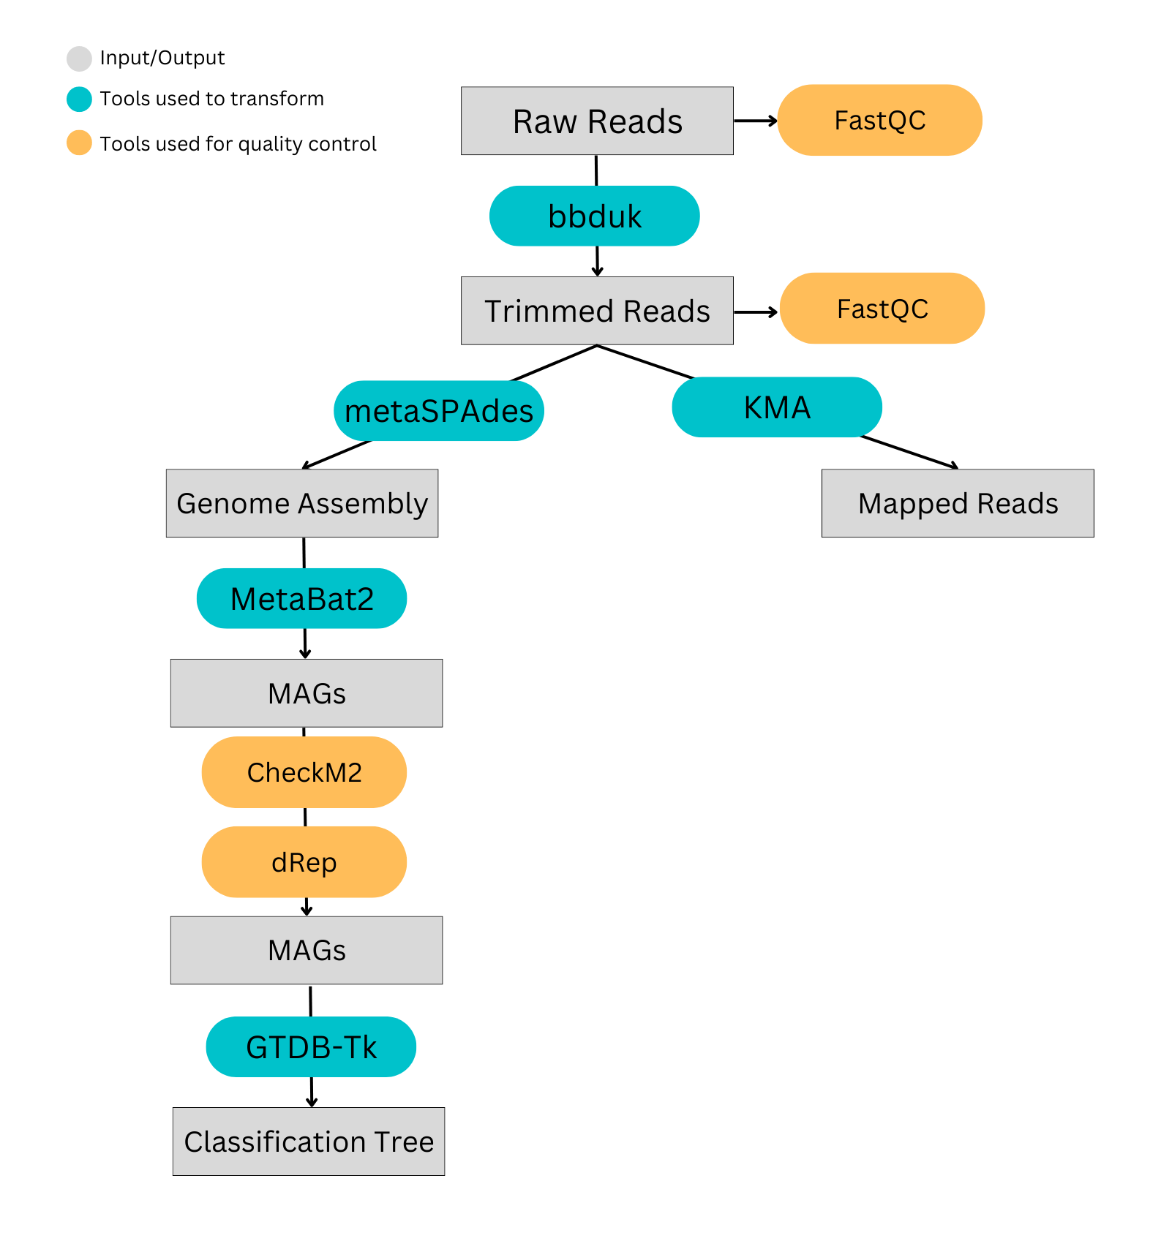
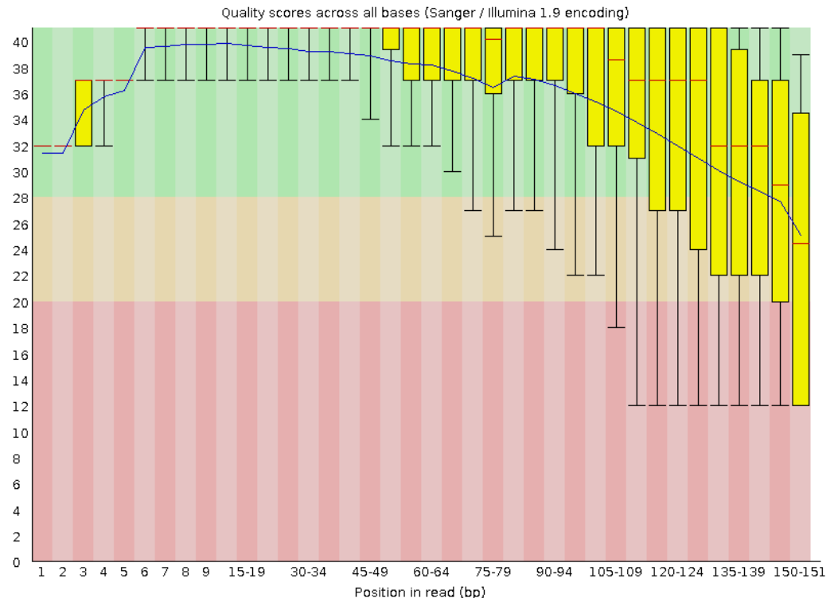
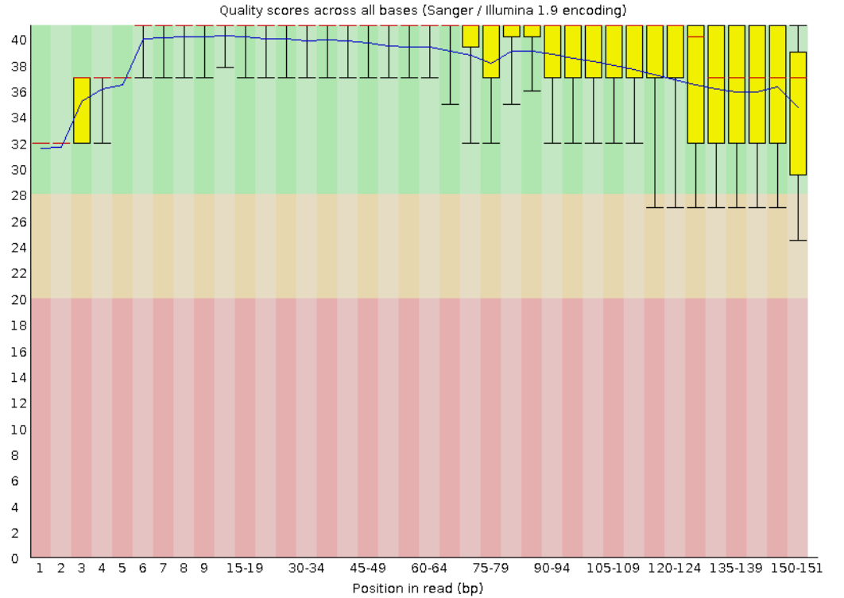
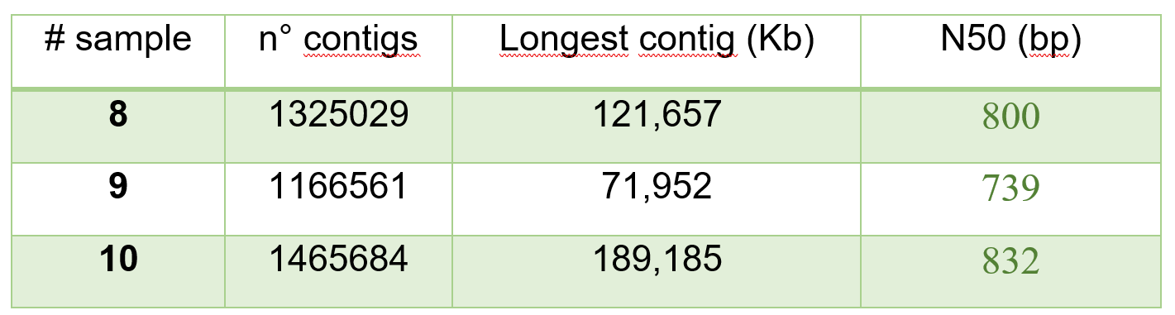
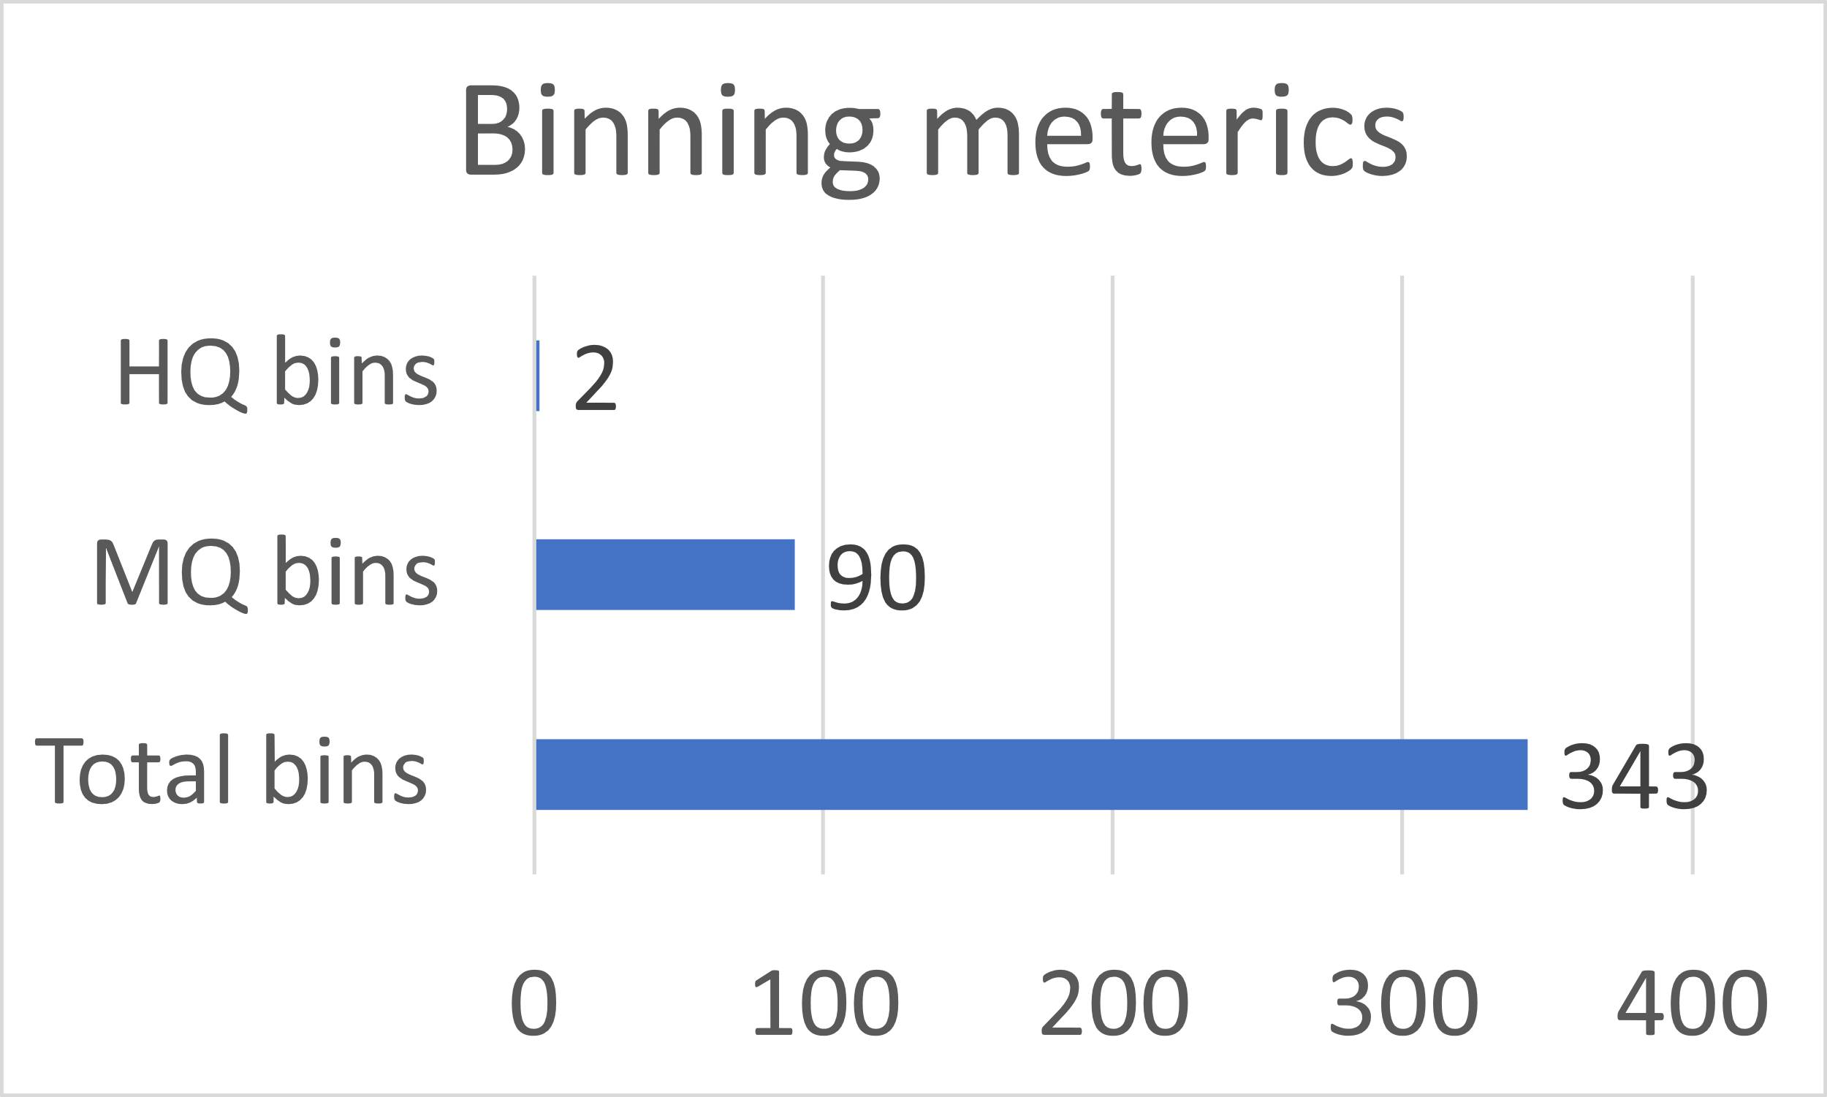
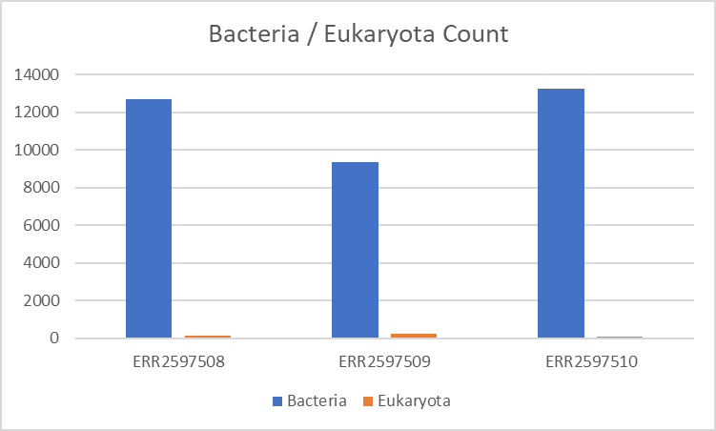

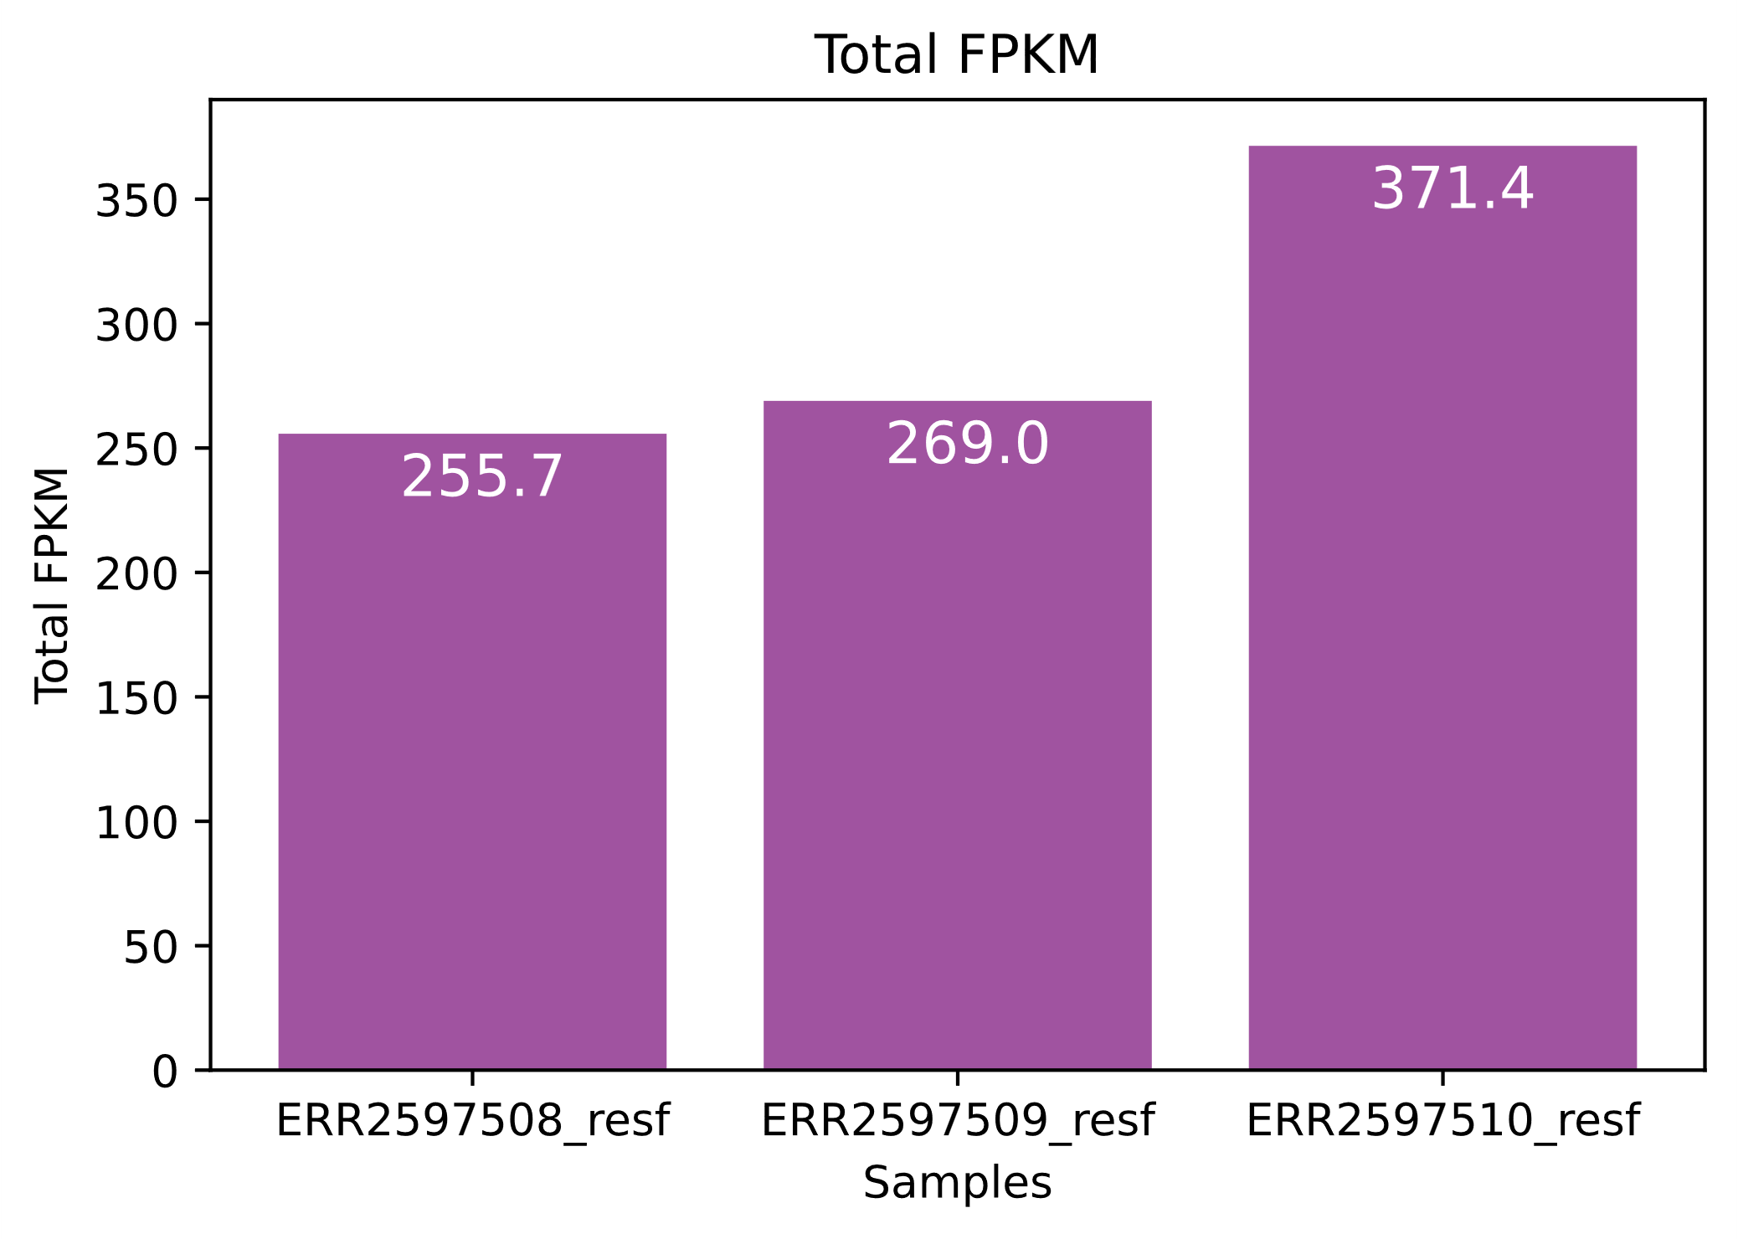
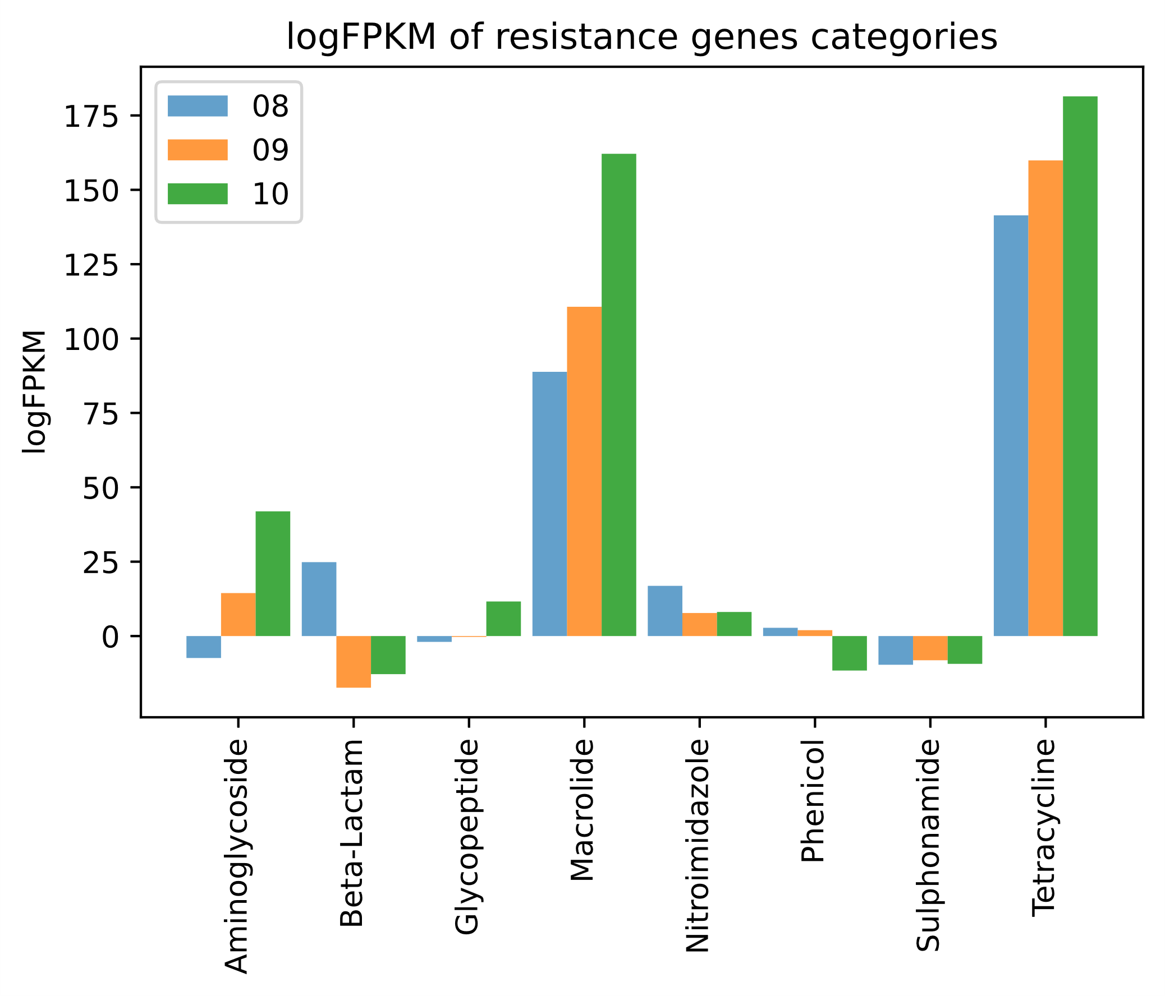

DTU 15th Dec 2022
23260 Applied methods in metagenomics
Resistance genes abundances in different pig feces samples from Danish farms
By Anna Miotto, Anna Keisha Boateng, Helene Brasch Lind Petersen and Paolo Federico
INTRO
This analysis compare three pig feces samples obtained from three different farms. The aim of this analysis is to find resistance genes in the three samples and compare results among the three samples. The analysis will follow a metagenomic workflow
TRIMMING and FASTQC Trimming of raw sequences is performed with bbduk applying both K-trim and Q-trim. Both raw reads and trimmed reads are analyzed with FastQC to investigate the quality of reads.
FLOWCHART
Figure A e B : pre and post trimming
ASSEMBLY AND BINNING De novo assembly by metaSPAdes applies De Bruijn graphs to transform the reads into assembly graphs, with the goal in the end to have long genomic fragments(contigs).
Trimmed reads are mapped back to the contigs by BBMap for coverage information. MetaBat2 bin contigs together that are believed to come from one organism (draft genomes), using contigs > 1000bp long and coverage table as input.
The 22 found dereplicated MAGs are mapped to the GTDB database, giving the following abundances for phylum and for top 4 genus. MAGs from pigs' gut microbiome are known to mainly map to Firmicutes and Bacteroidota.
MAPPING WITH KMA and COMPOSITIONAL ANALISYS
By mapping trimmed sequences to the SILVA database, the following distribution of bacteria and eukaryote are obtained in the three samples.
The fragmentCountAln from SILVA and ResFinder was used to obtain values for calculation of Fragments per Kb of transcript, per M fragments
$$\log{FPKM}= \frac{\log{([n° of fragmentes mapped to gene])}{10}^{3}{10}^{6}}{\left[total n° of mapped bacteria\right][gene length in bp]}$$
Phylum | Counts
Bacteroidota | 11
Firmicutes | 9
Proteobacteria | 1
Spirochaetota | 1
Genus
Prevotella | 2
Limimorph | 2
Cryptobacteroides | 6
Lactobacillus | 2
CONCLUSIONS
Most resistance genes were found in sample 10. Two classes of resistance genes are being far most abundant in all three samples; resistance against Marcrolide and Tetracycline antibiotics

