Slide 1
Applied methods in metagenomics
Week 5

Slide 2
Snakemake –
Scientific workflow system

Slide 3



What is a scientific pipeline?

Slide 4

Who am I
Georgios-Nikiforos Pyrounakis (Niki)
Greece,Athens
BSc in Computer Science and Telecommunications - Greece
Msc in Bioinformatics - Sweden
PhD - 1st year
DTU Food
nipy@dtu.dk

Slide 5

A scientific pipeline is ...
A set of actions which changes the raw data from various sources, to an understandable format so that we can store it and use it for analysis.”

Slide 6
A scientific pipeline really is ...
Data
Final product
Analysis 1
Analysis 2
fastq
Trimmed reads
Quality check
Trim

Slide 7
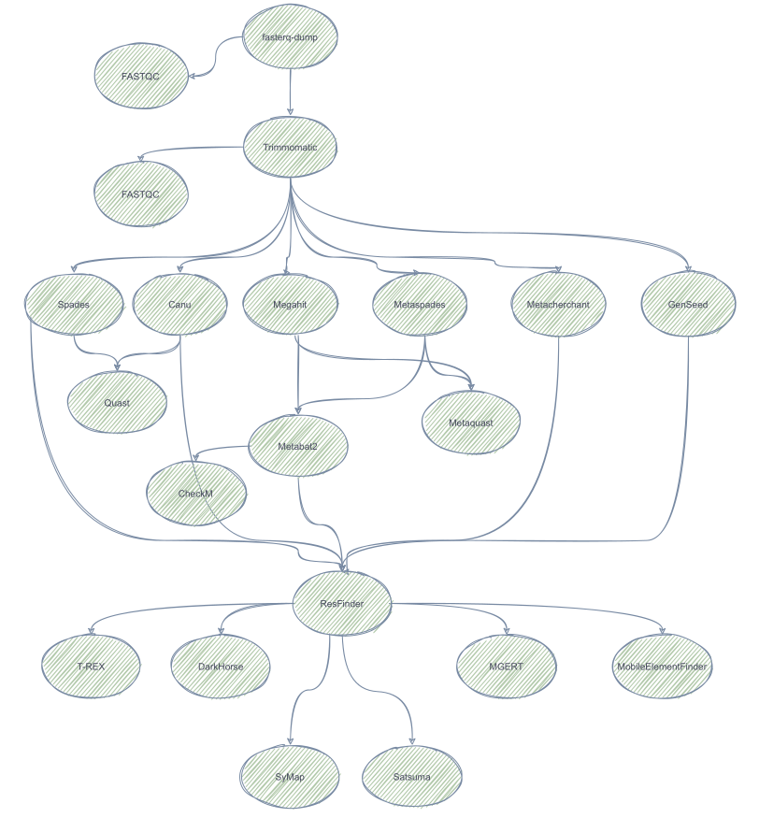
A scientific pipeline is ...
A set of actions which changes the raw data from various sources, to an understandable format so that we can store it and use it for analysis.”

Slide 8
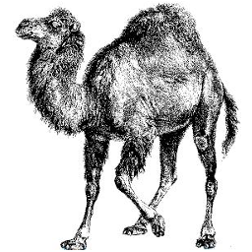


What we were doing before….

Slide 9

What we were doing before….
fastq
Trimmed reads
Quality Check
Trim
1 file...
2 files...
3 files...
.........
500 files...

Slide 10

Do we want that?

Slide 11
Workflow managers
A language to build (bioinformatics) pipelines:
  Specify Input files
  Analysis steps
  Get output files
By using workflow managers:
  No manual work
  Less mistakes

Slide 12
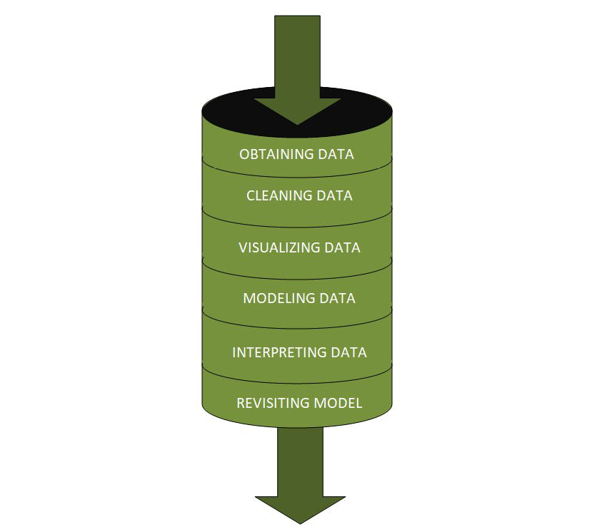
Workflow managers
Automation
Convenience
Portability
Reproducability

Slide 13



Workflow managers

Slide 14
Snakemake
Published in 2012
Johannes Köster
Snakemake workflows are essentially Python scripts extended by declarative code to define rules
Rules describe how to create output files from input files
Output files in a rule can be used as input in another
Snakemake works backwards from requested output, and not from available input
  Readable
  Portable
  Scalable

Slide 15
Snakemake – A simple rule
fastq
Trimmed reads
Quality Check
Trim
rule quality_check:
Rule trim:
input:
”A.fastq.gz”
output:
”A.trimmed.fastq.gz”
shell:
”””
bbduk {input} -o {output}
”””
input:
“A.fastq.gz”
output:
“A_fastqc.html”
shell:
”””
fastqc {input}
”””

Slide 16
Snakemake – Generalizing input
Snakemake allows generalizing rules by using named wildcards!
rule trim:
input:
”{sample}.fastq.gz”
output:
”{sample}.trimmed.fastq.gz”
shell:
”””
bbduk {input} -o {output}
”””
snakemake -- cores 1 A.trimmed.fastq
snakemake -- cores 1 A.trimmed.fastq B.trimmed.fastq
snakemake -- cores 1 {A,B}.trimmed.fastq

Slide 17
Snakemake – Generalizing input
Snakemake allows generalizing rules by using named wildcards!
rule samtools:
input:
”input/{sample}.bam”
output:
”output/{sample}.sorted.bam”
shell:
”””
samtools sort -T output/{wildcards.sample}
- 0 bam {input} > {output}
”””
Snakemake allows to access wildcards in the shell command via the wildcards object.

Slide 18
Snakemake – Generalizing input (Expand function)
Snakemake provides a helper function for collecting input files called expand
SAMPLES=["A", "B"]
rule trim:
input:
”expand("{sample}.fastq.gz", sample=SAMPLES)”
output:
”{sample}.trimmed.fastq.gz"
shell:
”””
bbduk {input} -o {output}
”””
snakemake -np {A,B}.trimmed.fastq.gz

Slide 19
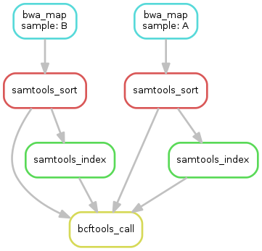
Snakemake – Directed Acyclic Graph (DAG)
Snakemake provide the option to visualize your steps by using DAGs
By executing:
  Snakemake --dag ....... | dot -Tsvg > dag.svg
Snakemake specifies the DAG in the dot language and pipes it into the dot command, which renders the definition into SVG format.
Other formats also available

Slide 20
Snakemake – Scripts
Snakemake offers the script directive!
rule makeplot:
input:
”{sample}.fasta”
output:
”{sample}.pdf”
script:
”makescript_script.py”

Slide 21
Snakemake – params
rule quality_check:
input:
”A.fastq”
output:
”A_fastqc.html”
params:
outdir=”FASTQC_results/”
shell:
”””
fastqc {input} -o {params.outdir}
”””
Shell commands are not only composed of input and output files
Snakemake allows to define specific parameters for rules with the params directive

Slide 22
Snakemake – Target rule
So far, we executed the workflow by specifying a target file at the command line like this:
    snakemake -- cores 1 {A,B}.trimmed.fastq
Snakemake accepts rule names as targets if the requested rule does not have wildcards.
It is possible to write target rules for collecting particular result files
Remember here, that Snakemake works backwards from requested output, and not from available input
rule all will specify the final result of the pipeline!!!!
rule all:
input:
”final_result.fasta”

Slide 23
Snakemake – Target rule
SAMPLES=["A", "B"]
rule all:
input:
”{sample}.pdf”
rule quality_check:
input:
expand(”{sample}.fastq”, sample=SAMPLES)
output:
”{sample}_fastqc.html”
params:
outdir=”FASTQC_results/”
shell:
”””
fastqc {input} -o {params.outdir}
rule trim:
input:
expand("{sample}.fastq.gz", sample=SAMPLES)
output:
”{sample}.trimmed.fastq.gz”
shell:
”””
bbduk {input} -o {output}
”””
rule makeplot:
input:
”{sample}.trimmed.fastq.gz”
output:
”{sample}.pdf”
script:
”makescript_script.py”
snakemake -np
Is there a problem here????

Slide 24
Snakemake – Target rule
SAMPLES=["A", "B"]
rule all:
input:
”{sample}.pdf”,
”{sample}_fastqc.html”,
”{sample}.trimmed.fastq.gz”
rule quality_check:
input:
expand(”{sample}.fastq”, sample=SAMPLES)
output:
”{sample}_fastqc.html”
params:
outdir=”FASTQC_results/”
shell:
”””
fastqc {input} -o {params.outdir}
rule trim:
input:
expand("{sample}.fastq.gz", sample=SAMPLES)
output:
”{sample}.trimmed.fastq.gz”
shell:
”””
bbduk {input} -o {output}
”””
rule makeplot:
input:
”{sample}.trimmed.fastq.gz”
output:
”{sample}.pdf”
script:
”makescript_script.py”
snakemake -np

Slide 25
Snakemake – Target rule and expand function
Good practice is to use the expand function in rule all.
Remember that rule all has the final result file or files of the pipeline.
SAMPLES=[“SRR4345213”,”ERR9809456”]
rule all:
input:
expand("bbduk_results/{sample}_1.trimmed.fastq.gz", sample=SAMPLES),
expand("bbduk_results/{sample}_2.trimmed.fastq.gz", sample=SAMPLES),
expand("assembly/{sample}/contigs.fasta", sample=SAMPLES)
rule trim:
input:
infile1="raw_reads/{sample}_1.fastq.gz",
infile2="raw_reads/{sample}_2.fastq.gz"
output:
outfile1="bbduk_results/{sample}_1.trimmed.fastq.gz",
outfile2="bbduk_results/{sample}_2.trimmed.fastq.gz",
shell:
"""
bbduk.sh in={input.infile1} in2=......
"""
rule assembly:
input:
in1="bbduk_results/{sample}_1.trimmed.fastq.gz",
in2="bbduk_results/{sample}_2.trimmed.fastq.gz"
output:
"assembly/{sample}/contigs.fasta"
shell:
"""
metaspades.py -t 20 -1 {input.in1} .......
"""

Slide 26
Snakemake – Target rule and expand function
Good practice is to use the expand function in rule all.
Remember that rule all has the final result file or files of the pipeline.
SAMPLES=[“SRR4345213”,”ERR9809456”]
rule all:
input:
expand("assembly/{sample}/contigs.fasta", sample=SAMPLES)
rule trim:
input:
infile1="raw_reads/{sample}_1.fastq.gz",
infile2="raw_reads/{sample}_2.fastq.gz"
output:
outfile1="bbduk_results/{sample}_1.trimmed.fastq.gz",
outfile2="bbduk_results/{sample}_2.trimmed.fastq.gz",
shell:
"""
bbduk.sh in={input.infile1} in2=......
"""
rule assembly:
input:
in1="bbduk_results/{sample}_1.trimmed.fastq.gz",
in2="bbduk_results/{sample}_2.trimmed.fastq.gz"
output:
"assembly/{sample}/contigs.fasta"
shell:
"""
metaspades.py -t 20 -1 {input.in1} .......
"""

Slide 27
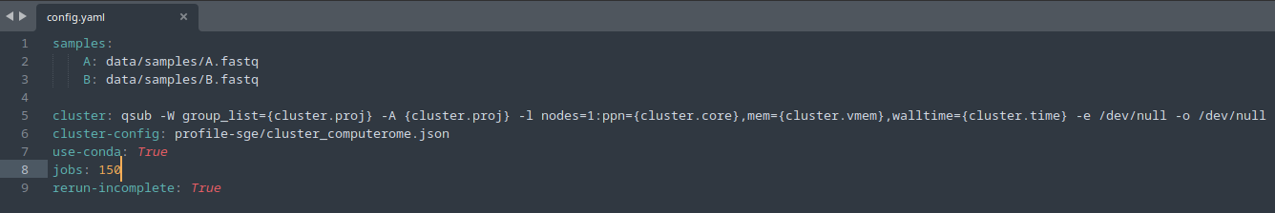
Snakemake – config file
Most of the times we want our workflow to be customizable, so that can easily be adapted to new data.
Snakemake provides a config file mechanism (JSON or YAML)
Snakemake directive: configure
configfile: "config.yaml" ----> Goes on top of the Snakefile
configfile: "config.yaml"
rule trim:
input:
expand("{sample}.fastq.gz", sample=config["samples"])
output:

Slide 28

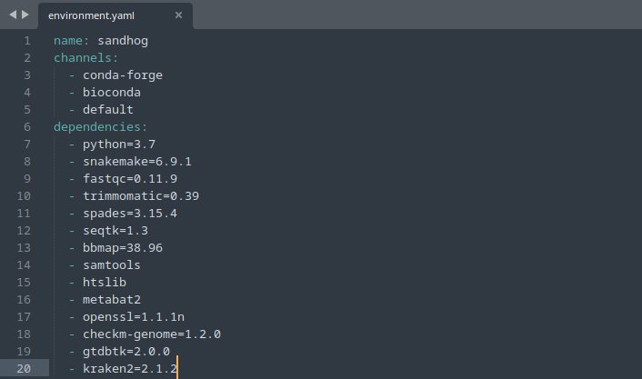
Snakemake – conda
Snakemake integrates with the conda package manager
Conda is a system for installing software packages into self-contained directories called environments.
By enabling conda in Snakemake all the necessary tools/software needed for the pipeline to run, can be automatically deployed upon execution.

Slide 29
Snakemake – Best practices
Think of the rules you need to create before you start writing your workflow
It is recommended to use the rule all as target
rule all defines the final product of the pipeline. The final result file
Execute your commands in bash first. Then use the same syntax in the Snakemake shell directive
Start slow. In the beginning use one or two samples and observe if the pipeline runs. If it runs with 2 files then it will be ok with 50,100,200…
Snakemake works backwards from requested output, and not from available input
Pay attention on the wildcards. Shell directive needs the “wildcards” object in order to handle sample values
https://snakemake.readthedocs.io/en/stable/index.html

Slide 30
THANK YOU

