Slide 1
<number>
Notes:
<number>

Slide 2
Week 4: Making your own WGS pipeline
<number>

Slide 3
Overview of today’s class
8.00-10.00: Making Finder tools for WGS analysis of incetious diseases.
Formulate the objective of our analysis
Set the data and databases
Run aligner and analyze the output
Make predictions of real data
10.00-12.00: Making a pipeline of tools for WGS analysis.
<number>

Slide 4
Design WGS Tool
Tool
Data
Trimming, QC, Assembly
PREDICTION
Database
Known
Sequences
Aligner
Dictionary for
predicting
<number>

Slide 5
Examples of WGS Tools
KmerFinder:
Mapping of k-mers
Typers (MLST, SalmonellaTypeFinder, SerotypeFinder):
Find DNA sequences, with accuracy at variant level
Dictionary relating type with sequence variants scheme
Finders (ResFinder, VirulenceFinder, PlasmidFinder):
Find DNA sequences
Dictionary relating sequences with phenotype
MutationFinders (PointFinder):
Find point variations (not interested in sequence)
Dictionary relating point variation with phenotype
<number>

Slide 6
What does the Blue Box of Finders?
Run aligner with
the parameters required
Tool
Choose hits on the database
for the prediction
Find point variations that
matter for the prediction
Map sequences/point variations
to predict phenotypes
<number>

Slide 7
Why predictions?
How sure can we be of our findings?
Data related issues:
Sequencing
Assembly
Database sequences
Biology related issues:
Functionality of found sequences
Duplication of sequences
Objective related issues:
Finding point variants vs sequences
<number>

Slide 8
But wait… why not to use the existing Finders?
Create your own database
Analyze the data instead of simple predictions
More flexibility with the parameters of the aligners
Control of the methods of your tool
New approaches to predict from the results of the alignment
Avoid redundancy in research
NO MORE PUSHING
A BUTTON WHEN DOING
RESEARCH
<number>

Slide 9
Example: ResFinder
FASTA data
BlastN
Choose aligned
sequences that
could predict
the phenotype of
the Single Cell
Dictionary
genome-to
-phenotype
Known
AMR
genes
Phenotype
FASTQ data
KMA
Identity
and
template
coverage
<number>

Slide 10
Time to create your own Finder
Use your knowledge of today and the previous weeks to create a Finder to investigate the data of the publication of ResFinder
Benefit from not being restrained by ResFinder code. You can report Depth when using reads!
Two exercises:
How does changing Identity/Template Coverage/(Depth) affects our predictions?
Investigate why the wrong predictions of ResFinder-4.0
We have not found the answer to these questions. So we are looking forward to your conclusions!
<number>

Slide 11

Creating a pipeline for WGS analysis

Slide 12
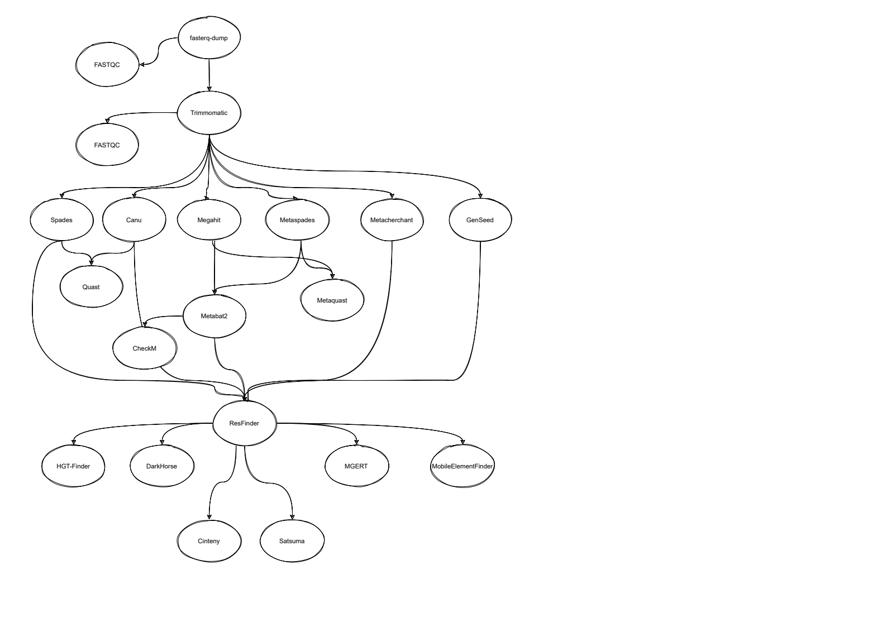
What is a scientific pipeline?
A set of actions which changes the raw data from various sources, to an understandable format so that we can store it and use it for analysis.”

Slide 13

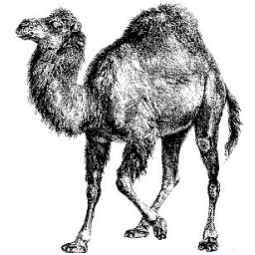

What we were doing before

Slide 14
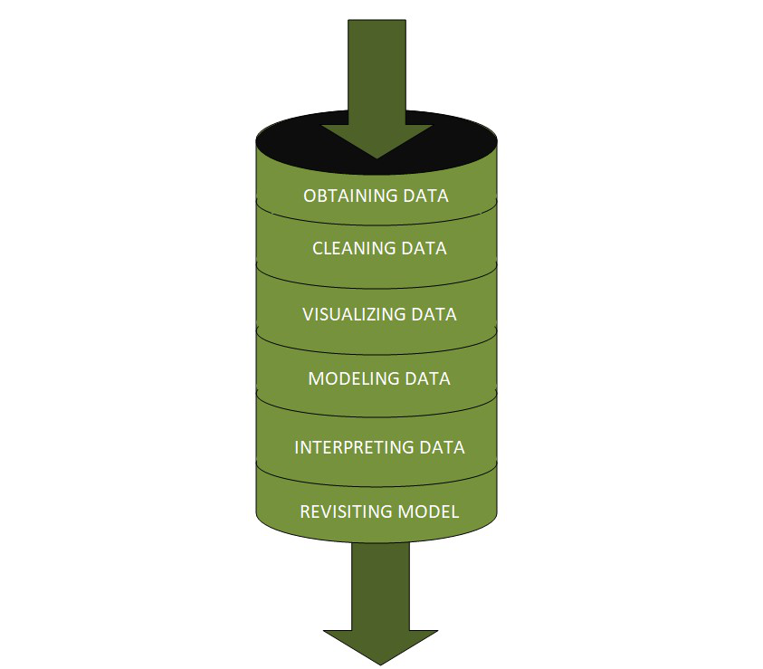
Why do we need scientific pipelines?
Automation
Convenience
Reproducibility
Portability

Slide 15



Workflow managers

Slide 16
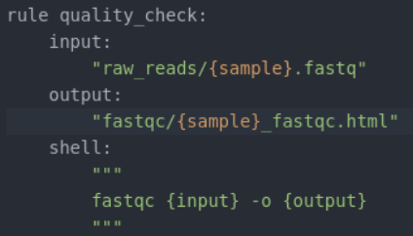

Snakemake
https://snakemake.readthedocs.io/en/stable/
Scientific workflow management system
Working with Python Interpreter
Rules that define how to create output files from input files
Readable
Portable
Scalable
Snakemake executable → Snakefile

Slide 17
Snakemake – Basic example
Basic example
rule bwa_map:
input:
"data/genome.fa",
"data/samples/A.fastq"
output:
"mapped_reads/A.bam"
shell:
"bwa mem {input} | samtools view -Sb - > {output}"
snakemake -np mapped_reads/A.bam
Generalizing the basic example
rule bwa_map:
input:
"data/genome.fa",
"data/samples/{sample}.fastq"
output:
"mapped_reads/{sample}.bam"
shell:
"bwa mem {input} | samtools view -Sb - > {output}"
snakemake -np mapped_reads/B.bam

Slide 18
Snakemake - Expand
Snakemake provides a helper function for collecting input files called expand
SAMPLES=[“A”, “B”]
rule bwa_map:
input:
"data/genome.fa",
expand("data/samples/{sample}.fastq", sample=SAMPLES)
output:
"mapped_reads/{sample}.bam"
shell:
"bwa mem {input} | samtools view -Sb - > {output}"

Slide 19
Snakemake - Scripts
Snakemake also allow the use of customade scripts (Python, R)
SAMPLES=[“A”, “B”]
rule bwa_map:
input:
"data/genome.fa",
expand("data/samples/{sample}.fastq", sample=SAMPLES)
output:
"mapped_reads/{sample}.bam"
script:
"scripts/bwa_script.py"

Slide 20
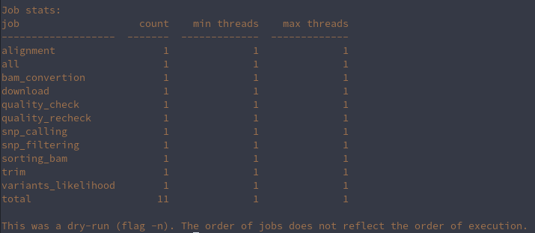
Snakemake – Target rules
How can we execute Snakemake:
snakemake -np mapped_reads/A.bam
Snakemake -np bwa_map (Snakemake accepts rule names as targets if the requested rule does not have wildcards.)
Snakemake -np (Dry run)
Snakemake –cores 1
SAMPLES=[“A”, “B”]
rule all:
input:
”expand("data/samples/{sample}.fastq", sample=SAMPLES)”
rule bwa_map:
input:
"data/genome.fa",
output:
"mapped_reads/{sample}.bam"
shell:
"bwa mem {input} | samtools view -Sb - > {output}"
Moreover, if no target is given at the command line, Snakemake will define the first rule of the Snakefile as the target. Hence, it is best practice to have a rule all at the top of the workflow which has all typically desired target files as input files.

Slide 21
Now go and create your own Snakemake pipeline for exercise 2

