Slide 1
Predicting PhageHost Interaction
With Language Models

Slide 2
What is it about?
Brief summary

Slide 3
What is the aim?
Provide a new tool to deepen the understanding ofhow virus infect the bacteria, as way of defeating infections

Slide 4
Why is it needed?
Shortly state some pandemic history
Bacteria are resistent

Slide 5
How could it be employed?
Phage therapy
Name some other novel therapies

Slide 6
Few words about infection mechanisms

Slide 7
How do protein-interactions work? Or what should the model learn?

Slide 8
Materials and methods

Slide 9
Graphical overview of the model and its input

Slide 10
Datasets
Insert a visualization of the whole model, with everything faded, except for the part in interest (repeat next)
BASEL receptors
BASEL proteome
K12 proteome
Explain how the final dataset was achieved

Slide 11
Making positive and negative samples

Slide 12
Letters to numbers – language models

Slide 13
Classifier – random forest

Slide 14
Balancing problem
Common issue (in bioinformatics)
techniques

Slide 15
Nested CV andparameter-tuning
Explain in detail how and which model is chosen, and where do the scores come from (outer loop average score is from different models)

Slide 16
Nested CV visualization
Show that only resampling and classification enter the loops (saves a lot of time and computation resources)

Slide 17
Results and discussion

Slide 18
Representing the true population
How is the true population defined? (all proteins vs only rbp-rp)
Mind the balance

Slide 19
Present the pipelines
T5 , XL
x ADASYN, SMOTE, None
= all the combinations

Slide 20
Overall results
F1

Slide 21
Overall results
Precision vs recall

Slide 22
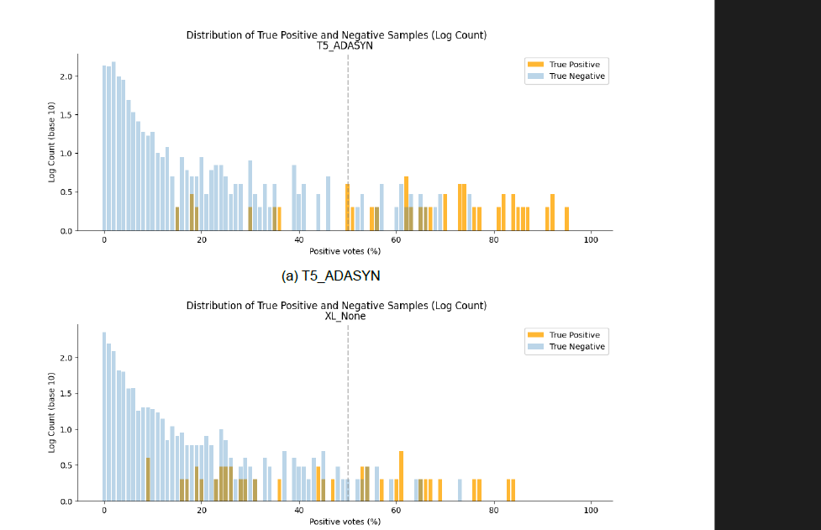
Moving the threshold

Slide 23
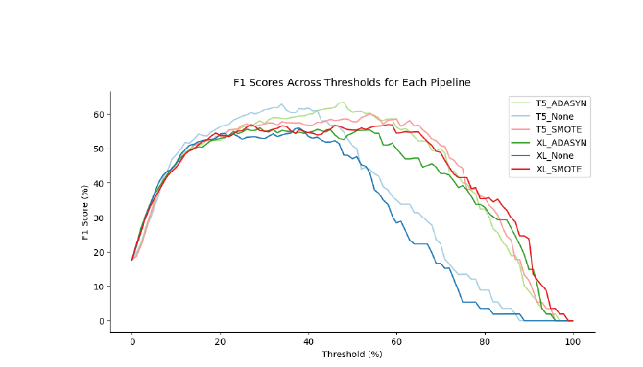
Moving the threshold

Slide 24
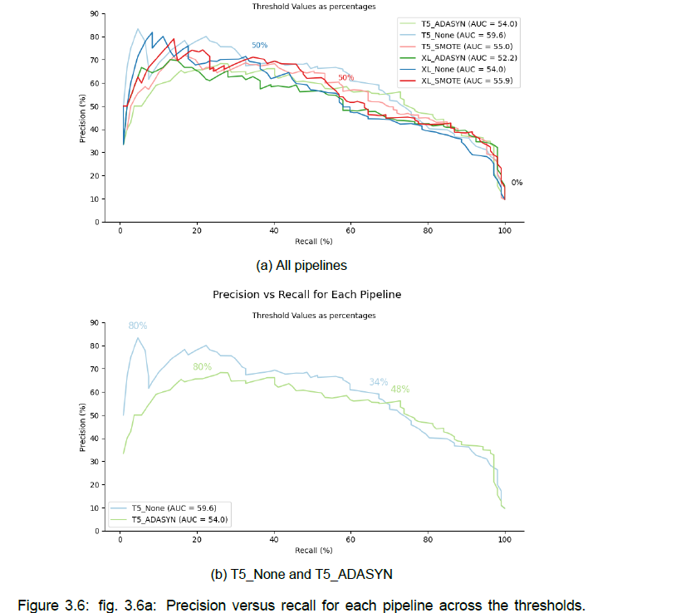
Moving the threshold

Slide 25
Comparisons

Slide 26
Other classifications
First Boeckaerts
Then Gonzales

Slide 27
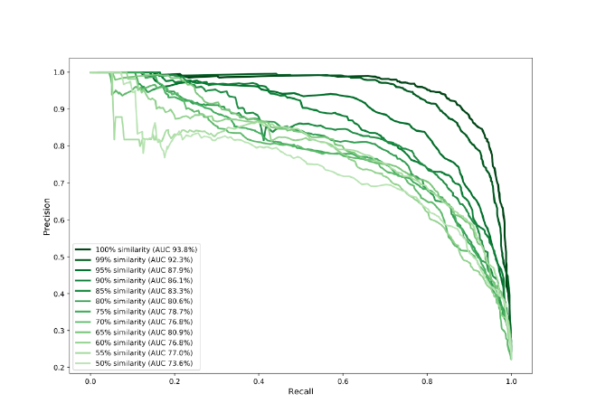
Hand-crafted features
What is better here
Discuss the percentages

Slide 28
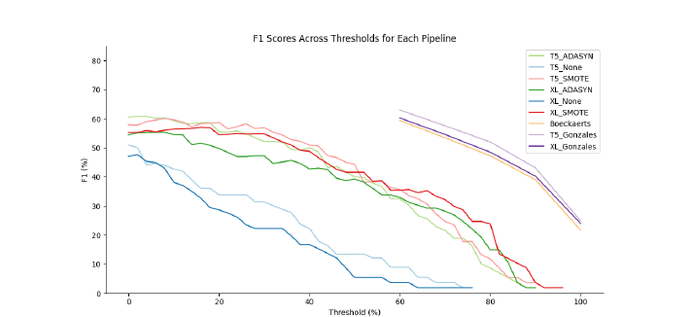
Confidence in the predictions
Who wins
Resampling is good

Slide 29
Why lower performances?
What I said in the previous paragraphs
Reconnect with the infection and PPI part

Slide 30
Space for improvement

Slide 31
Thank you

