Slide 1
Large-scale and multi-structured databases Project Design OKIBO ANIME
Daniel Deiana
Marco Galante
Lorenzo Guidotti

Slide 2

Application Highlights
OkiboAnime is an application that allows users to explore the anime world.
They can review anime and view its characteristics, with suggestions.
They can open a daily pack in which he could find cards from characters that he reviewed and insert them in the Top10.
They get in touch with other users following them and viewing their Top10 list, with suggestions

Slide 3
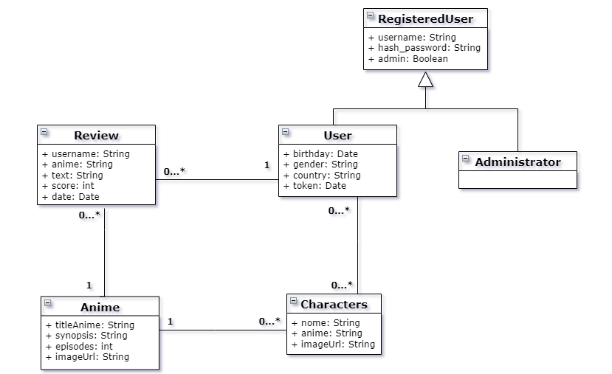
UML Class Diagram

Slide 4
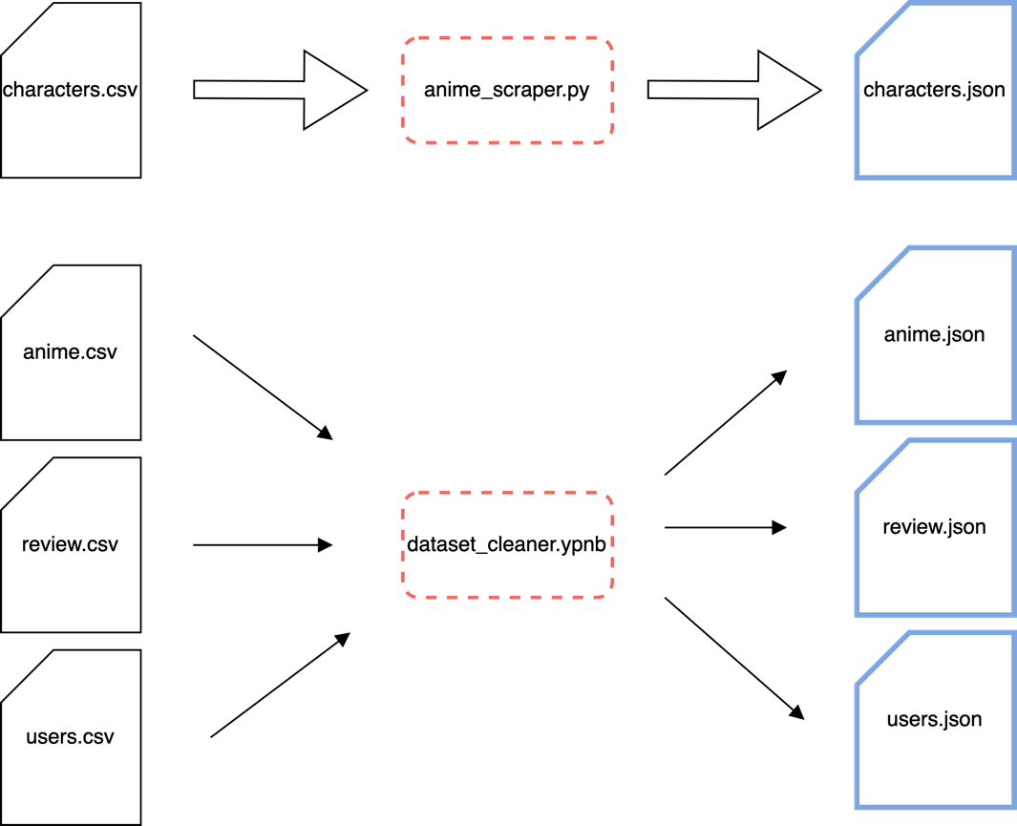
Dataset Description

Slide 5
Non-Functional Requirements
The application needs to be available 24/7
The system must be a responsive web application.
Tolerance to loss of data.
High availability for the data, at the cost of maybe showing old versions.
The code must be modular, and implemented using OOP paradigm.
Avoid a single point of failure

Slide 6
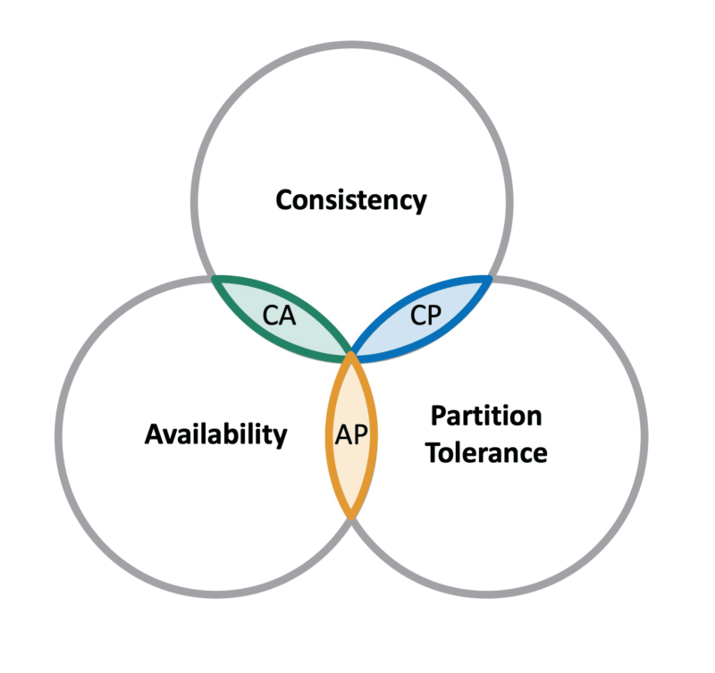



CAP Theorem
Since we accept out-of-date version of data, and the application needs to be available 24/7, we stay on the AP SIDE OF THE TRIANGLE.

Slide 7
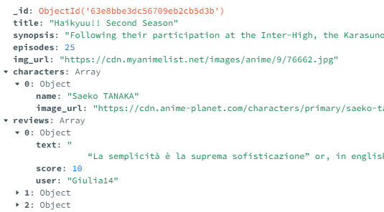
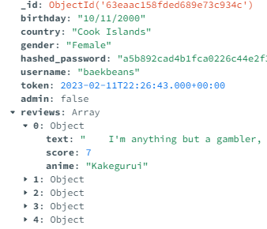
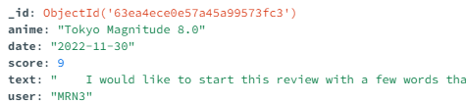
MongoDB collections
Anime
User
Review

Slide 8
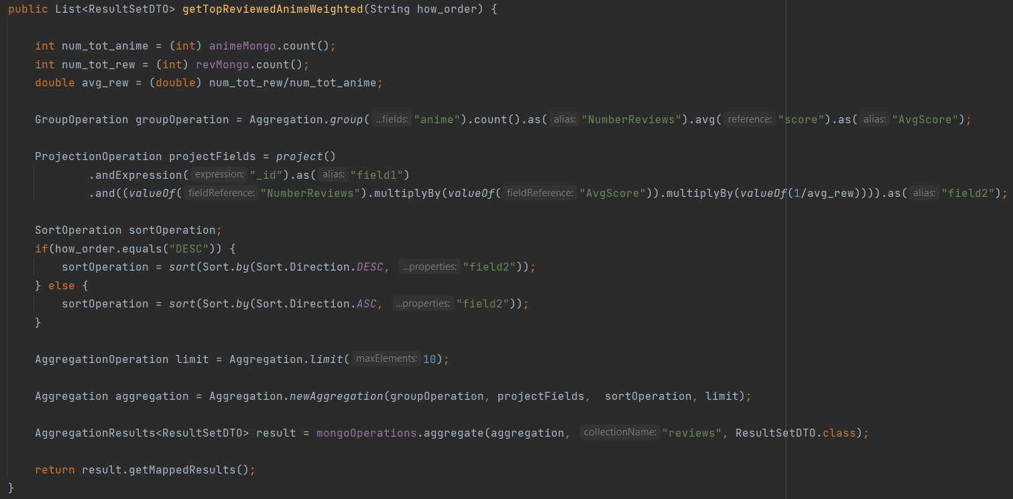
Relevant MongoDB queries
Operations:
Loading user profile
Loading anime page
Seeing all reviews of a anime
Analytics:
Best and worst rated anime for each year based on reviews (on the slide)
Most and less reviewed anime for each year
Number of users for each country
Users with most written reviews for each review

Slide 9
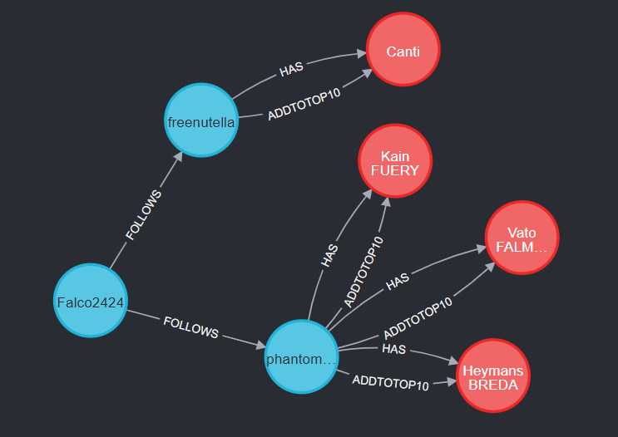
Neo4j design
ENTITIES
USER (username)
CHARACTER (name, anime, ImgUrl)
RELATIONSHIPS
FOLLOWS (user-user)
HAS (user-character)
ADDTOTOP10 (user-character)

Slide 10
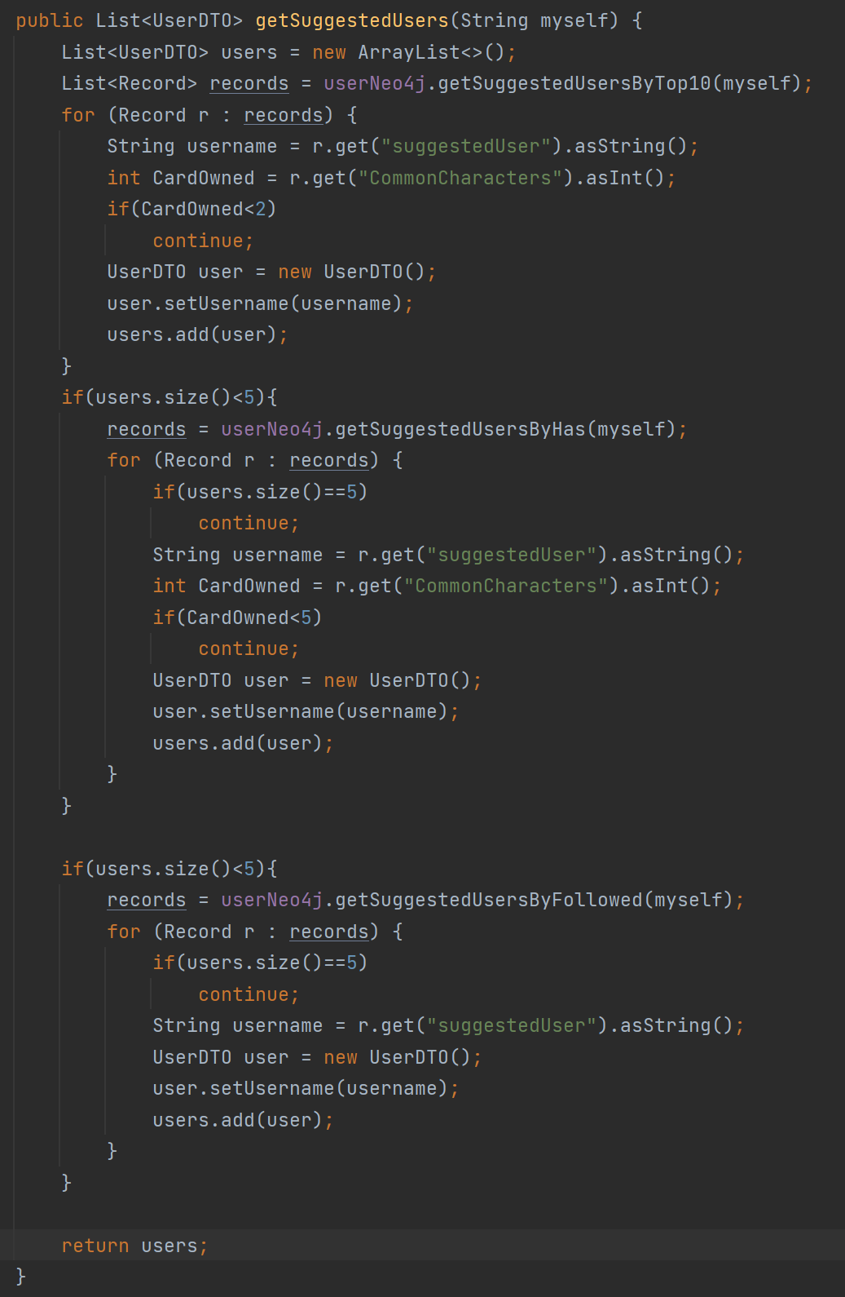
Relevant neo4j queries
USER SUGGESTIONS (ON THE SLIDE)
Based on Top10 List
Based on cards owned
Based on followed followings
ANIME SUGGESTIONS
Based on cards owned by followed followings
ANALYTICS
Most popular user
Most loved character (based on Top10 list)
Most rare characters (based on HAS relationship)
Most unused characters (based on both HAS and ADDTOTOP10 lists)

Slide 11
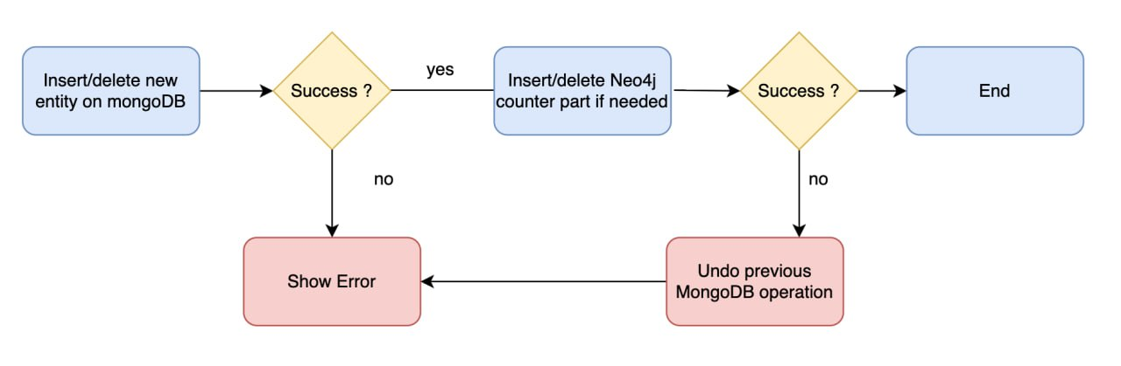
Consistency between databases

Slide 12
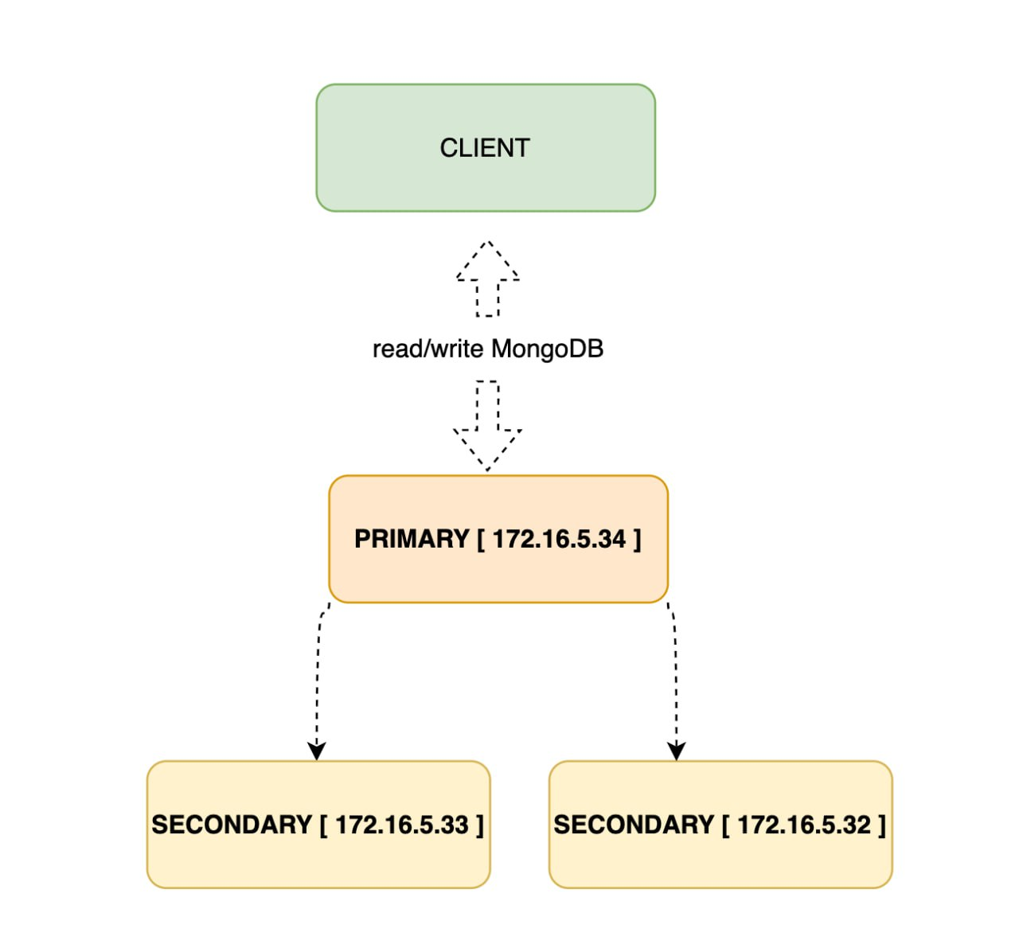
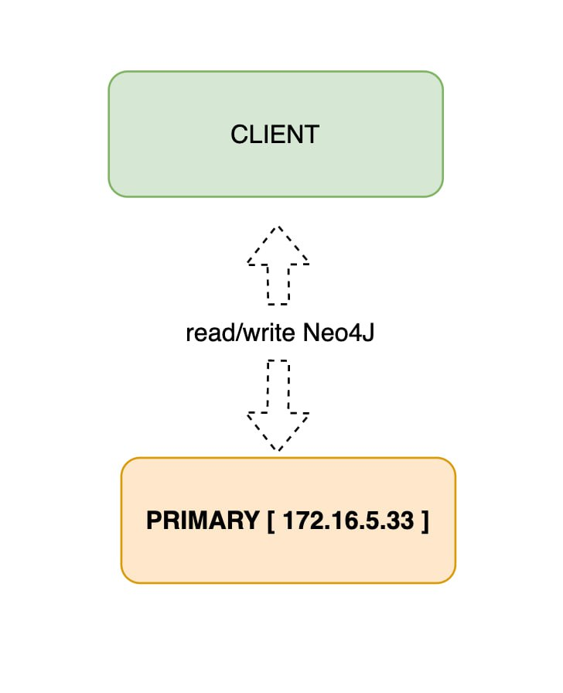
Replica Set
MongoDB
Write Concern = 1
Neo4j

Slide 13

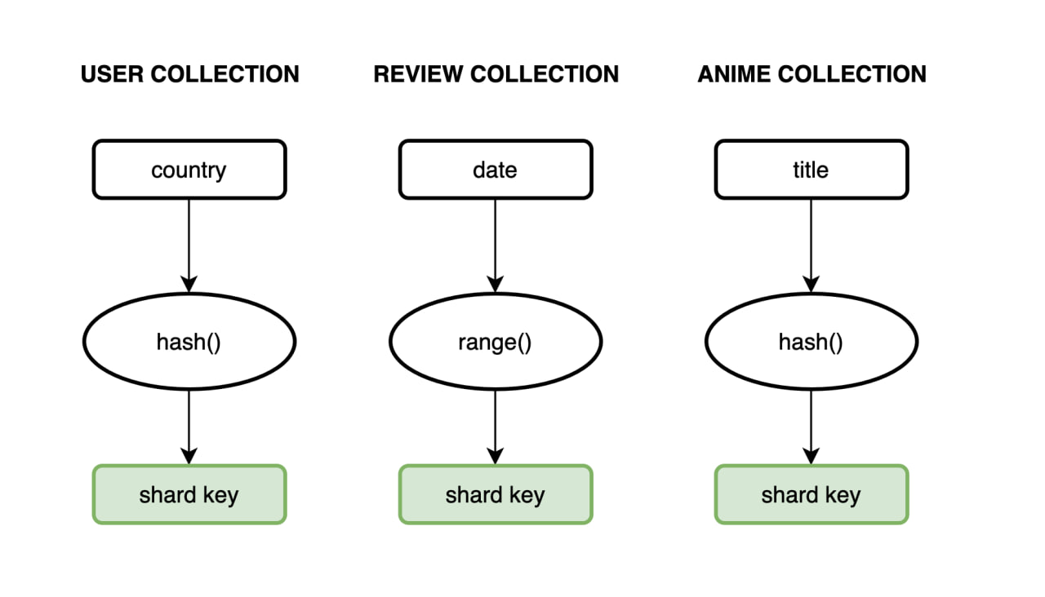

Frameworks

Slide 14



Thank you For the attention

