Slide 1

Comparison of Classification Techniques for Fraud Detecting Among Credit Card Transactions
Iymen Abdella 40218280
Maryam Hatami 40254179
Sepehr Seifpour 40197899
Saeed JamaliFashi 40093292

Slide 2
Introduction & Motivation
Fraud is a major issue all over the globe
Leads to $5.9 billion in losses in the USA 2021
Analyze historical data to detect fraudulent transactions
Compare and Contrast 4 popular methods

Slide 3
Background Materials & Related Works
Gaussian Mixture Models
Assumes class distribution is Normal
Iteratively generates a model for the distribution of classes
SVM
Separating Hyperplane
Kernel to handle higher dimensions
Logistic Regression
Linearly separates data
Based on sigmoid
Complement Naïve Bayes
Assumes features are orthogonal, independent
Generates a prior probability based on frequency samples in class.

Slide 4
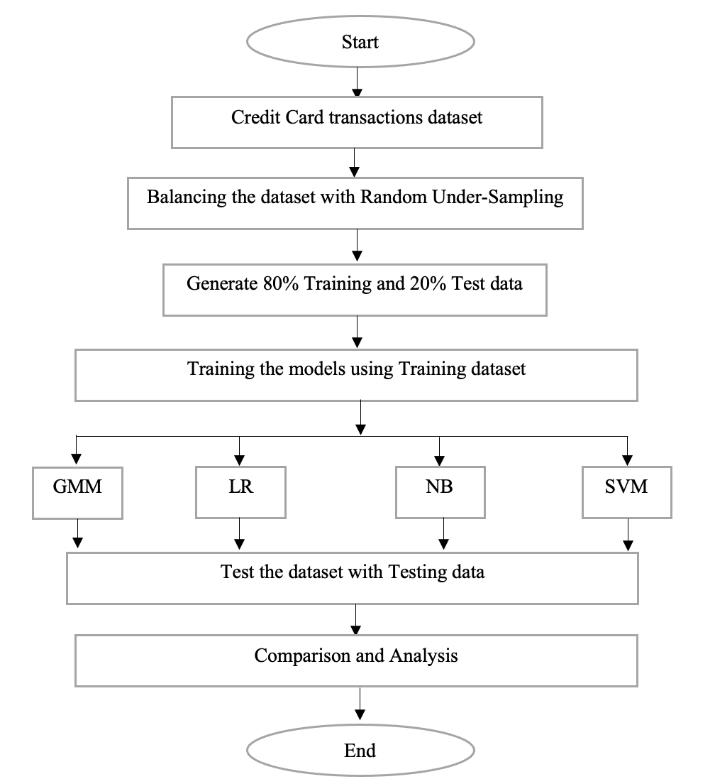
Methods

Slide 5



 | 1:1 | 1:10 | 1:100 | 1:1000 | Total Set
Gaussian Mixture Model | 64 | 61 | 64 | 60 | 31
SVM | 94 | 98 | 100 | 100 | 100
Naïve bayes (Gaussian) | 89 | 96 | 97 | 98 | 98
Logistic Regression | 95 | 98 | 100 | 100 | 100
Accuracy
Precision
Recall
 | 1:1 | 1:10 | 1:100 | 1:1000 | Total Set
Gaussian Mixture Model | 20 | 68 | 93 | 82 | 90
SVM | 91 | 82 | 83 | 72 | 81
Naïve bayes (Gaussian) | 80 | 81 | 83 | 74 | 85
Logistic Regression | 94 | 84 | 82 | 50 | 63
 | 1:1 | 1:10 | 1:100 | 1:1000 | Total Set
Gaussian Mixture Model | 100 | 15 | 3 | 0 | 0
SVM | 96 | 98 | 98 | 100 | 99
Naïve bayes (Gaussian) | 95 | 76 | 27 | 3 | 7
Logistic Regression | 95 | 94 | 97 | 78 | 88

Slide 6
Conclusion -- SVM
Strong Accuracy, Precision and Recall
Data linearly separable
Performed well even with unbalanced data

