Slide 1
JessTab Tutorial
Henrik Eriksson

Slide 2
Outline
Introduction
Background
Installation
Interaction with JessTab
Introduction to Jess programming
  Jess functions
  Rule-based reasoning with Jess
Managing Protégé ontologies with Jess
Mapping Protégé ontologies to Jess
Metalevel mappings
JessTab and Protégé OWL
Example
Conclusion
Tip: Slides available at http://www.ida.liu.se/~her/JessTab/tutorial06/

Slide 3
2. Background
Ontologies are nice to look at, but…
…they do not do anything.

Slide 4
Background (cont.)
Protégé-related problems
  Difficult to directly integrate problem solving and ontology development in Protégé
    ⇨ Languages/shells need direct access to Protégé
  Difficult manage large/complex ontologies
    Ontology editors should be programmable
Protégé allows alternative problem-solving engines through the plug-in API
  The Java API allows access to the internal ontology representation

Slide 5
Why Jess and JessTab?
Jess
  Popular language/shell
  Active user community
  Implemented in Java
JessTab
  A Protégé plug-in for running Jess under Protégé
  Combines the strengths of Protégé and Jess

Slide 6
Practical uses of JessTab
Macro language
  Creating lots of classes quickly
  Making large changes to ontologies
Rule engine
  Information retrieval
  Classification
  Decision support
  Planning

Slide 7
Examples of applications
Ontology engineering and reengineering
  Jess as macro/scripting for ontologies
Importing ontologies
  Jess as input filter
Semantic Web
Problem-solving methods
Agent frameworks
  JadeJessProtege
Classic expert-system development

Slide 8
What is Jess?
Java Expert System Shell; based on CLIPS
Forward chaining; production rules
Fact-base and pattern matching
Lisp-like syntax
No support for object orientation
  The Cool subsystem of CLIPS not implemented
Developed by Sandia Laboratories
  http://herzberg.ca.sandia.gov/jess/

Slide 9
Historical background
OPS5
Art
Protégé-I
Cool
CLIPS
Protégé-II
Java
Protégé/Win
Jess
Java
KIF/OKBC/Clos
Current Protégé
Descendants
JessTab
Influences

Slide 10
Tool integration – Two possibilities
Loose integration
  No changes to each representation model
  Translators between formats
  Independent software
Tight integration
  Changes to representation models when needed
  Integrated software (e.g., same Java VM)
  Unified user interface
JessTab supports tight integration

Slide 11
Approach – JessTab plug-in for Protégé
Jess console window in Protégé
Mapping instances to Jess facts
Functions for knowledge-base operations
Mirroring Jess definitions in Protégé knowledge bases
Support for metalevel objects
Support for methods and message handlers

Slide 12
3. Installation
JessTab is bundled with the Protégé distribution
Latest JessTab version available from SourceForge
It is necessary to download and install Jess separately
  Because of licensing

Slide 13
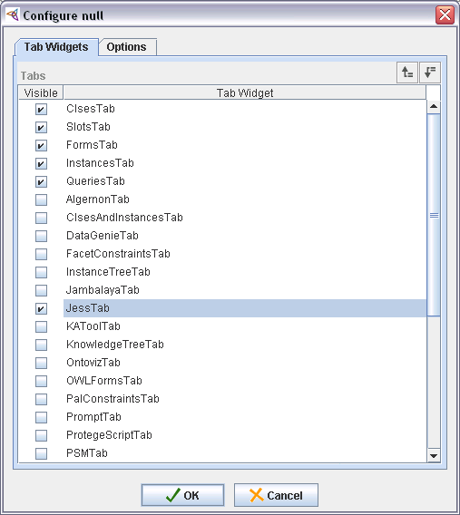
Enabling JessTab
Enable the tab

Slide 14
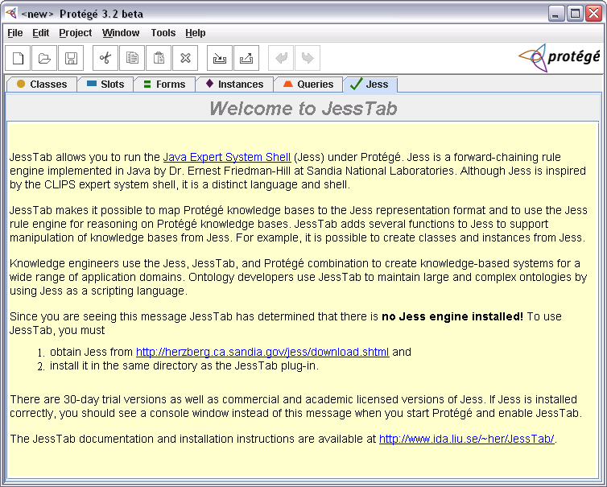
JessTab with no Jess engine

Slide 15
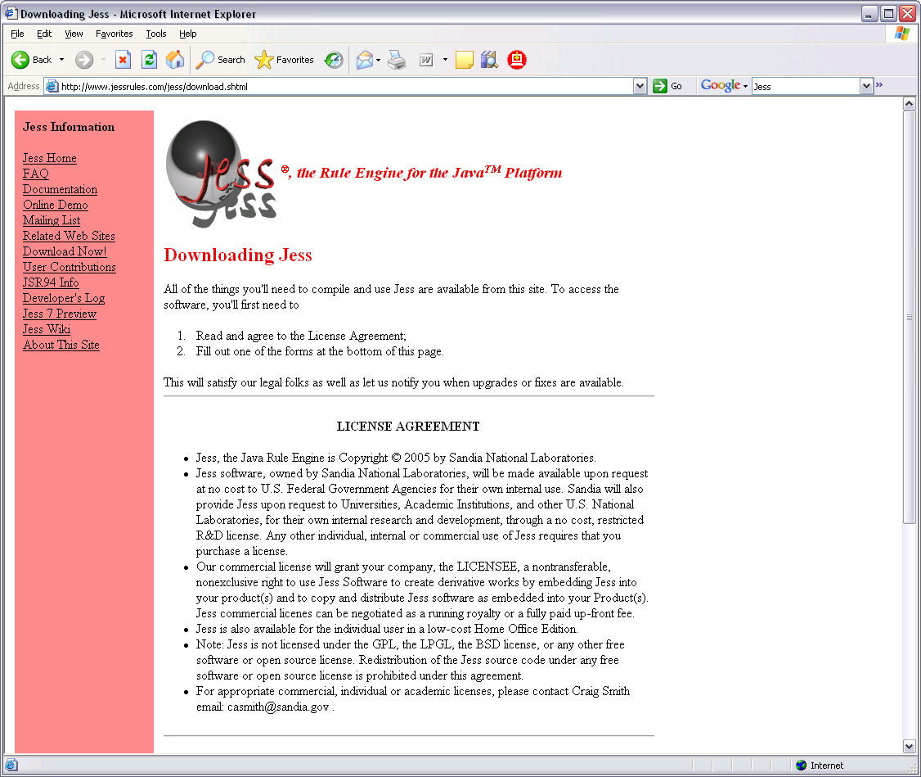
Jess installation
Visit http://www.jessrules.com/
Choose license type
  Trial – expires after 30 days
  Licensed – commercial or academic (includes source)
Choose version
  Stable (e.g., 6.1p8)
  Development (e.g., 7.0b7)
Tip: Development versions of Jess are usually stable

Slide 16
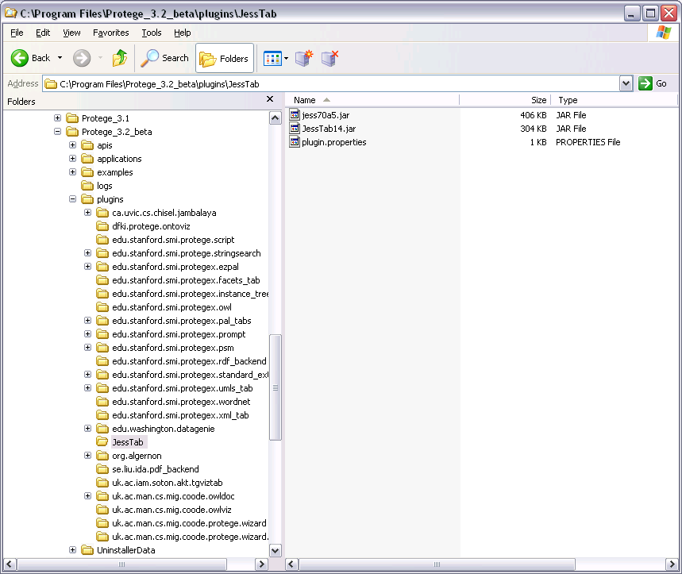
Jess installation (cont.)
The distribution contains the file jess.jar
Put the file jess.jar in the Protege/plugins/JessTab directory in the Protégé installation
jess.jar
JessTab.jar
plugin.properties
Tip: The file names sometimes contain version number. Protégé will usually find them anyway

Slide 17
Installation troubleshooting tips
Make sure everything is in the correct directory
  The files jess.jar, JessTab.jar, and plugin.properties should be in the plugins/JessTab directory
Two or more versions of the same .jar file on the CLASSPATH means trouble. Double check this.
Check Jess version number in startup message
Check the plugin.properties file
Try running Jess without Protégé/JessTab
If all else fails, try a clean installation of Protégé

Slide 18
4. Interaction with JessTab
Ready to go
  Jess installation completed
  JessTab enabled
Interaction based on read-evaluate-print loop
  Just like Lisp

Slide 19
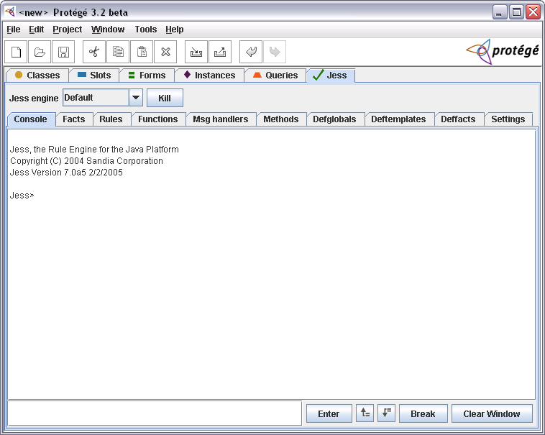
Jess console window in Protégé

Slide 20
Console window (upper part)
Console selected
Default engine
JessTab selected
subtabs
Jess startup message
Jess version
Jess prompt

Slide 21
Console window (lower part)
Enter Jess expressions here
Command history
Clear console window
Tip: It is possible to copy & paste commands with ctrl-C and ctrl-V
Evaluate expression
Break execution

Slide 22
Console Window (subtabs)
The Jess console
Console
Facts
Rules
Functions
Message handlers
Methods
Defglobals
Deftamplates
Deffacts
Settings
Lists of Jess constructs
Various settings

Slide 23
5. Introduction to Jess programming
The CLIPS heritage
Jess basics
Running Jess
Jess facts
Jess constructs

Slide 24

CLIPS
Forward-chaining system
Object-oriented part (COOL)
Lisp-like syntax
Based on Art
Developed by NASA
Implemented in C
  available on several platforms (e.g., Unix, PC, and Macintosh)
  source code available
Homepage: http://www.ghg.net/clips/CLIPS.html
  documentation, discussion forum, download area

Slide 25

Jess
Based on CLIPS
  Rules from CLIPS but no object-oriented part
Developed by Dr. Ernest Friedman-Hill at Sandia National Laboratories
Implemented in Java
  source code license available
Homepage: http://www.jessrules.com/
  documentation, download area

Slide 26
Running Jess
> jess ↵
Jess, the Rule Engine for the Java Platform
Copyright (C) 2004 Sandia Corporation
Jess Version 7.0a5 2/2/2005
Jess> exit ↵
exit
Jess> (+ 3 4) ↵
7
Jess> (exit) ↵
>
Exits Protégé if running in JessTab

Slide 27
Jess Facts
Jess manages a list of known facts
Sample Jess fact:
(person (hair-color black)
(name ”John Smith”)
(eye-color blue)
(age 23))

Slide 28
The Deftemplate Construct
Declaration of valid slots for a given relation name
The general format of deftemplate is
(deftemplate <relation-name> [<optional-comment>]
<slot-definition>*)
where <slot-definition> is defined as
(slot <slot-name>) | (multislot <slot-name>)

Slide 29
Sample Deftemplate
Information about a person
(deftemplate person ”A sample deftemplate”
(slot name)
(slot age)
(slot eye-color)
(slot hair-color))

Slide 30
Multifield slots
Normal, single-field slots can hold only one value
Multifield slots can hold several values
The values are ordered in a list

Slide 31
Sample Fact Revisited
(person (name John Smith)
(age 23)
(eye-color blue)
(hair-color brown))
Illegal if name is a single-field slot, but
legal is name is a multifield slot

Slide 32
Ordered Facts
Implied deftemplate: Single implied multifield slot
List of elements
Order of elements important; slot names not required
Example: list of numbers
(number-list 7 9 3 4 20)

Slide 33
Adding and Removing Facts
All facts known to Jess are stored in the fact list
Add new facts with the assert command:
(assert <fact>+)
More than one fact can be added with assert

Slide 34
Adding Facts: Example
Jess>
(deftemplate person
(slot name)
(slot age)
(slot eye-color)
(slot hair-color))↵
Jess>
(assert (person (name ”John Q. Public”)
(age 23)
(eye-color blue)
(hair-color black))) ↵
<Fact-0>
Jess>

Slide 35
Displaying Facts
The facts command: (facts)
Example:
Jess> (facts) ↵
f-0 (MAIN::person (name ”John Smith”) (age 23)
(eye-color blue) (hair-color black))
For a total of 1 fact.
Jess>

Slide 36
Adding another Fact
Jess>
(assert (person (name ”Jane Smith”)
(age 36)
(eye-color green)
(hair-color red))) ↵
<Fact-1>
Jess> (facts) ↵
f-0 (person (name ”John Smith”) (age 23)
(eye-color blue) (hair-color black))
f-1 (person (name ”Jane Smith”) (age 36)
(eye-color green) (hair-color red))
For a total of 2 facts.
Jess>
Normally, Jess does not accept duplicate fact entries

Slide 37
Jess Rules
Sample rule:
IF the emergency is a fire
THEN the response is to activate the sprinkler system
Step 1 — Define the relevant deftemplates:
(deftemplate emergency (slot type))
(deftemplate response (slot action))

Slide 38
Jess Rules (cont.)
rule header
Step 2 — Define the rule
(defrule fire-emergency ”A sample rule”
(emergency (type fire))
=>
(assert (response
(action activate-sprinkler-system))))
patterns
actions

Slide 39
The Run Command
Run the forward-chaining system
Jess> (run) ↵
Jess> (facts) ↵
f-0 (emergency (type fire))
f-1 (response (action activate-sprinkler-system))
For a total of 2 facts in module MAIN.
Jess>

Slide 40
Printing the Result
(defrule fire-emergency
(emergency (type fire))
=>
(printout t ”Activate the sprinkler system” crlf))
output stream (t = stdout)

Slide 41
Multiple Rules
(defrule fire-emergency
(emergency (type fire))
=>
(printout t ”Activate the sprinkler system” crlf))
(defrule flood-emergency
(emergency (type flood))
=>
(printout t ”Shut down electrical equipment” crlf))

Slide 42
Single-Field Patterns
(deftemplate person
(multislot name)
(slot social-security-number))
(deffacts some-people
(person (name John Smith)
(social-security-number 483-98-9083))
(person (name Jack Smith)
(social-security-number 483-98-9084)))
(defrule print-social-security-numbers
(print-ss-numbers-for ?last-name)
(person (name ?first-name ?middle-name ?last-name)
(social-security-number ?ss-number))
=>
(printout t ?ss-number crlf))

Slide 43
Single-Field Wildcards
(defrule print-social-security-numbers
(print-ss-numbers-for ?last-name)
(person (name ? ? ?last-name)
(social-security-number ?ss-number))
=>
(printout t ?ss-number crlf))

Slide 44
Conditional Patterns
(defrule black-or-brown-hair
(person (name ?name) (hair brown | black))
=>
(printout t ?name ” has dark hair” crlf))
(defrule black-or-brown-hair
(person (name ?name) (hair ?color&brown | black))
=>
(printout t ?name ” has ” ?color ” hair” crlf))

Slide 45
Conditional Patterns (cont.)
(defrule not-black-or-brown-hair
(person (name ?name)
(hair ?color&~brown&~black))
=>
(printout t ?name ” has ” ?color ” hair” crlf))

Slide 46
Conditional Patterns (cont.)
(defrule complex-eye-hair-match
(person (name ?name1)
(eyes ?eyes1&blue | green)
(hair ?hair1&~black))
(person (name ?name2&~?name1)
(eyes ?eyes1&~?eyes2)
(hair ?hair2&~red | ?hair1))
=>
(printout t ?name1 ” has ” ?eyes1 ” eyes and ” ?hair1 ” hair” crlf)
(printout t ?name2 ” has ” ?eyes2 ” eyes and ” ?hair2 ” hair” crlf))

Slide 47
Conditional Patterns (cont.)
(defrule no-identical-birthdays
(not (and (person (name ?name)
(birthday ?date))
(person (name ~?name)
(birthday ?date))))
=>
(printout t ”No two people have the same birthday”
crlf)

Slide 48
Loading Jess Constructs from a File
Create the Jess source file with a text editor
Use the batch command:
(batch <file>)
Example:
Jess> (batch ”fire.clp”) ↵
Defining deftemplate emergency
Defining deftemplate response
Defining defrule: fire-emergency +j

Slide 49
6. Managing Protégé ontologies with Jess
The Protégé GUI is nice but sometimes scripting or programmatically modifying an ontology is better
JessTab adds several functions and constructs for managing ontologies
Naturally, these functions and constructs are available from the Jess command prompt and from Jess programs

Slide 50
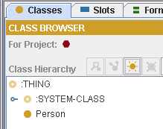
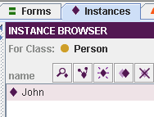
Defining classes and instantiating them
Jess> (defclass Person (is-a :THING)
(slot name (type string))
(slot age (type integer))) ↵
TRUE
Jess> (make-instance john of Person (name "John") (age 20)) ↵
<External-Address:SimpleInstance>
Jess>

Slide 51
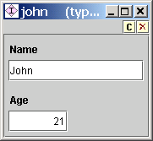
Modifying slots
Jess> (slot-set john age 21) ↵
Jess>
Jess> (slot-get john age) ↵
21
Jess>

Slide 52
Creating a second instance
Jess> (make-instance sue of Person (name "Sue") (age 22)) ↵
<External-Address:SimpleInstance>
Jess>
Jess> (slot-get sue age) ↵
22
Jess>

Slide 53
Functions for knowledge-base operations
mapclass
mapinstance
unmapinstance
defclass
make-instance
initialize-instance
modify-instance
duplicate-instance
definstances
unmake-instance
slot-get
slot-set
slot-replace$
slot-insert$
slot-delete$
slot-facets
slot-types
slot-cardinality
slot-range
slot-allowed-values
slot-allowed-classes
slot-allowed-parents
slot-documentation
slot-sources
facet-get
facet-set
class
class-existp
class-abstractp
class-reactivep
superclassp
subclassp
class-superclasses
class-subclasses
get-defclass-list
class-slots
instancep
instance-existp
instance-name
instance-address
instance-addressp
instance-namep
slot-existp
slot-default-value
set-kb-save
get-kb-save
load-kb-definitions
load-project
include-project
save-project
jesstab-version-number
jesstab-version-string
get-knowledge-base
get-tabs

Slide 54
7. Mapping Protégé ontologies to Jess
Transferring the Protégé representation to the Jess representation
Protégé
ontology
f-0
f-1
f-2
f-3
Jess facts

Slide 55
Mapping classes
Jess> (defclass Person (is-a :THING)
(slot name (type string))
(slot age (type integer))) ↵
TRUE
Jess> (make-instance john of Person (name "John") (age 20)) ↵
<External-Address:SimpleInstance>
Jess> (mapclass Person) ↵
Person
Jess> (facts) ↵
f-0 (object (is-a Person) (is-a-name "Person")
(OBJECT <External-Address:SimpleInstance>)
(age 20) (name "John"))
For a total of 1 facts.

Slide 56
The “object” fact
Pattern for facts corresponding to Protégé instances
Fact name
Class name
Class name as string
(object (is-a Person) (is-a-name "Person")
(OBJECT <External-Address:SimpleInstance>)
(age 20) (name "John"))
Reference to Protégé instance
Slot values

Slide 57
Modifying slots
Jess> (slot-set john age 21) ↵
Jess> (facts) ↵
f-1 (object (is-a Person) (is-a-name "Person")
(OBJECT <External-Address:SimpleInstance>)
(age 21) (name "John"))
For a total of 1 facts.

Slide 58
Creating Instances
Jess> (make-instance sue of Person (name "Sue") (age 22)) ↵
<External-Address:SimpleInstance>
Jess> (facts) ↵
f-1 (object (is-a Person) (is-a-name "Person")
(OBJECT <External-Address:SimpleInstance>)
(age 21) (name "John"))
f-4 (object (is-a Person) (is-a-name "Person")
(OBJECT <External-Address:SimpleInstance>)
(age 22) (name "Sue"))
For a total of 2 facts.

Slide 59
Adding a Jess rule
Jess> (defrule twenty_one
(object (is-a Person)
(name ?n) (age ?a&:(>= ?a 21)))
=>
(printout t "The person " ?n
" is 21 or older" crlf)) ↵
TRUE
Jess> (run) ↵
The person John is 21 or older
The person Sue is 21 or older
2
Jess>

Slide 60
More rule examples
(defrule twenty_two
(object (name ?n)
(age 22))
=>
(printout t "The object " ?n " is 22" crlf))
(defrule print_age
(object (is-a Person)
(name ?n)
(age ?a))
=>
(printout t "The person " ?n " is " ?a crlf))

Slide 61
Accessing instances from rules
(defrule print_age_2
(object (is-a Person)
(OBJECT ?obj)
(name ?n))
=>
(printout t "The person " ?n
" is " (slot-get ?obj age) crlf))
(defrule print_age_3
?f <- (object (is-a Person)
(name ?n))
=>
(printout t "The person " ?n
" is " (slot-get ?f age) crlf))

Slide 62
Modifying slot values from rules
(defrule upgrade_my_age
?f <- (object (is-a Person)
(name ”Joe Hacker”)
(age 20))
=>
(slot-set ?f age 21))
(defrule upgrade_my_age_2
?f <- (object (is-a Person)
(name ”Joe Hacker”)
(age ?a))
=>
(slot-set ?f age (+ ?a 1)))
Tip: Avoid.
Infinite loop!

Slide 63
Consistency rules
(defrule set_john_doe_if_no_name
?f <- (object (is-a Person)
(name nil)
(age ?a&:(numberp ?a)))
=>
(slot-set ?f name ”John Doe”)
)
(defrule remove_if_no_name_and_no_age
?f <- (object (is-a Person)
(name nil)
(age nil))
=>
(unmake-instance ?f)
)

Slide 64
Matching instances in rules
Remove duplicates
(defrule remove_if_duplicate_name_and_age
(object (is-a Person)
(OBJECT ?p)
(name ?n)
(age ?a))
(object (is-a Person)
(OBJECT ~?p)
(name ?n)
(age ?a))
=>
(unmake-instance ?p)
)

Slide 65
Matching instances in rules (cont.)
Find pet owners
(defrule print_owner_and_pet
(object (is-a Person)
(OBJECT ?p)
(name ?n))
(object (is-a Dog|Cat|Bird)
(is-a-name ?type)
(owner ?p)
(name ?an))
=>
(printout t "The person " ?n " has a " ?type
" called " ?an crlf))

Slide 66
Mappings and rules – Summary
Use (mapclass <class-name>) or (mapinstance <instance>) to map instances to facts
Use (facts) to check what facts you got
Define the rules matching the object facts (defrule …)
Use (run) to invoke the rules
Tip #1: Learn as much Jess as possible (e.g., rule patterns)
Tip #2: Start out with simple examples (when learning and troubleshooting)

Slide 67
Question #1: Why mappings?
Separates the Protégé model from the Jess model
Allows selected parts of the Protégé kb to be visible to Jess
Allows for large ontologies and/or fact bases with a small common part
Different Jess engines can map in different part of a Protégé kb
Why not have Jess index the Protégé frames directly?
  Implementation complexity
  Maintenance problem: The Jess indexing scheme changes often (due to code optimizations)
  Several Jess versions supported simultaneously
  However, mappings increase memory consumption

Slide 68
Question #2: Why does mapclass map to these “object” facts?
Backward compatibility with CLIPS rules
  The Jess rules have (almost) the same syntax as the CLIPS rules for objects
Support for more general patterns in rules
  Example: Find an instance of any class with a certain slot value
No name conflicts with other types of facts
  The name object is reserved for facts coming from Protégé
Why can’t I change the mappings to something else?
  In fact, there is an API for this
  Using Java, you can write arbitrary mappings

Slide 69
Mirroring Jess definitions in Protégé knowledge bases
Reverse mapping
Jess definitions become instances in the Protégé kb
Graphical browsing of definition instances in Protégé
Definition instances visible to other tabs
Introspection because JessTab can access the definition instances
Limited support for editing and customization of definition editors in Protégé
Limited support for saving these Jess definitions with the Protégé kb
  Not recommended unless you know its limitations

Slide 70
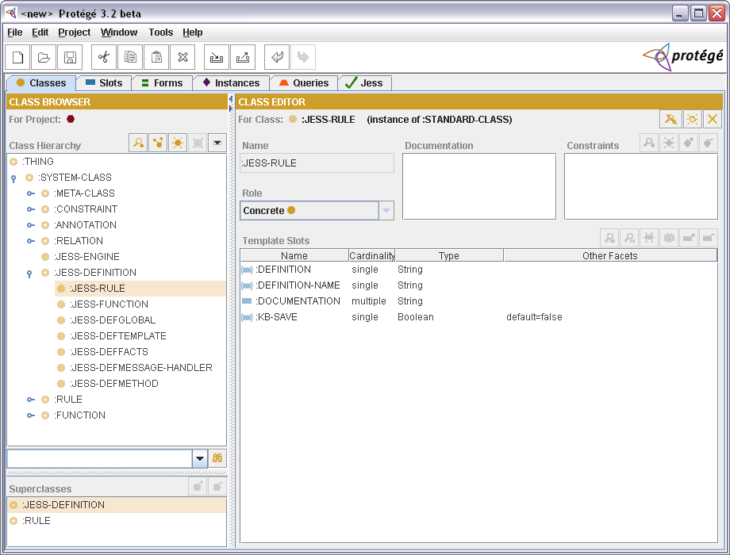
Mirroring Jess definitions in Protégé knowledge bases (cont.)
Your Jess definitions as first-class citizen in Protégé

Slide 71
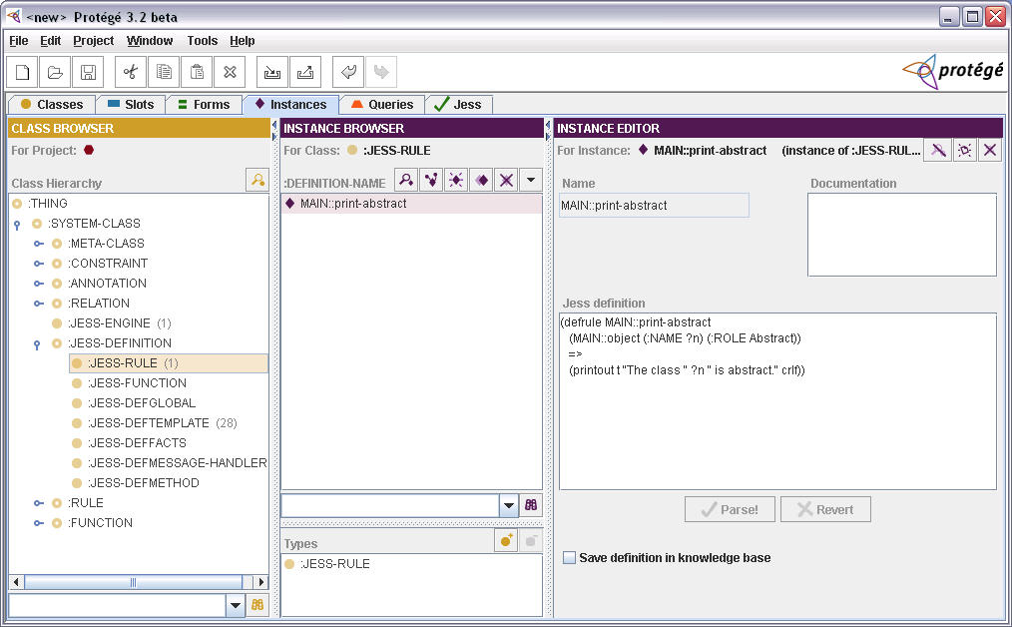
Editing Jess definitions in Protégé
Jess rule editor in Protégé

Slide 72
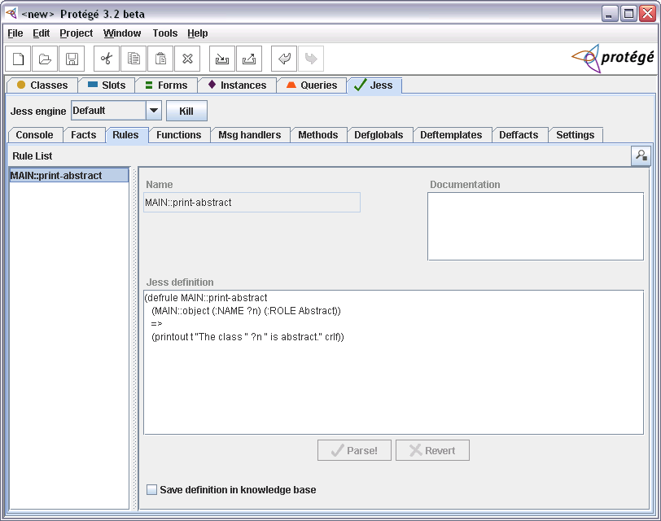
Editing Jess definitions in Protégé (cont.)
Rule-editor subtab in JessTab

Slide 73
8. Metalevel mappings
The Next Level!
Mapping classes to facts
Good news: Classes are instances!
Metaclass
instance of
Class
instance of
Instance

Slide 74
Support for Protégé metalevel objects
JessTab support for metaclasses, metaslots, and metafacets
Functions for instances work for classes too
  and for slots and facets
Defining classes by instantiating metaclasses:
(make-instance Person of :STANDARD-CLASS
(:DIRECT-SUPERCLASSES :THING))

Slide 75
Class definition by instantiation
(defclass LivingThing
(make-instance of :STANDARD-CLASS
(:NAME LivingThing)
(:ROLE Abstract)
(:DIRECT-SUPERCLASSES :THING))
(make-instance of :STANDARD-CLASS
(:NAME Person)
(:DIRECT-SUPERCLASSES LivingThing)
(:DIRECT-TEMPLATE-SLOTS
(make-instance of :STANDARD-SLOT
(:NAME name)
(:SLOT-VALUE-TYPE String))
(make-instance of :STANDARD-SLOT
(:NAME age)
(:SLOT-VALUE-TYPE Integer)) ))
(defclass Person

Slide 76
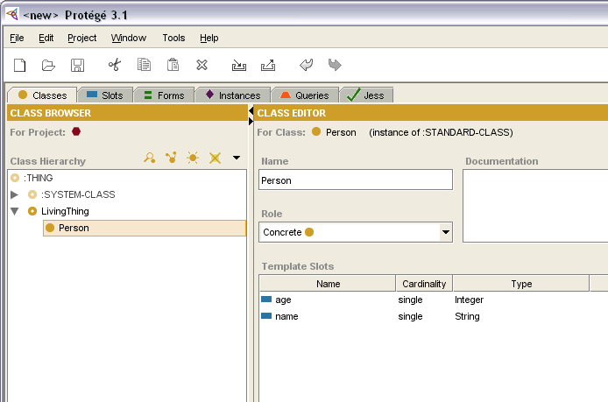
Class definition by instantiation (cont.)
Resulting classes: LivingThing and Person
Tip: Classes can also be created programmatically with calls to defclass (which is a construct implemented as a function)

Slide 77
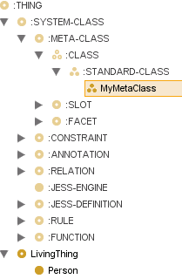
Class definition with custom metaclass
(make-instance of :STANDARD-CLASS
(:NAME MyMetaClass)
(:DIRECT-SUPERCLASSES :STANDARD-CLASS)
(:DIRECT-TEMPLATE-SLOTS
(make-instance of :STANDARD-SLOT
(:NAME AUTHOR)
(:SLOT-VALUE-TYPE String)) ))
(make-instance of MyMetaClass
(:NAME Person2)
(:DIRECT-SUPERCLASSES Person)
(:DIRECT-TEMPLATE-SLOTS
(make-instance of :STANDARD-SLOT
(:NAME income)
(:SLOT-VALUE-TYPE Integer)) ))
; Set the AUTHOR value for Person2
(slot-set Person2 AUTHOR "The meta man")
Add AUTHOR property to classes

Slide 78
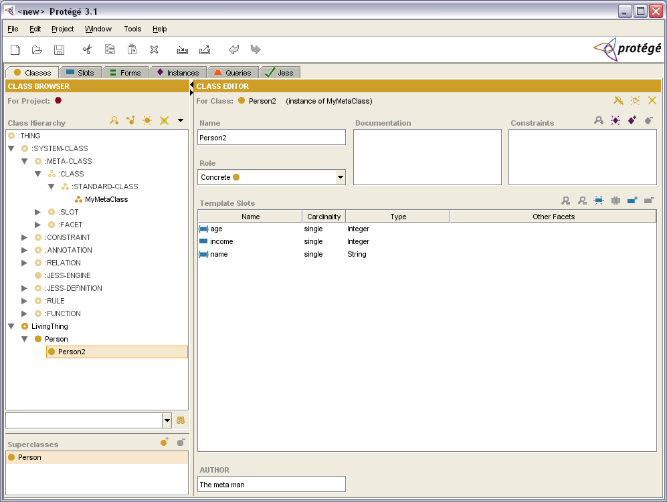
Resulting class with AUTHOR property
(instance of MyMetaClass)

Slide 79
Class changes
Change the metaclass of an existing class
BTW, you can change the class of an existing ordinary instance
(slot-set Person :DIRECT-TYPE MyMetaClass)
(slot-set john :DIRECT-TYPE Person2)

Slide 80
Rules and metalevel objects
Use mapclass on metaclasses
  Maps classes (as instances) to facts
  Check result with (facts)
Define rules matching the facts representing the classes
  Rules for searching ontologies and identifying patterns
  Rules for modifying ontologies
Useful for ontology development and maintenance
  Rules for ontology-wide changes
  Rules for identifying inconsistencies

Slide 81
Printing abstract classes in Protégé
Map every class to Jess
(mapclass :THING)
(defrule print-all-abstract-classes
?c <- (object )
(test (class-abstractp ?c))
=>
(printout t "The class "
(instance-name ?c)
" is abstract." crlf))
Match every object
Test for abstract classes
Print matches

Slide 82
Modifying ontologies
Change the role to abstract for classes that have subclasses, but do not have any instances:
Concrete classes & no instances
(defrule make-classes-abstract
?c <- (object (:NAME ?n)
(:ROLE Concrete)
(:DIRECT-INSTANCES ))
(not (object (:NAME ?n) (:DIRECT-SUBCLASSES)))
=>
(slot-set ?c :ROLE Abstract))
Not no subclasses = subclasses exist
Change role

Slide 83
Methods and Message Handlers
Object-oriented programming for Protégé/Jess
  Complements rule-based modeling
Methods
  Respond to generic function calls
  Match on parameter types
Message handlers
  Handle messages sent to objects
  Allow parameters, but not pattern matching
  Before, after, and around handlers
Implementation of methods and message-handlers supported by CLIPS

Slide 84
Defining methods
Syntax
Examples
(defmethod <name> [<index>] [<comment>]
(<parameter-restriction>* [<wildcard-parameter-restriction>])
<action>* )
(defmethod add ((?a STRING) (?b STRING))
(str-cat ?a ?b))
(defmethod add ((?a MyClass) (?b MyClass))
…)

Slide 85
Defining message handlers
Syntax
Examples
(defmessage-handler <class-name> <message-name>
[<handler-type>] [<comment>]
(<parameter>* [<wildcard-parameter>])
<action>* )
(defmessage-handler MyClass get-foo ()
?self:foo)
(defmessage-handler rectangle find-area ()
(* ?self:side-a ?self:side-b))

Slide 86
Invoking message handlers
Sending messages
Syntax: (send <instance> <message> <param>* )
Example
Jess> (defclass MyClass (is-a :THING)
(slot foo (type integer))) ↵
TRUE
Jess> (make-instance x of MyClass (foo 42)) ↵
<External-Address:DefaultSimpleInstance>
Jess> (slot-get x foo) ↵
42
Jess> (defmessage-handler MyClass get-foo () ?self:foo) ↵
TRUE
Jess> (send x get-foo) ↵
42
Jess>

Slide 87
Methods and Message Handlers – Summary
Object-oriented modeling
Methods
  Advanced parameter matching (similar to CLOS)
  Both classes and datatypes in parameter patterns
  Overloading of existing functions
Message handlers
  Message passing
  Invoked with (send <inst> <msg> <param>* )
  Easy access to slot values (through ?self)
  Before, after, and around methods

Slide 88
9. JessTab and Protégé OWL
Basic support for OWL
JessTab uses the Protégé frames API
  which provides a best-effort implementation of OWL functionality
Metaclasses not supported
OWL constraints/expressions not supported
Jess definition mirroring not supported

Slide 89
10. Example
Based on the Protégé newspaper example
Goal: Layout rules in Jess
  Reuse ontology
  Add new rules
Step-wise development
Download from http://www.ida.liu.se/~her/JessTab/tutorial06/

Slide 90
Steps
Prerequisite
  Jess and JessTab installed
Open newspaper example
  Available in the standard Protégé installation
Enable JessTab
  Project -> Configure -> select JessTab
Cut-and-paste from source file (newspaper.jess)
Alternatively, load with (batch ”newspaper.jess”)
  Tip: You probably need the full pathname for this file

Slide 91
Rule overview
Mapclass for newspaper articles and ads
  (mapclass Content)
Rules for mapping instance facts to page-area facts
  page_area_r1, page_area_r2
Rules for creating size facts from the page-area facts
  size_r1, size_r2, size_r3, size_r4
Rules for creating layout instances from the size facts
  layout_r1

Slide 92
Graphical rule overview
Personals_Ad
width
Content_Layout
Standard_Ad
page-area
Article
height
Rectangle
page_area_r1
page_area_r2
size_r1
size_r2
size_r3
size_r4
layout_r1
Instance
Fact
Rules

Slide 93
Rules – Code
(mapclass Content)
(defrule area_r1
(object (is-a Personals_Ad|Standard_Ad)
(OBJECT ?a)
(name ?n)
(page_number ?p))
=>
(assert (page-area ?p Ad ?n "" ?a))
)
(defrule area_r2
(object (is-a Article)
(OBJECT ?a)
(headline ?h)
(text ?t)
(page_number ?p))
=>
(assert (page-area ?p Article ?h ?t ?a))
)
(defrule size_r1
(page-area ?p&:(< ?p 10) Article ? ? ?a)
=>
(assert (width ?a 100.0))
)
(defrule size_r2
(page-area ?p&:(>= ?p 10) Article ? ? ?a)
=>
(assert (width ?a 50.0))
)
(defrule size_r3
(page-area ? Article ? ?t ?a)
=>
(assert (height ?a (* (str-length ?t) 2.0)))
)
(defrule size_r4
(page-area ?p Ad ? ? ?a)
=>
(assert (width ?a 50.0) (height ?a 50.0))
)
(defrule layout_r1
(width ?a ?w) (height ?a ?h)
=>
(slot-set ?a layout
(make-instance of Content_Layout
(main_rectangle (make-instance of Rectangle
(width ?w) (height ?h)))))
)

Slide 94
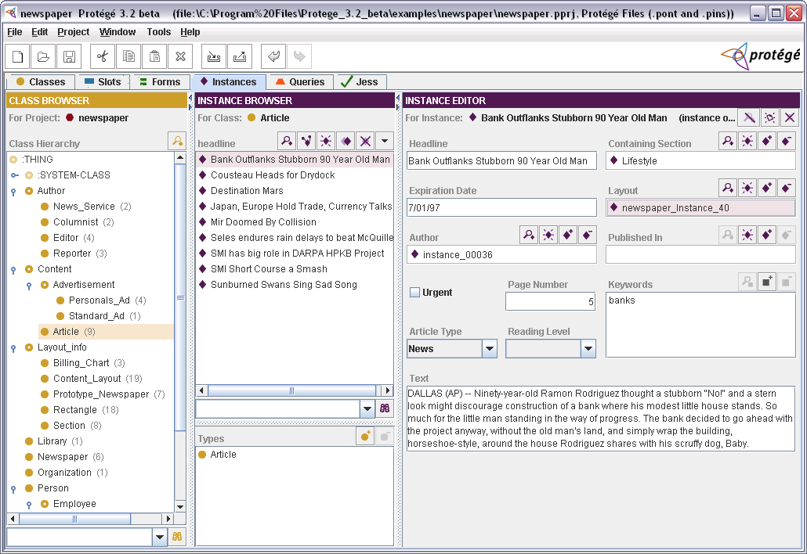
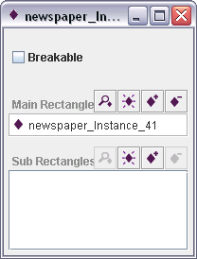

Result

Slide 95
11. Conclusion
Web of tools
Future work
Trying JessTab
Learning more
Summary
Questions

Slide 96
Tool Web/Library
FuzzyJess
PrologTab
More Jess extensions
FloraTab
JessTab
Algernon
Jess
Protégé
JadeJessProtege
Your tab
More Protégé plug-ins
JADE
Your system

Slide 97
Ideas for future work
Improved OWL support
Custom mappings (defined in Jess)
Support for managing Protégé forms
Improved GUI
Aspect-oriented functionality (e.g., pointcut for message-handlers)
???

Slide 98
Trying JessTab
Obtain Protégé
  Download from http://protege.stanford.edu/
  License: MPL 1.1
Obtain Jess
  Download from http://www.jessrules.com/
  License: Special Jess license (commercial or free academic)
  Compilation sometimes required
Get JessTab
  Download from http://www.ida.liu.se/~her/JessTab/
  License: MPL 1.1

Slide 99
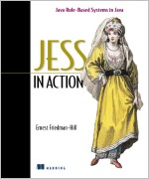

Learning more about Jess and JessTab
Jess manual
  See http://www.jessrules.com/
Jess book
  Ernest Freidman-Hill. Jess in Action: Java Rule-based Systems. Manning Press, 2003. ISBN: 1930110898
  See http://manning.com/friedman-hill/
Jess mailing list
  See http://www.jessrules.com/jess/mailing_list.shtml
JessTab manual
  See http://www.ida.liu.se/~her/JessTab/
Jess publication
  Henrik Eriksson. Using JessTab to integrate Protégé and Jess. IEEE Intelligent Systems, 18(2):43– 50, 2003.

Slide 100
Summary
JessTab: Protégé – Jess integration
Manage Protégé ontologies and knowledge bases from Jess
Rule-based reasoning in Protégé
Protégé as graphical, object-oriented extension to Jess

