Slide 1

Genomic differences between long-term, short-term and moderate-term survivors of high-grade serous ovarian cancer
Dillan Maraj, Seraj Saboungi, and Devin Rodriguez
Team 6

Slide 2
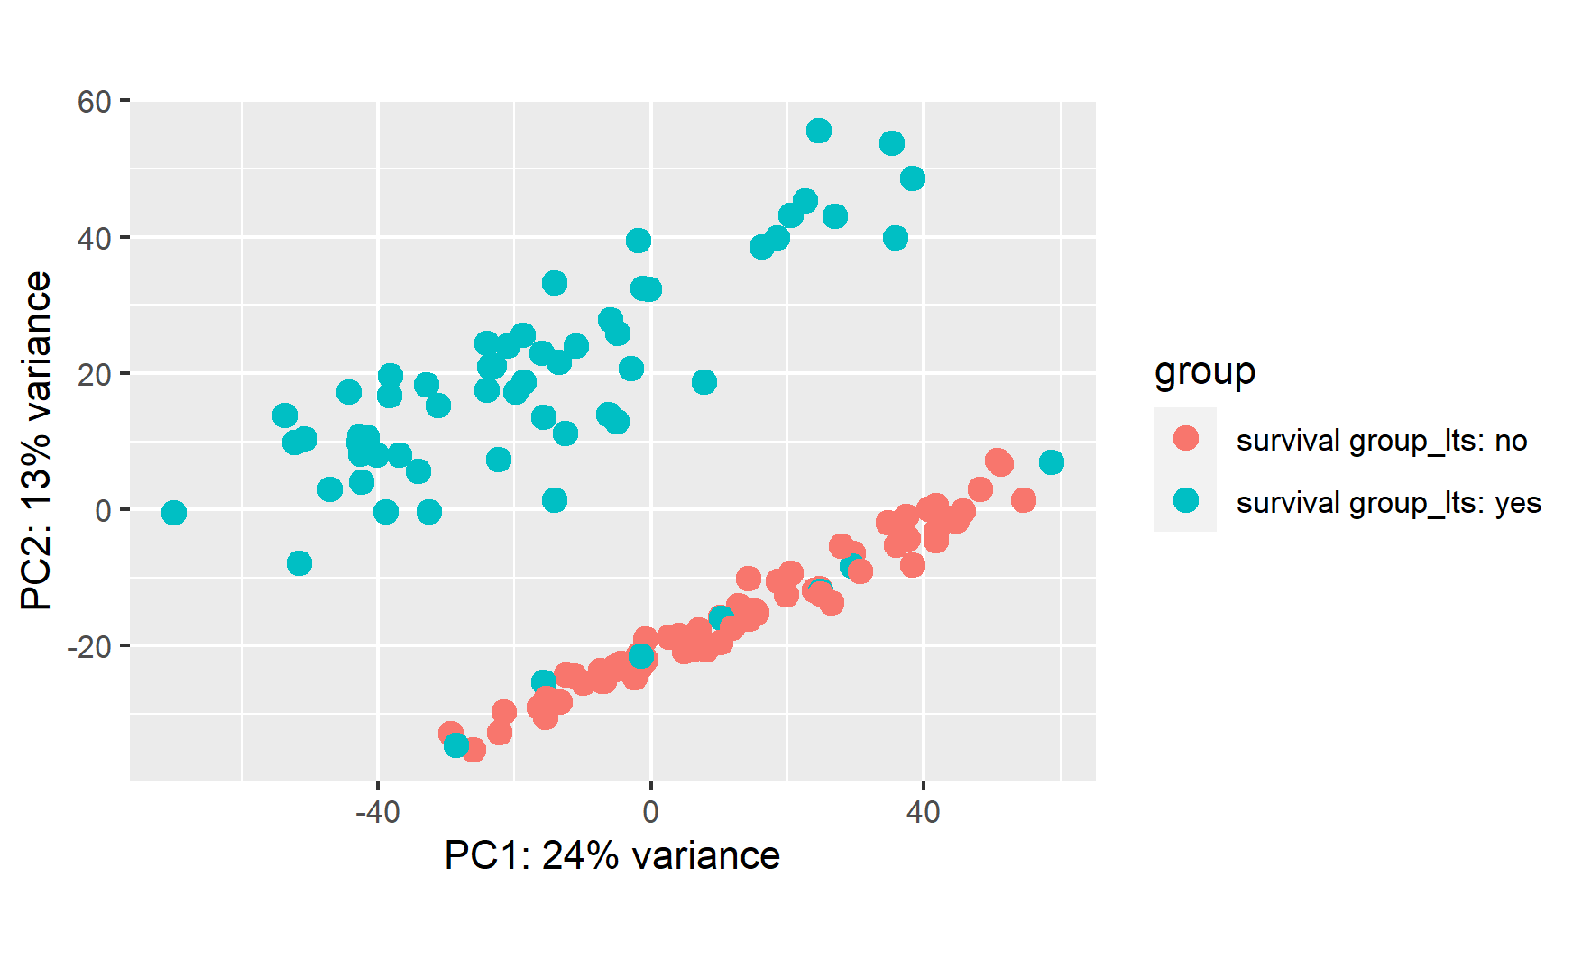
Introduction
Samples are RNA sequences of human (homosapien) genes.
The data consisted of 131 samples from humans with advanced-stage high-grade serous ovarian cancer (HGSC):
63 long-term survivors (survived 10+ years after diagnosis)
68 short to moderate term survivors ( survived <5 or 5-10 years after diagnosis respectively)
When analyzing out data, our first approach was to use a PCA plot to understand the similarities that can be found within our data. From this PCA plot we discovered a subgroup of long-term survivors that were more like short-term survivors then other long-term survivors.

Slide 3
Introduction
Notes:
PCA Plot

Slide 4

Hypothesis
What are the genomic differences between long-term, short-term and moderate-term survivors of high-grade serous ovarian cancer?
We chose this question because if we could discover differences between short-term and long-term HGSC survivors, that data could be used to develop new approaches and treatments for HGSC patients.
Our data came from research on the genomic and immune landscape of long-term survivors of HGSC. Our plan was to use different analysis methods assessing gene level expressions on the samples collected from the two different survivor groups in that study and see if we could find differences between the two groups.

Slide 5
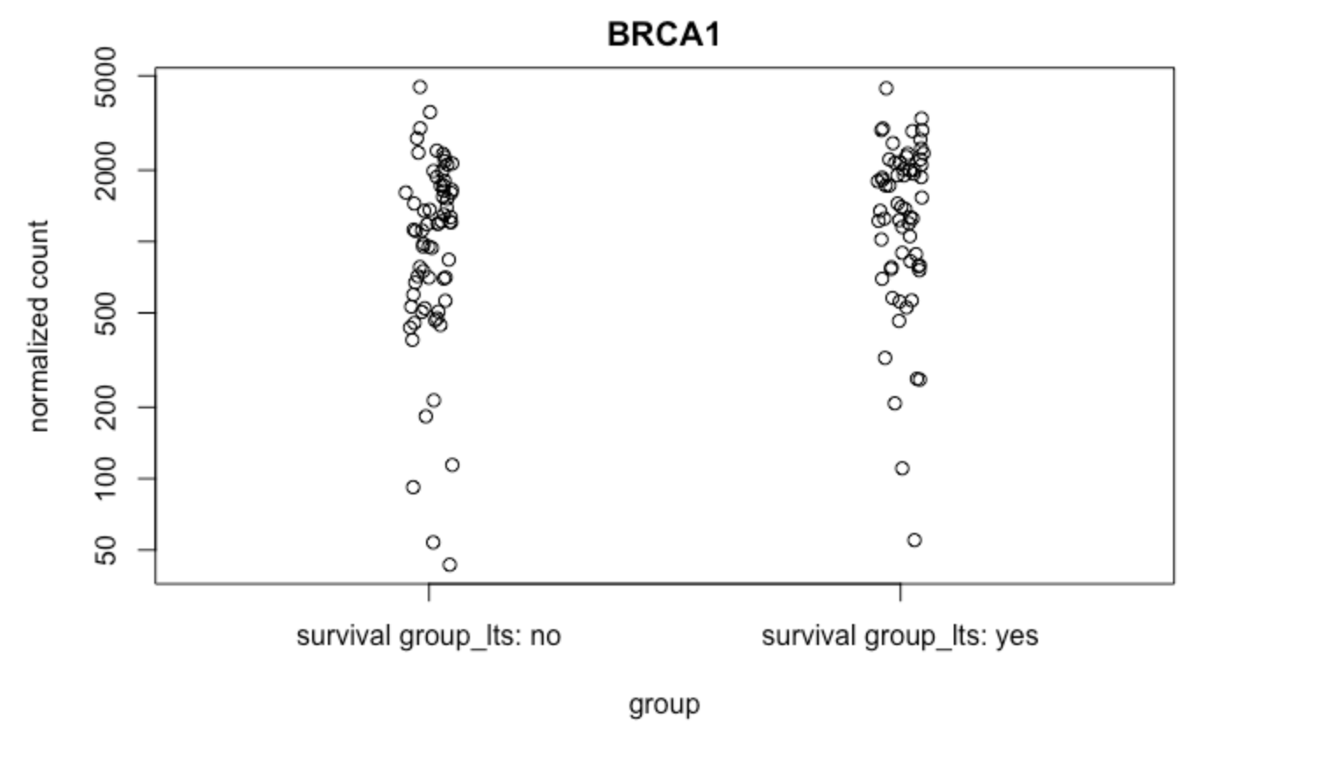
Hypothesis
Notes:
Normalized count of survival groups

Slide 6
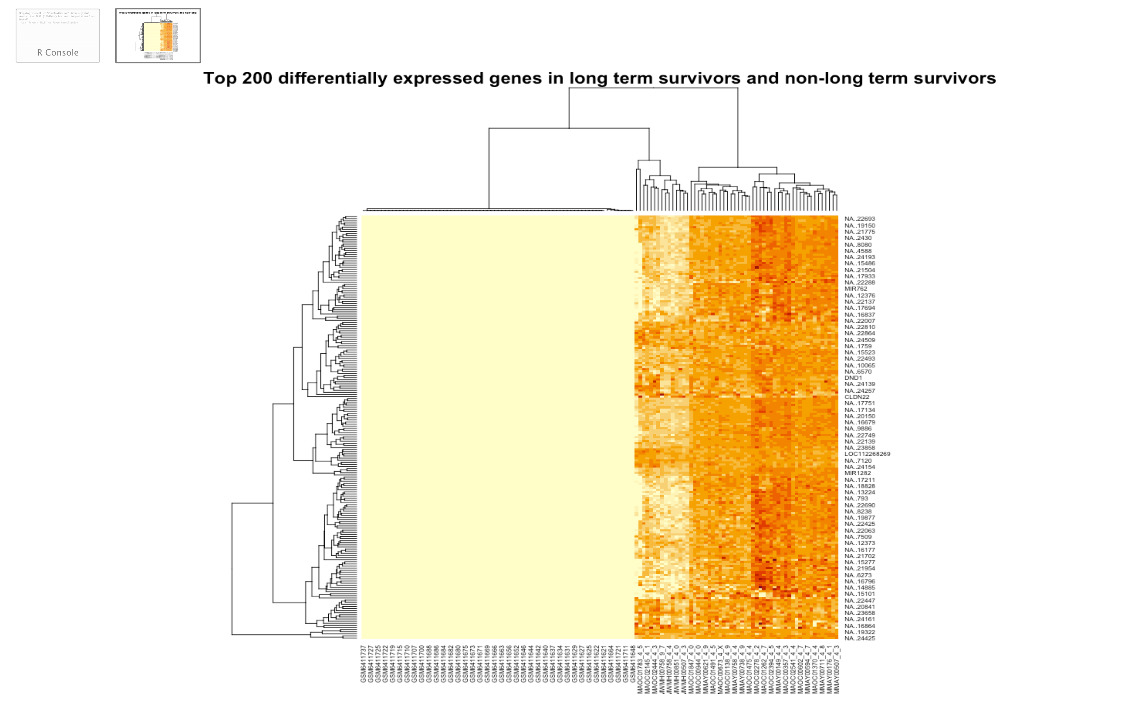
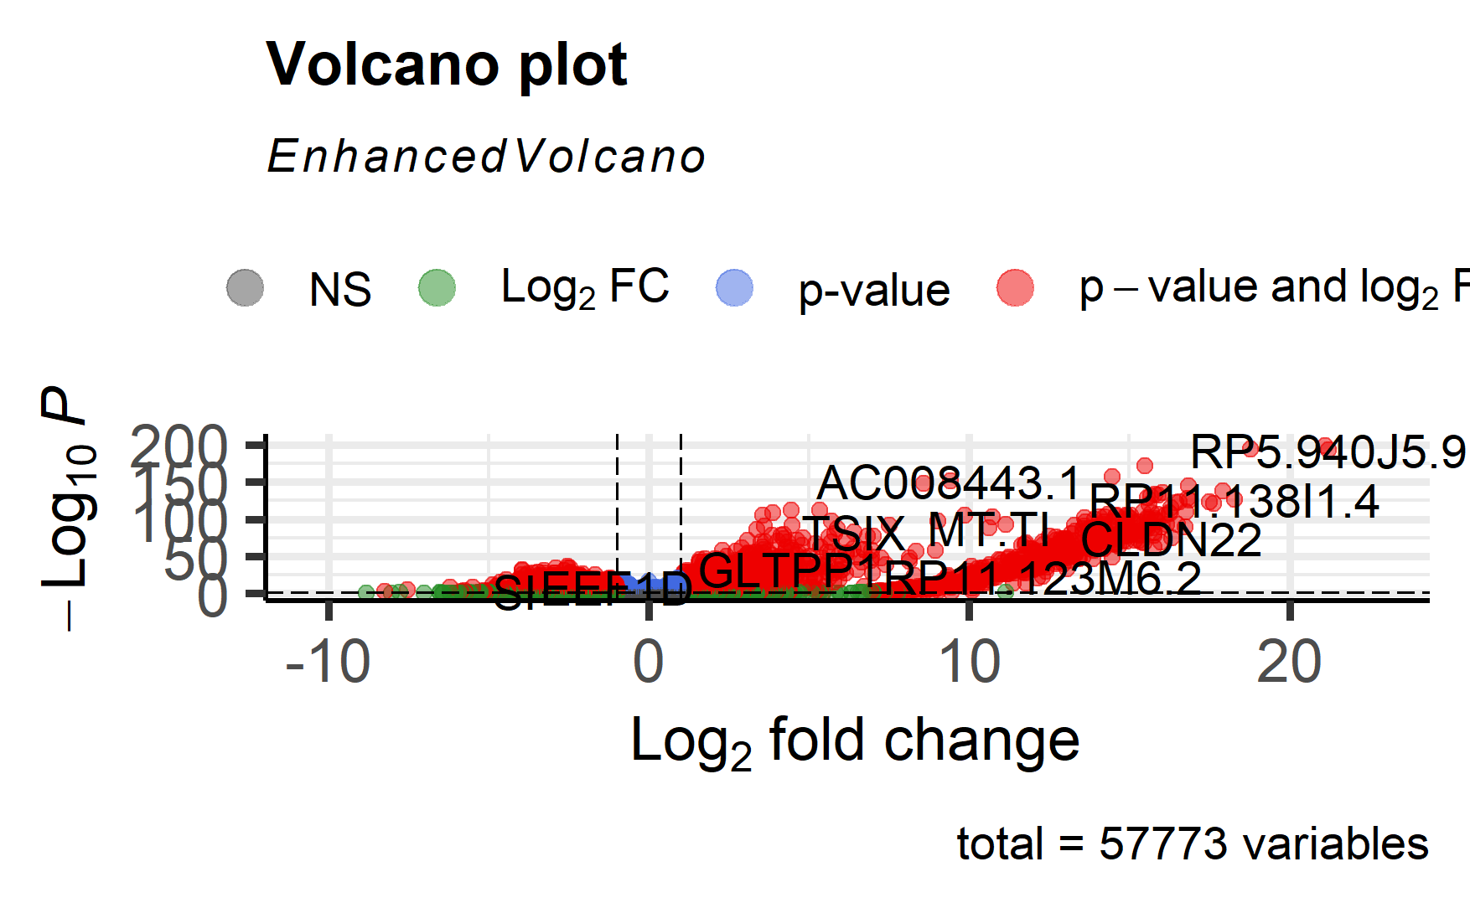
Differential Expression and Enrichment Analysis
From our differential expression analysis, we found a clear distinction between two primary groups of samples, but these two groups do not match our two control groups.
Enrichment analyses was used to try and visibly identify statistically over/underrepresented genes within long-term survivors in our sample compared to short- and moderate-term survivors.
Some members of the long-term survivor group shared characteristics with the non-long-term survival group. This confirms a result found in our PCA plot where a similar result was observed.
This did not help us to answer our hypothesis since we could not determine any clear distinction between our two sample groups.

Slide 7
Differential Expression and Enrichment Analysis
Notes:
The heatmap was also created to help us find any changes in gene expression of the different survivors in our sample.
This heatmap exhibits a clear distinction between two primary groups of samples on the basis of the top 200 differential expressed genes in our data.
The group on the right, with sample title beginning with M, is composed entirely of long term survivors. But the left group also contains long term survivors as well, although that wouldn’t be able to be inferred by the heatmap.

Slide 8
Differential Expression and Enrichment Analysis
Notes:
The volcano plot helped us quickly identify whether certain gene expressions in long-term survivors are more biologically significant than those found in short- and moderate-term survivors
This volcano plot is comparing the statistical significance, p-value, to the fold change, magnitude/amount of change.
Here we see which of the 57,000 genes simultaneously have large fold changes and are also statistically significant
These genes that fall into that category are more biologically significant genes
Top right most significant (Click again for circle fade in animation)

Slide 9
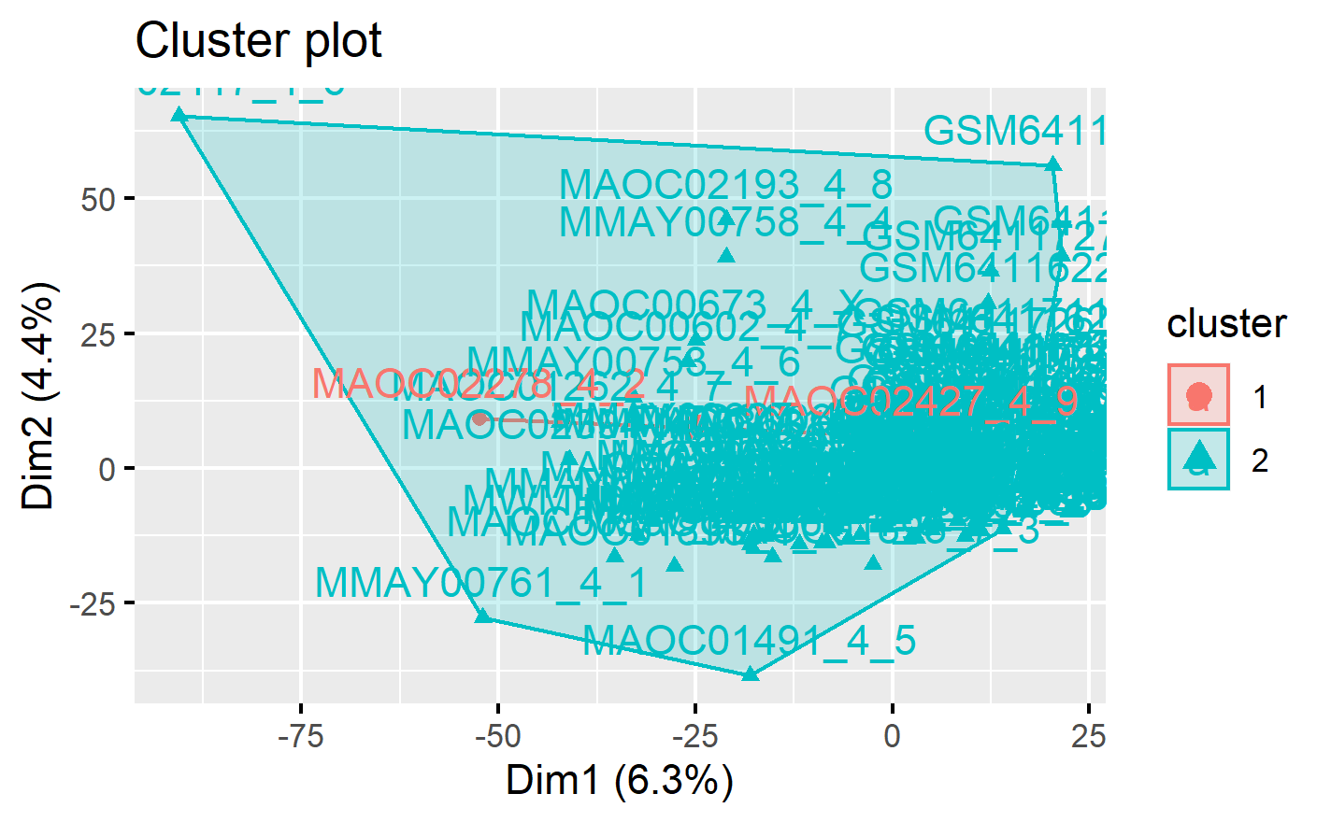
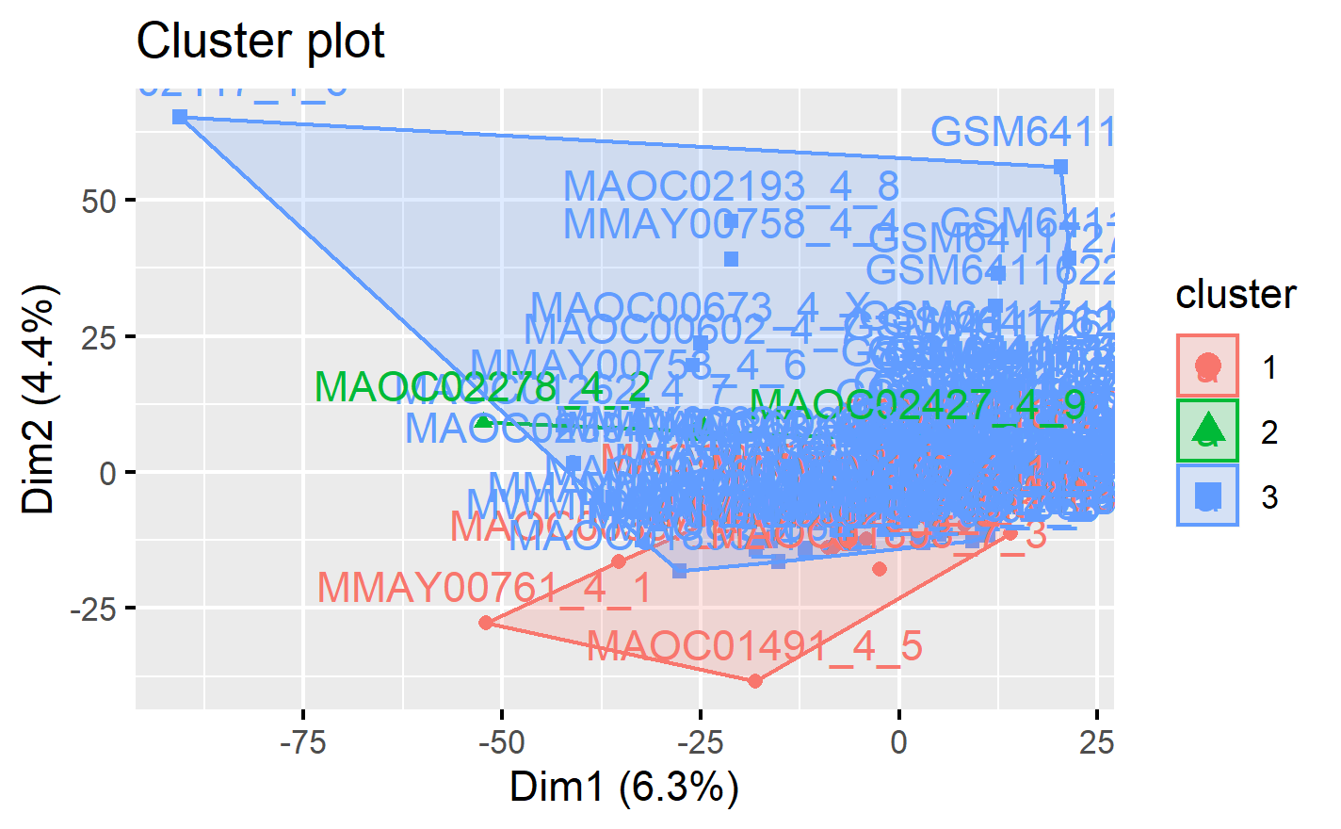
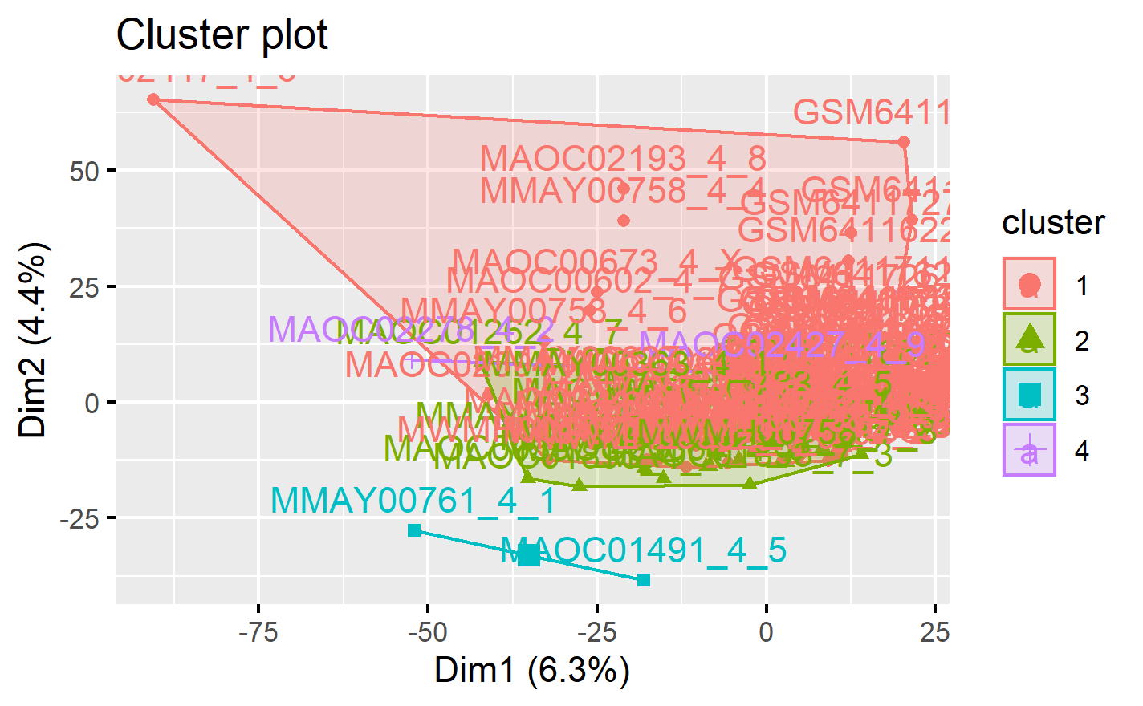
Clustering & Enrichment Analysis
Results of the three clustering method we ran:
Kmeans – clusters often found nested within each other and disproportionate cluster sizes throughout
Hierarchical - the three to four primary clusters still maintain an extreme inequality in terms of sample membership, possibly due to the clustering function not choosing a proper k value
Consensus - delta area graph showed no appreciable difference in consensus beyond k-3, consensus clustering graph showed most memberships in one group
We were not able to answer our original scientific question because, in each clustering method, the proportion of cluster membership did not reflect our initial control groups populations for our experiment.

Slide 10
Clustering & Enrichment Analysis
Notes:
Kmeans clustering plots (some stuff mentioned on text slide):
initial cluster number of 2, one small cluster is nested within a cluster that was much larger in terms of area and membership (left)
With k=3, the small nested cluster persists, but the larger cluster is split into two. As in the previous case, there is a cluster with a membership that is much larger than the other clusters (middle)
The same pattern can be oberved for k=4 (right)

Slide 11
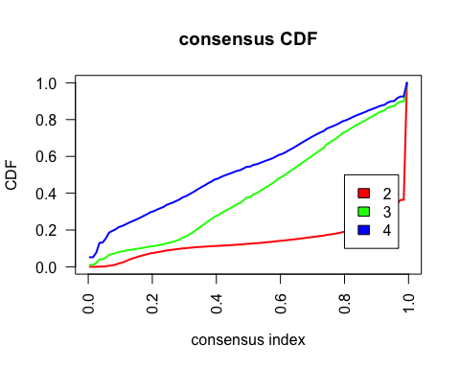
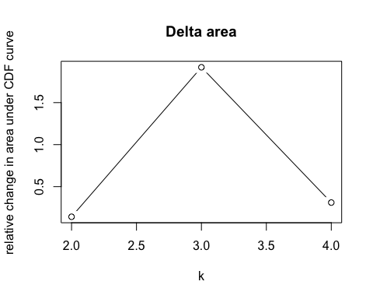
Clustering & Enrichment Analysis
Notes:
Consensus Clustering (some stuff mentioned on text slide):
our delta area graph no appreciable difference in consensus beyond k-3
The consensus clustering graph shows a majority of membership in one group with a smaller group and an even smaller group next to that
With an increase to a cluster number of 4, the appearance of a larger group emerges. This group is possibly analogous to the nested group that appeared in the k=4 kmeans clustering

Slide 12
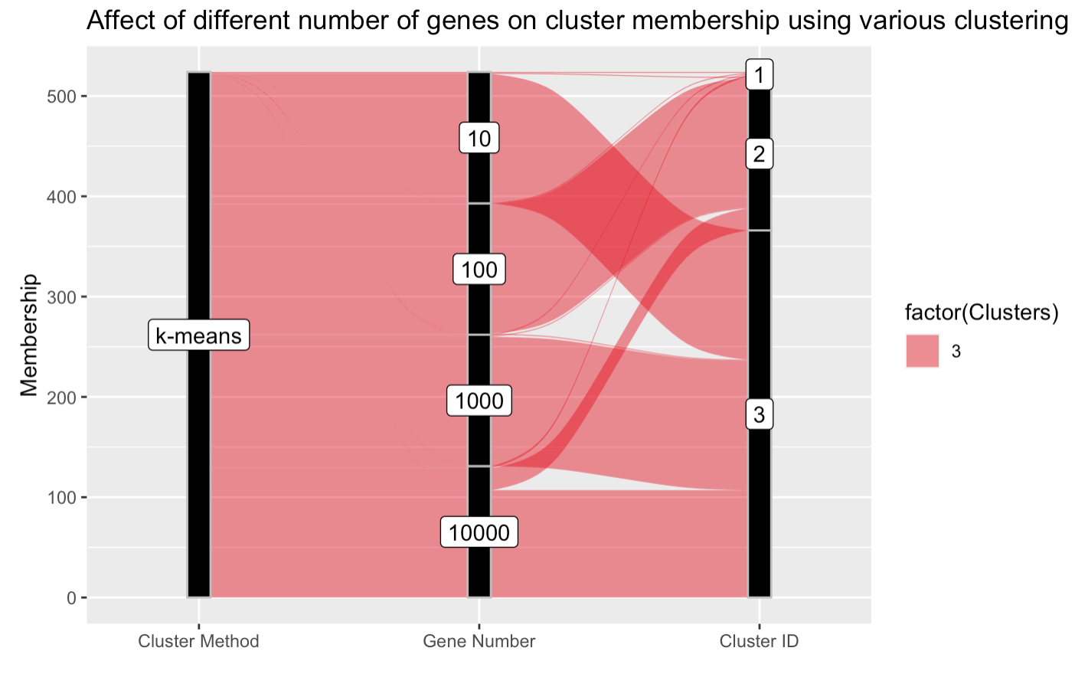
Clustering & Enrichment Analysis
Notes:
alluvial plot

Slide 13
Conclusions & Future Work
We found that while there is a genetic difference between long-term and short-term survivors of High Grade Serous Ovarian Cancer, the differences themselves can not be observed at the gene expression level.
Our hypothesis was that there would be a genetic difference between long-term and short- and moderate-term survivors of high-grade serous ovarian cancer.
We have determined from the results of our assignments that gene count is not the primary driver of long-term survival of HGSC. This is because, the results we obtained did not correspond to our control groups.
If we were to continue working on this research in the future, we would want to do differential expression at an allele count level instead of a gene count level like we have done so far in this experiment. The study that our samples were pulled from found conclusive results from working on an allele level. We would like to find out if the methods we used in this experiment would produce more conclusive results if we did them on the allele level .

Slide 14

Thank You For Listening!

