Slide 1
Food-Sales-Prediction
Where are people buying their food?

Slide 2
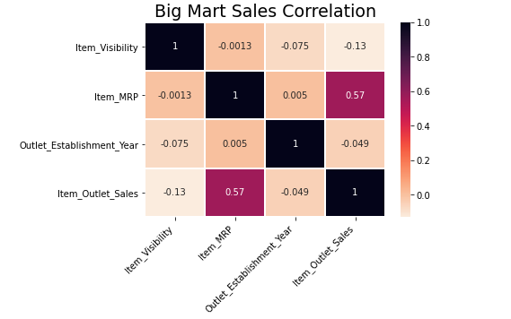
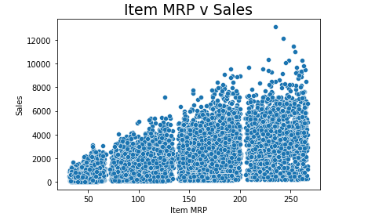
Where do we begin?
Which characteristics correlate the best with Sales?
Item MRP

Slide 3
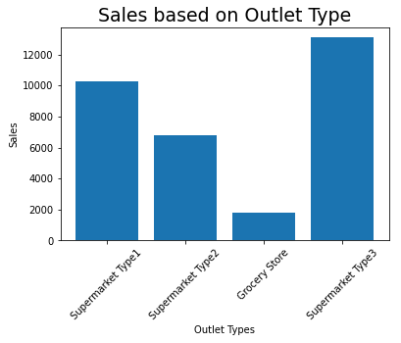
Which Outlet is selling more?
4 Kinds of Outlets
Size of Outlets were not given
Supermarket Type 3 has highest sales

Slide 4

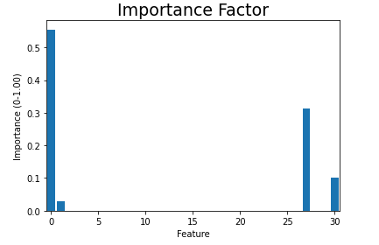

Recommendations for increasing profits

Slide 5
How did we come to these conclusions?
Deciding on which model to use:
Linear Regression:
R²
^{Training: 0.561}
^{Test: 0.567}
RMSE
^{Training:1139.32}
^{Test: 1092.52}
Bagged Trees:
R²
^{Training: 0.914}
^{Test: 0.486}
RMSE
^{Training: 503.62}
^{Test: 1190.55}
Decision Tree:
R²
^{Training: 0.999}
^{Test: 0.175}
RMSE
^{Training: 21.16}
^{Test: 1508.30}
Random Forests:
R²
^{Training: 0.914}
^{Test: 0.486}
RMSE
^{Training: 1074.67}
^{Test: 1047.92}

Slide 6
Random Forest and Linear Model
Random Forest:
R²
^{Training: 0.914}
^{Test: 0.486}
RMSE
^{Training: 1074.67}
^{Test: 1047.92}
Linear Regression
R²
^{Training: 0.561}
^{Test: 0.567}
RMSE
^{Training: 1139.32}
^{Test: 1092.52}

Slide 7
In Conclusion:
Focus on:
Item MRP
The higher MRP = Increase in Sales
Outlet Type
Supermarket Type 3 produces the highest sales

