Slide 1
Fundamentals of Computer Design
Unit 1- Chapter 1
Reference :
Computer Architecture, A Quantitative Approach – John L. Hennessey and David A. Patterson. 4th edition
8/10/2018
1
Notes:
1

Slide 2
Outline
Introduction
Computing Classes
Measuring, Reporting,
Summarizing Performance
Quantitative Principles of Design
8/10/2018
2
Notes:
2

Slide 3
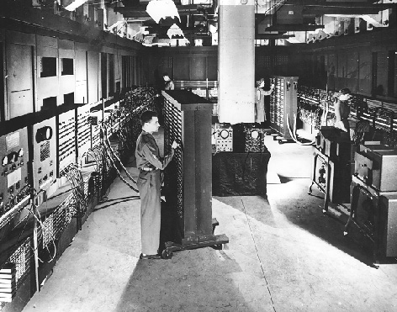
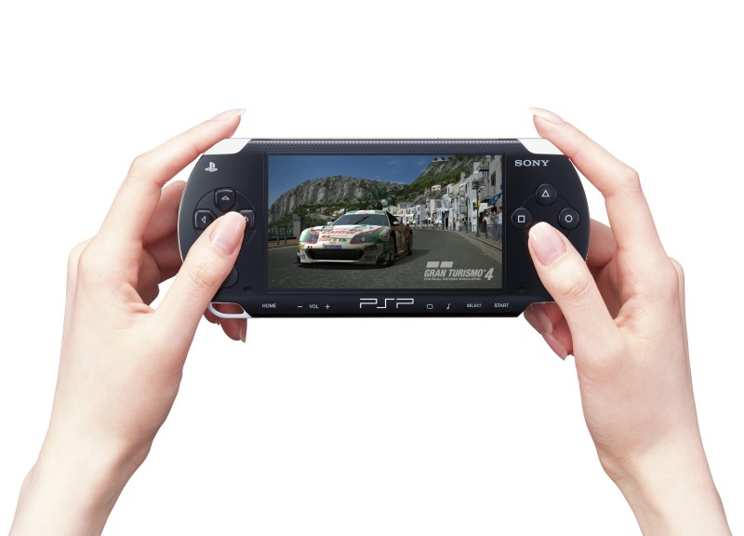
Introduction
CHANGE!
Eniac, 1946
(first stored-program computer)
Occupied 50x30 feet room,
weighted 30 tonnes,
contained 18000 electronic valves, consumed 25KW of electrical power;
capable to perform 100K calc. per second
PlayStation Portable (PSP)
Approx. 170 mm (L) x 74 mm (W) x 23 mm (D)
Weight: Approx. 260 g (including battery)
CPU: PSP CPU (clock frequency 1~333MHz)
Main Memory: 32MB
Embedded DRAM: 4MB
Profile: PSP Game, UMD Audio, UMD Video
8/10/2018
3
Notes:
3

Slide 4
A short history of computing
Continuous growth in performance due to advances in technology and innovations in computer design
First 25 years (1945 – 1970)
25% yearly growth in performance
Both forces contributed to performance improvement
Mainframes and minicomputers dominated the industry
Late 70s, emergence of the microprocessor
35% yearly growth in performance thanks to integrated circuit technology
Changes in computer marketplace:
elimination of assembly language programming,
emergence of Unix ➔ easier to develop new architectures
8/10/2018
4
Notes:
4

Slide 5
Mid 80s, emergence of RISCs (Reduced Instruction Set Computers)
52% yearly growth in performance
Performance improvements through instruction level parallelism (pipelining, multiple instruction issue), caches
Since ‘02, end of 16 years of renaissance
20% yearly growth in performance
Limited by 3 hurdles: maximum power dissipation, instruction-level parallelism, and so called “memory wall”
Switch from ILP to TLP and DLP (Thread-, Data-level Parallelism)
8/10/2018

Slide 6
Effect of this Dramatic Growth
Significant enhancement of the capability
available to computer user
Example: a today’s $500 PC has more performance, more main memory, and more disk storage than a $1 million computer in 1985
Microprocessor-based computers dominate
Workstations and PCs have emerged as major products
Minicomputers - replaced by servers
Mainframes - replaced by multiprocessors
Supercomputers - replaced by large arrays of microprocessors
8/10/2018
6
Notes:
6

Slide 7
Changing Face of Computing
In the 1960s mainframes roamed the planet
Very expensive, operators oversaw operations
Applications: business data processing,
large scale scientific computing
In the 1970s, minicomputers emerged
Less expensive, time sharing
In the 1990s, Internet and WWW, handheld devices (PDA), high-performance consumer electronics for video games and set-top boxes have emerged
Dramatic changes have led to 3 different computing markets
Desktop computing, Servers, Embedded Computers
8/10/2018
7
Notes:
7

Slide 8
Desktop Computers
Largest market in dollar terms
Spans low-end (<$500) to high-end ($5K) systems
Optimize price-performance
Performance measured in the number of calculations and graphic operations
Price is what matters to customers
As a result the newest, highest-performance and cost-reduced microprocessors appear
Reasonably well characterized in terms of applications and benchmarking
8/10/2018
8
Notes:
8

Slide 9
Servers
Provide more reliable file and computing services (Web servers)
Key requirements
Dependability – effectively provide service (Yahoo!, Google, eBay)
Scalability – server systems grow over time, so the ability to scale up the computing capacity is crucial
Throughput – transactions per minute
8/10/2018
9
Notes:
9

Slide 10
Embedded Computers
Fastest growing portion of the market
E.g., home appliances, printers, smart cards,
cell phones, palmtops, gaming consoles, network routers
Wide range of processing power and cost
Hard real time and soft real time.
Requirements
Real-time performance requirement
(e.g., time to process a video frame is limited)
Minimize memory requirements, power.
8/10/2018
10
Notes:
10

Slide 11
Computing Classes: A Summary
Feature | Desktop | Server | Embedded
Price of the system | $500-$5K | $5K-$5M | $10-$100K (including network routers at high end)
Price of the processor | $50-$500 | $200-$10K | $0.01 - $100
Sold per year (estimates for 2000) | 150M | 4M | 300M (only 32-bit and 64-bit)
Critical system design issues | Price & performance. graphics, compute performance | Dependability, Scalability, Throughput | Price, power consumption, application-specific performance
8/10/2018
11
Notes:
11

Slide 12
Measuring, Reporting,
Summarizing Performance
8/10/2018
12
Notes:
12

Slide 13
Response Time, Throughput, and Performance
Response time : the time between the start and the completion of an event – also referred to as execution time.
The computer user is interested.
Throughput : the total amount of work done in a given time.
The administrator of a large data processing center may be interested.
8/10/2018

Slide 14
In comparing design alternatives,
The phrase “X is faster than Y” is used here to mean that the response time or execution time is lower on X than on Y.
In particular, “X is n times faster than Y” or “the throughput of X is n times higher than Y” will mean
8/10/2018

Slide 15
Performance Measuring
Execution is the reciprocal of performance,
8/10/2018

Slide 16
Measuring Performance
Execution Time :
Response time, elapsed time ,the latency to complete a task, including disk accesses, memory accesses, input/output ,operating system overhead activities.
CPU time:
The time the CPU is computing, excluding I/O or running other programs with multiprogramming
Divided into user and system CPU times
User CPU time
The CPU time spent in the program
System CPU time
Te CPU time spent in the operating system
90.7u 12.9s 2:39 65%
8/10/2018
16
Notes:
16
Wall-clock time, response time, elapsed time
the latency to complete a task, including disk accesses, memory accesses, input/output activities, operating system overhead,...
CPU time
the time the CPU is computing, excluding I/O or running other programs with multiprogramming
often further divided into user and system CPU times
User CPU time
the CPU time spent in the program
System CPU time
the CPU time spent in the operating system performing tasks requested by the program

Slide 17
SPEC- Benchmarks
Want to compare two processors by measuring their performance
Need some standardized set of programs
These are called benchmark programs
Each market sector has a different focus: needs different set of benchmark
Run the multiple copies of standard SPEC CPU bench mark and convert cpu time to spec rate.
Benchmark suit and Benchmark specific flags
8/10/2018
17

Slide 18
Benchmarks
Different types of benchmarks
Real programs
Kernels
Toy Benchmarks
Synthetic benchmarks
8/10/2018
18
Notes:
18
There are 4 levels of programs used in such circumstances, listed below in decreasing order of accuracy of prediction.
-real programs like MSWord, Excel, Photoshop...
-kernels - small pieces extracted from real programs
-toy benchmarks - short, easy to type and run programs
-synthetic benchmarks - code that matches frequency of key instruction and operations to real programs
The question of right benchmarks is very important since the company thrive or go bankrupt depending on price/performance of their products relative to the others in the marketplace.
To make this comparison arena fair,
several companies and organization have been founded.

Slide 19
1.No source code modifications are allowed.
2.Source code modifications are allowed, but are essentially impossible.
3.Source modifications are allowed, as long as the modified version produces the same output.
8/10/2018

Slide 20
Desktop benchmarks
SPEC CPU is the standard
Provided by Standard Performance Evaluation Corporation (SPEC) http://www.spec.org/
Currently in the 5th generation: SPEC89, SPEC92, SPEC95, SPEC2000, SPEC2006
Has two types of programs: integer and floating-point to stress different CPU units
SPEC2000 has 12 integer and 14 floating-point programs
introducing a new processor for desktop or workstation- report performance of all 26 programs
For graphics performance two available benchmarks: SPECviewperf and SPECapc
8/10/2018
20
Notes:
20

Slide 21
Server benchmarks
SPECrate
Not the most reliable measure: run a copy of the same SPEC application on each processor and report average number of jobs finished per unit time
SPECSFS
Tests the performance using a series of file server requests; measures CPU, disk and network throughput;
SPECWeb
Web server benchmark; simulates multiple clients requesting both static and dynamic pages from a server; also clients can upload data on the server
8/10/2018
21

Slide 22
Server benchmarks
Transaction processing (TP)
Probably the most widely used benchmark in server community
Measures database access and update throughput of a server
Simple examples: airline reservation, bank ATM
TPC-A-1985
TPC-C-1992
TPC-H-Model adhoc decision
TPC-W –Transactional Web benchmark
TPC-App-Application Server bechmark.
Embedded sector
EEMBC (Embedded Microprocessor Benchmark Consortium)
22

Slide 23
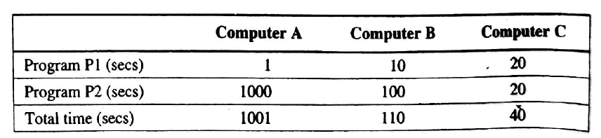
Summarizing Performance Results
A is 10 times faster than B for program p1.
B is 10 times faster than A for program p2.
A is 20 times faster than C for program p1.
C is 50 times faster than A for program p2.
B is 2 times faster than C for program p1.
C is 5 times faster than C for program p1.
8/10/2018

Slide 24

Summarizing Performance Results: Arithmetic Mean
A straightforward approach to computing a summary result
Compare the arithmetic means of the execution times of the programs.
Where Timei is execution time of ith program and n is program.
8/10/2018

Slide 25

Summarizing Performance Results: SPEC RATIO
A Benchmark Program is compiled and run on computer under test- note the running time
The same program is compiled and run on a reference computer
Compute the SPEC ratio : SPEC ratio of 50 means comp. under test is 50 times faster than ref. comp.
Where,
n – number of pgms in the suite
SPECi – ratio for the pgm i in the suite
8/10/2018

Slide 26
Comparing and Sum. Per. (cont’d)
SPECRatio of computer A on a benchmark was 1.25 times higher than computer B
8/10/2018
26

Slide 27
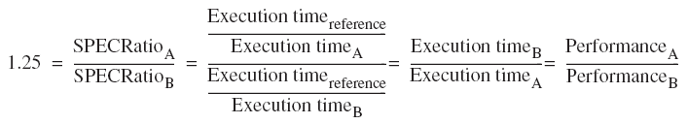
This means performance of computer A is 1.25 times higher than computer B
8/10/2018

Slide 28
Quantitative Principles of Design
Take the advantage of Parallism
System Level
Multiple processor and multiple Disk,Memory:throughput,Scalabilty
Individual Processor Level
Through pipelining :Executing instruction compleltely or partially in parallel.
Prinicple of Locality
Rule of Thumb:Program spends 90% execution time in only 10% of Code.
Predict with accuracy what instruction and data are used in future
Temporal locality :recently acceses items likely to accesed in near fututre.
Spatial locality:Items whose address are near one another are tend to be referenced close together in time.
8/10/2018
28
Notes:
28

Slide 29
Focus on Common Sense:
Favour the frequent case over infrequent case.
Ex:Instruction fetch and decode of processor Vs Multiplier of processor.
Improve the optimization of common cases.
8/10/2018

Slide 30

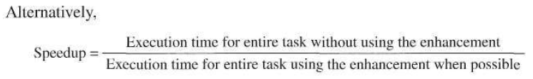
Amdahl’s Law
The performance gain that can be obtained by improving some portion of a computer can be calculated using Amdahl's Law.
“Performance improvement to be gained from using some faster mode of execution is limited by the fraction of the time the faster mode can be used”
8/10/2018

Slide 31
Amdahl's Law gives us a quick way to find the speedup from some enhancement based on 2 factors.
1. The fraction of the computation time in the original computer that can be converted to take advantage of the enhancement
Ex:20 seconds of the execution time of a program that takes 60 seconds , the fraction is 20/60.
Fraction enhanced :is always less than or equal to 1.
2. The improvement gained by the enhanced execution mode; that is, how much faster the task would run if the enhanced mode were used for the entire program.
Ex: Enhanced mode takes, 2 seconds for a portion of the program, while it is 5 seconds in the original mode, the improvement is 5/2 Speedup enhanced is always greater than 1.
8/10/2018

Slide 32
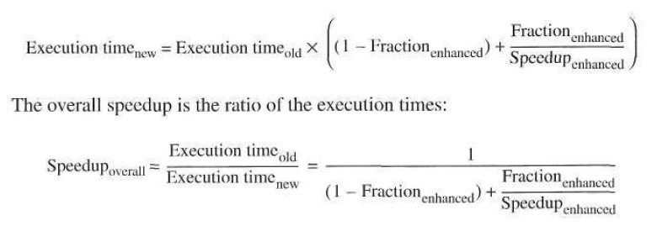
8/10/2018

Slide 33
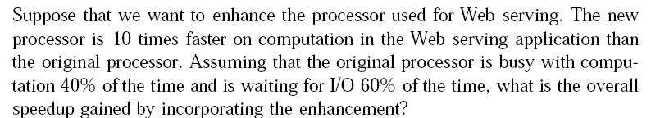
8/10/2018

Slide 34
8/10/2018

Slide 35
Example 2
A common transformation required in graphics processors is square root. Implementations of floating-point (FP) square root vary significantly in performance, especially among processors designed for graphics. Suppose FP square root (FPSQR) is responsible for 20% of the execution time of a critical graphics benchmark. One proposal is to enhance the FPSQR hardware and speed up this operation by a factor of 10.
The other alternative is just to try to make all FP instructions in the graphics processor run faster by a factor of 1.6; FP instructions are responsible for half of the execution time for the application. The design team believes that they can make all FP instructions run 1.6 times faster with the same effort as required for the fast square root. Compare these two design alternatives.
8/10/2018
35

Slide 36
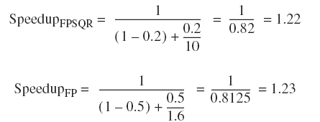
Hence improving the performance of the FP operations overall is slightly better because of the higher frequency.
8/10/2018
36
Notes:
36

Slide 37

The Processor Performance Equation
Computers are constructed using a clock running at a constant rate.
These discrete time events are called ticks, clock ticks, clock periods, clocks, cycles, or clock cycles.
CPU time = CPU clock cycles for a program x Clock cycle time----(1)
8/10/2018

Slide 38

Number of instructions executed—The instruction path length or instruction count (IC).
clock cycles per instruction CPI is computed as
---------------(2)

Slide 39
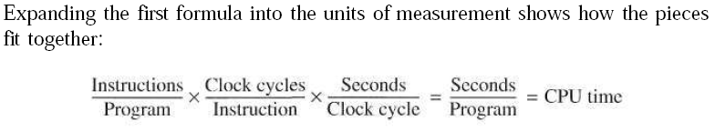
Clock cycles can be defined as IC*CPI substitute in equation 1 results in:
8/10/2018

Slide 40

The CPU clock cycles taken by a program is given by :
where –
IC_{i} represents number of times instruction i is executed in a program
CPI_{i} represents the average number of clocks per instruction for instruction i.
8/10/2018
40

Slide 41

The CPU time taken by a program is given by :
The overall CPI is can be computed now using equation 2
8/10/2018
41

Slide 42
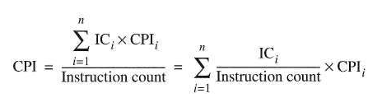
The overall CPI is expressed by :

Slide 43
Example 3
Suppose we have made the following measurements:
Frequency of FP operations =25%
Average CPI of FP operations =4.0
Average CPI of other instructions = 1.33
Frequency of FPSQR=2%
CPI of FPSQR=20
Assume that the two design alternatives are to decrease the CPI of FPSQR to 2 or to decrease the average CPI of all FP operations to 2.5. Compare these two design alternatives using the processor performance equation.
8/10/2018
43

Slide 44

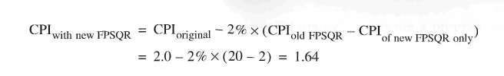
Find the original CPI with neither enhancement
Compute the CPI for the enhanced FPSQR by subtracting the cycles saved from the original CPI:
8/10/2018
44

Slide 45
compute the CPI for the enhancement of FP instructions the same way:
CPI_{newFP} = CPI_{original} - 25% x (CPI_{oldFP} - CPI_{newFPonly} )
=2 – 0.25 x (4 - 2.5)
=2 – (0.25 X 1.5)
=1.625
Performance is marginally better with FP enhancement since CPI is slightly lower.
Speedup with new FP = CPU time original/CPI new FP
=2 / 1.625
= 1.23
8/10/2018
45

Slide 46
Introduction to Parallel Processing
Unit 1 – Chapter 2
References:
Advanced computer architecture … Dezo Sima
Advanced computer architecture… Kai Hwang

Slide 47
Introduction to Parallel Processing
Parallel Processing is the simultaneous execution of multiple instructions of a computational task
Mainly 2 types :
Thread level parallelism (Multiprocessor systems)
Instruction level parallelism (Pipelined processors)

Slide 48
Multiprocessor systems
Threads are to be run using multiple processors or Processing Elements
A problem is broken into discrete parts that can be solved concurrently
Each part (thread) is further broken down to a series of instructions
Instructions from each part (thread) execute simultaneously on different CPUs/PE s (Processing Element)

Slide 49
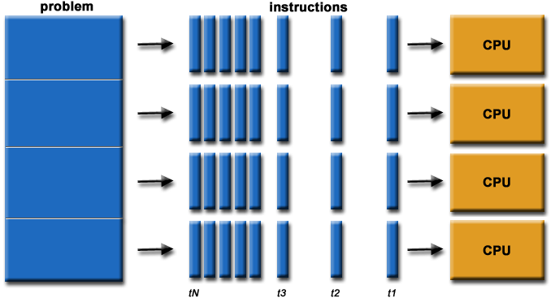
Parallel computing

Slide 50
Instruction-level parallelism
Parallelism at the machine-instruction level
Rather than wait for an instruction to finish, start the next one as soon as possible
Very common in RISC architectures
The processor can re-order, pipeline instructions, do aggressive branch prediction, etc.
Instruction-level parallelism enabled rapid increases in processor speeds over the last 15 years
50
Notes:
50

Slide 51
Concurrency vs. Parallelism
CPU
CPU1
CPU2
Time
Multiple tasks are executed in an interleaved order
Multiple tasks are executed simultaneously

Slide 52
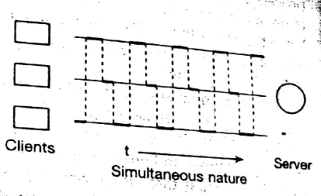
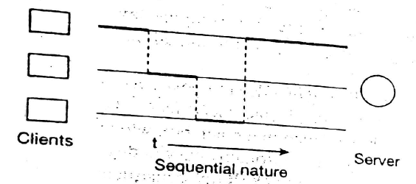
The concepts of concurrent execution
The temporal behaviour of N-client 1-server
One client is served at any given moment
Key problem – how competing process/threads are scheduled ?
Scheduling policies –
Pre-emption rule : time sharing, priority based.
Selection rule : priority, time of arrival.

Slide 53
Pre-emption schemes
Pre-emption rule
Non pre-emptive
Pre-emptive
Time-shared
Prioritized
Priority
Sever
Sever
Sever
Client
Client
Client
Time

Slide 54
Parallel execution
N-client N-server model
Service more than one client at the same time
Synchronous or Asynchronous
Sync : each processor starts service at same moment
Async : different moments..
Client
Sever
Client
Sever
Sync
Async

Slide 55
Types and levels of parallelism
Available and utilized parallelism
available: in program or in the problem solutions
utilized: occurring during execution
Types of available parallelism
Data parallelism
arises from data structures
Functional parallelism
arises from the logic of a problem solution

Slide 56
Data Parallelism
Independent tasks apply same operation to different elements of a data set
for i ← 0 to 99 do
a[i] ← b[i] + c[i]
endfor
Okay to perform operations concurrently

Slide 57
Functional Parallelism
Independent tasks apply different operations to different data elements
a ← 2
b ← 3
m ← (a + b) / 2
s ← (a² + b²) / 2
v ← s - m²

Slide 58
Functional Parallelism: Another example:
for (int i = 0; i < 10; i++) //loop1 { c[ i ] = a[ i ] + b[ i ]; }
for (int i = 0; i < 10; i++) //loop2 { d[ i ] = a[ i ] * b[ i ]; } for (int i = 0; i < 10; i++) //loop3 { e[ i ] = d[ i ] - c[ i ]; }
The first two loops can run in parallel (by Functional Parallelism)
Each operation in the loop is actually Data Parallelism
However, the third loop can't. Because it depends on the result of the first and second loops.

Slide 59
Available and utilized levels of functional parallelism
Available levels
Utilized levels
User (program) level
User level
2
Procedure level
Process level
Loop level
Thread level
1
Instruction level
Instruction level
1.Exploited by architectures
2.Exploited by means of operating systems

Slide 60
Utilization of functional parallelism
Available parallelism can be utilized by
Architecture: Capable of parallel instruction execution: instruction-level parallel architectures
Multi threaded Architecture and MIMD architecture: Thread or the Process
User level --- Multiprogramming, time sharing
Process level --- Multitasking
Thread level --- Multi-threading

Slide 61
Shared Memory Multiprocessors
Shared-memory multiprocessor models:
The uniformmemory-access (UMA) model,
The nonuniform-memory-access (NUMA) model, and
The cache-only memory architecture (COMA) model.

Slide 62
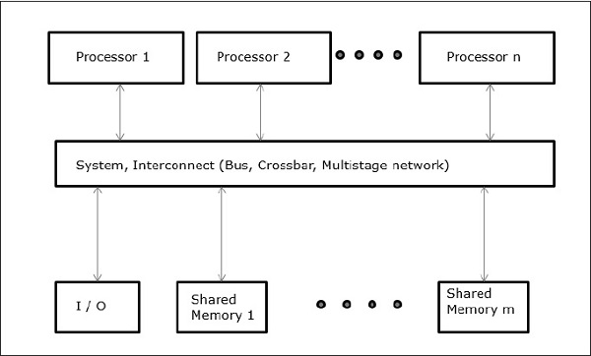
The UMA Model

Slide 63
The UMA Model
Physical memory is uniformly shared.
Uniform memory access.
Private cache.
Tightly coupled systems
suitable for general-purpose and timesharing applications by multiple users.
Speed up the execution of a time critical applications.
Synchronization and communication among processors are done through using shared variables.

Slide 64
Symmetric multiprocessor :Processor have equal access to all peripheral
Asymmetric multiprocessor :Only one or subset processor are executive capable ,handle I/O.
Remaining processor have no I/O capability: attached processor.

Slide 65
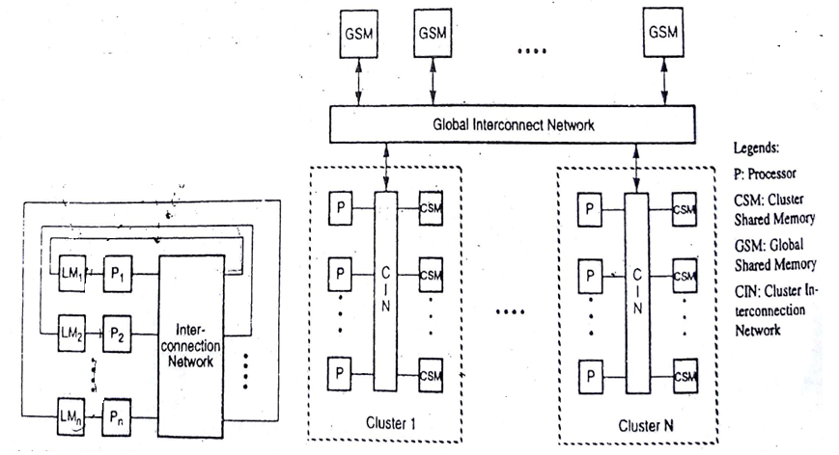
Non uniform memory access (NUMA)

Slide 66
Non uniform memory access (NUMA)
Do not allow uniform access to all shared memory locations.
Access time varies with location of memory word.
This architecture still allows all processors to access all shared memory locations but in a non uniform way.
Shared memory physically distributed to all processors.
Each processor can access its local shared memory more quickly than the other memory modules not next to it.
Collection of all local memories: Global address space
Three memory access pattern: a)local memory access
b)global memory access
c)remote memory access
66

Slide 67
Access of remote memory attached to processor takes longer time due to interconnected network.
Processor divided into several cluster.
Cluster connected to global memory modules.
Processor with same cluster can access cluster shared memory modules.
Access time to cluster memory is shorter than global memory.

Slide 68
The COMA model Cache Only Memory Model
Interconnection Network
D –Directory
C- Cache
P- Processor
D
D
D
……
C
C
C
P
P
P

Slide 69
COMA Model
A multiprocessor using cache only memory.
It is special case of NUMA machines
Distributed main memory are converted to caches.
All caches form global address space.
Remote cache access is assisted by distributed cache directories.
Hierarchical directories are used to locate copies of cache blocks.

Slide 70
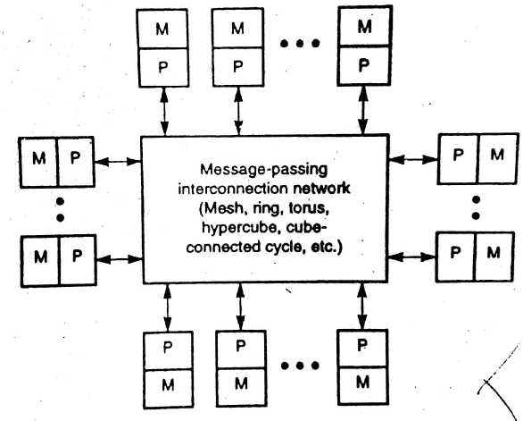
Distributed Memory Multi computer

Slide 71
Distributed Memory Multi computer
The system consists of multiple computers called nodes, interconnected by a message-passing network.
Each node is an autonomous computer consisting of a processor, local memory, and attached disks or I/O peripherals.
The message-passing network provides point-to-point static connections among the nodes.
All local memories are private and are accessible only by local processors

Slide 72
Multicomputer Generations
Modern multi computers use hardware routers to pass messages.
The boundary router may be connected to I/O and peripheral devices.
The inter node communications achieved through compatible data representations and message-passing protocols.
Message-passing multicomputers have gone through two generations

Slide 73
The first generation (1983-1987) was based on processor board technology “software-controlled message switching”.
The second generation (1988-1992) was implemented with mesh-connected architecture, hardware message routing.
The third generation (1993-1997) was based on fine-grain multi computers.

Slide 74
Important issues for multicomputers include
message-routing schemes,
network flow control strategies,
deadlock avoidance,
virtual channels, message-passing primitives

Slide 75
Problems based on Amdahal’s Law
We are considering an enhancement to the processor of a web server. The new CPU is 20 times faster on search queries than the old processor. The old processor is busy with search queries 70% of the time, what is the speedup gained by integrating the enhanced CPU?

Slide 79
Suppose a cache is 10 times faster than main memory and support that the cache can be use 90% of the time. How much speedup do we gain by using cache?

Slide 80
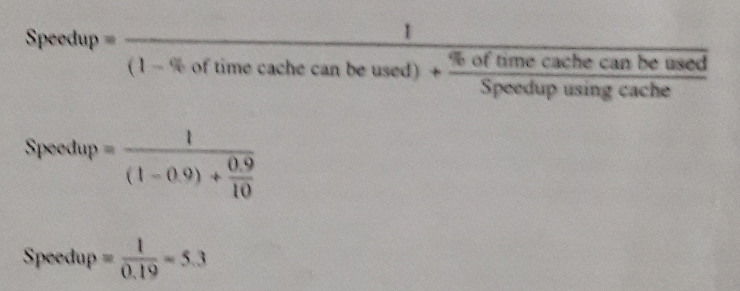

Slide 82
END
of
Unit 1
8/10/2018
82

