Slide 1
Introduction to Parallel Processing
Unit 1 – Chapter 2
References:
Advanced computer architecture … Dezo Sima
Advanced computer architecture… Kai Hwang

Slide 2
Outline
Introduction
Concepts of Concurrent and Parallel execution
Types and levels of parallelism
Classification of parallel architecture
Basic parallel techniques
Reference : From Dezo Sima; chapter 3
Parallel computer models
Shared memory multiprocessors
Distributed-Memory multicomputers
Reference : Kai Hwang; chapter 1

Slide 3
Introduction to Parallel Processing
Parallel Processing is the simultaneous execution of multiple instructions of a computational task
Mainly 2 types :
Thread level parallelism (Multiprocessor systems)
Instruction level parallelism (Pipelined processors)

Slide 4
Multiprocessor systems
Threads are to be run using multiple processors or Processing Elements
A problem is broken into discrete parts that can be solved concurrently
Each part (thread) is further broken down to a series of instructions
Instructions from each part (thread) execute simultaneously on different CPUs/PE s (Processing Element)

Slide 5
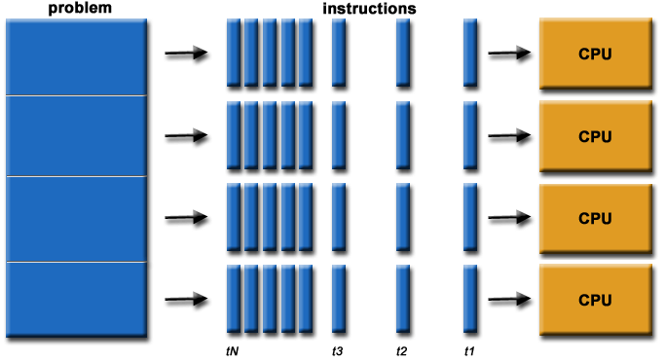
Parallel computing

Slide 6
Instruction-level parallelism
Parallelism at the machine-instruction level
Rather than wait for an instruction to finish, start the next one as soon as possible
Very common in RISC architectures
The processor can re-order, pipeline instructions, do aggressive branch prediction, etc.
Instruction-level parallelism enabled rapid increases in processor speeds over the last 15 years
6
Notes:
6

Slide 7
Concurrency vs. Parallelism
CPU
CPU1
CPU2
Time
Multiple tasks are executed in an interleaved order
Multiple tasks are executed simultaneously

Slide 8
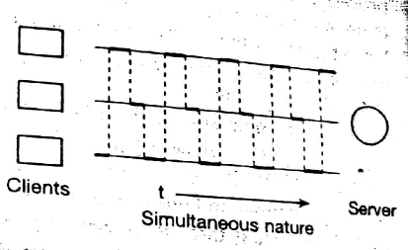
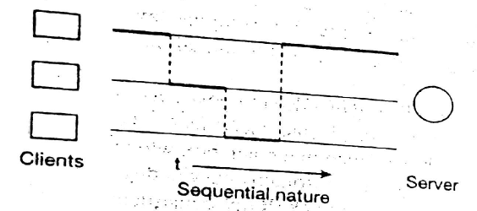
The concepts of concurrent execution
The temporal behaviour of N-client 1-server
One client is served at any given moment
Key problem – how competing process/threads are scheduled ?
Scheduling policies –
Pre-emption rule : time sharing, priority based.
Selection rule : priority, time of arrival.

Slide 9
Pre-emption schemes
Pre-emption rule
Non pre-emptive
Pre-emptive
Time-shared
Prioritized
Priority
Sever
Sever
Sever
Client
Client
Client
Time

Slide 10
Parallel execution
N-client N-server model
Service more than one client at the same time
Synchronous or Asynchronous
Sync : each processor starts service at same moment
Async : different moments..
Client
Sever
Client
Sever
Sync
Async

Slide 11
Types and levels of parallelism
Available and utilized parallelism
available: in program or in the problem solutions
utilized: occurring during execution
Types of available parallelism
Data parallelism
arises from data structures
Functional parallelism
arises from the logic of a problem solution

Slide 12
Data Parallelism
Independent tasks apply same operation to different elements of a data set
for i ← 0 to 99 do
a[i] ← b[i] + c[i]
endfor
Okay to perform operations concurrently

Slide 13
Functional Parallelism
Independent tasks apply different operations to different data elements
a ← 2
b ← 3
m ← (a + b) / 2
s ← (a² + b²) / 2
v ← s - m²

Slide 14
Functional Parallelism: Another example:
for (int i = 0; i < 10; i++) //loop1 { c[ i ] = a[ i ] + b[ i ]; }
for (int i = 0; i < 10; i++) //loop2 { d[ i ] = a[ i ] * b[ i ]; } for (int i = 0; i < 10; i++) //loop3 { e[ i ] = d[ i ] - c[ i ]; }
The first two loops can run in parallel (by Functional Parallelism)
Each operation in the loop is actually Data Parallelism
However, the third loop can't. Because it depends on the result of the first and second loops.

Slide 15
Available and utilized levels of functional parallelism
Available levels
Utilized levels
User (program) level
User level
2
Procedure level
Process level
Loop level
Thread level
1
Instruction level
Instruction level
1.Exploited by architectures
2.Exploited by means of operating systems

Slide 16
Utilization of functional parallelism
Available parallelism can be utilized by
Architecture: Capable of parallel instruction execution: instruction-level parallel architectures
Multi threaded Architecture and MIMD architecture: Thread or the Process
User level --- Multiprogramming, time sharing
Process level --- Multitasking
Thread level --- Multi-threading

Slide 17
Shared Memory Multiprocessors
Shared-memory multiprocessor models:
The uniformmemory-access (UMA) model,
The nonuniform-memory-access (NUMA) model, and
The cache-only memory architecture (COMA) model.

Slide 18
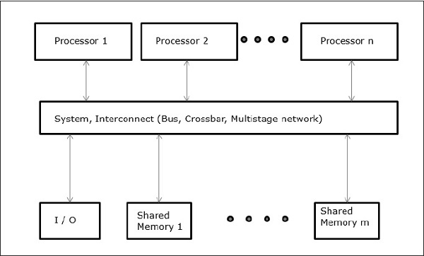
The UMA Model

Slide 19
The UMA Model
Physical memory is uniformly shared.
Uniform memory access.
Private cache.
Tightly coupled systems
suitable for general-purpose and timesharing applications by multiple users.
Speed up the execution of a time critical applications.
Synchronization and communication among processors are done through using shared variables.

Slide 20
Symmetric multiprocessor :Processor have equal access to all peripheral
Asymmetric multiprocessor :Only one or subset processor are executive capable ,handle I/O.
Remaining processor have no I/O capability: attached processor.

Slide 21
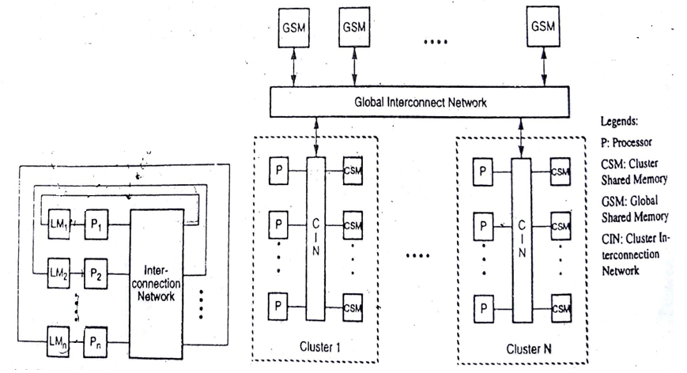
Non uniform memory access (NUMA)

Slide 22
Non uniform memory access (NUMA)
Do not allow uniform access to all shared memory locations.
Access time varies with location of memory word.
This architecture still allows all processors to access all shared memory locations but in a non uniform way.
Shared memory physically distributed to all processors.
Each processor can access its local shared memory more quickly than the other memory modules not next to it.
Collection of all local memories: Global address space
Three memory access pattern: a)local memory access
b)global memory access
c)remote memory access
22

Slide 23
Access of remote memory attached to processor takes longer time due to interconnected network.
Processor divided into several cluster.
Cluster connected to global memory modules.
Processor with same cluster can access cluster shared memory modules.
Access time to cluster memory is shorter than global memory.

Slide 24
The COMA model Cache Only Memory Model
Interconnection Network
D –Directory
C- Cache
P- Processor
D
D
D
……
C
C
C
P
P
P

Slide 25
COMA Model
A multiprocessor using cache only memory.
It is special case of NUMA machines
Distributed main memory are converted to caches.
All caches form global address space.
Remote cache access is assisted by distributed cache directories.
Hierarchical directories are used to locate copies of cache blocks.

Slide 26
Distributed Memory Multi computer
The system consists of multiple computers called nodes, interconnected by a message-passing network.
Each node is an autonomous computer consisting of a processor, local memory, and attached disks or I/O peripherals.
The message-passing network provides point-to-point static connections among the nodes.
All local memories are private and are accessible only by local processors

Slide 27
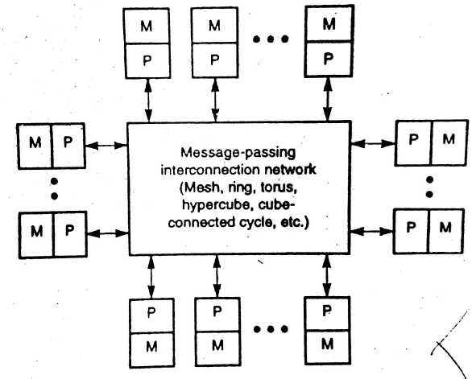
Distributed Memory Multi computer

Slide 28
Multicomputer Generations
Modern multi computers use hardware routers to pass messages.
The boundary router may be connected to I/O and peripheral devices.
The inter node communications achieved through compatible data representations and message-passing protocols.
Message-passing multicomputers have gone through two generations

Slide 29
The first generation (1983-1987) was based on processor board technology “software-controlled message switching”.
The second generation (1988-1992) was implemented with mesh-connected architecture, hardware message routing.
The third generation (1993-1997) was based on fine-grain multi computers.

Slide 30
Important issues for multicomputers include
message-routing schemes,
network flow control strategies,
deadlock avoidance,
virtual channels, message-passing primitives

Slide 31
End of Unit 1 – Chapter 2

