Slide 1
UNIT -2 Achieving Qualities

Slide 2
Introducing Tactics
A tactic is a design decision that influences a quality attribute
We call a collection of tactics an architectural strategy
Stimulus
Response
Tactics to control Response

Slide 3
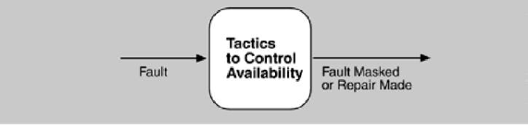
Availability Tactics

Slide 4
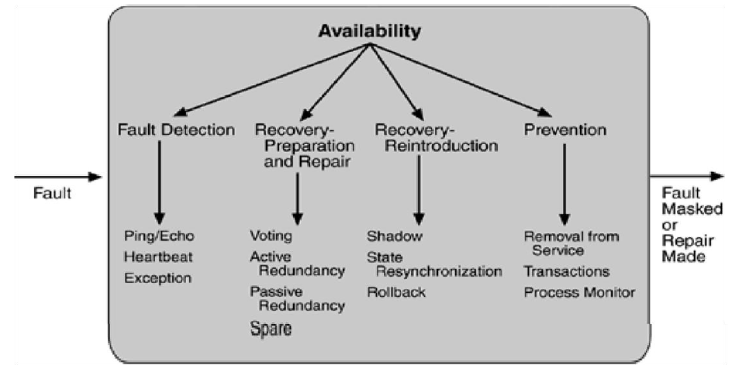
Availability Tactics

Slide 5
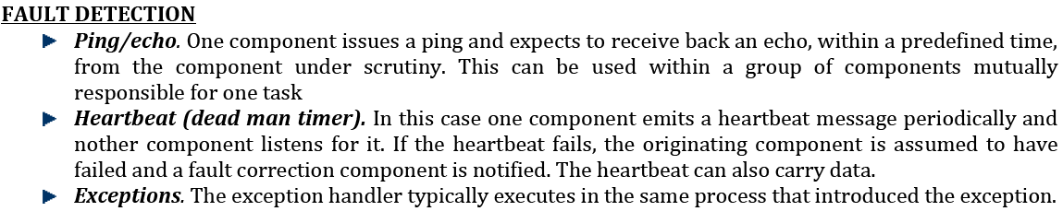

Slide 6
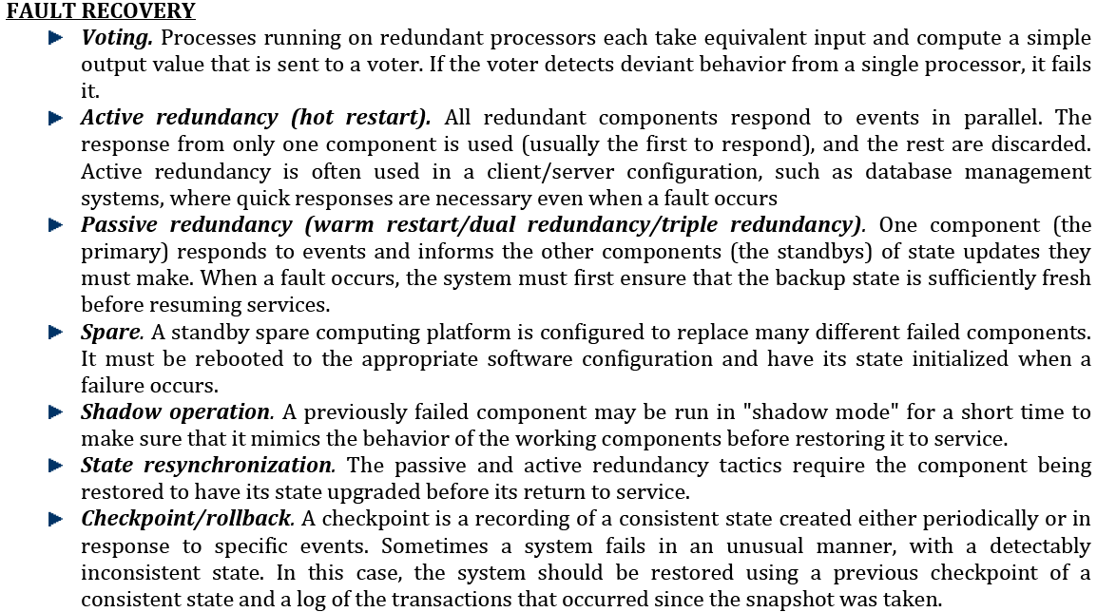

Slide 7
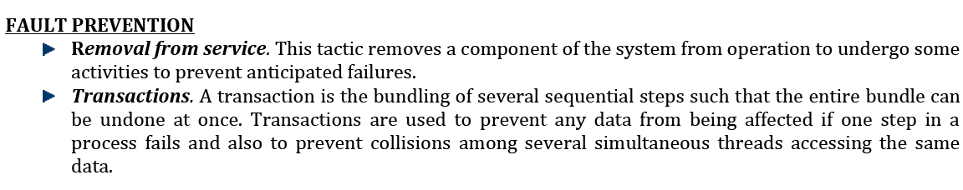

Slide 8
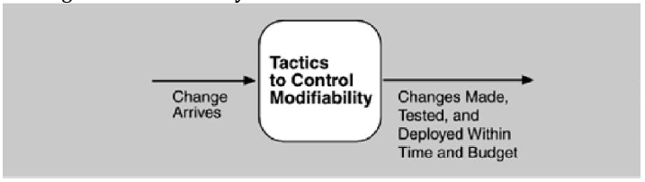
Modifiability tactics

Slide 9
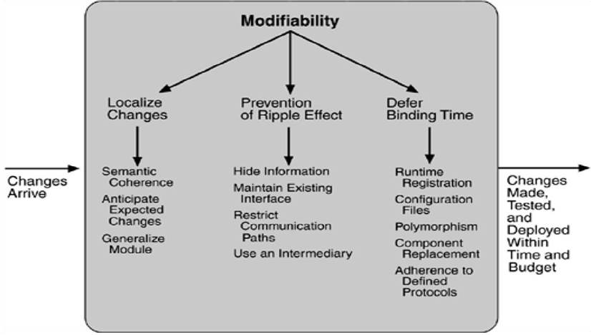
Modifiability tactics

Slide 10
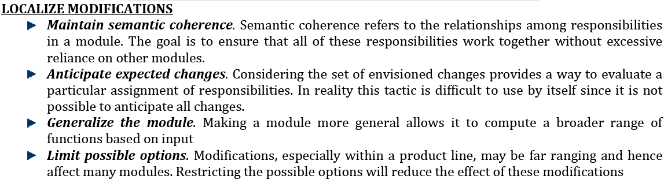

Slide 11
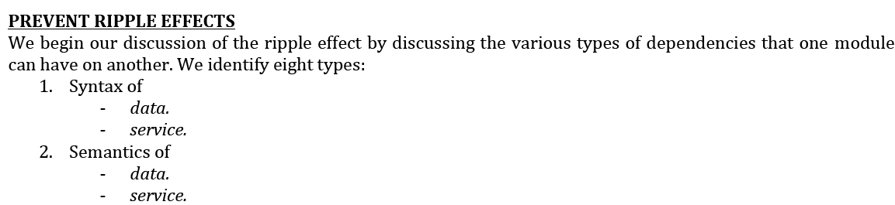
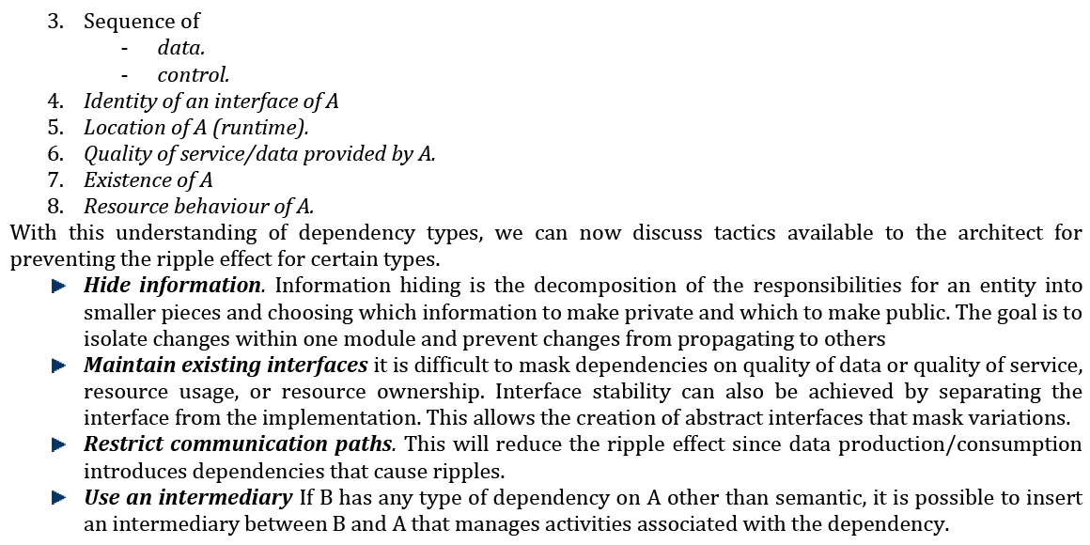

Slide 12
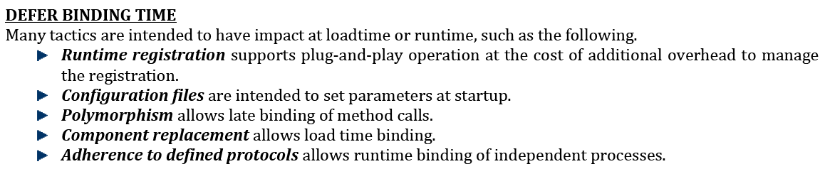

Slide 13
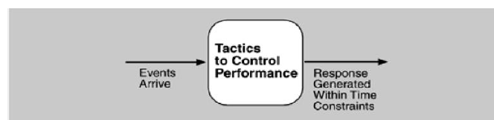
PERFORMANCE TACTICS

Slide 14
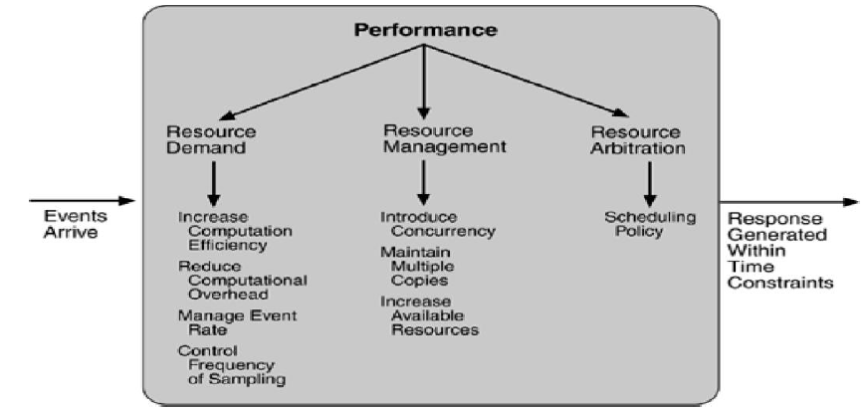
PERFORMANCE TACTICS

Slide 15
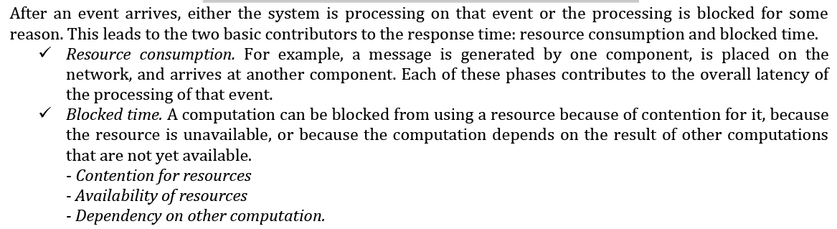

Slide 16
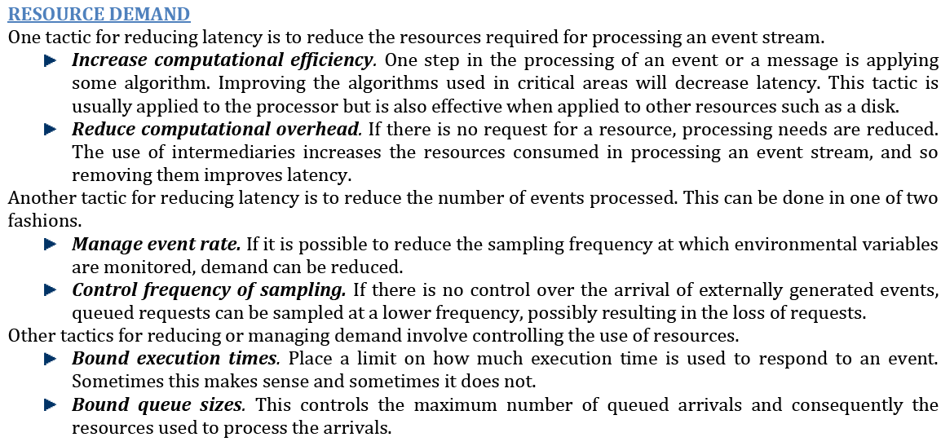

Slide 17
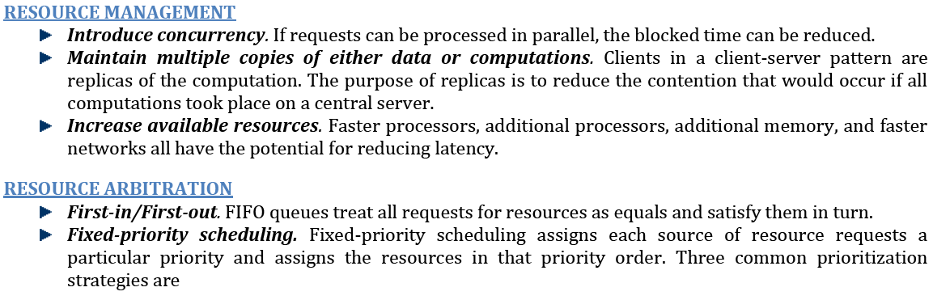

Slide 18
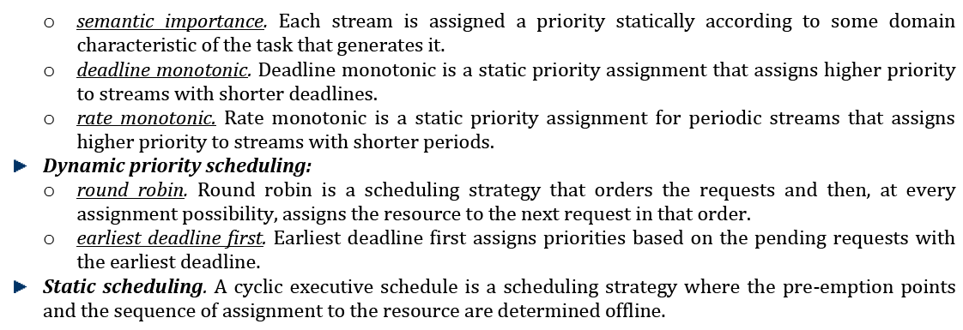

Slide 19
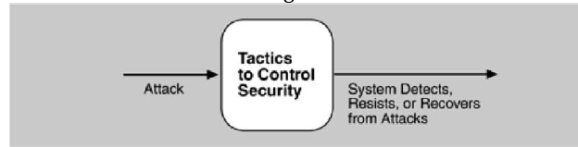
SECURITY TACTICS

Slide 20
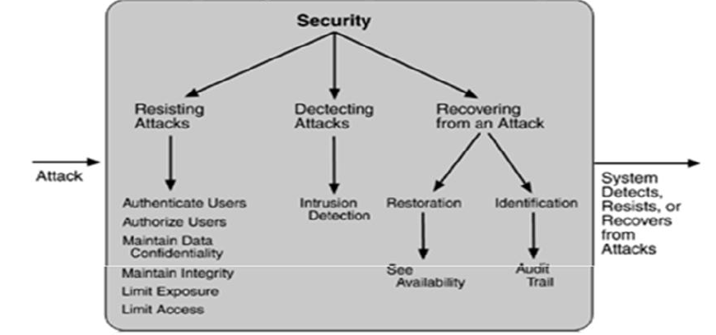
SECURITY TACTICS

Slide 21
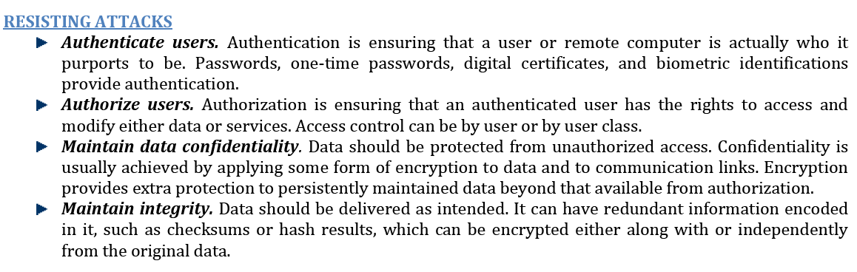

Slide 22
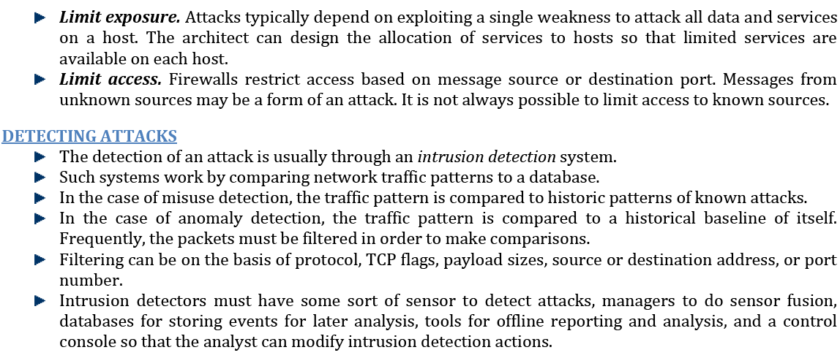

Slide 23
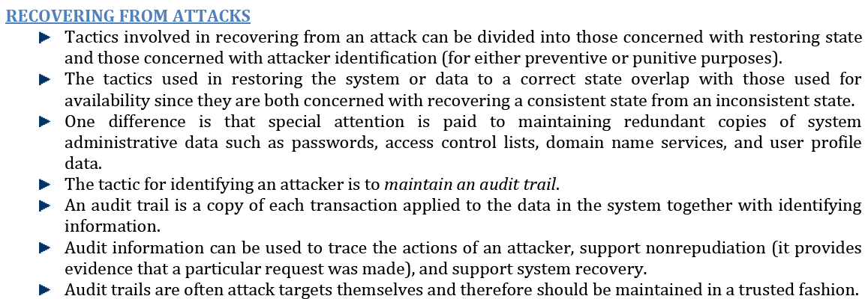

Slide 24
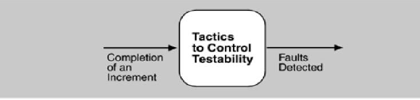
TESTABILITY TACTICS

Slide 25
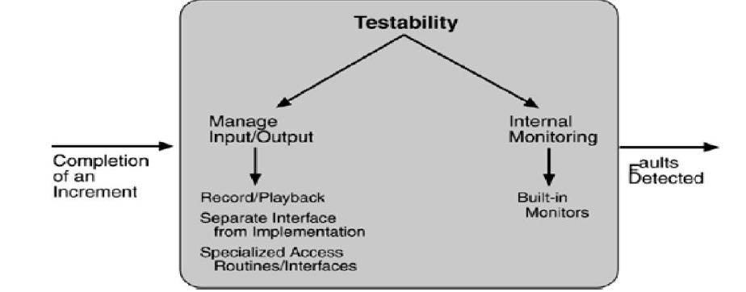
TESTABILITY TACTICS

Slide 26
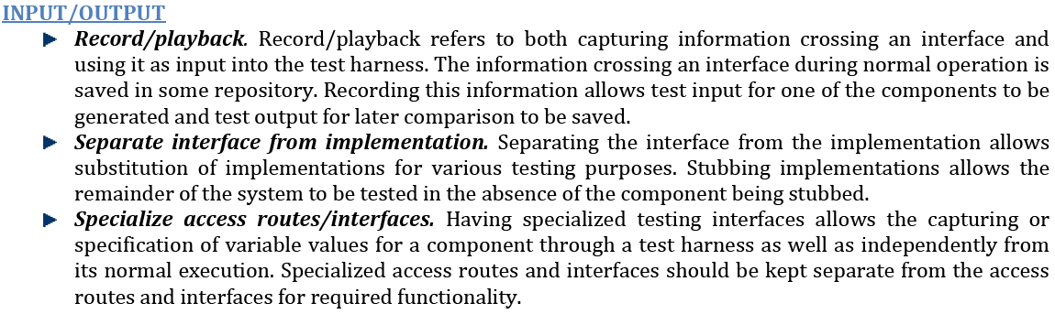

Slide 27
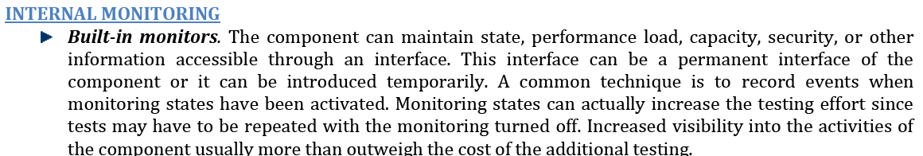

Slide 28
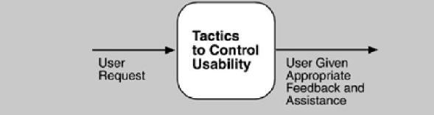
USABILITY TACTICS

Slide 29
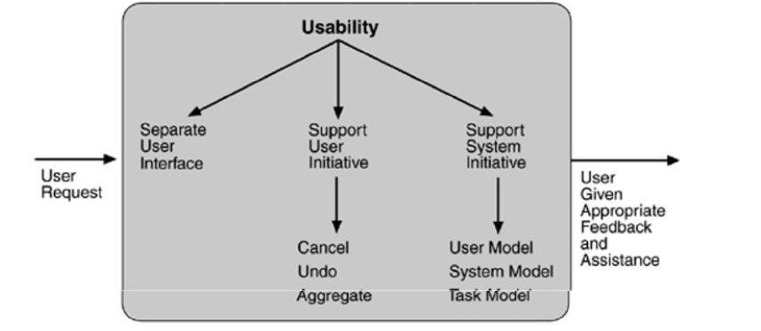
USABILITY TACTICS

Slide 30
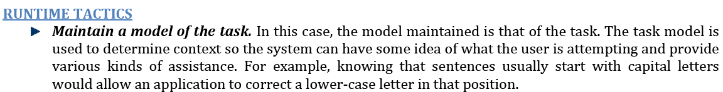

Slide 31
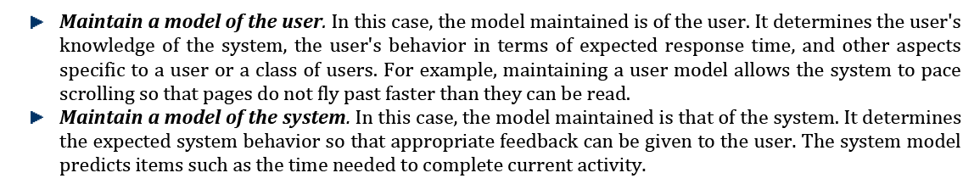

Slide 32
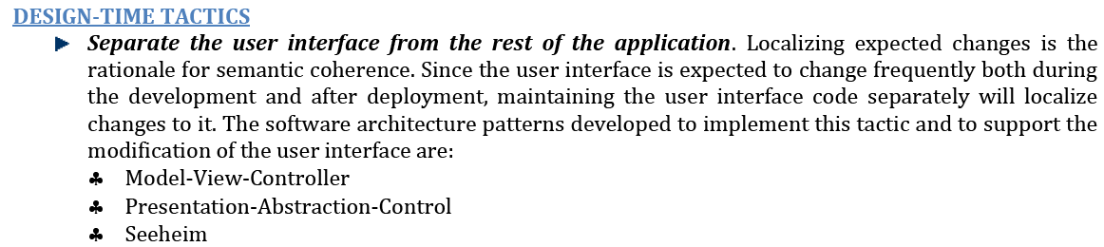

Slide 33
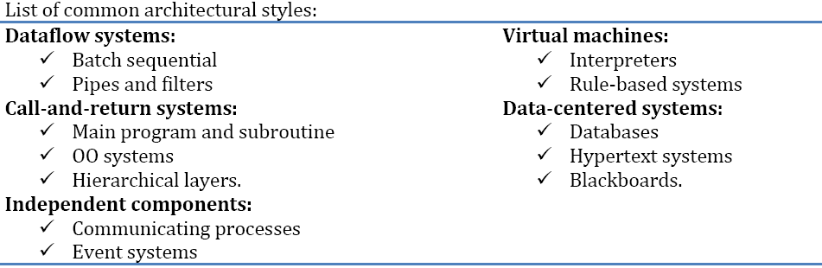
Architectural Styles
Architectural styles & Case studies
:SOFTWARE ARCHITECTURES
33

Slide 34
PIPES AND FILTERS
Each components has set of inputs and set of outputs
A component reads streams of data on its input and produces streams of data on its output.
By applying local transformation to the input streams and computing incrementally, so that output begins before input is consumed. Hence, components are termed as filters.
Connectors of this style serve as conducts for the streams transmitting outputs of one filter to inputs of another. Hence, connectors are termed pipes.
Architectural styles & Case studies
:SOFTWARE ARCHITECTURES
34

Slide 35
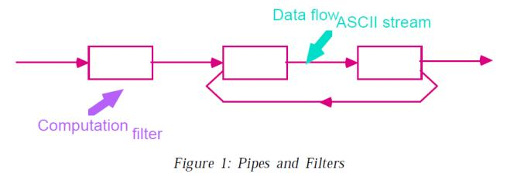
PIPES AND FILTERS
Architectural styles & Case studies
:SOFTWARE ARCHITECTURES
35

Slide 36
PIPES AND FILTERS
Conditions (invariants) of this style are:
Filters must be independent entities.
They should not share state with other filter
Filters do not know the identity of their upstream and downstream filters.
Specification might restrict what appears on input pipes and the result that appears on the output pipes.
Correctness of the output of a pipe-and-filter network should not depend on the order in which filter perform their processing.
Architectural styles & Case studies
:SOFTWARE ARCHITECTURES
36

Slide 37
PIPES AND FILTERS
Common specialization of this style includes
Bounded pipes:
Restrict the amount of data that can reside on pipe.
Typed pipes:
Requires that the data passed between two filters have a well-defined type.
Architectural styles & Case studies
:SOFTWARE ARCHITECTURES
37

Slide 38
Examples :
Example 1:
Best known example of pipe-and-filter architecture are programs written in UNIX-SHELL
Unix supports this style by providing a notation for connecting components [Unix process] and by providing run-time mechanisms for implementing pipes.
Example 2 :
Compilers have been viewed as pipeline system. Stages in the pipeline
lexical analysis
parsing,
semantic analysis and
code generation
Architectural styles & Case studies
:SOFTWARE ARCHITECTURES
38

Slide 39
Advantages
They allow the designer to understand the overall input/output behavior of a system as a simple composition of the behavior of the individual filters.
They support reuse: Any two filters can be hooked together if they agree on data.
Systems are easy to maintain and enhance: New filters can be added to exciting systems.
They permit certain kinds of specialized analysis
eg: deadlock, throughput
They support concurrent execution.
Architectural styles & Case studies
:SOFTWARE ARCHITECTURES
39

Slide 40
Disadvantages:
They lead to a batch organization of processing.
Filters are independent even though they process data incrementally.
Not good at handling interactive applications
When incremental display updates are required.
They may be hampered by having to maintain correspondences between two separate but related streams.
Architectural styles & Case studies
:SOFTWARE ARCHITECTURES
40

Slide 41
OBJECT-ORIENTED AND DATA ABSTRACTION
In this approach, data representation and their associated primitive operations are encapsulated in the abstract data type (ADT) or object.
The components of this style are- objects/ADT’s objects interact through function and procedure invocations.
Two important aspects of this style are:
Object is responsible for preserving the integrity of its representation.
Representation is hidden from other objects.
Architectural styles & Case studies
:SOFTWARE ARCHITECTURES
41

Slide 42
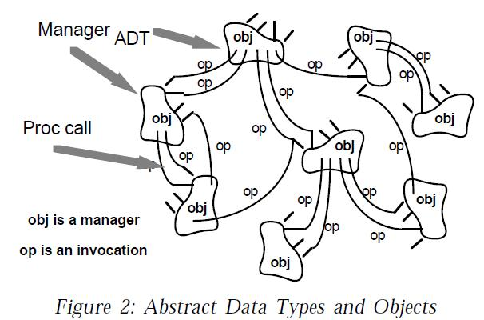
OBJECT-ORIENTED AND DATA ABSTRACTION
Architectural styles & Case studies
:SOFTWARE ARCHITECTURES
42

Slide 43
Advantages
It is possible to change the implementation without affecting the clients because an object hides its representation from clients.
The bundling of a set of accessing routines with the data they manipulate allows designers to decompose problems into collections of interacting agents.
Architectural styles & Case studies
:SOFTWARE ARCHITECTURES
43

Slide 44
Disadvantages
To call a procedure, it must know the identity of the other object.
Whenever the identity of object changes it is necessary to modify all other objects that explicitly invoke it.
Architectural styles & Case studies
:SOFTWARE ARCHITECTURES
44

Slide 45
EVENT-BASED, IMPLICIT INVOCATION
Instead of invoking the procedure directly a component can announce one or more events.
Other components in the system can register an interest in an event by associating a procedure to it.
When the event is announced, the system itself invokes all of the procedure that have been registered for the event. Thus an event announcement “implicitly” causes the invocation of procedures in other modules.
Architectural styles & Case studies
:SOFTWARE ARCHITECTURES
45

Slide 46
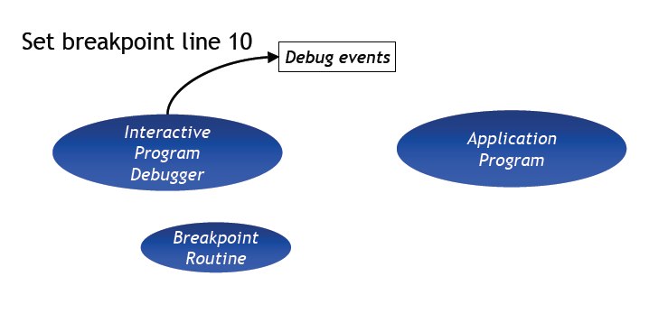
Implicit Invocation Example Program Debugging (1)
Architectural styles & Case studies
:SOFTWARE ARCHITECTURES
46

Slide 47
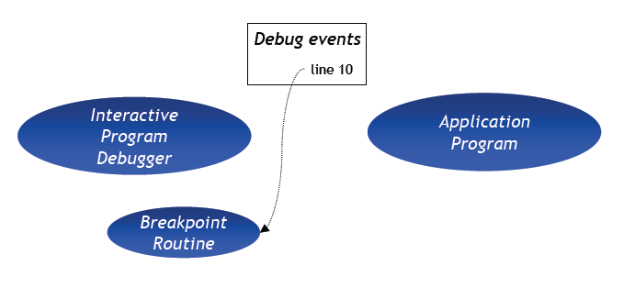
Implicit Invocation Example Program Debugging (2)
Architectural styles & Case studies
:SOFTWARE ARCHITECTURES
47

Slide 48
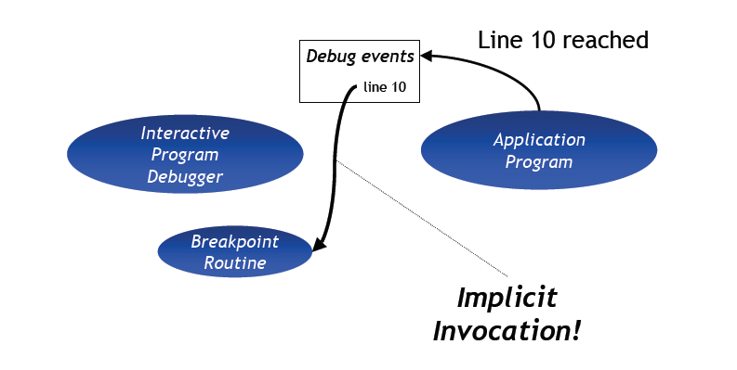
Implicit Invocation Example Program Debugging (3)
Architectural styles & Case studies
:SOFTWARE ARCHITECTURES
48

Slide 49
Advantages
It provides strong support for reuse
Any component can be introduced into the system simply by registering it for the events of that system.
Implicit invocation eases system evolution.
Components may be replaced by other components without affecting the interfaces of other components.
Architectural styles & Case studies
:SOFTWARE ARCHITECTURES
49

Slide 50
Disadvantages
Components relinquish control over the computation performed by the system.
Global performance and resource management can become artificial issues.
Architectural styles & Case studies
:SOFTWARE ARCHITECTURES
50

Slide 51
LAYERED SYSTEMS
A layered system is organized hierarchically
Each layer provides service to the layer above it.
Inner layers are hidden from all except the adjacent layers.
Connectors are defined by the protocols that determine how layers interact each other.
Goal is to achieve qualities of modifiability and portability.
Architectural styles & Case studies
:SOFTWARE ARCHITECTURES
51

Slide 52
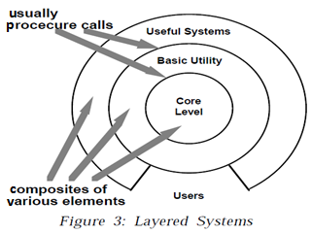
LAYERED SYSTEMS
Architectural styles & Case studies
:SOFTWARE ARCHITECTURES
52

Slide 53
Examples
Layered communication protocol
Operating systems
Database systems
Architectural styles & Case studies
:SOFTWARE ARCHITECTURES
53

Slide 54
Advantages
They support designs based on increasing levels abstraction.
Allows implementers to partition a complex problem into a sequence of incremental steps.
They support enhancement
They support reuse.
Architectural styles & Case studies
:SOFTWARE ARCHITECTURES
54

Slide 55
Disadvantages
Not easily all systems can be structures in a layered fashion.
Performance may require closer coupling between logically high-level functions and their lower-level implementations.
Difficulty to mapping existing protocols into the ISO framework as many of those protocols bridge several layers.
Layer bridging: functions is one layer may talk to other than its immediate neighbor.
Difficult to identify right level of abstraction.
Architectural styles & Case studies
:SOFTWARE ARCHITECTURES
55

Slide 56
REPOSITORIES [data centered architecture]
Suitable for applications in which the central issue is establishing, augmenting, and maintaining a complex central body of information
In this style, there are two kinds of components.
i. Central data structure- represents current state.
ii. Collection of independent components which operate on central data store.
Ex: Active repository such as blackboard.
Architectural styles & Case studies
:SOFTWARE ARCHITECTURES
56

Slide 57
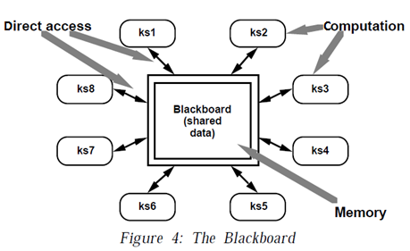
REPOSITORIES
Architectural styles & Case studies
:SOFTWARE ARCHITECTURES
57

Slide 58
REPOSITORIES
The knowledge sources:
separate, independent parcels of application dependent knowledge.
Interaction among knowledge sources takes place solely through the blackboard.
The blackboard data structure:
Problem-solving state data, organized into an application- dependent hierarchy.
Knowledge sources make changes to the blackboard that lead incrementally to a solution to the problem.
Architectural styles & Case studies
:SOFTWARE ARCHITECTURES
58

Slide 59
REPOSITORIES
Control:
Driven entirely by state of blackboard.
Invocation of a knowledge source (ks) is triggered by the state of blackboard.
Application:
complex interpretations of signal processing, such as speech and pattern recognition.
Architectural styles & Case studies
:SOFTWARE ARCHITECTURES
59

Slide 60
Blackboard Advantages and Disadvantages
Advantages
General style suitable for network-based applications, including network database servers
• Disadvantages
Blackboard becomes a bottleneck with too many clients
Architectural styles & Case studies
:SOFTWARE ARCHITECTURES
60

Slide 61
INTERPRETERS
Takes a program written in one language and interprets it to another language to execute a series of commands
Suitable for applications in which the most appropriate language or machine for executing the solution is not directly available.
translates programming language for the user without requiring user to know the language
Interpreter allows for portability
Architectural styles & Case studies
:SOFTWARE ARCHITECTURES
61

Slide 62
INTERPRETERS
Interpreter includes 4 components:
1. Interpretation engine: to do the work
2. Memory: that contains pseudo code to be interpreted.
3. Representation of control state of interpretation engine
4. Representation of current state of the program being simulated.
Architectural styles & Case studies
:SOFTWARE ARCHITECTURES
62

Slide 63
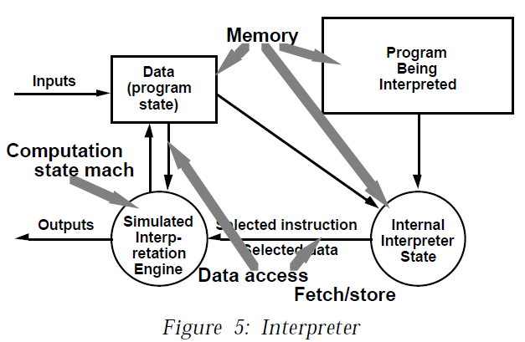
INTERPRETERS
Architectural styles & Case studies
:SOFTWARE ARCHITECTURES
63

Slide 64
Interpreter Style Examples
Programming Language Compilers:
– Java
Scripting Languages:
– Awk
– Perl
Architectural styles & Case studies
:SOFTWARE ARCHITECTURES
64

Slide 65
INTERPRETERS
Advantages:
Simulation of non-implemented hardware
Facilitates portability of application or languages across a variety of platforms
Disadvantages:
Performance cost because of additional computational involved.
Architectural styles & Case studies
:SOFTWARE ARCHITECTURES
65

Slide 66
PROCESS CONTROL STYLE
Suitable for applications whose purpose is to maintain specified properties of the outputs of the process at (sufficiently near) given reference values .
Components:
– Process Definition includes mechanisms for manipulating some
input variables
– Control Algorithm for deciding how to manipulate process
variables
Architectural styles & Case studies
:SOFTWARE ARCHITECTURES
66

Slide 67
PROCESS CONTROL STYLE
Variable of the process :The value of measurable properties of system state(materials, equipment settings,etc)
Controlled variable of the process: Process variable that measure the output materials.
Process variable: The properties of the input materials, intermediate products.
Manipulated variable: Variable that are associated with things that can be changed by the control system in order to regulate the process.
Set points: The purpose of a control system is to maintain specified properties of the output of the process at given reference value.
Architectural styles & Case studies
:SOFTWARE ARCHITECTURES
67

Slide 68
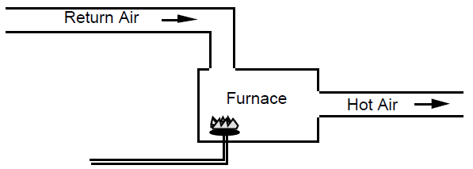
open-loop temperature control
Open loop System: If the input materials are pure , if the process is fully defined and if the operations are completely repeatable ,the process is fully, the process can run without surveillance.
Architectural styles & Case studies
:SOFTWARE ARCHITECTURES
68

Slide 69
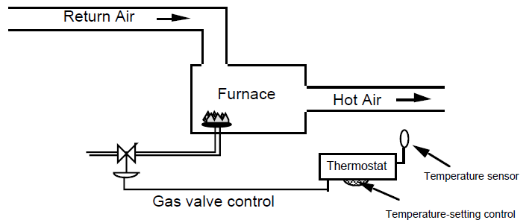
closed-loop temperature control
Properties such as temperature, pressure and flow rates are monitored,
Values are used to control the process by changing the settings of apparatus such as valve, heaters ,
Architectural styles & Case studies
:SOFTWARE ARCHITECTURES
69

Slide 70
closed-loop temperature control
The furnace with burner is the process
The thermostat is the controller
The return air temperature is the input variable
The hot air temperature is the controlled variable
The thermostat setting is the set point
Temperature sensor is the sensor
Architectural styles & Case studies
:SOFTWARE ARCHITECTURES
70

Slide 71
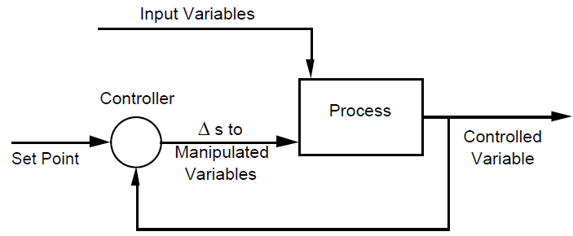
Feedback control
The controlled variable is measured and the result is used to manipulate one or more of the process variables
Architectural styles & Case studies
:SOFTWARE ARCHITECTURES
71

Slide 72
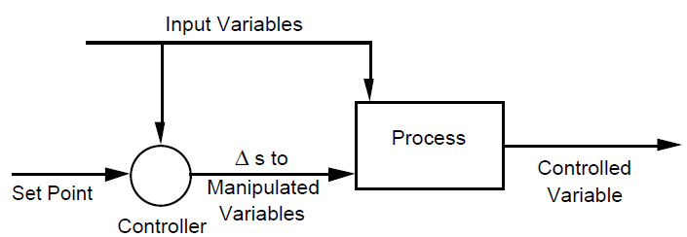
Feed forward control
Information about process variables is not used to adjust the system .
Architectural styles & Case studies
:SOFTWARE ARCHITECTURES
72

Slide 73
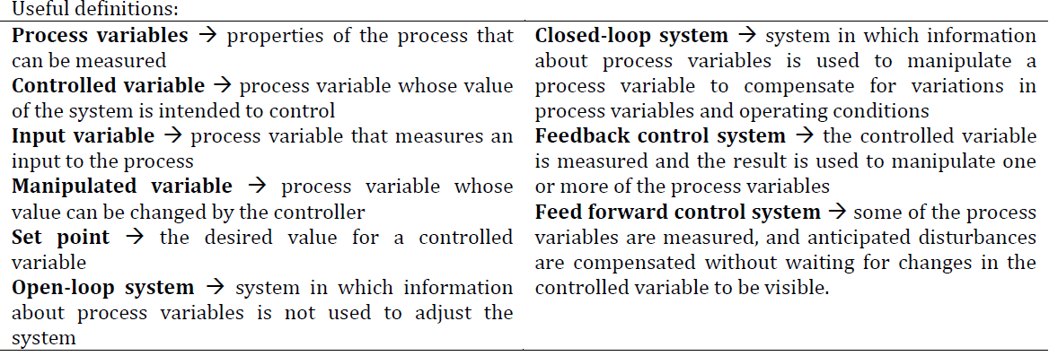
PROCESS CONTROL STYLE
PROCESS CONTROL PARADIGMS :
Architectural styles & Case studies
:SOFTWARE ARCHITECTURES
73

Slide 74
Process Control Examples
Real-Time System Software to Control:
– Automobile Anti-Lock Brakes
– Nuclear Power Plants
– Automobile Cruise-Control
Architectural styles & Case studies
:SOFTWARE ARCHITECTURES
74

Slide 75
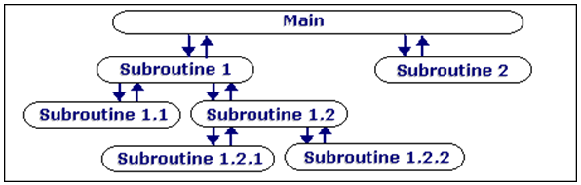
OTHER FAMILIAR ARCHITECTURES
Distributed processes:
Number of common architecture for multi-process systems.
Topological features ring and star .
Ex:Client Server System
Domain-specific software architectures:
Organizational structure tailored to a family of applications
ex: avionics, vehicle management systems.
Main program/subroutine organizations:
System organized around a main program and a set of subroutines.
Architectural styles & Case studies
:SOFTWARE ARCHITECTURES
75

Slide 76
HETEROGENEOUS ARCHITECTURES
Architectural style can be combined in several way.
A component of a system organized in one architectural style may have an internal structure that is developed in a completely different style.
Second way to combine style is to permit single component to use mixture of architectural connectors.
A third way for styles to be combined is to completely elaborate one level of architectural description in a completely different architectural style.
Ex: Case Studies.
9/10/2018
2/8/2016
76

Slide 77
A CASE STUDY :MOBILE ROBOTICS
Mobile Robotic systems
Controls a manned or semi-manned vehicle
E.g., car, space vehicle, submarines etc
Used in space exploration missions
Underwater exploration
The system is complex
Real Time respond
input from various sensors
Controlling the motion and movement of robots
Planning its future path/move

Slide 78
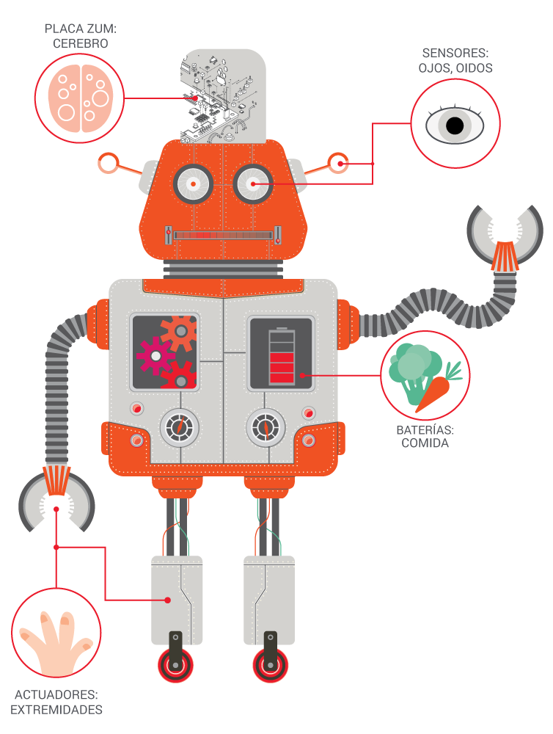

Slide 79
MOBILE ROBOTICS
Unpredictability of environment
Obstacles blocking robot path
Sensor may be imperfect
Power consumption
Respond to hazardous material and situations
Mechanical limitation may restrict accuracy of move
Unpredictable move may demand rapid response.

Slide 80
DESIGN CONSIDERATIONS
REQ1: architecture must accommodate deliberate and reactive behavior.
Robot must coordinate the actions to accomplish its mission.
REQ2: Allows uncertainty and unpredictability of environment.
The situations are not fully defined and/or predicable. The design should handle incomplete and unreliable information.

Slide 81
DESIGN CONSIDERATIONS
REQ3: Architecture must consider possible dangerous operations by robot and environment .
REQ4: The system must give the designer flexibility (mission’s change/requirement changes)

Slide 82
SOLUTION 1: CONTROL LOOP
Req1: an advantage of the closed loop paradigm is its simplicity -> it captures the basic interaction between the robot and the outside.
Req2: control loop paradigm is biased towards one method -> reducing the unknowns through iteration
Req3: fault tolerance and safety are supported which makes duplication easy and reduces the chances of errors
Req4: Major components of a robot architecture are separated from each other and can be replaced independently

Slide 83
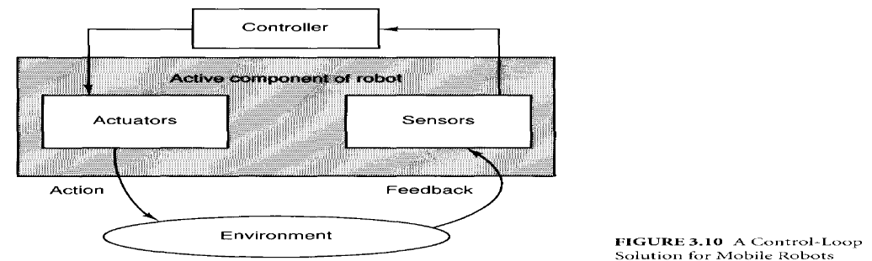
SOLUTION 1: CONTROL LOOP

Slide 84
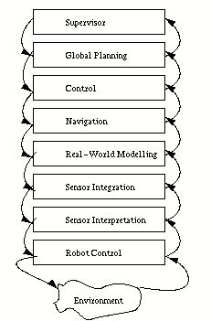
Mobile robotics- Solution 2-Layered architecture
Layer 1: (core) control routines
Layer 2, 3: Deals with input from the real world
Layer 4: Maintaining the robot’s model
Layer5: Manages Navigation
Layer 6, 7: Schedule and plan for actions
Layer 8: Provides User Interface

Slide 85
Mobile Robotics-2: Layered Architecture-evaluation
Req1:
Different components are used to assign different tasks
Functions of components must be addressed
It also defines abstraction levels for design.

Slide 86
Mobile Robotics- 2:Layered Architecture
Req2: layers addresses the need for managing uncertainty
Uncertainty problem from lowest level will be solved at higher level
Uncertainty is handled very well
Req3: Fault tolerance and passive safety are served by the abstraction mechanism
Data and commands are analyzed from different angles.
Req4: Replacement and addition of components are difficult due to Interlayer dependencies.

Slide 87
SOLUTION 3: IMPLICIT INVOCATION
Req1: permits clear cut separation of action and reaction
Req2: a tentative task tree can be built to handle uncertainty
Req3: performance, safety and fault tolerance are served
Req4: makes incremental development and replacement of components straight forward

Slide 88
SOLUTION 3: IMPLICIT INVOCATION
TCA’s implicit invocation mechanisms support three functions:
Exceptions: Exception handler can be used to handle task such as retry or abort.
Wiretapping: Intercept messages by superimposed tasks
E.g., Safety-checks of outgoing commands
Monitors: Monitors read information and execute some action if the data satisfy certain condition
E.g. battery check

Slide 89
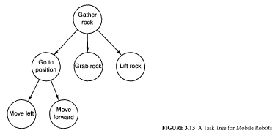
SOLUTION 3: IMPLICIT INVOCATION

Slide 90

SOLUTION 4: BLACKBOARD ARCHITECTURE

Slide 91
SOLUTION 4: BLACKBOARD ARCHITECTURE
The components :
Captain: overall supervisor
Map navigator: high-level path planner
Lookout: monitors environment for landmarks
Pilot: Motor controller
Perception subsystems: Modules that accepts the raw input from multiple sensors and integrate it into a logical system

Slide 92
SOLUTION 4: BLACKBOARD ARCHITECTURE
The requirements are as follows:
Req1: the components communicate via shared repository of the blackboard system.
Req2: the blackboard is also the means for resolving conflicts or uncertainties in the robot’s world view
Req3: speed, safety and reliability is guaranteed
Req4: supports concurrency and decouples senders from receivers, thus facilitating maintenance.

Slide 93

COMPARISONS

