Slide 1
UNIT -5 DESIGNING AND DOCUMENTING SOFTWARE ARCHITECTURE

Slide 2
DESIGNING THE ARCHITECTURE
ARCHITECTURE IN THE LIFE CYCLE :
Any organization that embraces architecture as a foundation for its software development processes needs to understand its place in the life cycle.
Several life-cycle models exist in the literature, but one that puts architecture squarely in the middle of things is the evolutionary delivery life cycle model shown in figure.

Slide 3
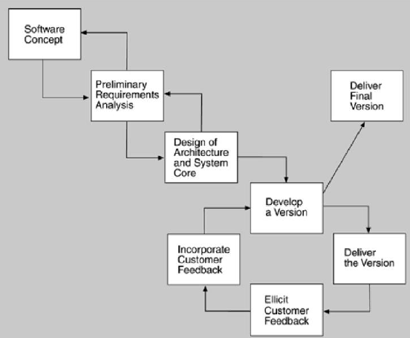
Evolutionary Delivery Life Cycle

Slide 4
WHEN CAN I BEGIN DESIGNING?
The life-cycle model shows the design of the architecture as iterating with preliminary requirements analysis.
An architecture is “shaped” by some collection of functional, quality, and business requirements
We call these shaping requirements architectural drivers
To determine the architectural drivers, identify the highest priority business goals.

Slide 5
DESIGNING THE ARCHITECTURE
A method for designing an architecture to satisfy both quality requirements and functional requirements is called attribute-driven design (ADD)
ADD takes as input a set of quality attribute scenarios and employs knowledge about the relation between quality attribute achievement and architecture in order to design the architecture.

Slide 6
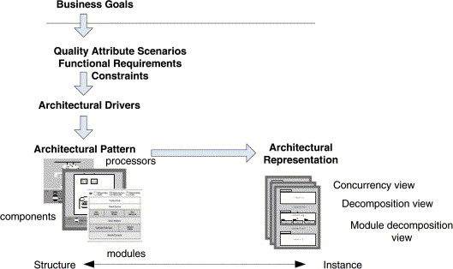

Slide 7
ATTRIBUTE DRIVEN DESIGN :
It is a recursive decomposition process where, at each stage, tactics and architectural patterns are chosen to satisfy a set of quality scenarios and then functionality is allocated to instantiate the module types provided by the pattern

Slide 8
Garage door opener example
Design a product line architecture for a garage door opener with a larger home information system the opener is responsible for raising and lowering the door via a switch, remote control, or the home information system.
It is also possible to diagnose problems with the opener from within the home information system.

Slide 9
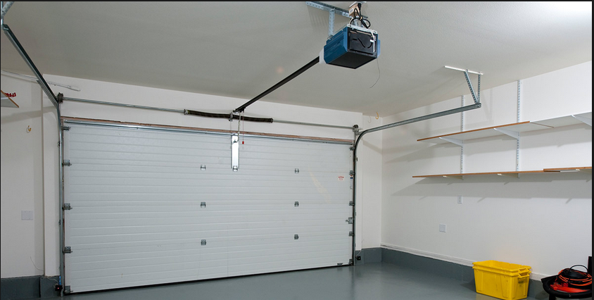

Slide 10
Input to ADD: a set of requirements
Functional requirements as use cases
Constraints
Quality requirements expressed as system specific quality scenarios

Slide 11
Scenarios for garage door system
o Device and controls for opening and closing the door are different for the various products in the product line
o The processor used in different products will differ
o If an obstacle is (person or object) is detected by the garage door during descent, it must stop within 0.1 second
o The garage door opener system needs to be accessible from the home information system for diagnosis and administration.
o It should be possible to directly produce an architecture that reflects this protocol

Slide 12
ADD Steps:
Steps involved in attribute driven design (ADD)
1. Choose the module to decompose
o Start with entire system
o Inputs for this module need to be available
o Constraints, functional and quality requirements

Slide 13
2. Refine the module
a) Choose architectural drivers relevant to this decomposition
b) Choose architectural pattern that satisfies these drivers
c) Instantiate modules and allocate functionality from use cases representing using multiple views
d) Define interfaces of child modules
e) Verify and refine use cases and quality scenarios
3. Repeat for every module that needs further decomposition

Slide 14
Discussion of the above steps in more detail:
1. Choose The Module To Decompose
o The following are the modules: system->subsystem->submodule
o Decomposition typically starts with system, which then decompose into subsystem and then into sub-modules.
o In our Example, the garage door opener is a system
o Opener must interoperate with the home information system

Slide 15
2. Refine the module
i. Choose Architectural Drivers:
o choose the architectural drivers from the quality scenarios and functional requirements
o The drivers will be among the top priority requirements for the module.
o In the garage system, the 4 scenarios were architectural drivers,
Real-time performance requirement
Modifiability requirement to support product line
Requirements are not treated as equals
Less important requirements are satisfied within constraints obtained by satisfying more important requirements

Slide 16
ii. Choose Architectural Pattern
o The goal of this step is to establish an overall architectural pattern for the module
o The pattern needs to satisfy the architectural pattern for the module tactics selected to satisfy the drivers
o Two factors involved in selecting tactics:
Architectural drivers themselves
Side effects of the pattern implementing the tactic on other requirements

Slide 17
3. Instantiate Modules And Allocate Functionality Using Multiple Views
Instantiate modules
Identify several responsibilities of the virtual machine: communication and sensor reading and actuator control. This yields two instances of the virtual machine that are shown in Figure 7.3
Allocate functionality
Assigning responsibilities to the children in a decomposition also leads to the discovery of necessary information exchange

Slide 18
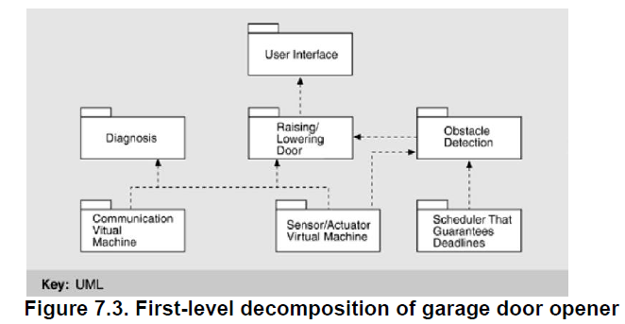

Slide 19
Represent the architecture with multiple views
Module decomposition view
Concurrency view
Two users doing similar things at the same time
One user performing multiple activities simultaneously
Starting up the system
Shutting down the system
Deployment view

Slide 20
4. Define Interfaces Of Child Modules
It documents what this module provides to others.
Analyzing the decomposition into the 3 views provides interaction information for the interface
Module view:
Producers/consumers relations
patterns of communication
Concurrency view:
Interactions among threads
Synchronization information
Deployment view
Hardware requirement
Timing requirements
Communication requirements

Slide 21
5. Verify And Refine Use Cases And Quality Scenarios as Constraints for the Child Modules Functional requirements
Using functional requirements to verify and refine
Decomposing functional requirements assigns responsibilities to child modules

Slide 22
FORMING THE TEAM STRUCTURES
Once architecture for the system under construction has been agreed on, teams are allocated to work on the major modules and a work breakdown structure is created that reflects those teams.
Each team then creates its own internal work practices.
For large systems, the teams may belong to different subcontractors.

Slide 23
Teams adopt “work practices’ including
Team communication via website/bulletin boards
Naming conventions for files
Configuration/revision control system
Quality assurance and testing procedure
The teams within an organization work on modules, and thus within team high level of communication is necessary

Slide 24
CREATING A SKELETAL SYSTEM
Develop a skeletal system for the incremental cycle.
Use the architecture as a guide for the implementation sequence
First implement the software that deals with execution and interaction of architectural components
Communication between components
Sometimes this is just install third-party middleware
Then add functionality
By risk-lowering
Or by availability of staff

Slide 25
DOCUMENTING SOFTWARE ARCHITECTURES
USES OF ARCHITECTURAL DOCUMENTATION
Architecture documentation is both prescriptive and descriptive. That is, for some audiences it prescribes what should be true by placing constraints on decisions to be made.
Different stakeholders for the documentation have different needs—different kinds of information, different levels of information, and different treatments of information

Slide 26
One of the most fundamental rules is to write from the point of view of the reader. Documentation that was easy to write but is not easy to read will not be used, and "easy to read" is in the eye of the beholder—or in this case, the stakeholder.

Slide 27
In addition, each stakeholders come in two varieties: seasoned and new.
A new stakeholder will want information similar in content to what his seasoned counterpart wants, but in smaller and more introductory doses.
Architecture documentation is a key means for educating people who need an overview: new developers, funding sponsors, visitors to the project, and so forth.

Slide 28
View
The concept of a view, which you can think of as capturing a structure, provides us with the basic principle of documenting software architecture .
Documenting an architecture is a matter of documenting the relevant views and then adding documentation that applies to more than one view.
It breaks the problem of architecture documentation into more tractable parts, which provide the structure for the remainder
Choosing the relevant views
Documenting view
Documenting information that applies to more than one view

Slide 29
CHOOSING THE RELEVANT VIEWS
A view simply represents a set of system elements and relationships among them, so whatever elements and relationships useful to a segment of the stakeholder community constitute a valid view. Here is a simple 3 step procedure for choosing the views for your project.

Slide 30
1. Produce a candidate view list:
Begin by building a stakeholder/view table.
Some views apply to every system, while others only apply to systems designed that way.
Once you have rows and columns defined, fill in each cell to describe how much information the stakeholder requires from the view: none, overview only, moderate detail, or high detail.

Slide 31
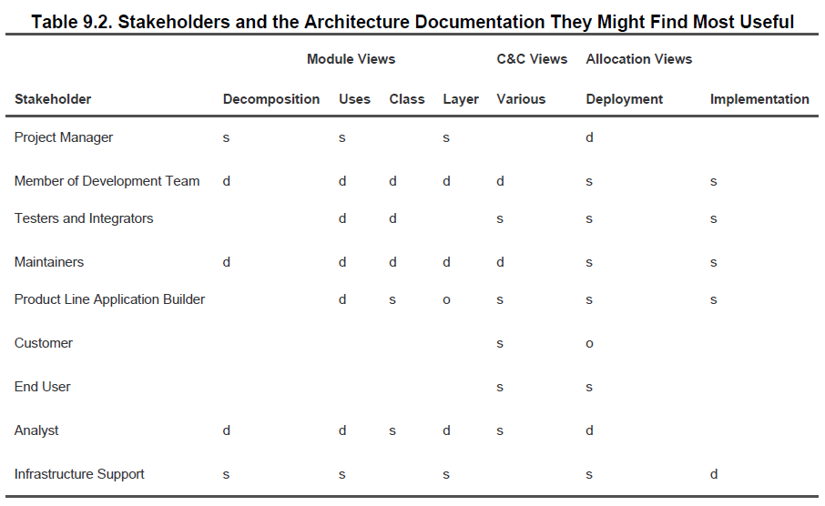

Slide 32
2. Combine views:
To reduce the list to a manageable size, first look for views in the table that require only overview depth or that serve very few stakeholders.
See if the stakeholders could be equally well served by another view having a stronger consistency.

Slide 33
Next, look for the views that are good candidates to be combined- that is, a view that gives information from two or more views at once.
For small and medium projects, the implementation view is often easily overlaid with the module decomposition view.
The module decomposition view also pairs well with users or layered views.
Finally, the deployment view usually combines well with whatever component-and-connector view shows the components that are allocated to hardware elements.

Slide 34
3. Prioritize:
After step 2 you should have an appropriate set of views to serve your stakeholder community. At this point you need to decide what to do first.
How you decide depends on the details specific project. But, remember that you don’t have to complete one view before starting another.
People can make progress with overview-level information, so a breadth-first approach is often the best.

Slide 35
DOCUMENTING A VIEW
1)Primary presentation- elements and their relationships, contains main information about these system , usually graphical or tabular.
2)Element catalog- details of those elements and relations
3)Context diagram- how the system relates to its environment
4)Variability guide- Include documentation about each point of variation in the architecture, including
The options among which a choice is to be made
The binding time of the option. Some choices are made at design time, some at build time, and others at runtime.

Slide 36
5)Architecture background –an architecture background includes
rationale, explaining why the decisions reflected in the view were made and why alternatives were rejected
analysis results, which justify the design or explain what would have to change in the face of a modification
assumptions reflected in the design

Slide 37
6)Glossary of terms used in the views, with a brief description of each.
7)Other information includes management information such as authorship, configuration control data, and change histories. Or the architect might record references to specific sections of a requirements document to establish traceability

Slide 38
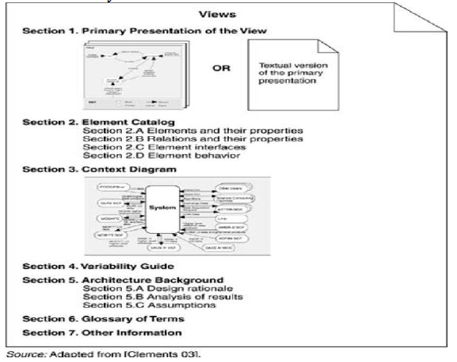

Slide 39
DOCUMENTING INTERFACES
An interface is a boundary across which two independent entities meet and interact or communicate with each other.
Interface identify
When an element has multiple interfaces, identify the individual interfaces to distinguish them. This usually means naming them. You may also need to provide a version number.
2. Resources provided:
The heart of an interface document is the resources that the element provides.

Slide 40
Resource syntax – this is the resource’s signature
Resource Semantics:
Assignment of values of data
Changes in state
Events signaled or message sent
how other resources will behave differently in future
humanly observable results
Resource Usage Restrictions
initialization requirements
limit on number of actors using resource

Slide 41
3. Data type definitions:
If used if any interface resources employ a data type other than one provided by the underlying programming language, the architect needs to communicate the definition of that type. If it is defined by another element, then reference to the definition in that element’s documentation is sufficient.
4. Exception definitions:
These describe exceptions that can be raised by the resources on the interface. Since the same exception might be raised by more than one resource, if it is convenient to simply list each resource’s exceptions but define them in a dictionary collected separately.

Slide 42
5. Variability provided by the interface.
Does the interface allow the element to be configured in some way? These configuration parameters and how they affect the semantics of the interface must be documented.
6. Quality attribute characteristics:
The architect needs to document what quality attribute characteristics (such as performance or reliability) the interface makes known to the element's users
7. Element requirements:
What the element requires may be specific, named resources provided by other elements. The documentation obligation is the same as for resources provided: syntax, semantics, and any usage restrictions.

Slide 43
8. Rationale and design issues:
Why these choices the architect should record the reasons for an elements interface design. The rationale should explain the motivation behind the design, constraints and compromises, what alternatives designs were considered.
9. Usage guide:
Item 2 and item 7 document an element's semantic information on a per resource basis. This sometimes falls short of what is needed. In some cases semantics need to be reasoned about in terms of how a broad number of individual interactions interrelate.

Slide 44
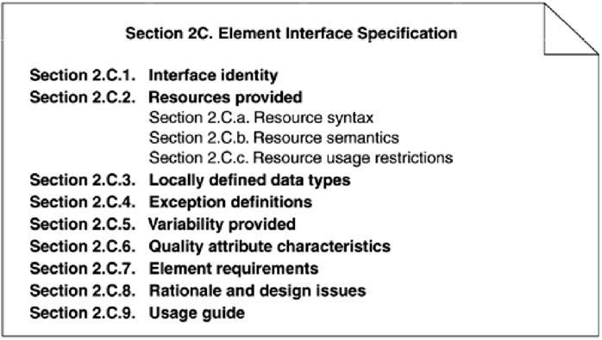

Slide 45
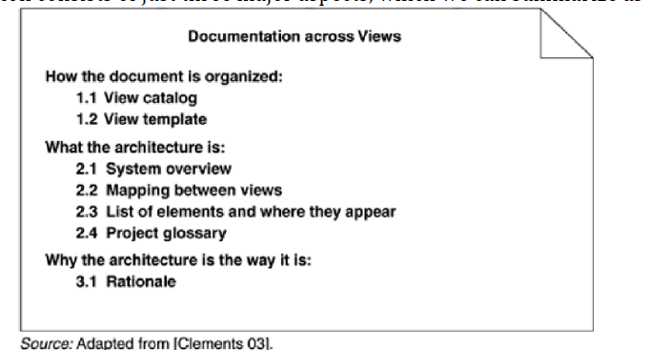
DOCUMENTATION ACROSS VIEWS
Cross-view documentation consists of just three major aspects, which we can summarize as how-what-why:

Slide 46
HOW THE DOCUMENTATION IS ORGANIZED TO SERVE A STAKEHOLDER
Every suite of architectural documentation needs an introductory piece to explain its organization to a new stakeholder and to help that stakeholder access the information he or she is most interested in.
There are two kinds of "how" information:
View Catalog
A view catalog is the reader's introduction to the views that the architect has chosen to include in the suite of documentation.
There is one entry in the view catalog for each view given in the documentation suite. Each entry should give the following:

Slide 47
The name of the view and what style it instantiates
A description of the view's element types, relation types, and properties
A description of what the view is for
Management information about the view document, such as the latest version, the location of the view document, and the owner of the view document

Slide 48
View Template
A view template is the standard organization for a view. It helps a reader navigate quickly to a section of interest, and it helps a writer organize the information.

Slide 49
WHAT THE ARCHITECTURE IS
This section provides information about the system whose architecture is being documented, the relation of the views to each other, and an index of architectural elements.
System Overview
This is a short prose description of what the system's function is, who its users are, and any important background or constraints.
The intent is to provide readers with a consistent mental model of the system and its purpose.

Slide 50
Mapping between Views
Since all of the views of an architecture describe the same system, it stands to reason that any two views will have much in common.
Being clear about the relationship by providing mappings between views is the key to increased understanding and decreased confusion.
Element List
The element list is simply an index of all of the elements that appear in any of the views, along with a pointer to where each one is defined. This will help stakeholders look up items of interest quickly.

Slide 51
Project Glossary
The glossary lists and defines terms unique to the system that have special meaning. A list of acronyms, and the meaning of each, will also be appreciated by stakeholders. If an appropriate glossary already exists, a pointer to it will suffice here.

Slide 52
WHY THE ARCHITECTURE IS THE WAY IT IS: RATIONALE
Cross-view rationale explains how the overall architecture is in fact a solution to its requirements. One might use the rationale to explain:
The implications of system-wide design choices on meeting the requirements or satisfying constraints.
The effect on the architecture when adding a foreseen new requirement or changing an existing one.
The constraints on the developer in implementing a solution.
Decision alternatives that were rejected.
In general, the rationale explains why a decision was made and what the implications are in changing it.

Slide 53
END UNIT 5

