Slide 1
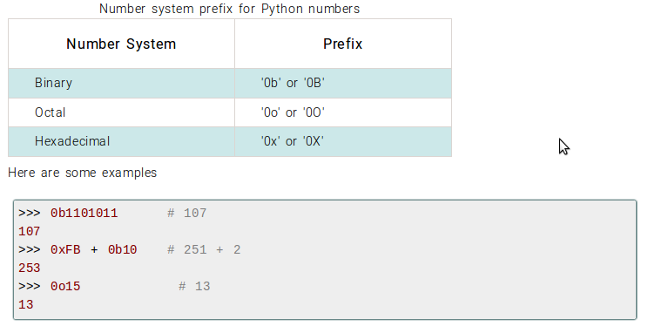
Python Native Datatypes
Python Numbers
While integers can be of any length, a floating point number is accurate only up to 15 decimal places (the 16th place is inaccurate).
Numbers we deal with everyday are decimal (base 10) number system. But computer programmers (generally embedded programmer) need to work with binary (base 2), hexadecimal (base 16) and octal (base 8) number systems. In Python we can represent these numbers by appropriately placing a prefix before that number.
Following table lists these prefix.

Slide 2
Python List
Creating a List
In Python programming, a list is created by placing all the items (elements) inside a square bracket [ ], separated by commas.
It can have any number of items and they may be of different types (integer, float, string etc.).
A list can even have another list as an item. These are called nested list.
Examples:
my_list = [] # empty list
my_list = [1, 2, 3] # list of integers
my_list = [1, "Hello", 3.4] # list with mixed datatypes
my_list = ["mouse", [8, 4, 6]] # nested list

Slide 3
Accessing Elements in a List
There are various ways in which we can access the elements of a list.
1) Indexing
We can use the index operator [] to access an item in a list.
Index starts from 0. So, a list having 5 elements will have index from 0 to 4.
Trying to access an element other that this will raise an IndexError.
The index must be an integer. We can't use float or other types, this will result into TypeError.
Nested list are accessed using nested indexing.

Slide 4
Example:
>>> my_list = ['p','r','o','b','e']
>>> my_list[0]
'p'
>>> my_list[2]
'o'
>>> my_list[4]
'e'
>>> my_list[4.0]
...
TypeError: list indices must be integers, not float
>>> my_list[5]
...
IndexError: list index out of range
>>> n_list = ["Happy", [2,0,1,5]]
>>> n_list[0][1] # nested indexing
'a'
>>> n_list[1][3] # nested indexing
5

Slide 5
2) Negative indexing
Python allows negative indexing for its sequences.
The index of -1 refers to the last item, -2 to the second last item and so on.
Example:
>>> my_list = ['p','r','o','b','e']
>>> my_list[-1]
'e'
>>> my_list[-5]
'p'

Slide 6
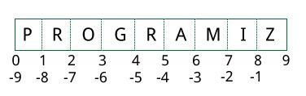
3) Slicing
We can access a range of items in a list by using the slicing operator (colon).
>>> my_list = ['p','r','o','g','r','a','m','i','z']
>>> my_list[2:5] # elements 3rd to 5th
['o', 'g', 'r']
>>> my_list[:-5] # elements beginning to 4th
['p', 'r', 'o', 'g']
>>> my_list[5:] # elements 6th to end
['a', 'm', 'i', 'z']
>>> my_list[:] # elements beginning to end
['p', 'r', 'o', 'g', 'r', 'a', 'm', 'i', 'z']
Slicing can be best visualized by considering the index to be between the elements as shown below. So if we want to access a range, we need two index that will slice that portion from the list.

Slide 7
Changing or Adding Elements to a List
List are mutable, meaning, their elements can be changed unlike string or tuple.
We can use assignment operator (=) to change an item or a range of items.
>>> odd = [2, 4, 6, 8] # mistake values
>>> odd[0] = 1 # change the 1st item
>>> odd
[1, 4, 6, 8]
>>> odd[1:4] = [3, 5, 7] # change 2nd to 4th items
>>> odd # changed values
[1, 3, 5, 7
]

Slide 8
We can add one item to a list using append() method or add several items using extend() method.
>>> odd
[1, 3, 5]
>>> odd.append(7)
>>> odd
[1, 3, 5, 7]
>>> odd.extend([9, 11, 13])
>>> odd
[1, 3, 5, 7, 9, 11, 13]

Slide 9
We can also use + operator to combine two lists. This is also called concatenation.
The * operator repeats a list for the given number of times.
>>> odd
[1, 3, 5]
>>> odd + [9, 7, 5]
[1, 3, 5, 9, 7, 5]
>>> ["re"] * 3
['re', 're', 're']
Furthermore, we can insert one item at a desired location by using the method insert() or insert multiple items by squeezing it into an empty slice of a list.
>>> odd
[1, 9]
>>> odd.insert(1,3)
>>> odd
[1, 3, 9]
>>> odd[2:2] = [5, 7] --- just inserting
>>> odd
[1, 3, 5, 7, 9]
>>>odd[3:4]=[1,2,3,4,5] ---- inserting with replacement
>>> odd
[1, 3, 7, 1, 2, 3, 4, 5, 9]

Slide 10
Deleting or Removing Elements from a List
We can delete one or more items from a list using the keyword del. It can even delete the list entirely.
>>> my_list = ['p','r','o','b','l','e','m']
>>> del my_list[2] # delete one item
>>> my_list
['p', 'r', 'b', 'l', 'e', 'm']
>>> del my_list[1:5] # delete multiplt items
>>> my_list
['p', 'm']
>>> del my_list # delete entire list
>>> my_list
...
NameError: name 'my_list' is not defined

Slide 11
We can use remove() method to remove the given item or pop() method to remove an item at the given index.
The pop() method removes and returns the last item if index is not provided.
This helps us implement lists as stacks (first in, last out data structure).
We can also use the clear() method to empty a list.
>>> my_list = ['p','r','o','b','l','e','m']
>>> my_list.remove('p')
>>> my_list
['r', 'o', 'b', 'l', 'e', 'm']
>>> my_list.pop(1)
'o'
>>> my_list
['r', 'b', 'l', 'e', 'm']
>>> my_list.pop()
'm'
>>> my_list
['r', 'b', 'l', 'e']
>>> my_list.clear() --- may not work in lower versions
>>> my_list –-- Added in Python 3.3
[]

Slide 12
Finally, we can also delete items in a list by assigning an empty list to a slice of elements.
>>> my_list = ['p','r','o','b','l','e','m']
>>> my_list[2:3] = []
>>> my_list
['p', 'r', 'b', 'l', 'e', 'm']
>>> my_list[2:5] = []
>>> my_list
['p', 'r', 'm']

Slide 13
List Membership Test
We can test if an item exists in a list or not, using the keyword in.
>>> my_list = ['p','r','o','b','l','e','m']
>>> 'p' in my_list
True
>>> 'a' in my_list
False
>>> 'c' not in my_list
True

Slide 14
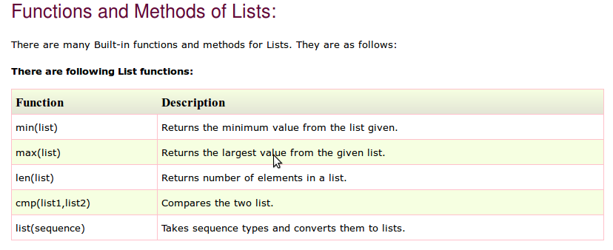
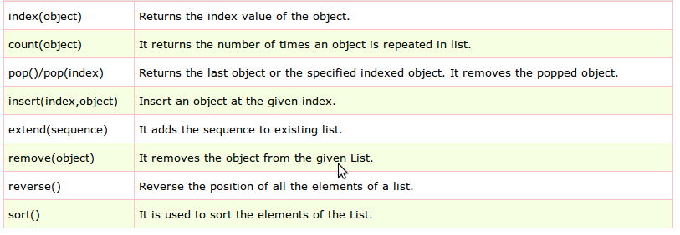

Slide 15
>>> len(my_list)
7
>>> min(my_list)
0
>>> list1=[101,981,'abcd','xyz','m']
>>> list2=['aman','shekhar',100.45,98.2]
>>> list3=[101,981,'abcd','xyz','m']
>>> cmp(list1,list2)
-1
>>> cmp(list2,list1)
1
>>> cmp(list3,list1)
0
>>>

Slide 16
>>> my_list=[1,2,3,4,5]
>>> sum(my_list)
15
>>> a = [3, 6, 8, 2, 78, 1, 23, 45, 9]
>>> sorted(a)
[1, 2, 3, 6, 8, 9, 23, 45, 78]
>>> a
[3, 6, 8, 2, 78, 1, 23, 45, 9]
>>> sorted(a, reverse=True)
[78, 45, 23, 9, 8, 6, 3, 2, 1]

Slide 17
List Comprehensions
List comprehensions provide a concise way to create lists. Common applications are to make new lists where each element is the result of some operations applied to each member of another sequence or iterable, or to create a subsequence of those elements that satisfy a certain condition.
For example, assume we want to create a list of squares, like using loop:
squares = []
for x in range(10):
squares.append(x**2)
output
squares [0, 1, 4, 9, 16, 25, 36, 49, 64, 81]
We can obtain the same result with list comprehensions:
squares = [x**2 for x in range(10)]
output
squares [0, 1, 4, 9, 16, 25, 36, 49, 64, 81]

