Slide 1
CSE P573
Applications of Artificial Intelligence
Bayesian Learning
Henry Kautz
Autumn 2004

Slide 2
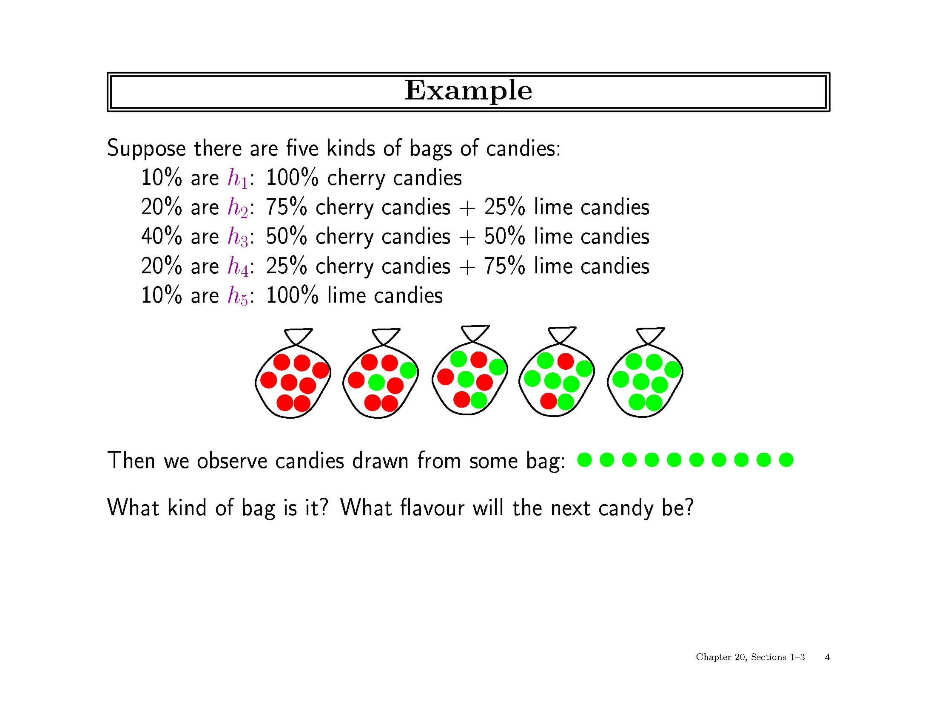

Slide 3
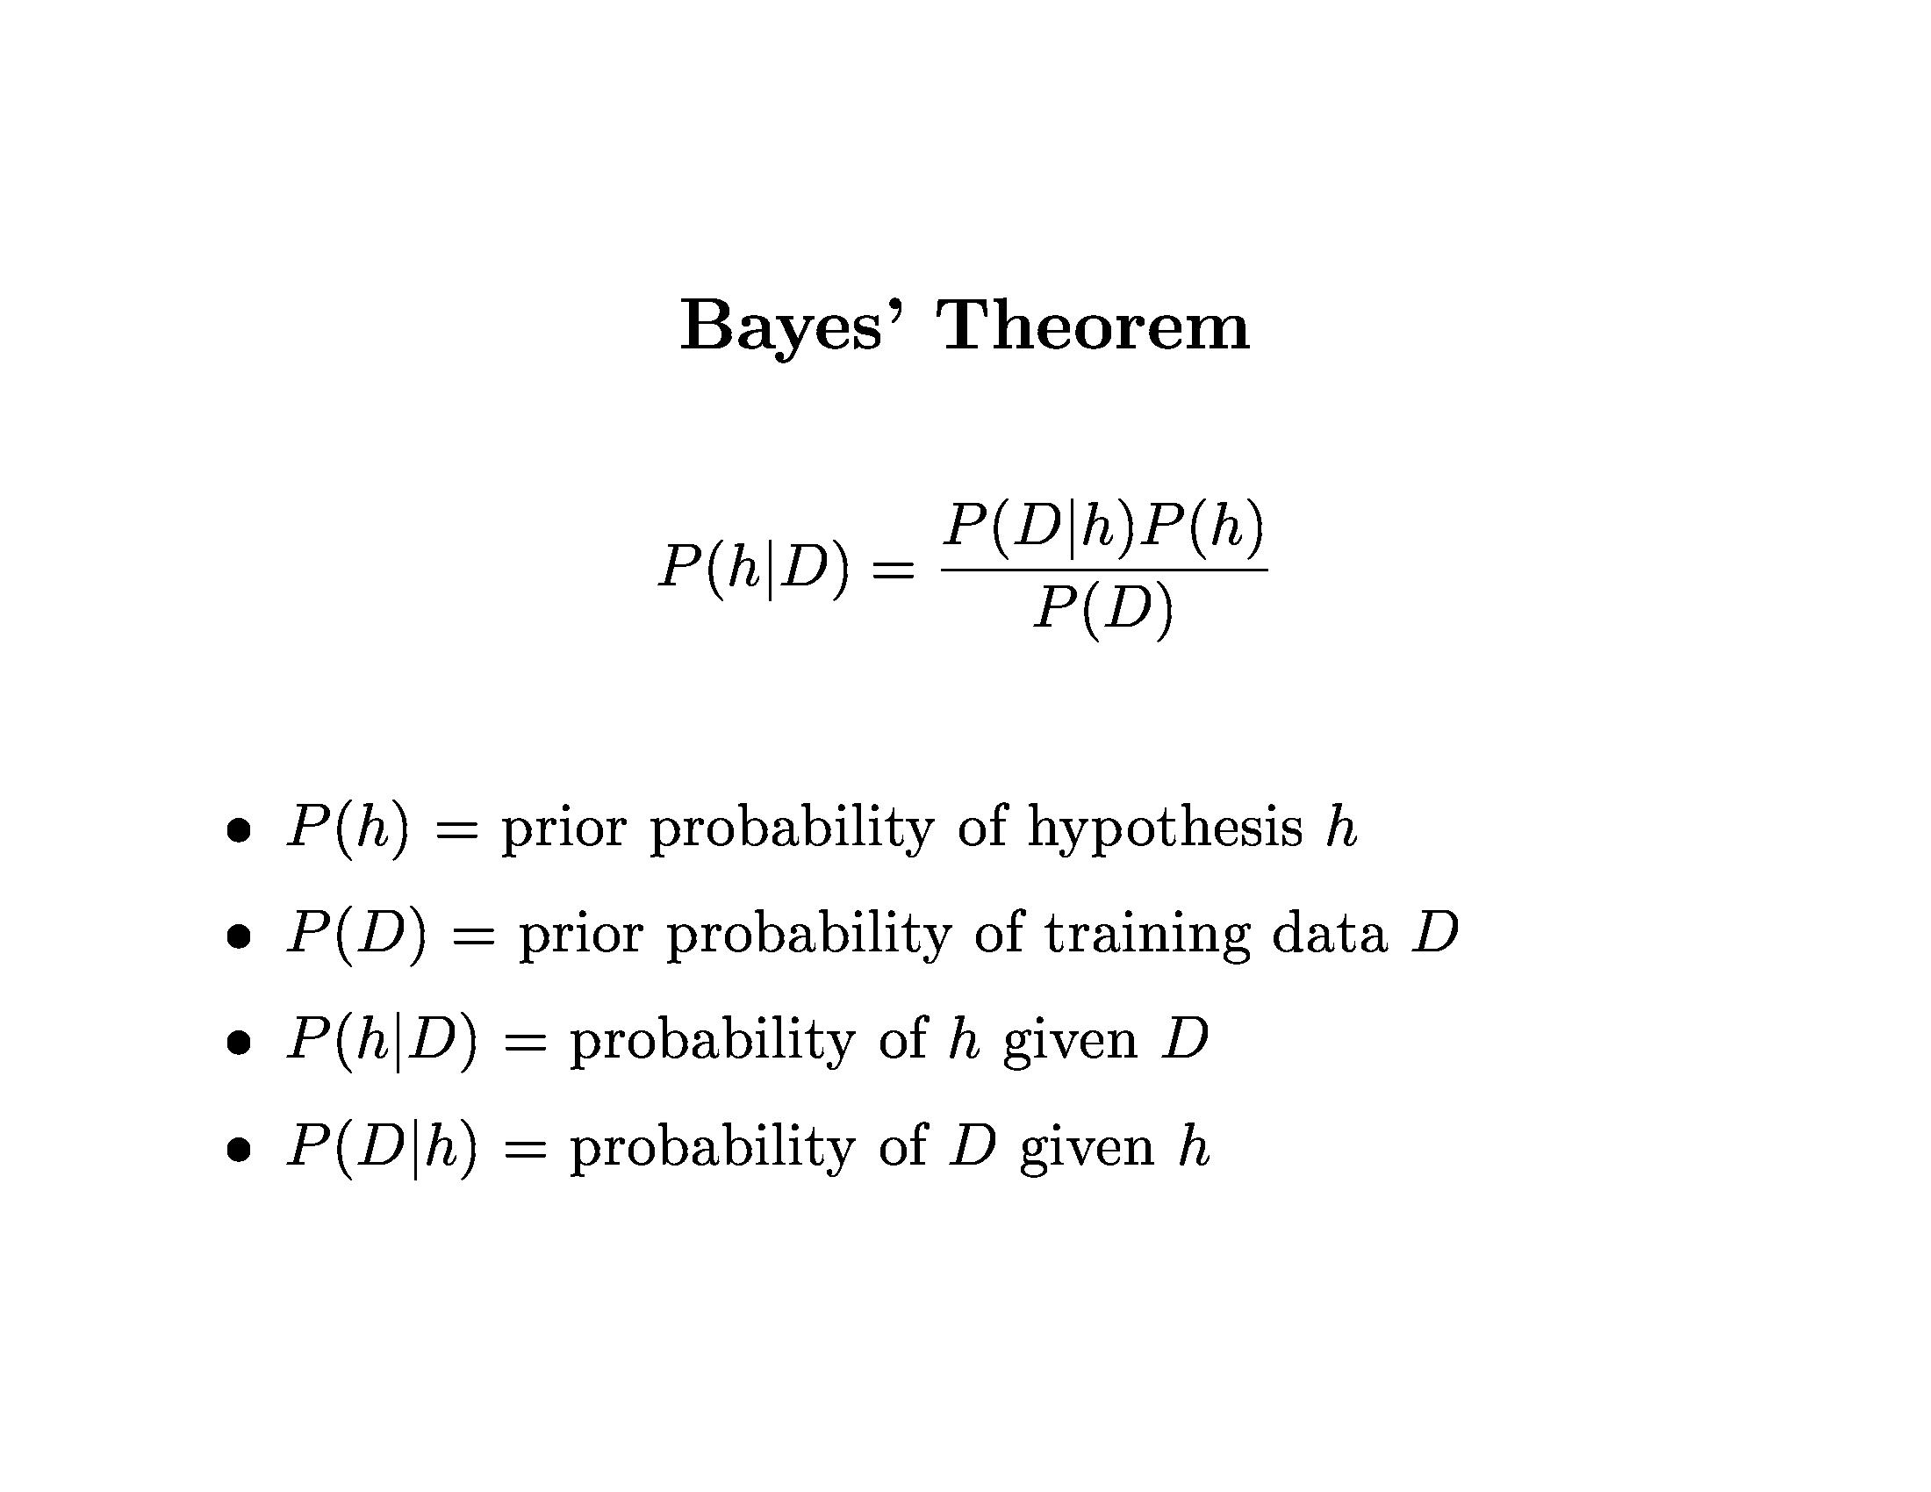

Slide 4
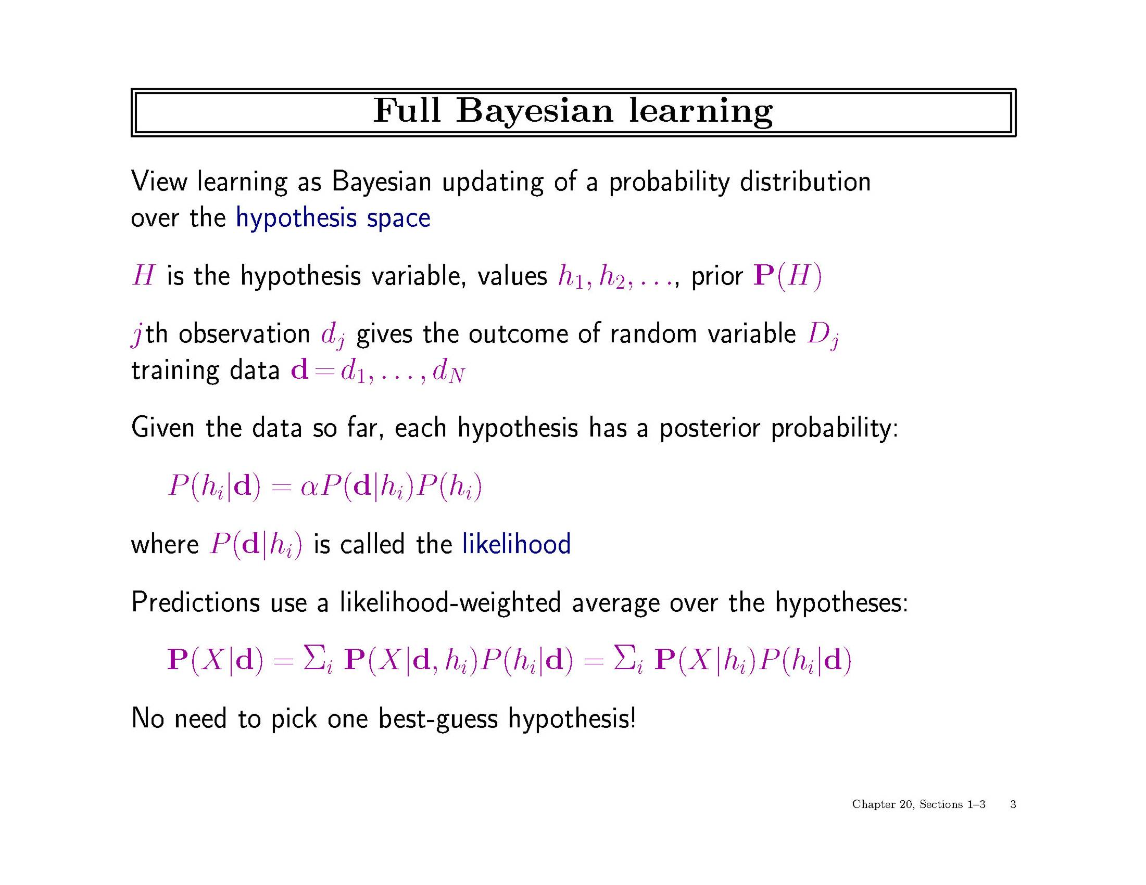

Slide 5
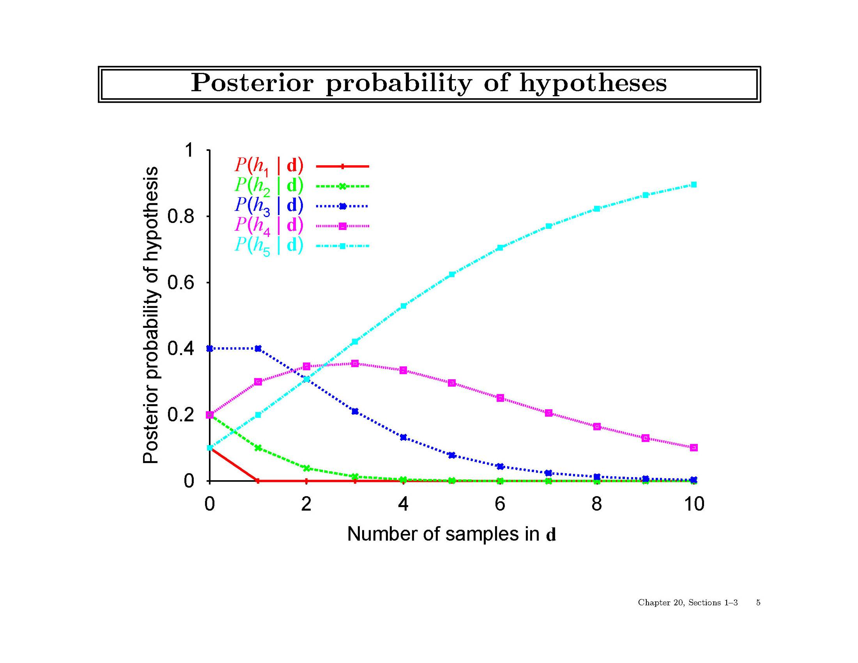

Slide 6
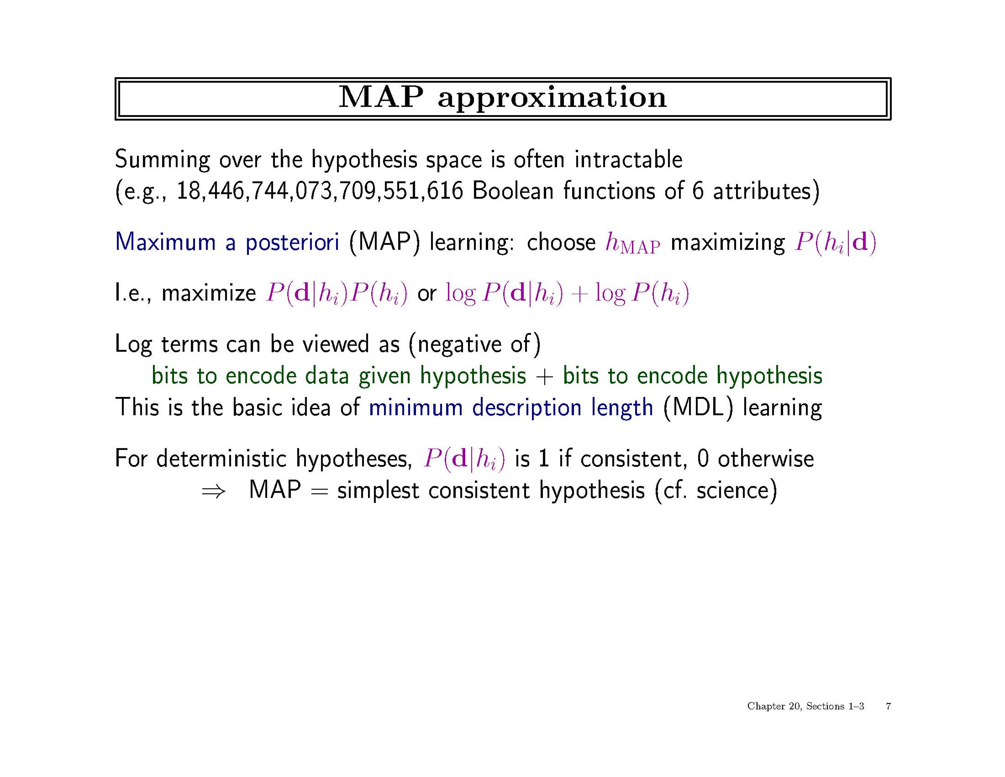

Slide 7
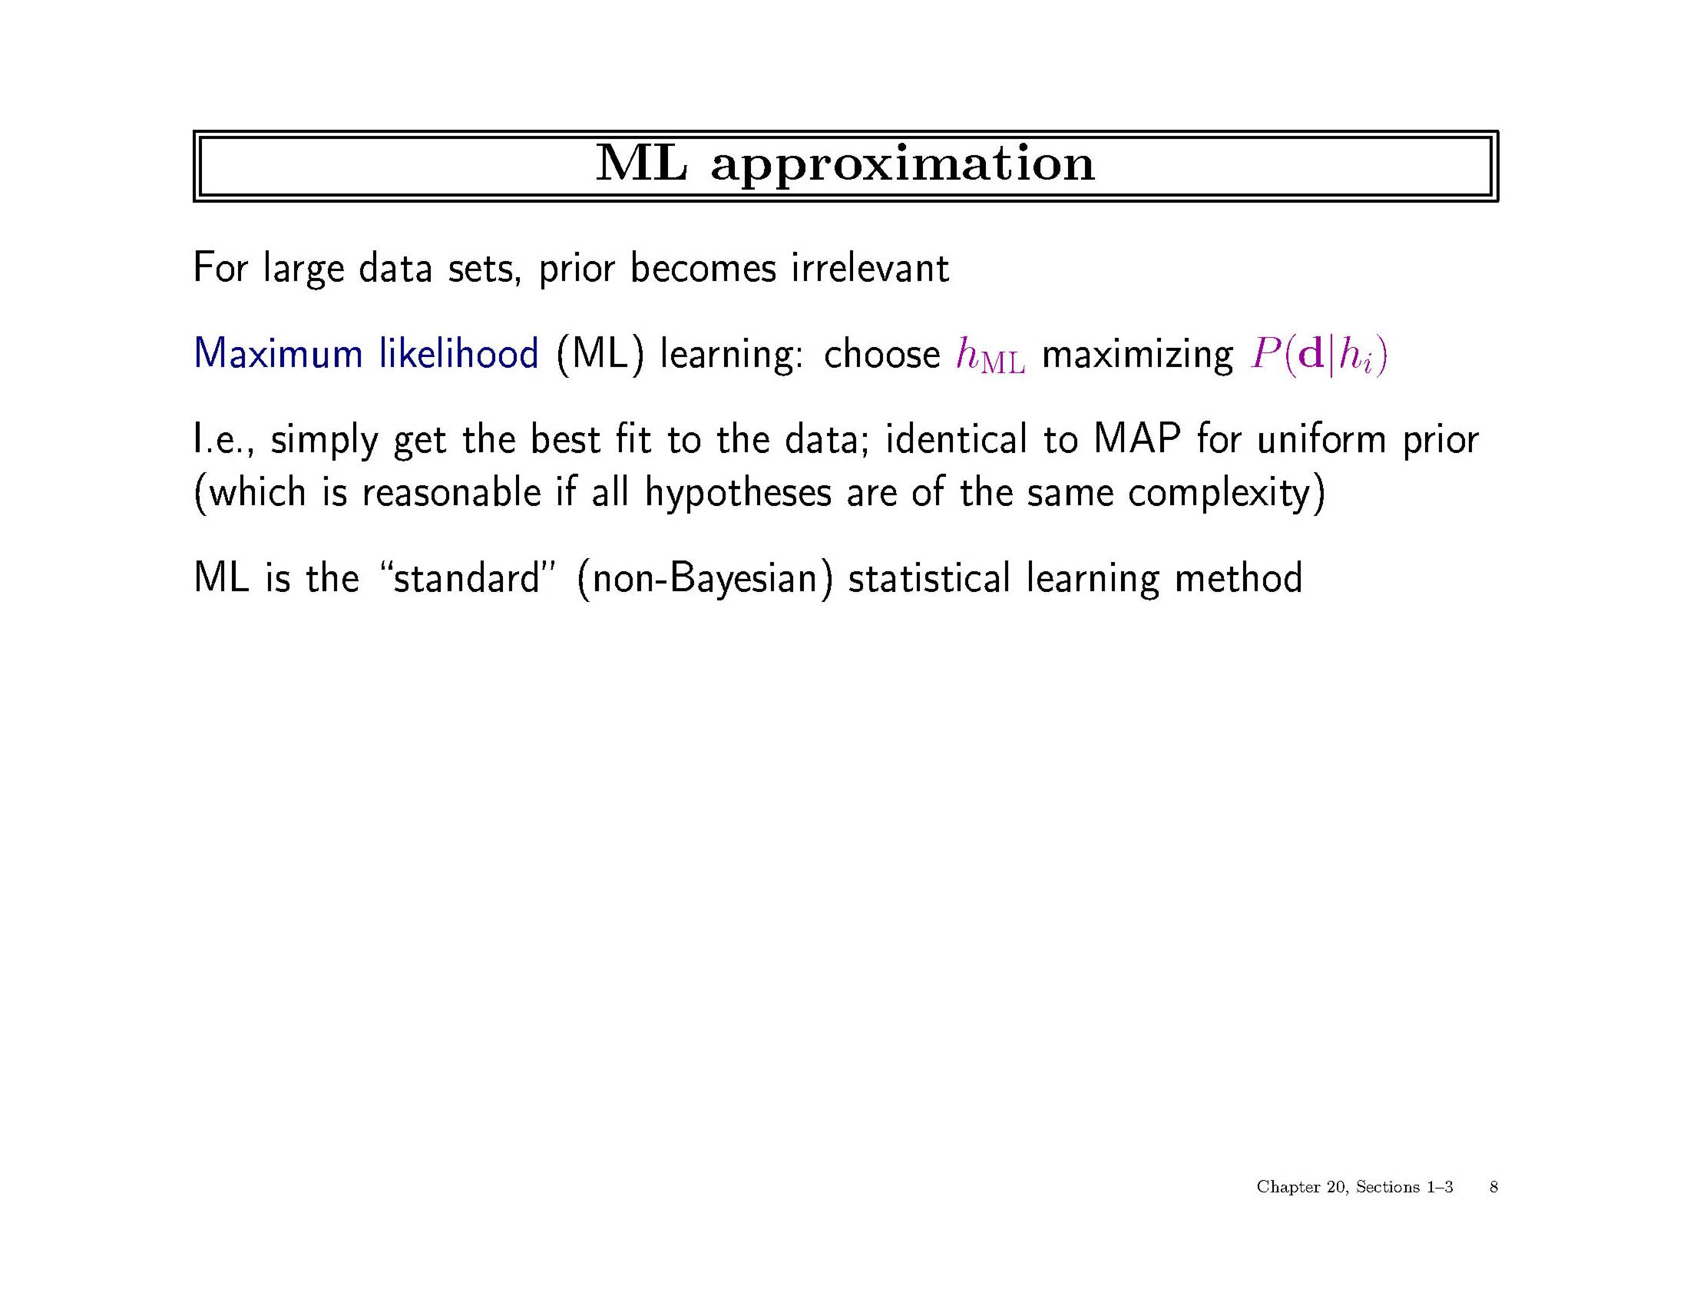

Slide 8
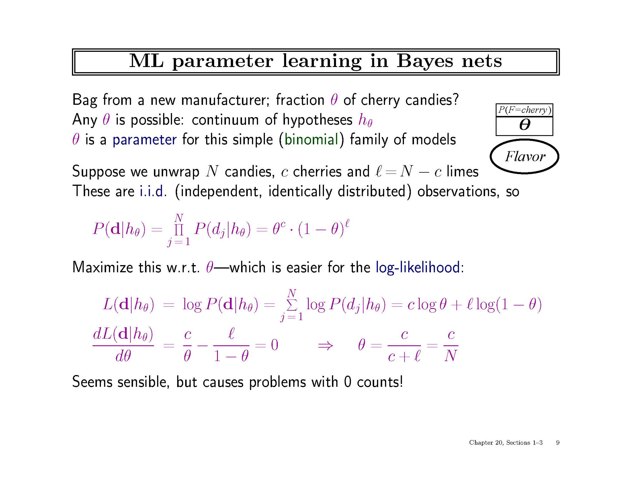

Slide 9
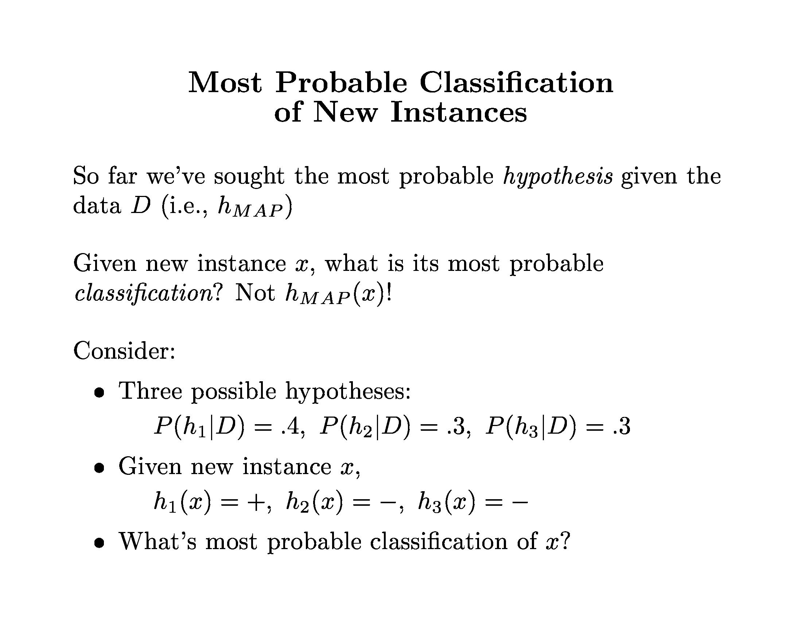

Slide 10
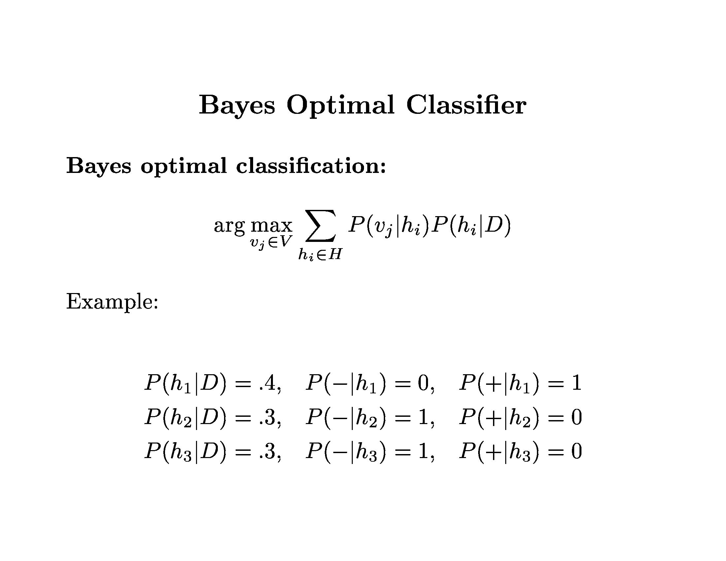
Classify instance D as:

Slide 11
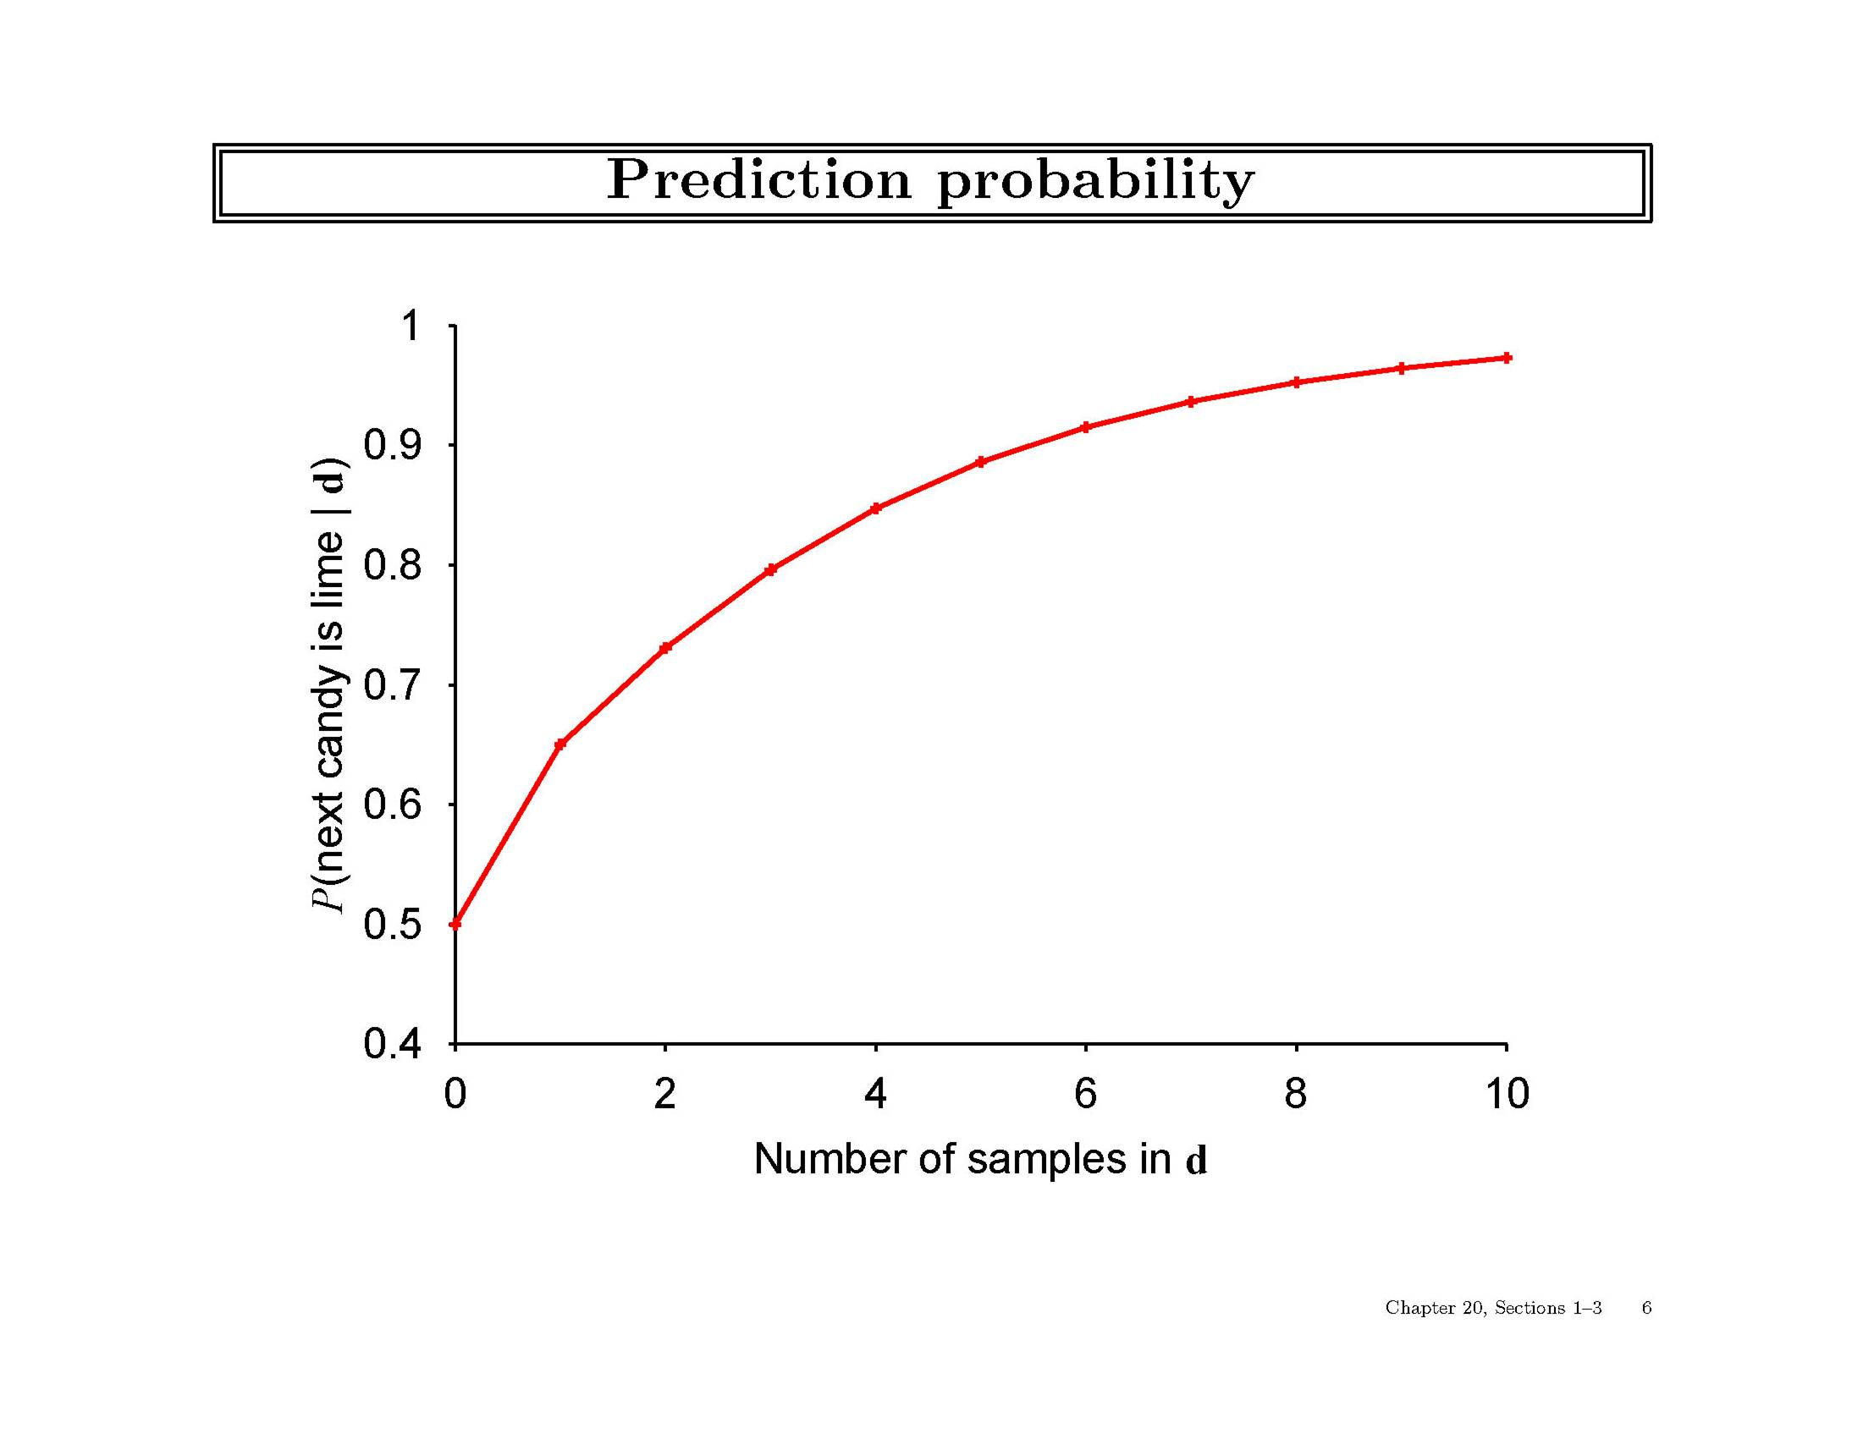

Slide 12
Naive Bayes Classifier
Important special, simple of a Bayes optimal classifier, where
  hypothesis = classification
  all attributes are independent given the class
class
attrib.
1
attrib.
2
attrib.
3

Slide 13
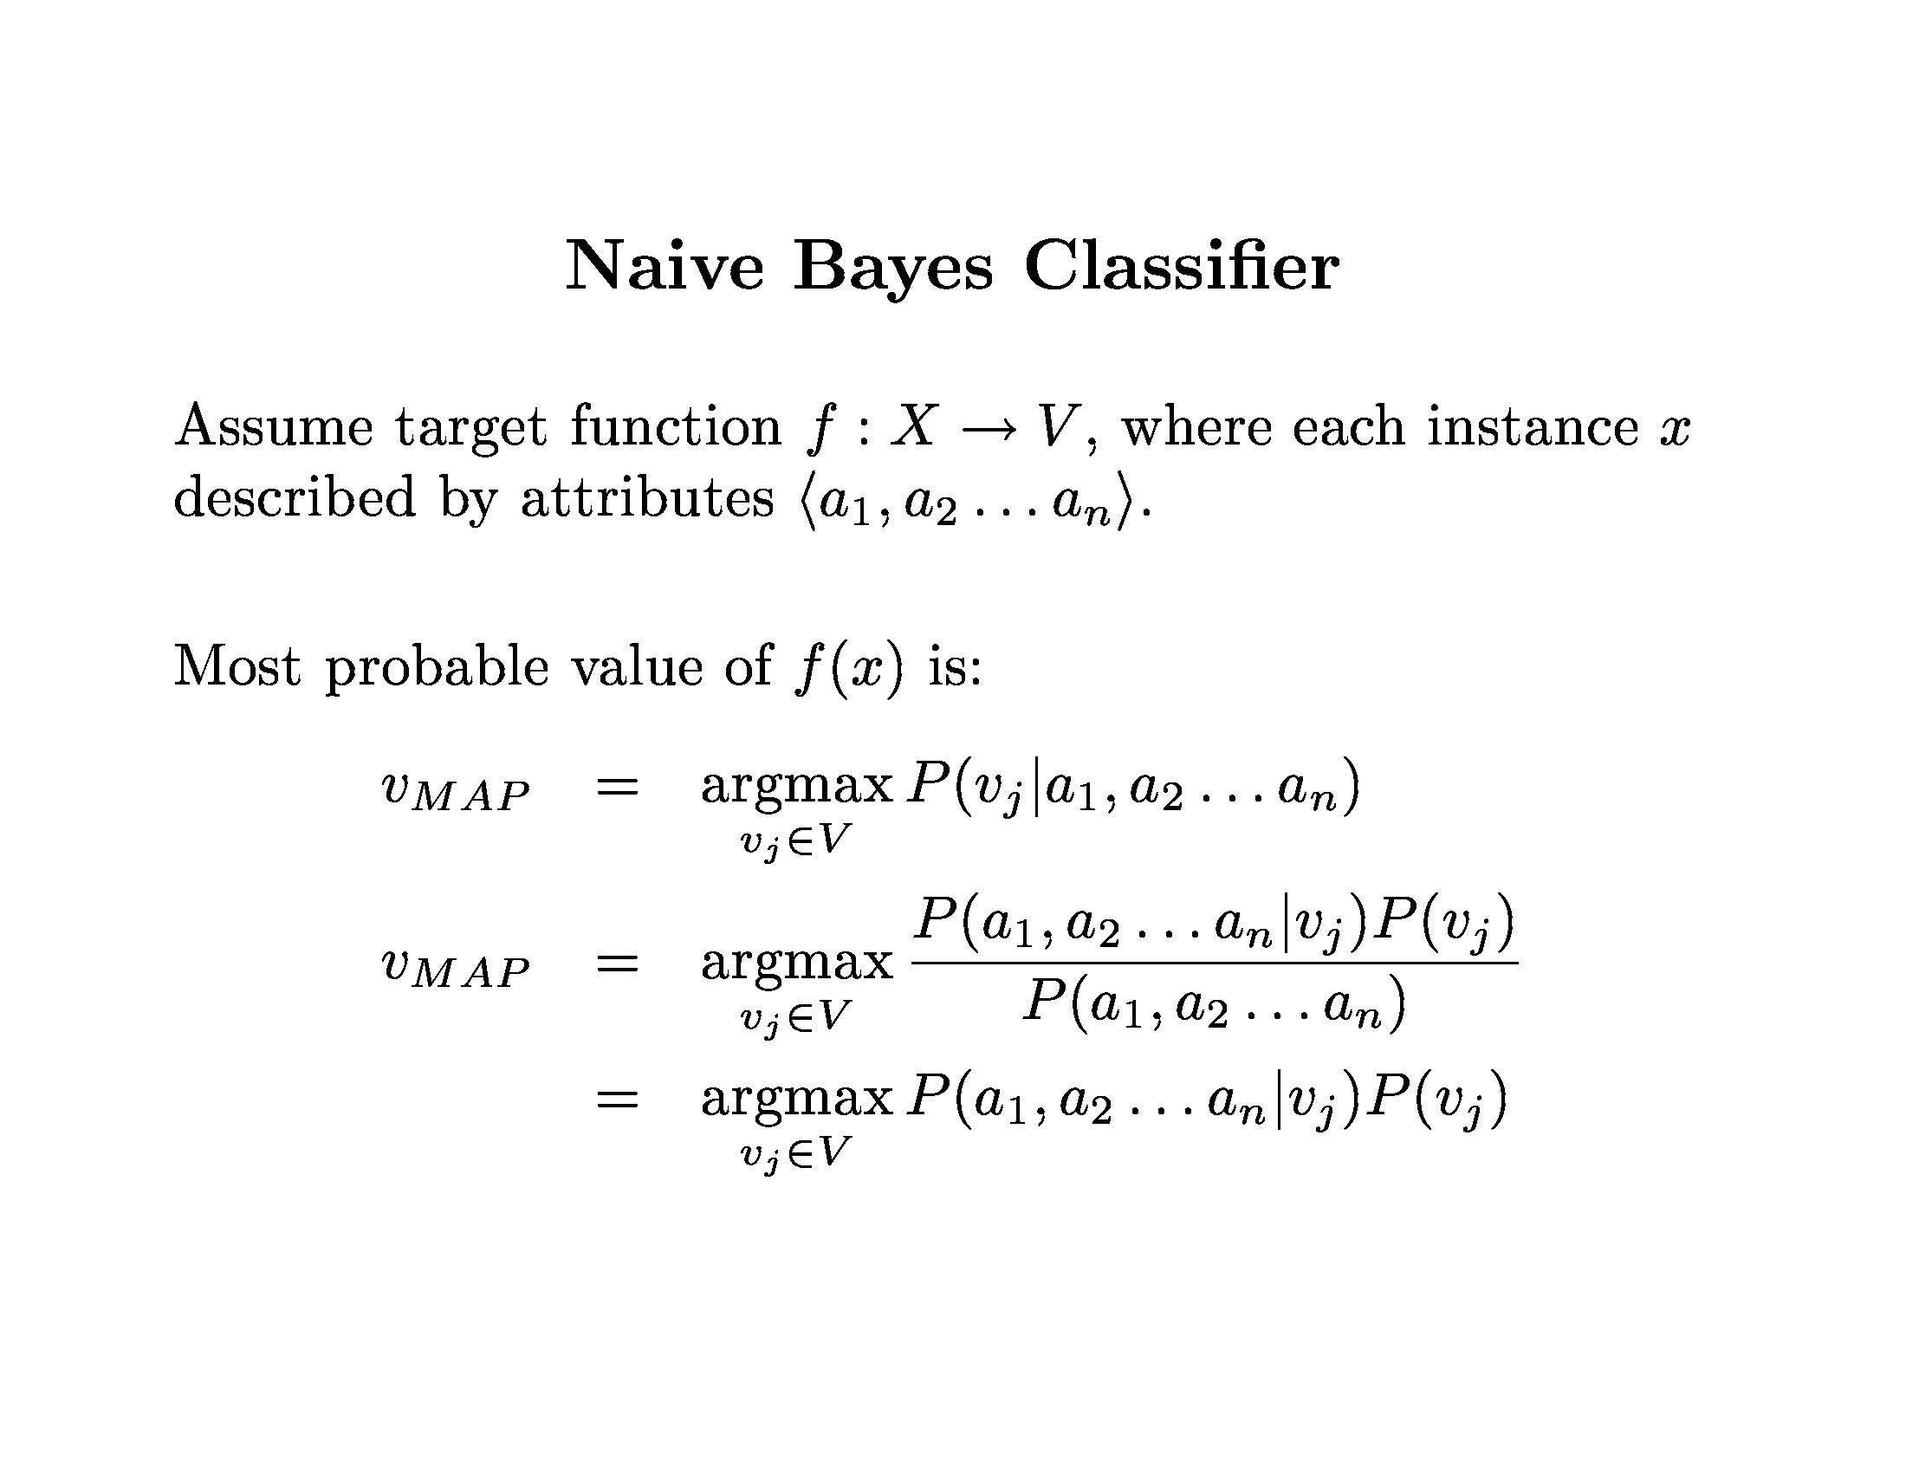
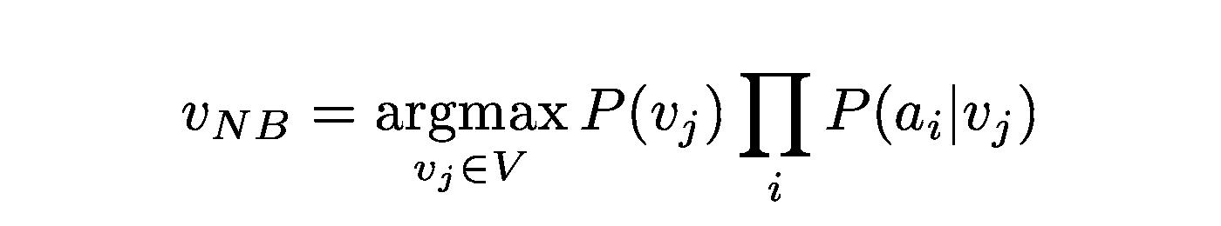

Slide 14
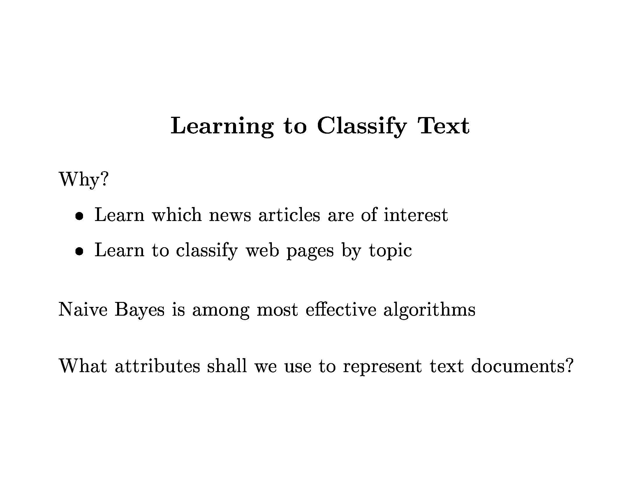

Slide 15
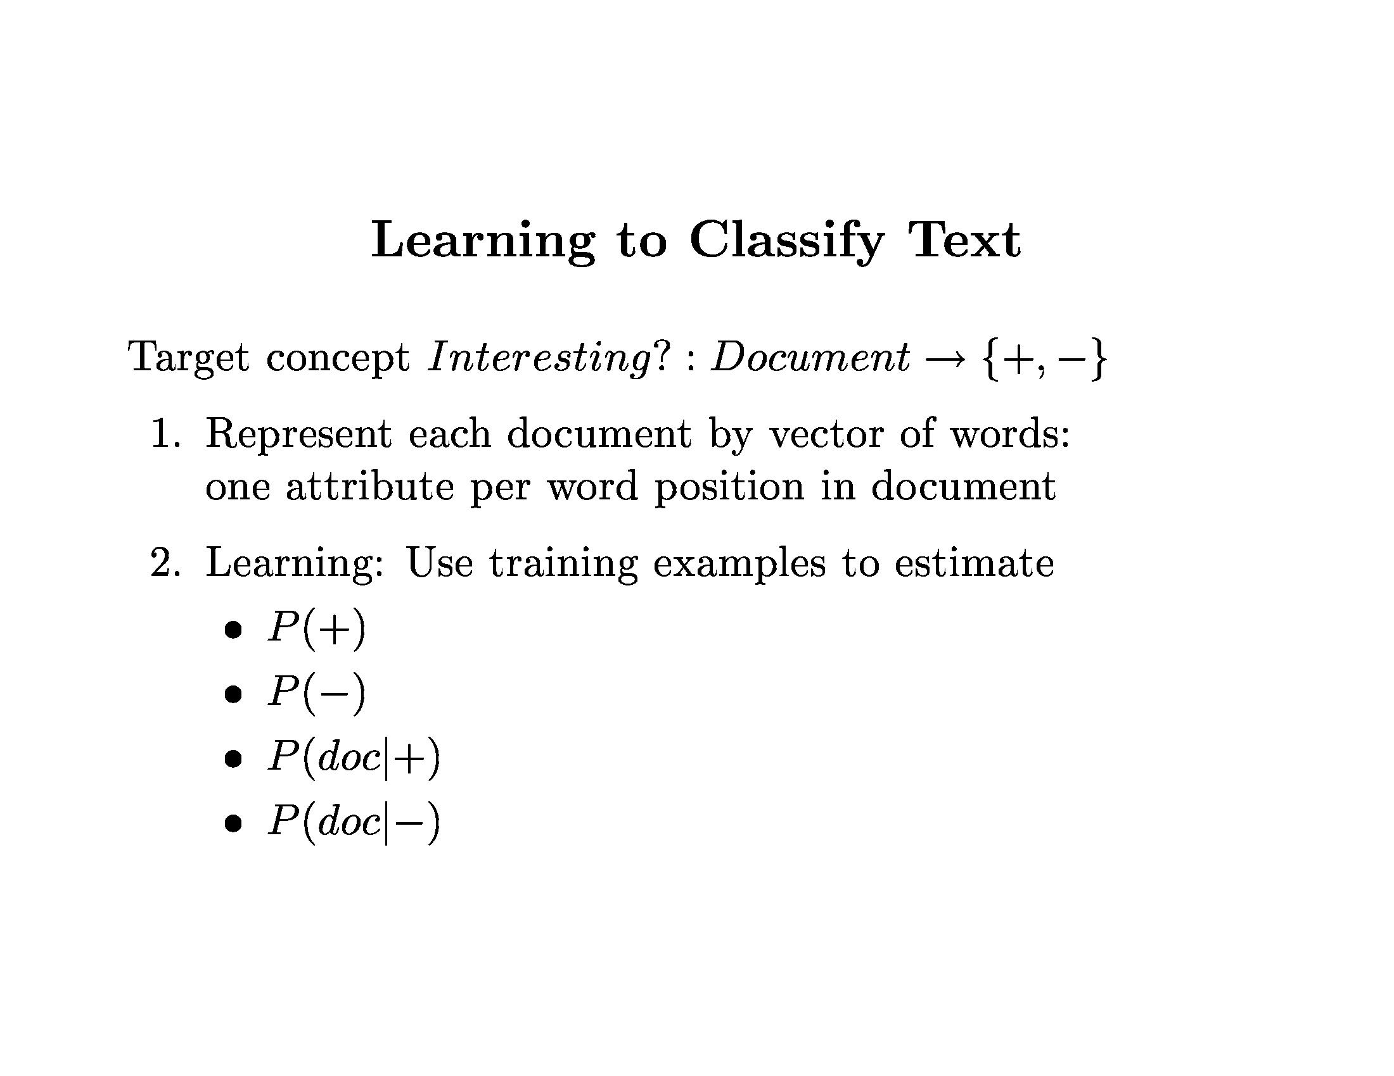

Slide 16
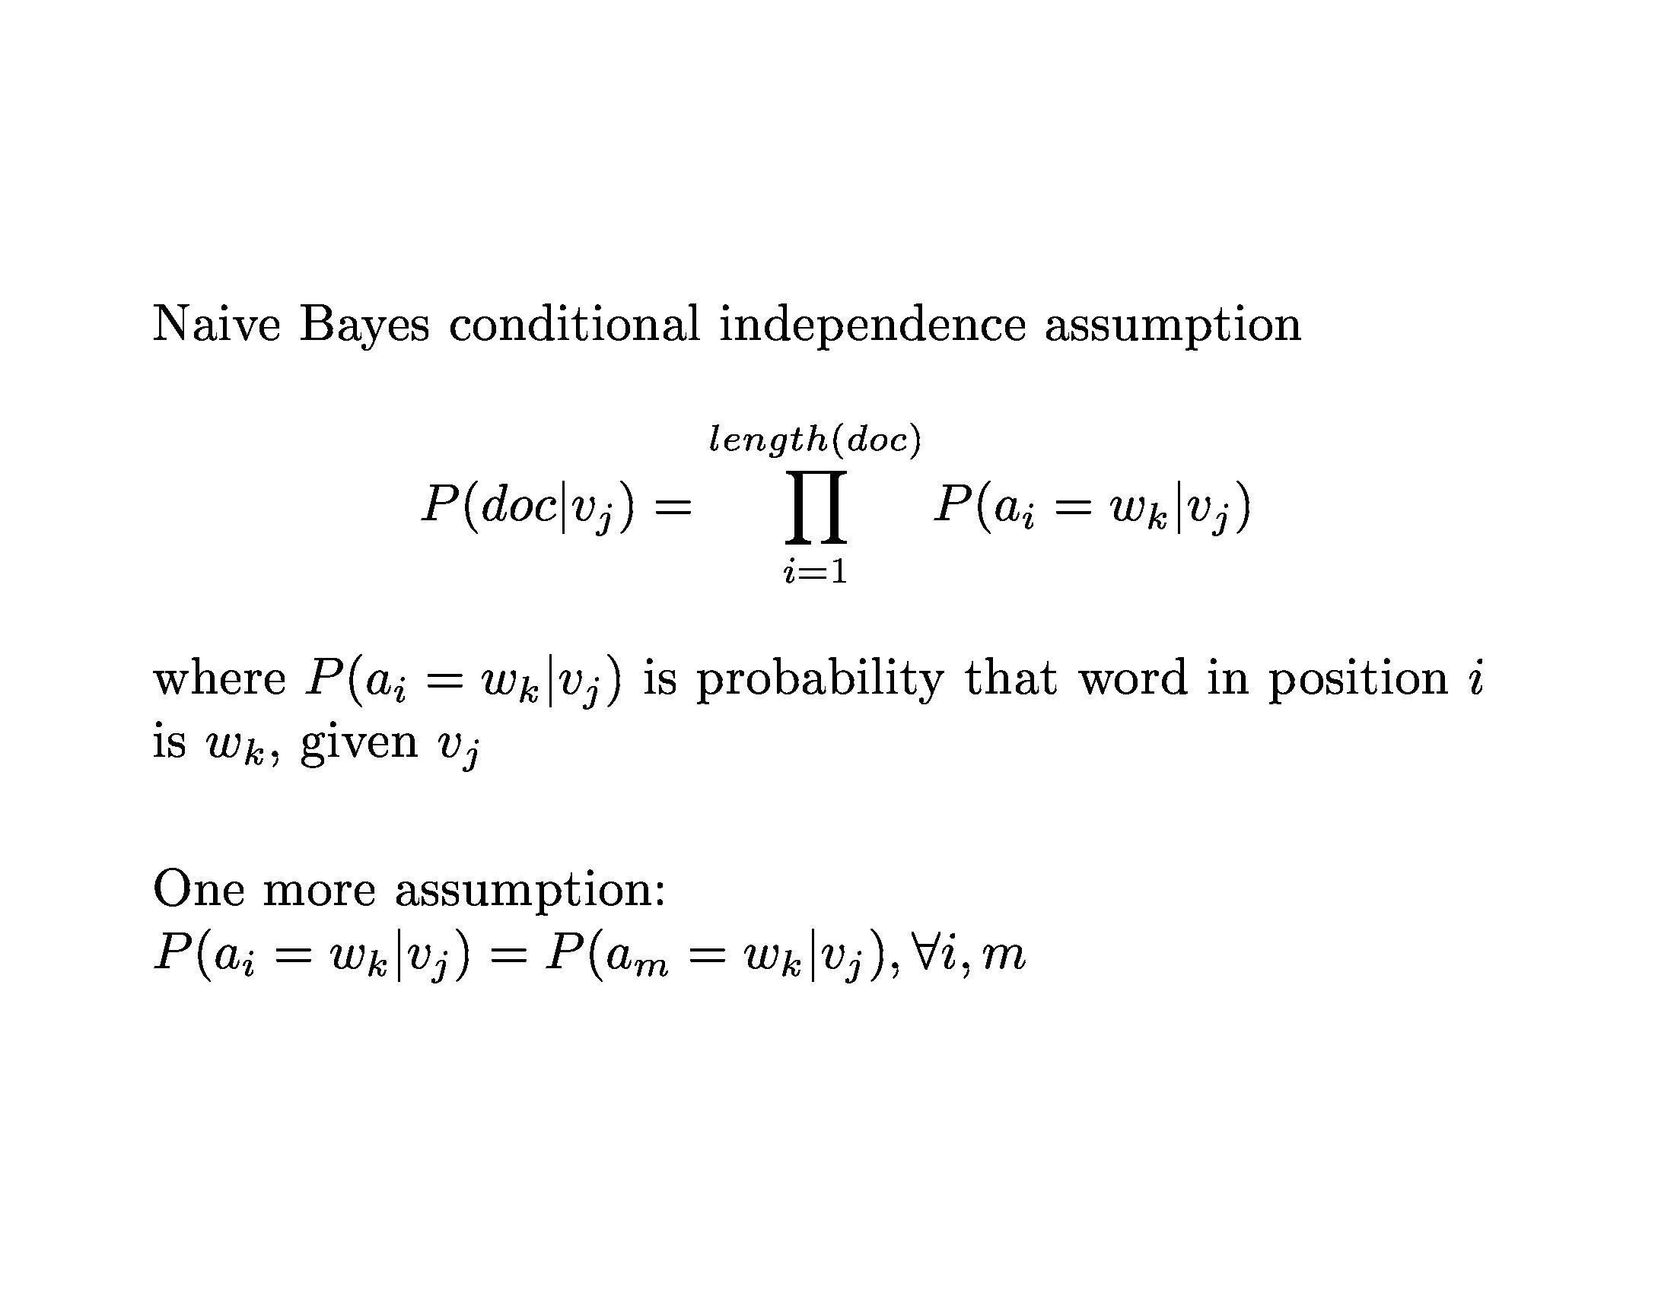

Slide 17
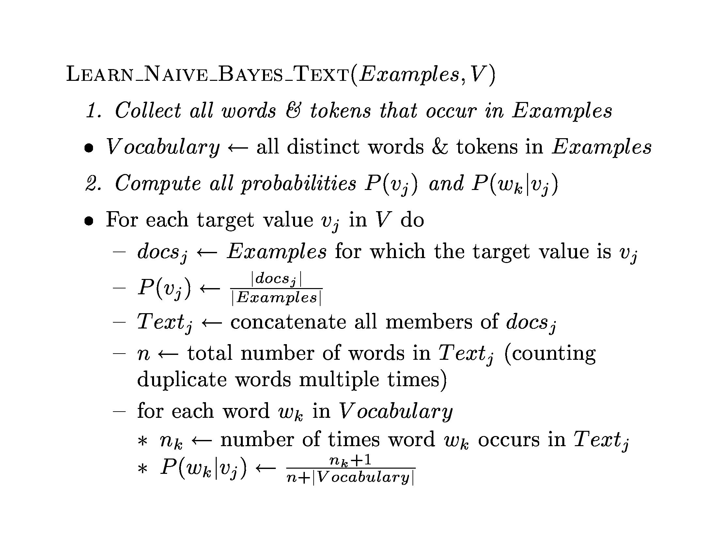

Slide 18
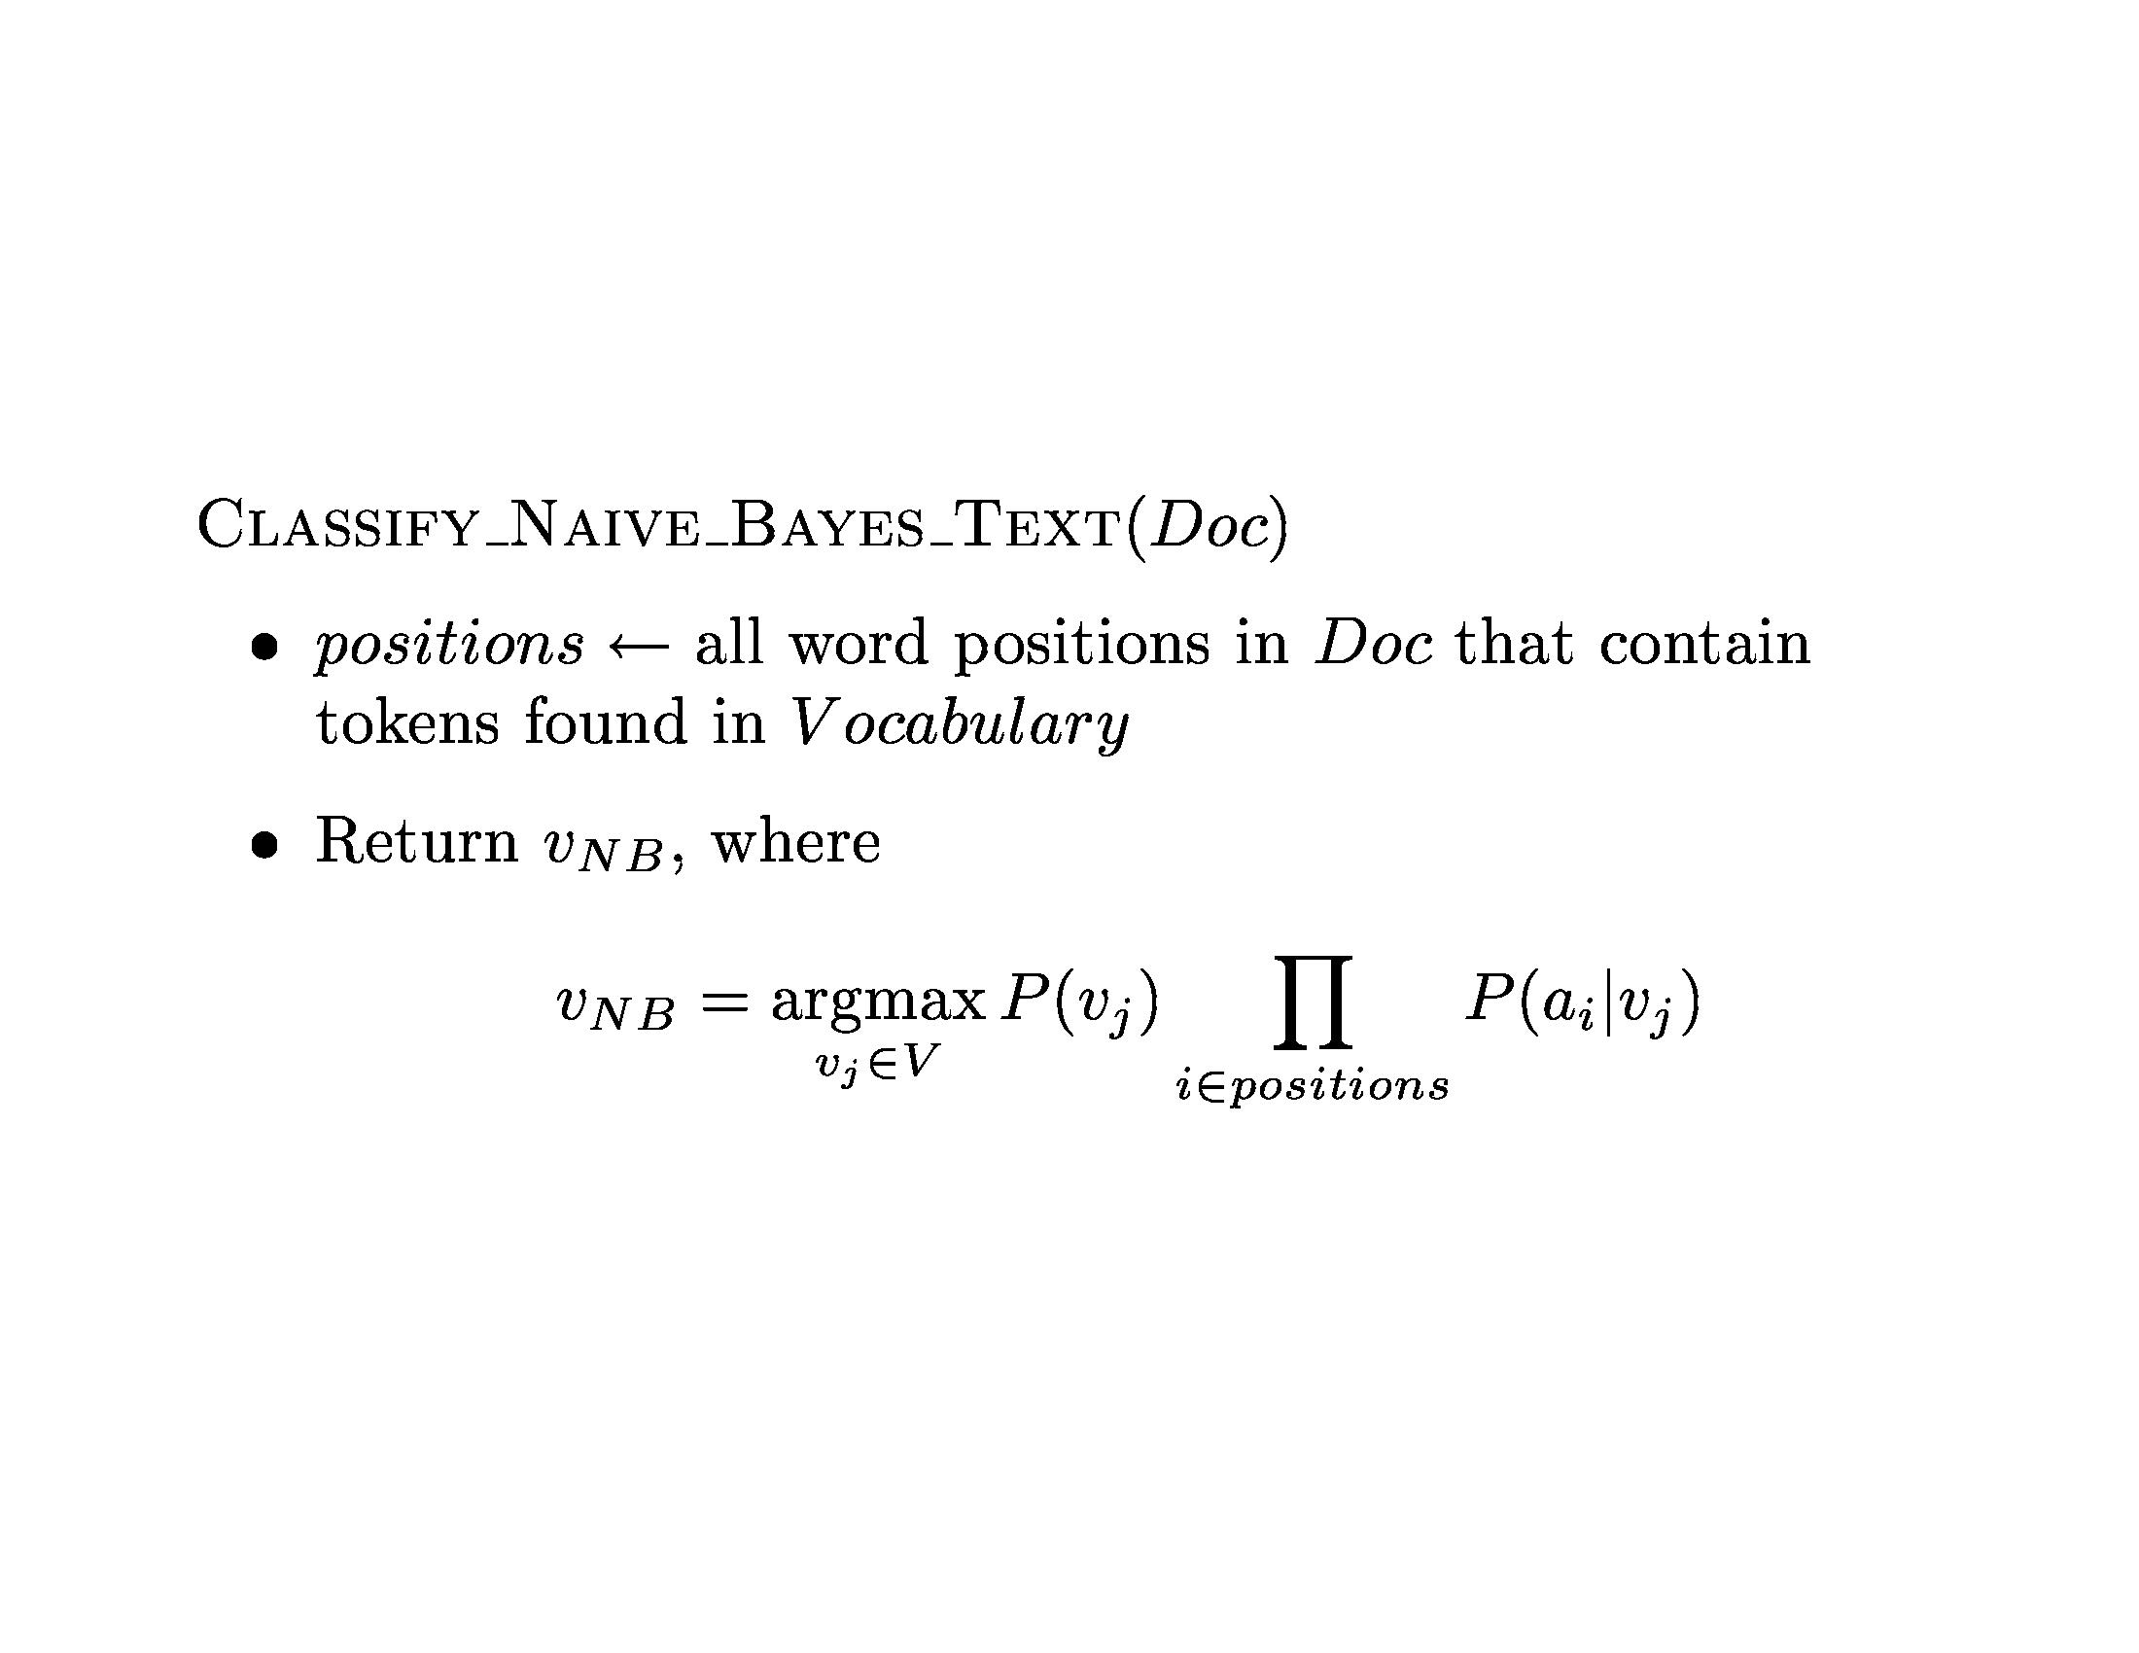

Slide 19
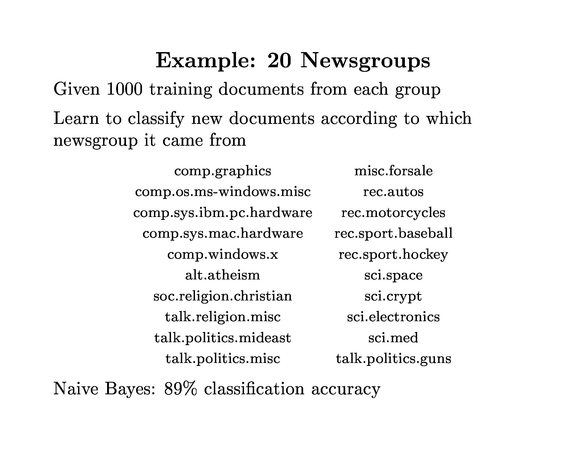

Slide 20
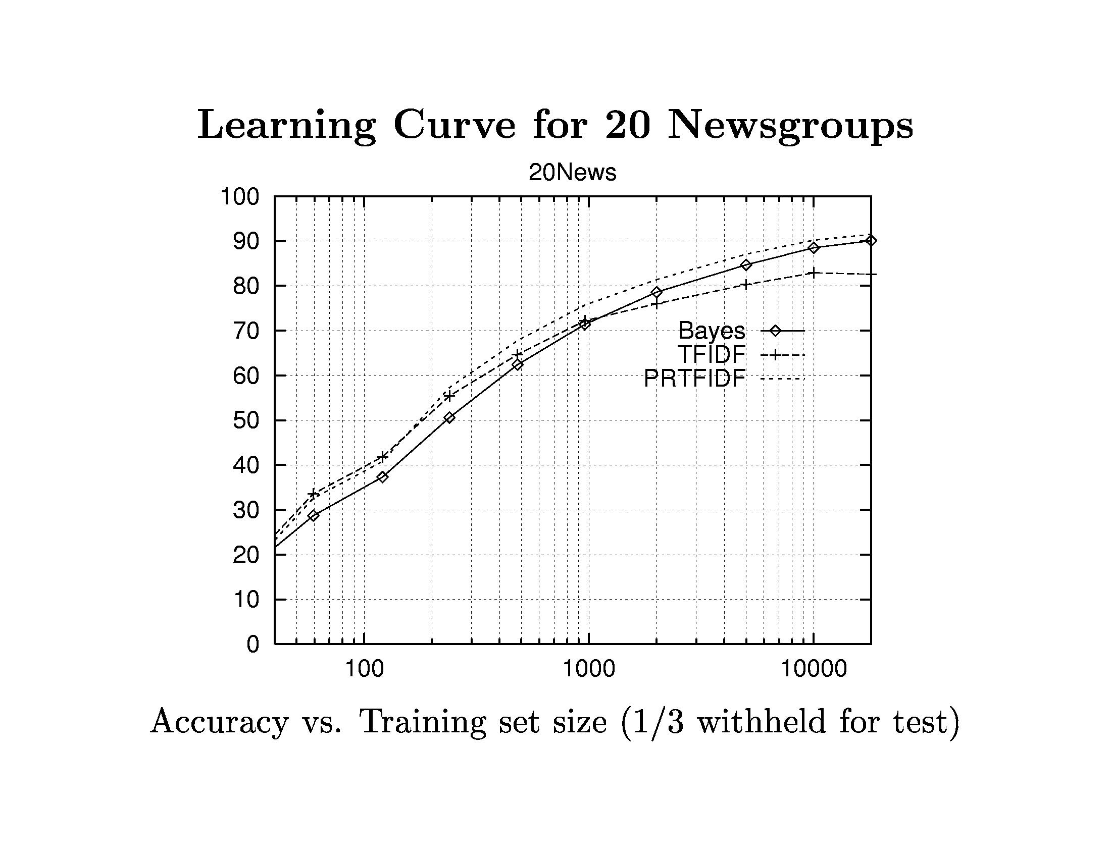

Slide 21
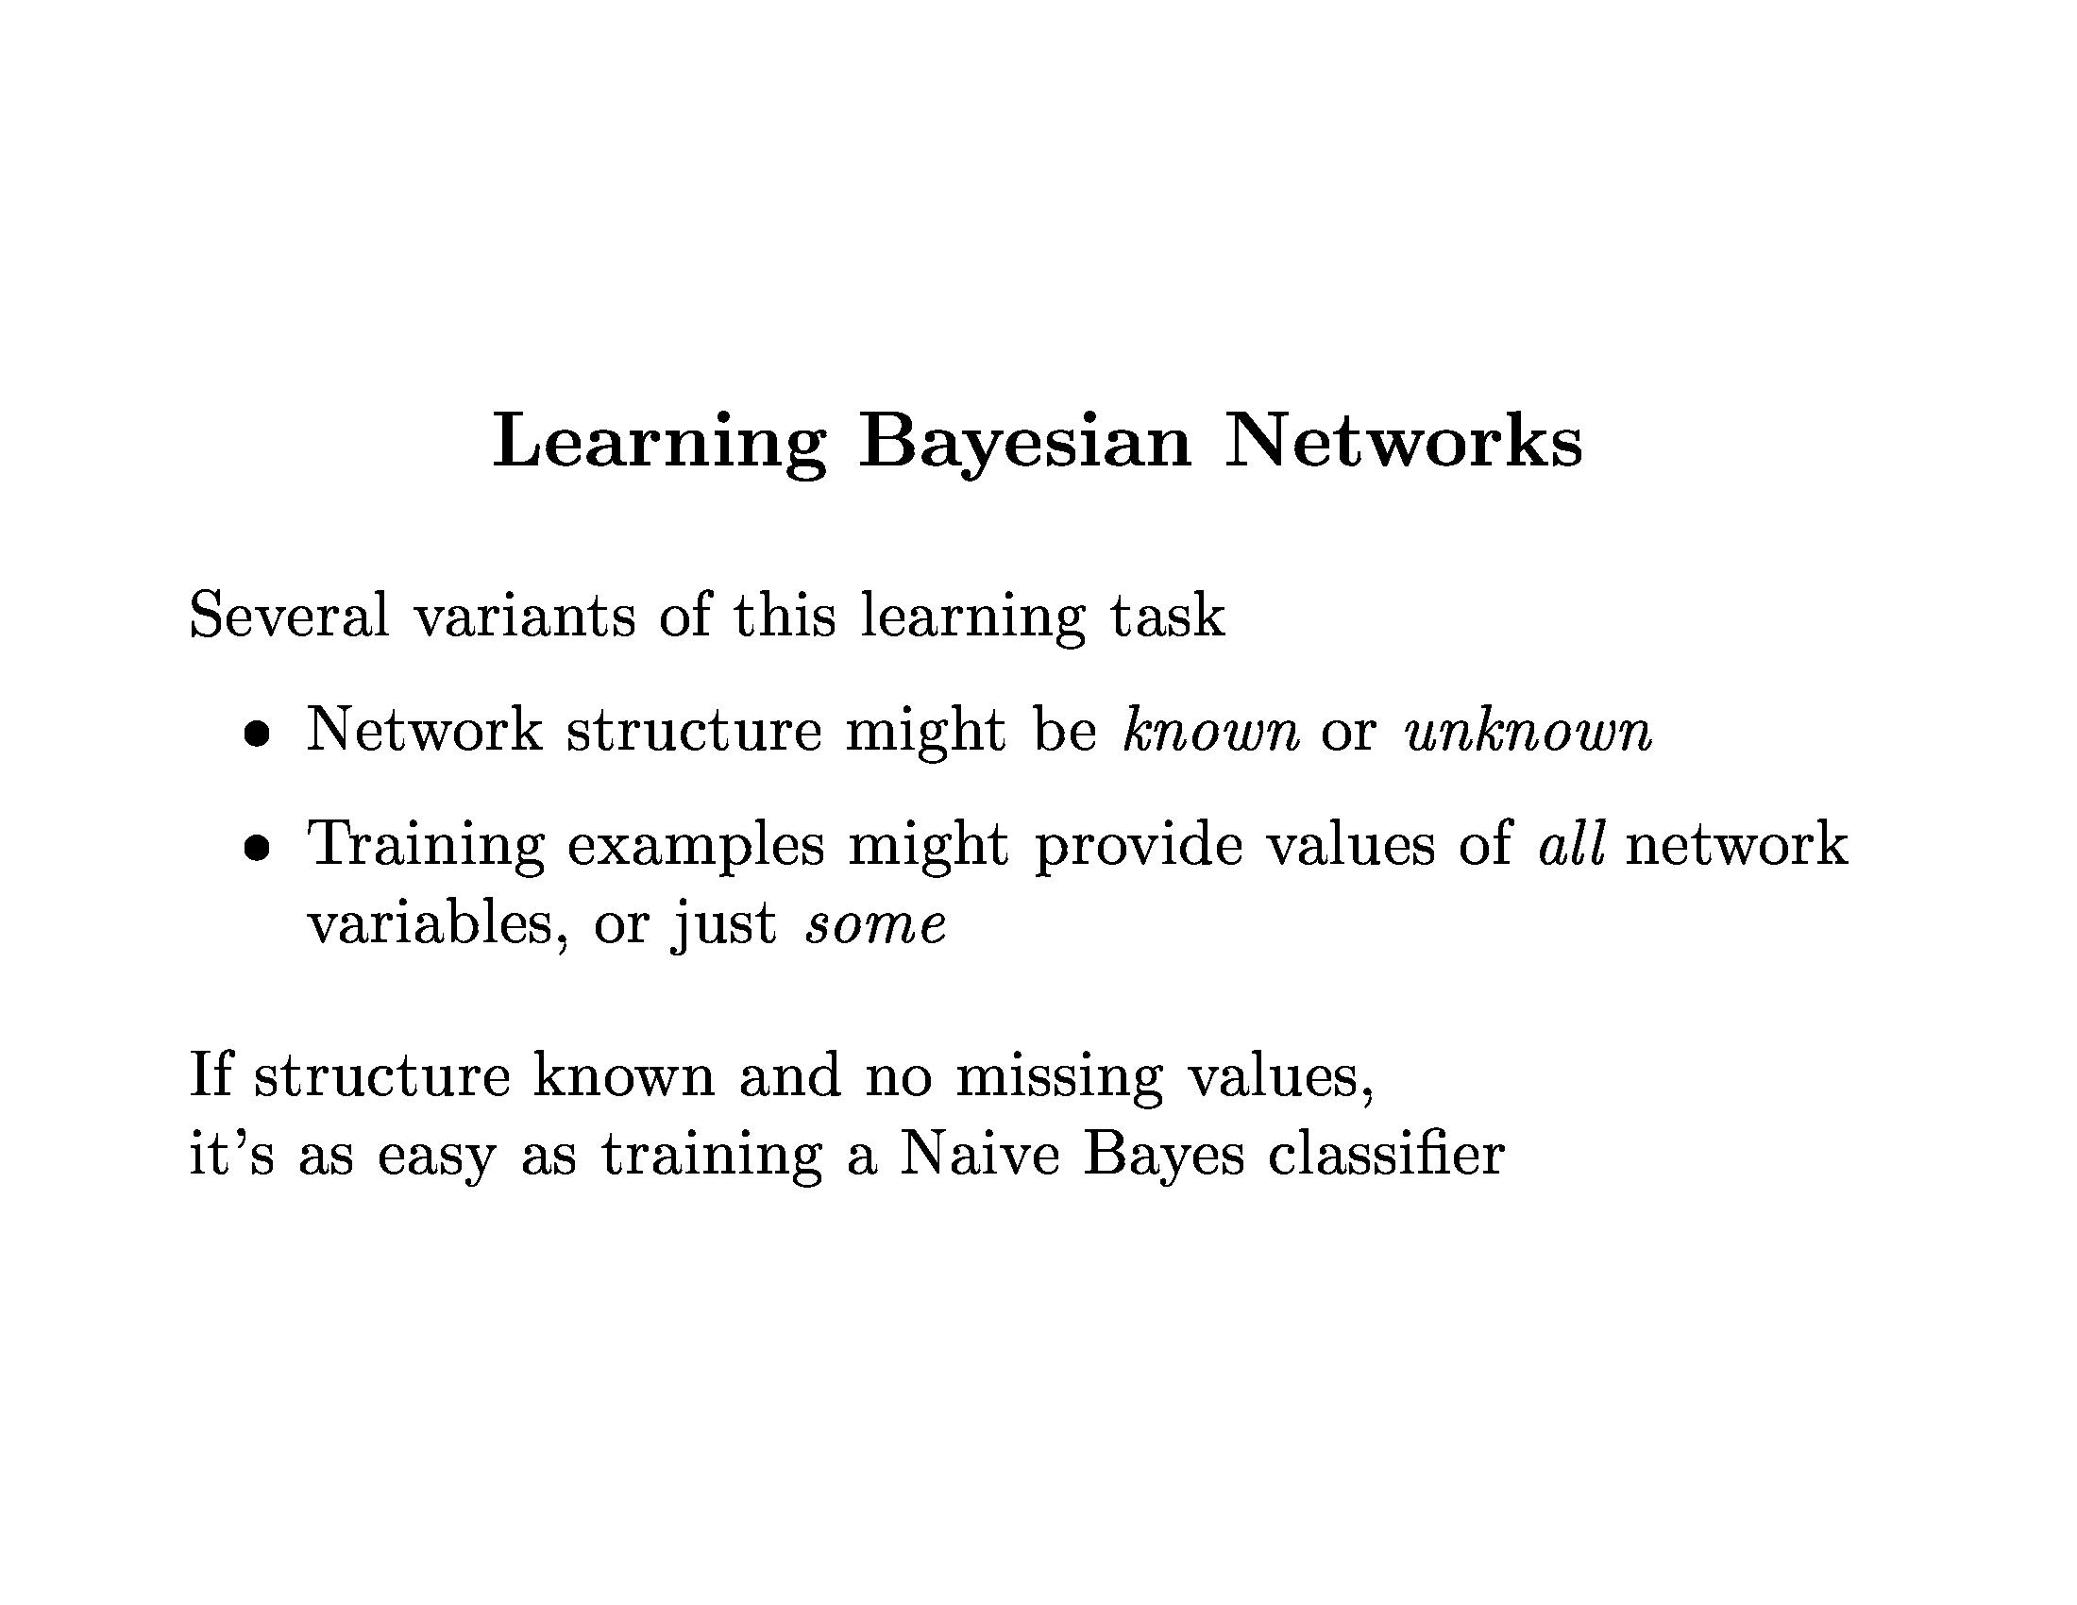

Slide 22
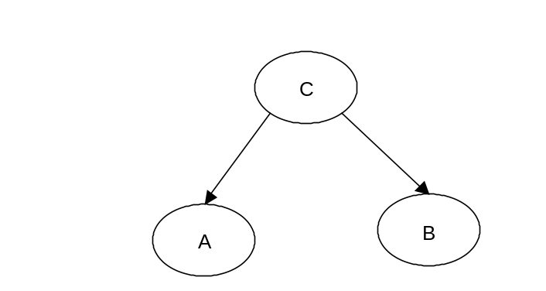
Expectation-Maximization
Consider learning a naïve Bayes classifier using unlabeled data. How can we estimate e.g. P(A|C)?
  Initialization: randomly assign numbers to P(C), P(A|C), P(B|C)
  repeat {
  E-step: Compute P(C|A,B):
  M-step: Re-compute maximum likelihood estimation
  of P(C), P(A|C), P(B|C)
  Calculate log likelihood of data
  } until (likelihood of data not improving)

Slide 23
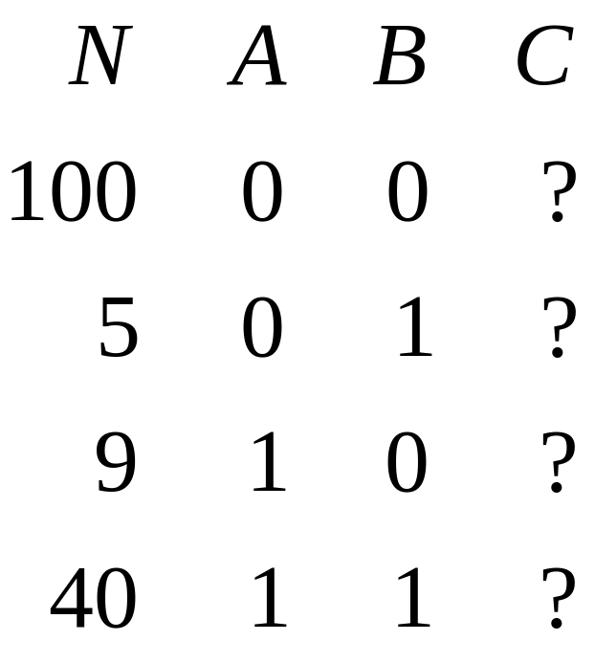
Expectation-Maximization
Initialization: randomly assign numbers to P(C), P(A|C), P(B|C).

Slide 24
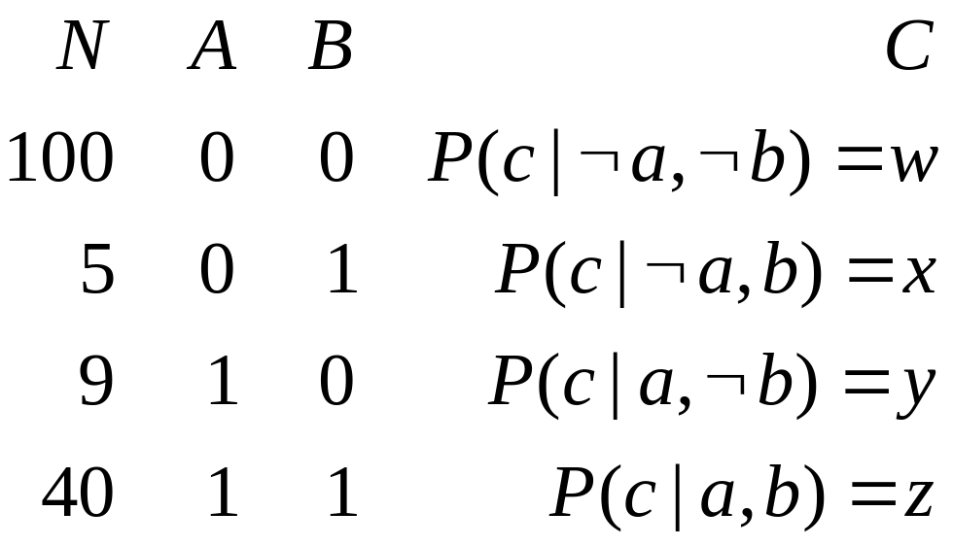
Expectation-Maximization
E-step:
Compute P(C|A,B)

Slide 25
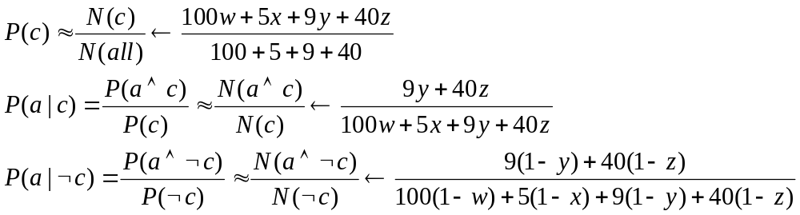
Expectation-Maximization
M-step:
Re-compute maximum likelihood estimation of P(C), P(A|C), P(B|C):

Slide 26
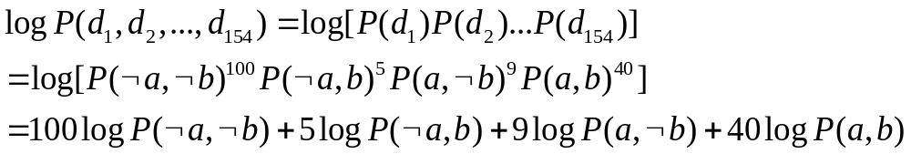
Expectation-Maximization
Calculate log likelihood of data:

Slide 27
EM Demo

Slide 28
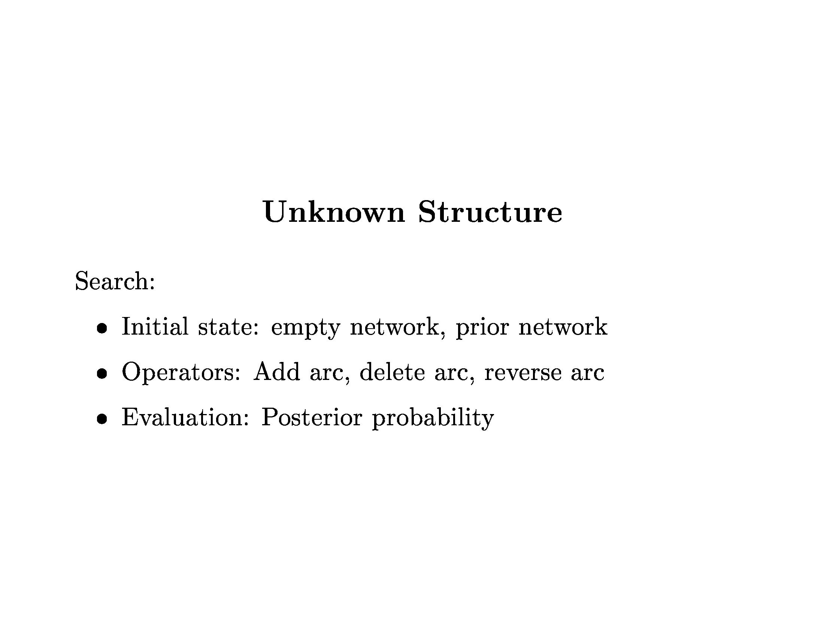

Slide 29
