Slide 1
Pipelining UNIT II – Chapter 3
Reference :
Appendix A,
Computer Architecture, A Quantitative Approach – John L. Hennessey and David A. Patterson

Slide 2
Introduction

Slide 3
Pipelining: Its Natural!
Laundry Example
Ann, Brian, Cathy, Dave each have one load of clothes to wash, dry, and fold
Washer takes 30 minutes
Dryer takes 40 minutes
“Folder” takes 20 minutes
A
B
C
D

Slide 4
Sequential Laundry
6 PM
7
8
9
10
11
Midnight
Time
30
40
20
30
40
20
30
40
20
30
40
20
T
a
s
k
O
r
d
e
r
A
B
C
D
Sequential laundry takes 6 hours for 4 loads
If they learned pipelining, how long would laundry take?

Slide 5
Pipelined Laundry Start Work
6 PM
7
8
9
10
11
Midnight
Time
30
40
40
40
40
20
T
a
s
k
O
r
d
e
r
A
B
C
D
Pipelined laundry takes 3.5 hours for 4 loads

Slide 6
Computer Pipelines
Pipelining is an implementation technique whereby multiple instructions are overlapped in execution; it takes advantage of parallelism.
In a computer pipeline, each step in the pipeline completes a part of an instructions.
Different steps are completing different parts of different instructions in parallel.
Each of these steps is called a pipe stage or a pipe segment
The stages are connected one to the next to form a pipe
The throughput of an instruction pipeline is determined by how often an instruction exits the pipeline

Slide 7
Computer Pipelines
Pipeline properties
Execute billions : throughput is what matters.
Processor cycle The time required between moving an instruction one step down the pipeline
Processor cycle is determined by slowest pipeline stage;
The time per instruction on the pipelined processor in ideal conditions is equal to,

Slide 8
The Basics of a RISC Instruction Set
Default RISC architecture is MIPS.
Few key properties of RISC architecture
-The only operations that affect memory are load and store operations that move data from memory to a register or to memory from a register, respectively.
Most RISC architectures, like MIPS, have three classes of instructions:
ALU instruction,
Load and store instructions,
Branches and jumps

Slide 9
A Simple Implementation of a RISC Instruction Set
Every instruction can be implemented in at most 5 clock cycles
Instruction fetch cycle (IF): send PC to memory, fetch the current instruction from memory, and update PC to the next sequential PC by adding 4 to the PC.
IR<-Mem[PC]
NPC<-PC+4
Instruction decode/register fetch cycle (ID): decode the instruction, read the registers corresponding to register source specifiers from the register file.
Execution/effective address cycle (EX): The ALU operates on the operands prepared in the prior cycle.
-Perform one of three functions
Memory reference, Register-Register ALU instruction and Register-Immediate ALU instruction.

Slide 10
A Simple Implementation of a RISC Instruction Set
Memory reference:
ALU output <- A +Imm
-The ALU adds the base register and the offset to form the effective address.
Offset: constant offset is added to a register to form the memory address
• Register-Register ALU instruction:
ALU output <- A OP B
-The ALU performs the operation specified by the ALU opcode on reg A and B
operation is typically specified in one field, called the opcode
• Register-Immediate ALU instruction:
ALU output <- A OP Imm
-The ALU performs the operation specified by the ALU opcode on the register A e and immediate.
ALU output <- NPC + Imm

Slide 11
Memory access (MEM): perform load/store instructions.
If the instruction is a load, memory does a read using the effective address computed in the previous cycle.
If it is a store, then the memory writes the data from register file using the effective address.
Write-back cycle (WB): Register-Register ALU instruction or Load instruction.
Write the result into the register file, whether it comes from the memory system (for a load) or from the ALU

Slide 12
Classic 5-Stage Pipeline for a RISC
Each cycle the hardware will initiate a new instruction and will be executing some part of the five different instructions
However, be ensure that the overlap of instructions in the pipeline cannot cause such a conflict. (also called Hazard)
Clock number
Instruction number | 1 | 2 | 3 | 4 | 5 | 6 | 7 | 8 | 9
Instruction i | IF | ID | EX | MEM | WB
Instruction i+1 |  | IF | ID | EX | MEM | WB
Instruction i+2 |  |  | IF | ID | EX | MEM | WB
Instruction i+3 |  |  |  | IF | ID | EX | MEM | WB
Instruction i+4 |  |  |  |  | IF | ID | EX | MEM | WB

Slide 13
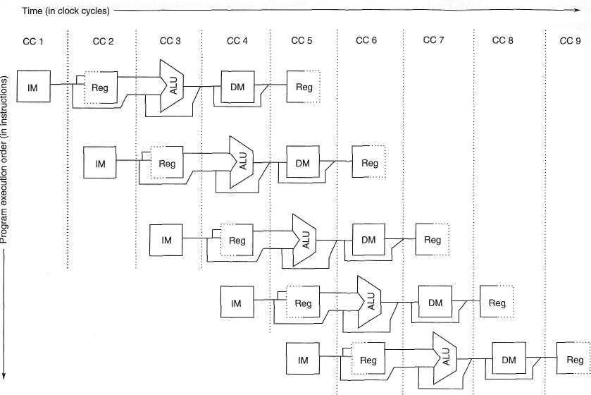
Series of Data Path

Slide 14
Three observations on which this fact rests.
Separate instruction and data memories, with separate instruction and data caches
-Eliminates a conflict between instruction fetch and data memory access.
The register file is used in the two stages: one for reading in ID and one for writing in WB.
Does not deal with the PC, IF stage in preparation for the next instruction

Slide 15
Ensure that instructions in different stages of the pipeline do not interfere with one another
introducing pipeline registers between successive stages of the pipeline
End of a clock cycle all the results from a given stage
are stored into a register that is used as the input to the next stage on the next clock cycle.

Slide 16
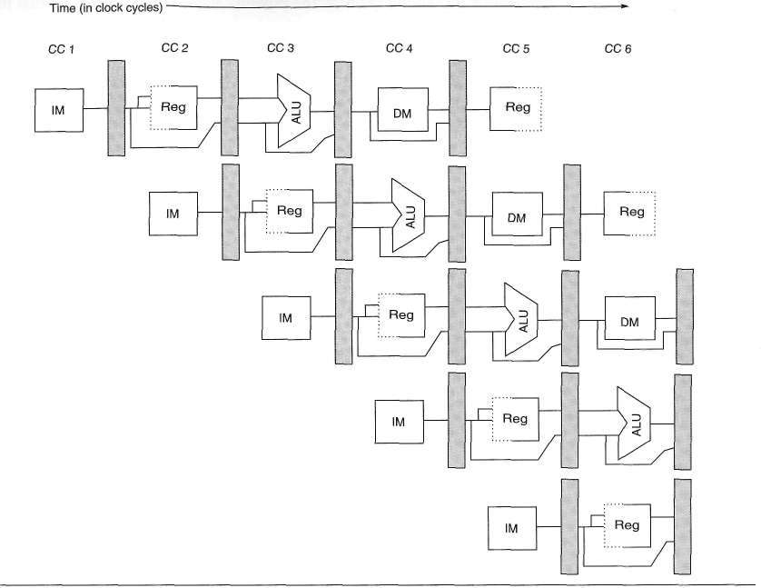

Slide 17
Pipelining Performance (1/2)
Pipelining increases throughput, not reduce the execution time of an individual instruction.
In fact, slightly increases the execution time (an instruction) due to overhead in the control of the pipeline.
Practical depth of a pipeline is limits by increasing execution time.
Pipeline overhead
Unbalanced pipeline stage;
Pipeline stage overhead;
Pipeline register delay;
Clock skew.

Slide 18
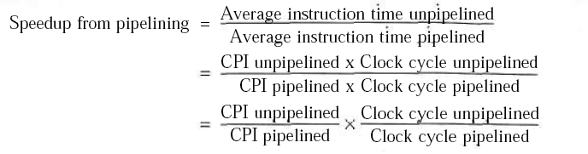

Performance of Pipelines with Stalls
A stall causes the pipeline performance to degrade from the ideal performance.

Slide 19
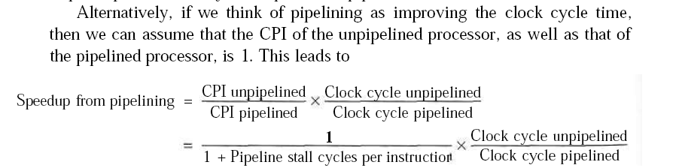

Slide 20
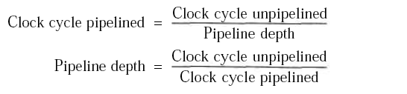
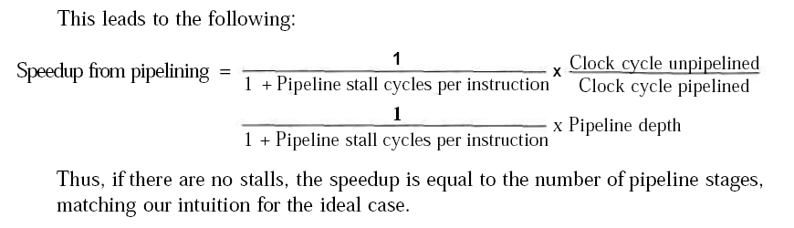

Slide 21
Exercise
Example : Consider an unpipelined processor. Assume that it has a 1 ns clock cycle and that it uses
4 cycles for ALU operations and branches
5 cycles for memory operations.
Assume that the relative frequencies of these operations are 40%, 20%, and 40% respectively.
Suppose that due to clock skew and set up, pipelining the processor adds 0.2 ns of overhead to the clock.
Ignoring any latency impact, how much speed up in the instruction execution rate will we gain from pipeline?

Slide 22
Answer
The average instruction execution time on the unpipelined processor is
Average instruction execution time = Clock cycle x Average CPI
= 1 ns x ((40% + 20%) x 4 + 40% x 5)
= 1 ns x 4.4 = 4.4 ns

Slide 23
Contd..
The average instruction execution time on the pipelined processor is
= speed of the Slowest stage + overhead
= 1 + 0.2 = 1.2 ns.
Speedup from pipelining = Avg. instruction time unpipelined / Avg. instruction time pipelined
= 4.4 ns / 1.2 ns = 3.7 times

Slide 24
A.2 The Major Hurdle of Pipelining – Pipeline Hazard
Limits to pipelining: there are situations, called Hazards, prevent next instruction from executing during its designated clock cycle, thus reduce the performance from the ideal speedup.
Three classes of hazards are:
Structural hazards: arise from resource conflicts when the hardware cannot support all possible combinations of instructions simultaneously in overlapped execution- two different instructions use same h/w in the same cycle .
Data hazards: arise when an instruction depends on result of prior instruction still in the pipeline, RAW, WAR and WAW.
Control hazards: Pipelining of branches & other instructions that change the PC.
Common solution is to stall the pipeline until the hazard is cleared, i.e., inserting one or more “bubbles” in the pipeline.

Slide 25
Structural Hazards
In pipelined processor, if some combination of instructions cannot be accommodated because of resource conflicts, the processor is said to have a structural hazard.
Arises when a
functional unit is not fully pipelined
resource is not duplicated enough
Ex:1) pipeline want to perform two writes in a clock cycle one with processor of one register-file write port,
2)processor with shared a single-memory pipeline for data
and instructions.
Solution :
To resolve the hazard, the pipeline is stalled until the required unit is available
Pipeline stalls increase the CPI

Slide 26
One Memory Port - Structural Hazards -a Load with one memory port -conflict arises whenever a memory reference occurs
Time (clock cycles)
Cycle 1
Cycle 2
Cycle 3
Cycle 4
Cycle 5
Cycle 6
Cycle 7
I
n
s
t
r.
O
r
d
e
r
Load
MEM
Reg
ALU
MEM
Reg
Instr 1
EM
Reg
Reg
M
ALU
MEM
Instr 2
MEM
Reg
ALU
MEM
Reg
Instr 3
MEM
Reg
ALU
MEM
Reg
Instr 4
MEM
Reg
ALU
MEM
Reg

Slide 27
One Memory Port/Structural Hazards (Similar to Figure A.5, Page A-15)
Time (clock cycles)
Cycle 1
Cycle 2
Cycle 3
Cycle 4
Cycle 5
Cycle 6
Cycle 7
I
n
s
t
r.
O
r
d
e
r
Load
MEM
Reg
ALU
MEM
Reg
Instr 1
MEM
Reg
ALU
MEM
Reg
Instr 2
MEM
Reg
ALU
MEM
Reg
Stall
Bubble
Bubble
Bubble
Bubble
Bubble
Instr 3
MEM
Reg
ALU
MEM
Reg

Slide 28
Data Hazards
Data hazards occur when the pipeline changes the order of read/write accesses to operands (registers) so that the order differs from the order seen by sequentially executing instructions on an unpipelined processor.
Where there’s real trouble is when we have:
instruction A
instruction B,
and B manipulates (reads or writes) data before A does. This violates the order of the instructions, since the architecture implies that A completes entirely before B is executed.

Slide 29
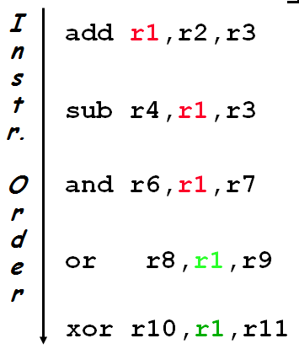

Slide 30
Data Hazard on R1
Time (clock cycles) 1 2 3 4 5 6 7 8
IF
ID/RF
EX
MEM
WB
I
n
s
t
r.
O
r
d
e
r
add r1,r2,r3
Reg
Ifetch
Reg
ALU
DMem
sub r4,r1,r3
Ifetch
Reg
ALU
DMem
Reg
and r6,r1,r7
Ifetch
Reg
ALU
DMem
Reg
or r8,r1,r9
Ifetch
Reg
ALU
DMem
Reg
xor r10,r1,r11
Ifetch
Reg
ALU
DMem
Reg

Slide 31
Three Generic Data Hazards
Read After Write (RAW) Instr_{J} tries to read operand before Instr_{I} writes it
Write After Read (WAR) Instr_{J} writes operand before Instr_{I} reads it
Write After Write (WAW) Instr_{J} writes operand before Instr_{I} writes it.

Slide 32
Minimizing Data Hazard Stalls by Forwarding
If the result can be moved from the pipeline register where the ADD stores it to where the SUB needs it, then the need for a stall can be avoided.
1. The ALU result from both the EX/MEM and MEM/WB pipeline registers is always fed back to the ALU inputs.
2. If the forwarding hardware detects previous ALU operation has written the register corresponding to a source for the current ALU operation control logic selects the forwarded result as the ALU input rather than the value read from the register file.

Slide 33
Forwarding to Avoid Data Hazard Figure A.7, Page A-19
Time (clock cycles) 1 2 3 4 5 6 7 8
I
n
s
t
r
O
r
d
e
r
add r1,r2,r3
iIM
Reg
ALU
DM
Reg
sub r4,r1,r3
IM
Reg
ALU
DM
Reg
and r6,r1,r7
iIM
Reg
ALU
DM
Reg
or r8,r1,r9
iIM
Reg
ALU
DM
Reg
xor r10,r1,r11
iIM
Reg
ALU
DM
Reg

Slide 34
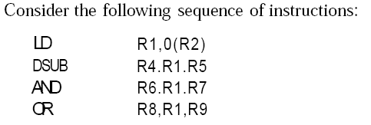

Slide 35
Data Hazards Requiring Stalls
Time (clock cycles)
CC1
CC2
CC3
CC4
CC5
CC6
CC7
CC8
I
n
s
t
r.
O
r
d
e
r
LD R1,0(R2)
Ifetch
Reg
ALU
DMem
Reg
DSUB R4,R1,R6
Ifetch
Reg
ALU
DMem
Reg
AND R6,R1,R7
Ifetch
Reg
ALU
DMem
Reg
OR R8,R1,R9
Ifetch
Reg
ALU
DMem
Reg
There are some instances where hazards occur, even with forwarding, e.g., the data isn’t loaded until after the MEM stage.

Slide 36
Data Hazard Even with Forwarding Figure A.9, Page A-21
HAZARD
Time (clock cycles) 1 2 3 4 5 6 7 8
I
n
s
t
r
O
r
d
e
r
Ld r1, 0(r2)
IM
Reg
ALU
DM
Reg
dsub r4,r1,r5
IM
Reg
ALU
DM
Reg
and r6,r1,r7
IM
Reg
ALU
DM
Reg
or r8,r1,r9
IM
Reg
ALU
DM
Reg
Notes:
MIPS actutally didn’t interlecok: MPU without Interlocked Pipelined Stages

Slide 37
Data Hazards Requiring Stalls
Time (clock cycles)
CC1
CC2
CC3
CC4
CC5
CC6
CC7
CC8
I
n
s
t
r.
O
r
d
e
r
LD R1,0(R2)
Ifetch
Reg
ALU
DMem
Reg
Bubble
DSUB R4,R1,R5
Ifetch
Reg
ALU
DMem
Reg
Bubble
AND R6,R1,R7
Ifetch
Reg
ALU
DMem
Reg
Bubble
OR R8,R1,R9
Ifetch
Reg
ALU
DMem
The stall is necessary for the case.

Slide 38
Another Representation of the Stall
LD R1, 0(R2) | IF | ID | EX | MEM | WB
DSUB R4, R1, R5 |  | IF | ID | EX | MEM | WB
AND R6, R1, R7 |  |  | IF | ID | EX | MEM | WB
OR R8, R1, R9 |  |  |  | IF | ID | EX | MEM | WB
LD R1, 0(R2) | IF | ID | EX | MEM | WB
DSUB R4, R1, R5 |  | IF | ID | stall | EX | MEM | WB
AND R6, R1, R7 |  |  | IF | stall | ID | EX | MEM | WB
OR R8, R1, R9 |  |  |  | stall | IF | ID | EX | MEM | WB
In the top table, we can see why a stall is needed: The MEM cycle
of the load produces a value that is needed in the EX cycle of the
DSUB, which occurs at the same time. This problem is solved by
inserting a stall, as shown in the bottom table.

Slide 39
Control hazard or Branch Hazard
Cause a greater performance loss for our MIPS pipeline than do data hazards
When a branch is executed, it may or may not change the PC to something other than its current value plus 4
if a branch changes the PC to its target address, it is a taken branch ,if it falls through, it is not taken.
If instruction i is a taken branch, then the PC is normally not changed until the end of ID.
redo the fetch of the instruction following a branch, once we detect the branch during ID.
One stall cycle for every branch will yield performance loss of 10% to 30% depending on the branch frequency

Slide 40
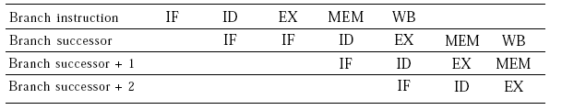
Number of clock cycle in branch stall can be reduced by
1.Find out whether branch is taken or not earlier in the pipeline
2.Compute the taken PC (address of branch target)

Slide 41
Four Solutions to Branch Hazards
#1: Stall until branch direction is clear
Simple both for software and hardware
Branch penalty is fixed (1-cycle penalty for revised MIPS)
Branch instr. | IF | ID | EX | MEM | WB
Branch successor |  | IF | IF | ID | EX | MEM | WB
Branch successor+1 |  |  |  | IF | ID | EX | MEM | WB
Branch successor+2 |  |  |  |  | IF | ID | EX | MEM | WB

Slide 42
Four Solutions to Branch Hazards
#2: Predict Branch Not Taken
Continue to fetch instructions as if the branch were a normal instruction.
If the branch is taken, turn the fetched instruction into a no-op and restart the fetch at the target address.
Untaken branch instr. | IF | ID | EX | MEM | WB
Branch successor |  | IF | ID | EX | MEM | WB
Branch successor+1 |  |  | IF | ID | EX | MEM | WB
Branch successor+2 |  |  |  | IF | ID | EX | MEM | WB
Branch successor+3 |  |  |  |  | IF | ID | EX | MEM | WB
Taken branch instr. | IF | ID | EX | MEM | WB
Branch successor |  | IF | idle | idle | idle | idle
Branch target |  |  | IF | ID | EX | MEM | WB
Branch successor+1 |  |  |  | IF | ID | EX | MEM | WB
Branch successor+2 |  |  |  |  | IF | ID | EX | MEM | WB

Slide 43
Four Solutions to Branch Hazards
#3: Predict Branch Taken
As soon as the branch is decoded and the target address is computed, we assume the branch to be taken and begin fetching and executing at the target.
But haven’t calculated the target address before we know the branch outcome in MIPS
MIPS still incurs 1-cycle branch penalty
Useful for other machines on which the target address is known before the branch outcome

Slide 44
Four Solutions to Branch Hazards
#4: Delayed Branch
The execution cycle with a branch delay of one is
branch instruction sequential successor₁ branch target if taken
The sequential successor is in the branch delay slot.
The instruction in the branch delay slot is executed whether or not the branch is taken (for zero cycle penalty)

Slide 45
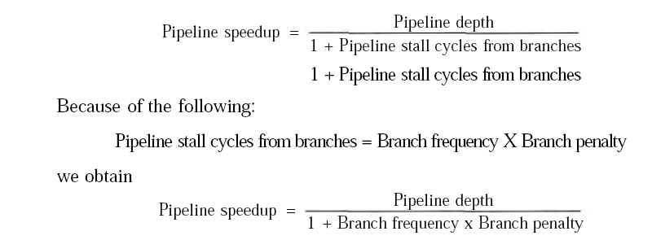
Performance of Branch Schemes

Slide 46
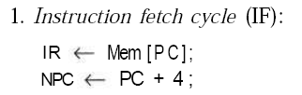
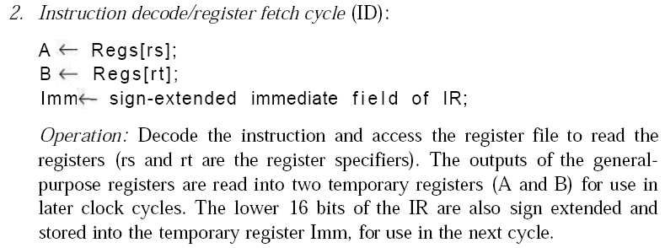
How Is Pipelining Implemented?
A Simple Implementation of MIPS

Slide 47
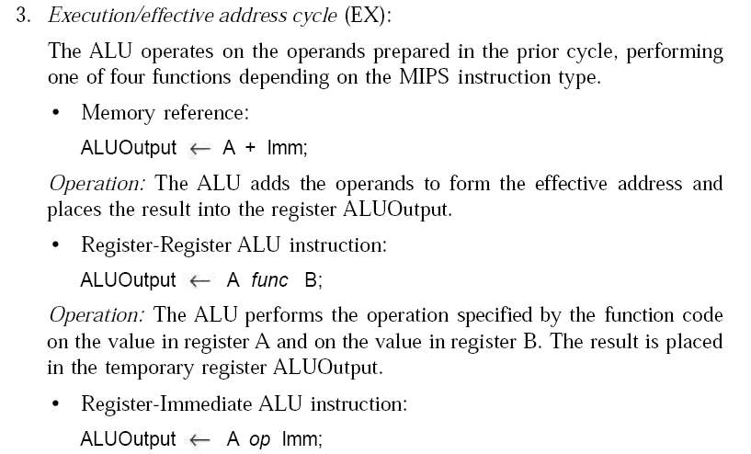
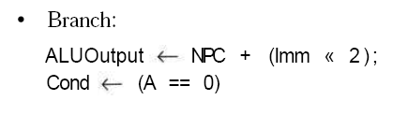

Slide 48
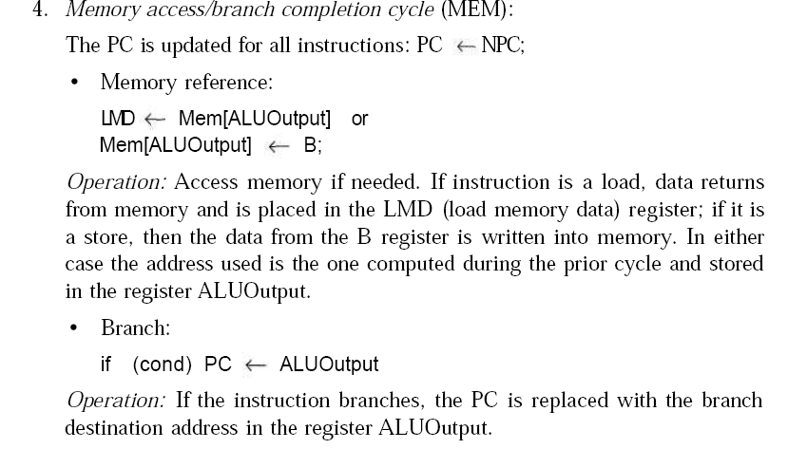

Slide 49
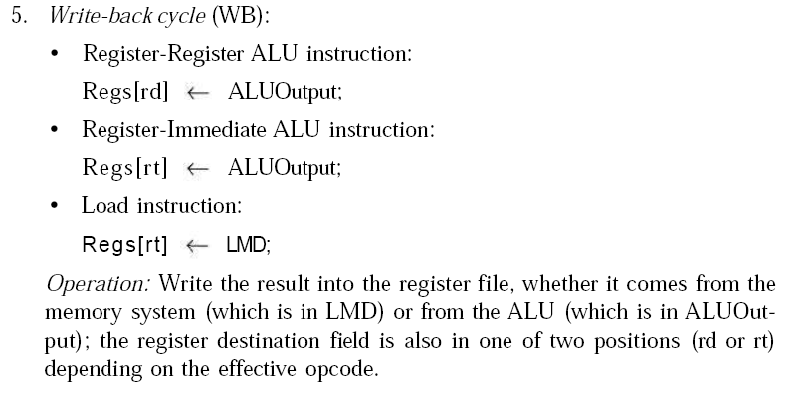

Slide 50
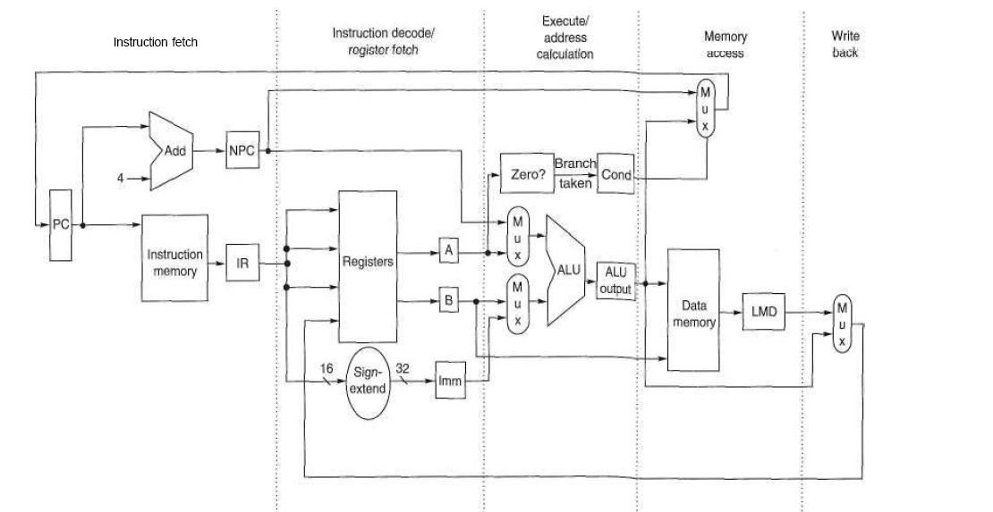

Slide 51
END of Unit II – Chapter 3

